Slide 1





Information Technology
Student Portfolio
Galeno, Swannie Mae B. .

Slide 2







List of Content
About Me
Personal Skills
Education
Project
Internship
Contact

Slide 3
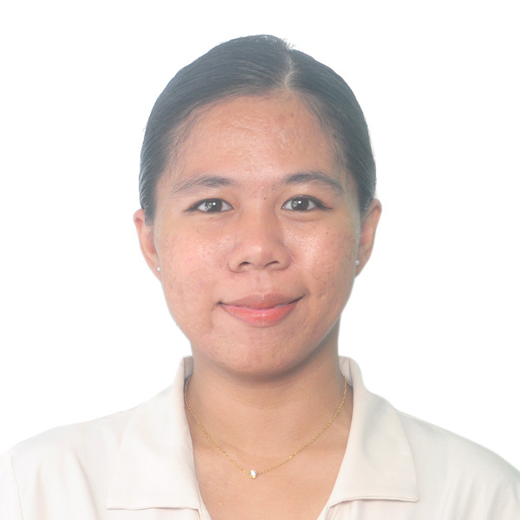
About Me
Hello! I am Swannie Mae, an Information Technology student passionate about solving problems through technology. Skilled in programming and web development, I enjoy learning new tools and applying them to real-world challenges. My goal is to contribute to innovative tech solutions while continuously growing as a professional. Let’s connect and collaborate!

Slide 4
Education
2016 - 2018
2019 - Present
Professional Electronics Institute, Inc.
Interface Computer College Manila

Slide 5

Internship
Dingle Multi-purpose Cooperative
Philippine Statistics Authority NCR II
March - April 2018
July - September 2024
Prioritize business and information needs with the help of the management.
Understanding each details to ensure the accuracy of each data.
Analyzing data results to the management
Trouleshooting and testing of PhilSys Registration Kit Devices.
Tagging of PhilSys ID Returns of Quezon City and Marikina
Encoding data to the ticketing system of PhilSys.

Slide 6



Personal Skills
Web Development
Adaptability to Technology
Detail-Oriented

Slide 7
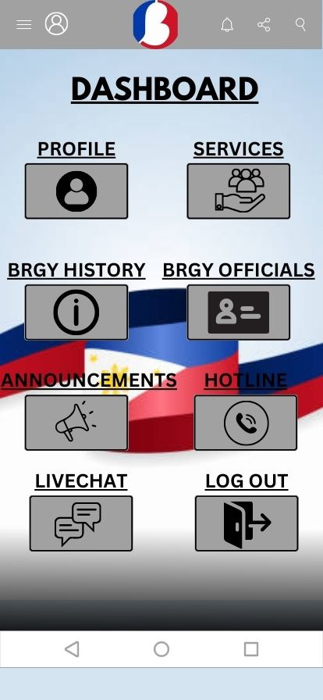
Project 1
Barangay Mobile-based System
This was our group project on the subject System Analysis and Design during second year college. This project is the barangay mobile web-based system is created for local residents in order to take advantage of modern website technology. For example, local residents can view the website's ongoing projects, announcements, job offers, and historical information about the barangay as well as contact the officials of the barangay and every barangay resident will mandatory sign up in the website to be a official resident of the barangay.

Slide 8
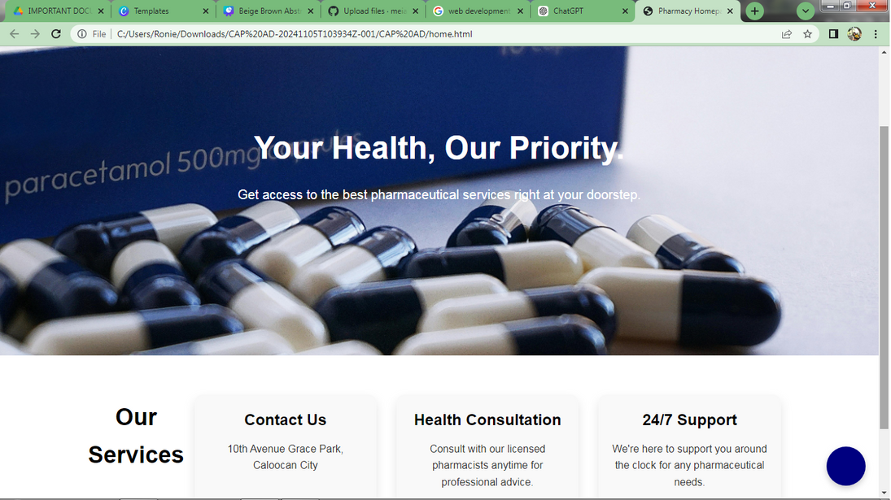
Project 2 - FZA Santella Pharmacy Monitoring System
Ths project two is our ongoing capstone project. FZA Santella Pharmacy will acquire significant implications for improving the accuracy of logs or the product, manage and monitor the stocks of the drugs available, and increase pharmacy efficiency.

Slide 9


Contact
+639123456789
swanniegaleno@gmail.com

Slide 10

Thank You

