Slide 1
Happiness
Regional Modeling and Analysis
Andrew Raymond and Megan Eichelberger

Slide 2
What to expect
Happiness: can we predict the region of the world from scores within the World Happiness Report 2021?
Comparing techniques, k-means was super effective!
Feature engineering was not super effective.

Slide 3
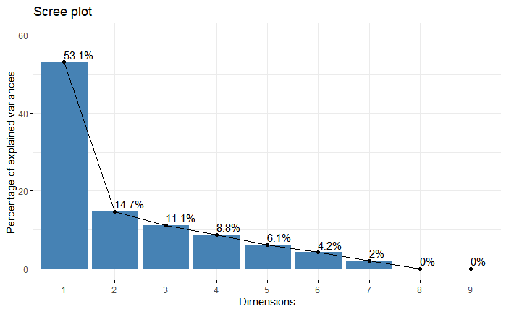
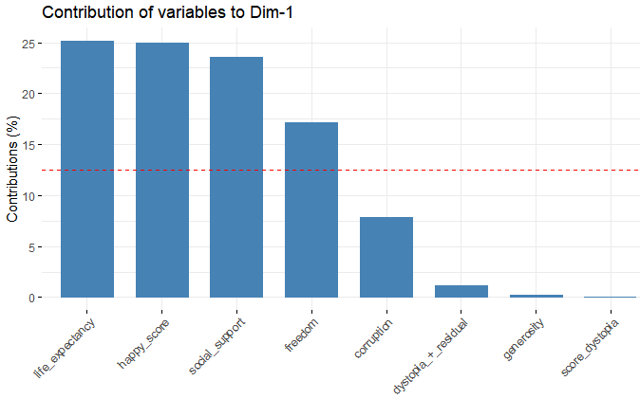
PCA
53% of variance explained in a single dimension
Dim-1 mostly comprised of
Life Expectancy
‘Happy Score’
Social Support
Freedom

Slide 4
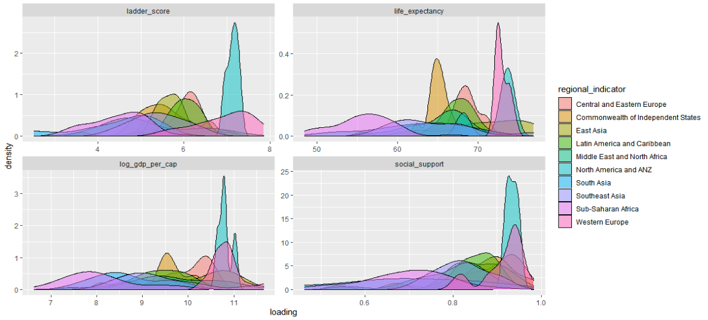
Component Density

Slide 5
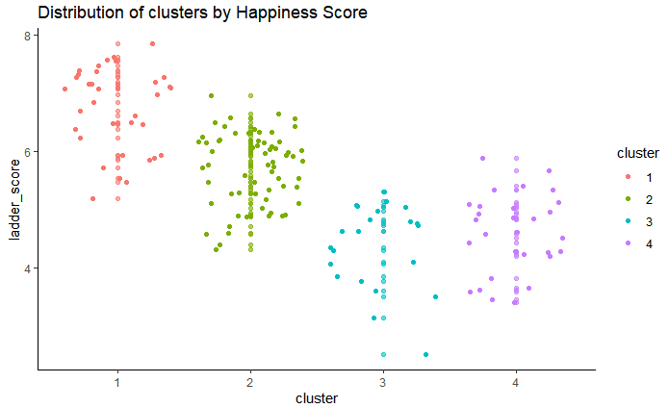
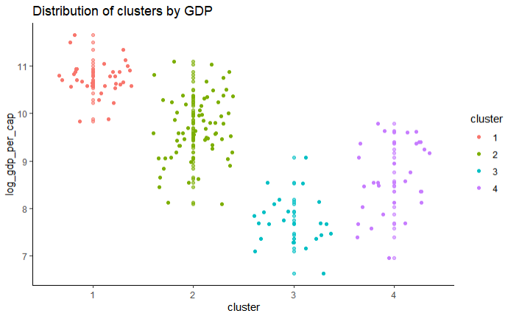
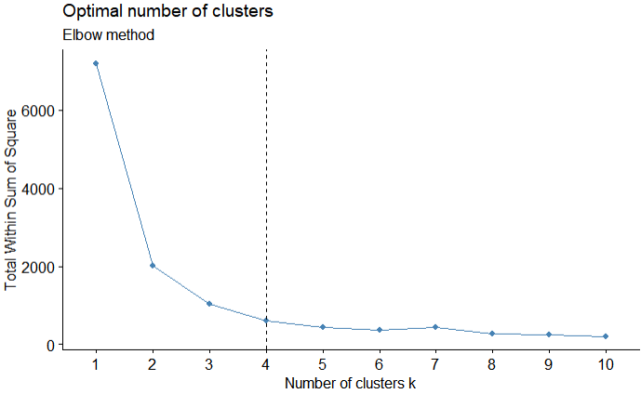
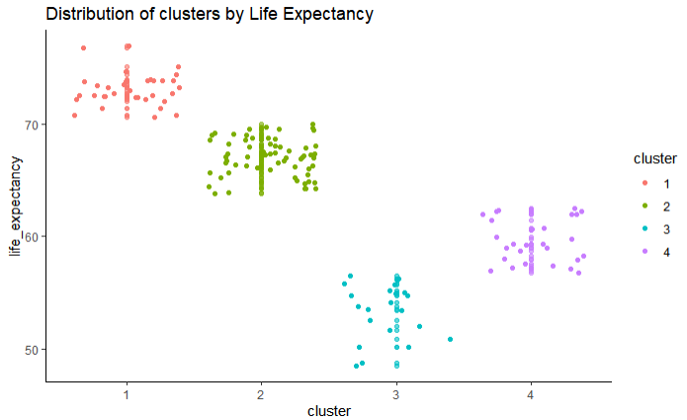
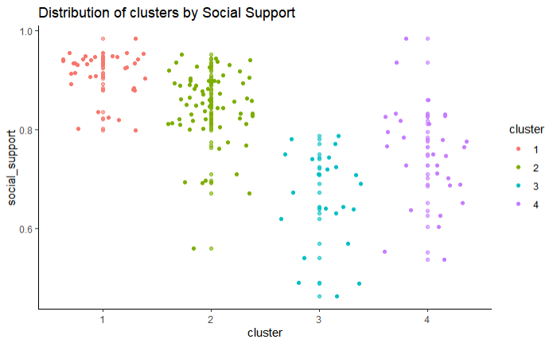
K Means
Clustering around each contributing variable
Choosing optimal clusters using Elbow method

Slide 6
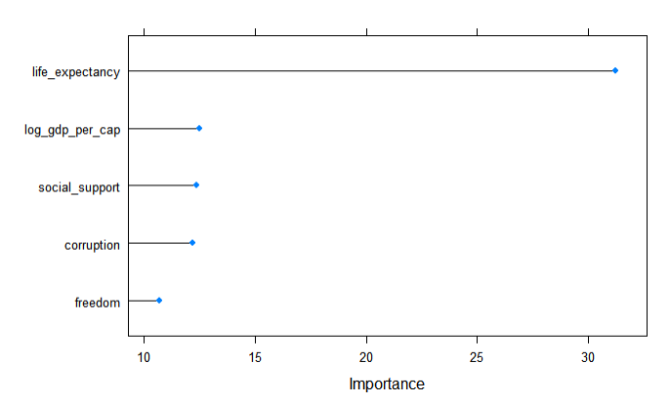
Other Predictive Models
Random Forest – Kappa .624
GBM – Kappa .562
Feature Engineering:
Not as helpful as hoped

