Slide 1

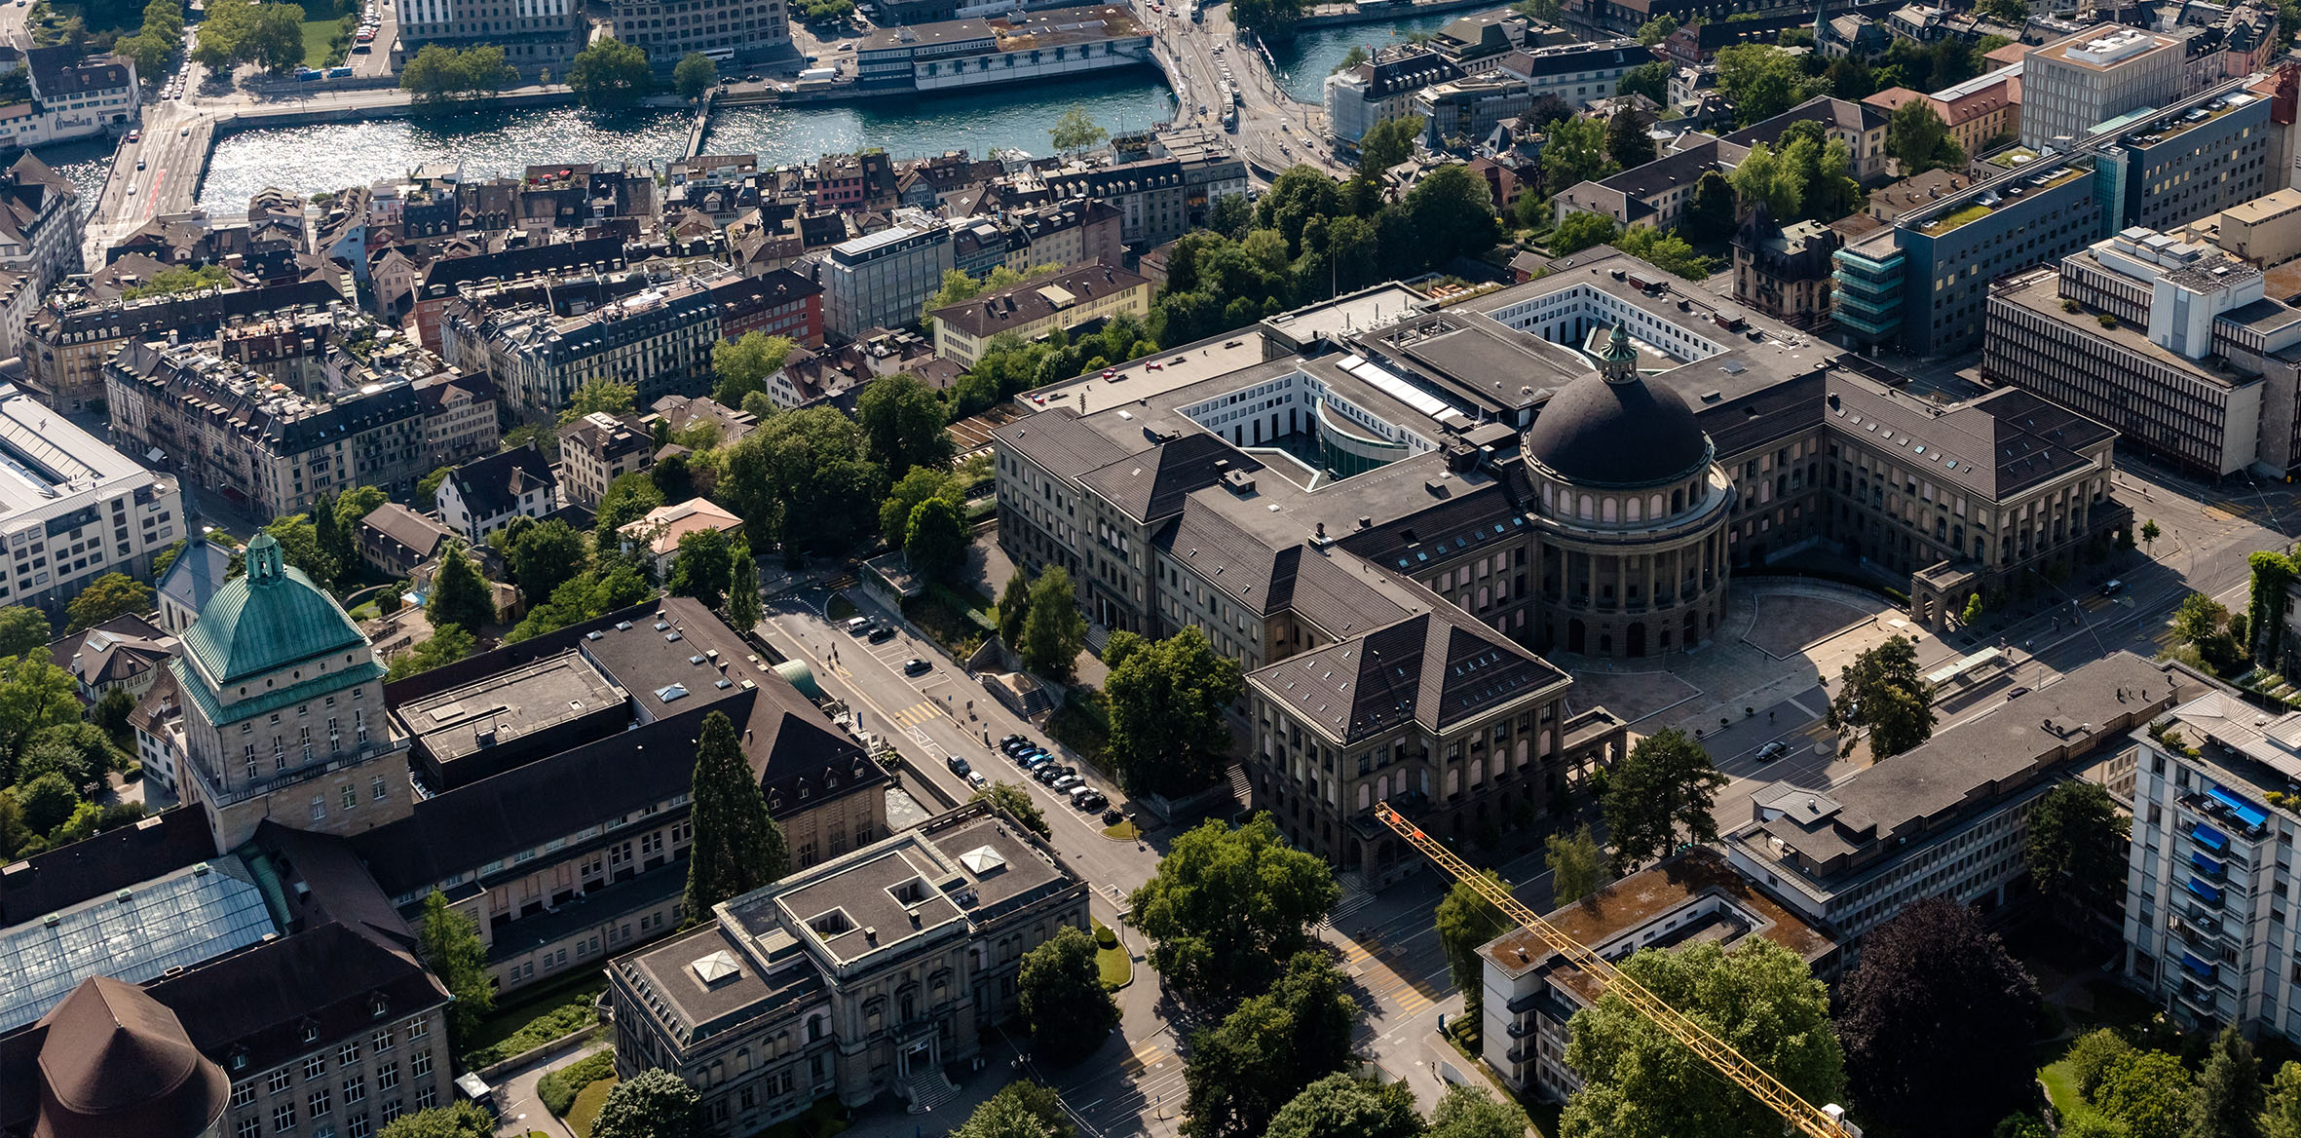
Results Overview
X
Biochemical Engineering Lab & Janssen Cilag AG
Eduard Meier
Master Thesis Student
18.07.23

