Slide 1
An Introduction to Programming with Python
Meifeng Lin
Computational Science Center
BNL Mini-Semester Workshop
January 6, 2016

Slide 2
Agenda
09:00-09:45, Software Installation and Warm-up
09:45-10:15, Introduction to Python
10:15-10:30, Break
10:45-12:00, Hands-On Exercises

Slide 3

What is Programming? Python?
Programming is writing a set of instructions for the computers to do things for us.
For most of us, this means writing a human-readable program which is then transformed to machine codes that the computer can understand by compilers/interpreters.
Python is a programming language that is wildly popular in many areas of applications.
Needs the python interpreter.
No need for compiling/linking the program.
www.python.org

Slide 4
Plan
Python Basics with Demonstration [20 minutes]
We’ll use Canopy for demonstration in class.
More experienced users feel free to use your own installation of python.
Examples [20 minutes]
Generate random numbers
Calculate average and standard deviation
Plots and curve fit
Q & A [5 minutes]

Slide 5
My Goals for this course
Introduce you to the world of programming
Give you a taste of flavors of Python
Hopefully can motivate you to learn more about programming and python.

Slide 6

Starting up Canopy
If you have Canopy installed on your own laptop, double click the launcher.
Something like this
If you want to use the version installed on the cloud machine, run the following command (in red) after you log onto the server with X Window forwarding:
mlin@workshop:~$/software/Canopy/canopy
You will be asked to do some setup the first time you run Canopy. For most of you, choosing the default should suffice.

Slide 7
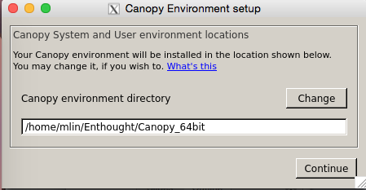

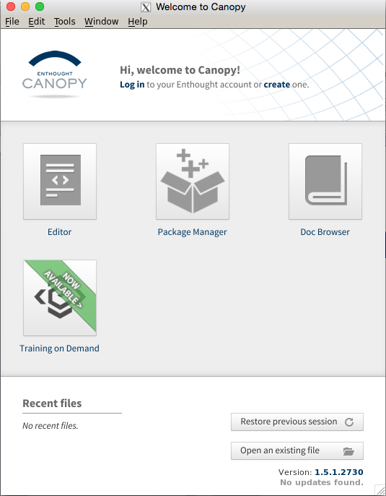
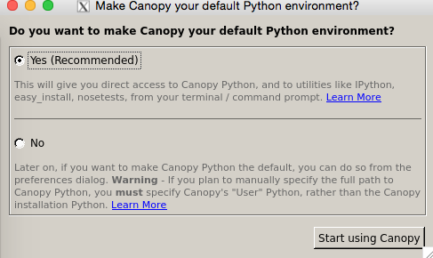
Setting up Canopy
1
2
3
4

Slide 8
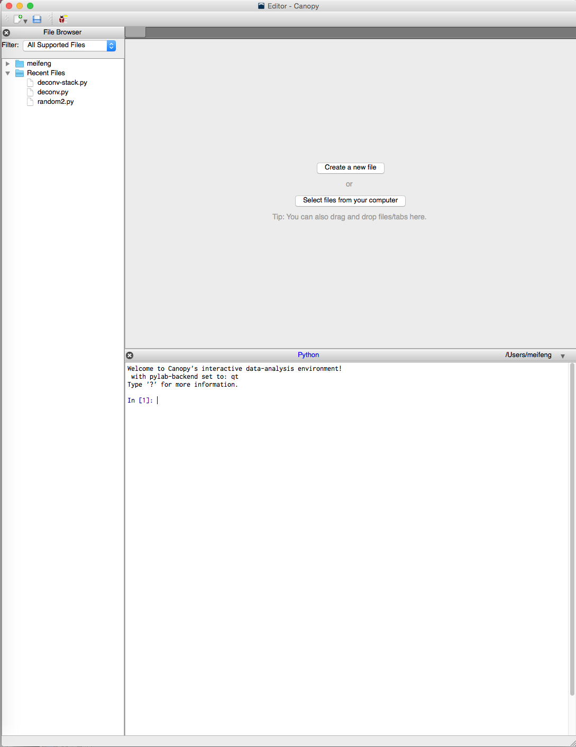
text editor
the IPython shell
An enhanced interactive python shell.

Slide 9
Standard Python Shell vs. IPython
The standard python shell
Barebones interpreter
This is what you get with the standard Python distribution.
IPython -- An advanced python shell
Tab completion of variable names
Supports some Unix/Windows commands
Inline documentation
Syntax highlighting
Good for beginners

Slide 10
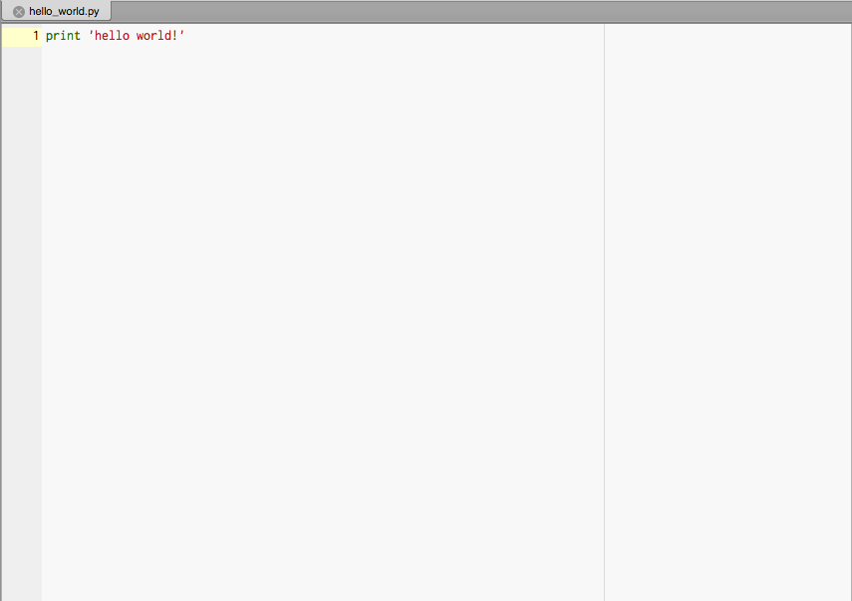
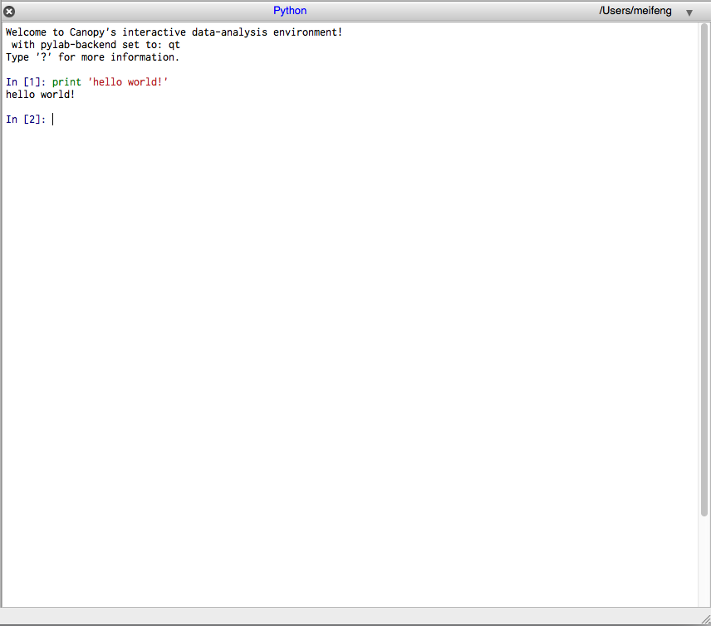
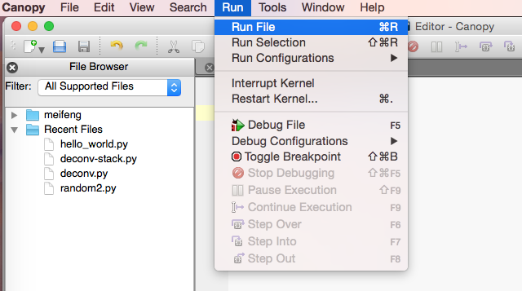
Two Ways to Use Python
Interactive mode
Script mode
Good for prototyping code segments or as a calculator.
Or in terminal: python hello_world.py

Slide 11
Good to know
There are two major releases of Python: Python 2.x and Python 3.x
Python 3.x is not backward compatible. So make sure you know which version you are using.
If you are using a terminal, you can check by running:
python --version
In the interactive mode, you can check with
print sys.version
Mine returns:
Python 2.7.6 -- 64-bit
We will be using Python 2.x.

Slide 12
Good to know
Code blocks are organized by indentation
Single-line comments start with #
Multiline comments start and end with matching ``` (three single quotation marks) or “”” (three double quotation marks)
Comments are ignored by the interpreter, except when the first line begins with #!
#!/usr/bin/python
It tells the os that the program is to be processed by /usr/bin/python.
Demo: hello_world.py

Slide 13
Python Basic Building Blocks
Data Types: int, float, str, long, bool,…
Variables: variable_name = value
Collection Data Types: tuples, lists, sets, dictionaries
Logical Operations: ==, >, <, and, or, not, in
Arithmetic Operators: +, -, /, *, **, %, …
Input / Output: input/raw_input, print, open, close
Control Flow Statements: if/elif/else, while, for
Creating and Using Functions: def, import
Other programming languages have more or less the same components, with different syntaxes.
Notes:
Data Types: int, float, str, long, bool (only two values: True or False),…
Can check the data type with type(value)

Slide 14
Data Types
Built-in data types:
int positive or negative whole numbers, e.g. 5, 100, -2
float decimal numbers, 1.2, 3.14159, -10.0
str ‘hello’, “This is a string”
bool Only two values of this type: True or False
Useful Utilities
type(some_value or variable)
sys.float_info
sys.maxint
Type conversion:
float(2) -> 2.0,int(1.1) -> 1
Be careful: 2/3 -> 0. Make sure one of them is a float.
Note: You can also have user-defined data types: classes, which we are not going to cover.

Slide 15
Variables and Assignment
Assignment
s = ‘hello world!’
Variable
Value
Variables have to be in one word. Can’t start with a number, but otherwise can be any combinations of numbers, letters and some special characters: _ and -.
my_variable, var1, var2, …
Can’t be any of the Python reserved words, such as if, else, True, False, class, etc.
Assignments can also be
a, b = 1.0, 2.2 -> a = 1.0, b = 2.2

Slide 16
Collection Data Types -- Represent a group of values
List
name = [‘Alice’, ‘Bob’, ‘Charlie’, ‘David’],
age = [20, 22, 23, 21]
List is mutable (append, remove, insert, …)
indexing, slicing
len(a), range([start,]stop[,step])
Dictionaries: associative key:value pairs
age={‘Alice’:20, ‘Bob’:22, ‘Charlie’:23, ‘David’:21}
Indexing: age[‘Alice’]
Insertion: age[‘Edward’] = 19
In random order by default. Try: print age
Tuples and Sets: not very commonly used

Slide 17
Logical Operation
Returns True or False
Demo
==
<, >
and
or
not

Slide 18
Arithmetic Operators
Demo: +, -, *, /, **, %
Order of operations

Slide 19
Input and Output (I/O)
Standard I/O
print
input – automatically detects the type based on the input
raw_input – everything is considered a string.
Hint: check using type(arg)
File I/O (demo in examples)
open
read
write
close

Slide 20
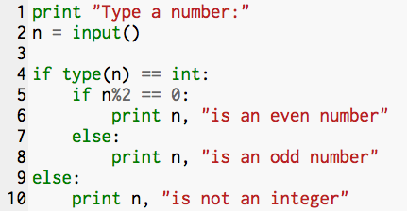
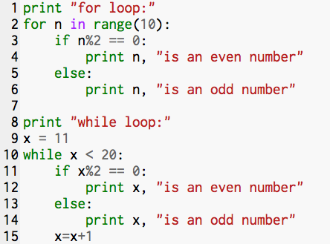
Control Flow Statements
Conditional: if/elif/else
Only execute if the statement is True
Can have nested conditionals
Looping: for, while

Slide 21
Functions
Functions have the form func([argument list])
Examples: sqrt(2), sin(pi), range(1,100,2), etc.
In addition to the built-in functions, we can also define our own
def my_func(arg1, arg2):
do something
return results
For example:
def square(x):
return x*x
print square(2)

Slide 22
Classes, Modules and Libraries
The true power of Python lies in the vast collection of open-source modules and libraries that are freely available.
Python comes with limited built-in functions. To use the external modules and functions, we have to let python know beforehand.
Ways to access external functions
import module_name
For C programmers, this is much like #include<header.h>
from module_name import func
Example:
import math
math.sqrt(2)
from math import sqrt
sqrt(2)

Slide 23
An Example – Random Numbers
Task 1
Generate N normally/Gaussian distributed random numbers with an average of μ (mu) and standard deviation σ (sigma)
Write them to disk
Task 2
Read them back in
Compute the average and standard deviation
Display the results on terminal
Task 3 (Time permitting)
Compute and display the histogram of the numbers
Do a curve fit

Slide 24
Normal/Gaussian Distribution
From Wikipedia:
A normal distribution is:
The parameter μ in this definition is the mean or expectation of the distribution (and also its median and mode). The parameter σ is its standard deviation; its variance is therefore σ². A random variable with a Gaussian distribution is said to be normally distributed and is called a normal deviate.
If μ= 0 and σ = 1, the distribution is called the standard normal distribution or the unit normal distribution

Slide 25
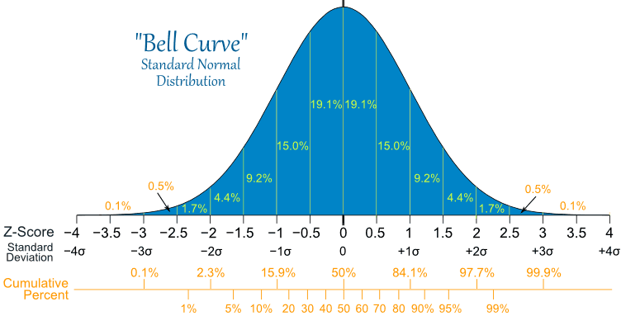
Normal/Gaussian Distribution
Image source: http://www.mathsisfun.com

Slide 26
Task1: Generate and save the random numbers
Code demo: generate.py
Features demonstrated:
Import external functions
Assignments
List operation
For loop
File output

Slide 27
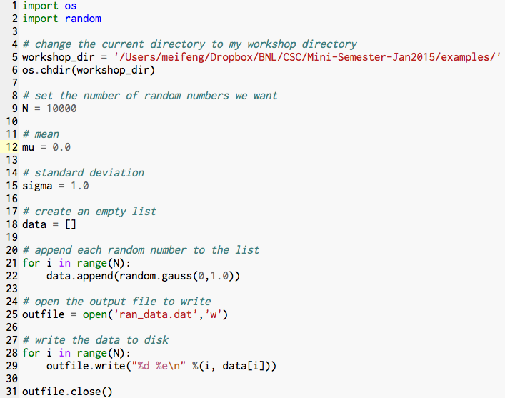

Slide 28
Statistical Analysis of Data
We can calculate the mean and standard deviation of the random numbers we just generated, and compare them to the input values: μ = 0, σ = 1.0
Mean:
Standard deviation:

Slide 29
Task2: Calculate the mean and standard deviation
Code demo: analyze.py
Features demonstrated:
File input
User-defined functions
Type conversion

Slide 30
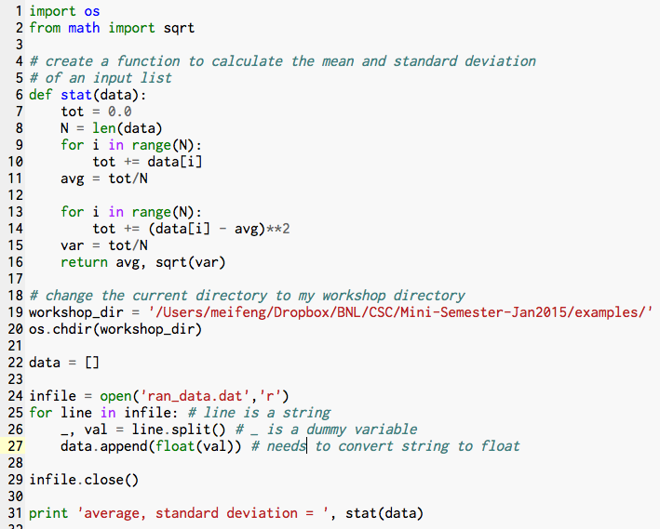

Slide 31
Histogram
A histogram is a graphical representation of the distribution of data.
The histogram of the random numbers we generated should be an approximation of the normal distribution.
The more data we generate, the closer our histogram is to the normal distribution.

Slide 32
Task3: Fit the data and plot the histogram
Code demo: fit.py
Features demonstrated:
Use of external libraries: numpy, scipy and matplotlib
Plotting
Curve fitting with scipy

Slide 33
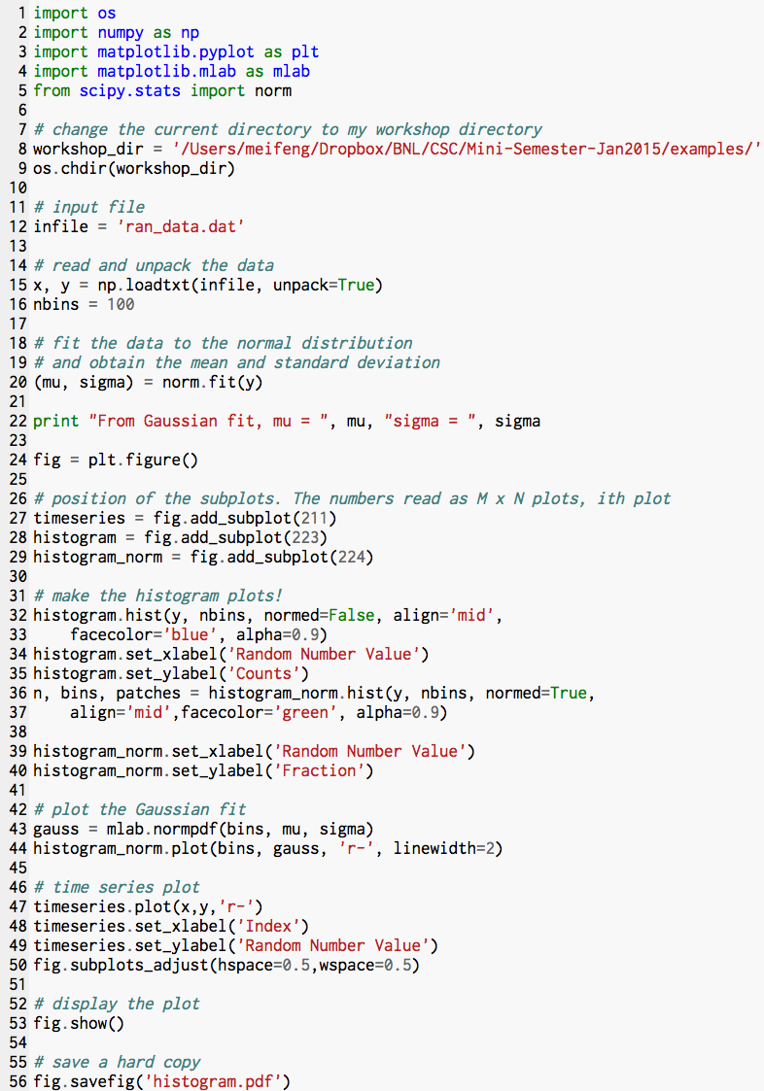

Slide 34
Closing Remarks
Python is powerful and fun.
It’s a good first language to learn if you don’t have any programming experience.
You can find many useful resources on the internet.
Official Python website: www.python.org
Online video courses:
www.udacity.com
www.coursera.org
www.edx.org
Codecademy interactive coding tutorials:
http://www.codecademy.com/tracks/python

Slide 35
print “Have fun coding!”

