Slide 1
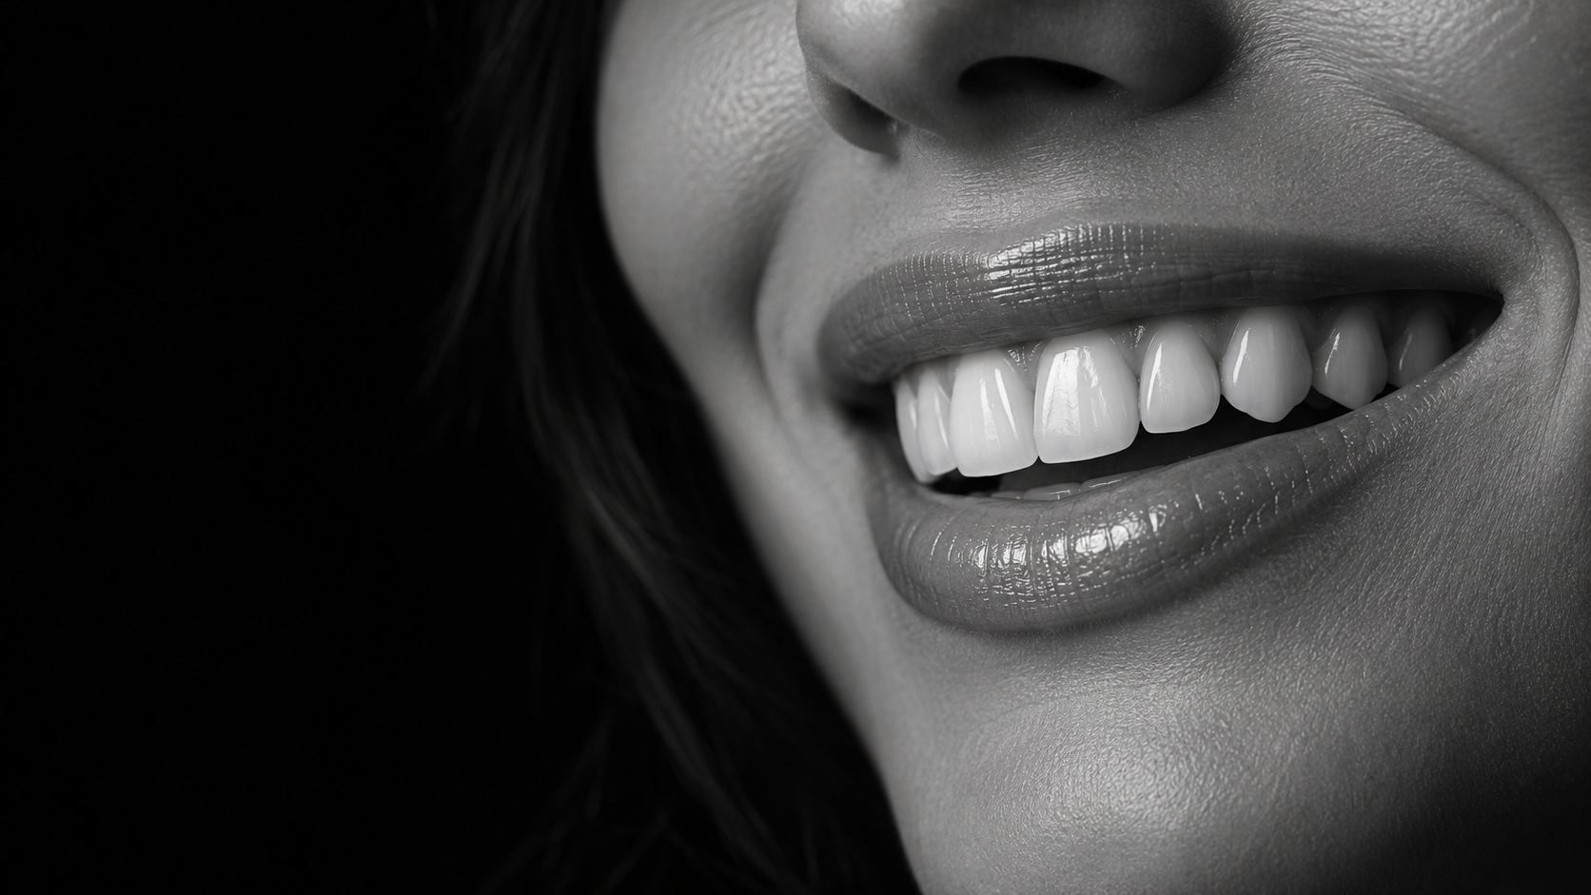
LITERATURE REVIEW
CEMENT
OR SCREW?
Peri-implant disease
REIS ET AL. / 2025
01
Notes:
SAY ALOUD
Good afternoon. Once an implant has successfully osseointegrated, we still have an important restorative decision to make: how are we going to retain the restoration, with screws or with cement?
In restorative dentistry, biology comes first, followed by restoring natural function. Esthetics must work within that biological foundation. If one retention method carries a greater biological risk, that truly matters.
That raises a key question: does the evidence support the assumption that screw-retained restorations are biologically safer?
Today I will discuss the systematic review and meta-analysis by Reis and colleagues, published in The Journal of Prosthetic Dentistry. I will focus on how they selected the evidence, what the statistics mean, and how confidently we can apply the findings.
PRIVATE STUDY NOTES
Opening adapted from our practiced introduction. The biology-first wording is presented as your clinical framing, not a verified direct quotation from Pascal Magne.
SOURCE
Reis et al. J Prosthet Dent. 2025;134:100–108. doi:10.1016/j.prosdent.2023.08.030. Supplied full text.
VISUAL
AI-generated conceptual editorial imagery. Not a study participant, clinical outcome, anatomical diagram, or Michael Apa clinical case.

Slide 2
NSU · AEGD LITERATURE REVIEW
ANDREYNA MEIJIDE
PG Resident • Advanced Education in General Dentistry
Nova Southeastern University · College of Dental Medicine
Faculty Mentor — Michelle Madera
September 30, 2026
02
Notes:
SAY ALOUD
My name is Andreyna Meijide. I am a postgraduate resident in the Advanced Education in General Dentistry program at Nova Southeastern University’s College of Dental Medicine. This literature review is presented under the mentorship of Dr. Michelle Madera.
With that introduction, let’s turn to the clinical decision this review addresses.
PRIVATE STUDY NOTES
Added to satisfy the AEGD Literature Review Protocol’s requirement to identify presenter, program, institution, faculty mentor, and presentation date on the opening slide. Confirm Dr. Madera’s preferred title and the presentation date against the current course schedule before presenting; September 30, 2026 was supplied as a placeholder.
SOURCE
Reis et al. J Prosthet Dent. 2025;134:100–108. doi:10.1016/j.prosdent.2023.08.030. Supplied full text.

Slide 3
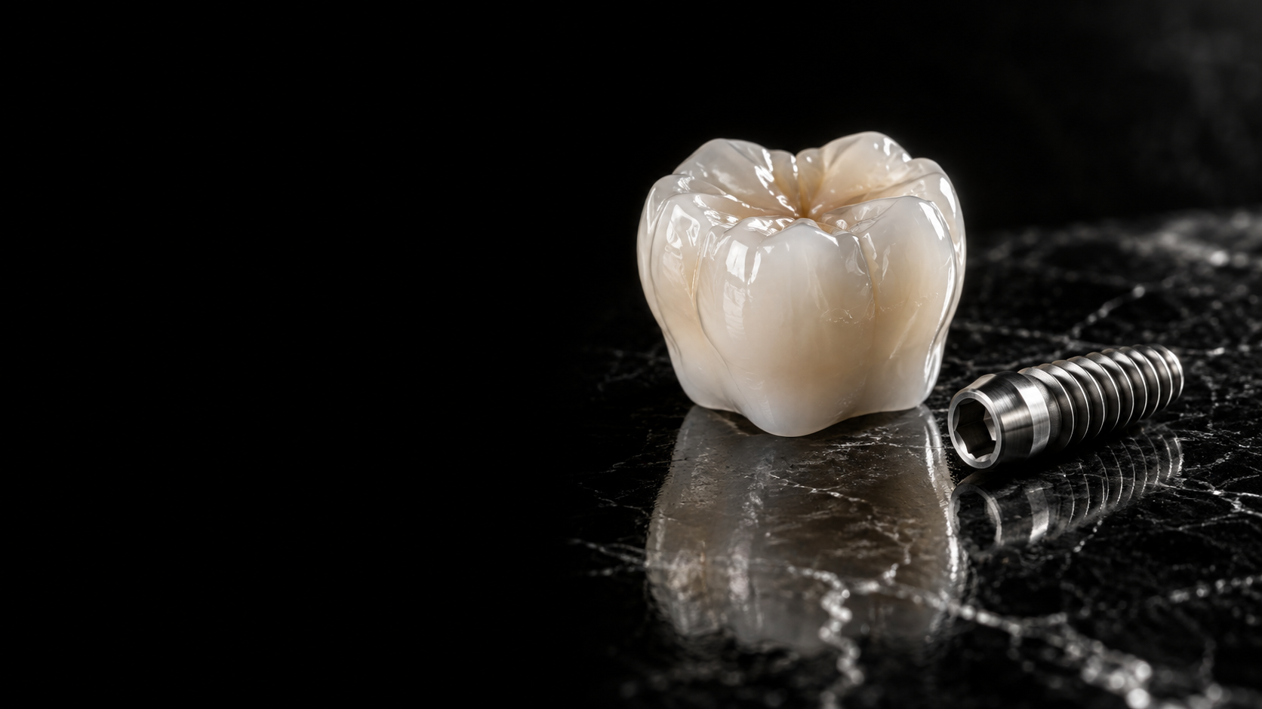
THE CLINICAL DECISION
RETENTION
Retrievability
Esthetics
03
Notes:
SAY ALOUD
Screw retention offers predictable retrievability and avoids intraoral cementation. This can simplify maintenance and provide access when complications occur. However, the screw access channel can create esthetic or technical challenges.
Cement retention can be useful when implant angulation makes the screw access unfavorable. The concern is residual cement, which may retain biofilm and make cleaning more difficult. Removing a cemented restoration can also be challenging.
However, a plausible biological mechanism does not automatically establish that every cement-retained restoration has a higher disease risk. We need to distinguish the risk associated with excess cement from the comparative risk of the retention method itself.
This distinction is the clinical reason for examining the evidence.
PRIVATE STUDY NOTES
Retention type and residual cement are different exposures. The review compares retention strategies; it does not isolate the causal effect of a measured amount of residual cement.
SOURCE
Reis et al. J Prosthet Dent. 2025;134:100–108. doi:10.1016/j.prosdent.2023.08.030. Supplied full text.
VISUAL
AI-generated conceptual editorial imagery. Not a study participant, clinical outcome, anatomical diagram, or Michael Apa clinical case.

Slide 4
THE BIOLOGICAL OUTCOMES
MUCOSITIS
Soft tissue
PERI-IMPLANTITIS
Inflammation + bone loss
04
Notes:
SAY ALOUD
The authors evaluated two outcomes separately. Peri-implant mucositis concerns inflammation in the soft tissues around an implant, commonly identified through bleeding on gentle probing. Peri-implantitis includes inflammation together with progressive loss of supporting bone.
The review asks about incidence: disease developing during follow-up. This differs from prevalence, which describes how many cases exist at a particular point in time.
An important limitation appears here already. The original studies did not all use the same disease definitions, and some did not report their diagnostic criteria clearly. So even when studies use the same disease name, they may not be counting exactly the same clinical condition.
PRIVATE STUDY NOTES
Simple analogy: incidence counts new cases during a period; prevalence counts existing cases at a point or over a defined period. The study-specific diagnostic thresholds vary in Table 3.
SOURCE
Reis et al. J Prosthet Dent. 2025;134:100–108. doi:10.1016/j.prosdent.2023.08.030. Supplied full text.

Slide 5
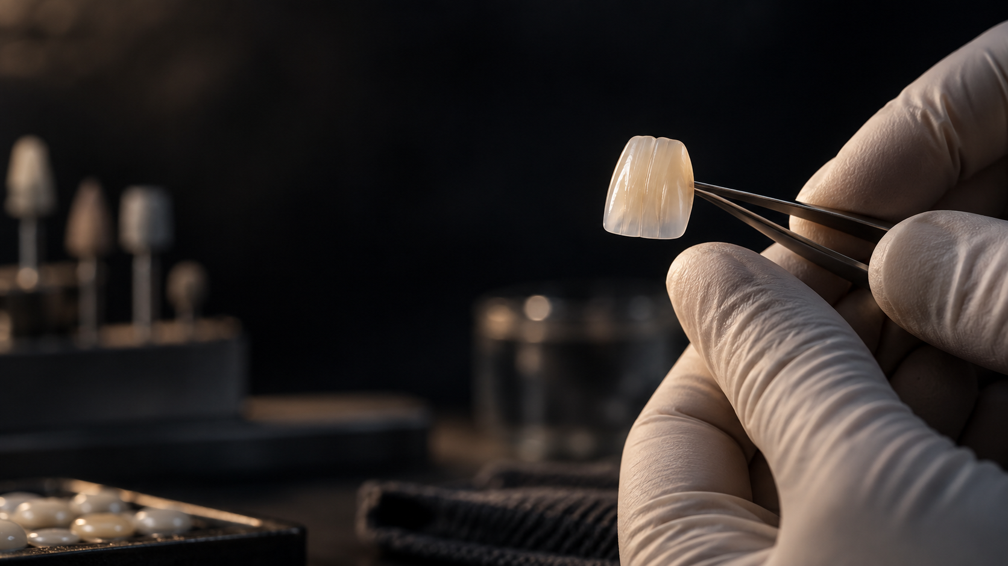
THE RESEARCH QUESTION
BIOLOGY
FIRST
Does retention
affect disease?
05
Notes:
SAY ALOUD
Earlier reviews gave inconsistent findings. Some reported more soft-tissue complications with screw retention, while others found more bone loss or other biological problems with cement retention. Several combined different study designs or relied on indirect comparisons.
The authors therefore focused on clinical trials containing both retention types. Their question was: in patients with implant-supported prostheses, is the incidence of peri-implant disease higher with cement retention than with screw retention?
The null hypothesis was that retention type would not be associated with disease incidence. The goal was to test that hypothesis using the available trial evidence. Failure to reject it, however, would not prove biological equivalence.
PRIVATE STUDY NOTES
H₀ is the starting assumption of no association. A nonsignificant result means the data did not provide sufficient evidence against it. An equivalence claim requires a different study framework and prespecified margins.
SOURCE
Reis et al. J Prosthet Dent. 2025;134:100–108. doi:10.1016/j.prosdent.2023.08.030. Supplied full text.
VISUAL
AI-generated conceptual editorial imagery. Not a study participant, clinical outcome, anatomical diagram, or Michael Apa clinical case.

Slide 6
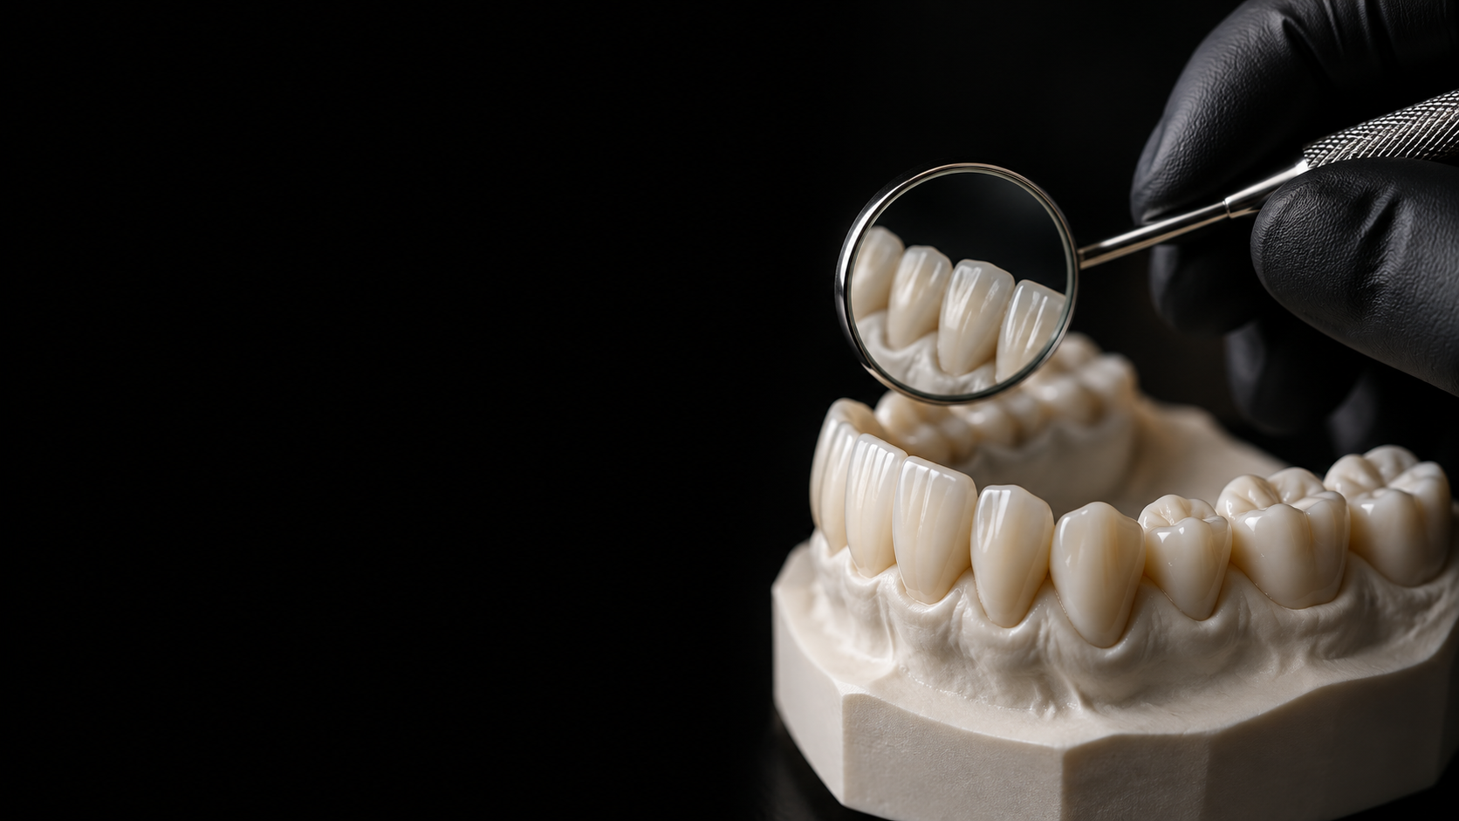
THE RESEARCH FRAMEWORK
P
I
C
O
S
Adults with
implant prostheses
Cement
retention
Screw
retention
Disease
incidence
Randomized
clinical trials
Mucositis + peri-implantitis
06
Notes:
SAY ALOUD
The methodology becomes clearer when we organize it using PICOS.
P is the population: patients who received implant-supported prostheses. The eligibility criteria required adults eighteen years or older.
I is the intervention: cement-retained prostheses. C is the comparison: screw-retained prostheses.
O is the outcome: the incidence of peri-implant mucositis and peri-implantitis. These were analyzed separately.
S is the study design: randomized clinical trials, or RCTs.
The review accepted original articles in any language. Studies needed to compare both retention types and provide usable disease and prosthesis data. When multiple publications described the same study, the authors retained the longer follow-up.
Although the population question was broad, the included restorations in Table 2 were single-unit crowns. That narrows the direct clinical application.
PRIVATE STUDY NOTES
PICOS = Who? Which treatment? Compared with what? Which outcome? What study design? S means study design, not sample size. Population eligibility is broader than the population actually represented.
SOURCE
Reis et al. J Prosthet Dent. 2025;134:100–108. doi:10.1016/j.prosdent.2023.08.030. Supplied full text.

Slide 7
PROTOCOL AND SEARCH
PRISMA
2020
PROSPERO
4 databases
January 2023
07
Notes:
SAY ALOUD
This was a systematic review with meta-analysis. A systematic review follows a structured process for finding and evaluating studies. A meta-analysis combines their numerical results.
The protocol was registered in PROSPERO, under CRD42022379444. The authors reported following PRISMA 2020.
These serve different purposes. PROSPERO records the planned review, while PRISMA guides transparent reporting of what the reviewers did. Neither one guarantees that the evidence is free from bias.
They searched MEDLINE through PubMed, Embase, Scopus, and Web of Science up to January 2023. They also searched grey literature and checked reference lists. January 2023 is the search cutoff, rather than the year the article appeared in its final journal issue.
PRIVATE STUDY NOTES
PROSPERO is like registering a recipe before cooking. PRISMA is the checklist used to explain how the recipe was followed. Search cutoff: January 2023. Final issue: July 2025; online publication was in 2023.
SOURCE
Reis et al. J Prosthet Dent. 2025;134:100–108. doi:10.1016/j.prosdent.2023.08.030. Supplied full text.

Slide 8
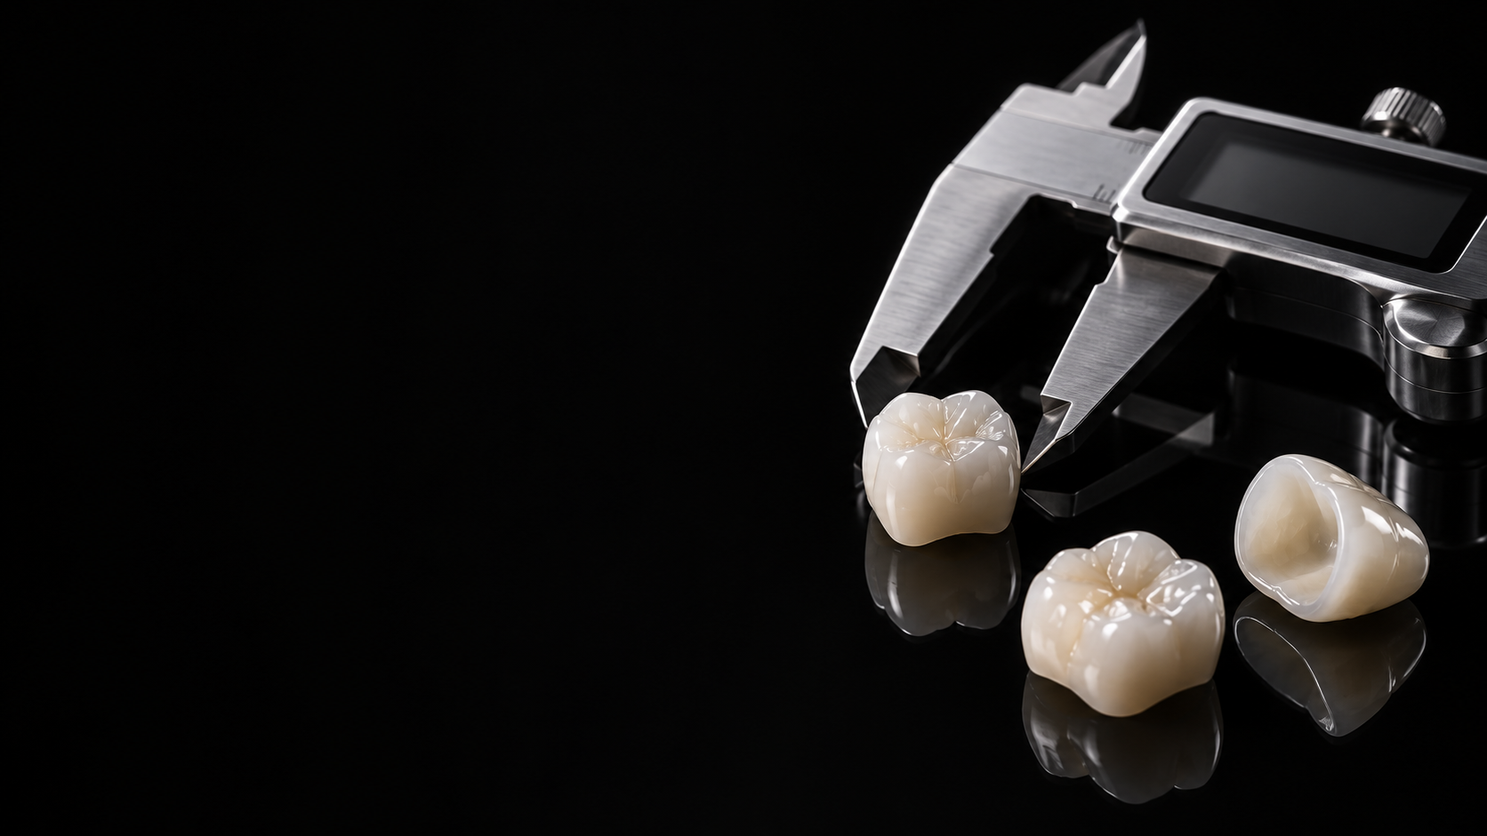
STUDY SELECTION
5,693
records identified
4,455
22
6
screened
full texts
RCTs
08
Notes:
SAY ALOUD
The search identified five thousand six hundred ninety-three records. These were search records, not five thousand completed trials included in the analysis.
After removing one thousand two hundred thirty-eight duplicates, four thousand four hundred fifty-five records remained for title and abstract screening. The authors report assessing twenty-two full-text articles and including six randomized trials.
Sixteen full-text articles were excluded for reasons such as missing disease classification, insufficient incidence or prosthesis data, an ineligible design, or a shorter report from the same trial.
So the large initial search produced a small final evidence base. A broad search supports completeness, but it does not make the final effect estimate precise when relatively few trials contribute usable events.
PRIVATE STUDY NOTES
Say 5,693 records, not 5,600 included studies. Figure 1 has a numerical inconsistency: 4,455 minus 4,435 exclusions leaves 20; adding the one hand-searched record shown gives 21, not 22. These slides preserve the reported major counts without inventing a correction.
SOURCE
Reis et al. J Prosthet Dent. 2025;134:100–108. doi:10.1016/j.prosdent.2023.08.030. Supplied full text.

Slide 9
INDEPENDENT REVIEW
2
κ 0.86
κ 0.90
reviewers
RoB 2
09
Notes:
SAY ALOUD
Two reviewers independently screened the records, assessed full texts, and extracted data. They resolved disagreements through discussion, with a third reviewer available when needed. They also contacted study authors for missing information.
Agreement between the reviewers was high. Cohen kappa was zero point eight six for title and abstract screening and zero point nine zero for full-text assessment. Kappa measures agreement beyond what might occur by chance.
Risk of bias was assessed with the Cochrane RoB 2 tool. Every included trial received an overall rating of some concerns. Relevant issues included unclear reporting of randomization, outcome assessment, and selection of reported results.
Independent review strengthens the review process, but it cannot remove limitations in the original trials.
PRIVATE STUDY NOTES
Kappa asks: did the reviewers agree more often than chance would predict? RoB 2 asks whether trial methods could systematically distort results. High screening agreement does not mean the trials themselves are high quality.
SOURCE
Reis et al. J Prosthet Dent. 2025;134:100–108. doi:10.1016/j.prosdent.2023.08.030. Supplied full text.

Slide 10
THE EVIDENCE BASE
6
255
participants
279
implants
2–10
TRIALS
years
10
Notes:
SAY ALOUD
The review reports six trials with two hundred fifty-five participants and two hundred seventy-nine implants. Follow-up ranged from two to ten years.
All included restorations were single crowns. The studies came from European settings, predominantly university environments, with some private-practice participation.
The studies varied in implant systems, restorative materials, loading protocols, and cement types. The cements included methacrylate-based or provisional cement, resin cement, zinc phosphate, and glass ionomer.
These differences matter when considering whether the combined result applies to our own patients. Also, six trials entered the review, but only four contributed to each disease analysis. The two analyses did not use exactly the same set of trials.
We should therefore avoid treating the total review sample as the denominator for every outcome.
PRIVATE STUDY NOTES
The 255/279 totals are the review’s reported aggregate figures, not a claim that all randomized participants completed follow-up. Table 1 includes varying baseline and follow-up counts. Do not generalize directly to full-arch prostheses.
SOURCE
Reis et al. J Prosthet Dent. 2025;134:100–108. doi:10.1016/j.prosdent.2023.08.030. Supplied full text.

Slide 11
STATISTICAL ANALYSIS
RANDOM
EFFECTS
Cement ÷ screw
RR + 95% CI
11
Notes:
SAY ALOUD
The authors used a random-effects meta-analysis and calculated pooled risk ratios with ninety-five percent confidence intervals. They performed the analysis in Review Manager version five point four.
A risk ratio compares the risk in the cement group with the risk in the screw group. A value of one represents equal estimated risk. Above one points toward more risk with cement. Below one points toward less risk with cement.
Random effects allows the underlying treatment effect to vary across studies. It is useful when clinical settings differ, but it does not make those differences disappear.
The pooled result is a weighted combination of study estimates. It is not simply the total number of cement events divided by the total number of screw events across all studies.
PRIVATE STUDY NOTES
Imagine each trial gives a slightly different answer. Meta-analysis combines those answers with weights. RR example, invented only for learning: 20% ÷ 10% = 2. The cement risk is twice the screw risk. This is not a result from the paper.
SOURCE
Reis et al. J Prosthet Dent. 2025;134:100–108. doi:10.1016/j.prosdent.2023.08.030. Supplied full text.
VISUAL
AI-generated conceptual editorial imagery. Not a study participant, clinical outcome, anatomical diagram, or Michael Apa clinical case.

Slide 12
PERI-IMPLANT MUCOSITIS
1.36
RISK RATIO
0.42–4.38
P = .61
95% CI
I² = 61%
12
Notes:
SAY ALOUD
For mucositis, four studies contributed to the meta-analysis. The pooled risk ratio was one point three six, with a ninety-five percent confidence interval from zero point four two to four point three eight. The P value was point six one.
The point estimate is numerically above one, but the confidence interval includes one and is very wide. The data are compatible with a lower risk, no difference, or a substantially higher risk with cement retention.
Therefore, the authors did not detect a statistically significant difference. I would describe the direction as a numerical tendency, not demonstrated superiority of screw retention.
Heterogeneity was I-squared sixty-one percent. The authors describe this as moderate heterogeneity, so the trial results were not fully consistent.
PRIVATE STUDY NOTES
RR 1.36 is a 36% higher point estimate, not 36 percentage points and not a proven increase. CI includes 1, so no difference remains compatible with the data. The 0.42–4.38 interval spans 58% lower to 338% higher relative risk.
SOURCE
Reis et al. J Prosthet Dent. 2025;134:100–108. doi:10.1016/j.prosdent.2023.08.030. Supplied full text.

Slide 13
PERI-IMPLANTITIS
1.00
RISK RATIO
0.23–4.31
P > .999
95% CI
I² = 0%
13
Notes:
SAY ALOUD
For peri-implantitis, four studies contributed. The pooled risk ratio was one point zero zero, with a confidence interval from zero point two three to four point three one. The reported P value was greater than point nine nine nine.
Again, the analysis did not detect a statistically significant difference. Although the point estimate is exactly one, the confidence interval remains wide. That means the apparent equality of the point estimate should not be confused with a precise demonstration of equal risk.
I-squared was zero percent, indicating no detected statistical heterogeneity in this analysis. This does not prove that the studies were clinically identical. With few trials and sparse events, important uncertainty remains even when I-squared is zero.
PRIVATE STUDY NOTES
I² = 0% means no observed excess variation detected by this analysis, not zero bias or perfect certainty. Sparse events and zero-event arms make the result sensitive to analytic choices. The paper’s pooled RR should not be recreated by simply dividing Table 4 totals.
SOURCE
Reis et al. J Prosthet Dent. 2025;134:100–108. doi:10.1016/j.prosdent.2023.08.030. Supplied full text.

Slide 14
READING UNCERTAINTY
1
Wide interval = low precision
P ≠ clinical importance
NO DIFFERENCE
14
Notes:
SAY ALOUD
Here is the simplest way to read these statistics. First, look at the risk ratio for the estimated direction. Then look at the confidence interval for precision and whether it includes one.
A confidence interval describes uncertainty around the estimated effect. A wide interval means the estimate is less precise. It does not mean that ninety-five percent of individual patients will have an outcome within that interval.
The P value asks how compatible the observed data are with a no-difference model and its assumptions. It does not tell us the probability that the null hypothesis is true, or the probability that a treatment is safe.
Finally, I-squared describes inconsistency across study estimates. Mucositis had sixty-one percent; peri-implantitis had zero percent. We must report them separately.
PRIVATE STUDY NOTES
Child-simple analogy: RR is the location of a guess. The CI shows how blurry that guess is. P tests evidence against the starting no-difference model. I² asks whether studies disagree beyond sampling variation. A 95% CI procedure would cover the true value in about 95% of repeated studies under its assumptions.
SOURCE
Reis et al. J Prosthet Dent. 2025;134:100–108. doi:10.1016/j.prosdent.2023.08.030. Supplied full text.

Slide 15
CERTAINTY OF EVIDENCE
MODERATE
GRADE
Imprecision
Sensitivity: P=.37 / P=.30
15
Notes:
SAY ALOUD
The authors rated the certainty of evidence as moderate for both outcomes using GRADE. They downgraded for imprecision because the available sample was below their stated optimal information size of three hundred.
Moderate certainty means that the true effect is probably reasonably close to the estimate, but it could still differ substantially.
They also analyzed subgroups by cement type. No statistically significant subgroup differences were found, but the subgroups contained few studies. This does not establish that all cements behave identically.
Sensitivity analysis asks whether the conclusion changes when particular studies are removed. Excluding two trials that did not primarily compare retention for disease incidence still produced nonsignificant results: P point three seven for mucositis and point three zero for peri-implantitis. This supports stability of the statistical conclusion, while uncertainty remains.
PRIVATE STUDY NOTES
GRADE considers risk of bias, inconsistency, indirectness, imprecision, and publication bias. The authors downgraded for imprecision. Sensitivity analysis is like removing one ingredient to see whether the overall result changes. A subgroup comparison with little data may miss a real difference.
SOURCE
Reis et al. J Prosthet Dent. 2025;134:100–108. doi:10.1016/j.prosdent.2023.08.030. Supplied full text.

Slide 16
CRITICAL APPRAISAL
01
Small samples
02
Variable definitions
03
Unequal groups
04
Single crowns
Also: the article’s own text and Table 1 disagree on publication years (2002–2012 in the text vs. 2012–2022 in the table).
16
Notes:
SAY ALOUD
The main strengths are the registered protocol, the systematic search, independent review, and the use of trials with both retention types. Follow-up of two to ten years also gives more clinical information than very short studies.
The limitations are equally important. Samples were small, disease definitions varied, and some key diagnostic details were missing. All trials had some risk-of-bias concerns.
Two trials did not primarily test the retention question, and some comparisons had very unequal group sizes. Calling the source studies RCTs therefore does not guarantee that retention itself was randomized equally in every comparison.
The studies also differed in materials and follow-up. Information about cement removal, operator experience, and other relevant factors was insufficient. These limitations restrict causal interpretation and application beyond the single-crown settings studied.
PRIVATE STUDY NOTES
If asked for your strongest critique: the review is rigorous in its process, but the primary evidence is small and does not uniformly isolate retention as the randomized intervention. Do not call all studies high risk; their overall RoB 2 rating was some concerns.
SOURCE
Reis et al. J Prosthet Dent. 2025;134:100–108. doi:10.1016/j.prosdent.2023.08.030. Supplied full text.

Slide 17
CLINICAL INTERPRETATION
BEYOND
RETENTION
Retrievability
Hygiene
Esthetics
17
Notes:
SAY ALOUD
How does this affect my clinical decision? The review does not justify claiming that screw retention is universally biologically superior. It also does not justify dismissing residual cement as harmless.
For an individual patient, I would consider retrievability, implant position, prosthetic design, esthetic requirements, and access for hygiene and maintenance. If cement retention is selected, careful cement management remains relevant.
My clinical preference can favor screw retention for practical reasons, especially retrievability, but I should separate that preference from what this meta-analysis proved.
The evidence supports an individualized decision. It does not provide a universal rule for every implant restoration, and its direct evidence is strongest for the types of single crowns actually studied.
PRIVATE STUDY NOTES
This is a clinical interpretation of the review, not a new guideline or a patient-specific treatment prescription. Keep preference, biological plausibility, and demonstrated comparative effects separate.
SOURCE
Reis et al. J Prosthet Dent. 2025;134:100–108. doi:10.1016/j.prosdent.2023.08.030. Supplied full text.
VISUAL
AI-generated conceptual editorial imagery. Not a study participant, clinical outcome, anatomical diagram, or Michael Apa clinical case.

Slide 18

THE CONCLUSION
NO CLEAR
BIOLOGICAL
WINNER
Moderate certainty.
Important uncertainty.
18
Notes:
SAY ALOUD
My conclusion is that this meta-analysis did not detect a statistically significant difference in peri-implant mucositis or peri-implantitis between cement- and screw-retained prostheses.
The authors judged the evidence to have moderate certainty. However, the wide confidence intervals mean that clinically important differences remain possible. I would therefore use the phrase no demonstrated difference, rather than proven equivalence.
We began with the idea that biology comes first. The evidence reminds us that protecting biology requires more than selecting a retention label. It also requires careful planning and attention to the patient and the prosthesis.
Future trials need clearer disease definitions, adequate sample sizes, and better control of relevant clinical variables. Thank you.
PRIVATE STUDY NOTES
If asked whether the null hypothesis was accepted: say it was not rejected. If asked whether screw retention is better: this review did not demonstrate lower disease incidence, although other practical considerations may favor it.
SOURCE
Reis et al. J Prosthet Dent. 2025;134:100–108. doi:10.1016/j.prosdent.2023.08.030. Supplied full text.
VISUAL
AI-generated conceptual editorial imagery. Not a study participant, clinical outcome, anatomical diagram, or Michael Apa clinical case.

Slide 19
THE CLINICAL BOTTOM LINE
SAME RISK.
DIFFERENT
TRADE-OFFS.
Retrievability, hygiene, and esthetics
still favor screw retention.
Disease risk no longer does.
19
Notes:
SAY ALOUD
One more concrete takeaway. If disease risk doesn’t distinguish these two retention methods, the decision should rest on what does: retrievability for maintenance and repair, hygiene access for the patient, and esthetics for the final restoration.
Those three factors still point toward screw retention in many cases — this review simply removes disease risk as a tie-breaker.
PRIVATE STUDY NOTES
This is the presenter’s synthesis, not a direct recommendation from Reis et al. — the authors report the statistical findings; the clinical framing here (retrievability/hygiene/esthetics as the deciding factors) echoes the ‘Beyond Retention’ slide earlier in the talk.
SOURCE
Reis et al. J Prosthet Dent. 2025;134:100–108. doi:10.1016/j.prosdent.2023.08.030. Supplied full text.

Slide 20
READ WITH CAUTION
TWO FLAGS
BEFORE YOU
CITE THIS
Sensitivity analysis: P=.37 mucositis,
P=.30 peri-implantitis — both null.
Table 1 lists 2012–2022.
The text says 2002–2012.
20
Notes:
SAY ALOUD
Two things worth flagging before you take this evidence elsewhere.
First, the authors’ own sensitivity analyses — removing the highest-risk-of-bias study — left both results non-significant, P=.37 for mucositis and P=.30 for peri-implantitis, so the null finding isn’t fragile to that one study.
Second, I noticed a small inconsistency in the article itself: the text states the included studies span 2002 to 2012, but Table 1 actually lists publication years from 2012 to 2022. It doesn’t change the pooled results, but it’s the kind of detail worth checking when you critically appraise a paper yourself.
PRIVATE STUDY NOTES
Both findings were independently verified against the supplied full-text PDF before including them here — the P-values are read directly from the sensitivity-analysis paragraph, and the date inconsistency is a direct text-vs-Table-1 comparison. If asked, be ready to point to the exact sentence and table.
SOURCE
Reis et al. J Prosthet Dent. 2025;134:100–108. doi:10.1016/j.prosdent.2023.08.030. Supplied full text.

Slide 21
DISCUSSION
EQUIVALENCE?
Cement type?
Full arch?
21
Notes:
SAY ALOUD
Backup slide. Open only for questions.
PRIVATE STUDY NOTES
Q: Did this prove equality? A: No. Wide intervals include clinically important differences.
Q: Were cement types compared? A: Yes, through small subgroups; no significant subgroup differences were detected.
Q: Does this cover full arches? A: Table 2 lists single crowns. Direct extrapolation is limited.
Q: Was heterogeneity high for both outcomes? A: No. I² was 61% for mucositis and 0% for peri-implantitis.
Q: Why not divide all event totals? A: A weighted study-level meta-analysis preserves each trial comparison; crude pooled totals do not.
Q: Any reporting concerns? A: The flowchart counts do not fully reconcile, and the text says publication dates 2002–2012 although Table 1 lists studies from 2012–2022. Report these as source inconsistencies, not corrected data.
Q: What about Table 4’s absolute peri-implantitis effect? A: Its zero baseline risk produces an uninformative absolute estimate. Do not present this as proof of zero possible harm.
SOURCE
Reis et al. J Prosthet Dent. 2025;134:100–108. doi:10.1016/j.prosdent.2023.08.030. Supplied full text.

Slide 22
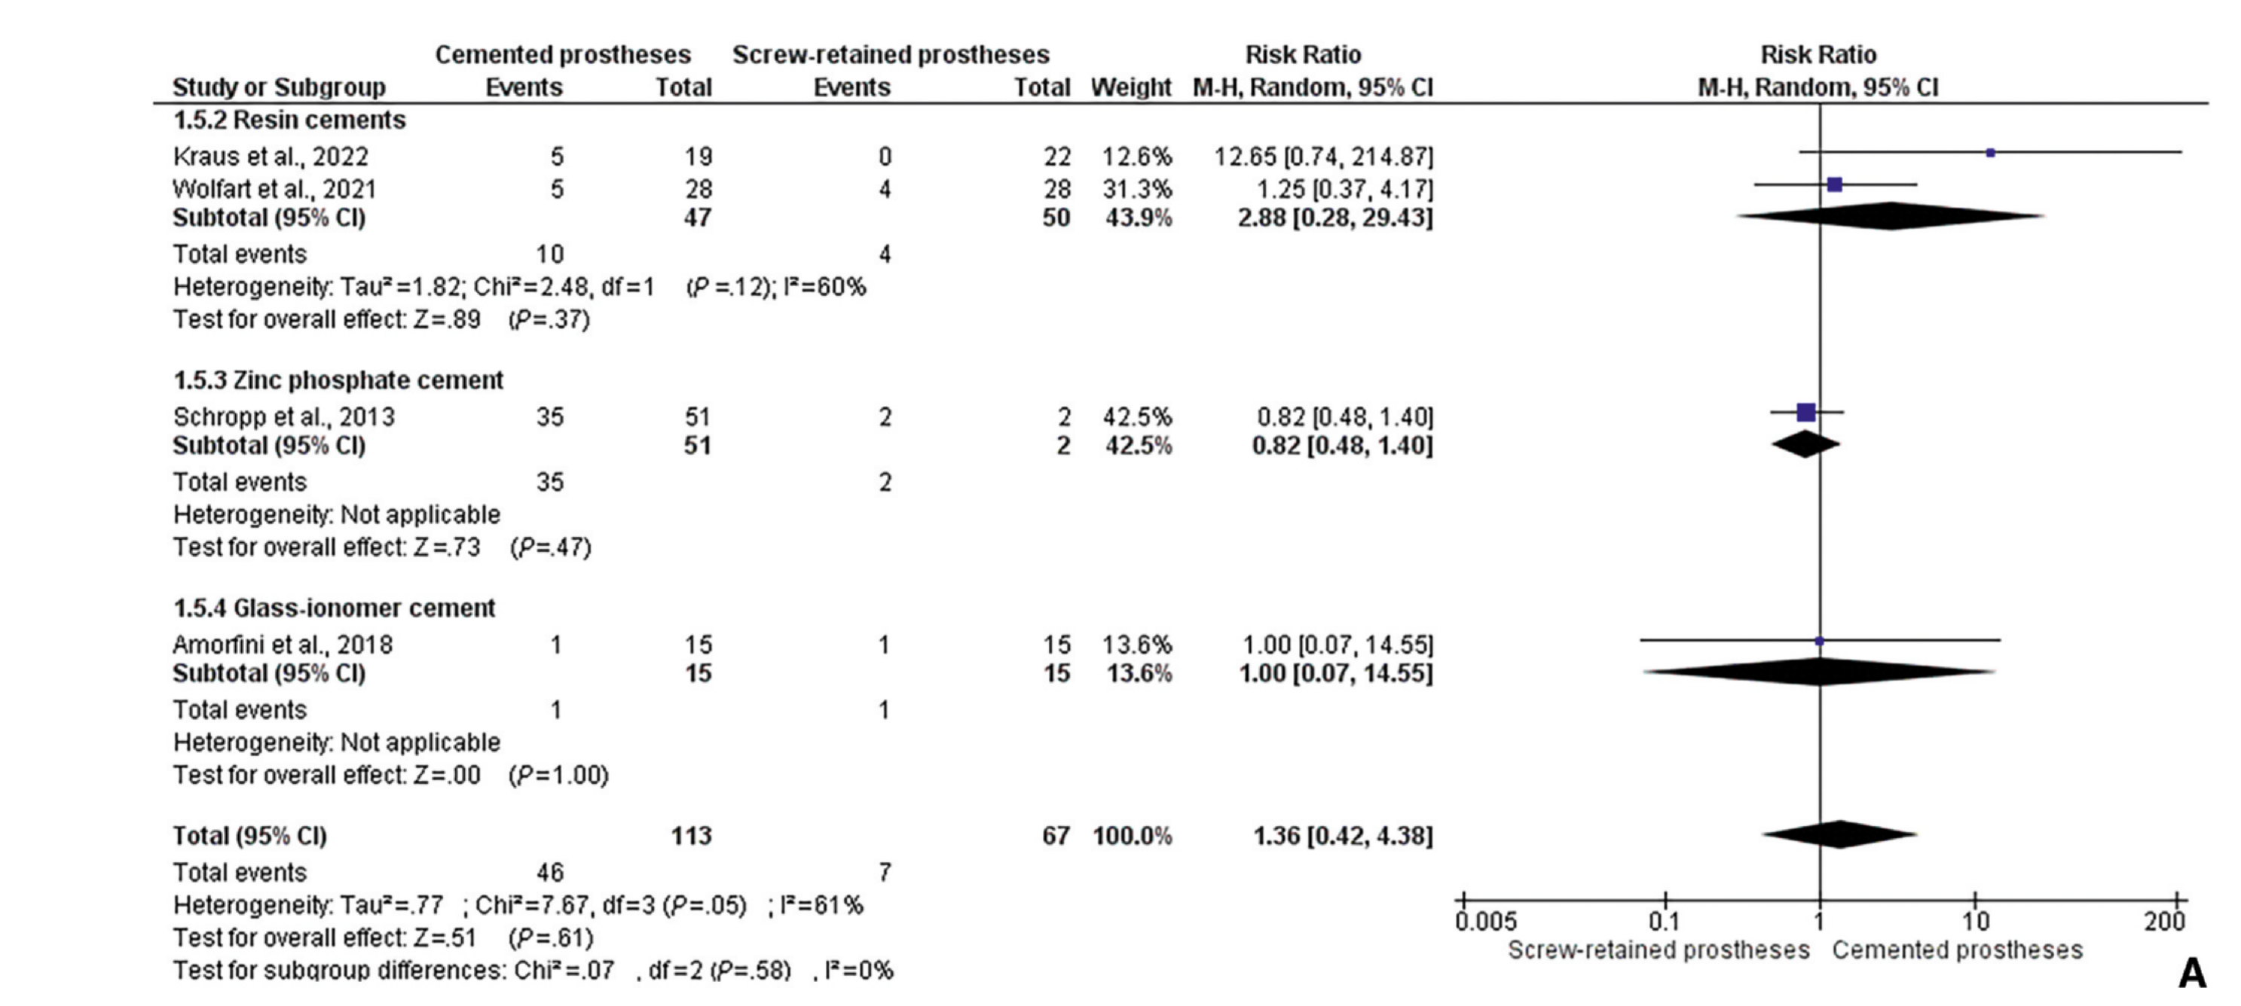
PERI-IMPLANT MUCOSITIS FOREST PLOT
Reis et al. / Figure 3A
22
Notes:
SAY ALOUD
Backup slide. Open only for questions.
PRIVATE STUDY NOTES
Backup, not part of the timed talk. Squares represent study estimates, horizontal lines their confidence intervals, and diamonds pooled estimates. The no-effect line is RR = 1. An interval crossing it includes no difference. This panel pools by cement type: resin cements, zinc phosphate cement, and glass-ionomer cement. Figure 3 reproduced from the user-supplied article.
SOURCE
Reis et al. J Prosthet Dent. 2025;134:100–108. doi:10.1016/j.prosdent.2023.08.030. Supplied full text.

Slide 23
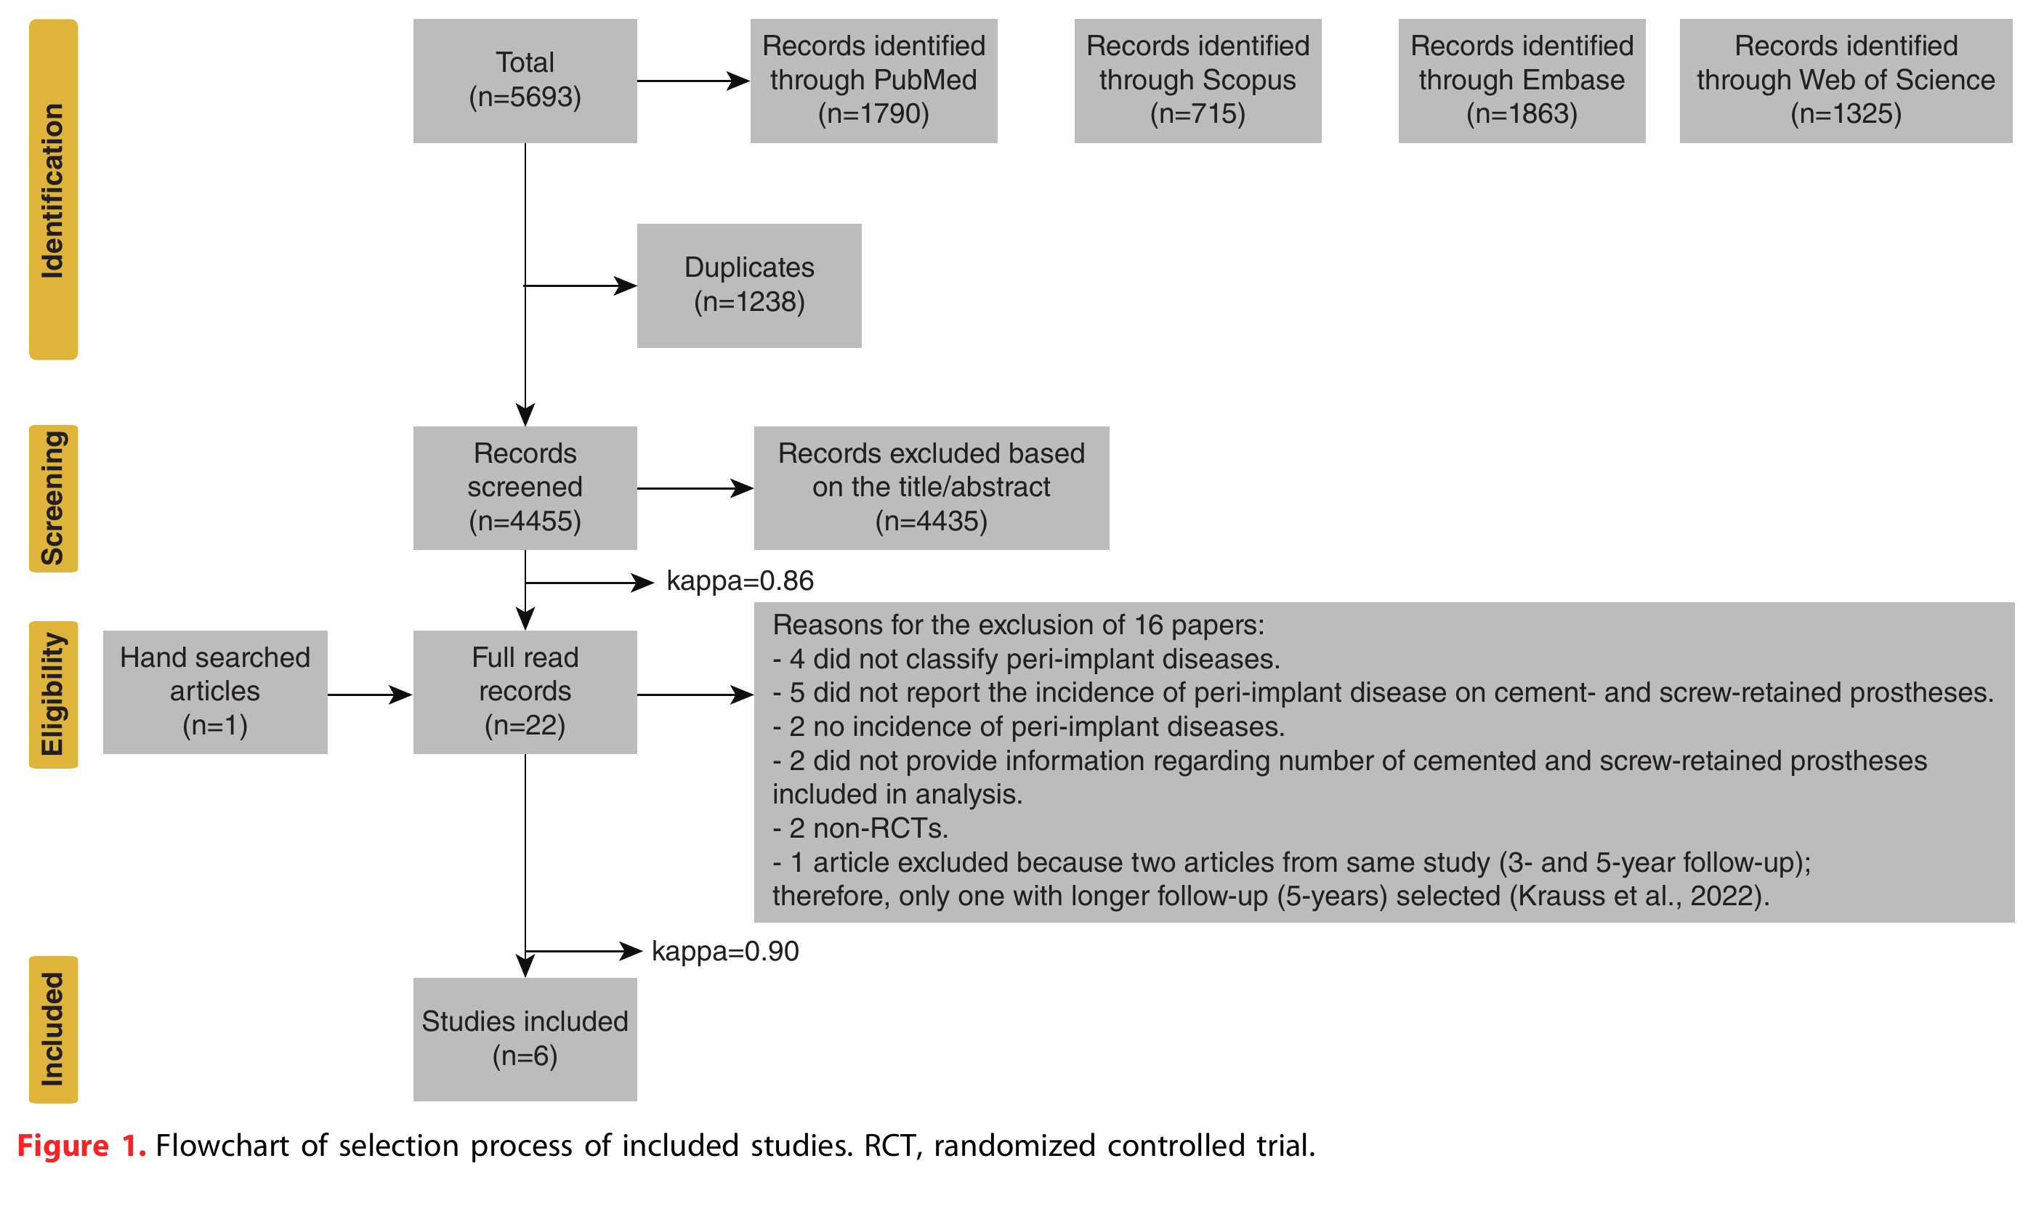
PRISMA FLOW DIAGRAM
Reis et al. / Figure 1
23
Notes:
SAY ALOUD
Backup slide. Open only for questions.
PRIVATE STUDY NOTES
Backup, not part of the timed talk. This is the reviewers’ own PRISMA 2020 flow diagram: 5,693 records identified across four databases, 1,238 duplicates removed, 4,455 records screened, 4,435 excluded at title/abstract, 22 full texts assessed plus 1 hand-searched, 16 excluded for the stated reasons, 6 studies included in the final synthesis. Figure 1 reproduced from the user-supplied article.
SOURCE
Reis et al. J Prosthet Dent. 2025;134:100–108. doi:10.1016/j.prosdent.2023.08.030. Supplied full text.

Slide 24
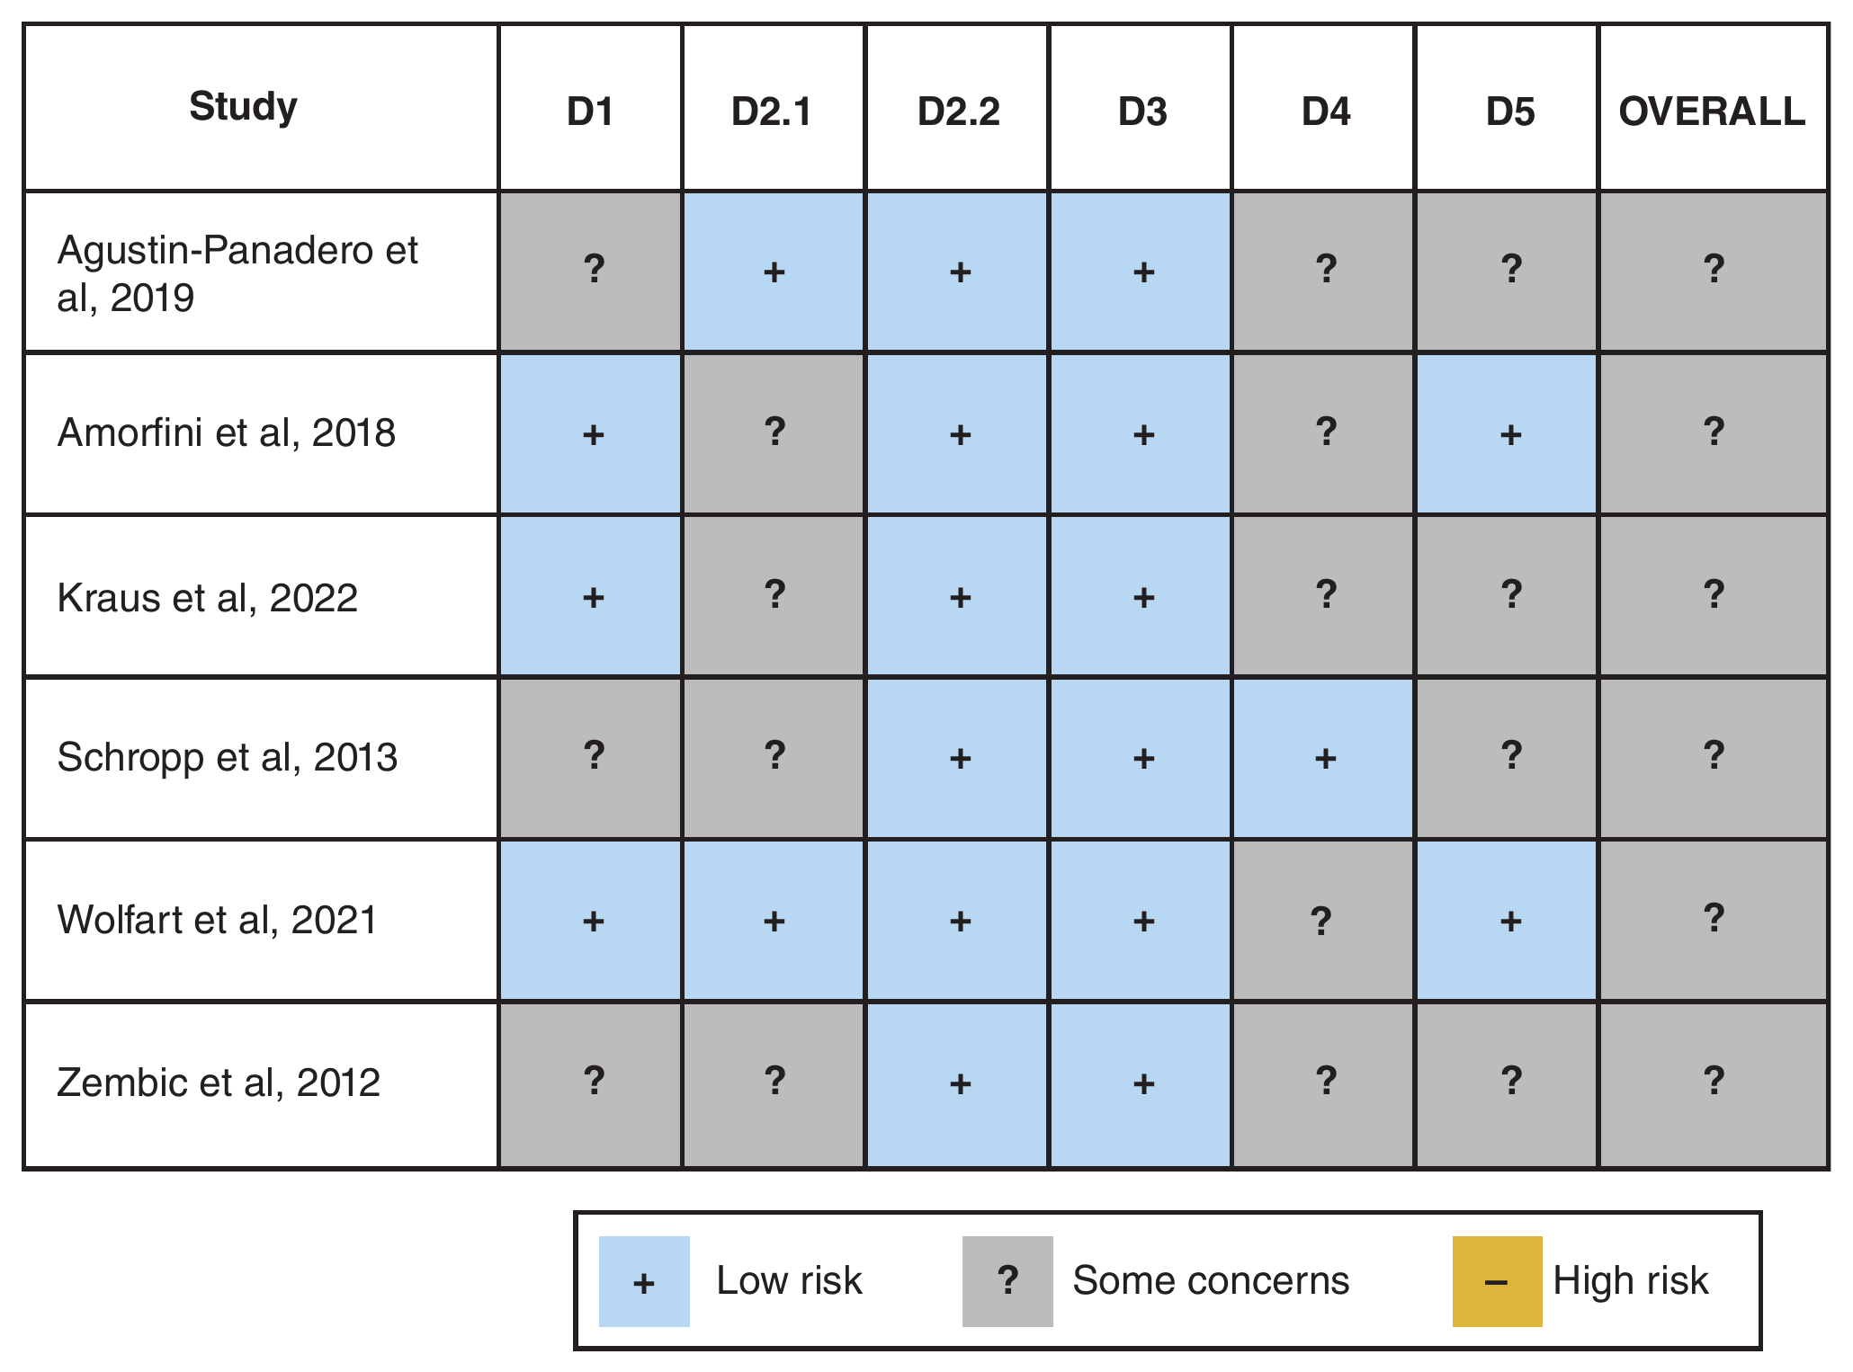
RISK OF BIAS
Reis et al. / Figure 2
24
Notes:
SAY ALOUD
Backup slide. Open only for questions.
PRIVATE STUDY NOTES
Backup, not part of the timed talk. Cochrane RoB 2 domain-level judgments for all 6 included trials: D1 randomization process, D2.1/D2.2 deviations from intended interventions, D3 missing outcome data, D4 outcome measurement, D5 selective reporting. Blue plus = low risk, gray question mark = some concerns, gold minus = high risk. No trial was rated high risk on any single domain, but every trial carried at least one ‘some concerns’ rating, which is why the overall column reads ‘some concerns’ throughout rather than ‘low risk.’ Figure 2 reproduced from the user-supplied article.
SOURCE
Reis et al. J Prosthet Dent. 2025;134:100–108. doi:10.1016/j.prosdent.2023.08.030. Supplied full text.

Slide 25
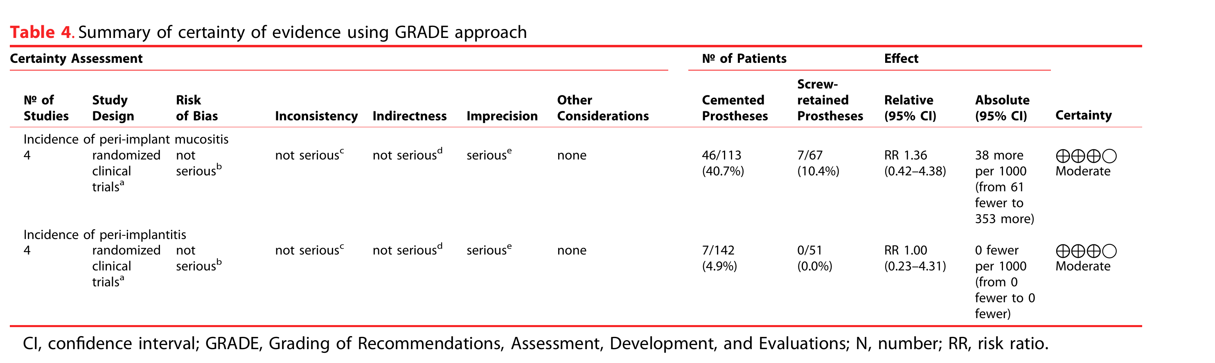
GRADE SUMMARY
Reis et al. / Table 4
25
Notes:
SAY ALOUD
Backup slide. Open only for questions.
PRIVATE STUDY NOTES
Backup, not part of the timed talk. GRADE summary of findings for both outcomes: certainty rated Moderate, downgraded one level for imprecision (wide confidence intervals crossing the line of no effect), with no downgrade for risk of bias, inconsistency, or indirectness. This is the same ‘moderate certainty’ judgment referenced earlier in the main talk. Table 4 reproduced from the user-supplied article.
SOURCE
Reis et al. J Prosthet Dent. 2025;134:100–108. doi:10.1016/j.prosdent.2023.08.030. Supplied full text.

Slide 26
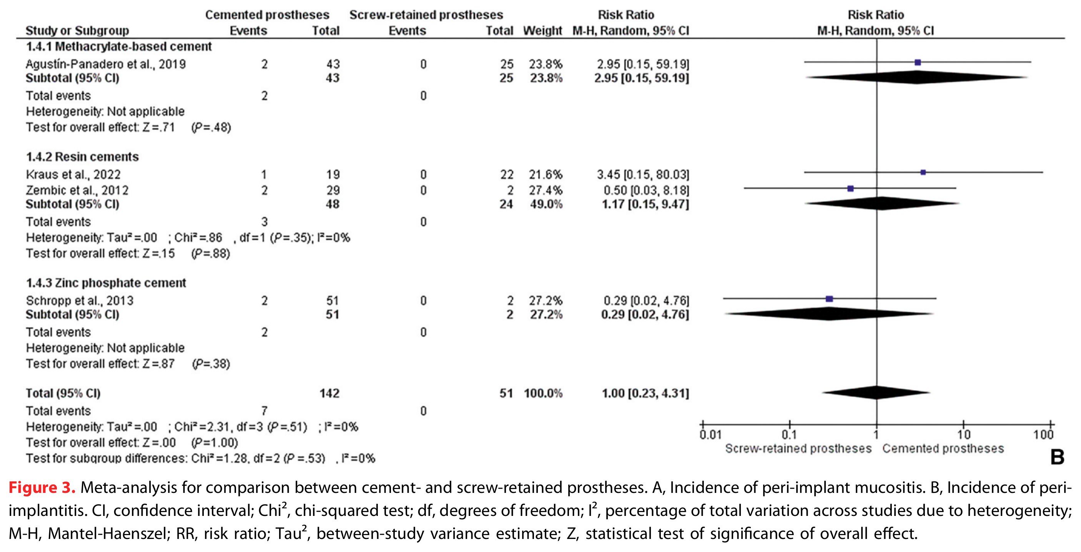
PERI-IMPLANTITIS FOREST PLOT
Reis et al. / Figure 3B
26
Notes:
SAY ALOUD
Backup slide. Open only for questions.
PRIVATE STUDY NOTES
Backup, not part of the timed talk. Squares represent study estimates, horizontal lines their confidence intervals, and diamonds pooled estimates. The no-effect line is RR = 1. An interval crossing it includes no difference. This panel pools by cement type: methacrylate-based, resin, and zinc phosphate. Figure 3 reproduced from the user-supplied article.
SOURCE
Reis et al. J Prosthet Dent. 2025;134:100–108. doi:10.1016/j.prosdent.2023.08.030. Supplied full text.

Slide 27
COMPLETE REFERENCES
01
Reis INR, Fukuoka GL, Nagay BE, Pannuti CM, Spin-Neto R, da Silva EVF. Incidence of peri-implant disease associated with cement- and screw-retained implant-supported prostheses: a systematic review and meta-analysis. J Prosthet Dent. 2025;134(1):100–108.
02
Berglundh T, Armitage G, Araujo MG, et al. Peri-implant diseases and conditions: consensus report of workgroup 4 of the 2017 World Workshop on the Classification of Periodontal and Peri-Implant Diseases and Conditions. J Clin Periodontol. 2018;45(Suppl 20):S286–S291.
03
Page MJ, McKenzie JE, Bossuyt PM, et al. The PRISMA 2020 statement: an updated guideline for reporting systematic reviews. BMJ. 2021;372:n71.
04
Nova Southeastern University College of Dental Medicine. Advanced Education in General Dentistry Literature Review Protocol. Internal course document.
27
Notes:
SAY ALOUD
Backup slide. Open only for questions.
PRIVATE STUDY NOTES
Backup, not part of the timed talk. Reference 1 is the primary source under review. References 2 and 3 are the definitional and methodological sources cited in the main talk (peri-implant disease case definitions; the PRISMA 2020 reporting guideline). Reference 4 is the AEGD literature review protocol governing this presentation’s required format.
SOURCE
Reis et al. J Prosthet Dent. 2025;134:100–108. doi:10.1016/j.prosdent.2023.08.030. Supplied full text.

Slide 28
REFERENCE
REIS ET AL.
Reis INR, Fukuoka GL, Nagay BE, Pannuti CM, Spin-Neto R, da Silva EVF
J Prosthet Dent
2025;134(1):100–108
JIF: verification required
doi:10.1016/j.prosdent.2023.08.030
28
Notes:
SAY ALOUD
Backup slide. Open only for questions.
PRIVATE STUDY NOTES
Primary source: Reis INR, Fukuoka GL, Nagay BE, Pannuti CM, Spin-Neto R, da Silva EVF. Incidence of peri-implant disease associated with cement- and screw-retained implant-supported prostheses: A systematic review and meta-analysis. User-supplied full-text PDF. Prior speaking script consulted to preserve the practiced opening. Design direction inspired by the requested luxury dental aesthetic; no affiliation or endorsement.
SOURCE
Reis et al. J Prosthet Dent. 2025;134:100–108. doi:10.1016/j.prosdent.2023.08.030. Supplied full text.

