Slide 1
NSU AEGD LITERATURE REVIEW
Cement- or Screw-Retained?
Comparing the Incidence of Peri-Implant Disease
A systematic review and meta-analysis of randomized clinical trials
Presenter PG Resident Andreyna Meijide
Program Advanced Education in General Dentistry
Institution Nova Southeastern University, College of Dental Medicine
Faculty Mentor Michelle Madera
Date September 30, 2026
Placeholder — confirm before presenting
Notes:
Good morning / good afternoon. Thank you for being here.
Today's review addresses a question that comes up at nearly every implant delivery appointment: once we restore an implant with a single crown, does the retention method — cement or screw — actually change the patient's risk of peri-implant mucositis or peri-implantitis?
I'll present a 2025 systematic review and meta-analysis from The Journal of Prosthetic Dentistry by Reis and colleagues, pooling randomized trials that directly compared cement- and screw-retained implant prostheses for this outcome.
Housekeeping: the presenter, mentor, and date fields here are standard AEGD placeholders — please confirm they match the current schedule before this is presented.
[Transition] Let's start with why retention method could plausibly matter biologically.
Source: Reis INR, Fukuoka GL, Nagay BE, Pannuti CM, Spin-Neto R, Silva EVF. J Prosthet Dent. 2025;134(1):100-108.

Slide 2
BACKGROUND
Cement Remnants Are a Recognized Biological Risk at the Margin
Implant-supported fixed prostheses can be cemented onto an abutment or screwed directly into the implant or abutment complex. Both approaches are widely used and both carry distinct mechanical and biological trade-offs.
RETENTION METHODS COMPARED
C
Cement-retained
Passive fit; strong esthetics; excess subgingival cement can be difficult to fully retrieve.
Excess subgingival cement has repeatedly been proposed as a bacterial reservoir that hinders biofilm control and has been associated with peri-implant disease in prior observational literature — the biological concern motivating this review.
S
Screw-retained
Fully retrievable; no cement risk; requires adequate prosthetic space and an accessible screw channel.
Peri-implant mucositis: reversible inflammation of the peri-implant soft tissue, without progressive bone loss.
Peri-implantitis: inflammation plus progressive loss of supporting bone around a functioning implant.
Prior systematic reviews on this question reached inconsistent conclusions and relied mainly on observational studies of mixed design.
Reis et al. J Prosthet Dent. 2025;134(1):100-108.
1
Notes:
Let's ground this in basic prosthodontic biology first.
An implant crown can be cemented onto an abutment or screwed directly into the implant or abutment. Screw retention gives predictable retrievability and no cementation; cement retention can offer a more passive fit and simplify esthetics when a screw-access channel would otherwise show, or angulation is unfavorable.
The biological concern is excess cement: when subgingival cement isn't fully removed, it can act as a bacteria-retentive reservoir and has been associated with peri-implant disease in earlier observational studies — though those mixed designs and couldn't isolate retention type as the cause.
Definitions we'll use throughout: peri-implant mucositis is reversible soft-tissue inflammation without bone loss; peri-implantitis adds progressive bone loss. These are the 2017 World Workshop / Berglundh et al. definitions (J Clin Periodontol. 2018;45(Suppl 20):S286-S291).
Because earlier reviews here were inconsistent and leaned on observational data, today's authors pooled only randomized trials instead.
[Transition] Here's the focused question they asked.

Slide 3
THE QUESTION
Does Retention Method Change the Risk of Peri-Implant Disease?
“Is the incidence of peri-implant diseases higher in cemented implant-supported prostheses than in screw-retained prostheses?”
Focused question, as stated by the authors
P
I
C
O
POPULATION
INTERVENTION
COMPARISON
OUTCOME
Patients who received implant-supported prostheses
Cement-retained prostheses
Screw-retained prostheses
Incidence of peri-implant mucositis and peri-implantitis
Study design (S): randomized controlled trials only.
Reis et al. J Prosthet Dent. 2025;134(1):100-108.
2
Notes:
This is the focused question the authors built their search around, quoted directly from the paper.
Using the PICO framework: Population — patients with implant-supported prostheses. Intervention — cement retention. Comparison — screw retention. Outcome — incidence of peri-implant mucositis and peri-implantitis.
One more letter matters: "S" for study design. The authors restricted this review to RCTs only — trading a larger observational evidence pool for a smaller, more internally valid one, since randomization balances unmeasured confounders like hygiene or bone quality between groups.
[Transition] Let's look at where this evidence was published and how the authors framed their objective and hypothesis.

Slide 4

THE EVIDENCE
A 2025 Systematic Review and Meta-Analysis of Randomized Trials
Reis INR, Fukuoka GL, Nagay BE, Pannuti CM, Spin-Neto R, Silva EVF. Incidence of peri-implant disease associated with cement- and screw-retained implant-supported prostheses: a systematic review and meta-analysis.
AUTHORS’ STATED HYPOTHESIS
Explicit null hypothesis reported: no association would be found between prosthesis retention type and the incidence of peri-implant disease.
The Journal of Prosthetic Dentistry · Published July 2025 · Vol. 134, Issue 1, pp. 100–108 · doi:10.1016/j.prosdent.2023.08.030
JIF: verification required
PRE-REGISTRATION
EVIDENCE LEVEL
PROSPERO CRD42022379444, conducted per PRISMA 2020.
Systematic review and meta-analysis of RCTs — the top tier of the evidence hierarchy.
AUTHORS’ OBJECTIVE
AUTHORS
To compare the incidence of peri-implant mucositis and peri-implantitis between cement- and screw-retained implant-supported prostheses, pooling data from RCTs.
Reis, Fukuoka, Nagay, Pannuti, Spin-Neto, Silva — University of São Paulo, Aarhus University
Reis et al. J Prosthet Dent. 2025;134(1):100-108.
3
Notes:
Here's the full citation: Reis and colleagues, The Journal of Prosthetic Dentistry, July 2025, volume 134, issue 1, pages 100-108.
One disclosure: I could not verify a single reliable current Journal Impact Factor — sources gave conflicting numbers, so I've flagged it "verification required" rather than guess. Please check the current Clarivate JCR before quiz day if needed.
This sits at the top of the evidence hierarchy: a systematic review and meta-analysis of RCTs.
The objective was to compare mucositis and peri-implantitis incidence between cement- and screw-retained prostheses using pooled RCT data.
To directly answer our protocol's question: yes, an explicit hypothesis is reported — a null hypothesis that no association would be found between retention type and peri-implant disease incidence.
This review was also pre-registered on PROSPERO and followed PRISMA 2020 — a real quality marker that reduces the chance outcomes were changed after the authors saw the data.
[Transition] Now let's see how they searched for and selected the six included trials.

Slide 5
METHODS
Only Head-to-Head Randomized Trials Qualified
ELIGIBILITY CRITERIA
SEARCH & SELECTION
• Randomized controlled trials, any language
• Databases: MEDLINE/PubMed, Embase, Scopus, Web of Science (through January 2023)
• Participants aged 18 years or older
• Peri-implant disease incidence categorized
• Grey literature: OpenGrey, Grey Literature Report, plus hand-searched reference lists
• Data reported separately for cement- vs screw-retained groups
• 2 independent reviewers screened titles/abstracts (κ = 0.86) and full texts (κ = 0.90); a 3rd reviewer arbitrated disagreements
Excluded: no disease classification, no incidence data by retention type, non-RCTs, or duplicate reports with shorter follow-up (16 full-text articles excluded for these reasons).
• Quality appraisal with RoB 2; random-effects meta-analysis; certainty rated with GRADE
Reis et al. J Prosthet Dent. 2025;134(1):100-108.
4
Notes:
Methodologically, this is a well-conducted systematic review.
Eligibility: RCTs only, any language, adult participants, and the trial had to classify peri-implant disease and report incidence separately by retention type. Sixteen full-text articles were excluded at the final stage for not classifying disease, not reporting incidence by retention type, not being randomized, or duplicating a study already included with shorter follow-up.
Search: four databases — PubMed, Embase, Scopus, Web of Science — through January 2023, plus grey literature and hand-searched reference lists.
Two independent reviewers screened everything. Quick stats note: kappa measures reviewer agreement beyond chance. Values of 0.86 and 0.90 are "almost perfect" agreement — the inclusion decisions weren't arbitrary.
Quality was appraised with RoB 2, effects pooled with random-effects meta-analysis, and certainty rated with GRADE — I'll unpack both shortly.
[Transition] Let's see how five thousand records narrowed to six trials.

Slide 6
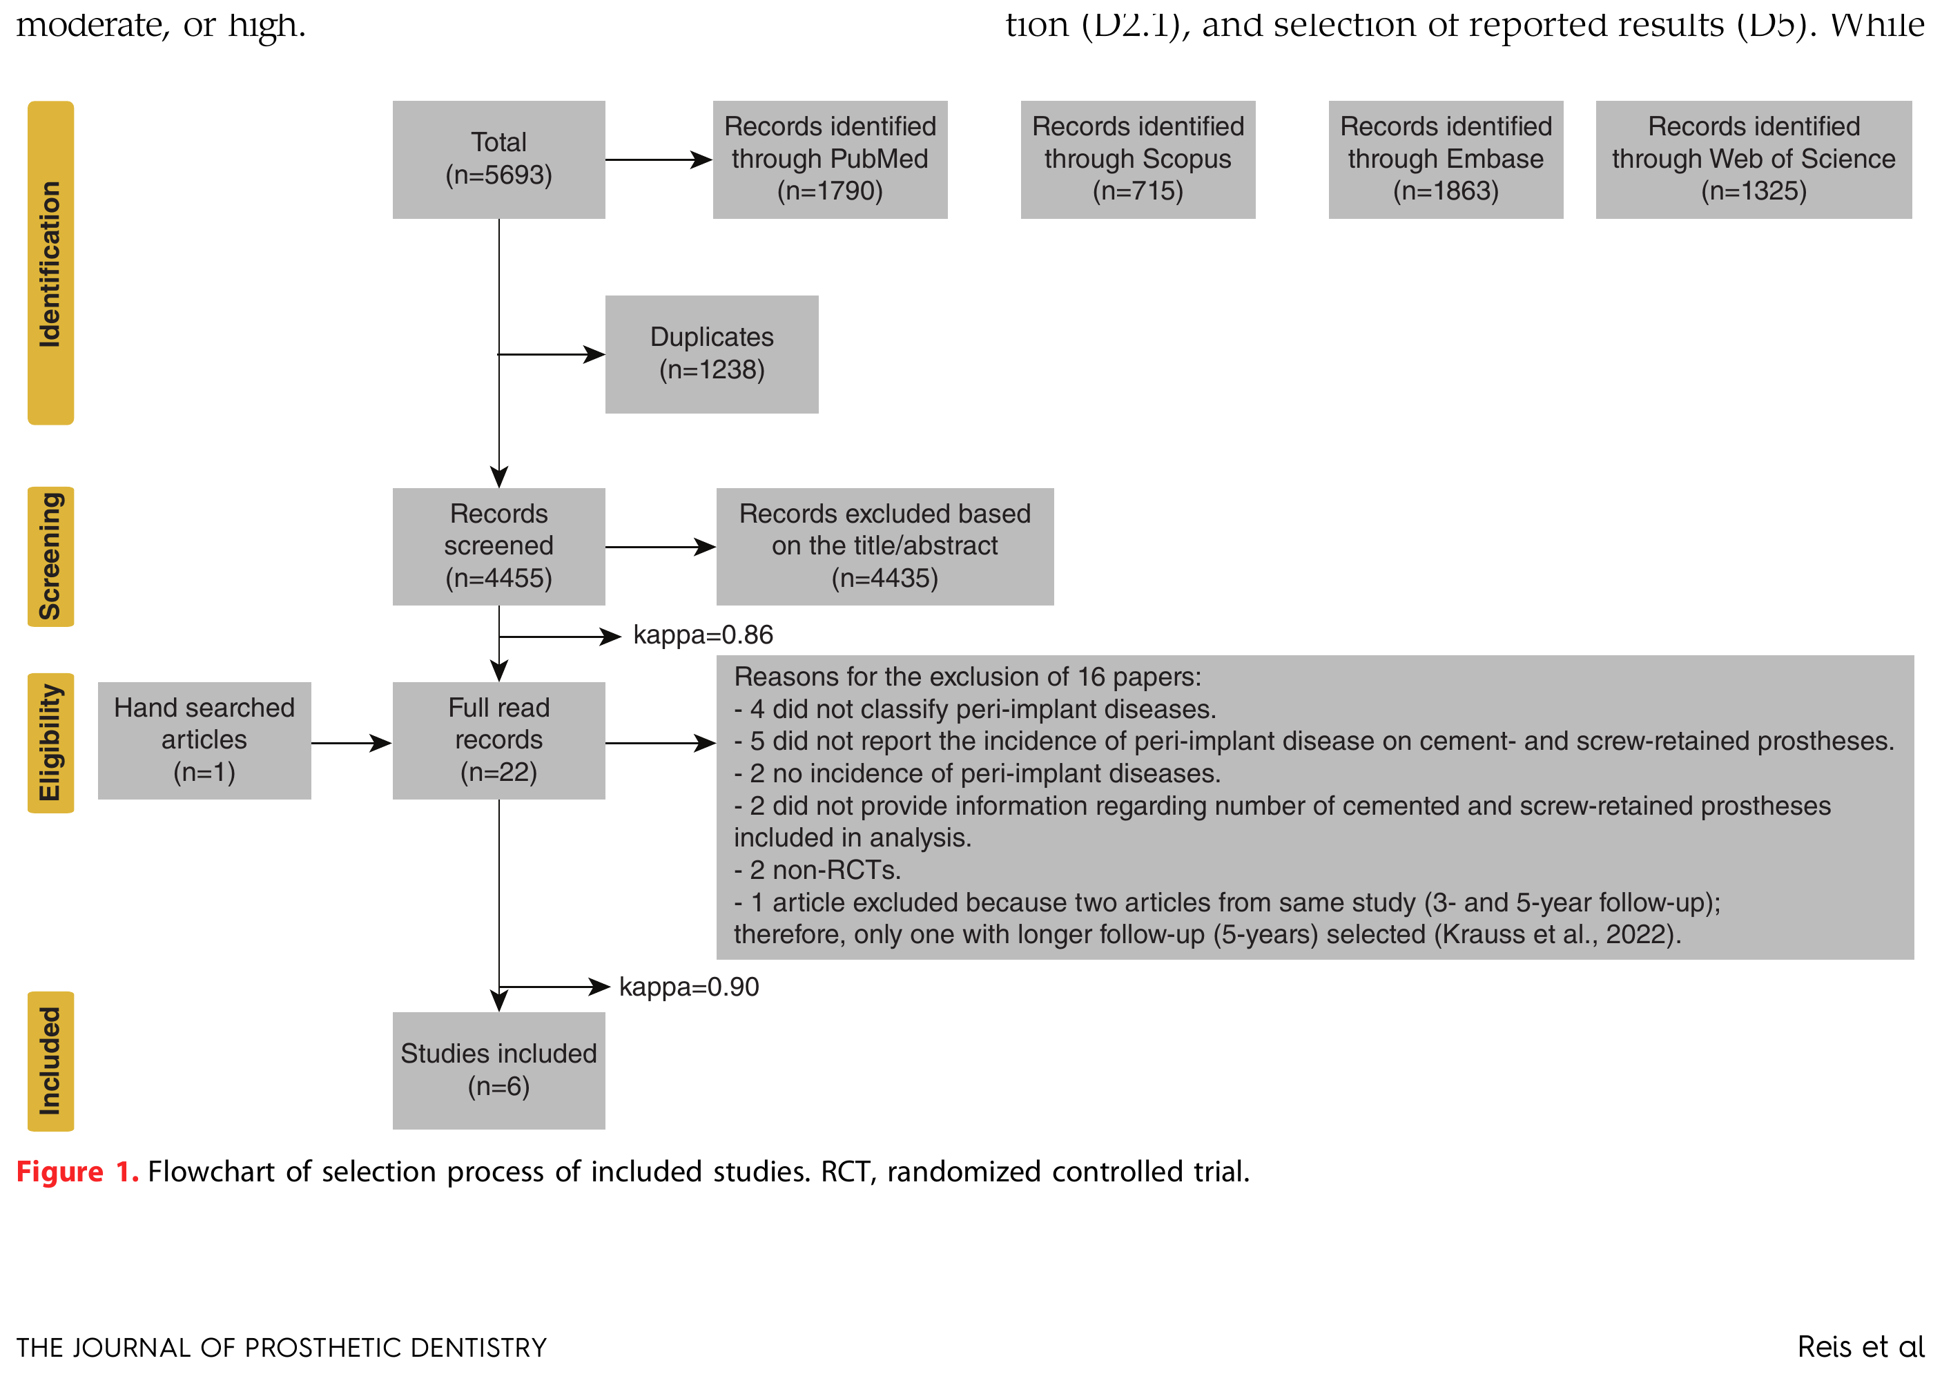
STUDY SELECTION
From 5,693 Records to Six Trials That Answered the Question
5,693
RECORDS IDENTIFIED
4,455
SCREENED AFTER DUPLICATES REMOVED
22
FULL TEXTS ASSESSED FOR ELIGIBILITY
6
RCTS INCLUDED IN THE REVIEW
Figure reproduced from Reis et al., Figure 1 (PRISMA 2020 flow diagram).
Reis et al. J Prosthet Dent. 2025;134(1):100-108.
5
Notes:
This is the PRISMA flow diagram from the article, Figure 1, reproduced for educational review.
The funnel starts at 5,693 records across PubMed, Scopus, Embase, and Web of Science. After removing 1,238 duplicates, 4,455 were screened by title/abstract, leaving 22 for full-text review (plus 1 hand-searched). Sixteen were excluded there — for not classifying disease, not reporting incidence by retention type, not being randomized, or duplicating an already-included study — leaving six RCTs.
Worth pausing on that funnel: out of nearly 5,700 records, only six trials actually randomized patients and reported disease incidence by retention type. That's how narrow the truly relevant evidence base is here.
[Transition] So who were these six trials, and what did their patients and prostheses look like?
Source: Reis et al. J Prosthet Dent. 2025;134(1):100-108, Figure 1.

Slide 7
THE EVIDENCE BASE
Six Small Trials, Single-Unit Crowns, Two to Ten Years of Follow-Up
6
~255
279
2–10 yr
RCTS
PARTICIPANTS
IMPLANTS
FOLLOW-UP RANGE
Study
Follow-up
N (baseline → final)
Agustín-Panadero et al, 2019
3 years
75 → 68
Amorfini et al, 2018
10 years
40 → 30
Kraus et al, 2022
5 years
44 → 41
Schropp et al, 2013
10 years
63 → 53
Wolfart et al, 2021
1–2 years
41
Zembic et al, 2012
5.6 years
22 → 18
All six trials restored single-unit implant crowns. Implant systems, abutment materials, and cements varied widely: 1 methacrylate-based, 3 resin, 1 zinc phosphate, and 1 glass-ionomer cement across the trials.
Reis et al. J Prosthet Dent. 2025;134(1):100-108.
6
Notes:
Here's the evidence base: six RCTs, roughly 255 participants, 279 implants, follow-up from two to ten years.
A few things stand out. Sample sizes are modest — the largest trial enrolled 75 patients. Attrition matters too: Amorfini's ten-year trial dropped from 40 to 30 patients — expected over a decade, but it shrinks the data available at the timepoints most relevant for peri-implantitis, which tends to develop later.
Clinically important: every trial restored single-unit crowns, not full arches — so these findings apply most directly to single-tooth restorations. The trials were also materially heterogeneous: different implant systems, abutment materials, and five different cement types. That heterogeneity matters a lot for interpreting the pooled statistics.
Source: Reis et al. J Prosthet Dent. 2025;134(1):100-108, Tables 1-2.
[Transition] Before trusting a pooled result, how much can we trust each trial individually? Let's look at risk of bias.

Slide 8
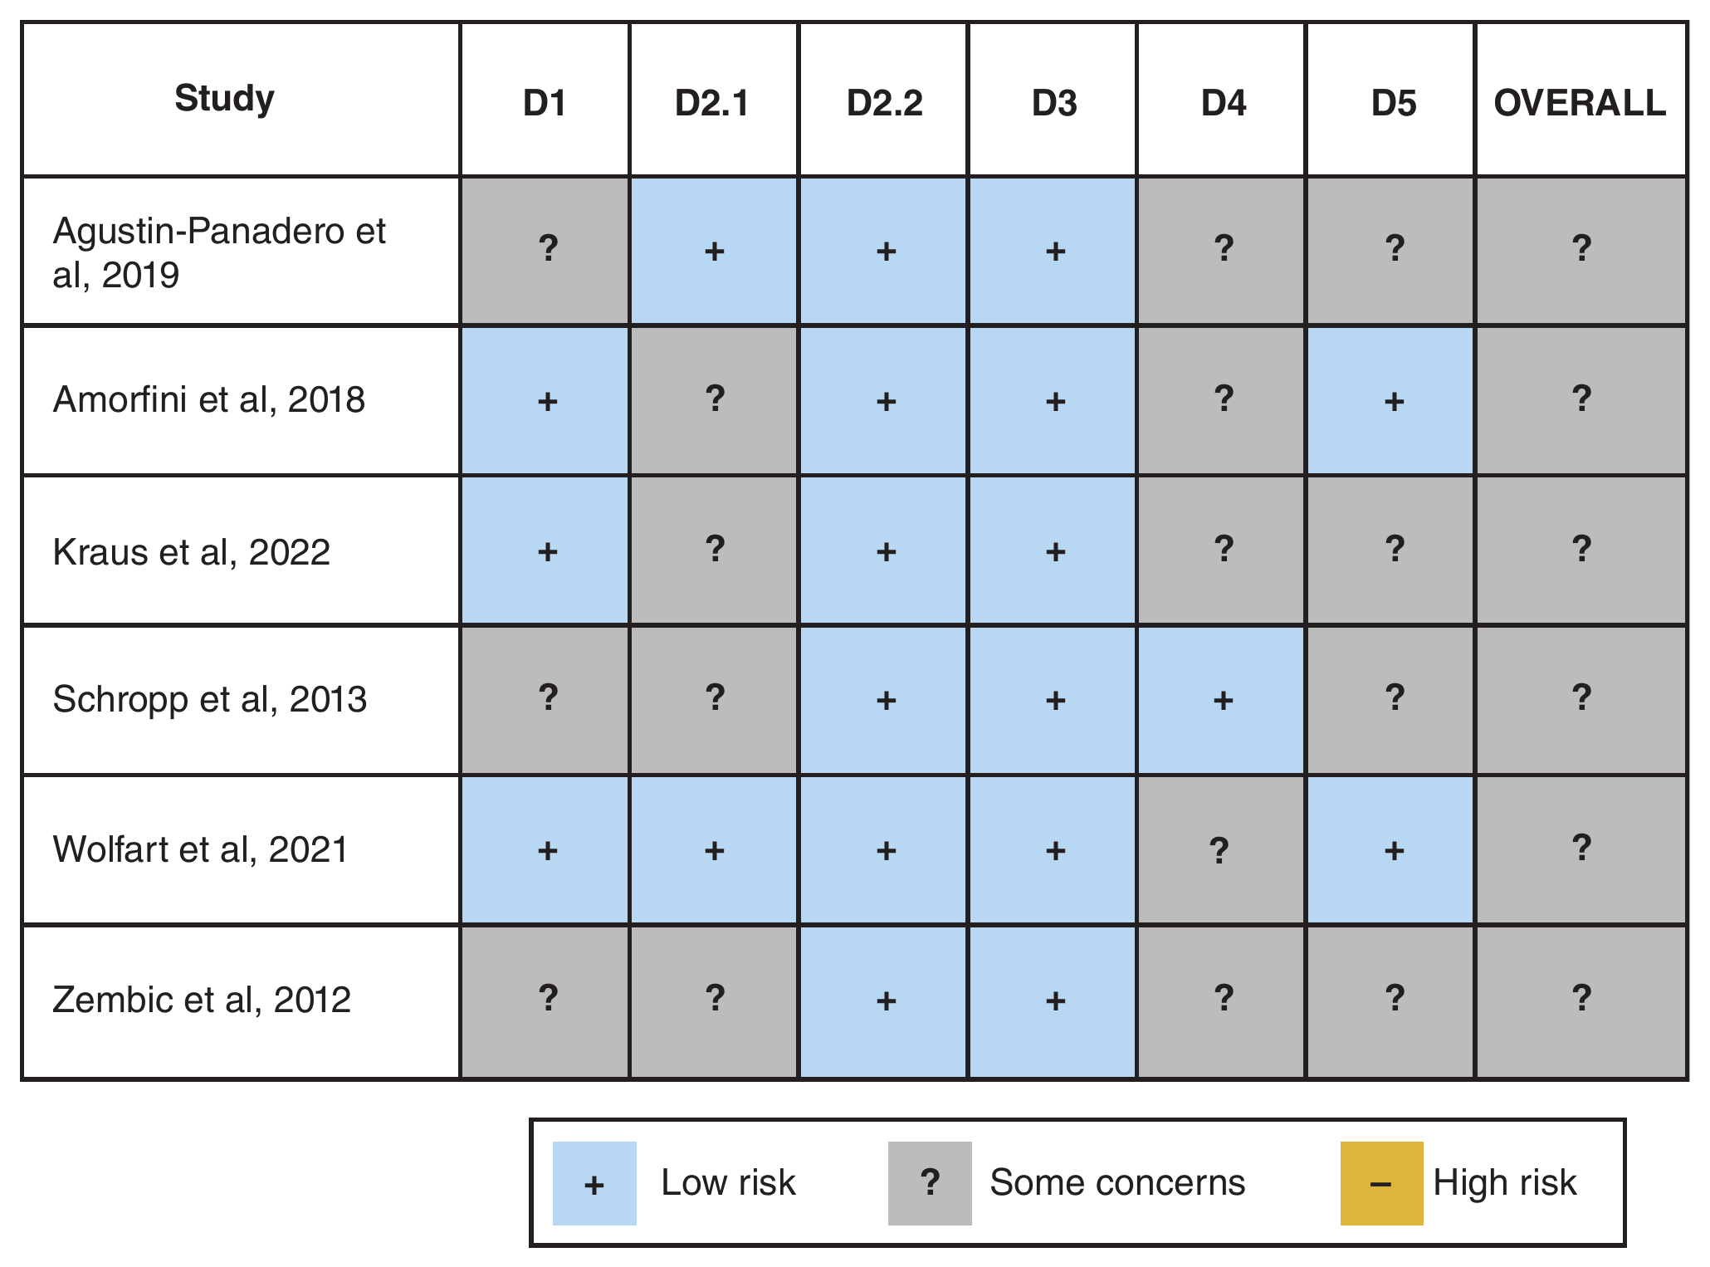
QUALITY APPRAISAL
Every Included Trial Raised Some Risk-of-Bias Concern
GRADE CERTAINTY
Moderate
⊕⊕⊕◯ both outcomes
All 6 RCTs were rated “some concerns” overall — none low risk, none high risk. Concerns clustered in randomization (D1), assignment to intervention (D2.1), and selective reporting (D5); only 1 trial clearly reported blinded outcome assessment (D4).
Cochrane RoB 2. D1 Randomization · D2.1/D2.2 Deviations from intended intervention · D3 Missing data · D4 Outcome measurement · D5 Selective reporting.
Reis et al. J Prosthet Dent. 2025;134(1):100-108.
7
Notes:
Before trusting a pooled estimate, we need to know how much bias each trial carries. RoB 2 grades five domains: randomization, deviations from intervention at assignment and adherence, missing outcome data, outcome measurement, and selective reporting.
The headline: all six trials landed in "some concerns" overall — none high risk, but none clearly low risk either. The recurring weak spots were unclear randomization or allocation-concealment reporting and incomplete reporting of blinded outcome assessment — only Schropp's trial clearly described blinding.
This feeds directly into GRADE, which rates confidence in the pooled estimate. Both outcomes were rated Moderate certainty — meaning we're fairly confident in the estimate, but further research could still change it. The downgrade wasn't driven by risk of bias itself, but by imprecision, which we'll see clearly in the confidence intervals next.
Source: Reis et al. J Prosthet Dent. 2025;134(1):100-108, Figure 2 and Table 4.
[Transition] Let's look at the pooled result for peri-implant mucositis.

Slide 9
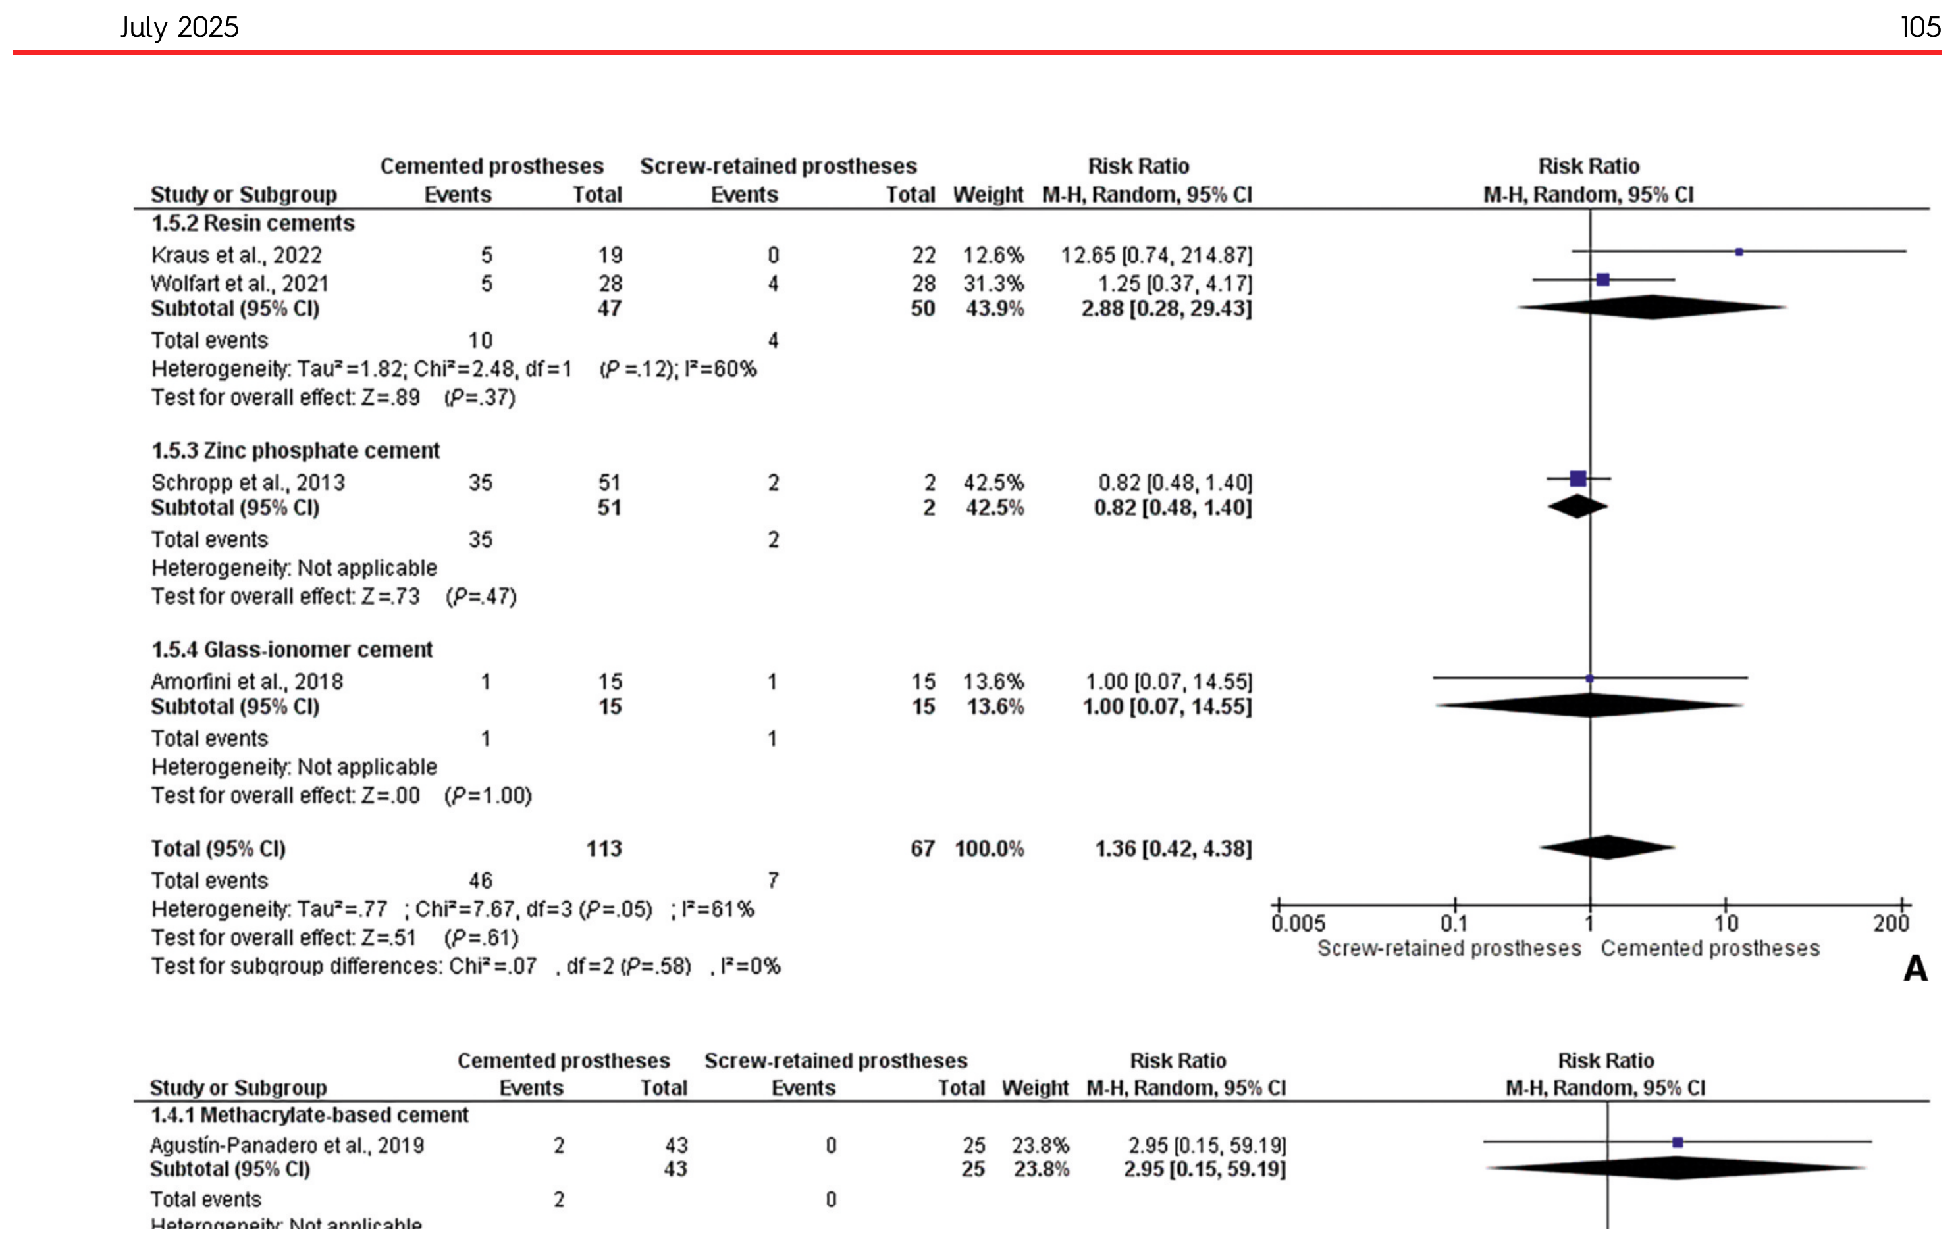
RESULTS · PERI-IMPLANT MUCOSITIS
No Statistically Significant Difference in Mucositis Risk
1.36
RR
0.42–4.38
95% CI
.61
P VALUE
61%
I²
Based on 4 of 6 trials (180 patients).
Figure reproduced from Reis et al., Figure 3A. Diamond = pooled effect; vertical line at 1.0 = line of no effect.
The confidence interval crosses 1.0 and is wide, spanning both a lower and a much higher risk with cement retention — the pooled result is not statistically significant.
Reis et al. J Prosthet Dent. 2025;134(1):100-108.
8
Notes:
This is Figure 3A, reproduced in full and unmodified.
Four of six trials contributed here — Amorfini, Kraus, Schropp, and Wolfart — subgrouped by cement type. Pooled RR is 1.36, 95% CI 0.42-4.38, P=.61, I²=61%.
In plain language: cemented prostheses showed a numerically 36% higher relative risk of mucositis. But the confidence interval crosses 1.0, the line of no effect — meaning the true effect could just as easily favor cement as screw retention; we can't rule out chance. P=.61 confirms that: a 61% probability of seeing a difference this large by chance alone if there truly were none.
I² of 61% shows moderate-to-substantial heterogeneity — the four trials didn't consistently point the same direction, and subgrouping by cement type didn't explain it.
Key point: this is a wide, imprecise estimate, not a precise finding of "no difference."
Source: Reis et al. J Prosthet Dent. 2025;134(1):100-108, Figure 3A, Table 4.
[Transition] Now the more clinically serious outcome — peri-implantitis.

Slide 10
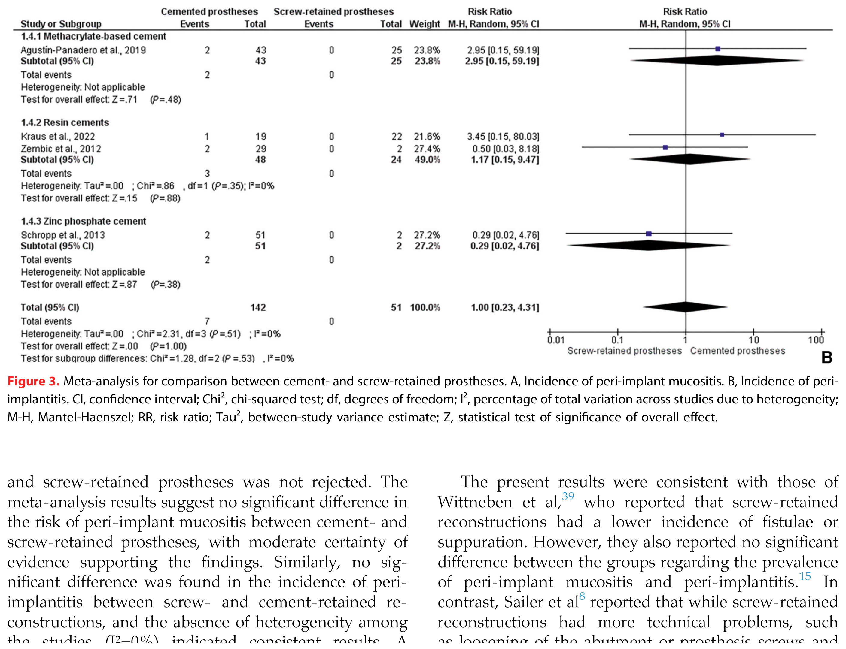
RESULTS · PERI-IMPLANTITIS
Peri-Implantitis Incidence Was Statistically Identical Between Groups
1.00
RR
0.23–4.31
95% CI
>.999
P VALUE
0%
I²
Based on 4 of 6 trials (193 patients; 7 total events).
Figure reproduced from Reis et al., Figure 3B.
A tidy point estimate (RR = 1.00) with no observed heterogeneity — but built on only 7 disease events total. Very low event counts make this precise-looking number fragile.
Reis et al. J Prosthet Dent. 2025;134(1):100-108.
9
Notes:
Figure 3B — peri-implantitis. Note this uses a different 4-of-6 subset than mucositis (Agustín-Panadero, Kraus, Schropp, Zembic), since not every trial reported both outcomes.
Pooled RR is 1.00 — identical point-estimate relative risk. 95% CI 0.23-4.31, P>.999, I²=0% — very consistent trials.
Anticipated faculty question: why is this still only "moderate" certainty when P is essentially 1.0 with zero heterogeneity? Answer — event rarity. Only 7 peri-implantitis events across 193 patients. Look at the GRADE table's absolute-risk column: 0 more or fewer per 1000, spanning 0 fewer to 0 fewer — essentially uninformative. When an outcome is this rare, even a clean, consistent meta-analysis can't rule out a meaningful difference either way. That's the imprecision that drove the moderate-certainty downgrade we saw in the GRADE table.
Source: Reis et al. J Prosthet Dent. 2025;134(1):100-108, Figure 3B, Table 4.
[Transition] Two non-significant outcomes — what does that actually tell us, and what doesn't it?

Slide 11
INTERPRETATION
Absence of Proof Is Not Proof of Equivalence
WHAT THE EVIDENCE SUPPORTS
WHAT IT DOES NOT ESTABLISH
Authors’ reported finding
Presenter’s critical interpretation
• No statistically significant difference in mucositis or peri-implantitis incidence between cement- and screw-retained single-unit implant crowns
• That the two retention methods carry truly equal risk for every patient or setting
• Consistent across the pooled RCT data available
• Full understanding of mucositis/peri-implantitis risk regardless of cement type, hygiene access, or maintenance
• Moderate-certainty evidence, per GRADE
• Generalizability beyond single-unit crowns, the specific systems tested, and 2–10 year follow-up
Reis et al. J Prosthet Dent. 2025;134(1):100-108.
10
Notes:
This is the crux of the critical appraisal, so let's slow down here.
On the left: what the authors reported — no statistically significant difference for either outcome, with moderate-certainty evidence. That's real and reassuring.
But — this is my own critical interpretation — failing to find a significant difference is not the same as proving equivalence. This is the classic "absence of evidence" versus "evidence of absence" distinction. With confidence intervals this wide — 0.42 to 4.38 for mucositis, 0.23 to 4.31 for peri-implantitis — the data are compatible with a wide range of true effects, some potentially clinically important.
This evidence is also bounded: single-unit crowns, the specific systems and cements tested, and 2-10 year follow-up. It doesn't automatically generalize to full arches or different technologies.
To be fair, the authors themselves are appropriately cautious too — their Clinical Implications box says the decision should still rest on clinician preference, technical factors, retrievability, and esthetics. My interpretation builds on that caution.
[Transition] Let's walk through the specific strengths and limitations.

Slide 12
CRITICAL APPRAISAL
A Rigorous Design Built on a Thin, Uneven Evidence Base
STRENGTHS
LIMITATIONS
+ PRISMA 2020 reporting + PROSPERO pre-registration
− Only 6 RCTs; just 4 of 6 contributed to each outcome
− Small samples, few disease events → imprecise estimates
+ RCTs only — minimizes confounding vs. observational data
− Wide, overlapping confidence intervals
+ Prospective follow-up from implant placement (disease-free at baseline)
− 3 of 6 trials did not report a definition of mucositis/peri-implantitis at all
+ Both retention types evaluated within the same trials
− Marked heterogeneity in implants, abutments, cements
− Unequal cement- vs. screw-group sizes in some trials
+ Duplicate independent screening/extraction, good–excellent kappa
− RoB 2 “some concerns” in every trial
− Older trials (enrollment 2000s–2010s) predate some contemporary workflows
Reis et al. J Prosthet Dent. 2025;134(1):100-108.
11
Notes:
Weighing this evidence fairly means naming both sides.
Strengths: PRISMA 2020 reporting, PROSPERO pre-registration, RCTs only — which minimizes confounding — prospective follow-up from implant placement so patients were disease-free at baseline, both retention types tested within the same trials, and independent duplicate screening with strong reviewer agreement.
Limitations, grouped: only six RCTs, and just four of six contributed to each outcome — a thin evidence base. Small samples and few events drive the wide confidence intervals. Three of six trials never reported a definition of mucositis or peri-implantitis at all, which undermines comparability. Implant systems, abutments, and five different cements were pooled together. Some trials had unequal cement-versus-screw group sizes. Every trial had RoB 2 "some concerns." And several trials enrolled patients in the 2000s-2010s, using implant and cement technology that may not fully reflect current workflows.
Anticipated faculty question: why not include observational studies for more data? Answer — that was a deliberate trade-off for causal rigor over volume, which costs precision.
[Transition] Given all that, how should this inform what we do at the chair?

Slide 13
CLINICAL IMPLICATIONS
Retention Choice Still Rests on the Whole Clinical Picture
1
Retrievability
6
Margin depth
For maintenance, repair, or peri-implant therapy
Deeper, less accessible margins raise cement risk
2
Prosthetic space
7
Maintenance needs
Interocclusal space and screw-access position
Recall compliance and hygiene access
3
Implant angulation
8
Technical complications
May dictate whether a screw channel is usable
Screw loosening vs. cement-related issues
4
Esthetics
9
Operator technique
Visibility of the screw-access channel
Cementation protocol or screw-torque technique
5
Cement control
10
Patient risk factors
Ability to fully remove subgingival excess
Periodontitis history, smoking, diabetes, hygiene
Framed as clinical context, not as a finding directly tested by this meta-analysis — consistent with the authors’ own Clinical Implications statement.
Reis et al. J Prosthet Dent. 2025;134(1):100-108.
12
Notes:
If disease-risk data don't strongly favor either method, what should drive the decision? These ten factors reflect standard prosthodontic reasoning, echoed directly in the authors' own Clinical Implications statement: the decision should rest on clinician preference, technical considerations, retrievability, and esthetics.
A few highlights: retrievability matters for long-term maintenance — a screw-retained restoration can be removed non-destructively if disease develops later, while a cemented one may need sectioning. Prosthetic space and angulation often decide the question before disease risk even enters — a screw-access channel isn't always achievable. Esthetics matters most anteriorly. And if cement is chosen, meticulous clean-up and margin accessibility become the operator's responsibility.
To be explicit: none of these ten factors were directly tested by this meta-analysis — this is clinical context, not a statistical result, and I'm flagging that distinction deliberately.
[Transition] Let's bring this together into one final take-home message.

Slide 14
BOTTOM LINE
Choose Retention on the Whole Clinical Picture — Not on Disease-Risk Data Alone
AUTHORS’ CONCLUSIONS
1. Moderate-certainty evidence suggests a similar risk of peri-implant mucositis and peri-implantitis for cement- and screw-retained prostheses.
2. The choice of retention method should be guided by additional clinical context and patient-specific factors.
PRESENTER’S TAKE-HOME MESSAGE
For single-unit implant crowns like those studied here, don’t let peri-implant disease risk alone dictate cement vs. screw retention. The current RCT evidence is reassuring but too imprecise to call the two techniques proven equivalent — base the decision on retrievability, access, esthetics, and the patient in front of you, and apply meticulous cement-removal or screw-maintenance protocols regardless of which you choose.
Reis et al. J Prosthet Dent. 2025;134(1):100-108.
Notes:
Bringing this together.
The authors drew two conclusions: moderate-certainty evidence suggests similar risk of mucositis and peri-implantitis between cement- and screw-retained prostheses; and the choice of retention method should be guided by additional clinical context and patient-specific factors, since the disease-risk data don't clearly favor either.
My take-home, building on that: for single-unit crowns like these, the evidence is reassuring but too imprecise to call the two techniques proven equivalent. Base the decision on retrievability, access, esthetics, and the patient in front of you — and whichever you choose, apply meticulous technique: complete cement removal, or a sound screw-maintenance protocol.
Thank you — happy to take questions, including how each of you currently chooses between cement and screw retention in your own cases.
Source: Reis INR, Fukuoka GL, Nagay BE, Pannuti CM, Spin-Neto R, Silva EVF. J Prosthet Dent. 2025;134(1):100-108.

Slide 15
REFERENCES
Complete References (Vancouver Style)
1. Reis INR, Fukuoka GL, Nagay BE, Pannuti CM, Spin-Neto R, Silva EVF. Incidence of peri-implant disease associated with cement- and screw-retained implant-supported prostheses: a systematic review and meta-analysis. J Prosthet Dent. 2025;134(1):100-108.
2. Berglundh T, Armitage G, Araujo MG, et al. Peri-implant diseases and conditions: consensus report of workgroup 4 of the 2017 World Workshop on the Classification of Periodontal and Peri-Implant Diseases and Conditions. J Clin Periodontol. 2018;45(Suppl 20):S286-S291.
3. Page MJ, McKenzie JE, Bossuyt PM, et al. The PRISMA 2020 statement: an updated guideline for reporting systematic reviews. BMJ. 2021;372:n71.
4. Nova Southeastern University College of Dental Medicine. Advanced Education in General Dentistry Literature Review Protocol. Internal course document.
Reis et al. J Prosthet Dent. 2025;134(1):100-108.
13
Notes:
All references used to prepare this review, in Vancouver style. I'm happy to share the full source PDFs — they were uploaded to Canvas / MS Teams with this presentation per protocol.

Slide 16
BACKUP SLIDE — NOT PART OF THE 15-MINUTE MAIN TALK
BACKUP · STUDY CHARACTERISTICS
Implant Systems, Abutments, and Cements Across the 6 Trials
Study
Implant system
Abutment
Cement / retention
Agustín-Panadero 2019
Internal hex, conical (Vega, Klockner)
Titanium grade IV
Methacrylate-based (provisional)
Amorfini 2018
Regular-neck tissue-level (Straumann)
Zirconia
Glass-ionomer
Kraus 2022
Two-piece (OsseoSpeed, Astra Tech)
Zirconia
Resin cement (Panavia 21)
Schropp 2013
Parallel-walled (Osseotite, Biomet 3i)
Gold alloy / STA
Zinc phosphate
Wolfart 2021
Screw-line (Promote Plus, Camlog)
Standard titanium
Resin cement (Multilink)
Zembic 2012
Regular platform, external hex (Brånemark, Nobel Biocare)
Zirconia or titanium
Resin (Panavia/RelyX) or glass ionomer
Reis et al. J Prosthet Dent. 2025;134(1):100-108.
14
Notes:
Backup detail slide for faculty questions on material-level heterogeneity. Source: Reis et al. J Prosthet Dent. 2025;134(1):100-108, Table 2. Use if asked which specific cements or implant systems were represented.

Slide 17
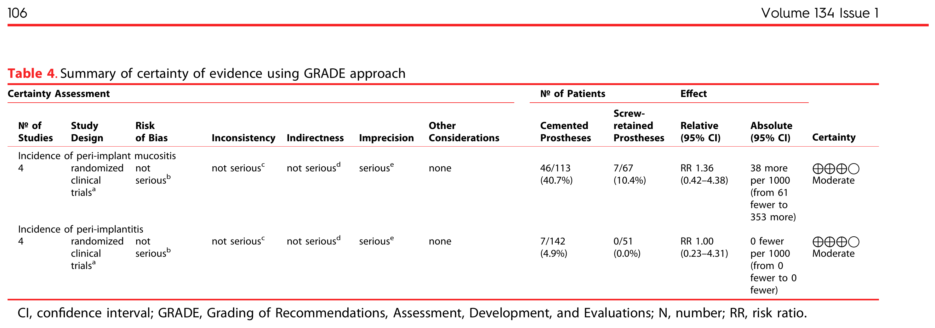
BACKUP SLIDE — NOT PART OF THE 15-MINUTE MAIN TALK
BACKUP · GRADE DETAIL
The Full GRADE Certainty-of-Evidence Table
Figure reproduced from Reis et al., Table 4.
Note on definitions: 3 of the 6 included trials (Agustín-Panadero, Amorfini, Zembic) did not report an explicit definition of peri-implant mucositis or peri-implantitis at all (Table 3) — a comparability limitation across the pooled outcome.
Reis et al. J Prosthet Dent. 2025;134(1):100-108.
15
Notes:
GRADE domains, for reference if asked: risk of bias, inconsistency, indirectness, imprecision, and other considerations (e.g., publication bias). Here, imprecision (footnote e: total participants below the Optimal Information Size of 300) was the domain driving the downgrade from high to moderate certainty for both outcomes. Source: Reis et al. J Prosthet Dent. 2025;134(1):100-108, Tables 3-4.

Slide 18
BACKUP SLIDE — NOT PART OF THE 15-MINUTE MAIN TALK
BACKUP · METHODOLOGICAL DETAIL
Search Strategy and RoB 2 Domain Glossary
SEARCH & REGISTRATION DETAIL
RoB 2 DOMAIN GLOSSARY
• PROSPERO CRD42022379444; PRISMA 2020 guidelines
D1
Randomization process
• Databases: MEDLINE/PubMed, Embase, Scopus, Web of Science, searched to Jan 2023
D2.1
Deviations from intended intervention — assignment
D2.2
Deviations from intended intervention — adherence
• Grey literature: OpenGrey, Grey Literature Report; hand-searched reference lists
D3
Missing outcome data
• Screening κ = 0.86 (title/abstract); κ = 0.90 (full text); 3rd reviewer (I.N.R.R.) arbitrated
D4
Measurement of the outcome
• Statistics: Review Manager v5.4; random-effects model; GRADEpro GDT
D5
Selection of the reported result
Reis et al. J Prosthet Dent. 2025;134(1):100-108.
16
Notes:
Reference slide for methods questions. Kappa interpretation: values above 0.80 are generally considered "almost perfect" agreement. Source: Reis et al. J Prosthet Dent. 2025;134(1):100-108, Materials and Methods.

