Slide 1

Computer Vision Homework #3
TA：Syahrul Munir
Email： t111999406@ntut.org.tw
Robot Vision Lab (Room 1421)

Slide 2
Homework Assignment
2024/09/30 – Homework 1 assigned, due 10/14
2024/10/21 – Homework 2 assigned, due 11/04
2024/11/11 – Homework 3 assigned, due 11/25
2024/12/09 – Homework 4 assigned, due 12/23

Slide 3
Notes from Homework #2
Please pay attention about what should you put in the report, such as result images, PSNR values, etc.
Don't forget to put your result's images inside the .zip files (not only in the report).
The score of Homework #2 will be available in this weekend. You can check the i-study for future updates.

Slide 4
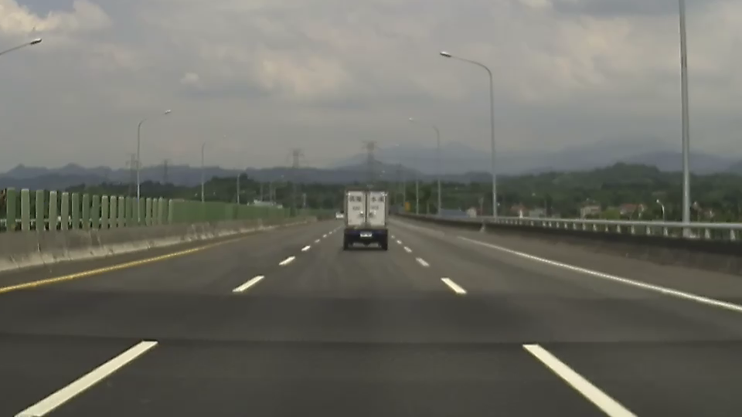
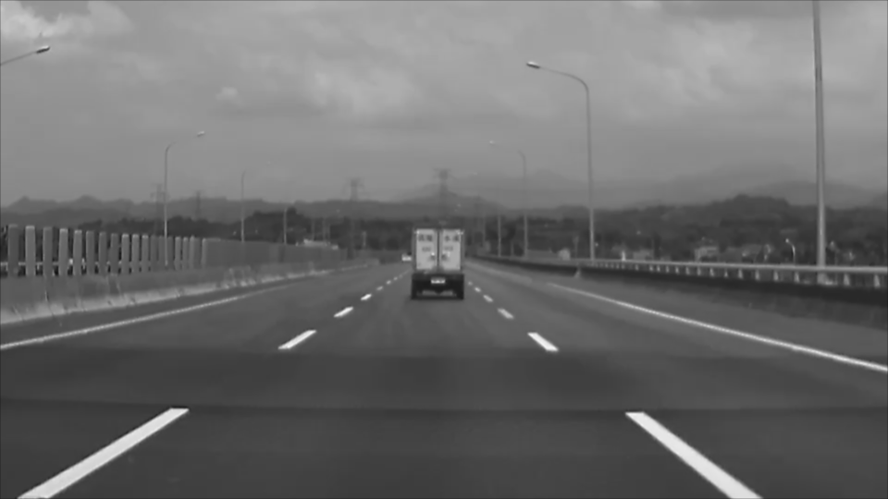
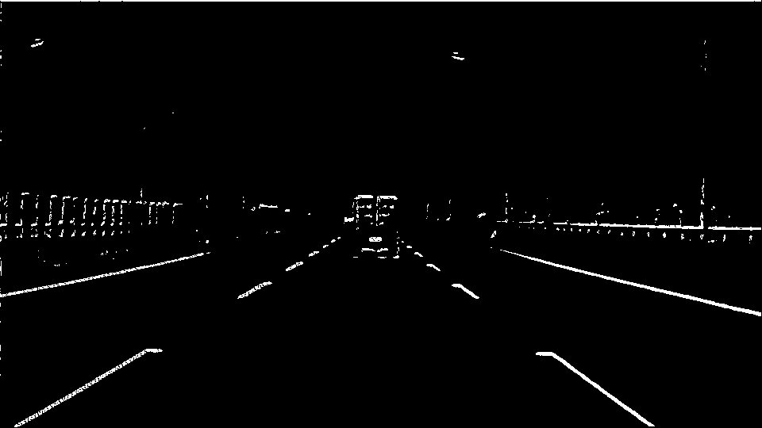
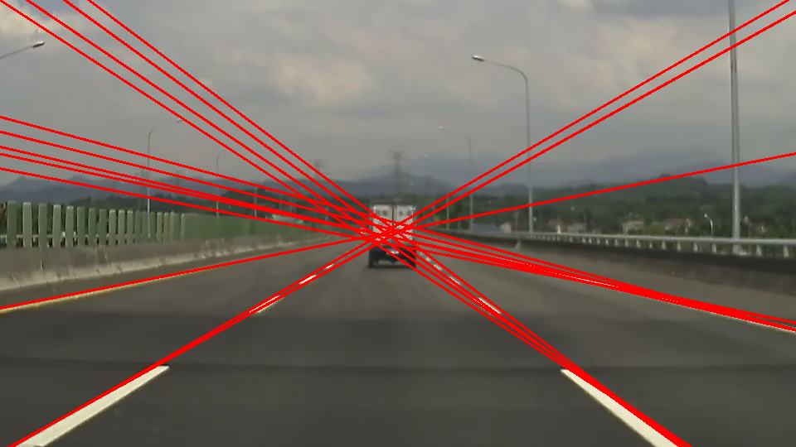
Homework 3
Lane Detection
Given 3 road images (img1.png, img2.png, img3.png) for testing, there are three functions that you need to implement.
Gaussian Blur (img?_q1)
Canny Edge Detection (img?_q2)
Hough Transform (img?_q3)
※There are totally 9 output images in your report.
※The parameters could be different for each images
※You can add some function other than those 3 to make better results, but you can't skip those 3 steps.
※Find the best output images that could:
Detect all road lane
Not detecting any lines that doesn't belong to road
Detect all road lane with the less number of lines
img1.png
img1_q1.png
img1_q2.png
img1_q3.png

Slide 5
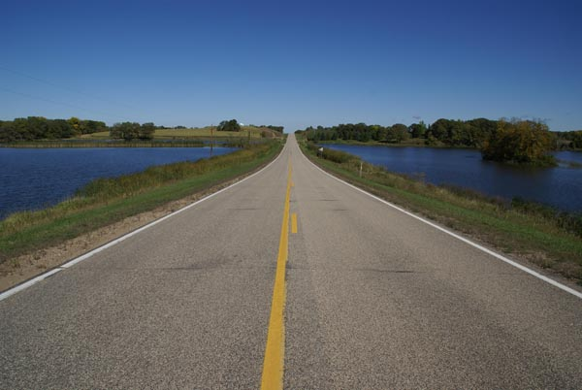
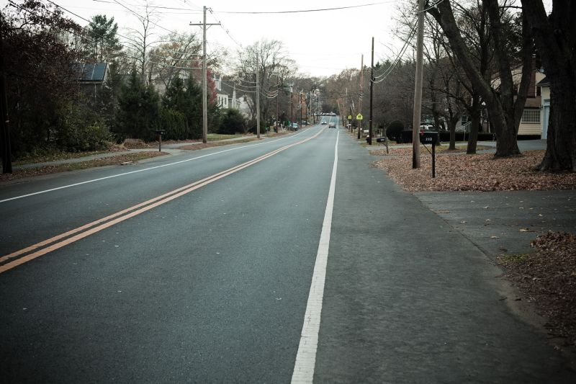
Homework 3 Workflow
img1.png
Input
Q1
img1_q1
Q2
img1_q2
Q3
img1_q3
img2.png
Input
Q1
img2_q1
Q2
img2_q2
Q3
img2_q3
img3.png
Input
Q1
img3_q1
Q2
img3_q2
Q3
img3_q3

Slide 6
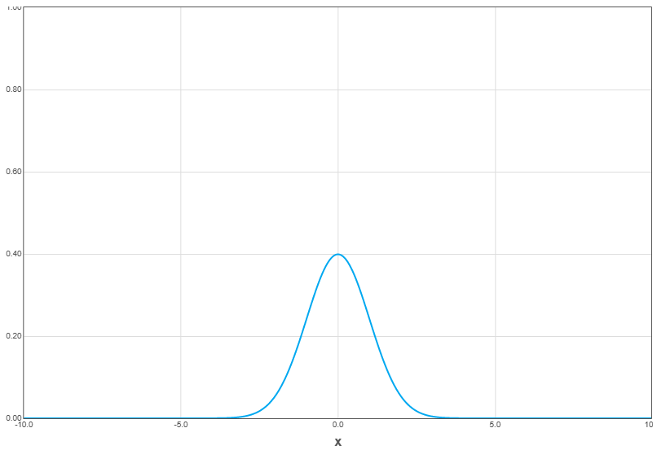
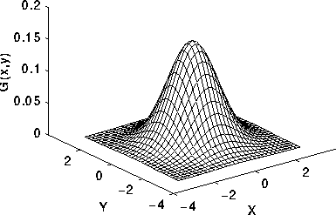
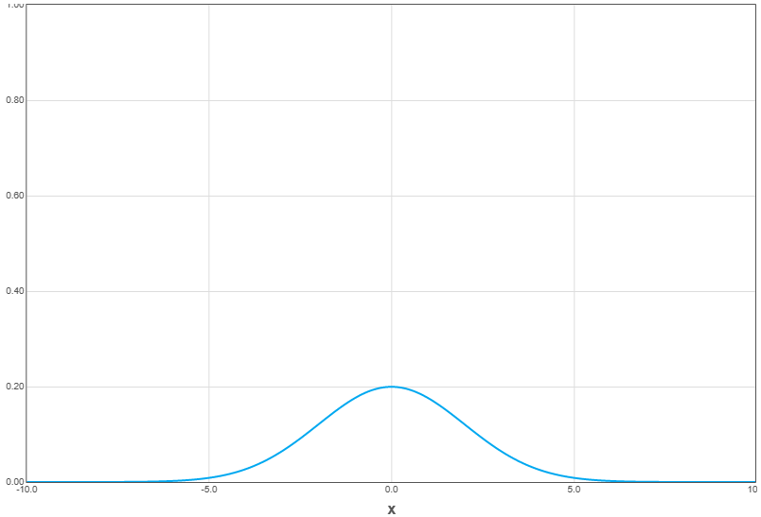

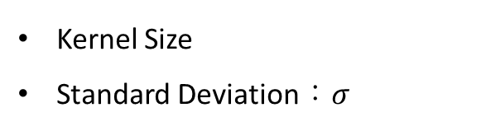

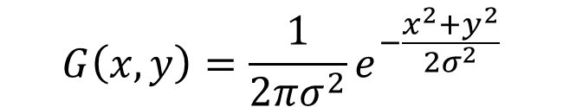
Gaussian Blur/Filter
Kernel Size
Standard Deviation：$σ$
$$σ=1.0$$
$$G\left(x, y\right)=\frac{1}{2πσ^{2}}e^{−\frac{x^{2}+y^{2}}{2σ^{2}}}$$
$$σ=2.0$$
※Implement the Gaussian equation by yourself
※You can use your homework 2 function

Slide 7

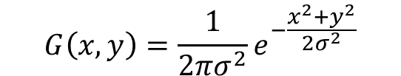
Gaussian Filter
(-1, -1) | (0, -1) | (1, -1)
(-1, 0) | (0, 0) | (1, 0)
(-1, 1) | (0, 1) | (1, 1)
0.0585 | 0.0965 | 0.0585
0.0965 | 0.1591 | 0.0965
0.0585 | 0.0965 | 0.0585
$$G\left(x, y\right)=\frac{1}{2πσ^{2}}e^{−\frac{x^{2}+y^{2}}{2σ^{2}}}$$
(x, y)
$$σ=1.0$$

Slide 8
Canny Edge Detection Steps
Noise reduction
Already done in Q1.
Gradient calculation You can use Sobel operator to get x and y direction gradient (G_{x} and G_{y}). Then calculate the magnitude and angle of gradient.
Non-maximum suppression
Consider in 4 directions and compare with neighbor pixels.
Double threshold and edge tracking by hysteresis Define the edge type of each pixel by setting the high threshold and low threshold. Then link the weak edge depend by the strength of neighbor pixels.

Slide 9
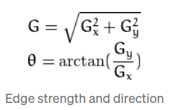
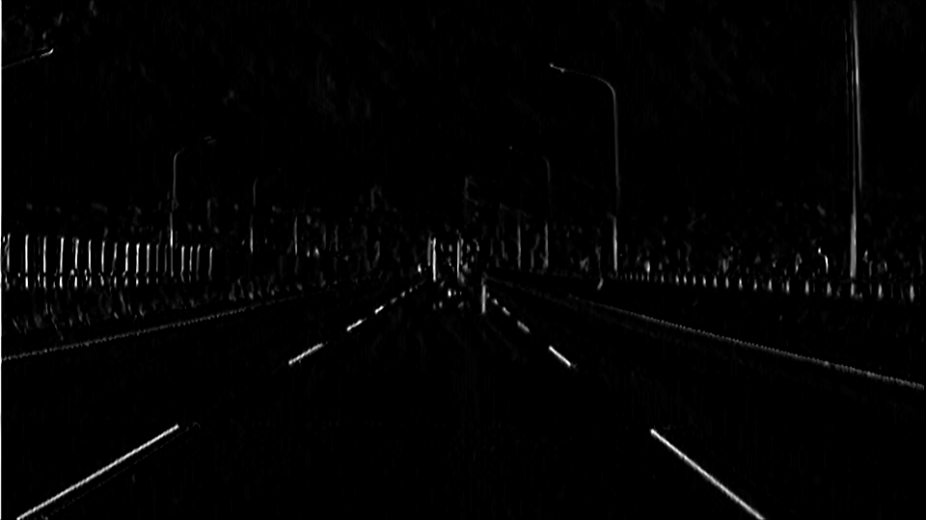
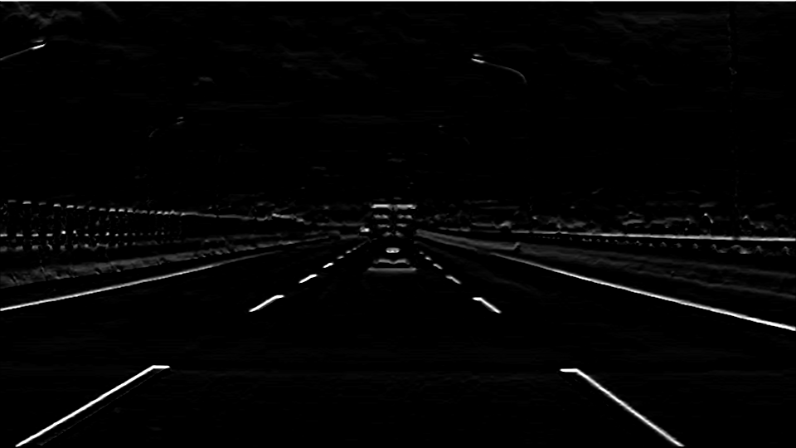
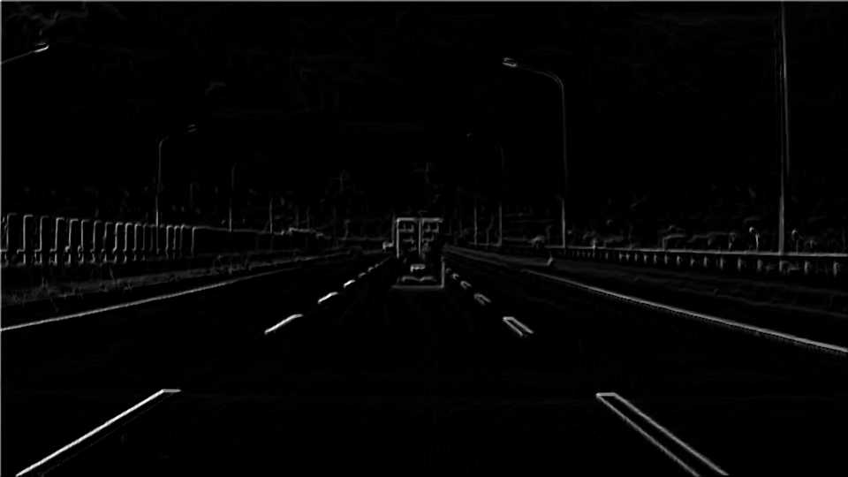
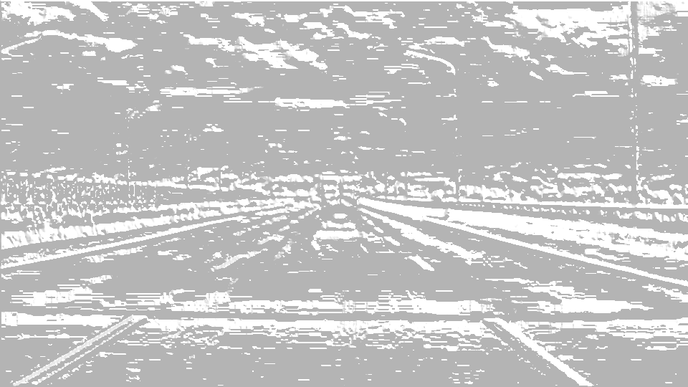
Canny Edge Detection
Gradient calculation
Do a convolution for each sobel operator (x and y), the output will be 2 kind of gradient intensity images, G_{x} and G_{y}.
Using those 2 gradient intensity images, calculate the magnitude and angle of gradient by using
※Not allowed to use libraries to do convolution
※Implement both of the gradient equation by yourself
※You can use your homework 1 function
-1 | 0 | 1
-2 | 0 | 2
-1 | 0 | 1
-1 | -2 | -1
0 | 0 | 0
1 | 2 | 1
Sobel x
Sobel y
Gx
Gy
G
θ

Slide 10
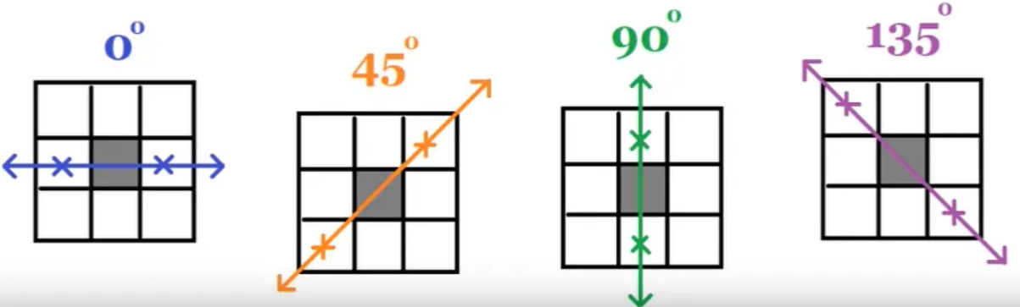
Canny Edge Detection
Non-maximum suppression
Refine the edge by only choose the best representation of the edges and removing any unnecessary edges.
Using both of θ and G information from before as input.
Consider in 4 directions (0°, 45°, 90°, 135°), classify the angle in each pixel to this 4 directions
Each angle is assigned to the closest primary direction. For example, an angle of 20° would be classified as 0°.
Each pixel’s gradient magnitude is compared with its neighbors along the specified direction (see the images on the right for better visualization)
0° is comparing with the left and right pixel
45° is comparing with top-right and bottom-left pixel
Etc.
If the pixel’s gradient magnitude G is greater than both neighboring pixels along the gradient direction, it is retained; otherwise, it is set to zero.
※Implement this function by yourself without any libraries

Slide 11
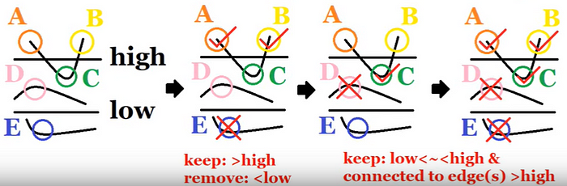
Canny Edge Detection
Double threshold and Edge Tracking by Hysteresis
Remove any edge noise to enhance the results
Define the edge type of each pixel by setting the high threshold and low threshold
Classify as strong edge if higher than high threshold
Classify as weak edge if it is between the high and low threshold
Remove the edge if it is lower than low threshold
Link the weak edge depend by the strength of neighbor pixels.
If the neighboring pixels are a strong edge, upgrade the weak edge to strong edge
If it is not, remove the weak edge
※Implement this function by yourself without any libraries
strong
High threshold
weak
Low threshold
ignore

Slide 12
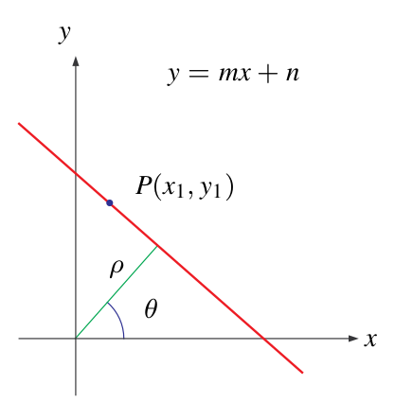




Hough Transform
Helps detect and link line segments by transforming the problem from the spatial (x-y) coordinate space to the rho-theta parameter space, where lines can be more easily identified.
Steps
Discretize θ and ρ in increment of θ_{d} and ρ_{d}
Initialize the counter matrix to 0
For each edge pixel
For each θ value in discrete array, the ρ value is computed using the formula:
Find the index of closest matching ρ value from the discrete array
Increment the counter at those θ and ρ value
Draw a line if the counter is beyond some threshold based on their ρ and θ value
$$θ$$
Counter matrix
$$ρ$$

Slide 13
Grading
Program (80%)
Gaussian Filter (10%)
Canny Edge Detection (40%)
Hough Transform (30%)
Report (20%)
Please explain your code.
Please paste 3 input images and 9 output images in your report.
Please state in your report the parameter setting that you choose for each input images.

Slide 14
Folder Structure
C/C++
Python
111999406 _hw3/
├─ project_hw3/
│ ├─ test_img/
│ │ ├─ img1.png
│ │ ├─ img2.png
│ │ ├─ img3.png
│ ├─ result_img/
│ │ ├─ img1_q1.png
│ │ ├─ img2_q1.png
│ │ ├─ img3_q1.png
│ │ ├─ img1_q2.png
│ │ ├─ img2_q2.png
│ │ ├─ img3_q2.png
│ │ ├─ img1_q3.png
│ │ ├─ img2_q3.png
│ │ ├─ img3_q3.png
│ ├─ include/
│ │ ├─ func.h
│ ├─ func.cpp
│ ├─ main.cpp
├─ 111999406 _hw3.pdf
├─ Readme.txt
Write your report in English (PDF)
Explaining how your main function working and shown the results on your report.
111999406 _hw3/
├─ test_img/
│ ├─ img1.png
│ ├─ img2.png
│ ├─ img3.png
├─ result_img/
│ ├─ img1_q1.png
│ ├─ img2_q1.png
│ ├─ img3_q1.png
│ ├─ img1_q2.png
│ ├─ img2_q2.png
│ ├─ img3_q2.png
│ ├─ img1_q3.png
│ ├─ img2_q3.png
│ ├─ img3_q3.png
├─ 111999406_hw3.py
├─ 111999406_hw3.pdf
├─ Readme.txt

Slide 15
Homework #3
Please compress your files (program and report)
StudentID_hw3( for example: 111999406_hw3.zip)
Please submit to iStudy, in Homework 3 Assignment.
Deadline: 2023/11/25 23:59:59
For each hour late, 10% of the total score will be deducted.
Don’t share your code with other students. Do it by yourself.

Slide 16
Thanks for your attention

