Slide 1

Computer Vision Homework #4
TA：Syahrul Munir
Email： t111999406@ntut.org.tw
Robot Vision Lab (Room 1421)

Slide 2
Homework Assignment
2024/09/30 – Homework 1 assigned, due 10/14
2024/10/21 – Homework 2 assigned, due 11/04
2024/11/11 – Homework 3 assigned, due 11/25
2024/12/09 – Homework 4 assigned, due 12/23

Slide 3
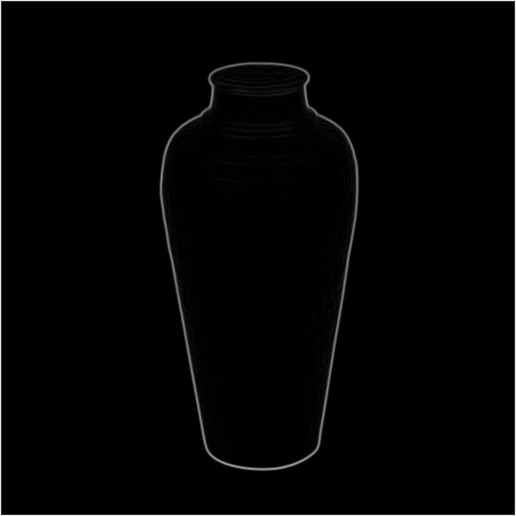
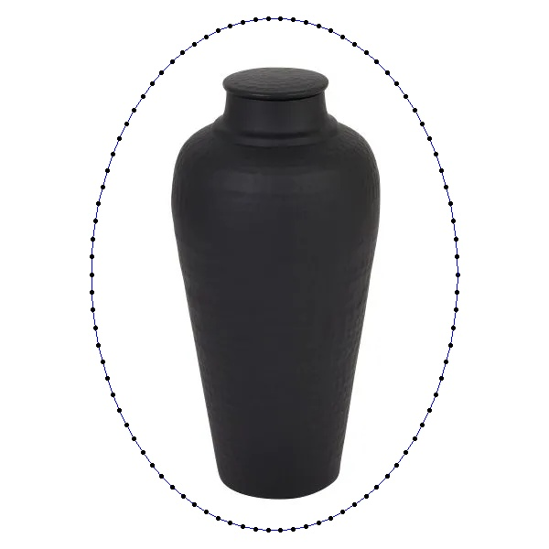
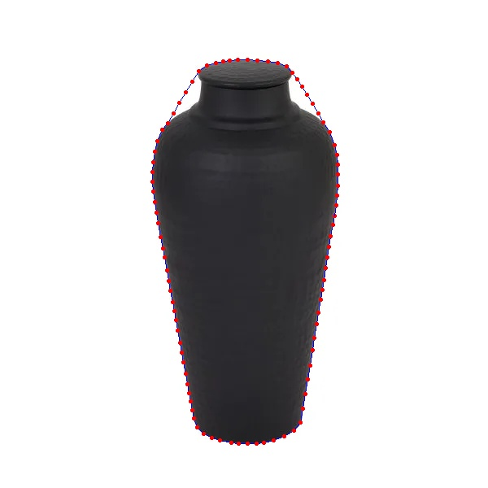
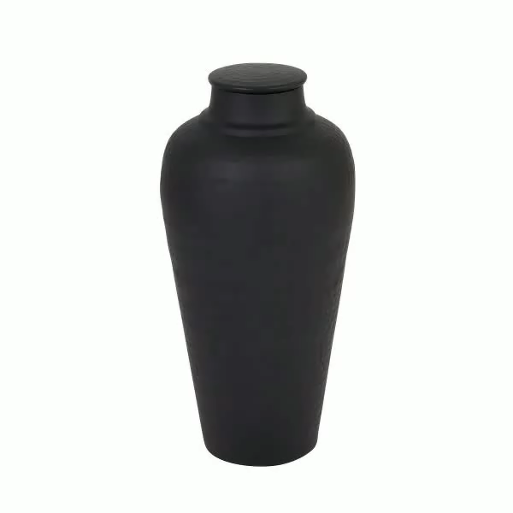
Homework 4
Active Contour
Given 3 grayscale images (img1.png, img2.png, img3.png) for testing, there are 4 main functions that you need to implement.
Image pre-processing (Sobel) (Q1)
Set initial contour (Q2)
Active Contour (Q3)
Save the result videos, measure the number of iteration and DSC value (Q4)
※ Use the original image to save you image and videos (as the picture on the left)
※ There are totally 9 output images in your report.
※The parameters could be different for each images
※Find the best output images and videos with the HIGHEST DSC values that you can get
※You can save the videos in any format (mp4, avi, etc.)
※There are some file size limit when you submit the homework, you can compress the video first before submit it
img1_q1.png
img1_q2.png
img1_q3.png
img1_q4.mp4

Slide 4
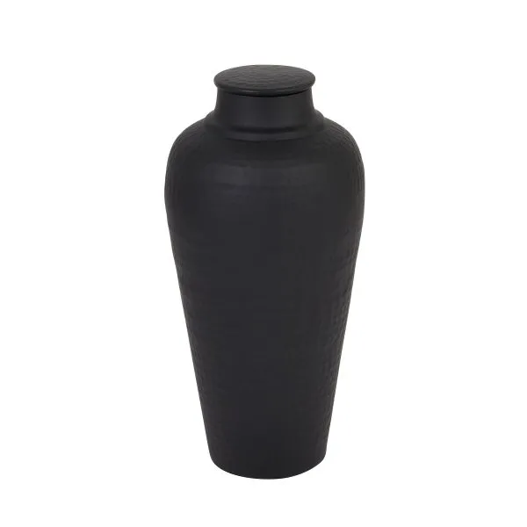
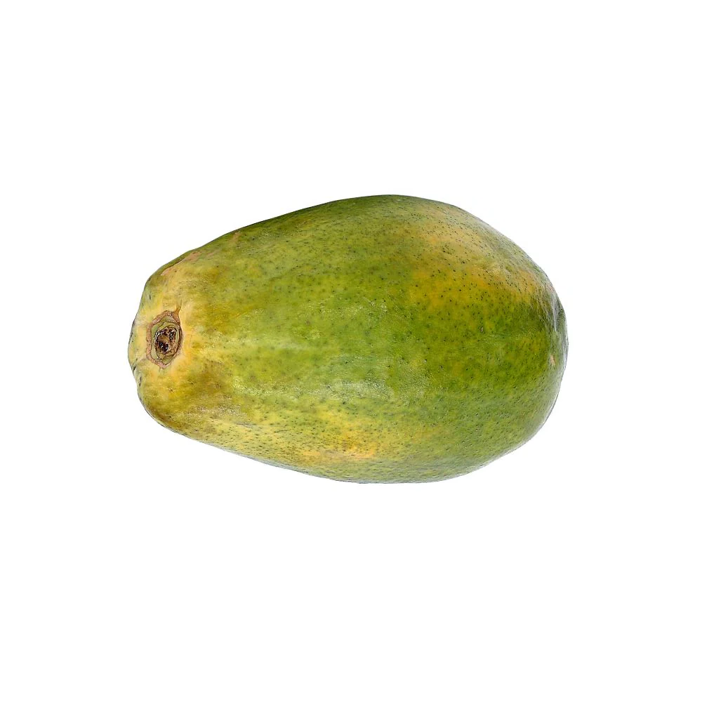
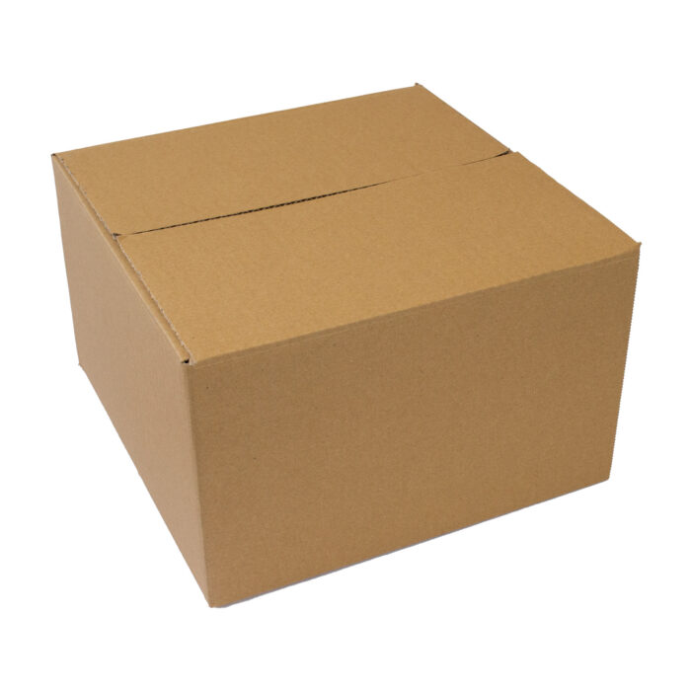
Homework 4 Workflow
img1.png
Input
Q1
img1_q1
Q2
img1_q2
Q3
img1_q3
Q4
img1_q4
img2.png
Input
Q1
img2_q1
Q2
img2_q2
Q3
img2_q3
Q4
img2_q4
img3.png
Input
Q1
img3_q1
Q2
img3_q2
Q3
img3_q3
Q4
img3_q4

Slide 5
Image Pre-processing
Convert the image into grayscale
Use Gaussian Blur to filter the image
Calculate the gradient of image by using Sobel Operator (G_{x} and G_{y})
※Not allowed to use libraries to convert to grayscale, to do convolution/gaussian blurring
※Implement the gaussian kernel equation by yourself
※Implement the gradient equation by yourself
※You can use your homework 2 and 3 function

Slide 6
Set Initial Points
You can find some ways to put your initial points of your active contour.
If your initial points are too far from your object, it will take a lot of "energy" to move, and it will cost more iterations to converge.
※Not allowed to use any libraries
※You can use different initial points for each image input

Slide 7
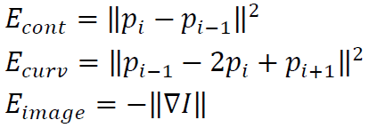
Active Contour (Pseudo Code)
ACTIVE_CONTOUR()
For each point:
Define a search region around the current point.
Initialize E_{min} = infinity.
For each pixel in the search region:
Calculate the energy components:
E_{cont}: Continuity energy.
E_{curv}: Curvature energy.
E_{img}: Image energy.
Combine the energy components:
E_{total} = α * E_{cont} + β * E_{curv} + γ * E_{img}.
If E_{total} < E_{min}
If E_{min} - E_{total} < threshold
Break loop
Update E_{min}.
Update the point's position to the current pixel.
Return the updated points.
Initialize a set of points near the object boundary.
Set MAX_ITERATION and convergence threshold.
For i = 0 to MAX_ITERATION:
Perform ACTIVE_CONTOUR() on all points.
Draw the updated points on the image.
Update total energy and total time spent.
If the energy change is below the convergence threshold:
Break the loop (early stopping).
Calculate DSC (Dice Similarity Coefficient).
Save the result as a video.
※Not allowed to use libraries to do the main active countour and do the points initialization
※Implement the energy calculation by yourself
※Library can be used only for creating the video

Slide 8
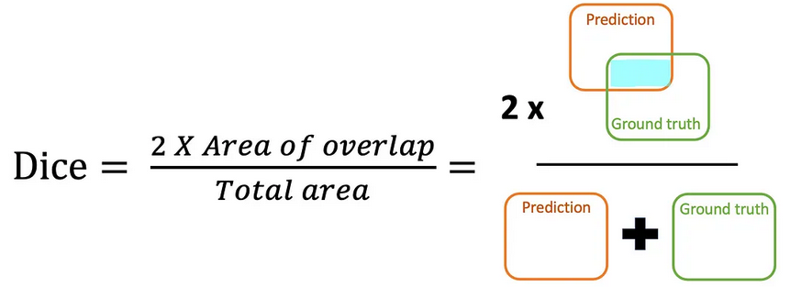
Dice Similarity Coefficient (DSC)
Statistical measure used to evaluate the overlap between two sets of data, commonly used in image processing and segmentation tasks.
It quantifies the similarity between the predicted segmentation mask and the ground truth mask.
Higher DSC values indicate better alignment between the two masks.

Slide 9

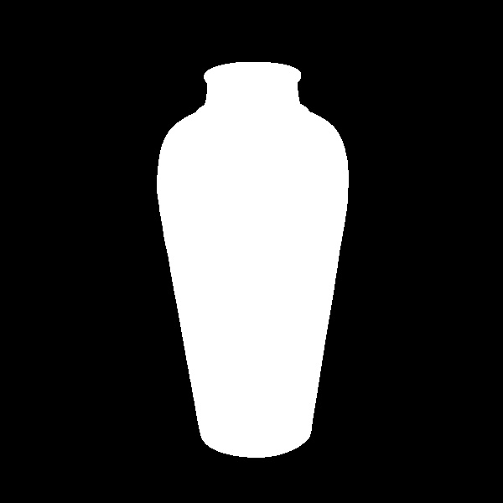
Dice Similarity Coefficient (DSC)
Steps:
Create 2 empty binary mask with the same dimension as the original image
One is for the ground truth mask, the other is for the active contour mask
Create a binary mask (with only 0 and 255 values) from the original image by using threshold value.
From the results of points after active contour:
Create an empty binary mask with the same dimensions as the original image.
Use a drawing function (e.g., cv2.polylines or cv2.fillPoly) to draw the contour on the mask.
Calculate the area overlap between those 2 masks (sum of the element-wise multiplication)
Calculate the total of both mask area
Calculate DSC
※Allowed to use library to draw/create the mask
Active Contour results
Active Contour mask
Original image mask

Slide 10
Grading
Program (80%)
Image pre-processing (5%)
Set initial contour (15%)
Active Contour (40%)
Save the result videos, measure the number of iteration and DSC value (20%)
Report (20%)
Please explain your code.
Please paste 9 output images in your report, the number of iterations, and their respective DSC values for each contour's images.
Please state in your report the parameter setting that you choose for each input images.

Slide 11
C/C++
Folder Structure
111999406 _hw4/
├─ project_hw4/
│ ├─ test_img/
│ │ ├─ img1.png
│ │ ├─ img2.png
│ │ ├─ img3.png
│ ├─ result_img/
│ │ ├─ img1_q1.png
│ │ ├─ img2_q1.png
│ │ ├─ img3_q1.png
│ │ ├─ img1_q2.png
│ │ ├─ img2_q2.png
│ │ ├─ img3_q2.png
│ │ ├─ img1_q3.png
│ │ ├─ img2_q3.png
│ │ ├─ img3_q3.png
│ │ ├─ img1_q4.avi
│ │ ├─ img2_q4.avi
│ │ ├─ img3_q4.avi
│ ├─ include/
│ │ ├─ func.h
│ ├─ func.cpp
│ ├─ main.cpp
├─ 111999406 _hw4.pdf
├─ Readme.txt
Python
Write your report in English (PDF)
Explaining how your main function working and shown the results on your report.
111999406 _hw4/
├─ test_img/
│ ├─ img1.png
│ ├─ img2.png
│ ├─ img3.png
├─ result_img/
│ ├─ img1_q1.png
│ ├─ img2_q1.png
│ ├─ img3_q1.png
│ ├─ img1_q2.png
│ ├─ img2_q2.png
│ ├─ img3_q2.png
│ ├─ img1_q3.png
│ ├─ img2_q3.png
│ ├─ img3_q3.png
│ ├─ img1_q4.avi
│ ├─ img2_q4.avi
│ ├─ img3_q4.avi
├─ 111999406_hw4.py
├─ 111999406_hw4.pdf
├─ Readme.txt

Slide 12
Homework #4
Please compress your files (program and report)
StudentID_hw4( for example: 111999406_hw4.zip)
Make sure the size of .zip file is less than 50MB
Please submit to iStudy, in Homework 4 Assignment.
Deadline: 2024/12/23 23:59:59
For each hour late, 10% of the total score will be deducted.
Don’t share your code with other students. Do it by yourself.

Slide 13
Thanks for your attention

