Slide 1

Computer Vision Homework #2
TA：Syahrul Munir
Email： t111999406@ntut.org.tw
Robot Vision Lab (Room 1421)

Slide 2
Homework Assignment
2024/09/30 – Homework 1 assigned, due 10/14
2024/10/21 – Homework 2 assigned, due 11/04
2024/11/11 – Homework 3 assigned, due 11/25
2024/12/09 – Homework 4 assigned, due 12/23

Slide 3
Notes from Homework #1
Upload your report only in PDF.
If you find your image after convolution is "weird", you need to check if the pixel's value of the output is between 0 and 255 or not. You can set the limit of your matrix, so the minimum value is 0 and the maximum value is 255.
Check the workflow of the Homework, don't use the wrong input.
The score of Homework #1 will be available by the end of this week. You can check the i-study for future updates.

Slide 4
Homework 2
Give an image with noise (img_noise.png) for testing as follow:
Median Filter：decide the kernel size, stride size, padding size by yourself. Find the best setting with the highest PSNR value that you can get (save as output_q1.png)
Gaussian Filter：decide the kernel size, stride size, padding size by yourself. Find the best setting with the highest PSNR value that you can get (save as output_q2.png)
Combine : by combining median and gaussian filter, find the best image results with the highest PSNR value that you can get (save as output_q3.png)
Image Histogram：accumulate the number of each pixel value, then draw a histogram for each output image from previous tasks. (save as : img_noise_his.png, output_q1_his.png, output_q2_his.png, output_q3_his.png)
※There are totally 7 images in your report.
※The kernel, stride, and padding size can be different for each question

Slide 5
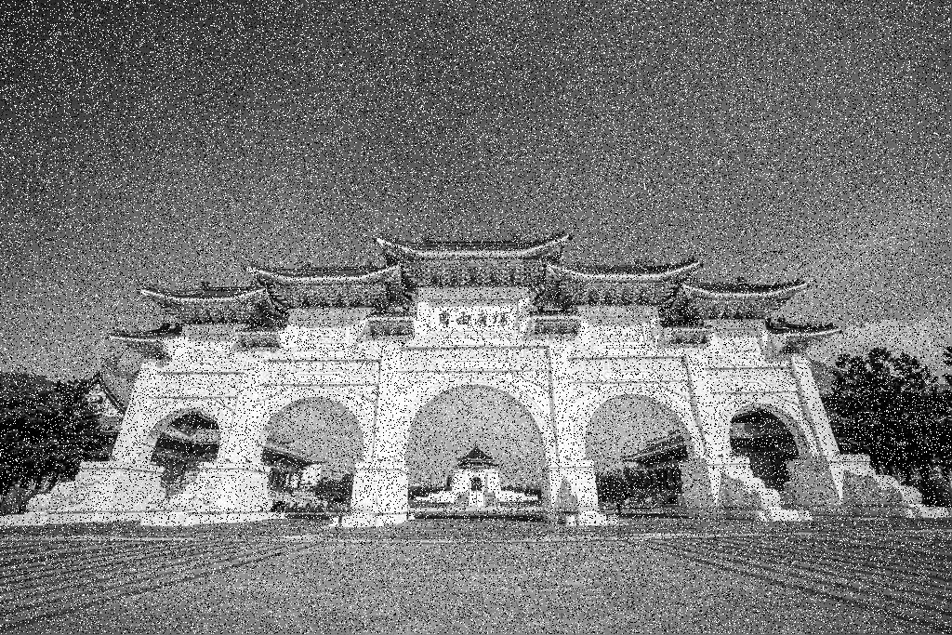
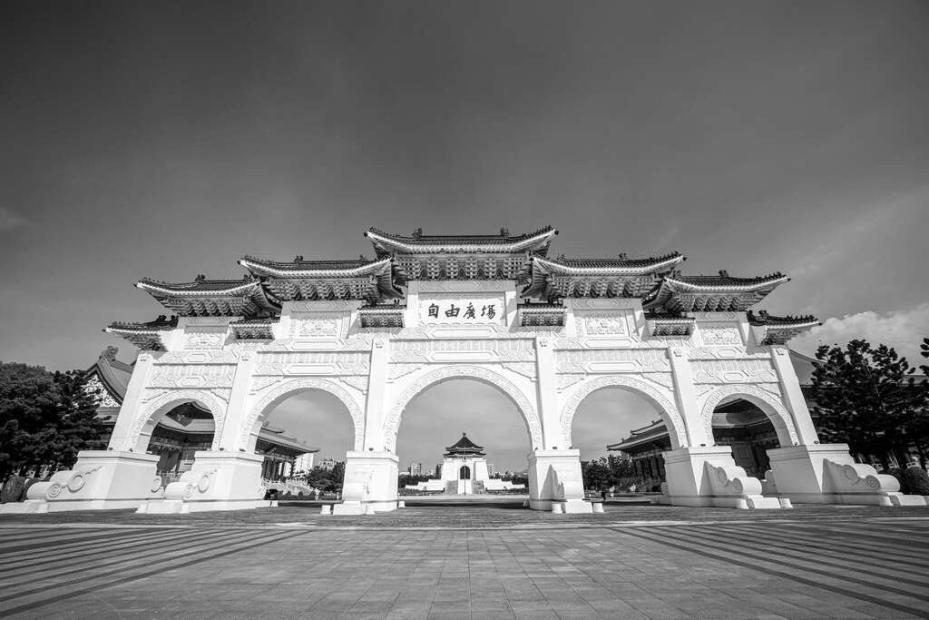
Homework 2 Workflow
noisy_image
Q4
img_noise_his
Input
Q1
output_q1
Q4
output_q1_his
Q2
output_q2
Q4
output_q2_his
Original image
Q3
output_q3
Q4
output_q3_his
※The original image will only be used to calculate the PSNR value

Slide 6
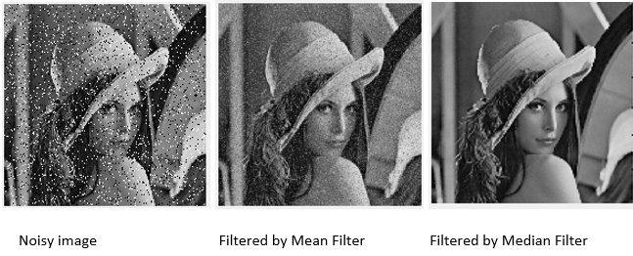
Salt & Pepper Noise and Median Filter
Median Filter is one of non-linear filters, which is also used for smoothing.
Its basic idea is to replace each pixel by the median of its neigboring pixels.
By doing so, it removes some spikes introduced by noise: especially impulse and salt & pepper noise.

Slide 7
Example：3*3 Median Filter
It’s a nonlinear filter.
152 | 124 | 252 | 163 | 32 | 67
128 | 40 | 220 | 190 | 142 | 216
68 | 157 | 24 | 30 | 140 | 36
81 | 7 | 25 | 149 | 155 | 41
22 | 33 | 100 | 131 | 75 | 67
69 | 44 | 44 | 167 | 231 | 161
128
Sorting：24, 40, 68, 124, 128, 152, 157, 220, 252
image
※ Please implement the sorting algorithm by yourself. Not allowed to use any median function from library

Slide 8
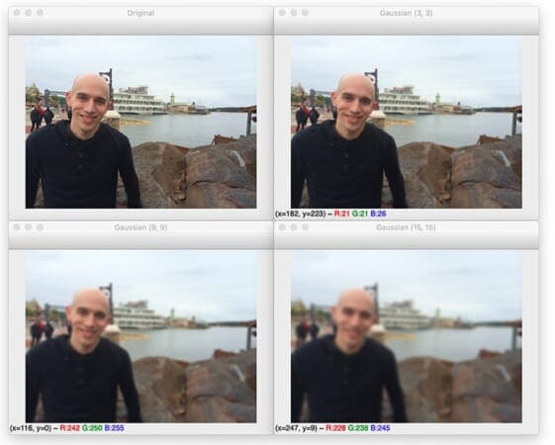
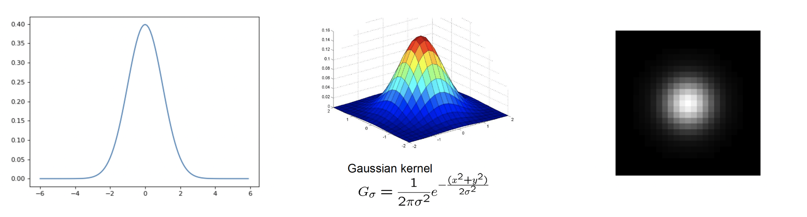
Gaussian Filter
Used to `blur' images and remove detail and noise.
Similar to the mean filter, but it uses a different kernel that represents the shape of a Gaussian (`bell-shaped') hump.
※ Please implement the Gaussian kernel equation by yourself.

Slide 9
Example：3*3 Gaussian Filter with sigma=1
As the kernel size increases, the image will become blurrier.
image
152 | 124 | 252 | 163 | 32 | 67
128 | 40 | 220 | 190 | 142 | 216
68 | 157 | 24 | 30 | 140 | 36
81 | 7 | 25 | 149 | 155 | 41
22 | 33 | 100 | 131 | 75 | 67
69 | 44 | 44 | 167 | 231 | 161
x
x=-1, y=1
123
0.08 | 0.12 | 0.08
0.12 | 0.2 | 0.12
0.08 | 0.12 | 0.08
*
y
x=0, y=0
=
x=1, y=-1
Approx.
(152*0.08) + (124*0.12) + (252*0.08)+ (128*0.12) + (40*0.2) + (220*0.12) + (68*0.08) + (157*0.12) + (24*0.08) = 123

Slide 10

Peak Signal-to-Noise Ratio (PSNR)
PSNR is the ratio between the maximum possible power of an image and the power of corrupting noise that affects the quality of its representation.
Calculated in dB.
※ Please implement the PSNR equation by yourself.
L is the maximum possible pixel (255)
N is the total number of pixel in an image (image height x image width)
I(i) is the original image
I^(i) is the noisy image that we want to calculate the PSNR

Slide 11
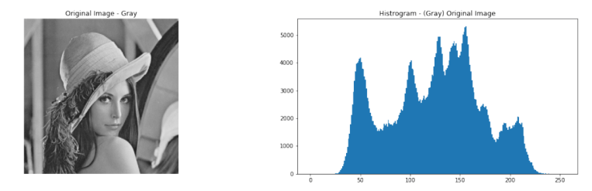
Image Histogram
Count the number of each pixel’s intensity (0~255)
Create a table to record the number of each pixel’s intensity.
You can draw the histogram by using the functions of matplotlib.

Slide 12
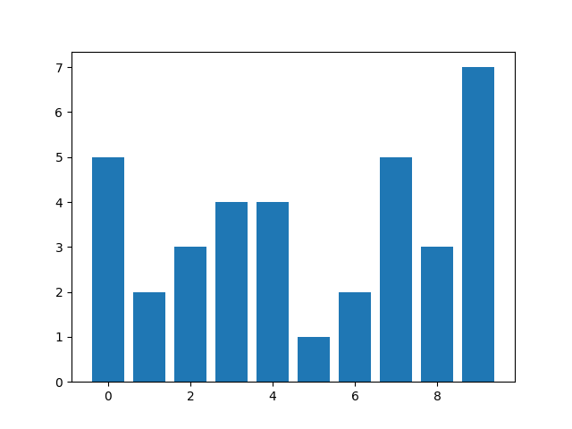
Example：Image Histogram
1 | 3 | 7 | 3 | 0 | 7
5 | 2 | 3 | 9 | 0 | 4
4 | 9 | 4 | 7 | 7 | 6
2 | 7 | 8 | 9 | 6 | 0
1 | 9 | 0 | 4 | 2 | 9
0 | 3 | 8 | 9 | 8 | 9
value | 0 | 1 | 2 | 3 | 4 | 5 | 6 | 7 | 8 | 9
#num | 5 | 2 | 3 | 4 | 4 | 1 | 2 | 5 | 3 | 7
statistics
draw histogram
image
※ The sum of #num must be equal to width of image * height of image

Slide 13
Grading
Program (80%)
Median Filter (20%)
Gaussian Filter (20%)
Combined Filter (30%)
Image Histogram (10%)
Report (20%)
Explain your code.
Put the 3 result images that were generated by 3 different filters and their corresponding PSNR values, compare and describe what you observe.
Put the 3 histograms results, analyze and describe the difference between them, and explain the reason.

Slide 14
Folder Structure
Python
C/C++
111999406 _hw2/
├─ test_img/
│ ├─ noisy_image.png
│ ├─ gray_image.png
├─ result_img/
│ ├─ output_q1.png
│ ├─ output_q2.png
│ ├─ output_q3.png
│ ├─ img_noise_his.png
│ ├─ output_q1_his.png
│ ├─ output_q2_his.png
│ ├─ output_q3_his.png
├─ 111999406_hw2.py
├─ 111999406_hw2.pdf
├─ Readme.txt
111999406 _hw2/
├─ project_hw2/
│ ├─ test_img/
│ │ ├─ noisy_image.png
│ │ ├─ gray_image.png
│ ├─ result_img/
│ │ ├─ output_q1.png
│ │ ├─ output_q2.png
│ │ ├─ output_q3.png
│ │ ├─ img_noise_his.png
│ │ ├─ output_q1_his.png
│ │ ├─ output_q2_his.png
│ │ ├─ output_q3_his.png
│ ├─ include/
│ │ ├─ func.h
│ ├─ func.cpp
│ ├─ main.cpp
├─ 111999406 _hw2.pdf
├─ Readme.txt
Write your report in English (PDF)
Explaining how your main function working and shown the results on your report.

Slide 15
Homework #2
Please compress your files (program and report)
StudentID_hw2( for example: 111999406_hw2.zip)
Please submit to iStudy, in Homework 2 Assignment.
Deadline: 2023/11/04 23:59:59
For each hour late, 10% of the total score will be deducted.
Don’t share your code with other students. Do it by yourself.

Slide 16
Thanks for your attention

