Slide 1

Computer Vision Homework #1
TA：Syahrul Munir (Moon)
Email： t111999406@ntut.org.tw
Robot Vision Lab (Room 1421)

Slide 2
Homework Assignment
2024/09/30 – Homework 1 assigned, due 10/14
2024/10/21 – Homework 2 assigned, due 11/04
2024/11/11 – Homework 3 assigned, due 11/25
2024/12/09 – Homework 4 assigned, due 12/23

Slide 3
Homework Assignment
Target:
Write the main functions by yourself to understand the theories of computer vision deeply.
Improve your skills about using C/C++/Python
Rules:
Cannot directly use the function of OpenCV Lib or others to do the main part of homework.
Example:
cvtColor(image, gray, CV_RGB2GRAY) //convert RGB to Gray
cv2.copyMakeBorder(image, pad, pad, pad, pad, cv2.BORDER_REPLICATE) //give a padding to an image
numpy.convolve() or cv2.filter2D() or from scipy.signal import convolve2d or etc //directly do a convolution
Can only use the basic function, such as load and save images, find the shape of images

Slide 4
OpenCV
OpenCV (Open Source Computer Vision Library) is a popular and widely used open-source library that provides tools for real-time computer vision applications.
Supports a wide range of image and video processing tasks, from basic operations like reading and manipulating images to advanced techniques like object detection and facial recognition.
It has C++, Python, Java and MATLAB interfaces and supports Windows, Linux, Android and Mac OS
How to install :
https://docs.opencv.org/master/df/d65/tutorial_table_of_content_introduction.html
With C++ : https://opencv.org/releases/ (download)
With Python : pip install opencv-python

Slide 5
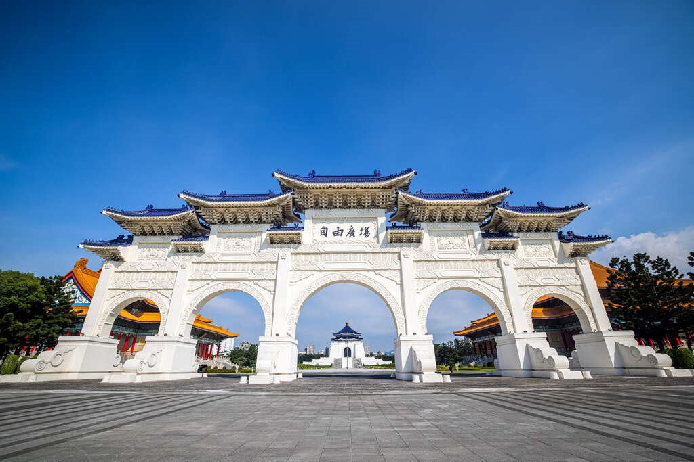
OpenCV (in Python)
Import Library:
import numpy as np
import cv2
Read an image:
img = cv2.imread('image.jpg’)
Check image size:
height, width, channels = img.shape
Show image:
cv2.imshow('My Image', img)
cv2.waitKey(0)
cv2.destroyAllWindows()
Write image:
cv2.imwrite('output.jpg', img)

Slide 6
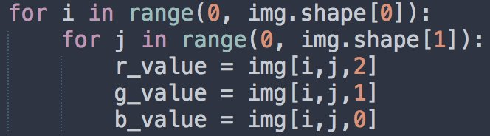
OpenCV (in Python)
Example for get each pixel value:
Create new mat:
rgb_mat = np.zeros((height, width, 3), np.uint8)
gray_mat = np.zeros((height, width, 1), np.uint8)

Slide 7

Homework 1
Give an image (CKS.jpg) for testing as follow:
Read a RGB image and write a function to convert the image to grayscale image. (save as CKS _Q1.jpg)
Write a convolution operation with Laplacian edge detection kernel using zero padding and stride 1. (save as CKS _Q2.jpg)
Write a pooling operation with each of
Average pooling (save as CKS _Q3a.jpg)
Max pooling (save as CKS _Q3b.jpg)
Using the SAME 3x3 kernel and stride 2
Write a binarization operation for each of the result of pooling operation (set the threshold by yourself, e.g. 128). (save as CKS _Q4a.jpg (using the average pooling output) and save as CKS _Q4a.jpg (using the max pooling output))
※ There are totally 6 result images in your report.

Slide 8
Homework 1
Input
Q1
Output1
Q2
Output2
Q3a
Output3a
Q4
Output4a
Q3b
Output3b
Q4
Output4b

Slide 9
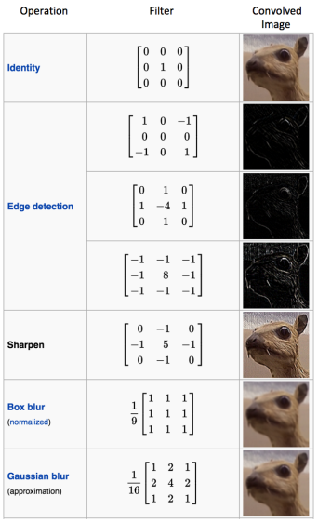
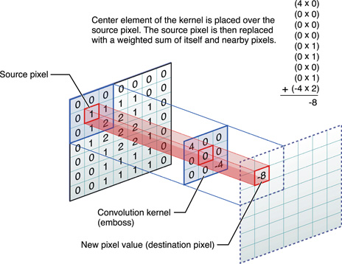
Convolution Operation
Operation that combines an image with a filter (also called a kernel) to produce a modified output

Slide 10
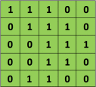

Convolution Operation
5 x 5 image
3 x 3 kernel

Slide 11
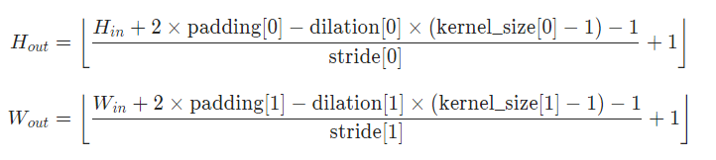
Padding
Adding extra pixels around the border of an image before performing convolution.
Control the size of the output image and ensure that the convolution can be applied to the pixels near the edges.
Img
Zero Padding :
https://www.youtube.com/watch?v=akf-b2jF3CA

Slide 12
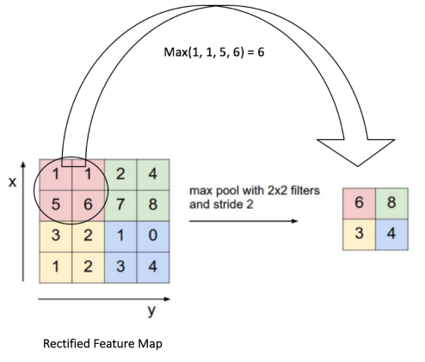
Pooling operations
Pooling Step: Spatial Pooling (also called sub-sampling or down sampling) reduces the dimension of each feature map but retains the most important information.
Some different types of Spatial Pooling : Max, Average, Sum etc.

Slide 13
Grading
Program (80%)
Q1: 10%
Q2: 25%
Q3: 30%
Q4: 15%
Report : 20%
Explain your program and method
Put the result images (1 input images, 6 outputs images)
Compare and discuss the difference between the output produced by mean pooling + binarization (Output4a) and max pooling + binarization (Output4b).

Slide 14
Folder Structure
Python
C/C++
111999406_hw1/
├─ test_img/
│ ├─ CKS.jpg
├─ result_img/
│ ├─ CKS _Q1.jpg
│ ├─ CKS _Q2.jpg
│ ├─ CKS _Q3a.jpg
│ ├─ CKS _Q3b.jpg
│ ├─ CKS _Q4a.jpg
│ ├─ CKS _Q4b.jpg
├─ 111999406 _hw1.py
├─ 111999406 _hw1.pdf
├─ Readme.txt
111999406 _hw1/
├─ project_hw1/
│ ├─ test_img/
│ │ ├─ CKS.jpg
│ ├─ result_img/
│ │ ├─ CKS _Q1.jpg
│ │ ├─ CKS _Q2.jpg
│ │ ├─ CKS _Q3a.jpg
│ │ ├─ CKS _Q3b.jpg
│ │ ├─ CKS _Q4a.jpg
│ │ ├─ CKS _Q4b.jpg
│ ├─ include/
│ │ ├─ func.h
│ ├─ func.cpp
│ ├─ main.cpp
├─ 111999406 _hw1.pdf
├─ Readme.txt
Write your report in English (PDF)
Explaining how your main function working and shown the results on your report.

Slide 15
Homework #1
Please compress your files (program and report)
StudentID_hw1( for example: 111999406_hw1.zip)
Please submit to iStudy, in Homework 1 Assignment.
Deadline: 2024/10/14 23:59:59
For each hour late, 10% of the total score will be deducted.
Don’t share your code and your report with other students. Do it by yourself.

Slide 16
Thanks for your attention

