Slide 1
Problem analysis

Slide 2
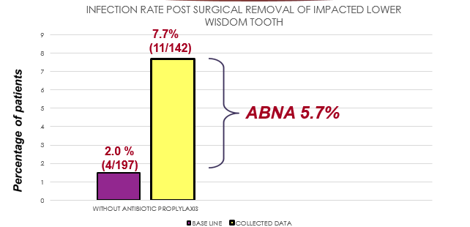
Pre-Remedial Findings
Chart 1 : Achievable Benefit Not Achieved (ABNA) graph of pre remedial and standard

Slide 3
Fishbone diagram showing problem analysis
Poor oral hygiene
Sterility of surgical site
Without usage of Chlorhexidine mouth wash
Without usage of sterile glove
Without cleaning and draping
Increase plaque score
Post surgical infection
Inadequate post operative instructions
Poor post operative wound care

Slide 4
Model of Good Care
NO | PROCESS | CRITERIA | STANDARD | PRE-REMEDIAL FINDING
1. | Clerking of patient for surgical removal of impacted third molars | Relevan Medical history, social history taken and recorded | 100% | 100%
2. | Oral hygiene examination | For patient plaque score more than 2, Oral prophylaxis performed | 100% | 10%
3. | Pre-surgical procedure | -Ask patient to rinse with Chlorhexidine mouthwash for 30 seconds | 100% | 5%
4. | Surgical procedure | - Patient been clean and drape properly | 100% | 8%
 |  | - Operator use sterile glove | 100% | 20%

Slide 5
Model of Good Care
NO | PROCESS | CRITERIA | STANDARD | PRE-REMEDIAL FINDING
5. | Post-op instruction | - Post-op instruction given verbally - Post-op instruction given writtenly for patient bring back | 100% | 100%
6. | Review | Patient given appointment 1 week post operatively for review and suture removal | 100% | 100%

