Slide 1
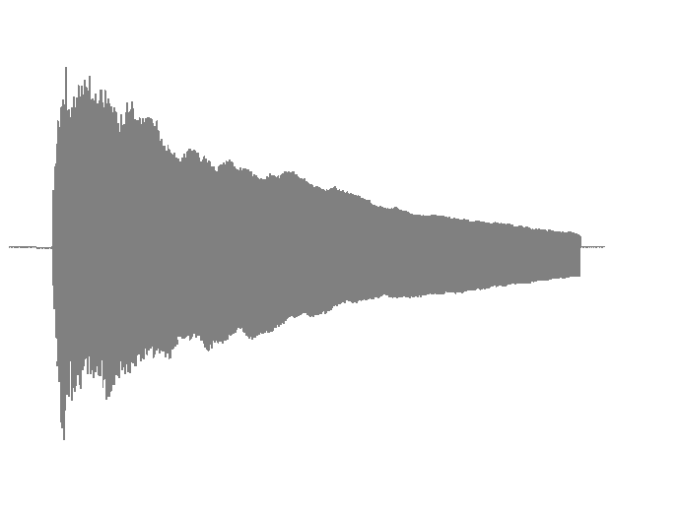
Waveform of a piano sound note
Idealized energy envelope curve
Attack
Decay
Onset
Transient

