Slide 1
Bitcoin ATM

Slide 2

Bitcoin ATM

Slide 3
In your pocket TM

Slide 4
Demo

Slide 5
What just happened?

Slide 6
Phone connects to card reader
via Bluetooth

Slide 7
Card reader does its thing

Slide 8
...using phone's internet connection

Slide 9
Payment confirmation to phone

Slide 10
Bitcoin wallet on phone sends transaction to remote Bitcoin address

Slide 11

Done

Slide 12
More of a vending machine

Slide 13
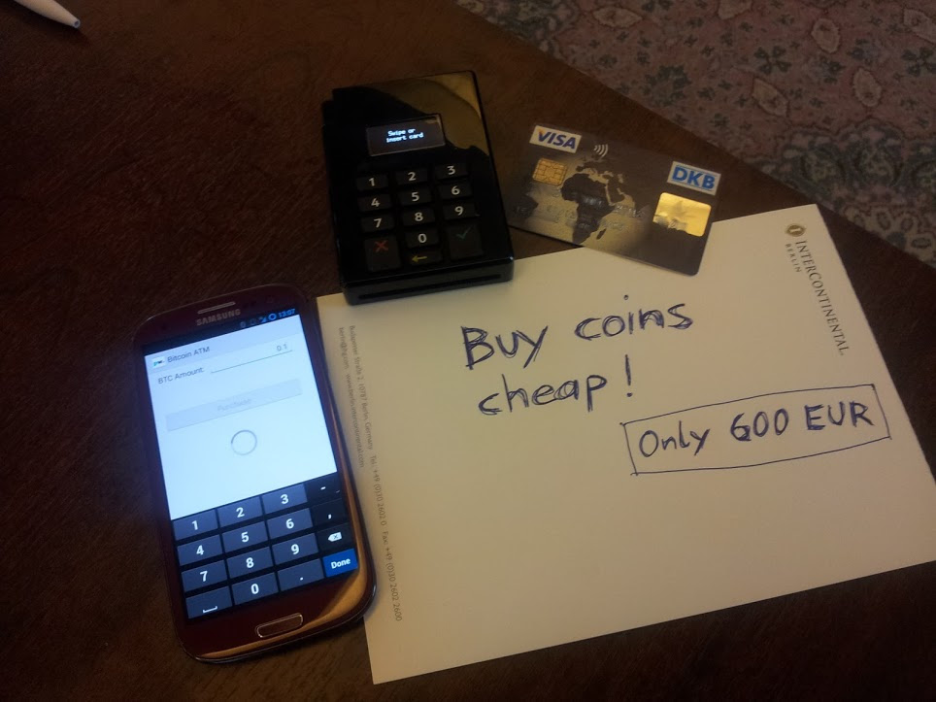
Seems legit

Slide 14
Credits:

Slide 15
Payworks
Android SDK, card reader

Slide 16
Andreas Schildbach
Android Bitcoin wallet

Slide 17
All code at
github.com/meinharrd

Slide 18
Thanks!

Slide 19
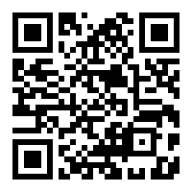
Tips:
meinhard@benn.org

