Slide 1




Sliced Data Migration Toolbox (SDMT)
Meinrad Weiss Senior Cloud Solution Architect Microsoft

Slide 2


Transfer Scenarios
Direct transfer
Transfer via data lake
SQL -> SQL
SQL -> data lake -> SQL
SQL -> ADX
SQL -> data lake -> ADX
SQL -> data lake

Slide 3
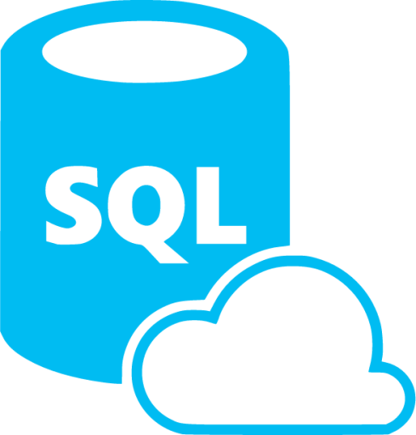
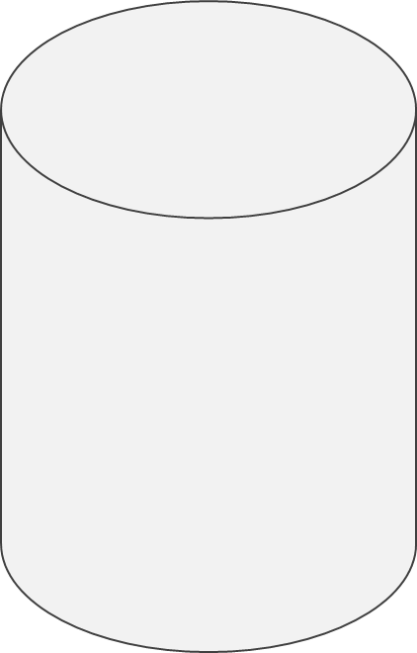
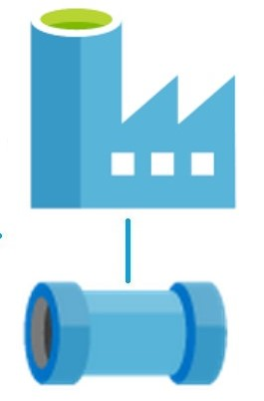


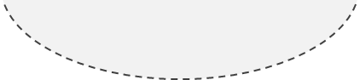


SDMT – Sliced Data Migration Tool - Overview
SMDT Meta Data
ADF/Synapse Pipelines
Source (SQL) Database
[Measurement]
[Core].[SlicedImportObject]
Target (ADX/SQL)
Database
[Measurement]
Measurement
2021-11-25
2021-11-26
2021-11-27

Slide 4


SDMT – Sliced Data Migration Tool – Error slice
SMDT Meta Data
ADF/Synapse Pipelines
Source (SQL) Database
[Measurement]
[Core].[SlicedImportObject]
Target (ADX/SQL)
Database
[Measurement]
Measurement
2021-11-25
2021-11-26
2021-11-27

Slide 5
SDMT – Sliced Data Migration Tool - Restart
SMDT Meta Data
ADF/Synapse Pipelines
Source (SQL) Database
[Measurement]
[Core].[SlicedImportObject]
Target (ADX/SQL)
Database
[Measurement]
Measurement
2021-11-25
Slice Reload
2021-11-26
2021-11-27

Slide 6
SDMT – Sliced Data Migration Tool - ADX
SMDT Meta Data
ADF/Synapse Pipelines
Source (SQL) Database
[Measurement]
[Core].[SlicedImportObject]
Target ADX
Database
[Measurement]
Measurement
{"creationTime": "2021-11-25",
"tags":
["Source:PipelineLoad",
"LoadedAt:2023-05-04T05:24:10.583",
"SlicedImportObject_Id:6DD4A13A-…-BF79"]
}
2021-11-25
{"creationTime": "2021-11-26",
"tags":
["Source:PipelineLoad",
"LoadedAt:2023-05-04T05:24:10.583",
"SlicedImportObject_Id:6DD4A13A-…-BF79"]
}
2021-11-26
2021-11-27
{"creationTime": "2021-11-27",
"tags":
["Source:PipelineLoad",
"LoadedAt:2023-05-04T05:24:10.583",
"SlicedImportObject_Id:6DD4A13A-…-BF79"]
}

Slide 7
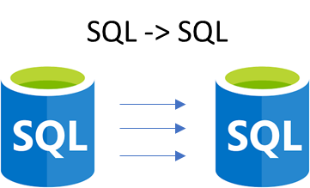
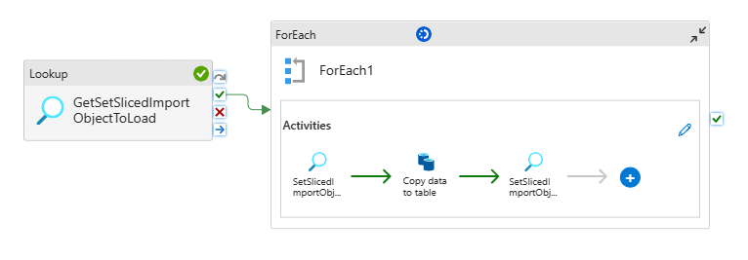
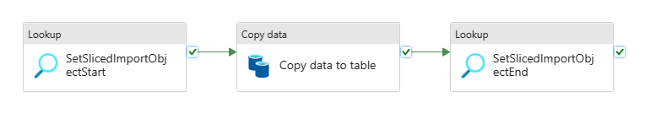
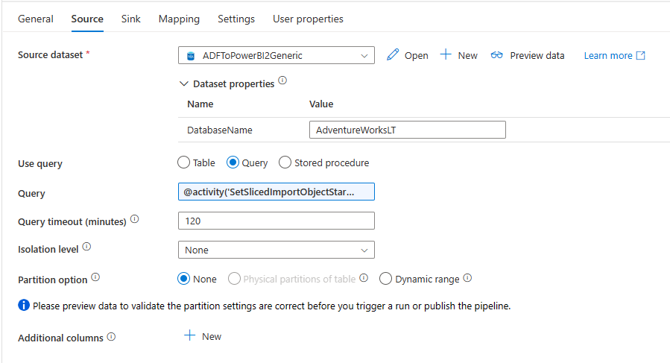
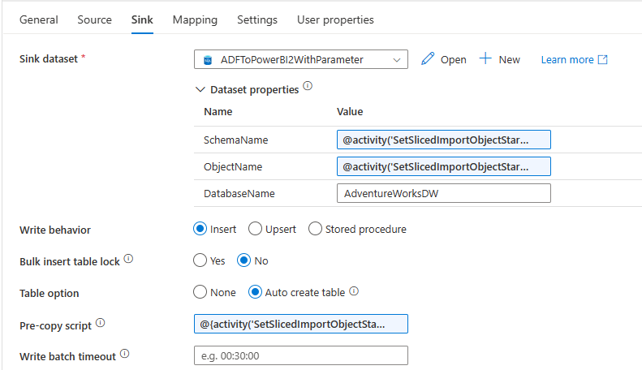
Direct Transfer (SQL -> SQL)
[Core].[SlicedImportObject]
@activity('SetSlicedImportObjectStart’) .output.firstRow.DestinationSchema
@activity('SetSlicedImportObjectStart’) .output.firstRow.SelectCommand
@activity('SetSlicedImportObjectStart’) .output.firstRow.DestinationObject
@{activity('SetSlicedImportObjectStart’) .output.firstRow.EmptyDestinationSliceCommand}

Slide 8
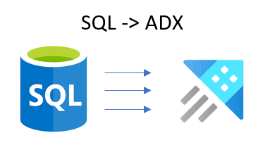
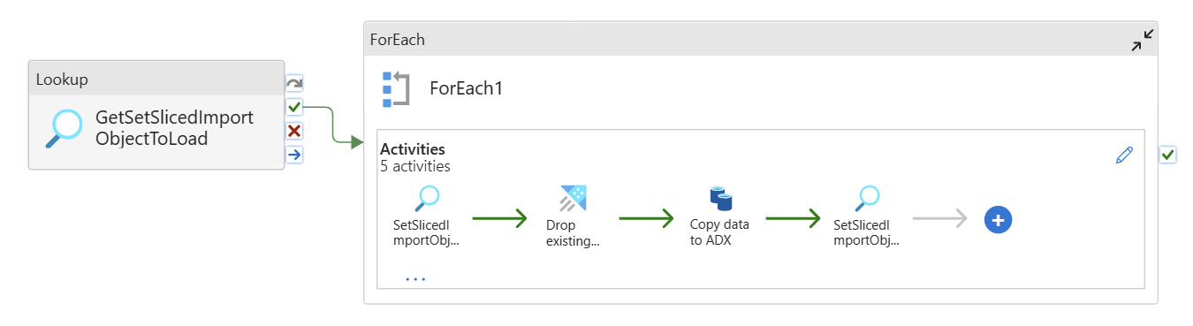
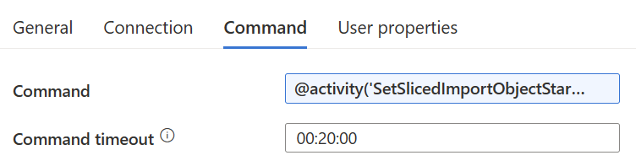
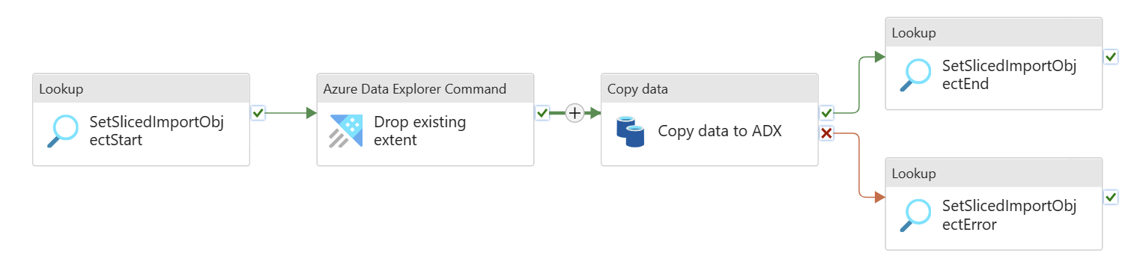
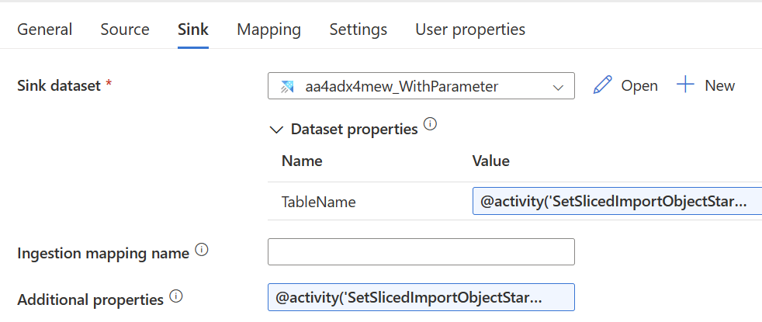
Direct Transfer (SQL -> ADX)
[Core].[SlicedImportObject]
@activity('SetSlicedImportObjectStart') .output.firstRow.ADX_DropExtentCommand
@activity('SetSlicedImportObjectStart') .output.firstRow.DestinationObject
@activity('SetSlicedImportObjectStart’) .output.firstRow.SelectCommand
@activity('SetSlicedImportObjectStart') .output.firstRow.AdditionalContext

Slide 9
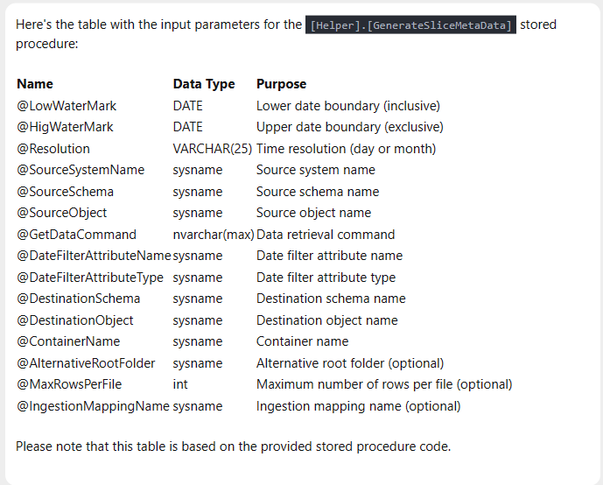
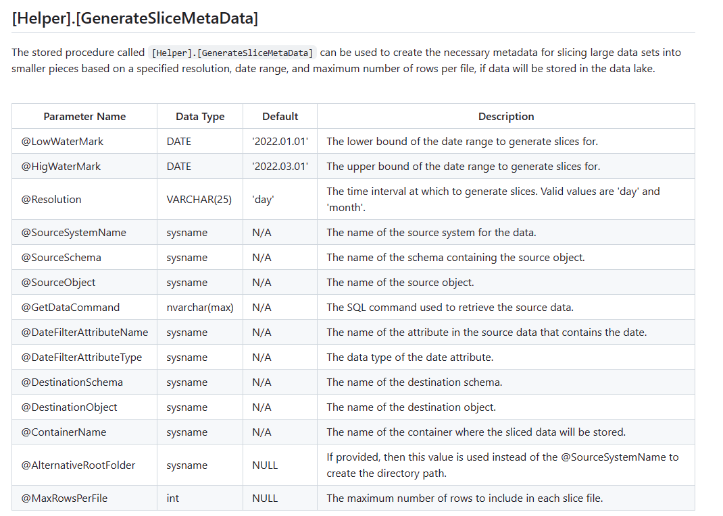
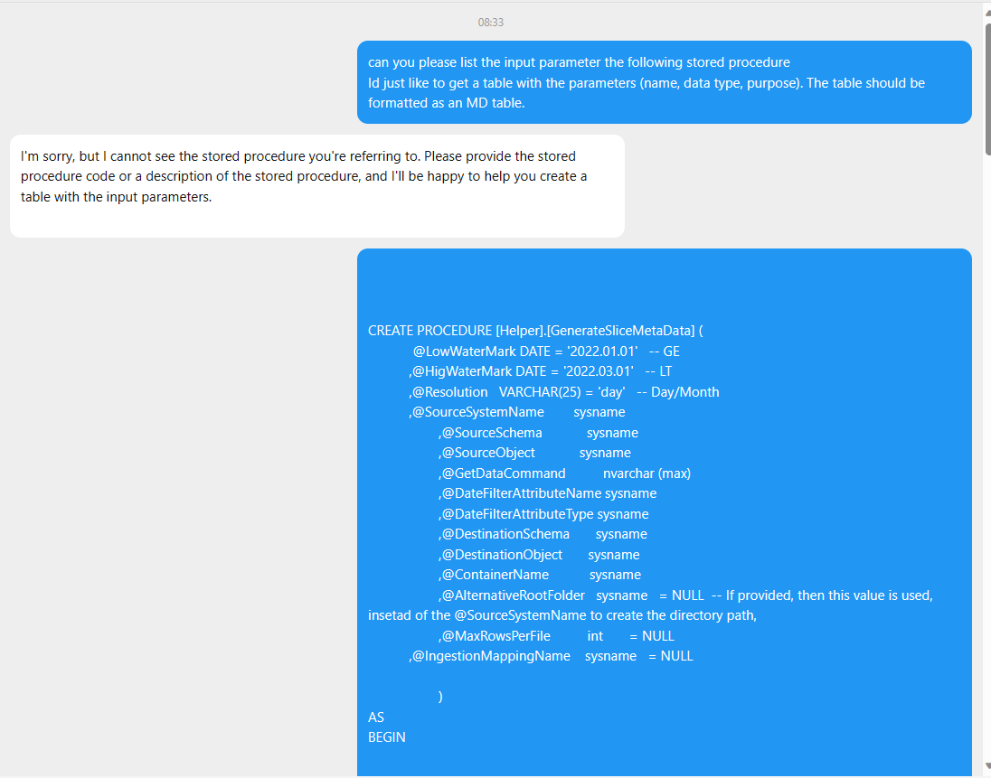
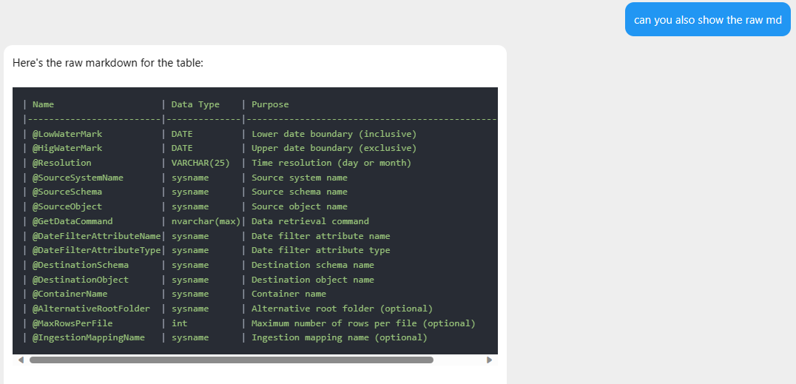
ChatGPT

Slide 10
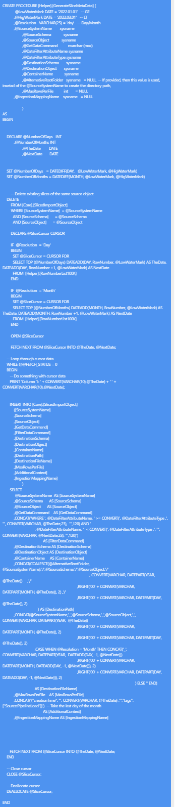
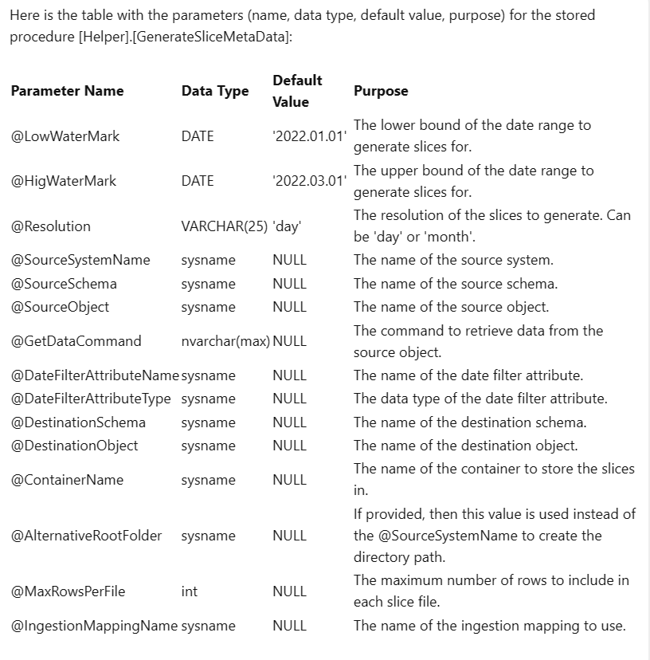
Can you please list the input parameter the following stored procedure Id just like to get a table with the parameters (name, data type, default value, purpose). The table should be formatted as a raw MD table.
| Parameter Name | Data Type | Default Value | Purpose |
| --- | --- | --- | --- |
| @LowWaterMark | DATE | '2022.01.01' | The lower bound of the date range to generate slices for. |
| @HigWaterMark | DATE | '2022.03.01' | The upper bound of the date range to generate slices for. |
| @Resolution | VARCHAR(25) | 'day' | The resolution of the slices to generate. Can be 'day' or 'month'. |
| @SourceSystemName | sysname | NULL | The name of the source system. |
| @SourceSchema | sysname | NULL | The name of the source schema. |
| @SourceObject | sysname | NULL | The name of the source object. |
| @GetDataCommand | nvarchar(max) | NULL | The command to retrieve data from the source object. |
| @DateFilterAttributeName | sysname | NULL | The name of the date filter attribute. |
| @DateFilterAttributeType | sysname | NULL | The data type of the date filter attribute. |
| @DestinationSchema | sysname | NULL | The name of the destination schema. |
| @DestinationObject | sysname | NULL | The name of the destination object. |
| @ContainerName | sysname | NULL | The name of the container to store the slices in. |
| @AlternativeRootFolder | sysname | NULL | If provided, then this value is used instead of the @SourceSystemName to create the directory path. |
| @MaxRowsPerFile | int | NULL | The maximum number of rows to include in each slice file. |
| @IngestionMappingName | sysname | NULL | The name of the ingestion mapping to use. |
Can you please generate the raw MD?

Slide 11
Generate Meta Data
DECLARE @LowWaterMark DATE = '2002-06-01' -- GE
,@HigWaterMark DATE = '2002-08-01' -- LT 05
,@Resolution VARCHAR(25) = 'Month' -- Day/Month
,@SourceSystemName sysname = 'AdventureWorksLTXXX'
,@ContainerName sysname = 'adftopowerbi'
EXEC [Helper].[GenerateSliceMetaData]
@LowWaterMark = @LowWaterMark
,@HigWaterMark = @HigWaterMark
,@Resolution = @Resolution
,@SourceSystemName = @SourceSystemName
,@SourceSchema = 'SalesLT'
,@SourceObject = 'MeasurementX'
,@GetDataCommand = 'SELECT [MeasurementID], [Name], [MeasurementNumber], [Color], [SellStartDate] FROM [SalesLT].[MeasurementX]'
,@DateFilterAttributeName = '[SellStartDate]'
,@DateFilterAttributeType = 'DATETIME'
,@DestinationSchema = 'SalesLT_SDMT'
,@DestinationObject = 'Measurement'
,@ContainerName = @ContainerName
,@AlternativeRootFolder = NULL
,@MaxRowsPerFile = 10
select *
from Core.SlicedImportObject
where SourceSystemName = 'AdventureWorksLTXXX'

Slide 12
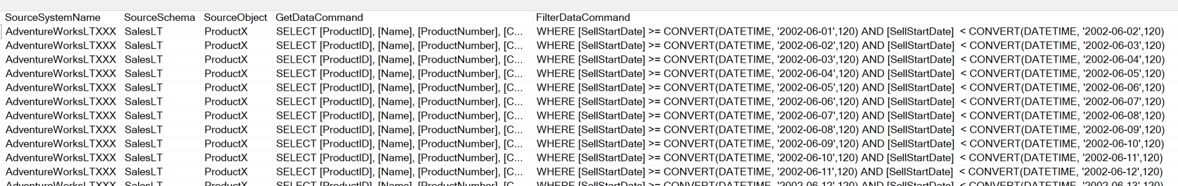
Generate Meta Data
DECLARE @LowWaterMark DATE = '2002-06-01' -- GE
,@HigWaterMark DATE = '2002-08-01' -- LT 05
,@Resolution VARCHAR(25) = 'Day' -- Day/Month
,@SourceSystemName sysname = 'AdventureWorksLTXXX'
,@ContainerName sysname = 'adftopowerbi'
EXEC [Helper].[GenerateSliceMetaData]
@LowWaterMark = @LowWaterMark
,@HigWaterMark = @HigWaterMark
,@Resolution = @Resolution
,@SourceSystemName = @SourceSystemName
,@SourceSchema = 'SalesLT'
,@SourceObject = 'MeasurementX'
,@GetDataCommand = 'SELECT [MeasurementID], [Name], [MeasurementNumber], [Color], [SellStartDate] FROM [SalesLT].[MeasurementX]'
,@DateFilterAttributeName = '[SellStartDate]'
,@DateFilterAttributeType = 'DATETIME'
,@DestinationSchema = 'SalesLT_SDMT'
,@DestinationObject = 'Measurement'
,@ContainerName = @ContainerName
,@AlternativeRootFolder = NULL
,@MaxRowsPerFile = 10
select *
from Core.SlicedImportObject
where SourceSystemName = 'AdventureWorksLTXXX'

Slide 13
Manual Meta Data
INSERT INTO [Core].[SlicedImportObject]
([SlicedImportObject_Id]
,[SourceSystemName]
,[SourceSchema]
,[SourceObject]
,[GetDataCommand]
,[FilterDataCommand]
,[DestinationSchema]
,[DestinationObject]
,[ContainerName]
,[DestinationPath]
,[DestinationFileName]
,[MaxRowsPerFile]
)
VALUES
('37C8B38B-B913-4593-B1F2-68EDCB5DC60F'
,'AdventureWorksLT'
,'SalesLT'
,'SalesOrderHeader'
,'SELECT [SalesOrderID], [RevisionNumber], [OrderDate], [Status] FROM [SalesLT].[SalesOrderHeader]'
,'WHERE [SalesOrderID] < 71815'
,'AdventureWorksLT_SalesLT_Sliced'
,'SalesOrderHeader'
,'adf-to-powerbi'
,'raw/SlicedImport/AdventureWorksLT/SalesLT/SalesOrder/SalesOrderID_lt71815'
,'SalesOrderHeader_lt71815'
,5
);

Slide 14
