Slide 1
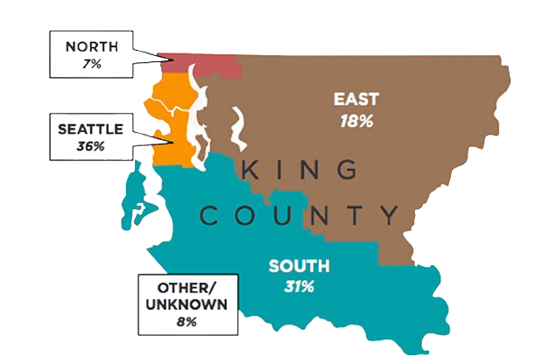
King County – Washington -US
House Price
Meir Bokobza
Ofir Zukerman

Slide 2
Our research - Intro
Questions:
Can we predict the main component to the price of an apartment?
Import
Data
Data Analyzing
Visualization
Machine
Learning

Slide 3
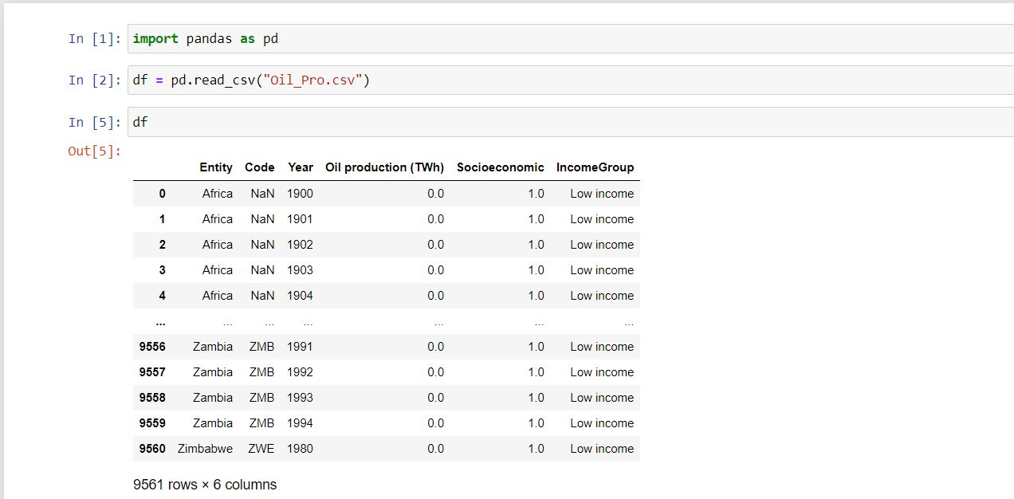
Data Source
Kaggle

Slide 4
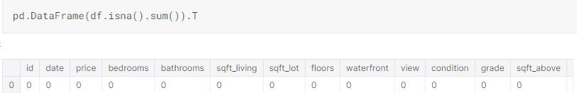
Data Cleaning
No null values found!!

Slide 5
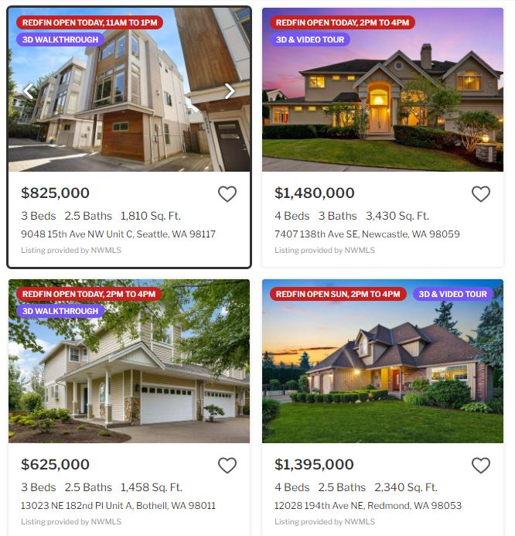
Example for House

Slide 6
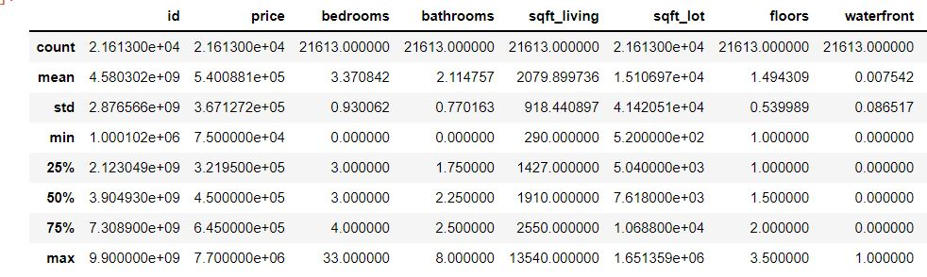
General Statistics on the Data Frame

Slide 7
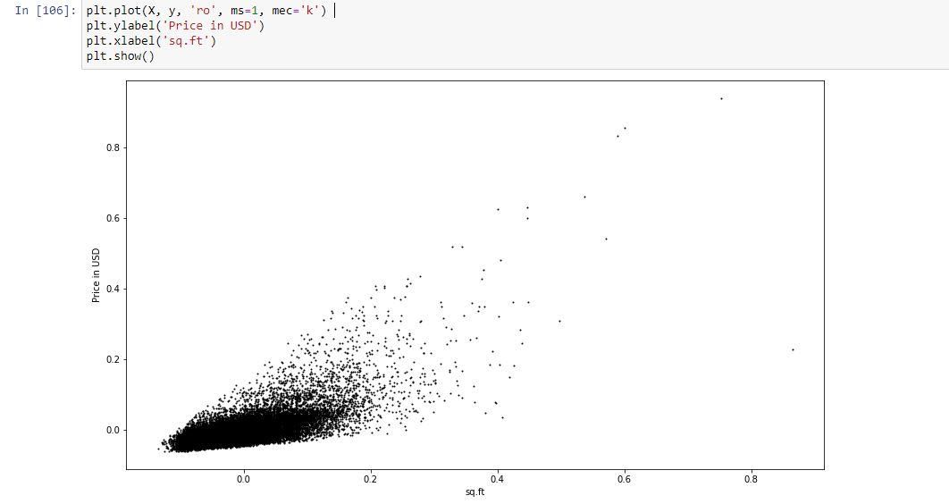
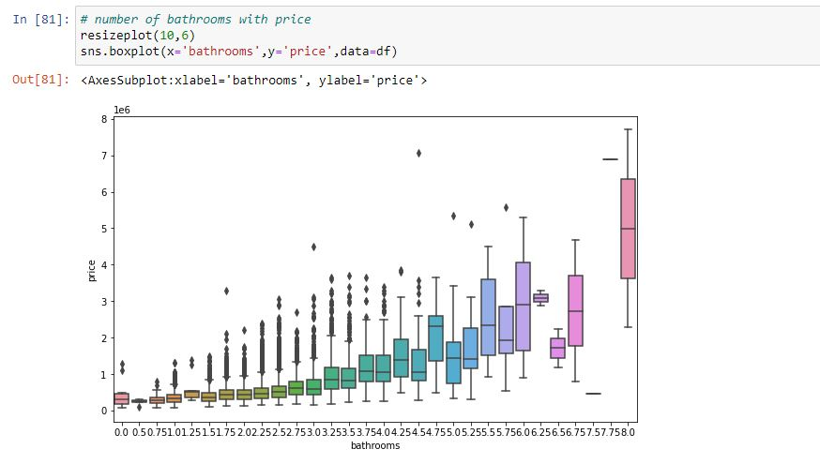
Visualization
Price distribution by
number of rooms
Price distribution by
number of bathrooms

Slide 8
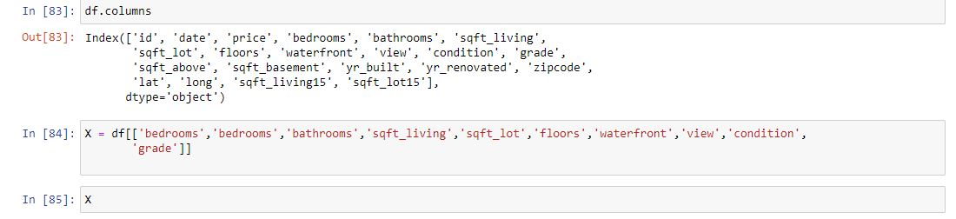
Determine the Features & Target
variable
VS

Slide 9
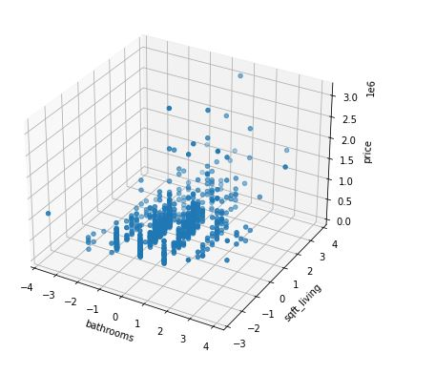
Data Integration

Slide 10
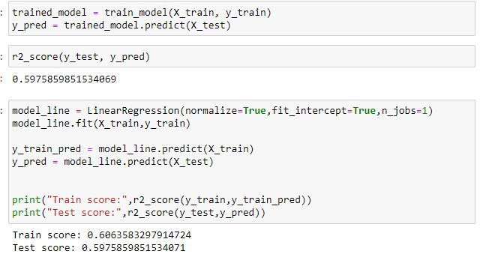
Machine learning

