Slide 1
QA system
Methodology, Results, Insights
By Roger Mei

Slide 2
Methodology
Document retrieval hashmap
Question type classification
Keyword extraction
Okapi BM25 for relevant document selection
Sentence selection based on cosine similarity to question

Slide 3
Document Retrieval Hashmap
Used to map all non-stop words in a document to the index of the document in the corpus
Pros:
Almost all words are captured correctly
Cons:
Some words not captured correctly due to bad spacing and escape characters in articles

Slide 4
Question Type Classification
After document retrieval, only sentences that include the specified named entities will be considered as answers.
Questions starting with :
“Who” or “Whom” are of type Person.
“Where” are of type Location.
“When” , “What time” or “What date” are of type Date/Time.
“How few”, “How great”, “How little”, “How many” or “How much” are of type Quantity.
"Which company/companies" are of type Organization.
"What" without any other information are of type Noun.
Pros:
Accurately extracts correct type of answer from sentence
Cons:
Not robust; sensitive to quantity of classifications captured

Slide 5
Keyword Extraction
Only documents that contain extracted keywords are examined for answers.
Selected keywords:
All non-stop words of a quoted expression
All name entities, recognized as proper nouns
All noun and their adjectival modifiers
Pros:
Questions with few but rare words can limit the number of documents examined greatly
Cons:
Part of speech tagger does not correctly classify some words; verbs can be incorrectly classified as nouns and adjectives as verbs
Does not capture synonyms, hypernyms so words like “people” and “organization” are taken as is
“people” and “organization” can be extended to “population”, ”residents”, “Co.”, “Ltd.” with wordnet but this is not robust and increases the number of documents retrieved greatly

Slide 6
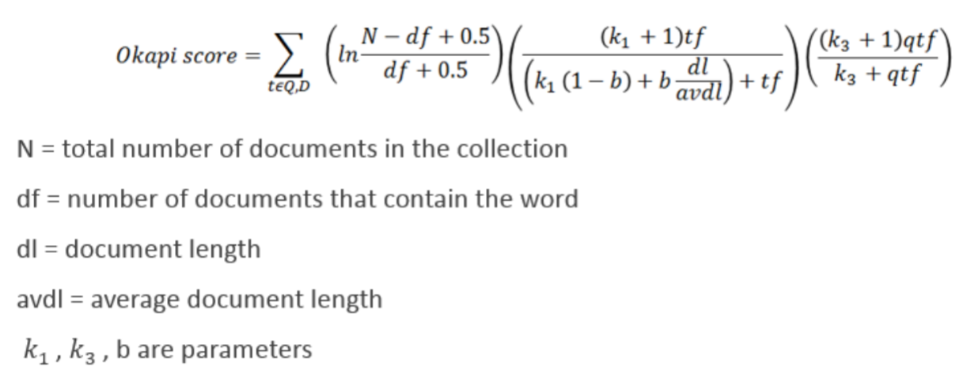
Okapi BM25
On selected documents, 5 documents with the best okapi scores are kept based on the BM25 algorithm.
5 documents is not too many so that irrelevant documents are selected and not too few so that answers are limited
Pros:
Accurately selects relevant documents with a quantified score
Cons:
Best number of documents to use can not be determined as that depends on how general or specific a given question is

Slide 7
Sentence Selection
Among the 5 documents, the sentence with the highest cosine similarity to the question is chosen to extract an answer from.
The answers extracted are the determined entities based on the question type.
Pros:
Accurately chooses the correct answer is there is a sentence in the corpus that matches question very closely
Cons:
There can be too many or too few sentences to choose from
System is very sensitive to number of choices provided

Slide 8
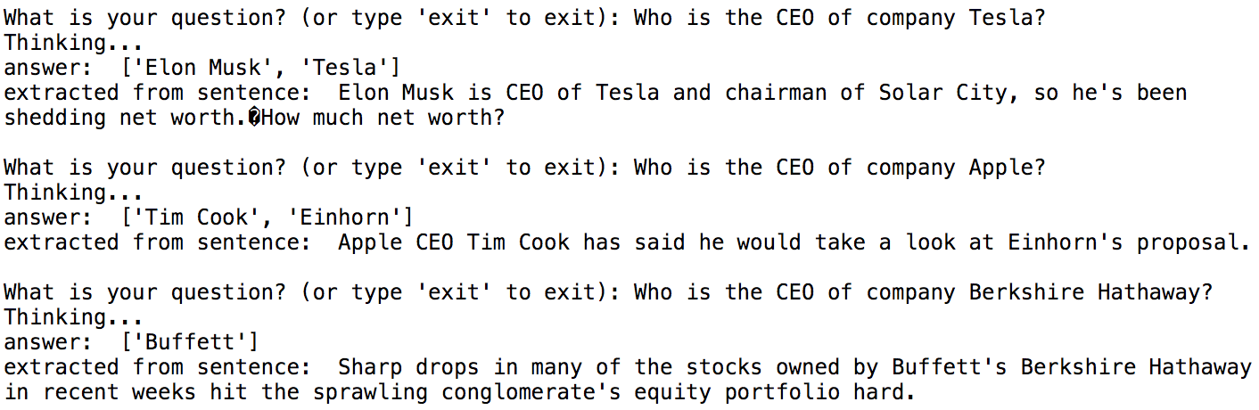
Results: Who is the CEO of company X?
Findings:
QA can be very accurate for this question because
there are very few keywords
answer requires a person to be in the sentence
Can be improved by
including an accurate CEO classifier
putting more weight on the company name as a keyword

Slide 9
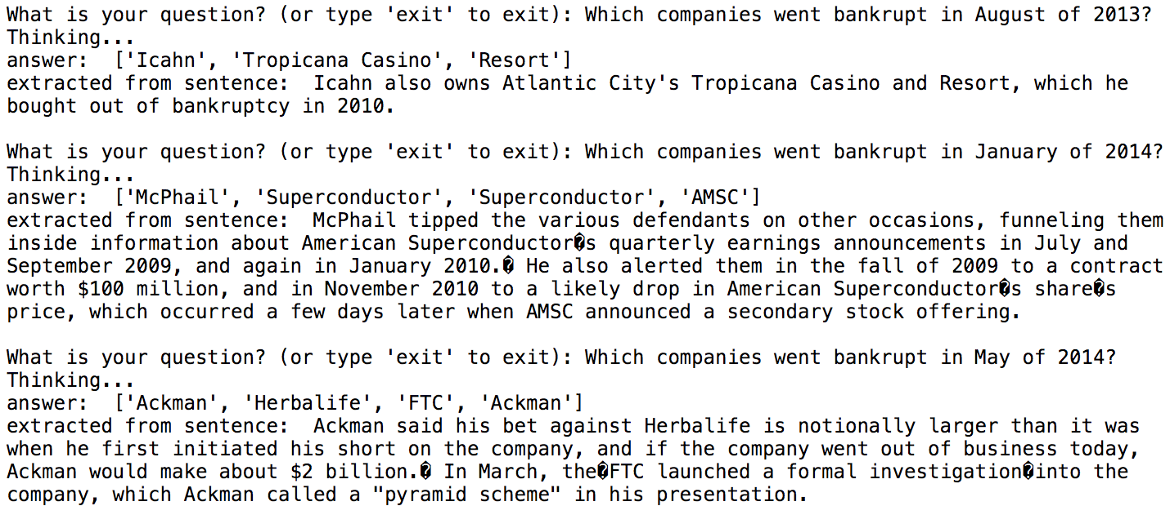
Results: Which companies went bankrupt in month X of year Y?
Findings:
Organizations extracted are not always companies
A company classifier can be used on top of a NER that retrieves organizations
More weight needs to be placed on the word “bankrupt” as many returned sentences do not contain that word.
“bankrupt” can be a mandatory word in the returned sentence

Slide 10
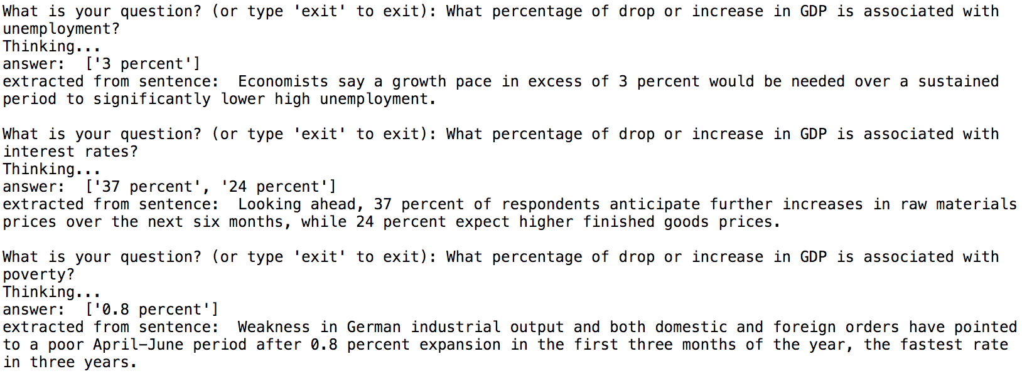
Results: What affects GDP? What percentage of drop or increase is associated with this property?
Findings:
Question is very general and can not have a specific question type classification.
Only information we know is that the answers should be nouns.
This can be solved by having “affects GDP” as a more heavily weighted bigram feature in determining similarity of sentences.
“GDP” can be a mandatory word in the extracted sentence.

Slide 11
Business Insights and Value
All problems mentioned can be used as insight into creating a better QA system.
QA systems need to be tailored to specific questions and topics.
Hard to generalize for all questions
Weights need to be placed on keywords.
Very important words (with highest weights) should be mandatory in an extracted answer sentence.
Corpus needs to be formatted well.
A proper knowledge base of facts and rules with an ontology can be used.

