Slide 1
Talk as a Service
@m_e_i_s
#MadPerl2017

Slide 2
So the people have chosen

Slide 3


Slide 4
Docker (&-compose) for (perl) developers

Slide 5
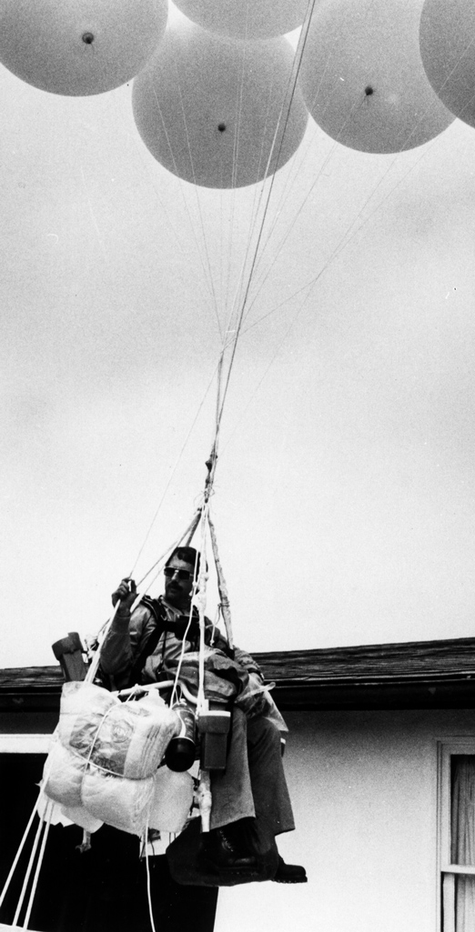
Larry Walters 1982

Slide 6
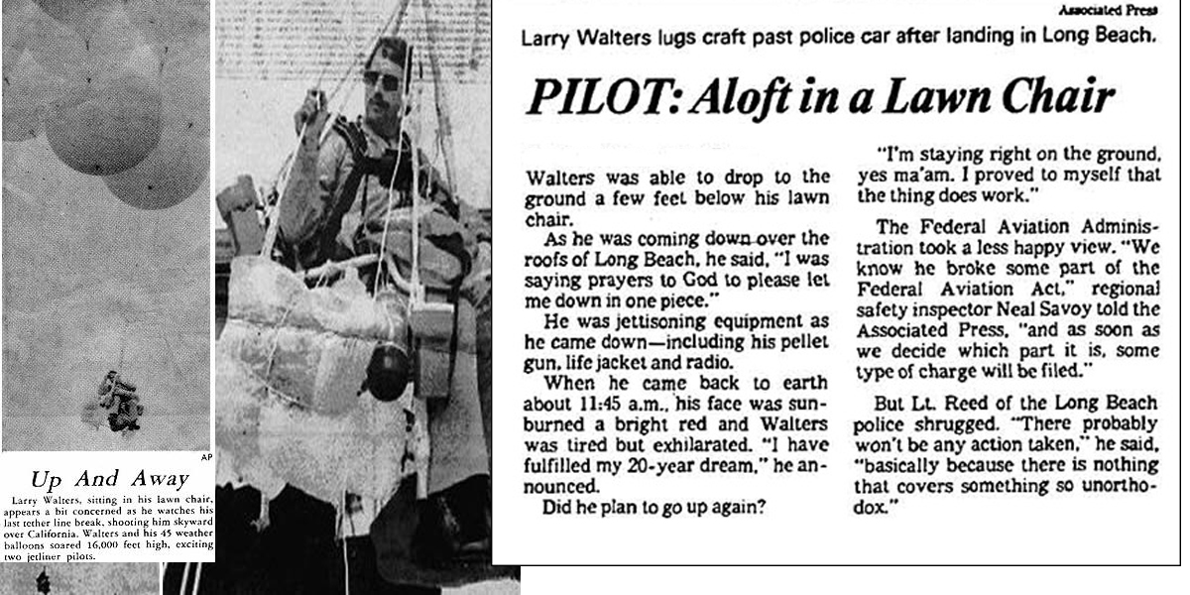

Slide 7


Slide 8
Images Containers

Slide 9
Dockerfile
FROM perl:5.24
RUN apt-get update && apt-get install -y \
iputils_ping
RUN useradd -ms /bin/bash code
ENV HOME=/home/code
WORKDIR /home/code
USER code
CMD echo "Madrid Perl Workshop"

Slide 10
# Build image
$ docker build –t my_image .
# Run container
$ docker run run –ti my_image
Madrid Perl Workshop
$ docker run –ti my_image /bin/bash
code@4557f41ec2fe:~$

Slide 11

Docker Compose

Slide 12
Services Network

Slide 13
docker-compose.yml
version: '2'
services:
web:
image: my_image
ports:
- "5000:5000"
volumes:
- .:/home/code
command: ./run_my_app.pl
depends_on:
-redis
redis:
image: "redis:alpine"

Slide 14
$ docker-compose up
Pulling image redis...
Pulling image my_image...
Starting composetest_redis_1...
Starting composetest_web_1...
redis_1 | [8] 02 Jan 18:43:35.576
web_1 | * Running on http://0.0.0.0:5000/

Slide 15
Ok, so?

Slide 16
CONSTRAINTS

Slide 17
No, really, constraints.

Slide 18
Can’t write to disk Immutability

Slide 19
Immutability Less uncertainty

Slide 20
Immutability Easy(er) to reason about

Slide 21
Support only one OS You only need one

Slide 22
Support only one OS (probably) Works on prod

Slide 23
Support only one OS Don’t need plenv/brew

Slide 24
Define your entire stack Infrastructure as code

Slide 25
Define your entire stack Explicit dependencies

Slide 26
Define your entire stack Works on ‘dev’ machine

Slide 27
Define your entire stack Integration first

Slide 28
Define your entire stack Infrastructure as code

Slide 29
Define your entire stack Try Perl 5.26 today

Slide 30
Infrastructure as code New dev? docker-compose up

Slide 31
docker-compose up My laptop can burn

Slide 32
1 container, 1 process 1 process, 1 service

Slide 33
1 process, 1 service Explicit communication

Slide 34
1 process, 1 service Better architecture

Slide 35
1 process, 1 service Look Ma! Microservices

Slide 36
1 process, 1 service Each service it’s the king

Slide 37
Only Linux? ?

Slide 38
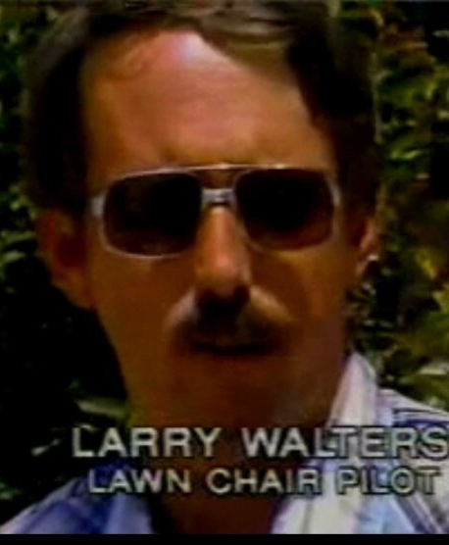
Remember Larry?

Slide 39
Why is relevant?

Slide 40
IT’S AWESOME

Slide 41
Why isn’t everyone talking about this?

Slide 42
Constraints are good

Slide 43
TIMTOWDY

Slide 44
Deployments are hard

Slide 45
Thanks

Slide 46
Questions?
(And apologies for the lack of kittens, you should have asked for it)

