Slide 1
MapReduce and Data Management
Based on slides from Jimmy Lin’s lecture slides (http://www.umiacs.umd.edu/~jimmylin/cloud-2010-Spring/index.html) (licensed under Creation Commons Attribution 3.0 License)

Slide 2
Mapreduce and Databases

Slide 3
Relational Algebra
Primitives
  Projection (π)
  Selection (σ)
  Cartesian product (×)
  Set union (∪)
  Set difference (−)
  Rename (ρ)
Other operations
  Join (⋈)
  Group by… aggregation
  …

Slide 4

Projection
R₁
R₁
R₂
R₂
R₃
R₃
R₄
R₄
R₅
R₅

Slide 5
Projection in MapReduce
Easy!
  Map over tuples, emit new tuples with appropriate attributes
  Reduce: take tuples that appear many times and emit only one version (duplicate elimination)
    Tuple t in R: Map(t, t) -> (t’,t’)
    Reduce (t’, [t’, …,t’]) -> [t’,t’]
Basically limited by HDFS streaming speeds
  Speed of encoding/decoding tuples becomes important
  Relational databases take advantage of compression
  Semistructured data? No problem!

Slide 6

Selection
R₁
R₂
R₁
R₃
R₃
R₄
R₅

Slide 7
Selection in MapReduce
Easy!
  Map over tuples, emit only tuples that meet criteria
  No reducers, unless for regrouping or resorting tuples (reducers are the identity function)
  Alternatively: perform in reducer, after some other processing
But very expensive!!! Has to scan the database
  Better approaches?

Slide 8
Union, Set Intersection and Set Difference
Similar ideas: each map outputs the tuple pair (t,t). For union, we output it once, for intersection only when in the reduce we have (t, [t,t])
For Set difference?

Slide 9
Set Difference
Map Function: For a tuple t in R, produce key-value pair (t, R), and for a tuple t in S, produce key-value pair (t, S).
Reduce Function: For each key t, do the following.
1. If the associated value list is [R], then produce (t, t).
2. If the associated value list is anything else, which could only be [R, S], [S, R], or [S], produce (t, NULL).

Slide 10
Group by… Aggregation
Example: What is the average time spent per URL?
In SQL:
  SELECT url, AVG(time) FROM visits GROUP BY url
In MapReduce:
  Map over tuples, emit time, keyed by url
  Framework automatically groups values by keys
  Compute average in reducer
  Optimize with combiners

Slide 11
Relational Joins
R₁
S₁
R₂
S₂
R₃
S₃
R₄
S₄
R₁
S₂
R₂
S₄
R₃
S₁
R₄
S₃

Slide 12
Join Algorithms in MapReduce
Reduce-side join
Map-side join
In-memory join
  Striped variant
  Memcached variant

Slide 13
Reduce-side Join
Basic idea: group by join key
  Map over both sets of tuples
  Emit tuple as value with join key as the intermediate key
  Execution framework brings together tuples sharing the same key
  Perform actual join in reducer
  Similar to a “sort-merge join” in database terminology

Slide 14
Map-side Join: Parallel Scans
If datasets are sorted by join key, join can be accomplished by a scan over both datasets
How can we accomplish this in parallel?
  Partition and sort both datasets in the same manner
In MapReduce:
  Map over one dataset, read from other corresponding partition
  No reducers necessary (unless to repartition or resort)
Consistently partitioned datasets: realistic to expect?

Slide 15
In-Memory Join
Basic idea: load one dataset into memory, stream over other dataset
  Works if R << S and R fits into memory
  Called a “hash join” in database terminology
MapReduce implementation
  Distribute R to all nodes
  Map over S, each mapper loads R in memory, hashed by join key
  For every tuple in S, look up join key in R
  No reducers, unless for regrouping or resorting tuples

Slide 16
In-Memory Join: Variants
Striped variant:
  R too big to fit into memory?
  Divide R into R₁, R₂, R₃, … s.t. each R_{n} fits into memory
  Perform in-memory join: ∀n, R_{n} ⋈ S
  Take the union of all join results
Memcached join:
  Load R into memcached
  Replace in-memory hash lookup with memcached lookup

Slide 17
Memcached Join
Memcached join:
  Load R into memcached
  Replace in-memory hash lookup with memcached lookup
Capacity and scalability?
  Memcached capacity >> RAM of individual node
  Memcached scales out with cluster
Latency?
  Memcached is fast (basically, speed of network)
  Batch requests to amortize latency costs
Source: See tech report by Lin et al. (2009)

Slide 18
Which join to use?
In-memory join > map-side join > reduce-side join
  Why?
Limitations of each?
  In-memory join: memory
  Map-side join: sort order and partitioning
  Reduce-side join: general purpose

Slide 19
Processing Relational Data: Summary
MapReduce algorithms for processing relational data:
  Group by, sorting, partitioning are handled automatically by shuffle/sort in MapReduce
  Selection, projection, and other computations (e.g., aggregation), are performed either in mapper or reducer
  Multiple strategies for relational joins
Complex operations require multiple MapReduce jobs
  Example: top ten URLs in terms of average time spent
  Opportunities for automatic optimization

Slide 20
Map-Reduce-Merge
Map-Reduce-Merge can form a hierarchical workflow which is similar to, but much more general than a DBMS query execution plan.
–No query operators, but arbitrary programming logic specified by the developers
–More general than relational query plans
–More general than Map-Reduce

Slide 21
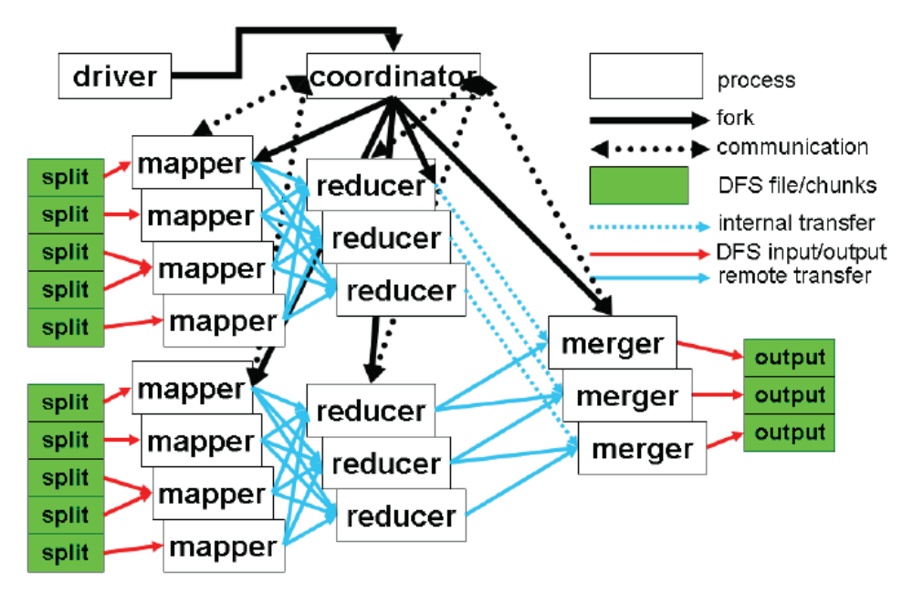
From the paper

Slide 22
MRM
MR: map: (k1, v1) -> [(k2, v2)]
reduce: (k2, [v2]) -> [v3]
MRM: map: (k1, v1) -> [(k2, v2)]
reduce: (k2, [v2]) -> [(k2, v3)]
merge((k2, [v2])_{a}, (k3, [v3])_{b}) -> [(k4, v5)]

Slide 23
Additional components
Merge function: user-defined data processing logic for the merger of two pairs of key/values, each coming from a different source.
•Processor function: user-defined function that processes data from one source only.
•Partition selector: user-definable module that shows I/O relationship btw reducers and mergers.
•Configurable iterator: user-configurable module that shows how to iteratethrougheachinput data as the mergingisdone.

Slide 24
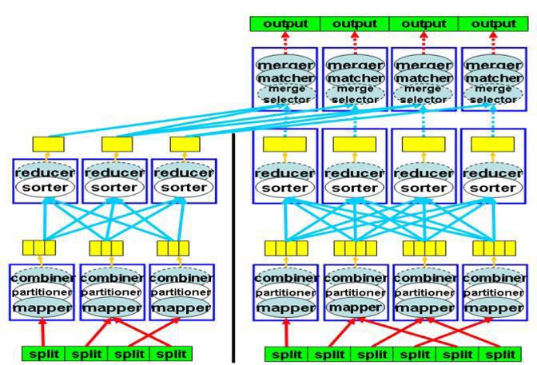

Slide 25
Sort-Merge Join Algorithm
Map: Partition records intobucketswhichare mutuallyexclusive and eachkeyrange isassignedto a Reducer.
•Reduce: Data in the sets are mergedintoa sortedset (sort the data).
•Merge: The mergerjoins the sorteddata for eachkeyrange.

Slide 26
Other Join Algorithms
MRM allows for implementation of other join algorithms like Hash Join and Nested Loop Join.

Slide 27
MRM join paper:
Hung-chih Yang, Ali Dasdan, Ruey-Lung Hsiao, Douglas Stott Parker Jr.: Map-reduce-merge: simplified relational data processing on large clusters. SIGMOD Conference 2007: 1029-1040

