Slide 1
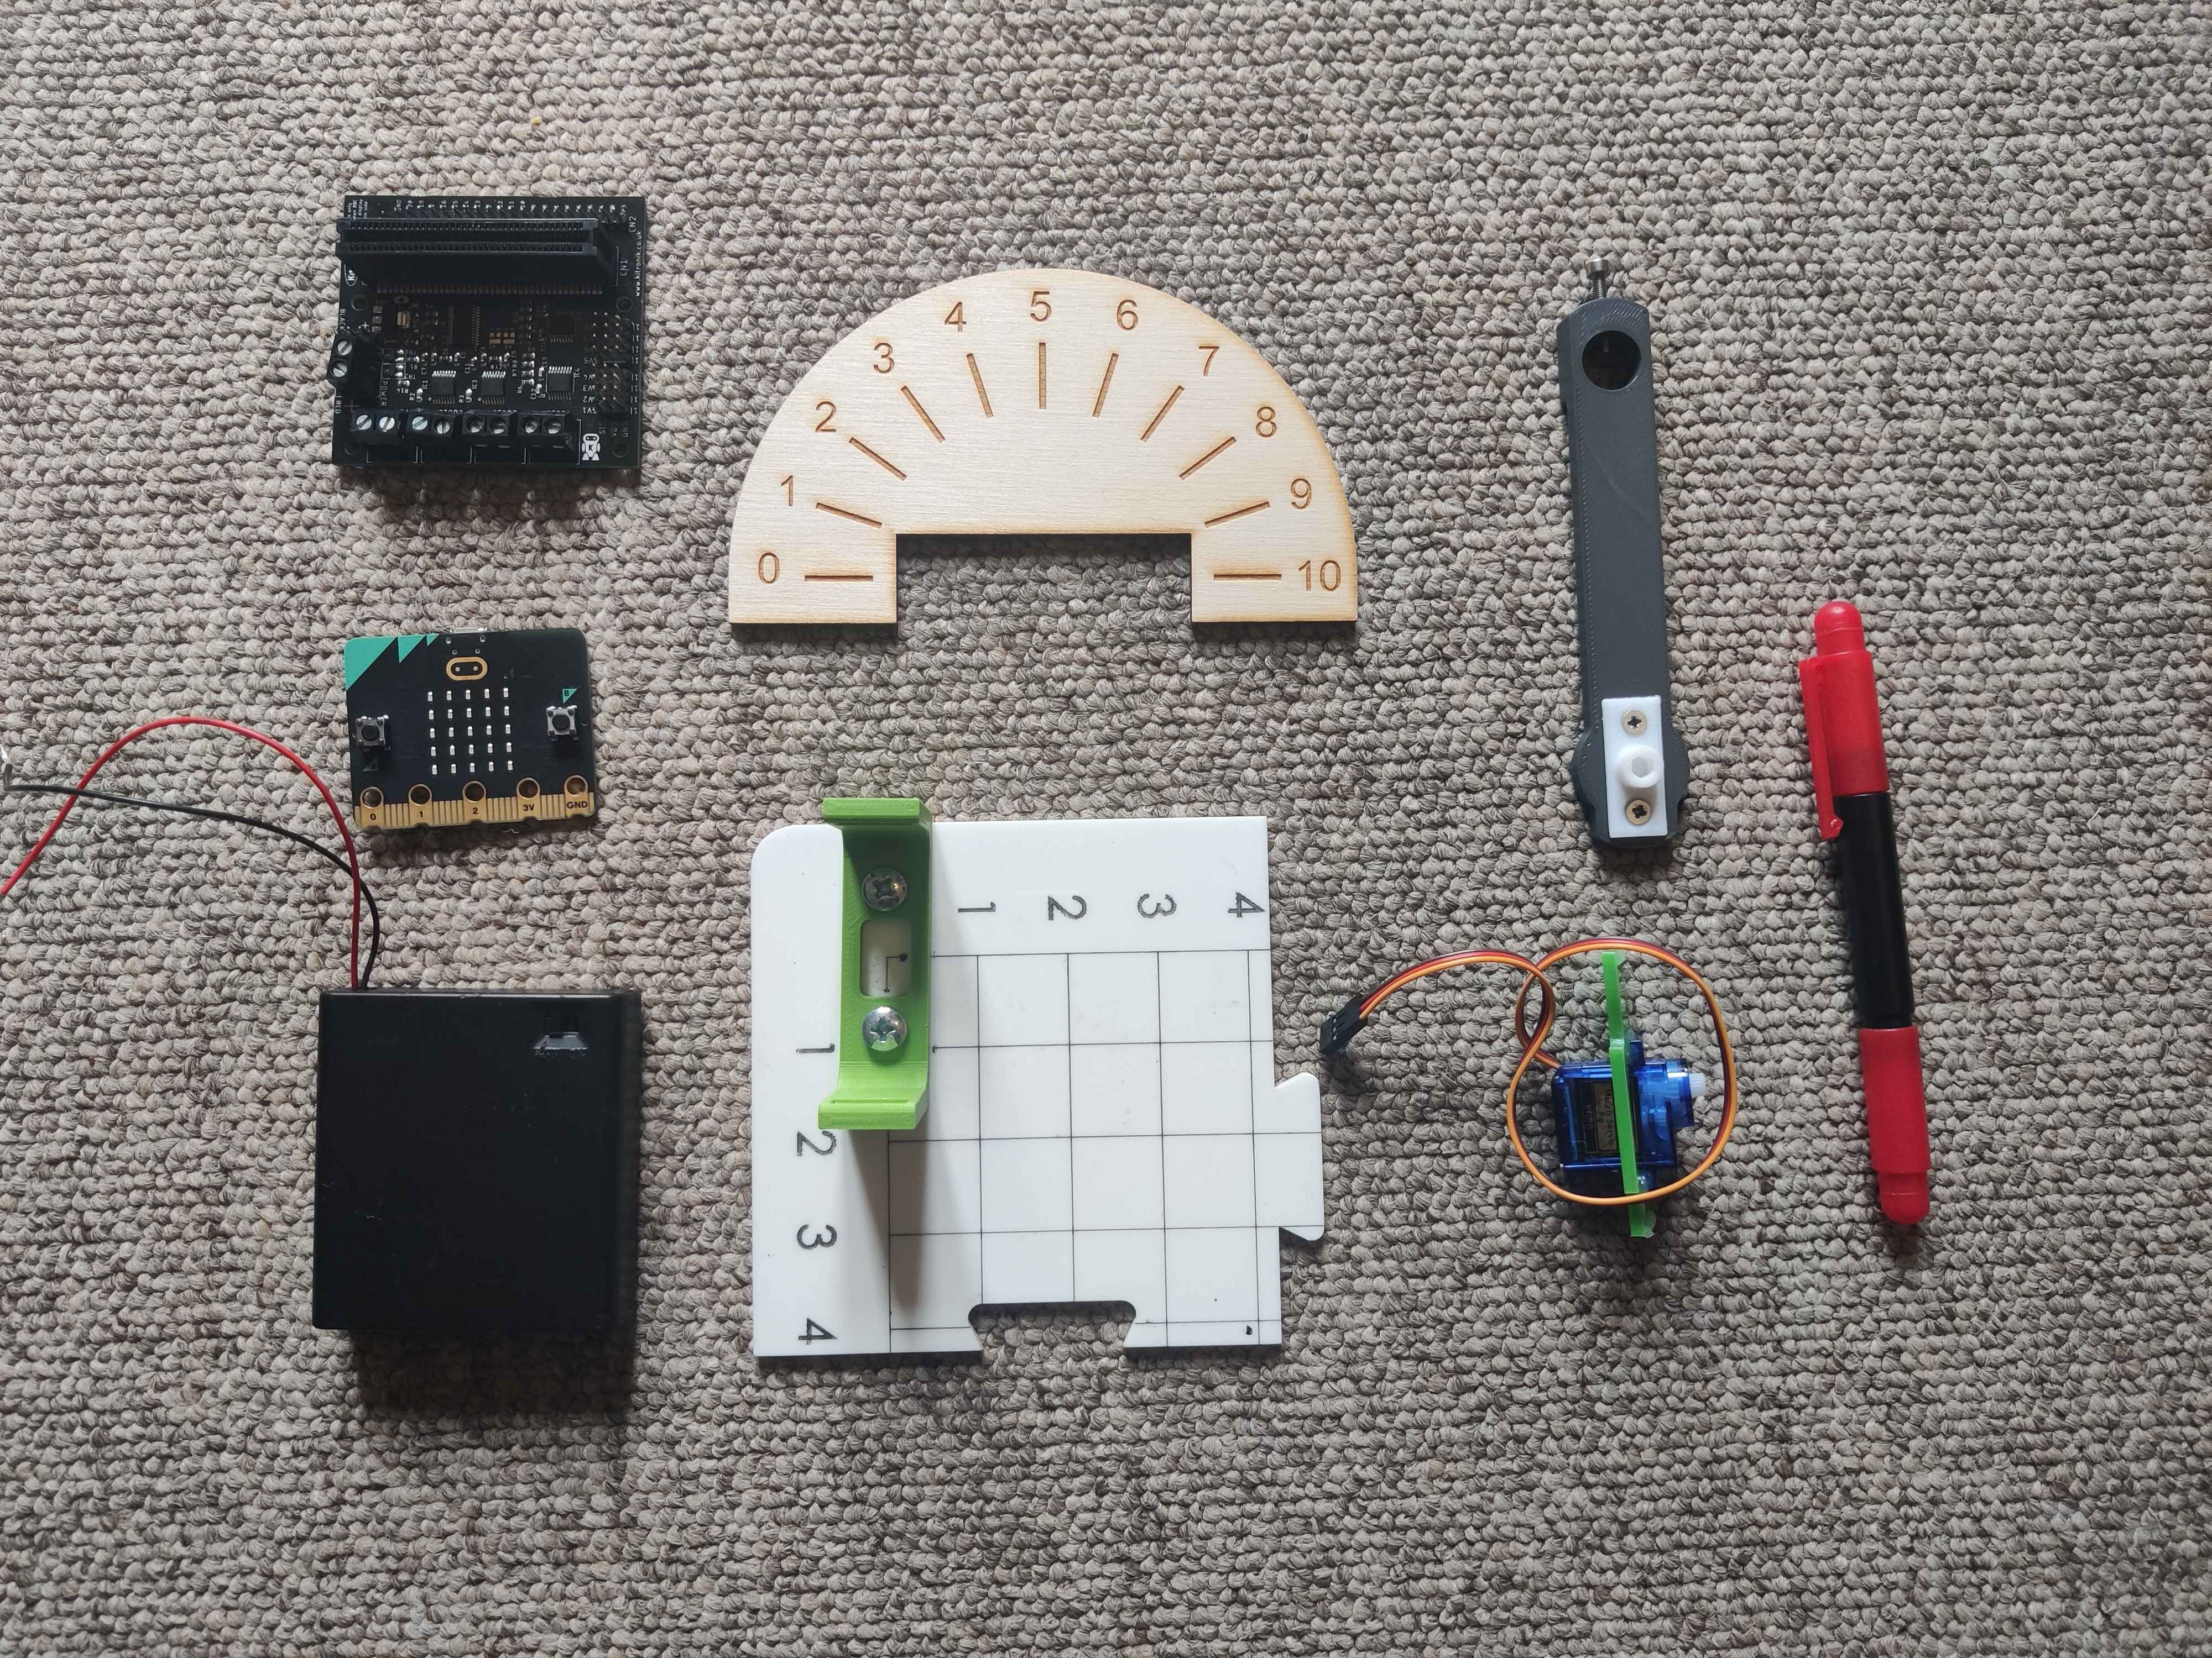
Motor arm (volume meter pointer)
Volume meter scale
Kitronik robotics board (PCB)
microbit
Screwdriver
Battery pack
Base
Servo motor

