Slide 1
Girls into Coding activity 3 images

Slide 2
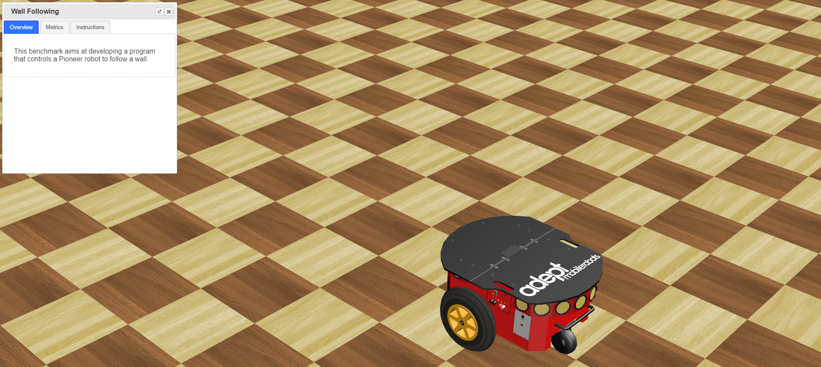
Image 1
We can close these instructions for the moment, we won’t use them yet for this activity! We will take a look at them later on ☺!
This is our robot ! ☺
These yellow spots are the robot’s ultrasonic distance sensors!!

Slide 3
Image 2

