Slide 1
Simulation of drag [Aerodynamics]
(Using computational fluid dynamics [CFD])

Slide 2
Resources
Youtube:
Pressure and drag: https://www.youtube.com/watch?v=GMmNKUlXXDs
Creating bodywork for cars: https://www.youtube.com/watch?v=4gzjcimjfTQ
Solidworks and CFD for cars: https://www.youtube.com/watch?v=GtQTlUuAmDE&t=856s
Solidworks flow simulation: https://www.solidworks.com/product/solidworks-flow-simulation

Slide 3
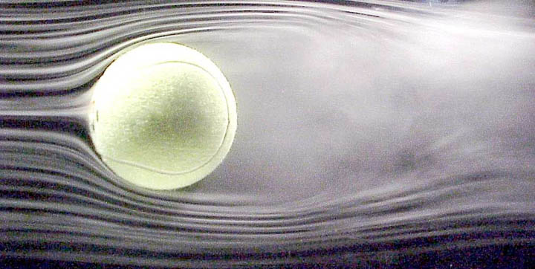
Computational fluid dynamics [CFD]
…. i.e. using maths to see how fluids flow

Slide 4
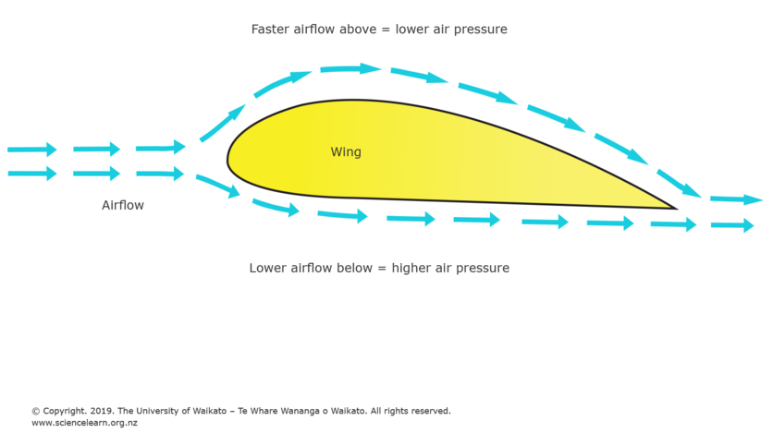
Frictional Forces (Friction Drag)

Slide 5
Pressure forces

Slide 6
Pressure forces (pressure drag)

Slide 7
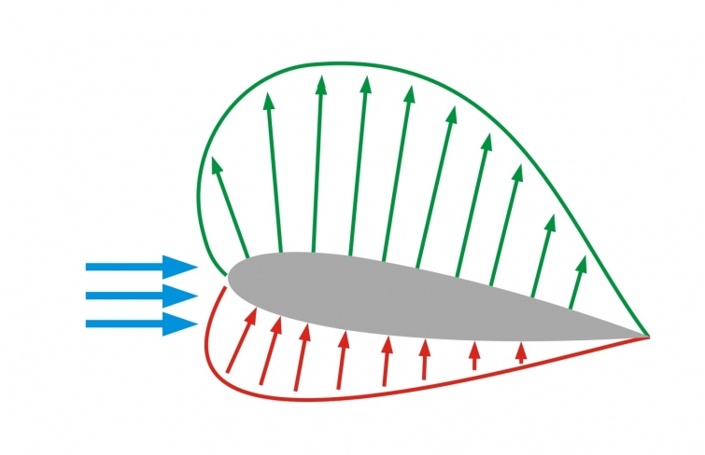
Pressure forces (pressure drag)

Slide 8
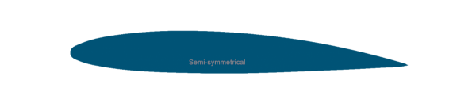
Combined forces
Lift
Drag

Slide 9
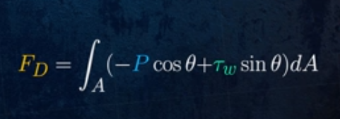
Combined forces (Add them all together)
Resulting force
+
=

Slide 10
Laminar, turbulent flow and vortices
Low pressure separation region

Slide 11

Which do you think is more significant (pressure or friction drag?)

