Slide 1
Database System Clothing E-Commerce Platform
倪煒傑 地理碩二
李明軒 工海四

Slide 2

Content
Database Setup
API implementation
System to be optimized
Using Python
Content
Database Setup
API implementation
System to be optimized

Slide 3
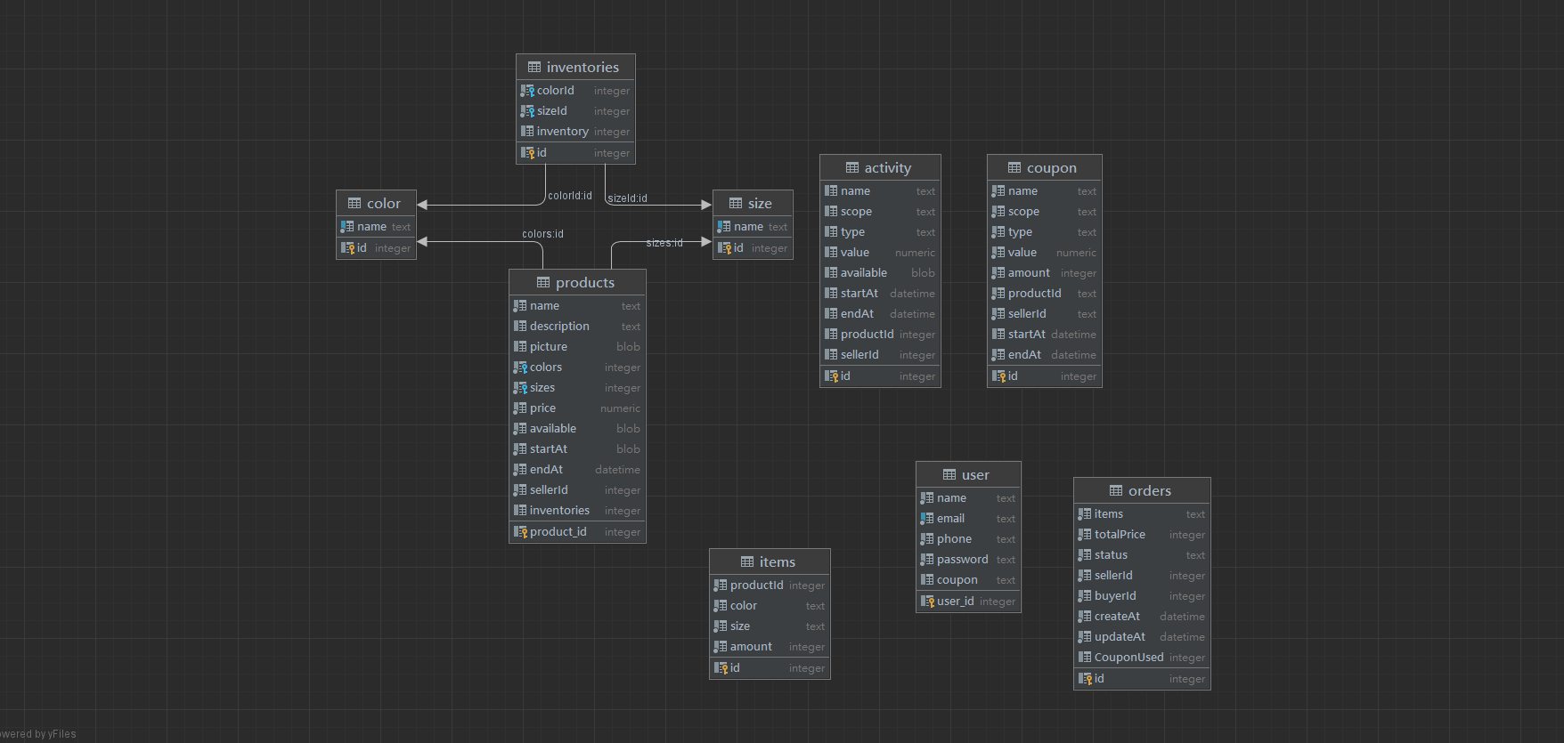
ER Diagram
Content
Database Setup
API implementation
System to be optimized

Slide 4
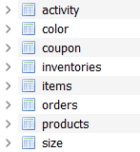
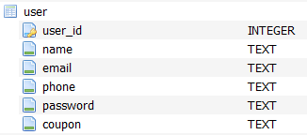
Database Setup
Content
Database Setup
API implementation
System to be optimized

Slide 5

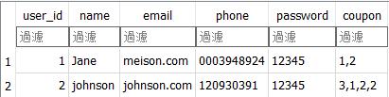
Database Setup
Coupon :
Identify the coupons which users have
Content
Database Setup
API implementation
System to be optimized

Slide 6
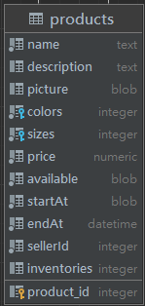
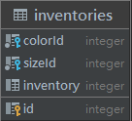
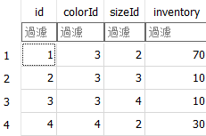
Database Setup
Inventory :
A specific code is recorded for the remaining stock of clothing in each color and size
Content
Database Setup
API implementation
System to be optimized

Slide 7
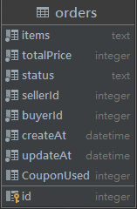
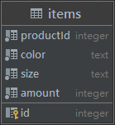

Database Setup
Id :
A specific code is recorded for the respective purchased item and purchased quantity
Content
Database Setup
API implementation
System to be optimized

Slide 8
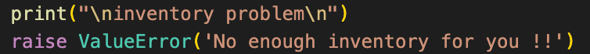
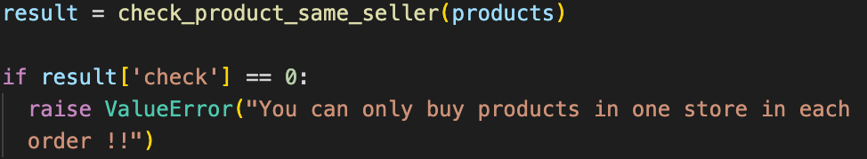

Try、except
And more..
Content
Database Setup
API implementation
System to be optimized

Slide 9
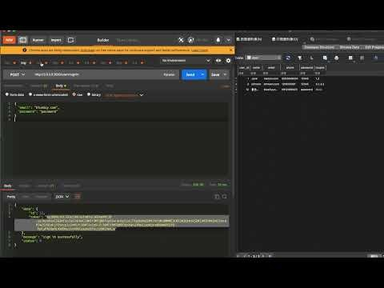
API implementation – DB User
https://www.youtube.com/watch?v=KDSdgODHUDw&list=PLKxvJsJcCzB7P3IjyZb4u6obP7Elhb6rh&index=1&ab_channel=%E6%9D%8E%E6%98%8E%E8%BB%92
Content
Database Setup
API implementation
System to be optimized

Slide 10
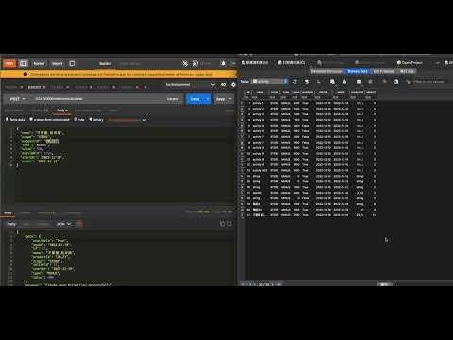
API implementation – DB Activities
https://www.youtube.com/watch?v=ZwbVpIcrbEU&list=PLKxvJsJcCzB7P3IjyZb4u6obP7Elhb6rh&index=2&ab_channel=%E6%9D%8E%E6%98%8E%E8%BB%92
Content
Database Setup
API implementation
System to be optimized

Slide 11
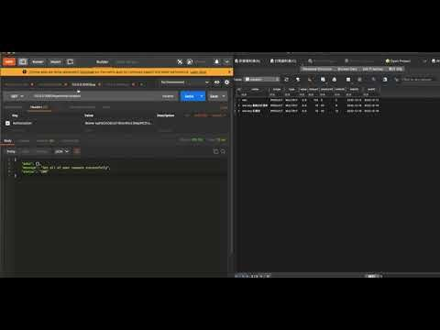
API implementation – DB Coupons
https://www.youtube.com/watch?v=ZnRUSxARQBM&list=PLKxvJsJcCzB7P3IjyZb4u6obP7Elhb6rh&index=3&ab_channel=%E6%9D%8E%E6%98%8E%E8%BB%92
Content
Database Setup
API implementation
System to be optimized

Slide 12
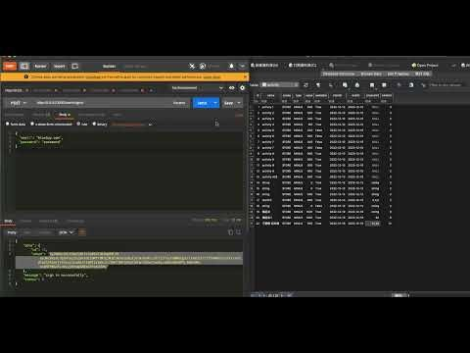
API implementation – DB Orders
https://www.youtube.com/watch?v=MtHIo9mv2fQ&list=PLKxvJsJcCzB7P3IjyZb4u6obP7Elhb6rh&index=4&ab_channel=%E6%9D%8E%E6%98%8E%E8%BB%92
Content
Database Setup
API implementation
System to be optimized

Slide 13
System to be optimized
資料庫的items資料表內的Colors沒有使用統一的id
沒有檢查期限相關資訊
登入格式以及安全問題，eg. 檢查email是否重複、email/password錯誤時回傳訊息
Try-catch 沒處理好，但不影響實際操作。
回傳資訊有些會包含foreign key，應該統整一下code 統一每個 route 下的回傳資料
Content
Database Setup
API implementation
System to be optimized

