Slide 1

Parallel Programming in C with MPI and OpenMP
Michael J. Quinn

Slide 2
Chapter 4 Message-Passing Programming

Slide 3
Learning Objectives
Understanding how MPI programs execute
Familiarity with fundamental MPI functions

Slide 4
Outline
Message-passing model
Message Passing Interface (MPI)
Coding MPI programs
Compiling MPI programs
Running MPI programs
Benchmarking MPI programs

Slide 5
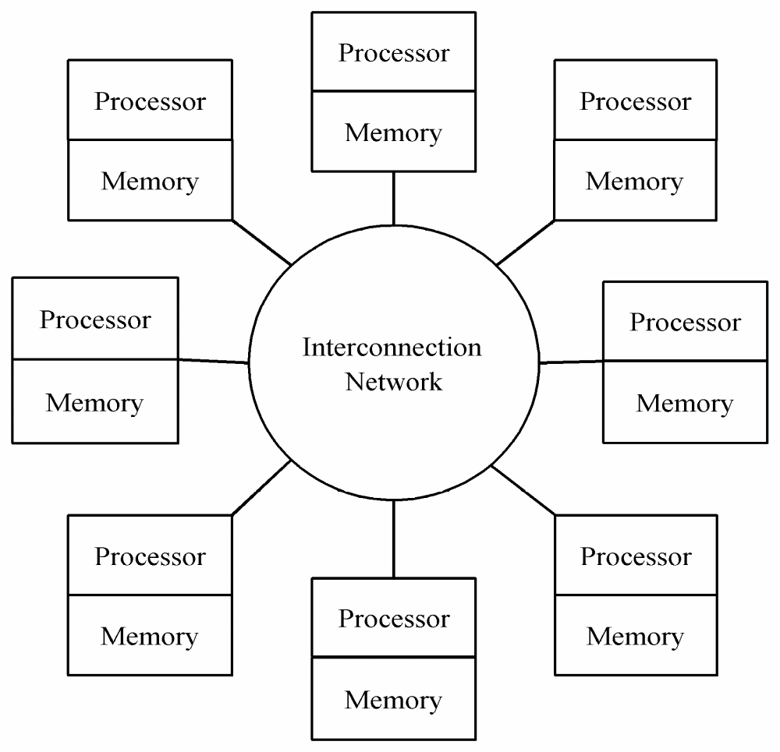
Message-passing Model

Slide 6
Task/Channel vs. Message-passing
Task/Channel | Message-Passing
Task | Process
Explicit Channels | Any-to-any communication

Slide 7
Processes
Number is specified at start-up time
Remains constant throughout execution of program
All execute same program
Each has unique ID number
Alternately performs computations and communicates
In a message-passing model, processes pass messages both to communication and to synchronize with each other.

Slide 8
Advantages of Message-passing Model
Portability to many architectures
  Gives programmer ability to manage the memory hierarchy
Simplifies debugging
  Easier to create a deterministic program

Slide 9
The Message Passing Interface
Late 1980s: vendors had unique libraries
1989: Parallel Virtual Machine (PVM) developed at Oak Ridge National Lab
1992: Work on MPI standard begun
1994: Version 1.0 of MPI standard
1997: Version 2.0 of MPI standard
Today: MPI is dominant message passing library standard

Slide 10
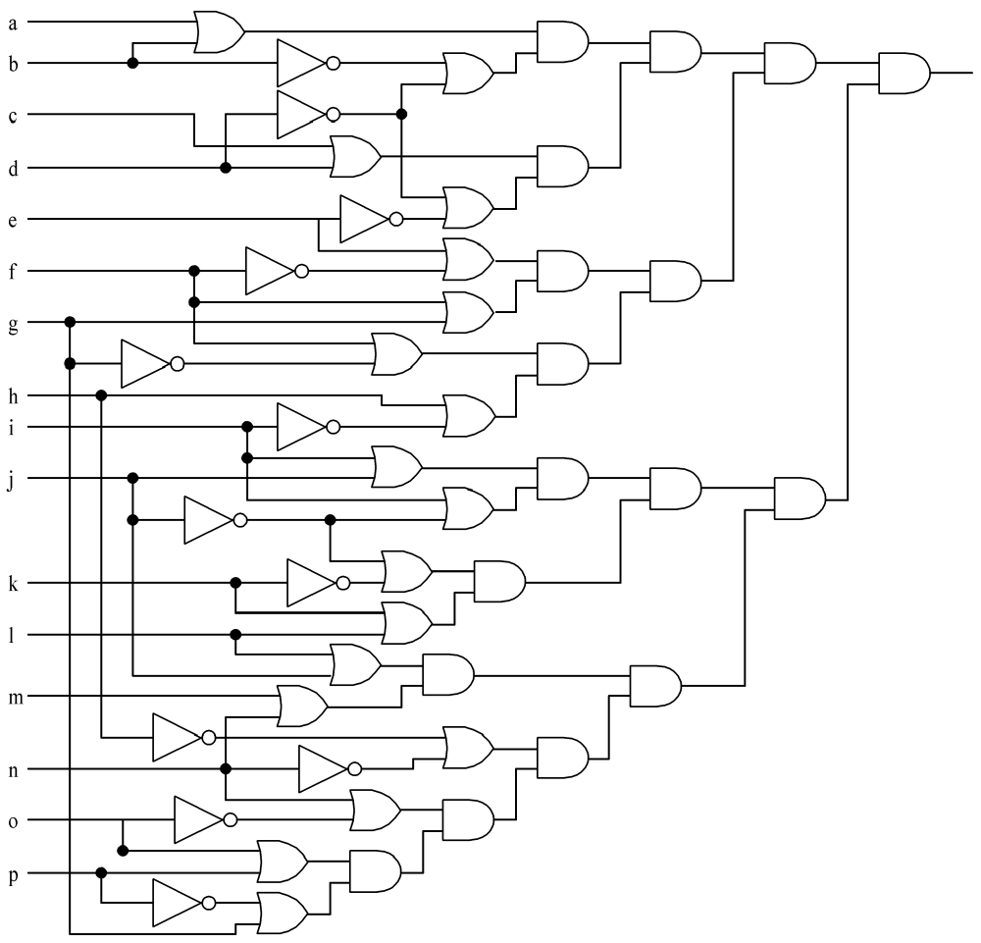
Circuit Satisfiability
1
1
0
1
Not satisfied
1
1
1
1
1
1
1
1
1
1
1
1
1

Slide 11
Solution Method
Circuit satisfiability is NP-complete
No known algorithms to solve in polynomial time (on deterministic machine)
We seek all solutions
We find through exhaustive search
16 inputs ⇒ 65,536 combinations to test

Slide 12
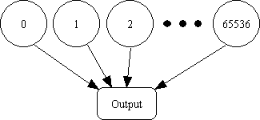
Partitioning: Data Decomposition
Embarrassingly parallel: No channels between tasks
65535

Slide 13
Agglomeration and Mapping
Properties of parallel algorithm
  Fixed number of tasks
  No communications between tasks
  Time needed per task is variable
Consult mapping strategy decision tree
  Map tasks to processors in a cyclic fashion

Slide 14
Cyclic (Interleaved) Allocation
Assume p processes
Each process gets every p^{th} piece of work
Example: 5 processes and 12 pieces of work
  P₀: 0, 5, 10
  P₁: 1, 6, 11
  P₂: 2, 7
  P₃: 3, 8
  P₄: 4, 9

Slide 15
Pop Quiz
Assume n pieces of work, p processes, and cyclic allocation
What is the most pieces of work any process has?
What is the least pieces of work any process has?
How many processes have the most pieces of work?

Slide 16
Summary of Program Design
Program will consider all 65,536 combinations of 16 boolean inputs
Combinations allocated in cyclic fashion to processes
Each process examines each of its combinations
If it finds a satisfiable combination, it will print it

Slide 17
Include Files
#include <mpi.h>
MPI header file
#include <stdio.h>
Standard I/O header file

Slide 18
Local Variables
int main (int argc, char *argv[]) {
int i;
int id; /* Process rank */
int p; /* Number of processes */
void check_circuit (int, int);
Include argc and argv: they are needed to initialize MPI
One copy of every variable for each process running this program

Slide 19
Initialize MPI
MPI_Init (&argc, &argv);
First MPI function called by each process
Not necessarily first executable statement
Allows system to do any necessary setup

Slide 20
Communicators
Communicator
  opaque object that provides message-passing environment for processes
MPI_COMM_WORLD
  Default communicator
  Includes all processes
Possible to create new communicators
  Will do this in Chapters 8 and 9

Slide 21
Communicator
Communicator Name
Communicator
MPI_COMM_WORLD
Processes
0
5
Ranks
2
1
4
3

Slide 22
Determine Number of Processes
MPI_Comm_size (MPI_COMM_WORLD, &p);
First argument is communicator
Number of processes returned through second argument

Slide 23
Determine Process Rank
MPI_Comm_rank (MPI_COMM_WORLD, &id);
First argument is communicator
Process rank (in range 0, 1, …, p-1) returned through second argument

Slide 24
Replication of Automatic Variables
id
1
id
0
p
6
p
6
id
5
id
2
p
6
id
4
6
p
id
3
p
6
p
6

Slide 25
What about External Variables?
int total;
int main (int argc, char *argv[]) {
int i;
int id;
int p;
…
Where is variable total stored?

Slide 26
Cyclic Allocation of Work
for (i = id; i < 65536; i += p)
check_circuit (id, i);
Parallelism is outside function check_circuit
It can be an ordinary, sequential function

Slide 27
Shutting Down MPI
MPI_Finalize();
Call after all other MPI library calls
Allows system to free up MPI resources

Slide 28
#include <mpi.h>
#include <stdio.h>
int main (int argc, char *argv[]) {
int i;
int id;
int p;
void check_circuit (int, int);
MPI_Init (&argc, &argv);
MPI_Comm_rank (MPI_COMM_WORLD, &id);
MPI_Comm_size (MPI_COMM_WORLD, &p);
for (i = id; i < 65536; i += p)
check_circuit (id, i);
printf ("Process %d is done\n", id);
fflush (stdout);
MPI_Finalize();
return 0;
}
Put fflush()after every printf()

Slide 29
/* Return 1 if 'i'th bit of 'n' is 1; 0 otherwise */
#define EXTRACT_BIT(n,i) ((n&(1<<i))?1:0)
void check_circuit (int id, int z) {
int v[16]; /* Each element is a bit of z */
int i;
for (i = 0; i < 16; i++) v[i] = EXTRACT_BIT(z,i);
if ((v[0] || v[1]) && (!v[1] || !v[3]) && (v[2] || v[3])
&& (!v[3] || !v[4]) && (v[4] || !v[5])
&& (v[5] || !v[6]) && (v[5] || v[6])
&& (v[6] || !v[15]) && (v[7] || !v[8])
&& (!v[7] || !v[13]) && (v[8] || v[9])
&& (v[8] || !v[9]) && (!v[9] || !v[10])
&& (v[9] || v[11]) && (v[10] || v[11])
&& (v[12] || v[13]) && (v[13] || !v[14])
&& (v[14] || v[15])) {
printf ("%d) %d%d%d%d%d%d%d%d%d%d%d%d%d%d%d%d\n", id,
v[0],v[1],v[2],v[3],v[4],v[5],v[6],v[7],v[8],v[9],
v[10],v[11],v[12],v[13],v[14],v[15]);
fflush (stdout);
}
}

Slide 30
Compiling MPI Programs
mpicc -O -o foo foo.c
mpicc: script to compile and link C+MPI programs
Flags: same meaning as C compiler
  -O ⎯ optimize
  -o <file> ⎯ where to put executable

Slide 31
Running MPI Programs
mpirun -np <p> <exec> <arg1> …
  -np <p> ⎯ number of processes
  <exec> ⎯ executable
  <arg1> … ⎯ command-line arguments

Slide 32
Specifying Host Processors
File .mpi-machines in home directory lists host processors in order of their use
Example .mpi_machines file contents
  band01.cs.ppu.edu
  band02.cs.ppu.edu
  band03.cs.ppu.edu
  band04.cs.ppu.edu

Slide 33
Enabling Remote Logins
MPI needs to be able to initiate processes on other processors without supplying a password
Each processor in group must list all other processors in its .rhosts file; e.g.,
  band01.cs.ppu.edu student
  band02.cs.ppu.edu student
  band03.cs.ppu.edu student
  band04.cs.ppu.edu student

Slide 34
Execution on 1 CPU
% mpirun -np 1 sat
0) 1010111110011001
0) 0110111110011001
0) 1110111110011001
0) 1010111111011001
0) 0110111111011001
0) 1110111111011001
0) 1010111110111001
0) 0110111110111001
0) 1110111110111001
Process 0 is done

Slide 35
Execution on 2 CPUs
% mpirun -np 2 sat
0) 0110111110011001
0) 0110111111011001
0) 0110111110111001
1) 1010111110011001
1) 1110111110011001
1) 1010111111011001
1) 1110111111011001
1) 1010111110111001
1) 1110111110111001
Process 0 is done
Process 1 is done

Slide 36
Execution on 3 CPUs
% mpirun -np 3 sat
0) 0110111110011001
0) 1110111111011001
2) 1010111110011001
1) 1110111110011001
1) 1010111111011001
1) 0110111110111001
0) 1010111110111001
2) 0110111111011001
2) 1110111110111001
Process 1 is done
Process 2 is done
Process 0 is done

Slide 37
Deciphering Output
Output order only partially reflects order of output events inside parallel computer
If process A prints two messages, first message will appear before second
If process A calls printf before process B, there is no guarantee process A’s message will appear before process B’s message

Slide 38
Enhancing the Program
We want to find total number of solutions
Incorporate sum-reduction into program
Reduction is a collective communication

Slide 39
Modifications
Modify function check_circuit
  Return 1 if circuit satisfiable with input combination
  Return 0 otherwise
Each process keeps local count of satisfiable circuits it has found
Perform reduction after for loop

Slide 40
New Declarations and Code
int count; /* Local sum */
int global_count; /* Global sum */
int check_circuit (int, int);
count = 0;
for (i = id; i < 65536; i += p)
count += check_circuit (id, i);

Slide 41
Prototype of MPI_Reduce()
int MPI_Reduce (
void *operand,
/* addr of 1st reduction element */
void *result,
/* addr of 1st reduction result */
int count,
/* reductions to perform */
MPI_Datatype type,
/* type of elements */
MPI_Op operator,
/* reduction operator */
int root,
/* process getting result(s) */
MPI_Comm comm
/* communicator */
)

Slide 42
MPI_Datatype Options
MPI_CHAR
MPI_DOUBLE
MPI_FLOAT
MPI_INT
MPI_LONG
MPI_LONG_DOUBLE
MPI_SHORT
MPI_UNSIGNED_CHAR
MPI_UNSIGNED
MPI_UNSIGNED_LONG
MPI_UNSIGNED_SHORT

Slide 43
MPI_Op Options
MPI_BAND
MPI_BOR
MPI_BXOR
MPI_LAND
MPI_LOR
MPI_LXOR
MPI_MAX
MPI_MAXLOC
MPI_MIN
MPI_MINLOC
MPI_PROD
MPI_SUM

Slide 44
Our Call to MPI_Reduce()
MPI_Reduce (&count,
&global_count,
1,
MPI_INT,
MPI_SUM,
0,
MPI_COMM_WORLD);
Only process 0
will get the result
if (!id) printf ("There are %d different solutions\n",
global_count);

Slide 45
Execution of Second Program
% mpirun -np 3 seq2
0) 0110111110011001
0) 1110111111011001
1) 1110111110011001
1) 1010111111011001
2) 1010111110011001
2) 0110111111011001
2) 1110111110111001
1) 0110111110111001
0) 1010111110111001
Process 1 is done
Process 2 is done
Process 0 is done
There are 9 different solutions

Slide 46
Benchmarking the Program
MPI_Barrier ⎯ barrier synchronization
MPI_Wtick ⎯ timer resolution
MPI_Wtime ⎯ current time

Slide 47
Benchmarking Code
double elapsed_time;
…
MPI_Init (&argc, &argv);
MPI_Barrier (MPI_COMM_WORLD);
elapsed_time = - MPI_Wtime();
…
MPI_Reduce (…);
elapsed_time += MPI_Wtime();

Slide 48
Benchmarking Results
Processors | Time (sec)
1 | 15.93
2 | 8.38
3 | 5.86
4 | 4.60
5 | 3.77

Slide 49
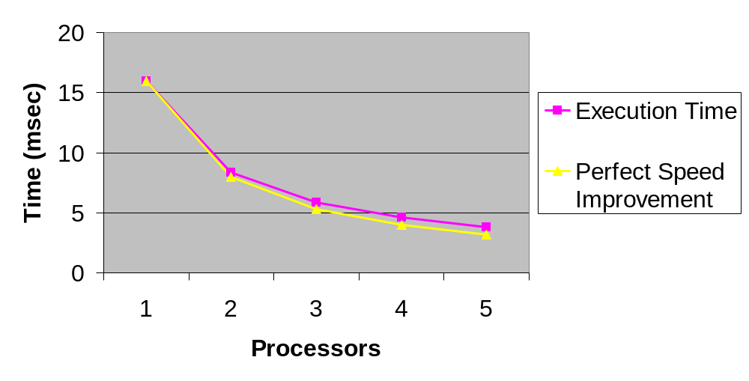
Benchmarking Results

Slide 50
Summary (1/2)
Message-passing programming follows naturally from task/channel model
Portability of message-passing programs
MPI most widely adopted standard

Slide 51
Summary (2/2)
MPI functions introduced
  MPI_Init
  MPI_Comm_rank
  MPI_Comm_size
  MPI_Reduce
  MPI_Finalize
  MPI_Barrier
  MPI_Wtime
  MPI_Wtick

Slide 52
Exercises
4.6
4.10
4.12

