Slide 1

Parallel Programming in C with MPI and OpenMP
Michael J. Quinn

Slide 2
Chapter 5.
The Sieve of Eratosthenes

Slide 3
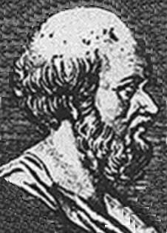
Eratosthenes
Born: 276 BC in Cyrene, North Africa (now Shahhat, Libya)
Died: 194 BC in Alexandria, Egypt

Slide 4
Chapter Objectives
Analysis of block allocation schemes
Function MPI_Bcast
Performance enhancements

Slide 5
Outline
Sequential algorithm
Sources of parallelism
Data decomposition options
Parallel algorithm development, analysis
MPI program
Benchmarking
Optimizations

Slide 6
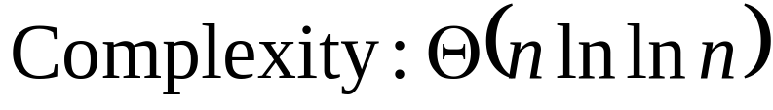
Sequential Algorithm
 | 2 | 3 | 4 | 5 | 6 | 7 | 8 | 9 | 10
11 | 12 | 13 | 14 | 15 | 16 | 17 | 18 | 19 | 20
21 | 22 | 23 | 24 | 25 | 26 | 27 | 28 | 29 | 30
31 | 32 | 33 | 34 | 35 | 36 | 37 | 38 | 39 | 40
41 | 42 | 43 | 44 | 45 | 46 | 47 | 48 | 49 | 50
51 | 52 | 53 | 54 | 55 | 56 | 57 | 58 | 59 | 60
 | 2 | 3 | 4 | 5 | 6 | 7 | 8 | 9 | 10
11 | 12 | 13 | 14 | 15 | 16 | 17 | 18 | 19 | 20
21 | 22 | 23 | 24 | 25 | 26 | 27 | 28 | 29 | 30
31 | 32 | 33 | 34 | 35 | 36 | 37 | 38 | 39 | 40
41 | 42 | 43 | 44 | 45 | 46 | 47 | 48 | 49 | 50
51 | 52 | 53 | 54 | 55 | 56 | 57 | 58 | 59 | 60
 | 2 | 3 | 4 | 5 | 6 | 7 | 8 | 9 | 10
11 | 12 | 13 | 14 | 15 | 16 | 17 | 18 | 19 | 20
21 | 22 | 23 | 24 | 25 | 26 | 27 | 28 | 29 | 30
31 | 32 | 33 | 34 | 35 | 36 | 37 | 38 | 39 | 40
41 | 42 | 43 | 44 | 45 | 46 | 47 | 48 | 49 | 50
51 | 52 | 53 | 54 | 55 | 56 | 57 | 58 | 59 | 60
 | 2 | 3 | 4 | 5 | 6 | 7 | 8 | 9 | 10
11 | 12 | 13 | 14 | 15 | 16 | 17 | 18 | 19 | 20
21 | 22 | 23 | 24 | 25 | 26 | 27 | 28 | 29 | 30
31 | 32 | 33 | 34 | 35 | 36 | 37 | 38 | 39 | 40
41 | 42 | 43 | 44 | 45 | 46 | 47 | 48 | 49 | 50
51 | 52 | 53 | 54 | 55 | 56 | 57 | 58 | 59 | 60
 | 2 | 3 | 4 | 5 | 6 | 7 | 8 | 9 | 10
11 | 12 | 13 | 14 | 15 | 16 | 17 | 18 | 19 | 20
21 | 22 | 23 | 24 | 25 | 26 | 27 | 28 | 29 | 30
31 | 32 | 33 | 34 | 35 | 36 | 37 | 38 | 39 | 40
41 | 42 | 43 | 44 | 45 | 46 | 47 | 48 | 49 | 50
51 | 52 | 53 | 54 | 55 | 56 | 57 | 58 | 59 | 60

Slide 7
Pseudocode
Create list of unmarked natural numbers 2, 3, …, n
k ← 2
Repeat
(a) Mark all multiples of k between k² and n
(b) k ← smallest unmarked number > k
until k² > n
The unmarked numbers are primes

Slide 8
Sources of Parallelism
Domain decomposition
  Divide data into pieces
  Associate computational steps with data
One primitive task per array element

Slide 9
Making 3(a) Parallel
Mark all multiples of k between k² and n
⇒
for all j where k² ≤ j ≤ n do
if (j mod k = 0) then
mark j (it is not a prime)
endif
endfor

Slide 10
Making 3(b) Parallel
Find smallest unmarked number > k
⇒
Min-reduction (to find smallest unmarked number > k)
Broadcast (to get result to all tasks)

Slide 11
Agglomeration Goals
Consolidate tasks
Reduce communication cost
Balance computations among processes

Slide 12
Data Decomposition Options
Interleaved (cyclic)
  Easy to determine “owner” of each index
  Leads to load imbalance for this problem
Block
  Balances loads
  More complicated to determine owner if n not a multiple of p

Slide 13
Block Decomposition Options
Want to balance workload when n not a multiple of p
Each process gets either ⎡n/p⎤ or ⎣n/p⎦ elements
Seek simple expressions
  Find low, high indices given an owner
  Find owner given an index

Slide 14
Method #1
Let r = n mod p
If r = 0, all blocks have same size
Else
  First r blocks have size ⎡n/p⎤
  Remaining p – r blocks have size ⎣n/p⎦

Slide 15
Examples
17 elements divided among 7 processes
17 elements divided among 5 processes
17 elements divided among 3 processes

Slide 16
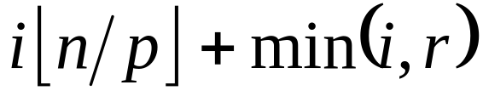
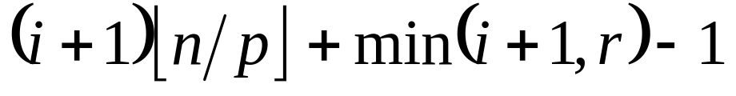
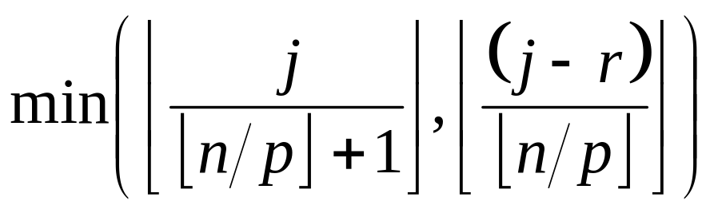
Method #1 Calculations
First element controlled by process i
Last element controlled by process i
Process controlling element j

Slide 17
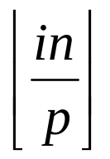
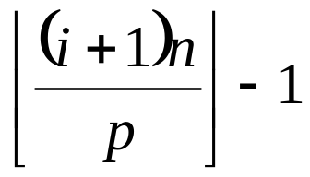
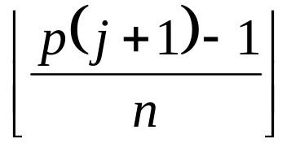
Method #2
Scatters larger blocks among processes
First element controlled by process i
Last element controlled by process i
Process controlling element j

Slide 18
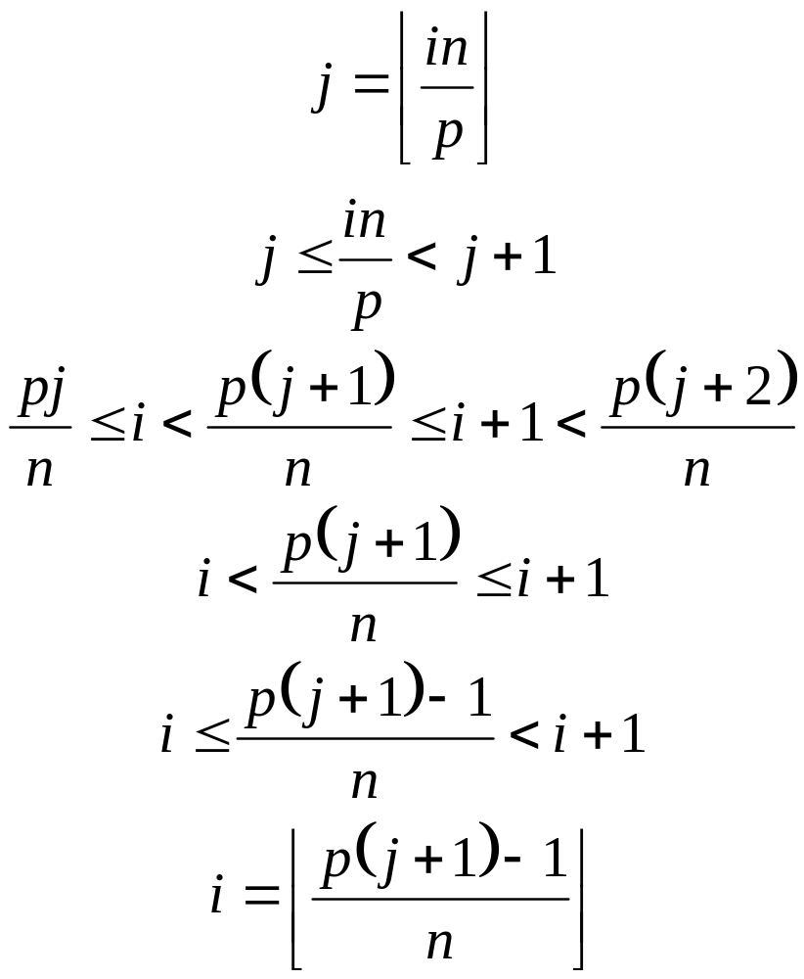

Slide 19
Examples
17 elements divided among 7 processes
17 elements divided among 5 processes
17 elements divided among 3 processes

Slide 20
Comparing Methods
Our choice
Operations | Method 1 | Method 2
Low index | 4 | 2
High index | 6 | 4
Owner | 7 | 4
Assuming no operations for “floor” function

Slide 21
Pop Quiz
Illustrate how block decomposition method #2 would divide 13 elements among 5 processes.
13(0)/5 = 0
13(2)/5 = 5
13(4)/5 = 10
13(1)/5 = 2
13(3)/5 = 7

Slide 22
Block Decomposition Macros
#define BLOCK_LOW(id,p,n) ((id)*(n)/(p))
#define BLOCK_HIGH(id,p,n) \
(BLOCK_LOW((id)+1,p,n)-1)
#define BLOCK_SIZE(id,p,n) \
(BLOCK_HIGH(id,p,n)-BLOCK_LOW(id,p,n)+1)
#define BLOCK_OWNER(index,p,n) \
(((p)*(index)+1)-1)/(n))

Slide 23
Local vs. Global Indices
L 0 1
L 0 1 2
G 0 1
G 2 3 4
L 0 1
G 5 6
L 0 1 2
L 0 1 2
G 7 8 9
G 10 11 12

Slide 24
Looping over Elements
Sequential program
  for (i = 0; i < n; i++) {
  …
  }
Parallel program
  size = BLOCK_SIZE (id,p,n);
  for (i = 0; i < size; i++) {
  gi = i + BLOCK_LOW(id,p,n);
  }
Index i on this process…
…takes place of sequential program’s index gi

Slide 25
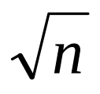
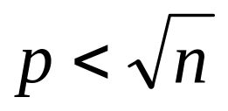
Decomposition Affects Implementation
Largest prime used to sieve is
First process has ⎣n/p⎦ elements
It has all sieving primes if
First process always broadcasts next sieving prime
No reduction step needed

Slide 26
Fast Marking
Block decomposition allows same marking as sequential algorithm:
j, j + k, j + 2k, j + 3k, …
instead of
for all j in block
if j mod k = 0 then mark j (it is not a prime)

Slide 27
Original Algorithm
Create list of unmarked natural numbers 2, 3, …, n
k ← 2
Repeat
(a) Mark all multiples of k between k² and n
(b) k ← smallest unmarked number > k
until k² > n
The unmarked numbers are primes

Slide 28
Parallel Algorithm Development
Create list of unmarked natural numbers 2, 3, …, n
Each process creates its share of list
k ← 2
Each process does this
Repeat
(a) Mark all multiples of k between k² and n
Each process marks its share of list
(b) k ← smallest unmarked number > k
Process 0 only
(c) Process 0 broadcasts k to rest of processes
until k² > n
The unmarked numbers are primes
Reduction to determine number of primes

Slide 29
Function MPI_Bcast
int MPI_Bcast (
void *buffer, /* Addr of 1st element */
int count, /* # elements to broadcast */
MPI_Datatype datatype, /* Type of elements */
int root, /* ID of root process */
MPI_Comm comm /* Communicator */
)
MPI_Bcast (&k, 1, MPI_INT, 0, MPI_COMM_WORLD);

Slide 30
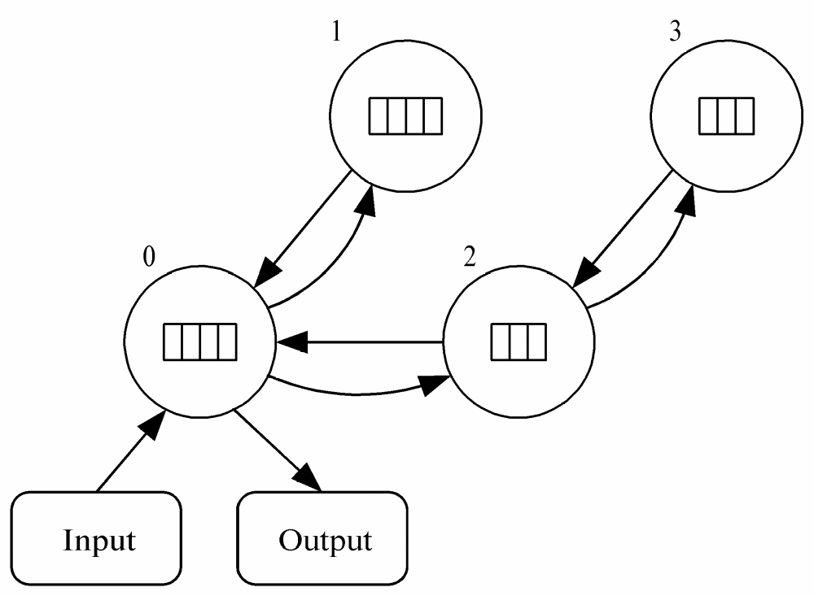
Task/Channel Graph

Slide 31
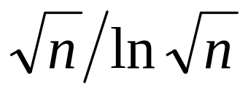
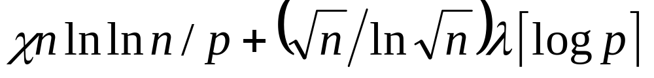
Analysis
χ is time needed to mark a cell
Sequential execution time: χn ln ln n
Number of broadcasts:
Broadcast time: λ ⎡log p⎤
Expected execution time:

Slide 32
Code (1/4)
#include <mpi.h>
#include <math.h>
#include <stdio.h>
#include "MyMPI.h"
#define MIN(a,b) ((a)<(b)?(a):(b))
int main (int argc, char *argv[])
{
...
MPI_Init(&argc, &argv);
MPI_Barrier(MPI_COMM_WORLD);
elapsed_time = -MPI_Wtime();
MPI_Comm_rank(MPI_COMM_WORLD, &id);
MPI_Comm_size(MPI_COMM_WORLD, &p);
if (argc != 2) {
if (!id) printf("Command line: %s <m>\n", argv[0]);
MPI_Finalize();
exit (1);
}

Slide 33
Code (2/4)
n = atoi(argv[1]);
low_value = 2 + BLOCK_LOW(id, p, n-1);
high_value = 2 + BLOCK_HIGH(id, p, n-1);
size = BLOCK_SIZE(id, p, n-1);
proc0_size = (n-1)/p;
if ((1 + proc0_size) < (int) sqrt((double) n)) {
if (!id) printf("Too many processes\n");
MPI_Finalize();
exit (1);
}
marked = (char *) malloc(size);
if (marked == NULL) {
printf("Cannot allocate enough memory\n");
MPI_Finalize();
exit (1);
}

Slide 34
Code (3/4)
for (i = 0; i < size; i++) marked[i] = 0;
if (!id) index = 0;
prime = 2;
do {
if (prime * prime > low_value)
first = prime * prime - low_value;
else {
if (!(low_value % prime)) first = 0;
else first = prime - (low_value % prime);
}
for (i = first; i < size; i += prime) marked[i] = 1;
if (!id) {
while (marked[++index]);
prime = index + 2;
}
MPI_Bcast(&prime, 1, MPI_INT, 0, MPI_COMM_WORLD);
} while (prime * prime <= n);

Slide 35
Code (4/4)
count = 0;
for (i = 0; i < size; i++)
if (!marked[i]) count++;
MPI_Reduce (&count, &global_count, 1, MPI_INT, MPI_SUM,
0, MPI_COMM_WORLD);
elapsed_time += MPI_Wtime();
if (!id) {
printf ("%d primes are less than or equal to %d\n",
global_count, n);
printf ("Total elapsed time: %10.6f\n", elapsed_time);
}
MPI_Finalize ();
return 0;
}

Slide 36
Benchmarking
Execute sequential algorithm
Determine χ = 85.47 nanosec
Execute series of broadcasts
Determine λ = 250 μsec

Slide 37
Execution Times (sec)
Processors | Predicted | Actual (sec)
1 | 24.900 | 24.900
2 | 12.721 | 13.011
3 | 8.843 | 9.039
4 | 6.768 | 7.055
5 | 5.794 | 5.993
6 | 4.964 | 5.159
7 | 4.371 | 4.687
8 | 3.927 | 4.222

Slide 38
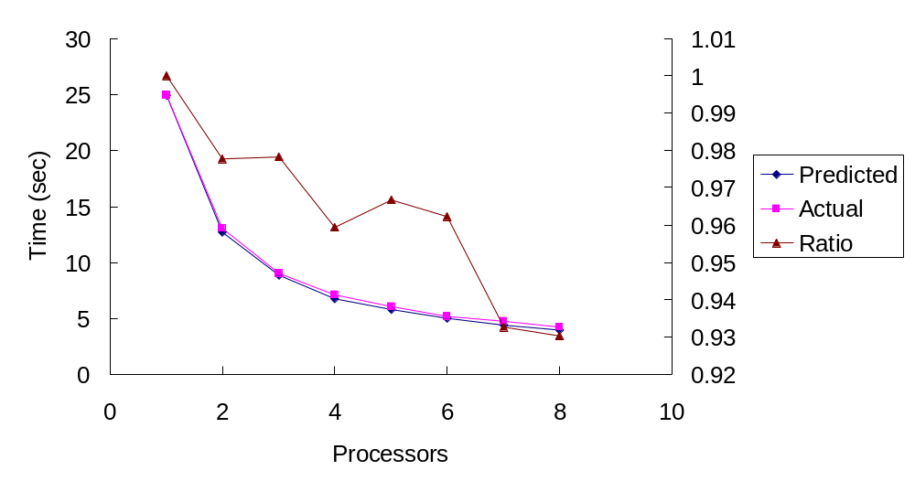
Execution Times and Speed Ratio

Slide 39

Improvements
Delete even integers
  Cuts number of computations in half
  Frees storage for larger values of n
Each process finds own sieving primes
  Replicating computation of primes to
  Eliminates broadcast step
Reorganize loops
  Increases cache hit rate

Slide 40
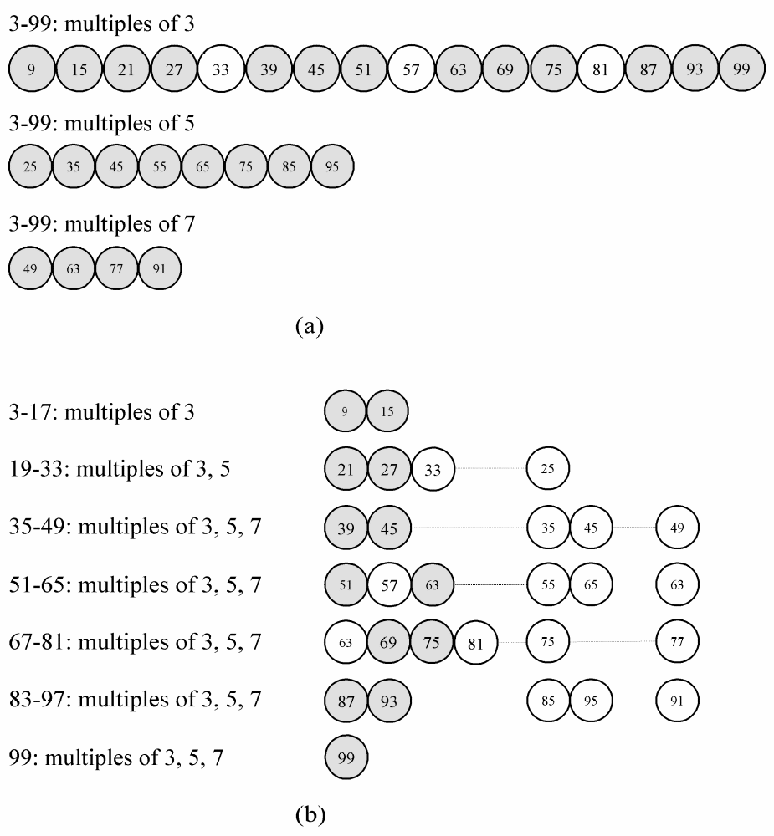
Reorganize Loops
Lower
↑
Cache hit rate
↓
Higher

Slide 41
Comparing 4 Versions
Procs | Sieve 1 | Sieve 2 | Sieve 3 | Sieve 4
1 | 24.900 | 12.237 | 12.466 | 2.543
2 | 12.721 | 6.609 | 6.378 | 1.330
3 | 8.843 | 5.019 | 4.272 | 0.901
4 | 6.768 | 4.072 | 3.201 | 0.679
5 | 5.794 | 3.652 | 2.559 | 0.543
6 | 4.964 | 3.270 | 2.127 | 0.456
7 | 4.371 | 3.059 | 1.820 | 0.391
8 | 3.927 | 2.856 | 1.585 | 0.342
10-fold improvement
7-fold improvement

Slide 42
Summary
Sieve of Eratosthenes: parallel design uses domain decomposition
Compared two block distributions
  Chose one with simpler formulas
Introduced MPI_Bcast
Optimizations reveal importance of maximizing single-processor performance

Slide 43
Exercises
5.9
5.11

