Slide 1

Parallel Programming in C with MPI and OpenMP
Michael J. Quinn

Slide 2
Chapter 6
Floyd’s Algorithm

Slide 3
Chapter Objectives
Creating 2-D arrays
Thinking about “grain size”
Introducing point-to-point communications
Reading and printing 2-D matrices
Analyzing performance when computations and communications overlap

Slide 4
Outline
All-pairs shortest path problem
Dynamic 2-D arrays
Parallel algorithm design
Point-to-point communication
Block row matrix I/O
Analysis and benchmarking

Slide 5
All-pairs Shortest Path Problem
4
A
 | A | B | C | D | E
A | 0 | 6 | 3 | 6 | 4
B | 4 | 0 | 7 | 10 | 8
C | 12 | 6 | 0 | 3 | 1
D | 7 | 3 | 10 | 0 | 11
E | 9 | 5 | 12 | 2 | 0
B
3
6
1
3
C
5
1
D
E
2
↑
Resulting Adjacency Matrix Containing Distances

Slide 6
Floyd’s Algorithm
for k ← 0 to n – 1
for i ← 0 to n – 1
for j ← 0 to n – 1
a[i,j] ← min(a[i,j], a[i,k]+a[k,j])
endfor
endfor
endfor

Slide 7
Why It Works
Shortest path from i to k
through 0, 1, …, k-1
i
k
Computed
in previous
iterations
Shortest path from i to j
through 0, 1, …, k-1
Shortest path from k to j
through 0, 1, …, k-1
j

Slide 8
Dynamic 1-D Array Creation
Run-time Stack
A
Heap

Slide 9
Dynamic 2-D Array Creation
Run-time Stack
Bstorage
B
Heap

Slide 10
Designing Parallel Algorithm
Partitioning
Communication
Agglomeration and Mapping

Slide 11
Partitioning
Domain or functional decomposition?
Look at pseudocode
Same assignment statement executed n³ times
No functional parallelism
Domain decomposition: divide matrix A into its n² elements

Slide 12
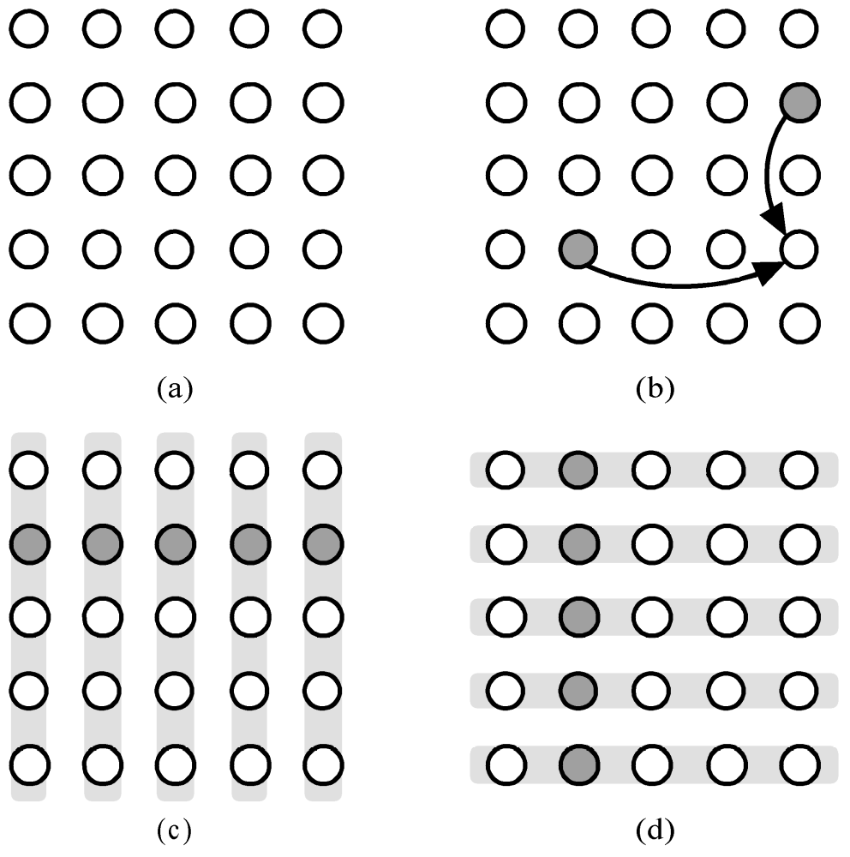
Communication
Updating
a[3,4] when
k = 1
Primitive tasks
Iteration k:
every task
in row k
broadcasts
its value w/in
task column
Iteration k:
every task
in column k
broadcasts
its value w/in
task row

Slide 13
Agglomeration and Mapping
Number of tasks: static
Communication among tasks: structured
Computation time per task: constant
Strategy:
  Agglomerate tasks to minimize communication
  Create one task per MPI process

Slide 14
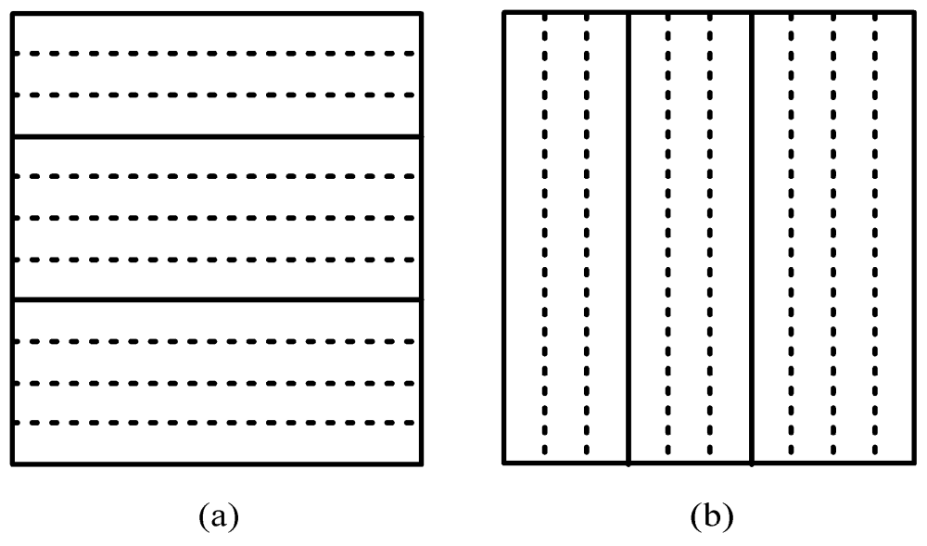
Two Data Decompositions
Rowwise block striped Columnwise block striped

Slide 15
Comparing Decompositions
Columnwise block striped
  Broadcast within columns eliminated
Rowwise block striped
  Broadcast within rows eliminated
  Reading matrix from file simpler
Choose rowwise block striped decomposition

Slide 16
File Input
File

Slide 17
Pop Quiz
Why don’t we input the entire file at once and then scatter its contents among the processes, allowing concurrent message passing?

Slide 18
Point-to-point Communication
Involves a pair of processes
One process sends a message
Other process receives the message

Slide 19
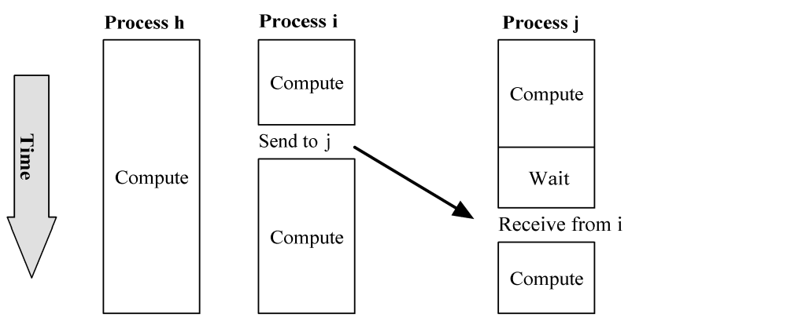
Send/Receive Not Collective

Slide 20
Function MPI_Send
int MPI_Send (
void *message,
int count,
MPI_Datatype datatype,
int dest,
int tag,
MPI_Comm comm
)

Slide 21
Function MPI_Recv
int MPI_Recv (
void *message,
int count,
MPI_Datatype datatype,
int source,
int tag,
MPI_Comm comm,
MPI_Status *status
)

Slide 22
Coding Send/Receive
...
if (ID == j) {
...
Receive from i
...
}
...
if (ID == i) {
...
Send to j
...
}
...
Receive is before Send.
Why does this work?

Slide 23
Inside MPI_Send and MPI_Recv
Sending Process
Receiving Process
Program
Memory
System
Buffer
System
Buffer
Program
Memory
MPI_Send
MPI_Recv

Slide 24
Return from MPI_Send
Function blocks until message buffer free
Message buffer is free when
  Message copied to system buffer, or
  Message transmitted
Typical scenario
  Message copied to system buffer
  Transmission overlaps computation

Slide 25
Return from MPI_Recv
Function blocks until message in buffer
If message never arrives, function never returns

Slide 26
Deadlock
Deadlock: process waiting for a condition that will never become true
Easy to write send/receive code that deadlocks
  Two processes: both receive before send
  Send tag doesn’t match receive tag
  Process sends message to wrong destination process

Slide 27
Computational Complexity
Innermost loop has complexity Θ(n)
Middle loop executed at most ⎡n/p⎤ times
Outer loop executed n times
Overall complexity Θ(n³/p)

Slide 28
Communication Complexity
No communication in inner loop
No communication in middle loop
Broadcast in outer loop
— complexity is Θ(n log p)
Overall complexity Θ(n² log p)

Slide 29
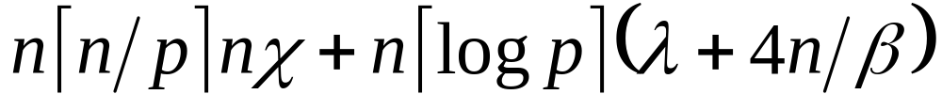
Execution Time Expression (1)
Message-passing time
Messages per broadcast
Iterations of outer loop
Cell update time
Iterations of inner loop
Iterations of middle loop
Iterations of outer loop

Slide 30
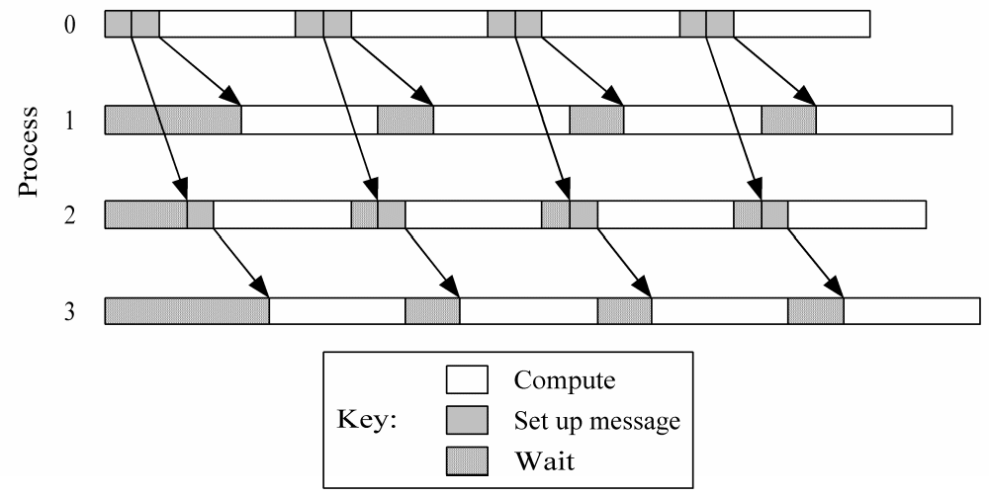
Computation/Communication Overlap

Slide 31
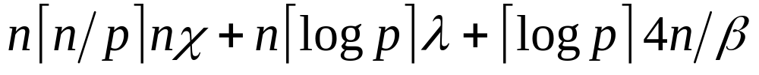
Execution Time Expression (2)
Message transmission
Message-passing time
Messages per broadcast
Iterations of outer loop
Cell update time
Iterations of inner loop
Iterations of middle loop
Iterations of outer loop

Slide 32
Predicted vs. Actual Performance
 | Execution Time (sec)
Processes | Predicted | Actual
1 | 25.54 | 25.54
2 | 13.02 | 13.89
3 | 9.01 | 9.60
4 | 6.89 | 7.29
5 | 5.86 | 5.99
6 | 5.01 | 5.16
7 | 4.40 | 4.50
8 | 3.94 | 3.98

Slide 33
Summary
Two matrix decompositions
  Rowwise block striped
  Columnwise block striped
Blocking send/receive functions
  MPI_Send
  MPI_Recv
Overlapping communications with computations

