Slide 1

Fast boot and suspend/resume
Zhang Rui
rui.zhang@intel.com
Beijing October 18th 2008

Slide 2
Agenda
Fast boot
  Current State of the Art
  Splash Screens
  Budget & Resource Scheduling
  Kernel
  Early Userspace
  X.org
Fast suspend/resume
  Driver optimization
  Device asynchronous resume
  More aggressive attempts

Slide 3
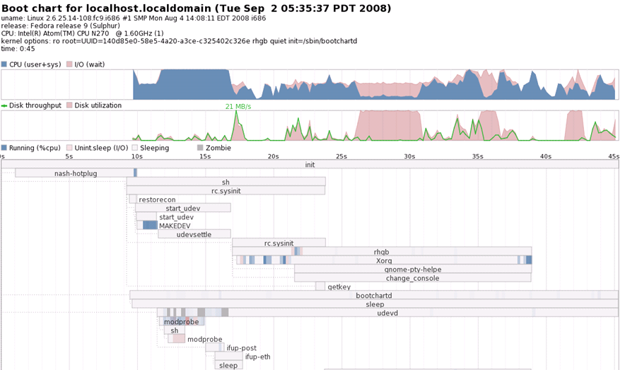
Current state
  boot to be completely done in 5 seconds

Slide 4


We hate splash screens
Splash screens
  By the time you see it.... we want to be done!

Slide 5
Time budgets, Resource scheduling
  boot to be completely done in 5 seconds
Component | Allocated time
Kernel | 1 second
Early boot | 1 second
X | 1 second
GUI/Desktop | 2 seconds

Slide 6
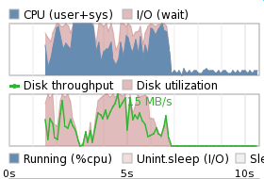
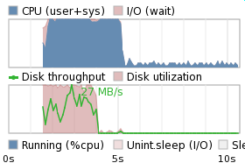
sReadAhead
read used portions of files in "use order" as early as possible to prime the pagecache
"idle" IO scheduler class

Slide 7
Kernel
Budget: 1 second
All system components built into the kernel image
  Modules are slow, synchronous, and not needed for core components
No initrd
  All key drivers are in the kernel
  /dev is populated with the fixed device nodes
  initrd management just plain takes too long

Slide 8
Kernel
Budget: 1 second
Asynchronous initialization of non-essential components with a new, asynchronous initcall
level
Reference: git://git.kernel.org/pub/scm/linux/kernel/git/arjan/linux-2.6-fastboot.git

Slide 9
Early boot / Init
Budget: 1 second
sysvinit, not upstart: Asynchronous, not Parallel
Udev
  Persistent /dev reduces overhead enormously

Slide 10
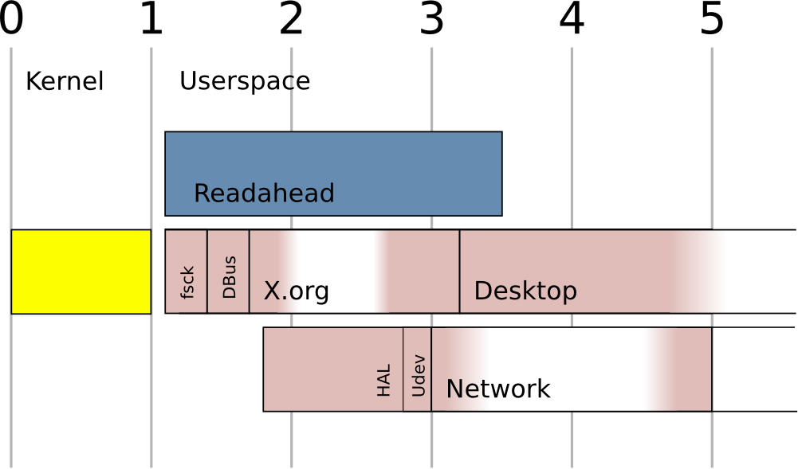
Early boot / Init
Budget: 1 second
Asynchronous for non-critical path

Slide 11
X.org
Budget: 1 second
xorg-x11-drv-intel driver
  Program everything during probing
  ... then restore it to standard
  ... then program it again for final use
  Various "extra" delays trimmed (after fixing PCI posting bugs)
XKB
  Calling CPP ??? <explicit language removed>
  Caching the result – Compute once, use forever

Slide 12
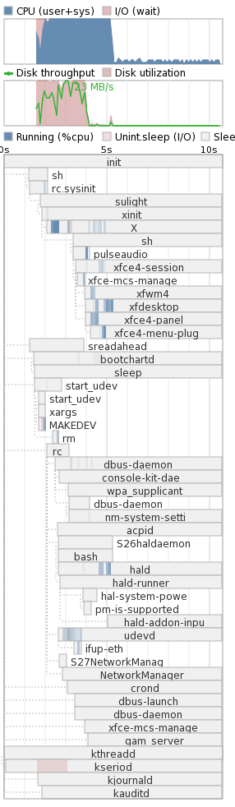
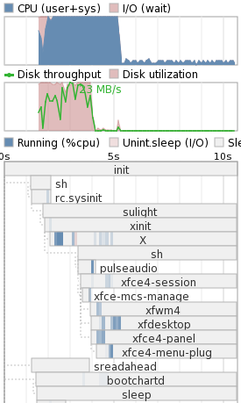
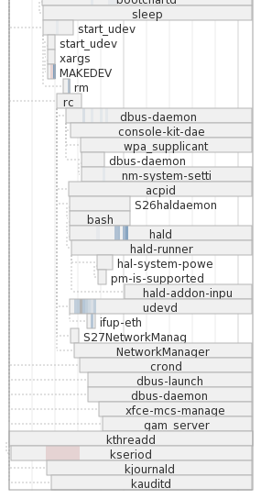

Slide 13
Fast suspend/resume
Not as complex as fast boot
  BIOS + kernel + X/application
  No critical disk I/O request
Time budget
  Resume Kernel + X/application in 1 second

Slide 14
Driver optimization
non-critical work can be deferred during device resume
  Serio
    offload resume to kseriod
Fix driver poor/wrong behavior
  AHCI
    HBA reset speed up

Slide 15
Device asynchronous resume
Resume devices asynchronously
Sync before resume X/applications
…
ACPI
…
SCSI
…
USB
…
X/app
USB
ACPI
…
X/app
SCSI

Slide 16
More aggressive attempts
Device deferred resume instead of asynchronous resume
  don’t sync before resuming X/applications
  Screen is back before all the devices are resumed
  works but may bring potential risks
USB
ACPI
…
X/app
SCSI

Slide 17
More aggressive attempts
Resume X with the highest priorities
  Resume drm driver first to light the screen
  Resume X process before the other kernel drivers
  Works but not for upstream yet

Slide 18
S3 resume time Moblin
BIOS
kernel
X/app.
Current state
1.65s
1.78s
0.37s
Asynchronous resume
1.65s
1.19s
0.36s
deferred resume
1.65s
0.25s
0.36s
resume X first
1.65s
0.25s
0.20s

Slide 19
TODO
push “deferred resume” mechanism upstream
Fast suspend
Fast shutdown

Slide 20
Acknowledgements
Arjan van de Ven
Auke Kok
Li, Shaohua
Zhao Yakui

Slide 21


