Slide 1
COLO: COarse-grain LOck-stepping Virtual Machine for Non-stop Service
Li Zhijian <lizhijian@cn.fujitsu.com>
Fujitsu Limited.

Slide 2
Agenda
Background
COarse-grain LOck-stepping
Summary

Slide 3
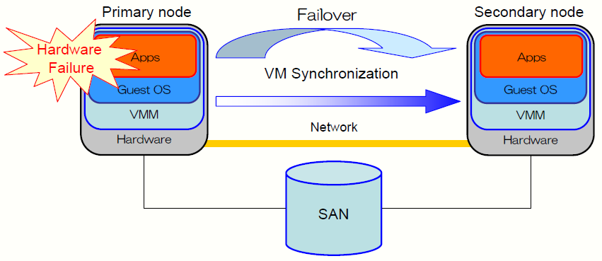
Non-Stop Service with VM Replication
Typical Non-stop Service Requires
  Expensive hardware for redundancy
  Extensive software customization
VM Replication: Cheap Application-agnostic Solution

Slide 4
Existing VM Replication Approaches
Replication Per Instruction: Lock-stepping
  Execute in parallel for deterministic instructions
  Lock and step for un-deterministic instructions
Replication Per Epoch: Continuous Checkpoint
  Secondary VM is synchronized with Primary VM per epoch
  Output is buffered within an epoch

Slide 5
Problems
Lock-stepping
  Excessive replication overhead
    memory access in an MP-guest is un-deterministic
Continuous Checkpoint
  Extra network latency
  Excessive VM checkpoint overhead

Slide 6
Agenda
Background
COarse-grain LOck-stepping
Summary

Slide 7
Why COarse-grain LOck-stepping (COLO)
VM Replication is an overly strong condition
  Why we care about the VM state ?
    The client care about response only
  Can the control failover without ”precise VM state replication”?
Coarse-grain lock-stepping VMs
  Secondary VM is a replica, as if it can generate same response with primary so far
    Be able to failover without service stop
Non-stop service focus on server response, not internal machine state!

Slide 8
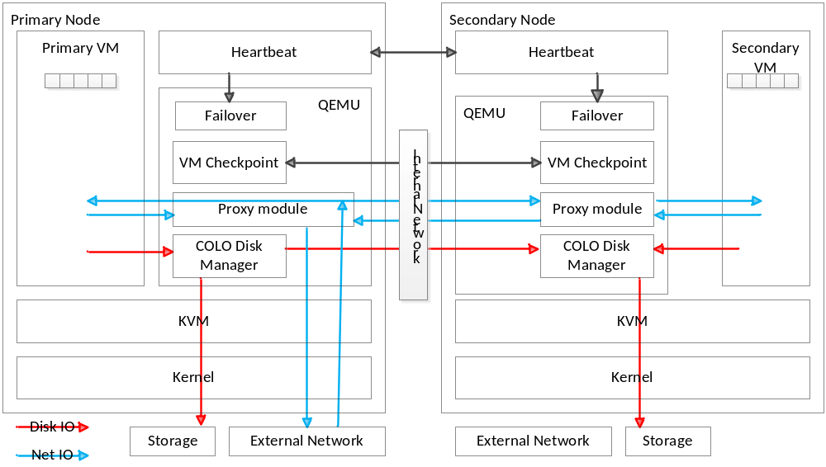
Architecture of COLO
Pnode: primary node; PVM: primary VM; Snode: secondary node; SVM: secondary VM
COarse-grain LOck-stepping Virtual Machine for Non-stop Service

Slide 9
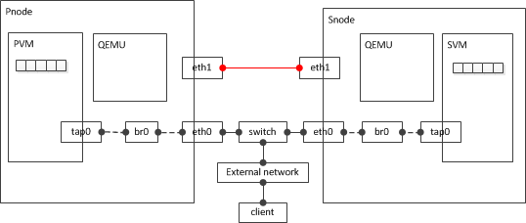
Network topology of COLO
Pnode: primary node; PVM: primary VM; Snode: secondary node; SVM: secondary VM
[eth0] : client and vm communication
[eth1] : migration/checkpoint, storage replication and proxy

Slide 10
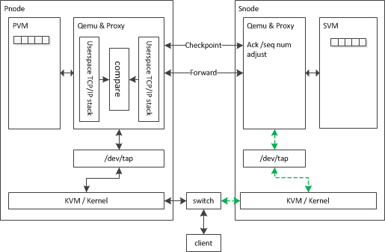
Network Process
Guest-RX
Pnode
  Receive a packet from client
  Copy the packet and send to Snode
  Send the packet to PVM
Snode
  Receive the packet from Pnode
  Adjust packet’s ack_seq number
  Send the packet to SVM
Guest-TX
Snode
  Receive the packet from SVM
  Adjust packet’s seq number
  Send the SVM packet to Pnode
Pnode
  Receive the packet from PVM
  Receive the packet from Snode
  Compare PVM/SVM packet
Same: release the packet to client
    Different: trigger checkpoint and release packet to client
Base on Qemu’s netfilter and SLIRP

Slide 11
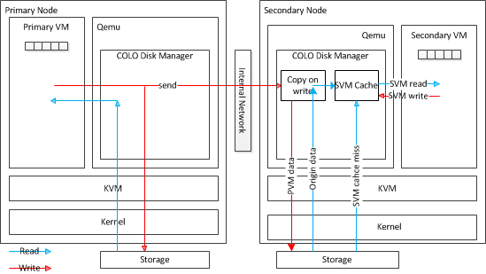
Storage Process
Write
Pnode
  Send the write request to Snode
  Write the write request to storage
Snode
  Receive PVM write request
  Read original data to SVM cache & write PVM write request to storage(Copy On Write)
  Write SVM write request to SVM cache
Read
Snode
  Read from SVM cache, or storage (SVM cache miss)
Pnode
  Read form storage
Checkpoint
  Drop SVM cache
Failover
  Write SVM cache to storage
Base on qemu’s quorum,nbd,backup-driver,backingfile

Slide 12
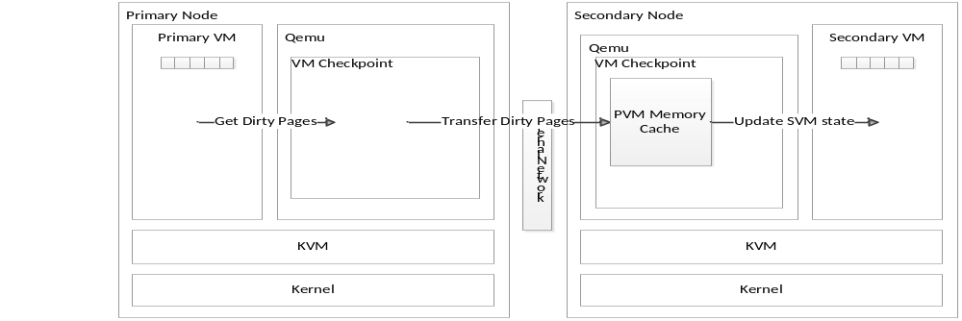
Memory Sync Process
PNode
  Track PVM dirty pages, send them to Snode periodically
Snode
  Receive the PVM dirty pages, save them to PVM Memory Cache
  On checkpoint, update SVM memory with PVM Memory Cache

Slide 13
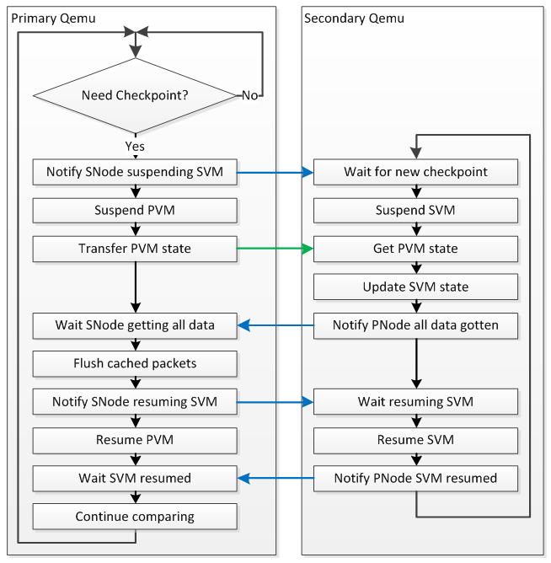
Checkpoint Process
Need modify migration process in Qemu to support checkpoint

Slide 14
Why Better
Comparing with Continuous VM checkpoint
  No buffering-introduced latency
  Less checkpoint frequency
    On demand vs. periodic
Comparing with lock-stepping
  Eliminate excessive overhead of un-deterministic instruction execution due to MP-guest memory access

Slide 15
Agenda
Background
COarse-grain LOck-stepping
Summary

Slide 16
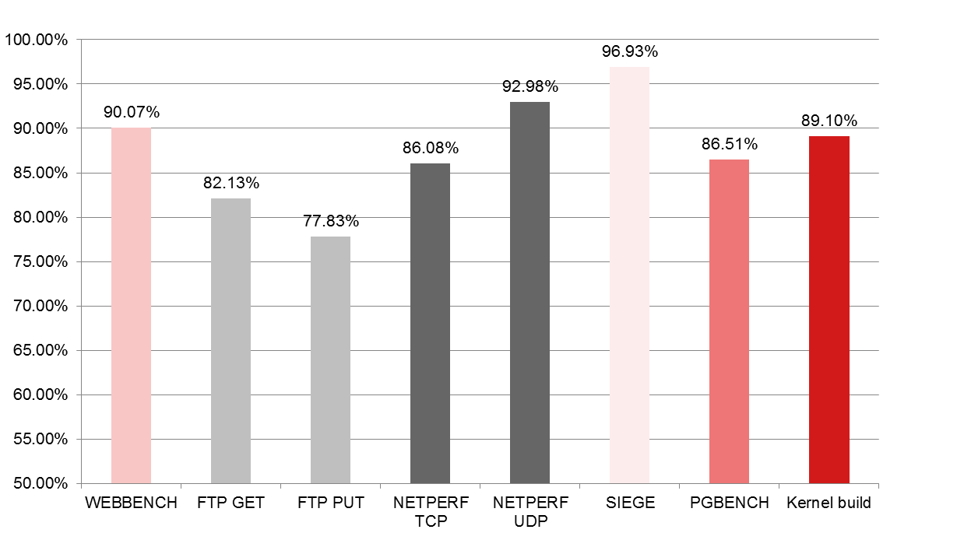
Summary
Performance

Slide 17
Summary
  COLO status
  colo frame: patchset v9 had been post(by zhang.zhanghailiang@huaei.com)
  colo-block: most of patch is reviewed (by wency@cn.fujitsu.com)
  colo-proxy: (by yanhy@cn.fujitsu.com)
  netfilter related is reviewed
  packet compare is developing

Slide 18
Summary
Next steps:
  Redesign based on feedbacks
  Develop and send out for review
  Optimize performance

