Slide 1
Neuroergonomic Assessment of
Human Robot Interaction
Dominik Limbach, B.Sc.
Kolloquium – Master Thesis
Systems Neuroscience & Neurotechnology Unit
Saarland University of Applied Sciences
Faculty of Engineering
24.01.2020
1

Slide 2
Outline
Introduction
Problem Analysis & Goals
Materials & Methods
Results
Conclusion & Future Work
2
Dominik Limbach, B.Sc.
24.01.2020

Slide 3
Introduction
Neuroergonomics
The study of brain and behaviour at work. (Parasuraman, 2003)
Comprised of neuroscience and ergonomics
Investigation of the neural bases of perceptual and cognitive functions, as well as, physical performance in relation to technologies and real world settings
Utilization of physiological measures that, directly or indirectly, reflect aspects of brain function.
3
Dominik Limbach, B.Sc.
24.01.2020
Notes:
The most direct measures are derived from the brain itself
E.g. Electroencephalogram (EEG), Event-Related Potentials (ERPs), Positron Emission Tomography (PET) and functional Magnetic Resonance Imaging (fMRI)

Slide 4
Introduction
Applications of Neuroergonomics
Understanding of how the brain carries out complex tasks of everyday life
To design technologies and work environments for safer and more efficient operation
To advance the understanding of brain function in relation to human performance in real-world tasks
4
Dominik Limbach, B.Sc.
24.01.2020
Notes:
But Why do we need Neuroergonomics?
Well, if we are able to understand … line 1
We can use this knowledge to… point 1, point 2

Slide 5
Introduction
Automated Workplaces
Optimizing Human Machine Interaction
Concept of adaptive automation, work environment sensitive to the mental state of the operator
Increase system performance and safety by reducing stress and human error, induced by static automation
Regulatory approach: Task allocation based on continuous monitoring of the human operator in conjunction with emotion recognition)
5
Dominik Limbach, B.Sc.
24.01.2020
Notes:
An recent example is HRI
In particular, Adaptive Automation Workplaces
Where some tasks are automated and humans need to interact with machines

Slide 6
Problem Analysis
Research on the matter, based on
Non representative subject groups (i.e. children, or a single subject)
Unauthentic data (selection bias, ideal recording conditions)
Obtrusive and expensive measurement methods (fMRI, PET, EEG)
6
Dominik Limbach, B.Sc.
24.01.2020

Slide 7
Goals
The facilitation of signal based emotion recognition in Human Robot Interaction by providing an unobtrusive monitoring method for peripheral physiological signals
7
Dominik Limbach, B.Sc.
24.01.2020

Slide 8
Scope
Design and Implementation of a wireless measurement system capable of real-time data acquisition, based on a wrist-worn device
Build a database for machine learning
Evaluate system capabilities based on the classification accuracy of selected machine learning algorithms
8
Dominik Limbach, B.Sc.
24.01.2020

Slide 9
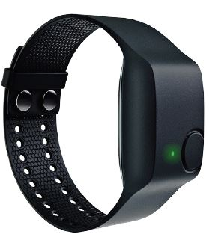
Materials & Methods
Empatica E4 Wristband
A medical grade wearable for real-time data acquisition
Capable of wireless data transmission
Designed for daily life usage
9
Dominik Limbach, B.Sc.
24.01.2020

Slide 10
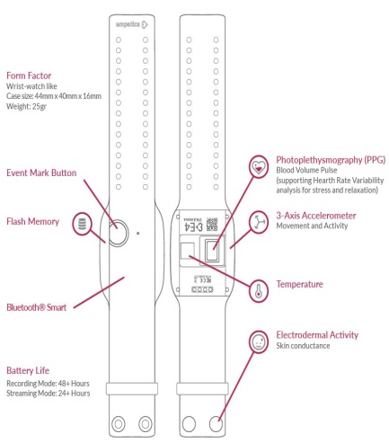
Materials & Methods
Physiological Channels
Blood Volume Pulse (BVP)
Galvanic Skin Response (GSR)
Skin Temperature (ST)
10
Dominik Limbach, B.Sc.
24.01.2020

Slide 11
Materials & Methods
Data Collection Experiment
14 participants, 50% male, aged between 24 and 50 years
Mental Arithmetic Stress Test (Jern et al., 1991), Stroop Test
Visual Stimulation (IAPS, Lang et al., 2008)
11
Dominik Limbach, B.Sc.
24.01.2020
Notes:
2 cognitive tasks to induce stress by presenting different level of workload
Stroop test: naming colors used to write an incongruous color name. task requires subjects to override a reading response. This conflict interference
situation is called the Stroop Effect
Visual stimulation for emotion elicitation

Slide 12
Materials & Methods
Experimental Procedure
Baseline Measurement
Mental Arithmetic Stress Test
Stroop Test
Visual Stimulation (Set 1, 32 p., pleasant)
Visual Stimulation (Set 2, 30 p., unpleasant)
5 min per session, plus a cooldown session after each session
12
Dominik Limbach, B.Sc.
24.01.2020

Slide 13
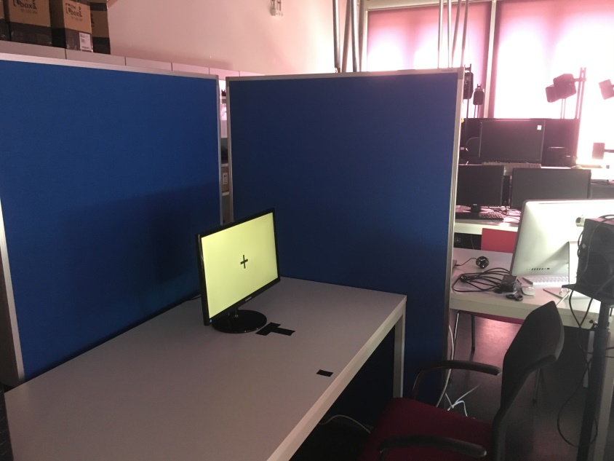
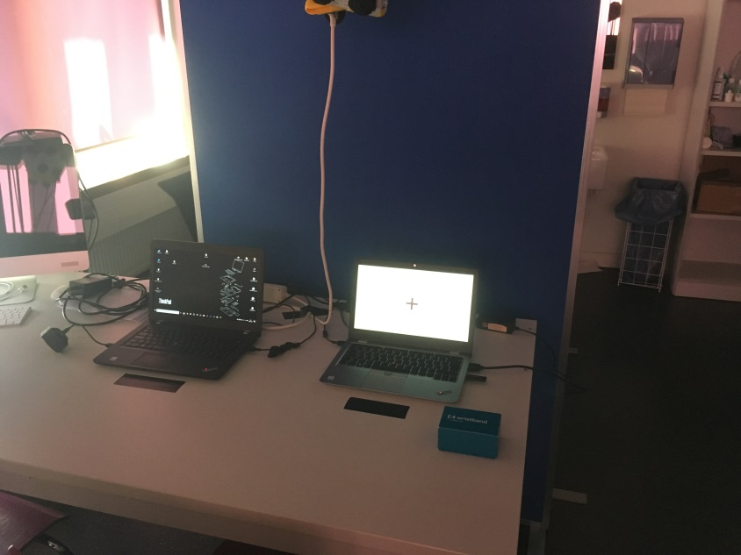
Materials & Methods
Experimental Setup
13
Dominik Limbach, B.Sc.
24.01.2020

Slide 14
Materials & Methods
Selected Algorithms
Choosen from the top 10 algorithms in data mining. (Wu et al., 2008)
K - Nearest Neighbor Classifier (kNN)
Support Vector Machines (SVM)
Random Forest Classifier (RFC)
Neural Networks (NN)
14
Dominik Limbach, B.Sc.
24.01.2020

Slide 15
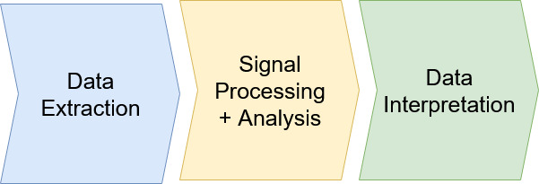
Materials & Methods
Data Processing Steps
15
Dominik Limbach, B.Sc.
24.01.2020
Notes:
Data Extraction: Access raw signal data recorded with the E4
<- using Streaming server App, Bluetooth dongle and TCP Client (implemented in matlab)

Slide 16
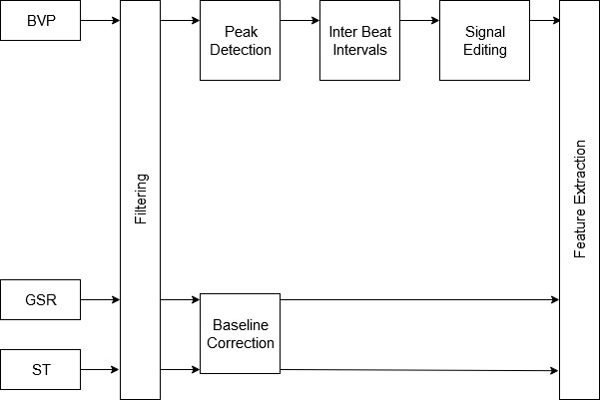
Signal Processing & Analysis
16
Dominik Limbach, B.Sc.
24.01.2020
Notes:
Filtering for GSR/ST : zero phase fourth order Butterworth filter, cutoff 1.0Hz

Slide 17
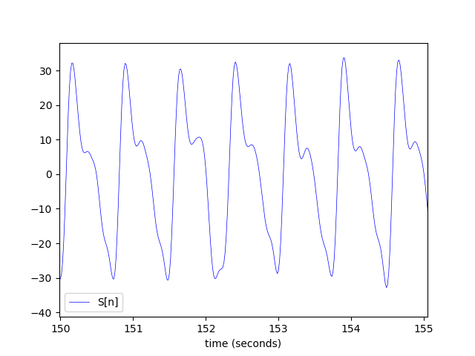
BVP Peak Detection
Zero-phase second-order Butterworth, bandpass of 0.5-8Hz
17
Dominik Limbach, B.Sc.
24.01.2020
Notes:
Elgendi et al 2013
Filtering, to remove the baseline wander and high frequencies that do not contribute to the
systolic peaks

Slide 18
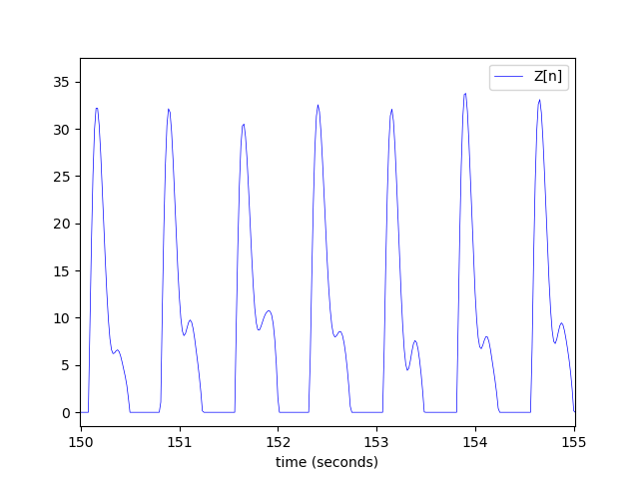
BVP Peak Detection
18
Dominik Limbach, B.Sc.
24.01.2020
Notes:
Clipping, keeping only the signal above 0

Slide 19
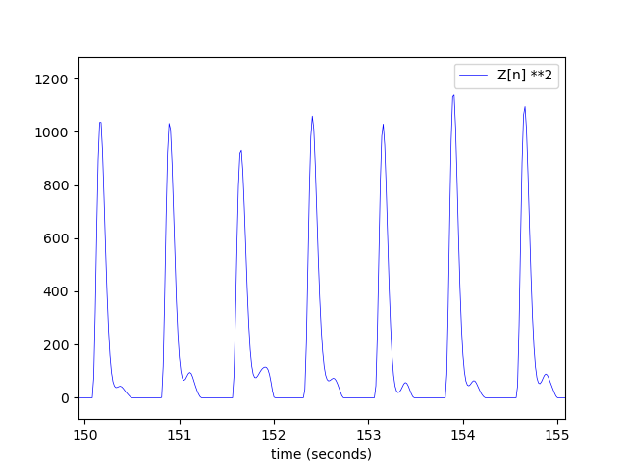
BVP Peak Detection
19
Dominik Limbach, B.Sc.
24.01.2020
Notes:
Squaring, to emphasize large differences resulting from sytolic waves

Slide 20


BVP Peak Detection
Generating event-related moving averages
MA_peak: emphasizes the systolic peak area (W1 = 111ms)
MA_beat: empasizes the beat area (W2 = 667ms)
20
Dominik Limbach, B.Sc.
24.01.2020
Notes:
Parameter optimization:
[Elgendi et al. 2013]
Performance evaluation based on Sensitivity (SE = TP/(TP+FN)) and Positive Predictivity +P= TP/(TP+FP)
Brute force search optimization for systolic peak detection function:
-Parameter: PPG signal, frequency Band (F1-F2), event-related duration (W1, W2) and offset (ß)

Slide 21
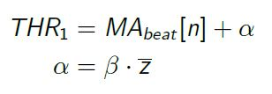
BVP Peak Detection
Generating Blocks of Interest
A new block is created for every interval where MA_peak exceeds a certain threshold THR1
21
Dominik Limbach, B.Sc.
24.01.2020
Notes:
Parameter optimization:
[Elgendi et al. 2013]
Performance evaluation based on Sensitivity (SE = TP/(TP+FN)) and Positive Predictivity +P= TP/(TP+FP)
Brute force search optimization for systolic peak detection function:
-Parameter: PPG signal, frequency Band (F1-F2), event-related duration (W1, W2) and offset (ß)

Slide 22
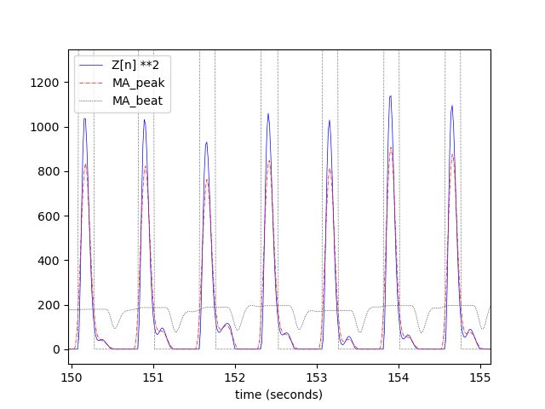
BVP Peak Detection
22
Dominik Limbach, B.Sc.
24.01.2020

Slide 23
BVP Peak Detection
Select valid Blocks of Interest
A block is marked as valid, if it is wider than THR2 = W1
23
Dominik Limbach, B.Sc.
24.01.2020

Slide 24
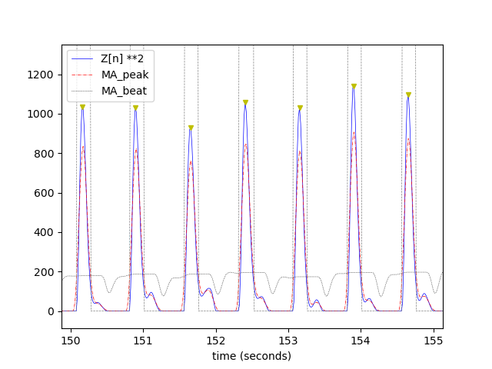
BVP Peak Detection
24
Dominik Limbach, B.Sc.
24.01.2020

Slide 25
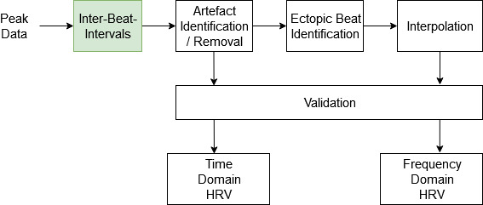

Editing Process
Calculate Inter-Beat-Interval (IBI) using the distance between successive peaks
25
Dominik Limbach, B.Sc.
24.01.2020

Slide 26
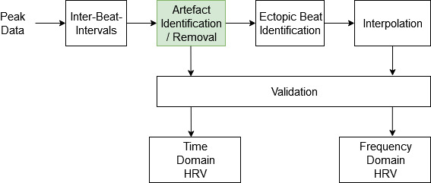
Editing Process
Identifcation of outlier intervals (45 bpm > HR > 191 bpm)
All outlier sequences with a length greater than 3 seconds were considered artefacts and removed, the rest interpolated. (Clifford, 2002)
26
Dominik Limbach, B.Sc.
24.01.2020

Slide 27
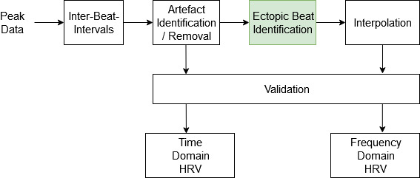
Editing Process
Identifcation of ectopic beats using Kamath‘s rule. (Choi et al., 2016)
i.e. An interval was considered abnormal, if it increased by more than 32.5% or decreased by more than 24.5% compared to the previous interval
27
Dominik Limbach, B.Sc.
24.01.2020

Slide 28
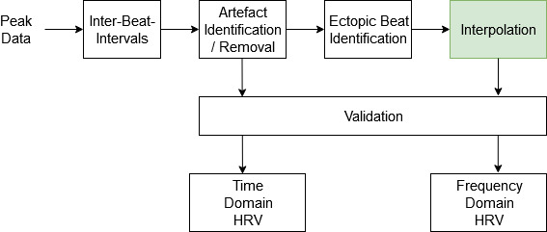
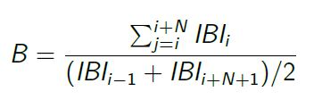
Editing Process
All intervals that were marked as abnormal were replaced using linear interpolation of the surrounding intervals
The number of inserted intervals B was calculated according to the total time encompassed by the ectopic beat/ or sequence. (Lippman et al., 1994)
28
Dominik Limbach, B.Sc.
24.01.2020

Slide 29
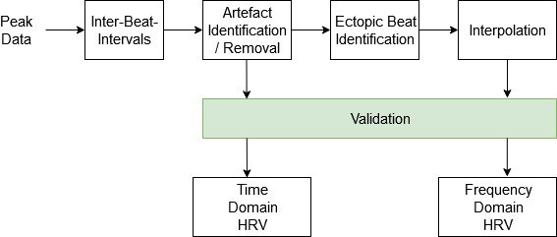
Editing Process
Data was considered valid if at least 80% of a 5 minute segment of data consisted of acceptable IBIs. (Clifford, 2002)
29
Dominik Limbach, B.Sc.
24.01.2020

Slide 30
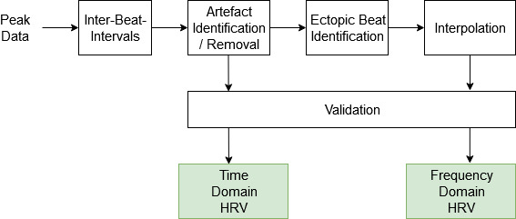
Editing Process
Heart rate variability (HRV), i.e. variations in the length of consecutive heart beat intervals
HRV feature extraction and selection according to the guidelines provided by the Task Force of The European Society of Cardiology and The North American Society of Pacing and Electrophysiology (1996)
30
Dominik Limbach, B.Sc.
24.01.2020

Slide 31
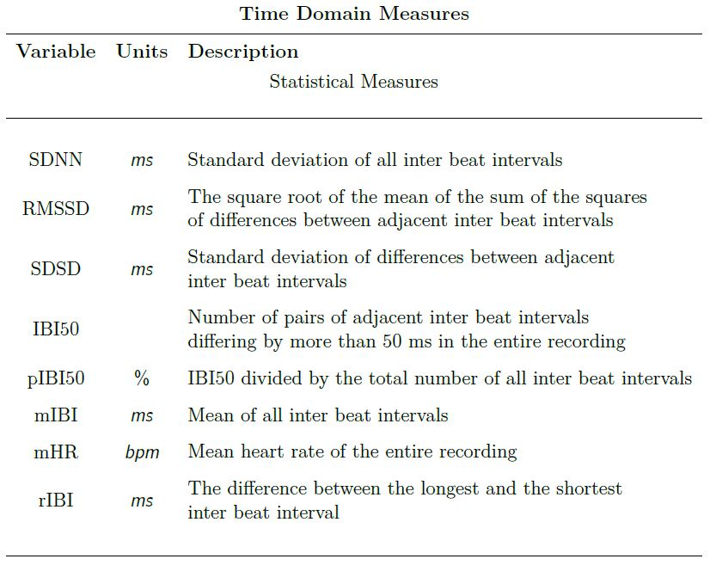
Feature Selection
HRV Measures – Time Domain
31
Dominik Limbach, B.Sc.
24.01.2020

Slide 32
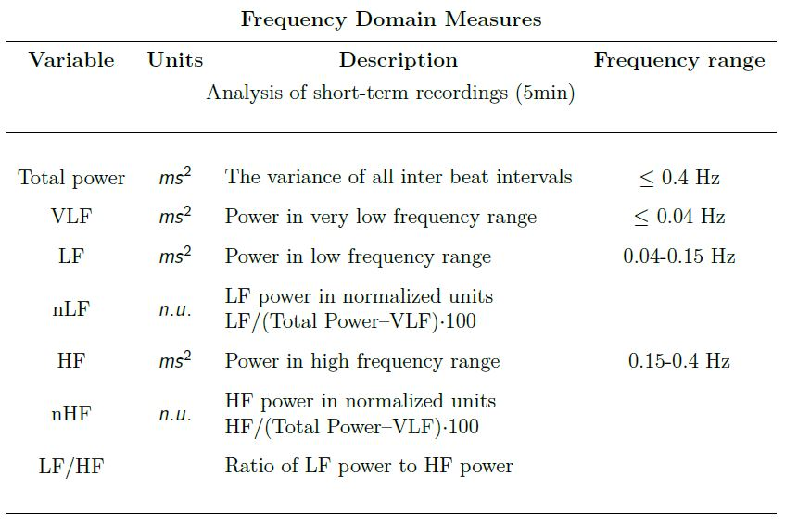
Feature Selection
HRV Measures – Frequency Domain
32
Dominik Limbach, B.Sc.
24.01.2020
Notes:
Power represented by average bandpower in the respective frequency band.
Average Bandpower calculated using Welch‘s method (Hann window): Calculates estimate of the spectral density by dividing the data into overlapping segments, computing a modified periodogram of each segment, and averaging all periodograms. Bandpower is then calculated by integrating over the frequency bands.(trapezoidal rule)
Preparation: Discrete event series (ibi tachogram interpolated with a frequency of 7 Hz)
Power spectral density (PSD) analysis provides the basic information of how power (i.e. variance) distributes as a function of frequency. Independent of the method
employed, only an estimate of the true PSD of the signals can be obtained by proper mathematical algorithms. (Task Force)
Variance, is the expectation of the squared deviation of a random variable from its mean. (IBI [ms] -> Variance [ms**2]

Slide 33
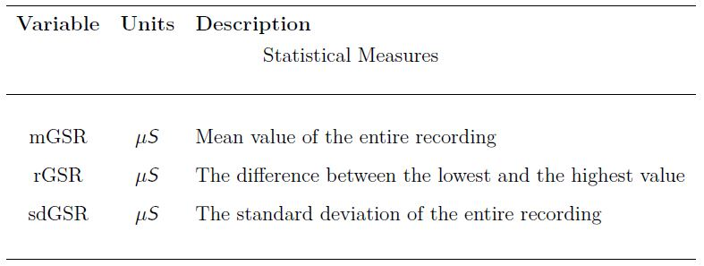
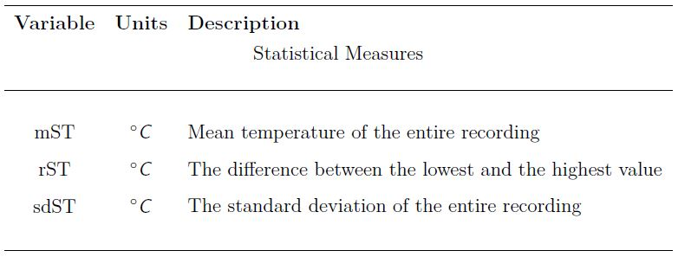
Feature Selection
GSR
ST
33
Dominik Limbach, B.Sc.
24.01.2020

Slide 34
Data Interpretation
Preparation
Generating Trainings- and Test-Data sets
Feature Normalization for SVM, NN
34
Dominik Limbach, B.Sc.
24.01.2020
Notes:
k-Fold Cross-Validation
Cross-validation is a resampling procedure used to evaluate machine learning models on a limited data sample.
The general procedure is as follows:
Shuffle the dataset randomly.
Split the dataset into k groups
For each unique group:
Take the group as a hold out or test data set
Take the remaining groups as a training data set
Fit a model on the training set and evaluate it on the test set
Retain the evaluation score and discard the model
Summarize the skill of the model using the sample of model evaluation scores
Importantly, each observation in the data sample is assigned to an individual group and stays in that group for the duration of the procedure. This means that each sample is given the opportunity to be used in the hold out set 1 time and used to train the model k-1 times.

Slide 35
Data Interpretation
Data Sets
Subsets to evaluate performance on binary classification tasks aimed to identify individual emotional states
Subsets to evaluate performance on binary classification tasks aimed to distinguish between similar emotional states
35
Dominik Limbach, B.Sc.
24.01.2020
Notes:
k-Fold Cross-Validation
Cross-validation is a resampling procedure used to evaluate machine learning models on a limited data sample.
The general procedure is as follows:
Shuffle the dataset randomly.
Split the dataset into k groups
For each unique group:
Take the group as a hold out or test data set
Take the remaining groups as a training data set
Fit a model on the training set and evaluate it on the test set
Retain the evaluation score and discard the model
Summarize the skill of the model using the sample of model evaluation scores
Importantly, each observation in the data sample is assigned to an individual group and stays in that group for the duration of the procedure. This means that each sample is given the opportunity to be used in the hold out set 1 time and used to train the model k-1 times.

Slide 36
Data Interpretation
Feature sets
Complete, 21 features (HRV, GSR, ST)
Reduced T, 14 features, (HRV time, GSR, ST)
Reduced F, 13 features, (HRV frequency, GSR, ST)
Single Sets
36
Dominik Limbach, B.Sc.
24.01.2020
Notes:
k-Fold Cross-Validation
Cross-validation is a resampling procedure used to evaluate machine learning models on a limited data sample.
The general procedure is as follows:
Shuffle the dataset randomly.
Split the dataset into k groups
For each unique group:
Take the group as a hold out or test data set
Take the remaining groups as a training data set
Fit a model on the training set and evaluate it on the test set
Retain the evaluation score and discard the model
Summarize the skill of the model using the sample of model evaluation scores
Importantly, each observation in the data sample is assigned to an individual group and stays in that group for the duration of the procedure. This means that each sample is given the opportunity to be used in the hold out set 1 time and used to train the model k-1 times.

Slide 37
Data Interpretation
Hyperparameter Optimization – Grid Search
Hyperparameters, are algorithm specific parameters that control the learning process and are set beforehand (e.g. the hidden layer size or the learning rate of a Neural Network)
Choosing an optimal set of hyperparameters, by exhaustively searching through a specified subset of the hyperparameter space of a learning algorithm
3-, 5-fold Crossvalidation to improve generalization
Conducted for every algorithm and all possible combinations of feature- and data sets
37
Dominik Limbach, B.Sc.
24.01.2020
Notes:
k-Fold Cross-Validation
Cross-validation is a resampling procedure used to evaluate machine learning models on a limited data sample.
The general procedure is as follows:
Shuffle the dataset randomly.
Split the dataset into k groups
For each unique group:
Take the group as a hold out or test data set
Take the remaining groups as a training data set
Fit a model on the training set and evaluate it on the test set
Retain the evaluation score and discard the model
Summarize the skill of the model using the sample of model evaluation scores
Importantly, each observation in the data sample is assigned to an individual group and stays in that group for the duration of the procedure. This means that each sample is given the opportunity to be used in the hold out set 1 time and used to train the model k-1 times.

Slide 38
Data Interpretation
Evaluation
Based on the accuracy of the best performing classifiers (determined by Grid Search) on the test data
38
Dominik Limbach, B.Sc.
24.01.2020
Notes:
k-Fold Cross-Validation
Cross-validation is a resampling procedure used to evaluate machine learning models on a limited data sample.
The general procedure is as follows:
Shuffle the dataset randomly.
Split the dataset into k groups
For each unique group:
Take the group as a hold out or test data set
Take the remaining groups as a training data set
Fit a model on the training set and evaluate it on the test set
Retain the evaluation score and discard the model
Summarize the skill of the model using the sample of model evaluation scores
Importantly, each observation in the data sample is assigned to an individual group and stays in that group for the duration of the procedure. This means that each sample is given the opportunity to be used in the hold out set 1 time and used to train the model k-1 times.

Slide 39
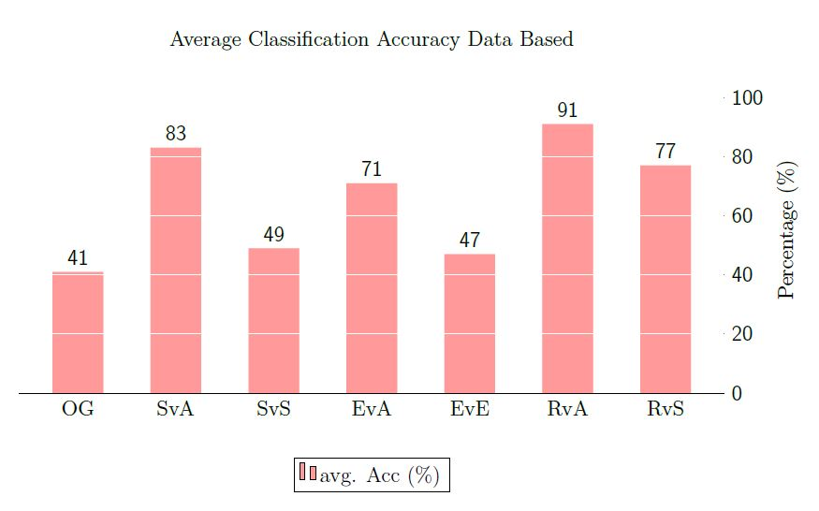
Results
39
Dominik Limbach, B.Sc.
24.01.2020

Slide 40
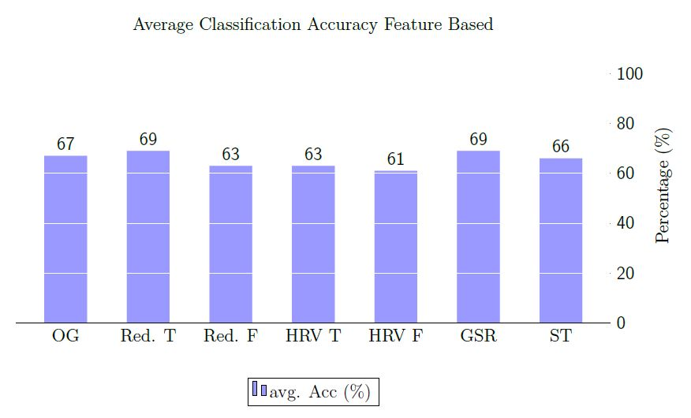
Results
40
Dominik Limbach, B.Sc.
24.01.2020

Slide 41
Conclusion & Future Work
Conclusion
Realization of real-time data acquisition using the Empatica E4
Established a database for machine learning, deploying our wireless recording system in an experimental setting
Method for coarse emotion classification using peripheral physiological signals, i.e. individual emotional states
Further optimization is needed to increase capability in more complex classification tasks
41
Dominik Limbach, B.Sc.
24.01.2020

Slide 42
Conclusion & Future Work
Future Work
Large Scale Data Collection
Artefact Compensation, for motion based artefacts introduced by sensor displacement or muscle activity
HRI Focused Experiment, authentic data collection and emotion elicition
42
Dominik Limbach, B.Sc.
24.01.2020

Slide 43
References
R. Parasuraman. Neuroergonomics: Research And Practice. Theoretical Issues in Ergonomics Science, 2003.
Task Force of The European Society of Cardiology and The North American Society of Pacing and Electrophysiology. Heart rate variability. Standards of measurement, physiological interpretation, and clinical use. European Heart Journal, 1996.
X. Wu, V. Kumar, J. R. Quinlan, J. Gosh, Q. Yang, H. Motoda, G. J. McLachlan, A. Ng, B. Liu, P. S. Yu, Z.-H. Zhou, M. Steinbach, D. J. Hand, and D. Steinberg. Top 10 Algorithms In Data Mining. Knowl Inf Syst, 2008.
E. A. Byrne and R. Parasuraman. Psychophyiology And Adaptive Automation. Biological Psychology, 1996.
A. Choi and H. Shin. Quantative Analysis of the Effect of an Extopic Beat on the Heart Rate Variability in the Resting Condition. Frontiers in Physiology, 2016.
G. D. Clifford. Signal Processing Methods for Heart Rate Variability. PhD thesis, St. Cross College, 2002.
M. Elgendi, I. Norton, M. Brearley, D. Abbott, and D. Schuurmans. Systolic Peak Detection in Acceleration Photoplethysmograms Measured from Emergency Responders in Tropical Conditions. PLoS ONE, 2013.
43
Dominik Limbach, B.Sc.
24.01.2020

Slide 44
References
P. J. Lang, M. M. Bradley, and B. N. Cuthbert. International Affective Picture System (iaps): Affective Ratings Of Pictures And Instruction Manual. Technical Report A-8, University of Florida, Gainesville, FL., 2008.
N. Lippman, K. M. Stein, and B. B. Lerman. Comparison Of Methods For Removal Of Extopy In Measurement Of Heart Rate Variablility. American Journal of Physiology, 1994.
Empatica, Via Stendhal 36, 20144 Milano (MI). E4 Wristband From Empatica. User’s Manual.
M. Mitrushina, K. B. Boone, J. Razani, and L. F. D’Elia. Handbook of Normative Data for Neuropsychological Assessment. Oxford University Press, USA, 2005.
44
Dominik Limbach, B.Sc.
24.01.2020

Slide 45
Thank you very much for your attention !
45
Dominik Limbach, B.Sc.
24.01.2020

