Slide 1
Midterm Exam
Virtual Memory Part II
CSC 374: Computer Systems II
6th Lecture, February 6, 2018
Instructor:
Walter Martens

Slide 2
Today
Virtual Memory
  Review of Key Concepts
  Simple memory system example
  Case study: Core i7/Linux memory system
  Memory mapping
  Dynamic Memory Mapping

Slide 3
Review: Virtual Memory & Physical Memory
Physical memory
(DRAM)
Physical page
number or
disk address
Virtual address
Valid
VP 1
PP 0
PTE 0
0
null
VP 2
1
VP 7
VP 4
PP 3
1
0
1
0
null
Virtual memory
(disk)
0
PTE 7
1
VP 1
Memory resident
page table
(DRAM)
VP 2
VP 3
VP 4
VP 6
VP 7
A page table contains page table entries (PTEs) that map virtual pages to physical pages.

Slide 4
Translating with a k-level Page Table
Having multiple levels greatly reduces page table size
Page table base register
(part of the process’ context)
n-1
VIRTUAL ADDRESS
p-1
0
VPN 1
VPN 2
...
VPN k
VPO
the Level 1
page table
a Level 2
page table
a Level k
page table
...
...
PPN
m-1
p-1
0
PPN
PPO
PHYSICAL ADDRESS

Slide 5
Translation Lookaside Buffer (TLB)
A small cache of page table entries with fast access by MMU
TLB
2
PTE
VPN
3
Cache/
Memory
MMU
CPU
VA
PA
1
4
Data
5
Typically, a TLB hit eliminates the k memory accesses required to do a page table lookup.

Slide 6
Address Translation: Page Hit
CPU Chip
2
Cache/
Memory
MMU
PTEA
1
PTE
CPU
VA
3
PA
4
Data
5
1) Processor sends virtual address to MMU
2-3) MMU fetches PTE from page table in memory
4) MMU sends physical address to cache/memory
5) Cache/memory sends data word to processor

Slide 7
Address Translation: Page Fault
Exception
Page fault handler
4
CPU Chip
2
Cache/
Memory
Disk
MMU
PTEA
Victim page
1
5
CPU
VA
PTE
7
3
New page
6
1) Processor sends virtual address to MMU
2-3) MMU fetches PTE from page table in memory
4) Valid bit is zero, so MMU triggers page fault exception
5) Handler identifies victim (and, if dirty, pages it out to disk)
6) Handler pages in new page and updates PTE in memory
7) Handler returns to original process, restarting faulting instruction

Slide 8
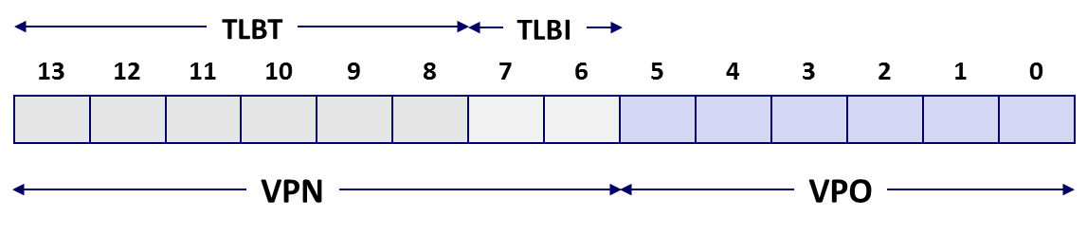
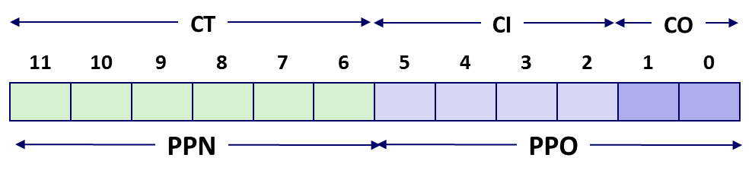

Review of Symbols
Basic Parameters
  N = 2^{n} : Number of addresses in
  virtual address space
  M = 2^{m} : Number of addresses in
  physical address space
  P = 2^{p} : Page size (bytes)
Components of the virtual address (VA)
  TLBI: TLB index
  TLBT: TLB tag
  VPO: Virtual page offset
  VPN: Virtual page number
Components of the physical address (PA)
  PPO: Physical page offset (same as VPO)
  PPN: Physical page number
  CO: Byte offset within cache line
  CI: Cache index
  CT: Cache tag
(bits per field for our simple example)

Slide 9
Today
Virtual Memory
  Review of Key Concepts
  Simple memory system example
  Case study: Core i7/Linux memory system
  Memory mapping
  Dynamic Memory Mapping

Slide 10
Simple Memory System Example
Addressing
  14-bit virtual addresses
  12-bit physical address
  Page size = 64 bytes
13
12
11
10
9
8
7
6
5
4
3
2
1
0
VPN
VPO
Virtual Page Number
Virtual Page Offset
11
10
9
8
7
6
5
4
3
2
1
0
PPN
PPO
Physical Page Number
Physical Page Offset

Slide 11
Simple Memory System TLB
16 entries
4-way associative
TLBT
TLBI
13
12
11
10
9
8
7
6
5
4
3
2
1
0
0
0
0
0
1
1
0
1
VPN
VPO
VPN = 0b1101 = 0x0D
Translation Lookaside Buffer (TLB)
Set
Tag
PPN
Valid
Tag
PPN
Valid
Tag
PPN
Valid
Tag
PPN
Valid
Set
Tag
PPN
Valid
Tag
PPN
Valid
Tag
PPN
Valid
Tag
PPN
Valid
0
03
–
0
09
0D
1
00
–
0
07
02
1
0
03
–
0
09
0D
1
00
–
0
07
02
1
1
03
2D
1
02
–
0
04
–
0
0A
–
0
1
03
2D
1
02
–
0
04
–
0
0A
–
0
2
02
–
0
08
–
0
06
–
0
03
–
0
2
02
–
0
08
–
0
06
–
0
03
–
0
3
07
–
0
03
0D
1
0A
34
1
02
–
0
3
07
–
0
03
0D
1
0A
34
1
02
–
0

Slide 12
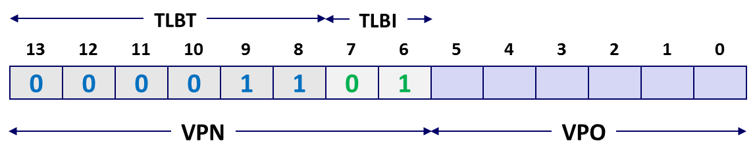
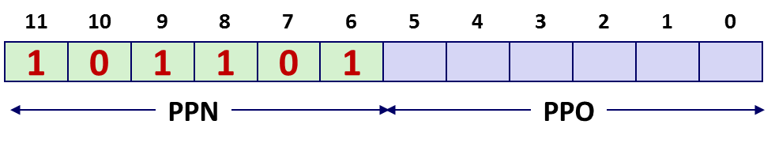
Simple Memory System Page Table
Only showing the first 16 entries (out of 256)
VPN
PPN
Valid
VPN
PPN
Valid
00
28
1
08
13
1
01
–
0
09
17
1
02
33
1
0A
09
1
03
02
1
0B
–
0
04
–
0
0C
–
0
05
16
1
0D
2D
1
0x0D → 0x2D
06
–
0
0E
11
1
07
–
0
0F
0D
1

Slide 13
Simple Memory System Cache
16 lines, 4-byte block size
Physically addressed
Direct mapped
V[0b00001101101001] = V[0x369]
P[0b101101101001] = P[0xB69] = 0x15
CT
CI
CO
11
10
9
8
7
6
5
4
3
2
1
0
1
0
1
1
0
1
1
0
1
0
0
1
PPN
PPO
Idx
Idx
Tag
Tag
Valid
Valid
B0
B0
B1
B1
B2
B2
B3
B3
Idx
Idx
Tag
Tag
Valid
Valid
B0
B0
B1
B1
B2
B2
B3
B3
0
0
19
19
1
1
99
99
11
11
23
23
11
11
8
8
24
24
1
1
3A
3A
00
00
51
51
89
89
1
1
15
15
0
0
–
–
–
–
–
–
–
–
9
9
2D
2D
0
0
–
–
–
–
–
–
–
–
2
2
1B
1B
1
1
00
00
02
02
04
04
08
08
A
A
2D
2D
1
1
93
93
15
15
DA
DA
3B
3B
3
3
36
36
0
0
–
–
–
–
–
–
–
–
B
B
0B
0B
0
0
–
–
–
–
–
–
–
–
4
4
32
32
1
1
43
43
6D
6D
8F
8F
09
09
C
C
12
12
0
0
–
–
–
–
–
–
–
–
5
5
0D
0D
1
1
36
36
72
72
F0
F0
1D
1D
D
D
16
16
1
1
04
04
96
96
34
34
15
15
6
6
31
31
0
0
–
–
–
–
–
–
–
–
E
E
13
13
1
1
83
83
77
77
1B
1B
D3
D3
7
7
16
16
1
1
11
11
C2
C2
DF
DF
03
03
F
F
14
14
0
0
–
–
–
–
–
–
–
–

Slide 14
Address Translation Example
Idx
Tag
Valid
B0
B1
B2
B3
Idx
Tag
Valid
B0
B1
B2
B3
Idx
Tag
Valid
B0
B1
B2
B3
Idx
Tag
Valid
B0
B1
B2
B3
Virtual Address: 0x03D4
  VPN ___ TLBI ___ TLBT ____ TLB Hit? __ Page Fault? __ PPN: ____
Physical Address
  CO ___ CI___ CT ____ Hit? __ Byte: ____
0
19
1
99
11
23
11
8
24
1
3A
00
51
89
0
19
1
99
11
23
11
8
24
1
3A
00
51
89
1
15
0
–
–
–
–
9
2D
0
–
–
–
–
1
15
0
–
–
–
–
9
2D
0
–
–
–
–
TLBT
TLBI
2
1B
1
00
02
04
08
A
2D
1
93
15
DA
3B
2
1B
1
00
02
04
08
A
2D
1
93
15
DA
3B
13
12
11
10
9
8
7
6
5
4
3
2
1
0
3
36
0
–
–
–
–
B
0B
0
–
–
–
–
3
36
0
–
–
–
–
B
0B
0
–
–
–
–
0
0
0
0
1
1
1
1
0
1
0
1
0
0
4
32
1
43
6D
8F
09
C
12
0
–
–
–
–
4
32
1
43
6D
8F
09
C
12
0
–
–
–
–
5
0D
1
36
72
F0
1D
D
16
1
04
96
34
15
5
0D
1
36
72
F0
1D
D
16
1
04
96
34
15
VPN
VPO
6
31
0
–
–
–
–
E
13
1
83
77
1B
D3
6
31
0
–
–
–
–
E
13
1
83
77
1B
D3
7
16
0x0F
0x3
0x03
Y
N
0x0D
7
16
1
11
C2
DF
03
F
14
0
–
–
–
–
1
11
C2
DF
03
F
14
0
–
–
–
–
Translation Lookaside Buffer (TLB)
Set
Tag
PPN
Valid
CT
CI
CO
Tag
PPN
Valid
Tag
PPN
Valid
Tag
PPN
Valid
Set
Tag
PPN
Valid
Tag
PPN
Valid
Tag
PPN
Valid
Tag
PPN
Valid
0
03
11
10
9
8
7
6
5
4
3
2
1
0
–
0
09
0D
1
00
–
0
07
02
1
0
03
–
0
09
0D
1
00
–
0
07
02
1
1
03
0
0
1
1
0
1
0
1
0
1
0
0
2D
1
02
–
0
04
–
0
0A
–
0
1
03
2D
1
02
–
0
04
–
0
0A
–
0
2
02
–
0
PPN
PPO
08
–
0
06
–
0
03
–
0
2
02
–
0
08
–
0
06
–
0
03
–
0
3
07
–
0
03
0D
1
0A
34
1
02
–
0
3
0
0x5
0x0D
Y
0x36
07
–
0
03
0D
1
0A
34
1
02
–
0

Slide 15
Address Translation Example: TLB/Cache Miss
Idx
Tag
Valid
B0
B1
B2
B3
Idx
Tag
Valid
B0
B1
B2
B3
Virtual Address: 0x0020
  VPN ___ TLBI ___ TLBT ____ TLB Hit? __ Page Fault? __ PPN: ____
Physical Address
  CO___ CI___ CT ____ Hit? __ Byte: ____
0
19
1
99
11
23
11
8
24
1
3A
00
51
89
1
15
0
–
–
–
–
9
2D
0
–
–
–
–
TLBT
TLBI
2
1B
1
00
02
04
08
A
2D
1
93
15
DA
3B
13
12
11
10
9
8
7
6
5
4
3
2
1
0
3
36
0
–
–
–
–
B
0B
0
–
–
–
–
0
0
0
0
0
0
0
0
1
0
0
0
0
0
4
32
1
43
6D
8F
09
C
12
0
–
–
–
–
5
0D
1
36
72
F0
1D
D
16
1
04
96
34
15
VPN
VPO
6
31
0
–
–
–
–
E
13
1
83
77
1B
D3
7
16
0x00
0
0x00
N
N
0x28
1
11
C2
DF
03
F
14
0
–
–
–
–
Page table
VPN
PPN
Valid
CT
CI
CO
00
28
1
11
10
9
8
7
6
5
4
3
2
1
0
01
–
0
02
33
1
1
0
1
0
0
0
1
0
0
0
0
0
03
02
1
PPN
PPO
04
–
0
05
16
1
0
0x8
0x28
N
Mem
06
–
0
07
–
0

Slide 16
Address Translation Example
Virtual Address: 0x0B8F
  VPN ___ TLBI ___ TLBT ____ TLB Hit? __ Page Fault? __ PPN: ____
Physical Address
  CO ___ CI___ CT ____ Hit? __ Byte: ____
TLBT
TLBI
13
12
11
10
9
8
7
6
5
4
3
2
1
0
0
0
1
0
1
1
1
0
0
0
1
1
1
1
VPN
VPO
0x2E
2
0x0B
N
Y
TBD
CT
CI
CO
11
10
9
8
7
6
5
4
3
2
1
0
PPN
PPO

Slide 17
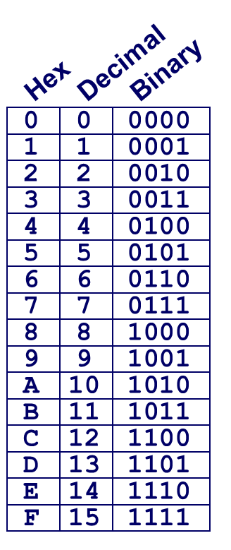
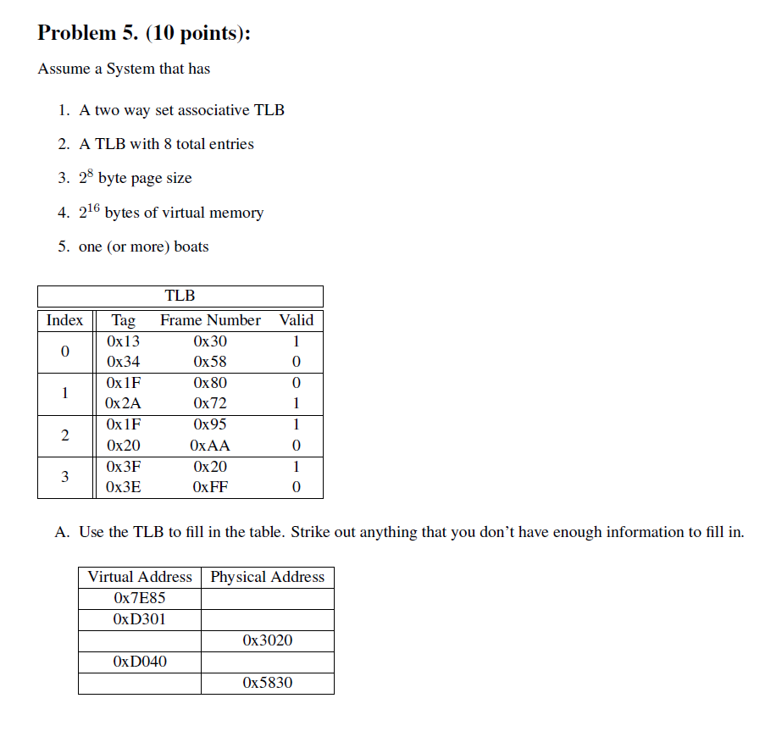
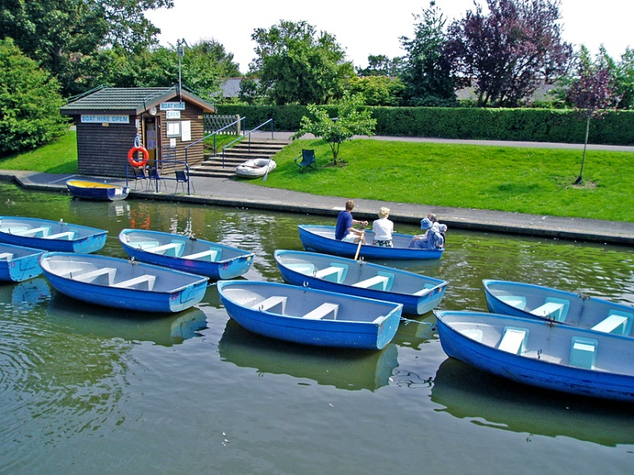
Virtual Memory Exam Question
TLBT
TLBI
15
14
13
12
11
10
9
8
7
6
5
4
3
2
1
0
0
1
1
1
1
1
1
0
1
0
0
0
0
1
0
1
0x7E85
0x9585
TLBI = 0x2
------
0x7E85
= 0x0111111010000101
0x4C20
TLBT = 0x1F
------
------
0x7E85 → 0x9585

Slide 18
Today
Virtual Memory
  Review of Key Concepts
  Simple memory system example
  Case study: Core i7/Linux memory system
  Memory mapping
  Dynamic Memory Mapping

Slide 19
Intel Core i7 Memory System
Processor package
Core x4
Registers
Instruction
fetch
MMU
(addr translation)
L1 d-cache
32 KB, 8-way
L1 i-cache
32 KB, 8-way
L1 d-TLB
64 entries, 4-way
L1 i-TLB
128 entries, 4-way
L2 unified cache
256 KB, 8-way
L2 unified TLB
512 entries, 4-way
To other
cores
QuickPath interconnect
4 links @ 25.6 GB/s each
To I/O
bridge
L3 unified cache
8 MB, 16-way
(shared by all cores)
DDR3 Memory controller
3 x 64 bit @ 10.66 GB/s
32 GB/s total (shared by all cores)
Main memory

Slide 20
End-to-end Core i7 Address Translation
CPU
32/64
L2, L3, and
main memory
Result
Virtual address (VA)
36
12
VPN
VPO
L1
hit
L1
miss
32
4
TLBT
TLBI
L1 d-cache
(64 sets, 8 lines/set)
TLB
hit
TLB
miss
...
...
L1 TLB (16 sets, 4 entries/set)
9
9
9
9
40
12
40
6
6
VPN1
VPN2
VPN3
VPN4
PPN
PPO
CT
CI
CO
Physical
address
(PA)
CR3
PTE
PTE
PTE
PTE
Page tables

Slide 21
Core i7 Level 1-3 Page Table Entries
63
62
52
51
12
11
9
8
7
6
5
4
3
2
1
0
XD
Unused
Page table physical base address
Unused
G
PS
A
CD
WT
U/S
R/W
P=1
Available for OS (page table location on disk)
P=0
Each entry references a 4K child page table. Significant fields:
P: Child page table present in physical memory (1) or not (0).
R/W: Read-only or read-write access access permission for all reachable pages.
U/S: user or supervisor (kernel) mode access permission for all reachable pages.
WT: Write-through or write-back cache policy for the child page table.
A: Reference bit (set by MMU on reads and writes, cleared by software).
PS: Page size either 4 KB or 4 MB (defined for Level 1 PTEs only).
Page table physical base address: 40 most significant bits of physical page table address (forces page tables to be 4KB aligned)
XD: Disable or enable instruction fetches from all pages reachable from this PTE.

Slide 22
Core i7 Level 4 Page Table Entries
63
62
52
51
12
11
9
8
7
6
5
4
3
2
1
0
XD
Unused
Page physical base address
Unused
G
D
A
CD
WT
U/S
R/W
P=1
Available for OS (page location on disk)
P=0
Each entry references a 4K child page. Significant fields:
P: Child page is present in memory (1) or not (0)
R/W: Read-only or read-write access permission for child page
U/S: User or supervisor mode access
WT: Write-through or write-back cache policy for this page
A: Reference bit (set by MMU on reads and writes, cleared by software)
D: Dirty bit (set by MMU on writes, cleared by software)
Page physical base address: 40 most significant bits of physical page address (forces pages to be 4KB aligned)
XD: Disable or enable instruction fetches from this page.

Slide 23
Core i7 Page Table Translation
9
9
9
9
12
Virtual
address
VPN 1
VPN 2
VPN 3
VPN 4
VPO
L1 PT
Page global
directory
L2 PT
Page upper
directory
L3 PT
Page middle
directory
L4 PT
Page
table
40
40
40
40
CR3
/
/
/
/
Physical
address
of L1 PT
Offset into
physical and
virtual page
/
12
L1 PTE
L2 PTE
L3 PTE
L4 PTE
Physical
address
of page
512 GB
region
per entry
1 GB
region
per entry
2 MB
region
per entry
4 KB
region
per entry
40
/
40
12
Physical
address
PPN
PPO

Slide 24
Cute Trick for Speeding Up L1 Access
CT
Tag Check
40
6
6
Physical
address
(PA)
CT
CI
CO
PPN
PPO
Address
Translation
No
Change
Virtual
address
(VA)
CI
VPN
VPO
L1 Cache
36
12
Observation
  Bits that determine CI identical in virtual and physical address
  Can index into cache while address translation taking place
  Generally we hit in TLB, so PPN bits (CT bits) available next
  “Virtually indexed, physically tagged”
  Cache carefully sized to make this possible

Slide 25
Virtual Address Space of a Linux Process
Process-specific data
structs (ptables,
task and mm structs, kernel stack)
Different for each process
Kernel
virtual
memory
Identical for each process
Physical memory
Kernel code and data
%rsp
User stack
Memory mapped region
for shared libraries
Process
virtual
memory
brk
Runtime heap (malloc)
Uninitialized data (.bss)
Initialized data (.data)
0x00400000
Program text (.text)
0

Slide 26
Linux Organizes VM as Collection of “Areas”
Process virtual memory
vm_area_struct
task_struct
mm_struct
vm_end
mm
pgd
vm_start
vm_prot
mmap
vm_flags
Shared libraries
vm_next
vm_end
pgd:
  Page global directory address
  Points to L1 page table
vm_prot:
  Read/write permissions for
  this area
vm_flags
  Pages shared with other processes or private to this process
vm_start
Data
vm_prot
vm_flags
vm_next
Text
vm_end
vm_start
vm_prot
vm_flags
vm_next
0
Each process has own task_struct, etc

Slide 27
Linux Page Fault Handling
vm_area_struct
Process virtual memory
vm_end
vm_start
vm_prot
vm_flags
shared libraries
vm_next
1
Segmentation fault:
accessing a non-existing page
read
vm_end
vm_start
data
3
vm_prot
read
Normal page fault
vm_flags
vm_next
text
2
Protection exception:
e.g., violating permission by writing to a read-only page (Linux reports as Segmentation fault)
write
vm_end
vm_start
vm_prot
vm_flags
vm_next

Slide 28
Today
Virtual Memory
  Review of Key Concepts
  Simple memory system example
  Case study: Core i7/Linux memory system
  Memory mapping
  Dynamic Memory Mapping

Slide 29
Memory Mapping
VM areas initialized by associating them with disk objects.
  Called memory mapping
Area can be backed by (i.e., get its initial values from) :
  Regular file on disk (e.g., an executable object file)
    Initial page bytes come from a section of a file
  Anonymous file (e.g., nothing)
    First fault will allocate a physical page full of 0's (demand-zero page)
    Once the page is written to (dirtied), it is like any other page
Dirty pages are copied back and forth between memory and a special swap file.

Slide 30
Review: Memory Management & Protection
Code and data can be isolated or shared among processes
0
Address
translation
0
Virtual Address Space for Process 1:
Physical
Address
Space (DRAM)
VP 1
VP 2
PP 2
...
N-1
PP 6
(e.g., read-only
library code)
Virtual Address Space for Process 2:
0
PP 8
VP 1
VP 2
...
...
N-1
M-1

Slide 31
Sharing Revisited: Shared Objects
Process 1
virtual memory
Physical
memory
Process 2
virtual memory
Process 1 maps the shared object (on disk).
Shared
object

Slide 32
Sharing Revisited: Shared Objects
Process 1
virtual memory
Physical
memory
Process 2
virtual memory
Process 2 maps the same shared object.
Notice how the virtual addresses can be different.
But, difference must be multiple of page size
Shared
object

Slide 33
Sharing Revisited:
Private Copy-on-write (COW) Objects
Process 1
virtual memory
Physical
memory
Process 2
virtual memory
Two processes mapping a private copy-on-write (COW) object
Area flagged as private copy-on-write
PTEs in private areas are flagged as read-only
Private
copy-on-write
area
Private
copy-on-write object

Slide 34
Sharing Revisited:
Private Copy-on-write (COW) Objects
Process 1
virtual memory
Physical
memory
Process 2
virtual memory
Instruction writing to private page triggers protection fault.
Handler creates new R/W page.
Instruction restarts upon handler return.
Copying deferred as long as possible!
Copy-on-write
Write to private
copy-on-write
page
Private
copy-on-write object

Slide 35
The fork Function Revisited
VM and memory mapping explain how fork provides private address space for each process.
To create virtual address for new process:
  Create exact copies of current mm_struct, vm_area_struct, and page tables.
  Flag each page in both processes as read-only
  Flag each vm_area_struct in both processes as private COW
On return, each process has exact copy of virtual memory.
Subsequent writes create new pages using COW mechanism.

Slide 36
The execve Function Revisited
User stack
Private, demand-zero
To load and run a new program a.out in the current process using execve:
Free vm_area_struct’s and page tables for old areas
Create vm_area_struct’s and page tables for new areas
  Programs and initialized data backed by object files.
  .bss and stack backed by anonymous files.
Set PC to entry point in .text
  Linux will fault in code and data pages as needed.
libc.so
.data
Memory mapped region
for shared libraries
Shared, file-backed
.text
Runtime heap (via malloc)
Private, demand-zero
Uninitialized data (.bss)
Private, demand-zero
a.out
Initialized data (.data)
.data
Private, file-backed
.text
Program text (.text)
0

Slide 37
Finding More Shareable Pages
Easy places to identify shareable pages
  Child create via fork
  Processes loading the same binary file
    E.g., bash or python interpreters, web browsers, ...
  Processes loading the same library file
What about others?
  Kernel Same-Page Merging
  OS scans through all of physical memory, looking for duplicate pages
  When found, merge into single copy, marked as copy-on-write
  Implemented in Linux kernel in 2009
  Limited to pages marked as likely candidates
  Especially useful when processor running many virtual machines

Slide 38
User-Level Memory Mapping
void *mmap(void *start, int len,
int prot, int flags, int fd, int offset)
Map len bytes starting at offset offset of the file specified by file description fd, preferably at address start
  start: may be 0 for “pick an address”
  prot: PROT_READ, PROT_WRITE, PROT_EXEC, ...
  flags: MAP_ANON, MAP_PRIVATE, MAP_SHARED, ...
Return a pointer to start of mapped area (may not be start)

Slide 39
User-Level Memory Mapping
void *mmap(void *start, int len,
int prot, int flags, int fd, int offset)
len bytes
start
(or address
chosen by kernel)
len bytes
offset
(bytes)
0
0
Disk file specified by
file descriptor fd
Process virtual memory

Slide 40
Example: Using mmap to Copy Files
Copying a file to stdout without transferring data to user space
  This code does not meet our coding standards.
#include "csapp.h"
void mmapcopy(int fd, int size)
{
/* Ptr to memory mapped area */
char *bufp;
bufp = mmap(NULL, size,
PROT_READ,
MAP_PRIVATE,
fd, 0);
write(STDOUT_FILENO,
bufp, size);
return;
}
/* mmapcopy driver */
int main(int argc, char **argv)
{
struct stat stat;
int fd;
/* Check for required cmd line arg */
if (argc != 2) {
printf("usage: %s <filename>\n",
argv[0]);
exit(0);
}
/* Copy input file to stdout */
fd = Open(argv[1], O_RDONLY, 0);
fstat(fd, &stat);
mmapcopy(fd, stat.st_size);
exit(0);
}
mmapcopy.c
mmapcopy.c

Slide 41
Some Uses of mmap
Reading big files
  Uses paging mechanism to bring files into memory
Shared data structures
  When call with MAP_SHARED flag
    Multiple processes have access to same region of memory
    Risky!
File-based data structures
  E.g., database
  Give prot argument PROT_READ | PROT_WRITE
  When unmap region, file will be updated via write-back
  Can implement load from file / update / write back to file

Slide 42
Summary
VM requires hardware support
  Exception handling mechanism
  TLB
  Various control registers
VM requires OS support
  Managing page tables
  Implementing page replacement policies
  Managing file system
VM enables many capabilities
  Loading programs from memory
  Forking processes
  Providing memory protection

Slide 43
Today
Virtual Memory
  Review of Key Concepts
  Simple memory system example
  Case study: Core i7/Linux memory system
  Memory mapping
  Dynamic Memory Mapping

Slide 44
Dynamic Memory Allocation
Memory
invisible to
user code
Application
Kernel virtual memory
Dynamic Memory Allocator
User stack
(created at runtime)
Heap
%rsp
(stack
pointer)
Programmers use dynamic memory allocators (such as malloc) to acquire virtual memory (VM) at run time.
  for data structures whose size is only known at runtime
Dynamic memory allocators manage an area of process VM known as the heap.
Memory-mapped region for
shared libraries
brk
Run-time heap
(created by malloc)
Read/write segment
(.data, .bss)
Loaded
from
the
executable
file
Read-only segment
(.init, .text, .rodata)
0x400000
Unused
0

Slide 45
Dynamic Memory Allocation
Allocator maintains heap as collection of variable sized blocks, which are either allocated or free
Types of allocators
  Explicit allocator: application allocates and frees space
    E.g., malloc and free in C
  Implicit allocator: application allocates, but does not free space
    E.g., new and garbage collection in Java
Will discuss simple explicit memory allocation today

Slide 46
The malloc Package
#include <stdlib.h>
void *malloc(size_t size)
  Successful:
    Returns a pointer to a memory block of at least size bytes
    aligned to a 16-byte boundary (on x86-64)
    If size == 0, returns NULL
  Unsuccessful: returns NULL (0) and sets errno to ENOMEM
void free(void *p)
  Returns the block pointed at by p to pool of available memory
  p must come from a previous call to malloc or realloc
Other functions
  calloc: Version of malloc that initializes allocated block to zero.
  realloc: Changes the size of a previously allocated block.
  sbrk: Used internally by allocators to grow or shrink the heap

Slide 47
malloc Example
#include <stdio.h>
#include <stdlib.h>
void foo(int n) {
int i, *p;
/* Allocate a block of n ints */
p = (int *) malloc(n * sizeof(int));
if (p == NULL) {
perror("malloc");
exit(0);
}
/* Initialize allocated block */
for (i=0; i<n; i++)
p[i] = i;
/* Return allocated block to the heap */
free(p);
}

Slide 48
Simplifying Assumptions Made in This Lecture
Memory is word addressed.
Words are int-sized.
Allocations are double-word aligned.
Allocated block
(4 words)
Free block
(2 words)
Free word
Allocated word

Slide 49
Allocation Example
#define SIZ sizeof(int)
p1 = malloc(4*SIZ)
p2 = malloc(5*SIZ)
p3 = malloc(6*SIZ)
free(p2)
p4 = malloc(2*SIZ)

Slide 50
Constraints
Applications
  Can issue arbitrary sequence of malloc and free requests
  free request must be to a malloc’d block
Explicit Allocators
  Can’t control number or size of allocated blocks
  Must respond immediately to malloc requests
    i.e., can’t reorder or buffer requests
  Must allocate blocks from free memory
    i.e., can only place allocated blocks in free memory
  Must align blocks so they satisfy all alignment requirements
    16-byte (x86-64) alignment on Linux boxes
  Can manipulate and modify only free memory
  Can’t move the allocated blocks once they are malloc’d
    i.e., compaction is not allowed. Why not?

Slide 51
Performance Goal: Throughput
Given some sequence of malloc and free requests:
  R₀, R₁, ..., R_{k}, ... , R_{n-1}
Goals: maximize throughput and peak memory utilization
  These goals are often conflicting
Throughput:
  Number of completed requests per unit time
  Example:
    5,000 malloc calls and 5,000 free calls in 10 seconds
    Throughput is 1,000 operations/second

Slide 52
Performance Goal: Peak Memory Utilization
Given some sequence of malloc and free requests:
  R₀, R₁, ..., R_{k}, ... , R_{n-1}
Def: Aggregate payload P_{k}
  malloc(p) results in a block with a payload of p bytes
  After request R_{k} has completed, the aggregate payload P_{k} is the sum of currently allocated payloads
Def: Current heap size H_{k}
  Assume H_{k} is monotonically nondecreasing
    i.e., heap only grows when allocator uses sbrk
Def: Peak memory utilization after k+1 requests
  U_{k} = ( max_{i≤k} P_{i} ) / H_{k}

Slide 53
Fragmentation
Poor memory utilization caused by fragmentation
  internal fragmentation
  external fragmentation

Slide 54
Internal Fragmentation
For a given block, internal fragmentation occurs if payload is smaller than block size
Caused by
  Overhead of maintaining heap data structures
  Padding for alignment purposes
  Explicit policy decisions
  (e.g., to return a big block to satisfy a small request)
Depends only on the pattern of previous requests
  Thus, easy to measure
Block
Internal
fragmentation
Payload
Internal
fragmentation

Slide 55

External Fragmentation
#define SIZ sizeof(int)
Occurs when there is enough aggregate heap memory, but no single free block is large enough
Amount of external fragmentation
depends on the pattern of future requests
  Thus, difficult to measure
p1 = malloc(4*SIZ)
p2 = malloc(5*SIZ)
p3 = malloc(6*SIZ)
free(p2)
p4 = malloc(7*SIZ)
Yikes! (what would happen now?)

Slide 56
Implementation Issues
How do we know how much memory to free given just a pointer?
How do we keep track of the free blocks?
What do we do with the extra space when allocating a structure that is smaller than the free block it is placed in?
How do we pick a block to use for allocation -- many might fit?
How do we reinsert freed block?

Slide 57
Knowing How Much to Free
Standard method
  Keep the length of a block in the word preceding the block.
    This word is often called the header field or header
  Requires an extra word for every allocated block
p0
p0 = malloc(4*SIZ)
5
block size
Payload
(aligned)
free(p0)

Slide 58
Keeping Track of Free Blocks
Method 1: Implicit list using length—links all blocks
Method 2: Explicit list among the free blocks using pointers
Method 3: Segregated free list
  Different free lists for different size classes
Method 4: Blocks sorted by size
  Can use a balanced tree (e.g. Red-Black tree) with pointers within each free block, and the length used as a key
Need to tag
each block as
allocated/free
Unused
4
6
4
2
Need space
for pointers
4
6
4
2

Slide 59
Homework – Week 5
Homework #3 – Due 2/13 @ 5:45PM
  Problems 9.11, 9.12, 9.13
Begin Shell Lab
Read: CS:APP
  Sections 9.1-9.8

