Slide 1
GAM 398: Topics in Rendering and Graphics Programming
Lecture 1:
Syllabus, Introduction and Software

Slide 2
Part 1:
Graphics Programming

Slide 3
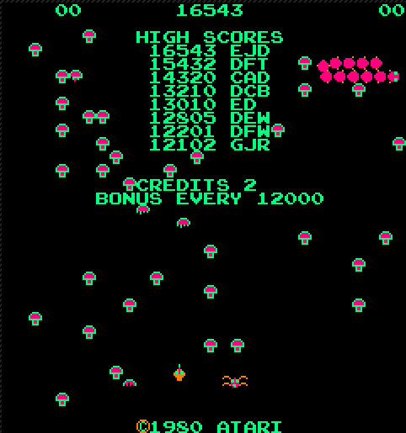
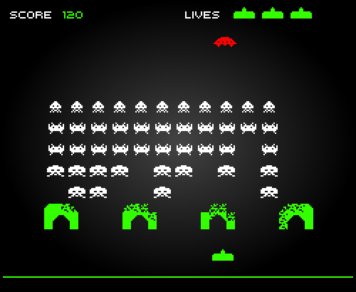
Programming Games
Game Engine
Asset Management
Level
Control
Game Loop
Game Object
Rendering System
Centipede
Input System
Ship
Mushroom
Levels
Aliens
Levels
Spider
Managers
Saucer
Managers
Systems Layer
Window and Inputs
(OS API)
Shield
Vector & Matrix
(optimized)
Graphic Support
(Graphic objects, Shaders, Rendering Control)

Slide 4
Rendering and Graphics Programming
Our focus will be on the Graphic Support
  Understanding the basics of computer graphics programming
  Creating an API to provide graphic support for an eventual game engine.
  For reasons that will become clear soon, we also have to deal with the other components: Windows & Input and Vector & Matrix package
Systems Layer
Window and Inputs
(OS API)
Vector & Matrix
(optimized)
Graphic Support
(Graphic objects, Shaders, Rendering Control)

Slide 5
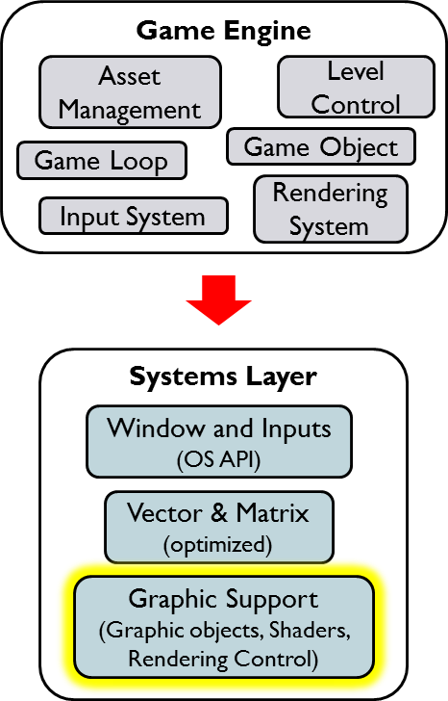
Student Preparation:
Differences Between Grad and UG.
Prerequisite: GAM 325/425 and CSC 361/461
  Everyone should have done those classes already.
Experience with Game Programming & Design Patterns
  UG: GAM 372 OO for Game Dev Taken last quarter
  Grad: SE 456 Architecture of Real-Time Systems Taken this quarter
Experience with Game Engine programming
  UG: GAM 374 Game Engine Prog. I Taken this quarter
  Grad: GAM 475 Game Engine Prog. I Taken next Fall
There is a clear asymmetry between Grad and UG students…
Grad Students:
This asymmetry should NOT affect your ability to succeed in this class.
However, it does mean that some of the requirements may not make intuitive sense until GAM 475

Slide 6
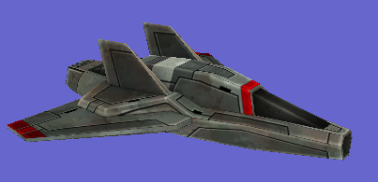
Final Product:
Expected API Example
10 weeks from now, we want our users to have this type of Graphics API
void Game::Initialize()
{
// Game Window Device setup
}
void Game::LoadContent()
{
// Load external assets
Model *pModelSpaceFrigate = new Model("space_frigate.azul");
Texture *pTexSpaceFrigate = new Texture("space_frigate.tga");
ShaderObject *pShaderObject_texture = new ShaderObject("textureFlatRender");
// Create graphic object
pGObj_SpaceshipWithTexture = new GraphicsObject_TextureFlat(
pModelSpaceFrigate,
pShaderObject_texture,
pTexSpaceFrigate);
// Setup the current 3D perspective Camera
pCam3D = new Camera( Camera::Type::PERSPECTIVE_3D );
// < details omitted >
}
void Game::Update()
{
pGObj_SpaceshipWithTexture->SetWorld( < details omitted > );
}
void Game::Draw()
{
pGObj_SpaceshipWithTexture->Render(pCam3D);
}
Specifically: You’ll need to provide
Game loop calling these 4 methods.
The ability to load external assets for Model, Textures and Shaders
Graphics objects (GPU connection)
Camera functionality and matrices
Control the rendering pipeline
And many more hidden systems
These represent the minimal set of functionalities needed for the next layer up (the game engine) to be built.

Slide 7
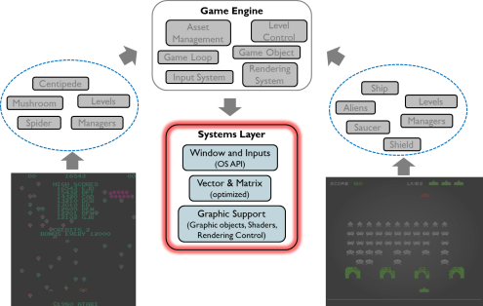
Final Product:
Things You May Not Know…
Model:
  More complex than just points and triangles: Normals, UV maps, Color, etc.
  Must be stored on the GPU but its access controlled by the game engine
Texture:
  More complex than an just an array of pixels: Sampling, LOD, etc
  Must be stored on the GPU but its access controlled by the game engine
Shader:
  Code controlling how objects actually appears (color, light, texture, etc.)
  Must be stored on the GPU but its access controlled by the game engine
Camera:
  At minimum, you need to create the view and projection matrices
Graphic Object:
  Lives on the CPU and orchestrates Model + Shader (and associated data) on the GPU
Draw/Rendering stage:
  Controlled from the CPU but working on the GPU. There is a LOT going on behind the scenes!
  Particularly complicated when you have multiple game objects, shaders, etc.
Our Job:
Use the low level controls offered by a graphics environment and create a framework on top of which a game engine could be built.

Slide 8
Graphic Support:
A Very Different Kind of Programming
Understanding the Rendering Pipeline
  How the GPU combines models, textures and matrices
  into a 3D scene projected onto a 2D image on screen
    The camera matrices (GAM 325/425) are only the start:
    Illumination and other visual effects are also needed.
    Many pipeline stages to review and understand
The GPU is a different computer, with its own memory and I/O.
  This is a new mindset: All the data (models, textures, matrices) and programs (shaders) need to be sent to the GPU. There is no ‘shared’ memory and no access to CPU data.
    Every frame is like sending off a new computing job to a remote computer!
The operating system must mediate our work:
    User input (keyboard, controllers, etc.) are devices managed by the OS
    The GPU’s output (Window/Full screen display) is also managed by the OS
Systems Layer
Window and Inputs
(OS API)
Vector & Matrix
(optimized)
Graphic Support
(Graphic objects, Shaders, Rendering Control)
The goal of the graphic support layer is to abstract away all these complexities behind a (hopefully) simple API

Slide 9
Part 2:
Graphic Environment Options

Slide 10
Graphic Environments Options:
OpenGL
OpenGL is the most commonly used graphics environment
  Cross-platform, open source with LOTS of documentation…
  Started in 1991, multiple versions since (Latests: OpenGL v4.5 in 2014, v4.6 in 2017)
  Showing its age: OpenGL 4 series (c. 2010) was designed for single core CPU!
  Associated Packages:
    Windowing: Your choice: GLEW, GL3W, glad, GLee, etc. Each of these have their own pros and cons, and some compatibility issues with older versions of OpenGL.
      Why so many options? Being multi-platform means you have to abstract away the OS layer from the windowing operations needed by OpenGL. Each package above represents a different approach to accomplish more or less the same thing.
    Math: GLM, though not strictly required to use OpenGL
    Graphics Support: Worked well for years, but the insistence on backwards compatibility for newer versions has prevented it from taking full advantage of the new features offered by modern GPUs. Game devs are slowly looking for other alternatives
IMHO: OpenGL is not particularly easy to work with as a ‘first’ graphics environment. But you once you’ve had experience on other graphics environments, OpenGL should be more approachable and its quirks won’t throw you off too badly.

Slide 11
Graphic Environments Options :
Vulkan
Vulkan (headed by the Khronos group) is a complete redesign of OpenGL from scratch, targeted at modern, high-performance GPU and multi-core CPU
  Cross-Platform, open source, still relatively new (released Feb 2016)
  Looks extremely promising and may eventually be a new industry standard.
  As of late 2017, a kerfuffle between Khronos and Apple is causing some compatibility issues, even when using BootCamp to run Windows on a Mac machine…
    Breaking News: As of Jan 2018, this seems to have been resolved…
IMHO: A bit too new for teaching as a first graphics environment:
  Still few demos available (more appearing every day though)
  Few books (only 6 as of in Dec 2017, up from 2 in 2016)
I say: let early adopters iron out the initial bugs and issues!
Side note: We will likely convert Azul to Vulkan soon, so expect more exposure to Vulkan in the future

Slide 12
Graphic Environments Options:
DirectX
DirectX is Microsoft’s version of graphics environment for Windows.
  Very much not cross-platform or open source: Only good for Microsoft hardware (still a substantial market though…)
  Many versions but very little concern for backwards compatibility
    DX 11 (released in 2009) was already trying to deal with multi-core CPU
    DX 12 (released in 2015) can handle multiple GPUs and has better high-performance tools
  Packages:
    Windowing: This is a Windows-only environment, so WinAPI it is (for better or worse)
    Math: DirectXMath (Previously: XNAMath), though not strictly required to use DirectX
    Graphics Support: DX 11 and DX12 offer a more modern and cohesive environment compared to OpenGL. Obviously, being Microsoft-only environment is a problem for general game development.
IMHO: DirectX is the most approachable option as a ‘first’ graphics environment.
It’s stable & well documented
Has much more intuitive API than OpenGL.
Has a more approachable API than Vulkan

Slide 13
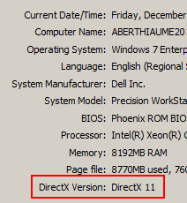
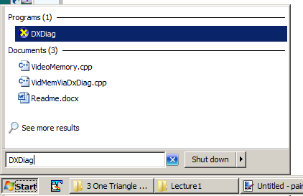
DirectX:
But Which Versions: DX 11 or DX 12?
Test your version of DirectX: Run ‘DXDiag
As of my last class survey:
  Still 1/3 students have no DX 12 hardware
Therefore: all our code will be targeted for DX 11
  Nothing we do here would require the performance benefit of DX 12 anyway
  The syntactic differences between DX 11 and DX 12 are very minor
Problem: Availability of DirectX SDK for DX 11
  Win 7: requires special download (dated from June 2010).
  Win 8 and later: already integrated ( NO DOWNLOAD REQUIRED )

Slide 14
Part 3:
Learning Graphics Programming

Slide 15
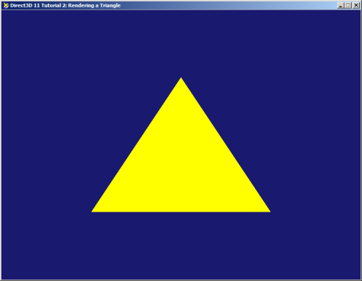
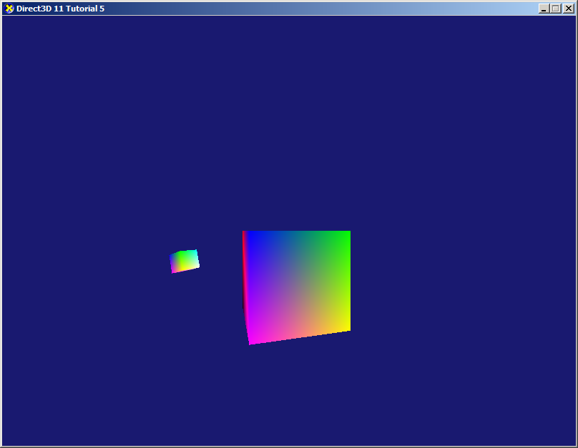
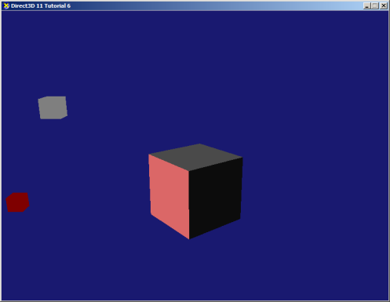
Learning about
Graphics Environments (GE)
You can find plenty of tutorials to learn about any GE
  Ex: Somebody kindly upgraded the old DX 11 tutorials for VS 2017
Unfortunately, IMHO most of these tutorials (for any GE) are terrible.
  If you already know how to work in with a GE, these tutorials help you quickly translate your prior knowledge to the new GE. Useless for us since this is our first GE.
  If you’ve never worked with a GE, these tutorials can be very confusing, Worse: they gloss over many important aspects while obfuscating other things with too many details
    By analogy: A seasoned C++ programmer can learn Java from a few code snippets. But a novice programmer viewing those same snippets of Java won’t turn into a Java programmer.
  By the way: most books on GE have the same problematic approach…
First Triangle
Color and Texture
Shaders and Lighting

Slide 16
Learning about
Graphics Environments (GE)
These tutorial do provide good information, if you know how to ‘read’ them
  Indeed, I fully expect you’ll study many of these online tutorials for DX 11
But this class is about more than just learning about DirectX. (Syllabus)
  By the end of the course, you will be able to:
    Describe and explain the various stages of a rendering pipeline.
    Write simple shaders to render a basic 3D scene.
    Implement the Phong Illumination model
    Implement Gouraud and Phong lighting shaders
    Build simple models, place them in 3D space and render the scene correctly.
    Apply textures to their models as well as control how this texture is applied using UV mapping, repeats/clamp, texture sampling, etc.
  Optionally (if we have time)
  Implement texture mipmaps to improve rendering performance.
  Implement environment maps, multi-texturing and reflections

Slide 17
Learning about
Graphics Environments (GE)
But this class is about more than just learning about DirectX. (Syllabus)
  By the end of the course, you will be able to:
    Describe and explain the various stages of a rendering pipeline.
    Write simple shaders to render a basic 3D scene.
    Implement the Phong Illumination model
    Implement Gouraud and Phong lighting shaders
    Build simple models, place them in 3D space and render the scene correctly.
    Apply textures to their models as well as control how this texture is applied using UV mapping, repeats/clamp, texture sampling, etc.
  Optionally (if we have time)
  Implement texture mipmaps to improve rendering performance.
  Implement environment maps, multi-texturing and reflections
These goals will give you a basic understanding of graphics programming.
Other classes will cover advanced shaders and high-performance rendering

Slide 18
Part 4:
Simple Projects

Slide 19
Software: Visual Studio
We’ll be using Visual Studio Enterprise 2017
    You must have activated your MSDNAA account
    Use the enterprise version, not ‘community’, ‘express’ or anything else…
  Installation has many options!
  Get to the Visual Studio Installer
    Either during initial install OR
    From Visual Studio top menu: Tools/Get tools and Features

Slide 20
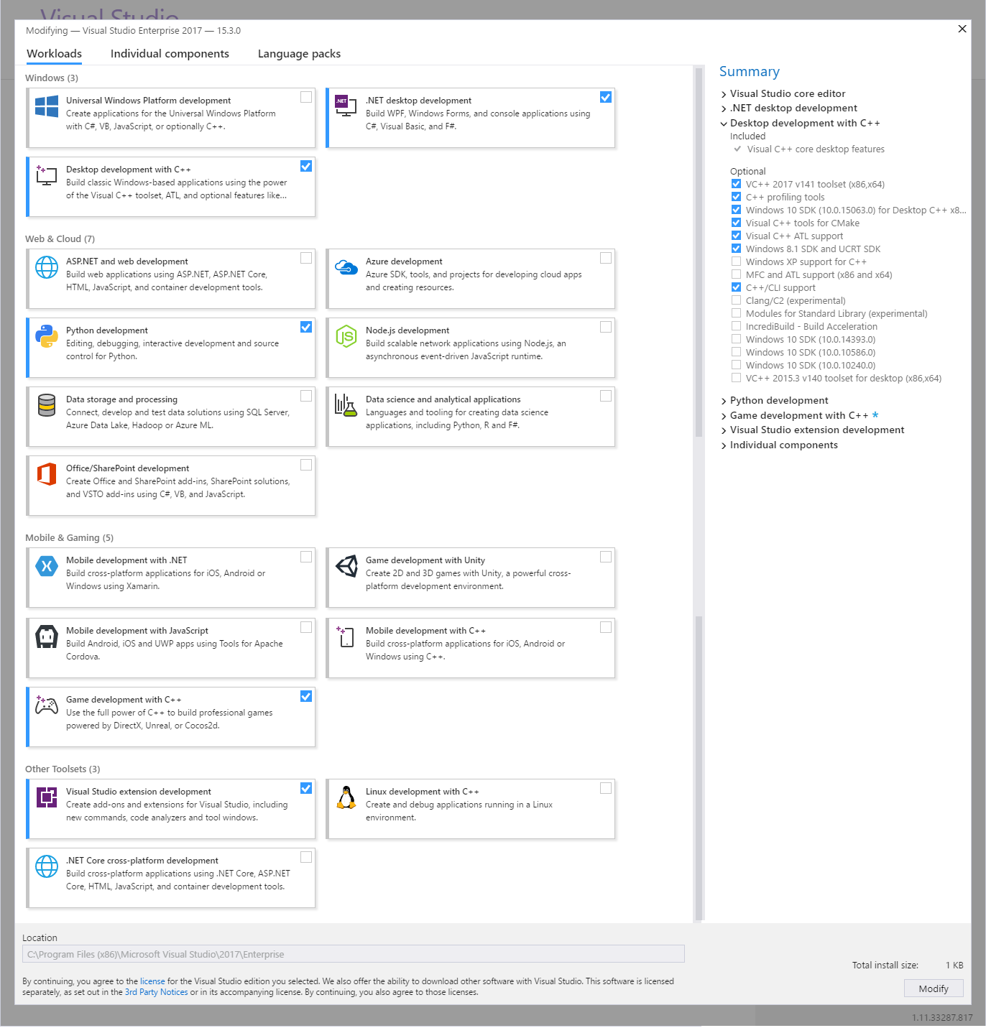
VS 2017
Workloads Tab:
Add these options:
  .Net Desktop Development
  Desktop Dev with C++
    Extra: Windows 8.1 SDK
  Python Development
  Game Dev with C++
  VS extension Dev.

Slide 21
Software and Environment
We’ll be using Visual Studio Enterprise 2017
    You must have activated your MSDNAA account
    Use the enterprise version, not ‘community’, ‘express’ or anything else…
Libraries: DirectX SDK for DX 11
    Win 7: requires special download (dated from June 2010).
    Win 8 and later: already integrated ( NO DOWNLOAD REQUIRED )
Version Control:
  Perforce: Specifically, the Helix P4V client (scroll down a bit to find it)

Slide 22
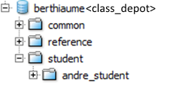
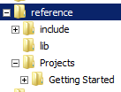
Perforce
Perforce:
  Follow the instructions for Perforce Client Setup
  Many documents to read and tutorials to watch!
  Read them and watch them!
Once you setup your local workspace you should see the following folders:
Public exchange folder:
  Everyone has Read/Write access
Lectures, Libraries, etc.:
  Read only
Student folders:
  You only see yours and have read/write access

Slide 23
Creating a Project:
Copying from existing
Copy any project into your own folder.
  The originals will be in ‘Reference/…’
Right-click the new folder and select ‘properties’
  Make sure to uncheck ‘Read Only’
(Optional) Rename the .sln file to fit the project
  The associated .exe will have the same name
Open the solution
Build, run
Let’s look at some examples…

Slide 24
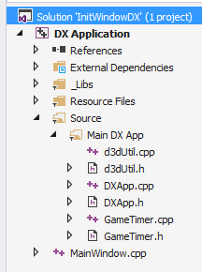
Getting Started:
Project: Initial Window
MainWindow Class
  Standard code for a window application (WinAPI). Details unimportant.
  InitWindow: Various settings, including Title and Size.
  wWinMain: Windows app entry point: sets up the event loop
  WndProc: Event dispatcher. Useful for a full game engine design.
  Any graphics env. needs to go through the OS to access to display and create the event loop
GameTimer Class
  Creates a time system. Details are unimportant
  Stop-watch mechanism based off the OS time.
  Tracks frame time and total time. Useful for a full game engine design.
  Typically offered by graphics environment because of their interfacing with the OS, but time has very little relevance to any graphics work we will do in this class.
d3dUtil Class
  Utilities to be discussed later. (Significantly modified from the original…)
DXApp Class
  This is the real DirectX application.
  All demos will take place here. Your job will be the improve on this mess…
3:
4:
2:
1:

Slide 25
Preliminaries:
(Book Chap 4.1: Please read it! Seriously…)
Component Object Model (COM): It’s a Windows thing…
  Objects that ‘live’ on the GPU (well, for our applications anyway).
  We only have access to them through ‘interface’ objects ( ID3D11<type> or IDXGI<type>)
  Managed pointers: We don’t create these directly and we must ‘release’ them when done.
void DXApp::InitDirect3D()
{
D3D11CreateDevice( … , &md3dDevice, …);
// DX application elements
ID3D11Device* md3dDevice;
ID3D11DeviceContext* md3dImmediateContext;
IDXGISwapChain* mSwapChain;
ID3D11RenderTargetView* mRenderTargetView;
DXApp::~DXApp()
{
ReleaseAndDeleteCOMobject(md3dDevice);
DirectX App
GPU
md3dDevice
ID3D11Device
Main Controls
md3dImmediateContext
ID3D11DeviceContext
Render Pipeline
mSwapChain
IDXGISwapChain
Swap Chain
mRenderTargetView
ID3D11RenderTargetView
Render Target View

Slide 26
Preliminaries:
Device & DeviceContext
// DX application elements
ID3D11Device* md3dDevice;
ID3D11DeviceContext* md3dImmediateContext;
IDXGISwapChain* mSwapChain;
ID3D11RenderTargetView* mRenderTargetView;
These two ‘handles’ give us our primary access to the GPU
  The details for how they work aren’t too important, but roughly speaking:
  Device deals with creation and initialization of various DirectX entities
  DeviceContext deals more closely with the render pipeline control and operations.
  Note: We will only work with a single device context, called ‘md3dImmediateContext’. The term ‘immediate’ is in contrast with multiple ‘deferred contexts’ used when working with DX in a multithreaded application. This is outside the scope of this class.
DirectX App
GPU
md3dDevice
ID3D11Device
Main Controls
md3dImmediateContext
ID3D11DeviceContext
Render Pipeline
mSwapChain
IDXGISwapChain
Swap Chain
mRenderTargetView
ID3D11RenderTargetView
Render Target View

Slide 27
Preliminaries:
Swap Chains
// DX application elements
ID3D11Device* md3dDevice;
ID3D11DeviceContext* md3dImmediateContext;
IDXGISwapChain* mSwapChain;
ID3D11RenderTargetView* mRenderTargetView;
Standard rendering procedure requires (at least) two rendering ‘buffers’
  When buffer #1 is being displayed (front buffer), buffer #2 (back buffer) is used to draw (out of sight) the next animation frame.
  Once the drawing is complete, buffer #2 is switched into view, freeing up buffer #1.
Buffer #1
Front Buffer
DX Application
Back buffer
Buffer #2

Slide 28
Preliminaries:
Swap Chains
// DX application elements
ID3D11Device* md3dDevice;
ID3D11DeviceContext* md3dImmediateContext;
IDXGISwapChain* mSwapChain;
ID3D11RenderTargetView* mRenderTargetView;
Standard rendering procedure requires (at least) two rendering ‘buffers’
  When buffer #1 is being displayed (front buffer), buffer #2 (back buffer) is used to draw (out of sight) the next animation frame.
  Once the drawing is complete, buffer #2 is switched into view, freeing up buffer #1.
  ‘Front buffer’ always refers to the one being displayed, ‘back buffer’, the other one.
  These two buffers together form the Swap Chain
    Swap chains can use more than two buffers for more advanced applications, but 2 is sufficient for most cases
Swap Chain
Buffer #1
Back buffer
DX Application
Front Buffer
Buffer #2

Slide 29
Preliminaries:
RenderTargetView
// DX application elements
ID3D11Device* md3dDevice;
ID3D11DeviceContext* md3dImmediateContext;
IDXGISwapChain* mSwapChain;
ID3D11RenderTargetView* mRenderTargetView;
RenderTargetView is a GPU resource that controls where the output of the render pipeline will be ‘written’.
  Normally, the pipeline is set to write its output to the back buffer (To prepare for the next frame)
    Note: in this case the render target isn’t a fixed location: it’s wherever the back buffer points to
  Another common render target option would be to render to a separate texture buffer used to ‘take a picture’ of your game scene.
md3dDevice->CreateRenderTargetView( pBackBuffer, nullptr, &mRenderTargetView);
Swap Chain
Buffer #1
Back buffer
DX Application
Front Buffer
RenderTargetView
Buffer #2

Slide 30
To Recap: A New Diagram
DirectX App
GPU
md3dDevice
ID3D11Device
Main Controls
Render Pipeline
md3dImmediateContext
ID3D11DeviceContext
mSwapChain
IDXGISwapChain
Swap Chain
FrontBuffer
BackBuffer
Buffer #1
Buffer #2
mRenderTargetView
ID3D11RenderTargetView
Render Target View
Send to SwapChain->BackBuffer
This diagram only ‘names’ things without giving too much details…
But before we look at the actual code, we need to look more closely at these ‘buffers’…

Slide 31
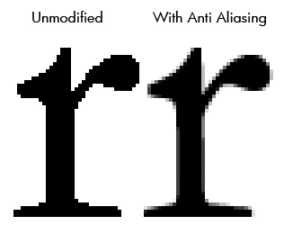
Preliminaries:
Buffers, Textures and Multisampling
Buffer:
  Generic term for a byte array (1D, 2D, 3D, etc.) that exists on the GPU
  When requesting a buffer on the GPU, you must specify the data format
    What is it you are storing and in what order?
Texture Buffer:
  DX can store texture information in many formats
Multisampling:
  Aliasing is the stair-step effect when rendering a line
  Many algorithms exist to fix it, at a cost.
  ‘Multisampling’ is DX’s solution/compromise (Ch 4.1.8)
  Details are not important for now

Slide 32
DXApp::InitDirect3D
DirectX App
GPU
md3dDevice
ID3D11Device
Main Controls
Render Pipeline
md3dImmediateContext
Viewport
ID3D11DeviceContext
mSwapChain
IDXGISwapChain
Swap Chain
FrontBuffer
BackBuffer
Buffer #1
Buffer #2
mRenderTargetView
ID3D11RenderTargetView
Render Target View
Send to SwapChain->BackBuffer
Some notes:
Simplification of Ch 4.2: we force DX11 regardless of your GPU’s DX capabilities
Swap-Chain creation: The contortions with IDXGIDevice, IDXGIAdapter and IDXGIFactory1 are ridiculous and vary based on DX version 10, 11, 11.1, 11.2 and 12.
  The bottom line: we need ‘the right factory’ to produce the swap-chain for us.
  ‘DXGI_<item>_DESC’ groups all the relevant properties of <item>. Google them!
  The swap chain is set to use two texture buffers with basic multisampling
The RenderTargetView is directed to the Swap-chain’s back buffer
The viewport is set to use the entire display area of the window

Slide 33
Main Loop:
Seen from the CPU Side
The window event loop drives the calls to DXApp::FrameTick
int WINAPI wWinMain( … )
{
// …
while( WM_QUIT != msg.message )
{
if( PeekMessage( &msg, nullptr, 0, 0, PM_REMOVE ) )
{
TranslateMessage( &msg );
DispatchMessage( &msg );
}
else
{
g_dxapp->FrameTick();
}
}
// …
}
FrameTick forms the basis for the Game Loop Update/Draw
void DXApp::FrameTick()
{
mTimer.Tick();
CalculateFrameStats();
UpdateScene();
DrawScene();
}
void DXApp::UpdateScene()
{
// nothing for now
}
The Draw step of the game loop is where we deal with rendering operations
void DXApp::DrawScene()
{
// Clear the back buffer
md3dImmediateContext->ClearRenderTargetView(mRenderTargetView, VasA(BackgroundColor) );
// nothing else to do for now
// Switches the display to show the now-finished back-buffer
mSwapChain->Present(0, 0);
}

Slide 34
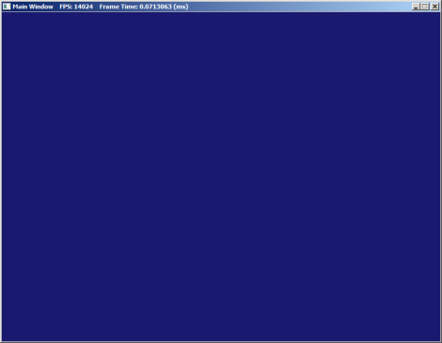
Main Loop:
Seen from the GPU side
DirectX App
GPU
md3dDevice
ID3D11Device
Main Controls
Render Pipeline
md3dImmediateContext
Viewport
ID3D11DeviceContext
mSwapChain
IDXGISwapChain
Swap Chain
FrontBuffer
BackBuffer
Buffer #1
Buffer #2
mRenderTargetView
ID3D11RenderTargetView
Render Target View
Send to SwapChain->BackBuffer
All this just for an empty window…
void DXApp::DrawScene()
{
// Clear the back buffer
md3dImmediateContext->ClearRenderTargetView(mRenderTargetView, VasA(BackgroundColor) );
// nothing to do for now
// Switches the display to show the now-finished back-buffer
mSwapChain->Present(0, 0);
}

Slide 35
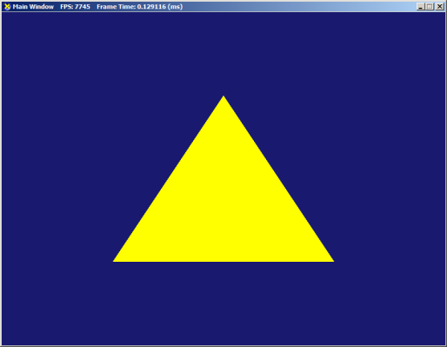
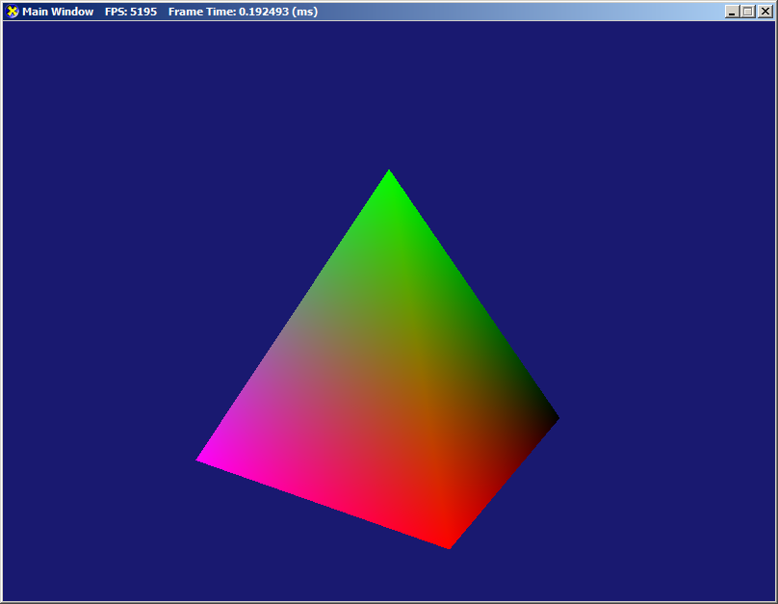
How About
Actually Rendering Something?
A single triangle: the “Hello World” of Graphics Prog. Simple enough, right?
Yet it requires:
  Model representation as vertices and triangles
  How to send inputs (verts and tris) to the GPU
  Basic functionality of the rendering pipeline
  Creating simple vertex and pixel shaders
  How data is passed in and out of shaders
How About 3D? Even a simple pyramid, requires
  Setting up the camera matrices
  Multiple source of data for the rendering pipeline
  Setting DX to work in Right-Hand space
  Far more complicated ‘draw’ stage in DX App.
And more complex scenes with multiple objects and visual effects require even more technical elements…

Slide 36


Warning!!!
Imminent Information Overload!
The examples I provide are my attempt at a simple intro to graphics programming.
Sadly, the nature of the topic requires:
Mental shift in how we code
Needs a lot of domain related jargon.
For Context:
  300+ lines just to draw our first triangle!
  We won’t even get to 3D until week 3!
Take a deep breath. Read the book!
Review the notes.
Work with the examples.
With some time and practice, this will all become natural soon enough.
If you’re not constantly Googling something in the code, you’re doing it wrong!

Slide 37
Part 5:
Rendering Pipeline

Slide 38
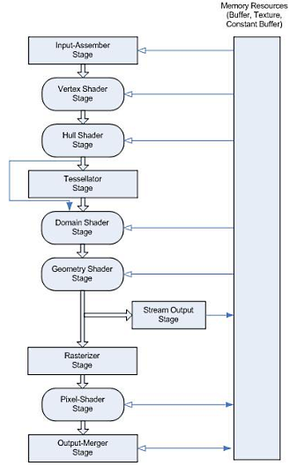
Rendering Pipeline:
Render Pipeline
Here is the full DirectX rendering pipeline:
(That cute little cloud from before…)
We can ignore the Tessellation Stage:
  What is it? See this video
  Terrain tessellation
  Scene tessellation
  Much too advanced for us right now.
We can ignore the Geometry Shader and
Stream Output Stage:
  Used for advanced shader operations
Let’s look at a simplified version…

Slide 39
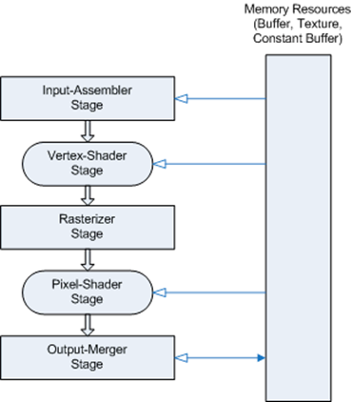
Rendering Pipeline:
Here’s a rough breakdown:
How is it controlled?
  Lives on the GPU but triggered from the CPU during the draw stage of the game loop
How often is it called?
  Triggered once per model
  (mostly… Sort of… It’s complicated)
What does it do?
  Given a model, a color, texture information and transform matrices, the pipeline computes the pixels to place on the screen
What input does it need?
  Lots of things! Every stage has its own collection of options and input mechanisms

Slide 40

Rendering Pipeline:
Input Assembler Stage (IA)
  Makes the inputs available to start the pipeline
  Typically: includes collections of verts and tris
Vertex Shader Stage (VS)
  Operates on each vertex
  Typically: Apply WordMat & Camera Matrices
Clipping: not shown
  Trim triangles/lines outside the view frustum.
  Performs homog. coord division to place verts in NDC.
Rasterizer Stage (RS)
  Adjust NDC to Viewport & performs backface culling
  Interpolates vertex attributes (can be color, texture, normal, etc.) across pixels
Pixel Shader Stage (PS)
  Applied to each pixels. Lighting effects (if any) are computed here.
Output Merger Stage (OM)
  Some depth, blending & transparency processing before sending it to the screen

Slide 41
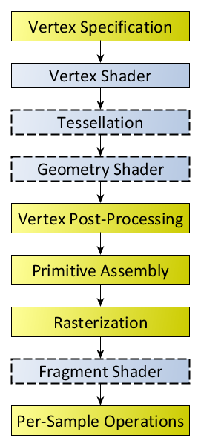
Rendering Pipeline:
This is the DirectX rendering pipeline, but
OpenGL’s Pipeline is similar
While we focus on DirectX for convenience, the broad lines of how we control a rendering pipeline apply to all modern Graphics Environment

Slide 42
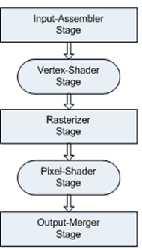
New-New Diagram
GPU
DirectX App
Main Controls
md3dDevice
ID3D11Device
md3dImmediateContext
ID3D11DeviceContext
Viewport
mSwapChain
IDXGISwapChain
Swap Chain
FrontBuffer
BackBuffer
mRenderTargetView
ID3D11RenderTargetView
Buffer #1
Render Target View
Send to SwapChain->BackBuffer
Buffer #2
It’s getting rather busy…. How long can we keep it up?

Slide 43
Part 6:
Rendering a Single Triangle

Slide 44

Rendering
To render something, we need ‘build’ the
missing pieces into the render pipeline
Input Assembler Stage:
  Needs the vertices and how they are connected
Vertex Shader Stage:
  Needs to know what to do with each vertex
  Given as separate HLSL code and must be
  compiled on the GPU
Pixel Shader Stage:
  Needs to know what to do with each pixels associated with each triangle
  Given as separate HLSL code and must be compiled on the GPU
???
???
???

Slide 45
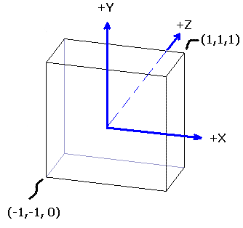
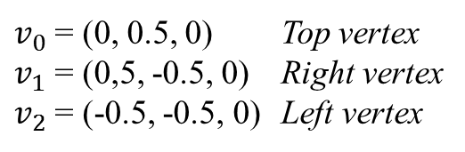
Constructing the Triangle
Recall (GAM 3/425): what appears on the 2D screen is coming from the 3D NDC
Important:
  The NDC is left-handed (regardless of the world space handedness)
  Note however that that DX’s NDC range from [0,1] on the z
For simplicity, let’s assume that the NDC coordinates for the triangle vertices are
We must somehow send this data (3 vertices forming 1 triangle) to the GPU
$v_{0}$ = (0, 0.5, 0) Top vertex
$v_{1}$ = (0,5, -0.5, 0) Right vertex
$v_{2}$ = (-0.5, -0.5, 0) Left vertex

Slide 46
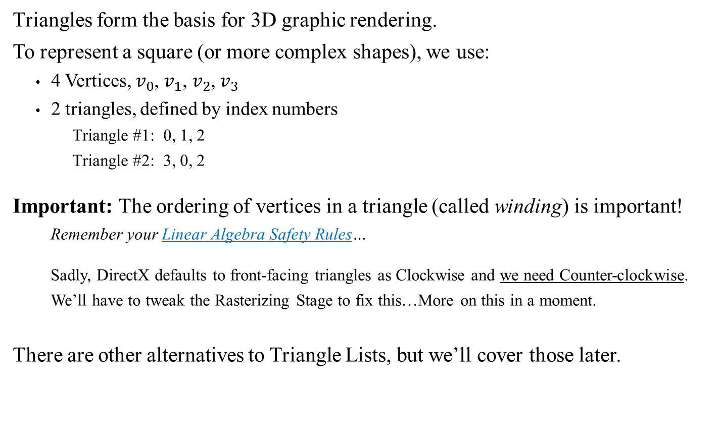




Triangle Lists
Triangles form the basis for 3D graphic rendering.
To represent a square (or more complex shapes), we use:
  4 Vertices, $v_{0}$, $v_{1}$, $v_{2}$, $v_{3}$
  2 triangles, defined by index numbers
    Triangle #1: 0, 1, 2
    Triangle #2: 3, 0, 2
Important: The ordering of vertices in a triangle (called winding) is important!
  Remember your Linear Algebra Safety Rules…
  Sadly, DirectX defaults to front-facing triangles as Clockwise and we need Counter-clockwise.
  We’ll have to tweak the Rasterizing Stage to fix this…More on this in a moment.
There are other alternatives to Triangle Lists, but we’ll cover those later.
$$v_{0}$$
$$v_{3}$$
$$v_{1}$$
$$v_{2}$$

Slide 47
Triangle Data
For our demo, we have only 3 vertices and a single triangle:
But now we must send this information to the GPU.
Problems:
  We can only send raw bytes to the GPU. This means we must also include the right data format information to allow the GPU to parse the raw bytes into the right values.
  We will also need to keep a handle pointing to the remote data.
Vect vertices[] =
{
Vect(0.0f, 0.5f, 0), // Top
Vect(0.5f, -0.5f, 0), // Bottom right
Vect(-0.5f, -0.5f, 0) // Bottom left
};
WORD indices[] =
{
0, 1, 2
};
DirectX App
GPU
Time for more DirectX esoterica…
mpVertexBuffer
ID3D11Buffer
Verts
mpIndexBuffer
ID3D11Buffer
Indices

Slide 48
Setting Up a Vertex Buffer
To create a vertex buffer on the GPU and keep a handle ‘mpVertexBuffer’
We also tell the Input Assembler stage that it should use this buffer next time we call the rendering pipeline
Vect vertices[] =
{
Vect(0.0f, 0.5f, 0), // Top
Vect(0.5f, -0.5f, 0), // Bottom right
Vect(-0.5f, -0.5f, 0) // Bottom left
};
D3D11_BUFFER_DESC bd;
ZeroMemory(&bd, sizeof(bd));
bd.Usage = D3D11_USAGE_DEFAULT;
bd.ByteWidth = sizeof(Vect) * 3; // size of verts * num of verts
bd.BindFlags = D3D11_BIND_VERTEX_BUFFER;
bd.CPUAccessFlags = 0; // zero means the cpu shall not have read nor write access
D3D11_SUBRESOURCE_DATA InitData;
ZeroMemory(&InitData, sizeof(InitData));
InitData.pSysMem = vertices;
hr = md3dDevice->CreateBuffer(&bd, &InitData, &mpVertexBuffer);
assert(SUCCEEDED(hr));
UINT stride = sizeof(Vect);
UINT offset = 0;
md3dImmediateContext->IASetVertexBuffers(0, 1, &mpVertexBuffer, &stride, &offset);

Slide 49
Setting Up an Index Buffer
To create an index buffer on the GPU and keep a handle ‘mpIndexBuffer’
We also tell the Input Assembler stage that how to use the index buffer next time we use the rendering pipeline
WORD indices[] =
{
0, 1, 2
};
bd.Usage = D3D11_USAGE_DEFAULT;
bd.ByteWidth = sizeof(WORD) * 3; // 3 vertices needed for each triangles in a triangle list
bd.BindFlags = D3D11_BIND_INDEX_BUFFER;
bd.CPUAccessFlags = 0;
InitData.pSysMem = indices;
hr = md3dDevice->CreateBuffer(&bd, &InitData, &mpIndexBuffer);
assert(SUCCEEDED(hr));
md3dImmediateContext->IASetIndexBuffer( mpIndexBuffer, DXGI_FORMAT_R16_UINT, 0);
md3dImmediateContext->IASetPrimitiveTopology( D3D11_PRIMITIVE_TOPOLOGY_TRIANGLELIST );

Slide 50
Rasterizer Stage Tweak:
Front Face Windings
During backface culling, DX’s default settings are to eliminate all triangle faces with a clockwise (CW) winding. Our standard calls for counter-clockwise.
Adding the following code to DXApp::InitDirect3D
D3D11_RASTERIZER_DESC rd;
rd.FillMode = D3D11_FILL_SOLID; // Also: D3D11_FILL_WIREFRAME
rd.CullMode = D3D11_CULL_BACK;
rd.FrontCounterClockwise = true; // true for RH forward facing
rd.DepthBias = 0;
rd.SlopeScaledDepthBias = 0.0f;
rd.DepthBiasClamp = 0.0f;
rd.DepthClipEnable = true;
rd.ScissorEnable = false;
rd.MultisampleEnable = true; // Does not in fact turn on/off multisample:
rd.AntialiasedLineEnable = false;
ID3D11RasterizerState* rs;
md3dDevice->CreateRasterizerState(&rd, &rs);
md3dImmediateContext->RSSetState(rs);
ReleaseAndDeleteCOMobject(rs);
New settings we want
Create the new Rasterizer State
Plug it into the Render Pipeline

Slide 51
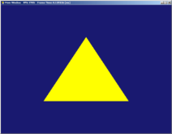
Updated New-New Diagram
Still missing:
Shaders!
DirectX App
GPU
md3dDevice
ID3D11Device
Main Controls
md3dImmediateContext
ID3D11DeviceContext
Verts
Indices
???
mpVertexBuffer
ID3D11Buffer
mpIndexBuffer
CCW
Viewport
ID3D11Buffer
???
Swap Chain
FrontBuffer
BackBuffer
mSwapChain
IDXGISwapChain
Buffer #1
mRenderTargetView
ID3D11RenderTargetView
Render Target View
Send to SwapChain->BackBuffer
Buffer #2
We can the activate the render pipeline in the draw step of the game loop:
void DXApp::DrawScene()
{
md3dImmediateContext->ClearRenderTargetView(mRenderTargetView, VasA(BackgroundColor) );
md3dImmediateContext->DrawIndexed(3 * 1, 0, 0); // 3 indices for each triangle in a list
mSwapChain->Present(0, 0);
}

Slide 52
Part 7:
More complex models

Slide 53

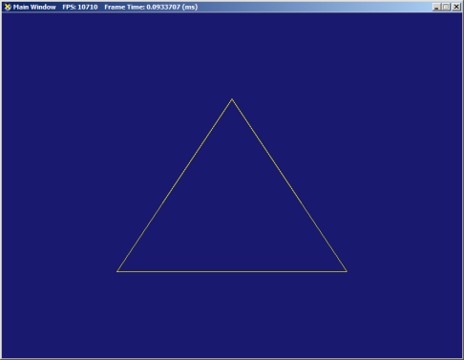
WireFrame Rendering
When we tweaked the RS, you may have noticed the FillMode option
Switching the FillMode to Wireframe can sometimes be a useful debugging tool
D3D11_RASTERIZER_DESC rd;
rd.FillMode = D3D11_FILL_SOLID; // Also: D3D11_FILL_WIREFRAME
rd.CullMode = D3D11_CULL_BACK;
rd.FrontCounterClockwise = true; // true for RH forward facing
rd.DepthBias = 0;
rd.SlopeScaledDepthBias = 0.0f;
rd.DepthBiasClamp = 0.0f;
rd.DepthClipEnable = true;
rd.ScissorEnable = false;
rd.MultisampleEnable = true; // Does not in fact turn on/off multisample:
rd.AntialiasedLineEnable = false;

Slide 54
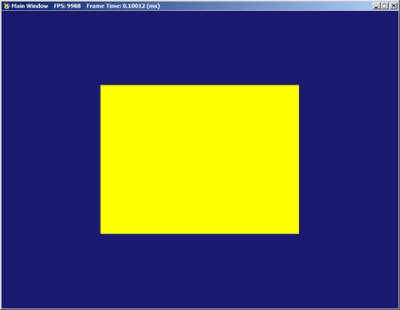
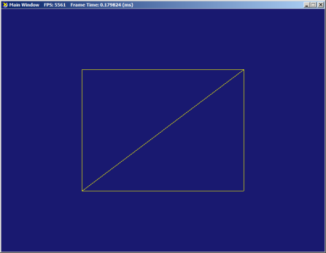
Rendering a Square
Q: How do we modify the previous triangle demo to show a square instead?
A: We make the following modifications:
  Create the 4 vertices needed (stay within the NDC values for now)
  Adjust the size of the vertex buffer on GPU
  Create the new index array (two triangles now)
  Adjust the size of the index buffer on GPU
  Adjust the number of indexed triangles drawn

Slide 55
Homework
Assignment 1

Slide 56
Next Week
Shaders and HLSL
Controlling shaders (sending data to the rendering pipeline)
Camera and 3D scenes

Slide 57
Information Overload!
The examples I provide are my attempt at a simple intro to graphics programming.
Sadly, the nature of the topic requires:
Mental shift in how we code
Needs a lot of domain related jargon.
For Context:
  300+ lines just to draw our first triangle!
  We won’t even get to 3D until week 3!
Take a deep breath. Read the book!
Review the notes.
Work with the examples.
With some time and practice, this will all become natural soon enough.
If you’re not constantly Googling something in the code, you’re doing it wrong!

