Slide 1
GAM 370/470:
Rendering and Graphics Programming
Lecture 2:
Introduction to Shaders

Slide 2
Part 1:
Review

Slide 3
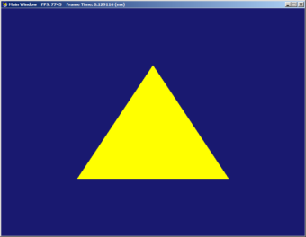
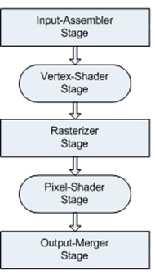
Updated New-New Diagram
DirectX App
GPU
md3dDevice
ID3D11Device
Main Controls
Verts
Still missing:
Shaders!
md3dImmediateContext
ID3D11DeviceContext
Indices
???
mpVertexBuffer
ID3D11Buffer
mpIndexBuffer
CCW
Viewport
ID3D11Buffer
???
Swap Chain
FrontBuffer
BackBuffer
mSwapChain
IDXGISwapChain
Buffer #1
mRenderTargetView
ID3D11RenderTargetView
Render Target View
Send to SwapChain->BackBuffer
Buffer #2
We can the activate the render pipeline in the draw step of the game loop:
void DXApp::DrawScene()
{
md3dImmediateContext->ClearRenderTargetView(mRenderTargetView, VasA(BackgroundColor) );
md3dImmediateContext->DrawIndexed(3 * 1, 0, 0); // 3 indices for each triangle in a list
mSwapChain->Present(0, 0);
}

Slide 4
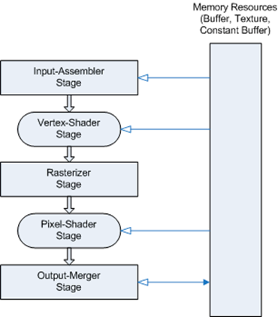

Recap:
Rendering Pipeline
Input Assembler Stage (IA)
  Makes the inputs available to start the pipeline
  Typically: these inputs include a collection of vertices
Vertex Shader Stage (VS)
  Operates on each the vertices
  Typically: Apply WordMat & Camera Matrices
Clipping: not shown
  Trim triangles/lines outside the view frustum.
  Performs homog. coord division to place verts in NDC.
Rasterizer Stage (RS)
  Adjust NDC to Viewport & performs backface culling
  Interpolates vertex attributes (color, texture, normal, etc.) across pixels
Pixel Shader Stage (PS)
  Applied to each pixels. Lighting effects (if any) are computed here.
Output Merger Stage (OM)
  Some depth, blending & transparency processing before sending it to the screen

Slide 5

Recap:
Rendering
To render something, we need ‘build’ the
missing pieces into the render pipeline
Input Assembler Stage:
  Needs the vertices and how they are connected
Vertex Shader Stage:
  Needs to know what to do with each vertex
  Given as separate HLSL code and must be
  compiled on the GPU
Pixel Shader Stage:
  Needs to know what to do with each pixels associated with each triangle
  Given as separate HLSL code and must be compiled on the GPU
???
???
???

Slide 6
Part 2:
Shaders and HLSL

Slide 7
High Level Shading Language
(HLSL )
Shaders for DirectX are written in HLSL
  Similar to C++ but not the same. We’ll learn about it as we go.
    See also book Appendix B, p813 and/or MS HLSL Reference and Guide
  Shader code must be sent to and compiled on the GPU
  In general, multiple shaders can be switched in and out of the rendering pipeline
    We’ll have examples of that later this quarter
HLSL peculiarities:
  Easy vectors / matrices from base data types
    IMPORTANT: LASR. What do we need to know?
      HLSL defaults to column-major matrices!
  Unique to HLSL: Semantics
struct VertexData
{
float4 Pos : POSITION;
};
struct PixelData
{
float4 Pos : SV_POSITION;
};
PixelData VS( VertexData inVert )
{
return inVert;
}
float4 PS( PixelData inPix ) : SV_Target
{
return float4( 1.0f, 1.0f, 0.0f, 1.0f );
}

Slide 8
HLSL Semantics
A semantic is a string attached to a shader resource (input or output) that conveys information to the compiler about the intended use of data.
Used by the rendering pipeline to resolve data ambiguities
  Ex: float4 can be a position in space, pixel on screens or a color
Semantics are required on all variables passed to and from shader stages.
Common Semantics:
  Vertex Shader Semantics
  Pixel Shader Sematics
  System Value semantics
    Read up on all these…
struct VertexData
{
float4 Pos : POSITION;
};
struct PixelData
{
float4 Pos : SV_POSITION;
};
PixelData VS( VertexData inVert )
{
return inVert;
}
float4 PS( PixelData inPix ) : SV_Target
{
return float4( 1.0f, 1.0f, 0.0f, 1.0f );
}

Slide 9
System Value Semantics
System Value Semantic are a bit different than the others:
  Identified by the ‘SV_’ prefix
  They represent data that the render pipeline must have in order to perform its job
  In other words: it’s a requirement on you to point out what the pipeline needs
Examples:
Not a System value: It’s typical for a vertex shader to receive the position of vertices, but it doesn’t have to.
struct VertexData
{
float4 Pos : POSITION;
};
struct PixelData
{
float4 Pos : SV_POSITION;
};
PixelData VS( VertexData inVert )
{
return inVert;
}
float4 PS( PixelData inPix ) : SV_Target
{
return float4( 1.0f, 1.0f, 0.0f, 1.0f );
}
System value: SV_POSITION Represents an expected value which is subject to clipping, etc. When presented to a Pixel Shader, these value will hold the screen pixel coordinates.
System value: SV_TARGET as the output of the PS must be sent to the render target, therefore the compiler must ensure the data formats match.
9

Slide 10
Shaders Input and Output
Just like with normal programming, there are many ways to code the same thing.
The following are all equivalent:
struct PixelData
{
float4 Pos : SV_POSITION;
};
PixelData VS( float4 inPos : POSITION )
{
PixelData pd;
pd.Pos = inPos;
return pd;
}
In general: use standard coding practices to write clear and efficient shader code.
struct VertexData
{
float4 Pos : POSITION;
};
struct PixelData
{
float4 Pos : SV_POSITION;
};
PixelData VS( VertexData inVert )
{
return inVert;
}
float4 VS( float4 Pos : POSITION ) : SV_POSITION
{
return Pos;
}
struct PixelData
{
float4 Pos : SV_POSITION;
};
VS( float4 inPos : POSITION, out PixelData pd )
{
pd.Pos = inPos;
}
Note the auto casting of inVert from VertexData to PixelData …

Slide 11
Understanding SimpleColor Shader
The IA has the verts and tris
For each verts, the VS shader is called
VS simply passes through the vert.
The RS clips and (using tri indices) creates the pixels for each triangles
For each pixel, the PS is called
The PS simply returns the color Yellow (RGBA)
OM sends the pixels to render target.
The swap chain switches the buffers.
GPU
struct VertexData
{
float4 Pos : POSITION;
};
struct PixelData
{
float4 Pos : SV_POSITION;
};
PixelData VS( VertexData inVert )
{
return inVert;
}
float4 PS( PixelData inPix ) : SV_Target
{
return float4( 1.0f, 1.0f, 0.0f, 1.0f );
}
Main Controls
Verts
Indices
VS
CCW
Viewport
PS
Swap Chain
FrontBuffer
BackBuffer
Buffer #1
Render Target View
Send to SwapChain->BackBuffer
Buffer #2

Slide 12
Loading and Compiling Shaders
This is another situation where we need to send data to the GPU while still keeping a handle to it.
Reading & compiling from file:
  This is hidden away in the DXApp::CompileShaderFromFile:
CompileShaderFromFile(L"../Assets/Shaders/SimpleColor.hlsl", "VS", "vs_4_0", &pVSBlob);
File name
Which shader to compile.
“VS” or “PS”
Shader Model aka feature levels. Stick to “vs_4_0” or “ps_4_0”
(temporary) Handle to resulting object code
DirectX App
GPU
mpVertexLayout
ID3D11InputLayout
Vert Layout
mpVertexShader
ID3D11VertexShader
VS
mpPixelShader
ID3D11PixelShader
PS

Slide 13
Loading and Compiling Shaders
Step 1: Compiling VS and sending it to the GPU
Step 2: (Only for VS) we need to define the input layout for the IA
ID3DBlob* pVSBlob = nullptr;
hr = CompileShaderFromFile( <…>, "VS", "vs_4_0", &pVSBlob);
assert(!FAILED(hr));
// Create the vertex shader on GPU
hr = md3dDevice->CreateVertexShader(
pVSBlob->GetBufferPointer(),
pVSBlob->GetBufferSize(),
nullptr,
&mpVertexShader);
assert(!FAILED(hr));
ReleaseAndDeleteCOMobject(pPSBlob);
Our handle to the vertex shader
We don’t need the VS blob anymore.
D3D11_INPUT_ELEMENT_DESC layout[] = {
{ "POSITION", 0, DXGI_FORMAT_R32G32B32A32_FLOAT, 0, 0, D3D11_INPUT_PER_VERTEX_DATA, 0 },
};
UINT numElements = ARRAYSIZE(layout);
// Create the input layout
hr = md3dDevice->CreateInputLayout(layout, numElements,
pVSBlob->GetBufferPointer(), pVSBlob->GetBufferSize(), &mpVertexLayout);
assert(!FAILED(hr));
ReleaseAndDeleteCOMobject(pVSBlob);
md3dImmediateContext->IASetInputLayout(mpVertexLayout); // Set the input layout
This is important, but we’ll ignore it for now. We’ll return to what this shortly.

Slide 14
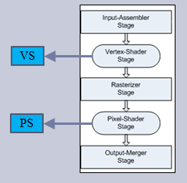
Loading and Compiling Shaders
Step 3: Compiling PS and sending it to the GPU
Step 4: Set rendering pipeline to use those shaders
ID3DBlob* pPSBlob = nullptr;
hr = CompileShaderFromFile( <…>, "PS", "ps_4_0", &pPSBlob);
assert(!FAILED(hr));
// Create the pixel shader
hr = md3dDevice->CreatePixelShader(
pPSBlob->GetBufferPointer(),
pPSBlob->GetBufferSize(),
nullptr,
&mpPixelShader);
assert(!FAILED(hr));
ReleaseAndDeleteCOMobject(pPSBlob);
Our handle to the pixel shader
We don’t need the PS blob anymore.
md3dImmediateContext->VSSetShader(mpVertexShader, nullptr, 0);
md3dImmediateContext->PSSetShader(mpPixelShader, nullptr, 0);

Slide 15
New Diagram Yet Again
DirectX App
GPU
md3dDevice
ID3D11Device
Main Controls
md3dImmediateContext
ID3D11DeviceContext
Verts
Indices
mpVertexBuffer
ID3D11Buffer
Layout
mpIndexBuffer
ID3D11Buffer
VS
mpVertexLayout
ID3D11InputLayout
CCW
Viewport
mpVertexShader
ID3D11VertexShader
PS
mpPixelShader
ID3D11PixelShader
Swap Chain
FrontBuffer
BackBuffer
Buffer #1
mSwapChain
IDXGISwapChain
Buffer #2
mRenderTargetView
ID3D11RenderTargetView
Render Target View
Send to SwapChain->BackBuffer
Still missing:
Specifying input layout (whatever that is…)
Having shaders that actually do something…

Slide 16
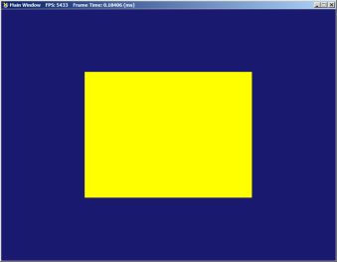
Visualizing the Rendering Pipeline
DirectX App
struct VertexData
{
float4 Pos : POSITION;
};
struct PixelData
{
float4 Pos : SV_POSITION;
};
PixelData VS( VertexData inVert )
{
return inVert;
}
float4 PS( PixelData inPix ) : SV_Target
{
return float4( 1.0f, 1.0f, 0.0f, 1.0f );
}
GPU
Verts
Vect vertices[] =
{
Vect(0.5f, 0.5f, 0),
Vect(-0.5f, 0.5f, 0),
Vect(-0.5f, -0.5f, 0),
Vect(0.5f, -0.5f, 0)
};
WORD indices[] =
{
0, 1, 2,
0, 2, 3
};
Indices
Layout
VS
PS
IA sends all verts to VS: Our simple VS simply returns them back out
The rasterizers expects values in the NDC
  Converts every vertex to screen pixels
  Uses indices to map out every pixels of triangles
For each pixel, PS is called
  Our input is SV_POSITION, screen pixels from the RS
  PS outputs a color (always yellow in our demo)

Slide 17
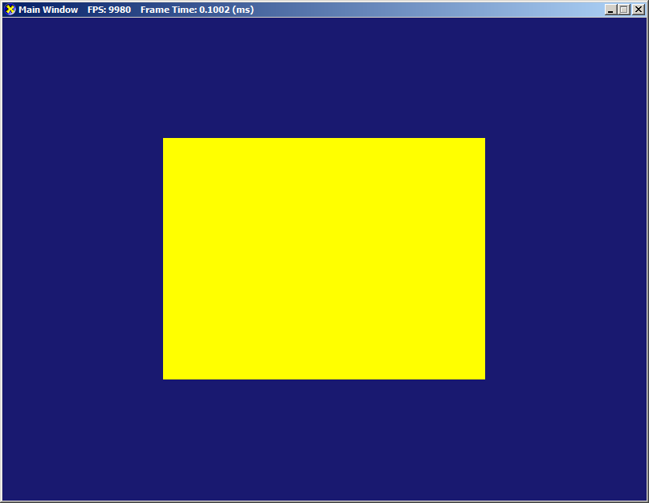
Warning!
Be Careful Reading Shader Code!
Reading our ‘SimpleColor’ shader, it easy to think that:
But that is incorrect: the RS converts POSITION into SV_POSITION
You can see this by replacing the PS with
  Converts x, y screen position in [0,1] red/green values
(0.5f, 0.5f, 0)
VS
(0.5f, 0.5f, 0)
PS
( 1.0f, 1.0f, 0.0f, 1.0f )
(0.5f, 0.5f, 0)
VS
(0.5f, 0.5f, 0)
RS
(600, 150, 0)
PS
( 1.0f, 1.0f, 0.0f, 1.0f )
float4 PS( PixelData inPix ) : SV_Target {
float red = (inPix.Pos.x - 200) / 400;
float green = (inPix.Pos.y - 150) / 300;
return float4(red, green, 0, 1);
}
800x600
struct VertexData
{
float4 Pos : POSITION;
};
struct PixelData
{
float4 Pos : SV_POSITION;
};
PixelData VS( VertexData inVert )
{
return inVert;
}
float4 PS( PixelData inPix ) : SV_Target
{
return float4( 1.0f, 1.0f, 0.0f, 1.0f );
}
(200,150)
(600,150)
(200,450)
(600,450)

Slide 18
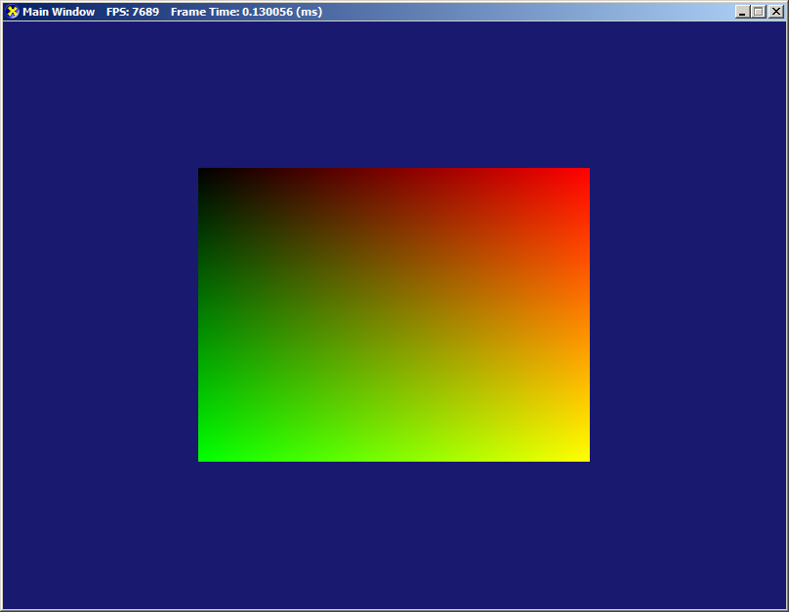
Warning!
Be Careful Reading Shader Code!
Reading our ‘SimpleColor’ shader, it easy to think that:
But that is incorrect: the RS converts POSITION into SV_POSITION
You can see this by replacing the PS with
  Converts x, y screen position in [0,1] red/green values
(0.5f, 0.5f, 0)
VS
(0.5f, 0.5f, 0)
PS
( 1.0f, 1.0f, 0.0f, 1.0f )
(0.5f, 0.5f, 0)
VS
(0.5f, 0.5f, 0)
RS
(600, 150, 0)
PS
( 1.0f, 1.0f, 0.0f, 1.0f )
float4 PS( PixelData inPix ) : SV_Target {
float red = (inPix.Pos.x - 200) / 400;
float green = (inPix.Pos.y - 150) / 300;
return float4(red, green, 0, 1);
}
800x600
Cleary the inPix parameter in PS is not the same set of values that came out of VS
struct VertexData
{
float4 Pos : POSITION;
};
struct PixelData
{
float4 Pos : SV_POSITION;
};
PixelData VS( VertexData inVert )
{
return inVert;
}
float4 PS( PixelData inPix ) : SV_Target
{
return float4( 1.0f, 1.0f, 0.0f, 1.0f );
}
(200,150)
(600,150)
See also Piazza post for Visual Studio graphics debug tool.
(200,450)
(600,450)

Slide 19
Part 3:
Color Control With Vertex Data

Slide 20

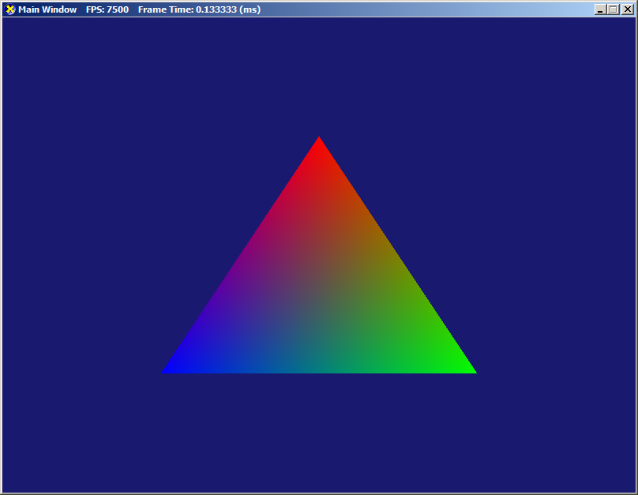
Adding Some Color Control
How do we change this:
To this?
Vect vertices[] =
{
Vect(0.0f, 0.5f, 0),
Vect(0.5f, -0.5f, 0),
Vect(-0.5f, -0.5f, 0),
};
WORD indices[] =
{
0, 2, 1
};
struct SimpleVertex
{
Vect Pos;
Vect Color;
};
SimpleVertex vertices[] =
{
{ Vect(0.0f, 0.5f, 0), Colors::Red },
{ Vect(0.5f, -0.5f, 0), Colors::Lime },
{ Vect(-0.5f, -0.5f, 0), Colors::Blue }
};
WORD indices[] =
{
0, 2, 1
};

Slide 21
Adding Color Control:
To Do List
Clearly the vertexbuffer on the GPU needs a different size and format
Clearly the PS needs to be changed: it must receive our selected color as input and use that in its output
Surprisingly: the VS needs to be changed too: it has to pass through the vertices’ color data so that the PS eventually gets it.
That means we also need to change the VS’s input layout to account for the extra parameters
struct SimpleVertex
{
Vect Pos;
Vect Color;
};
SimpleVertex vertices[] =
{
{ Vect(0.0f, 0.5f, 0), Colors::Red },
{ Vect(0.5f, -0.5f, 0), Colors::Lime },
{ Vect(-0.5f, -0.5f, 0), Colors::Blue }
};
WORD indices[] =
{
0, 2, 1
};

Slide 22
Vertex Buffer Changes
The only change is that the buffer size and stride must now be relative to the size of ‘SimpleVertex’
D3D11_BUFFER_DESC bd;
ZeroMemory(&bd, sizeof(bd));
bd.Usage = D3D11_USAGE_DEFAULT;
bd.ByteWidth = sizeof(SimpleVertex) * 3;
bd.BindFlags = D3D11_BIND_VERTEX_BUFFER;
bd.CPUAccessFlags = 0
D3D11_SUBRESOURCE_DATA InitData;
ZeroMemory(&InitData, sizeof(InitData));
InitData.pSysMem = vertices;
hr = md3dDevice->CreateBuffer(&bd, &InitData, &mpVertexBuffer);
assert(SUCCEEDED(hr));
UINT stride = sizeof(SimpleVertex);
UINT offset = 0;
md3dImmediateContext->IASetVertexBuffers(0, 1, &mpVertexBuffer, &stride, &offset);

Slide 23
New Shader Code:
SimpleColorPlus
struct VertexData
{
float4 Pos : POSITION;
float4 Color : COLOR;
};
struct PixelData
{
float4 Pos : SV_POSITION;
float4 Color : COLOR;
};
PixelData VS(VertexData inVert)
{
return inVert;
}
float4 PS(PixelData inPix) : SV_Target
{
return inPix.Color;
}
The revised shader code:
  Very similar to before
  New semantic: ‘COLOR’
  Note that VS receives color data to pass along
  PS outputs the received color
Again, don’t forget the RS that works in between the VS and PS
SimpleVertex vertices[] =
{
{ Vect(0.0f, 0.5f, 0), Colors::Red },
{ Vect(0.5f, -0.5f, 0), Colors::Lime },
{ Vect(-0.5f, -0.5f, 0), Colors::Blue }
};
WORD indices[] =
{
0, 2, 1
};

Slide 24
Coming Back to Input Layout
Some facts about the Input Assembly stage:
The IA has access to the vertex buffer but only as a byte array.
  By itself, there is no way to know how to extract data from it.
The IA also knows the input format for the VS
Question: Why can’t the IA use the VS input format to parse the vertex buffer?
Problem: In general:
  Each vertex in the vertex buffer may contain a lot of information:
    Ex: color, normals, texture data, etc.
  There can be multiple VS available, each with their own particular input parameters.
    Ex: rendering with texture, or color only. Light (using normals) or not, etc.
Question: How can the IA know which elements of a vertex buffer entry to extract and direct to the current VS’s parameter?
Answer: An input layout: Specify which bytes goes towards which VS input.
struct VertexData
{
float4 Pos : POSITION;
float4 Color : COLOR;
};
PixelData VS( VertexData inVert )

Slide 25

Input Layout:
Before (Yellow Triangle)
Each vertex is a ‘Vect’ i.e.: 4 floats
The VS expects 4 float as POSITION
Input Layout sent to the IA
  Note: For each of the VS’s input parameters, the input layout must
  Have matching semantic (1st and 2nd element)
  Matching format (3rd element)
  What is Aligned Byte Offset (5th element)? See next slides…
struct VertexData
{
float4 Pos : POSITION;
};
PixelData VS( VertexData inVert )
{
return inVert;
}
D3D11_INPUT_ELEMENT_DESC layout[] =
{
{ "POSITION", 0, DXGI_FORMAT_R32G32B32A32_FLOAT, 0, 0, D3D11_INPUT_PER_VERTEX_DATA, 0 },
};

Slide 26
Input Layout:
Now (Color-per-vertex Triangle)
Each vertex is a pair of position and color, both Vect:
The VS expect a POSITION and a COLOR
Input Layout sent to the IA
  Note: For each of the VS’s input parameters, the input layout must
  Have matching semantic (1st and 2nd element)
  Matching format (3rd element)
  Byte Offset (5th element): indicates where to start in the vertex entry
struct SimpleVertex
{
Vect Pos;
Vect Color;
};
struct VertexData
{
float4 Pos : POSITION;
float4 Color : COLOR;
};
PixelData VS(VertexData inVert)
{
return inVert;
}
D3D11_INPUT_ELEMENT_DESC layout[] =
{
{ "POSITION", 0, DXGI_FORMAT_R32G32B32A32_FLOAT, 0, 0, D3D11_INPUT_PER_VERTEX_DATA, 0 },
{ "COLOR", 0, DXGI_FORMAT_R32G32B32A32_FLOAT, 0, D3D11_APPEND_ALIGNED_ELEMENT , D3D11_INPUT_PER_VERTEX_DATA, 0 }
};

Slide 27
Input Layout:
Aligned Byte Offset (future example)
Here is an example to illustrate why we need the byte offset value:
A vertex buffer may have a lot of data. For example:
In order to use out current shader
We would need to following layout
struct VertexStride_VUN
{
Vect Pos;
Vect Normal;
float u; // UV tex coord
float v;
Vect Color;
}
struct VertexData
{
float4 Pos : POSITION;
float4 Color : COLOR;
};
PixelData VS(VertexData inVert)
{
return inVert;
}
Within one vertex entry:
POSITION is found at byte 0
COLOR at byte 40
D3D11_INPUT_ELEMENT_DESC layout[] =
{
{ "POSITION", 0, DXGI_FORMAT_R32G32B32A32_FLOAT, 0, 0, D3D11_INPUT_PER_VERTEX_DATA, 0 },
{ "COLOR", 0, DXGI_FORMAT_R32G32B32A32_FLOAT, 0, 40, D3D11_INPUT_PER_VERTEX_DATA, 0 }
};
1 3 3 4
0 6 2 6 0
|----|----|----|----|----|----|----|----|----|----|----|----|----|----|
4B | 4B | 4B | 4B
Vect Pos
4B | 4B | 4B | 4B Vect Normal
4B
u
4B
v
4B | 4B | 4B | 4B
Vect Color

Slide 28
Back to SimpleColorPlus
We have now modified our code so that the we can encode a color per vertex.
SimpleVertex vertices[] =
{
{ Vect(0.0f, 0.5f, 0), Colors::Red },
{ Vect(0.5f, -0.5f, 0), Colors::Lime },
{ Vect(-0.5f, -0.5f, 0), Colors::Blue }
};
WORD indices[] =
{
0, 2, 1
};
struct VertexData
{
float4 Pos : POSITION;
float4 Color : COLOR;
};
struct PixelData
{
float4 Pos : SV_POSITION;
float4 Color : COLOR;
};
PixelData VS(VertexData inVert)
{
return inVert;
}
float4 PS(PixelData inPix) : SV_Target
{
return inPix.Color;
}

Slide 29
Back to SimpleColorPlus:
Rasterizing Stage
We have now modified our code so that the we can encode a color per vertex.
It’s worth revisiting the RS. Let’s consider only the vertices
(0.0f, 0.5f, 0)
Color::Red
VS
(0.0f, 0.5f, 0)
Color::Red
RS
(400, 150, 0)
Color::Red
PS
( 1.0f, 0.0f, 0.0f, 1.0f )
(0.5f,-0.5f, 0)
Color::Lime
VS
(0.5f,-0.5f, 0)
Color::Lime
RS
(600, 450, 0)
Color::Lime
PS
( 0.0f, 1.0f, 0.0f, 1.0f )
struct VertexData
{
float4 Pos : POSITION;
float4 Color : COLOR;
};
struct PixelData
{
float4 Pos : SV_POSITION;
float4 Color : COLOR;
};
PixelData VS(VertexData inVert)
{
return inVert;
}
float4 PS(PixelData inPix) : SV_Target
{
return inPix.Color;
}
800x600
(400,150)
(200,450)
(600,450)

Slide 30
Back to SimpleColorPlus:
Rasterizing Stage
We have now modified our code so that the we can encode a color per vertex.
It worth revisiting the RS.
We know the color and position of three pixels… What about the rest of the Tri?
This is where Vertex Attribute Interpolation comes in.
(0.0f, 0.5f, 0)
Color::Red
VS
(0.0f, 0.5f, 0)
Color::Red
RS
(400, 150, 0)
Color::Red
PS
( 1.0f, 0.0f, 0.0f, 1.0f )
(0.5f,-0.5f, 0)
Color::Lime
VS
(0.5f,-0.5f, 0)
Color::Lime
RS
(600, 450, 0)
Color::Lime
PS
( 0.0f, 1.0f, 0.0f, 1.0f )
(-0.5f,-0.5f,0)
Color::Blue
VS
(-0.5f,-0.5f,0)
Color::Blue
RS
(200, 450, 0)
Color::Blue
PS
( 0.0f, 0.0f, 1.0f, 1.0f )
800x600
(400,150)
(200,450)
(600,450)

Slide 31









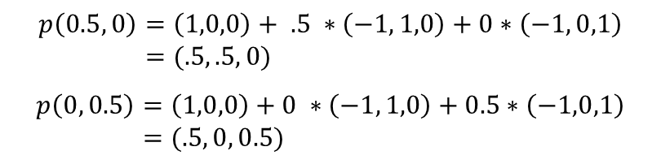


Vertex Attribute Interpolation
Once you know a value at each three vertices $v_{0}$, $v_{1}$ and $v_{2}$, you can interpolate anywhere inside the triangle using the formula:
Example: From the three pixels, we can interpolate the color
$$v_{0}$$
$$s(v_{1}−v_{0})$$
$$t(v_{2}−v_{0})$$
$$p(s,t)$$
(400, 150, 0) (1, 0, 0)
$v_{0}=\left(400,150\right)$ $p\left(0, 0\right)=\left(1,0,0\right)$
(600, 450, 0) (0, 1, 0)
$v_{1}=\left(600,450\right)$ $p\left(1, 0\right)=\left(0,1,0\right)$
$$v_{2}$$
$$v_{1}$$
(200, 450, 0) (0, 0, 1)
$v_{2}=\left(200,450\right)$ $p\left(0, 1\right)=\left(0,0,1\right)$
800x600
$$p\left(0.5, 0\right)=\left(1,0,0\right)+ .5 ∗\left(−1, 1,0\right)+0∗\left(−1, 0,1\right) \\ =(.5, .5, 0)$$
$$p\left(0, 0.5\right)=\left(1,0,0\right)+0 ∗\left(−1, 1,0\right)+0.5∗\left(−1,0,1\right) \\ =(.5, 0, 0.5)$$
(400,150)
p(0, .5)
p(0.5, 0)
In general, the RS will interpolate all vertex attributes this way for each pixel.
Note: see 5.10.3 for subtleties computing s and t values per pixel.
(200,450)
(600,450)

Slide 32
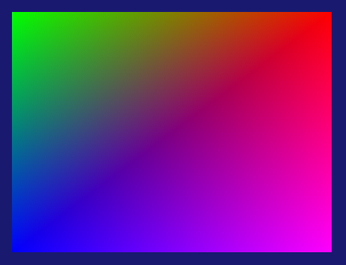
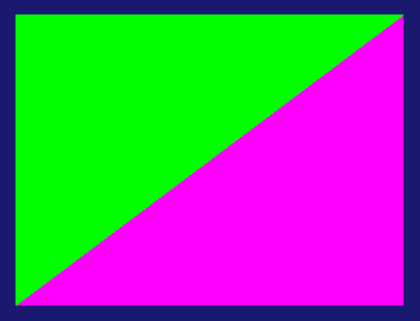
Color Control
It should be easy to render our previous square example in color:
But what if we want one each triangle to be a solid color?
  What is the color for the vertices in NE and SW corners?
SimpleVertex vertices[] =
{
{ Vect(0.5f, 0.5f, 0), Colors::Red },
{ Vect(-0.5f, 0.5f, 0), Colors::Lime },
{ Vect(-0.5f, -0.5f, 0), Colors::Blue },
{ Vect(0.5f, -0.5f, 0), Colors::Magenta }
};
WORD indices[] =
{
0, 1, 2,
0, 2, 3
};
Problem: We now have some vertices that appear to need different colors based on which triangle they are part of.
Solution: If any vertex attribute changes based on the triangles it’s in, we need a new vertex. A square like this needs 6 vertices

Slide 33







Color Control
$$v_{1}$$
$$v_{0}$$
SimpleVertex vertices[] =
{
// Upper triangle
{ Vect(0.5f, 0.5f, 0), Colors::Lime },
{ Vect(-0.5f, 0.5f, 0), Colors::Lime },
{ Vect(-0.5f, -0.5f, 0), Colors::Lime },
// Lower triangle
{ Vect(0.5f, 0.5f, 0), Colors::Magenta },
{ Vect(-0.5f, -0.5f, 0), Colors::Magenta },
{ Vect(0.5f, -0.5f, 0), Colors::Magenta }
};
WORD indices[] =
{
0, 1, 2,
3, 4, 5
};
$$v_{3}$$
$$v_{2}$$
$$v_{4}$$
$$v_{5}$$
Homework: Starting from last week’s star-shape homework, make it so that:
You have a color gradient from the center to the points
You have one solid color for the center and one color for all the points

Slide 34
Part 4:
Constant Buffers for Color Control

Slide 35
Dynamic Color Control
We are now able to change the color of a ‘model’ by changing the data within the vertex buffer.
Problem: What happens if we want the color to change at runtime?
  Re-uploading a new vertex buffer isn’t recommend. Typical models have many thousands of vertices and the upload time would affect the frame rate.
  Anticipating all possible color changes and uploading them all upfront would waste a lot of memory on the GPU (and may not always be feasible anyway)
Solution: we need another way to send data to the pipeline at runtime.

Slide 36
Constant Buffers and
Shader Constants
Constant buffers are data buffers for DX to hold data that
  Typically is much, much smaller than vertex buffers
  Can be changed at runtime by the CPU
  Have constants value during one execution of the render pipeline (shader constants)
As with other GPU resource, we must:
  Create them and keep a handle on the CPU
  Connect them to the pipeline, specifically to a shader constants
  Update the data as needed
Bored with color and 2D? We’ll need constant buffers to pass worldMat and camera matrices…
GPU
Verts
DirectX App
Indices
VS
mpcbColor
ID3D11Buffer
Color
CCW
Viewport
PS

Slide 37
Creating a Constant Buffer
Step 1: Buffer handle and structure
// DXApp.h file
ID3D11Buffer* mpcbColor;
// Not strictly necessary since we only have one data member, but it's common to do it this way
struct CBColor
{
Vect col;
};
// DXApp.cpp file
D3D11_BUFFER_DESC bd;
bd.Usage = D3D11_USAGE_DEFAULT;
bd.ByteWidth = sizeof(CBColor);
bd.BindFlags = D3D11_BIND_CONSTANT_BUFFER;
bd.CPUAccessFlags = 0;
hr = md3dDevice->CreateBuffer(&bd, nullptr, &mpcbColor);
assert(SUCCEEDED(hr));
GPU
Verts
DirectX App
Indices
VS
mpcbColor
ID3D11Buffer
Color
CCW
Viewport
PS
37

Slide 38
Creating a Constant Buffer
cbuffer bufColor
{
float4 ActiveCol;
}
float4 VS(float4 Pos : POSITION) : SV_POSITION
{
return Pos;
}
float4 PS(float4 pix : SV_POSITION) : SV_Target
{
return ActiveCol;
}
Step 2: Setting up shader constants
and connecting it with the constant buffer
shader constant
Note: no need for ‘bufColor::’ reference
md3dImmediateContext->PSSetConstantBuffers(0, 1, &mpcbColor);
GPU
Note: Only the PS needs knowledge of the color buffer
Verts
DirectX App
Indices
VS
mpcbColor
ID3D11Buffer
Color
CCW
Viewport
PS
38

Slide 39
Creating a Constant Buffer
Step 3: Updating the value from the CPU to the buffer on the GPU
At this point, the data is stored in the buffer on the GPU
  We only need to update once: all future execution of the pipeline will see this value
  The CPU can re-update this value at any time, changing what the color will be.
    Example: Copy the above code into ‘OnMouseDown’ but with a different color
CBColor cbMyColor;
cbMyColor.col = Colors::Lime;
md3dImmediateContext->UpdateSubresource(mpcbColor, 0, nullptr, &cbMyColor, 0, 0);
GPU
Verts
DirectX App
Indices
VS
mpcbColor
ID3D11Buffer
Color
CCW
Viewport
PS
39

Slide 40
Something Went Wrong
Did you notice the output window on exit?
D3D11 WARNING: Process is terminating. Using simple reporting. Please call ReportLiveObjects() at runtime for standard reporting. [ STATE_CREATION WARNING #0: UNKNOWN]
D3D11 WARNING: Live Producer at 0x00565208, Refcount: 2. [ STATE_CREATION WARNING #0: UNKNOWN]
D3D11 WARNING: Live Object at 0x01F40078, Refcount: 0. [ STATE_CREATION WARNING #0: UNKNOWN]
D3D11 WARNING: Live Object at 0x047AC100, Refcount: 0. [ STATE_CREATION WARNING #0: UNKNOWN]
D3D11 WARNING: Live Object at 0x0201E7C4, Refcount: 0. [ STATE_CREATION WARNING #0: UNKNOWN]
D3D11 WARNING: Live Object at 0x0201EA6C, Refcount: 0. [ STATE_CREATION WARNING #0: UNKNOWN]
D3D11 WARNING: Live Object at 0x0201EBA4, Refcount: 0. [ STATE_CREATION WARNING #0: UNKNOWN]
D3D11 WARNING: Live Object at 0x0201ED74, Refcount: 0. [ STATE_CREATION WARNING #0: UNKNOWN]
D3D11 WARNING: Live Object at 0x004B55AC, Refcount: 0. [ STATE_CREATION WARNING #0: UNKNOWN]
D3D11 WARNING: Live Object at 0x0201EE88, Refcount: 0. [ STATE_CREATION WARNING #0: UNKNOWN]
D3D11 WARNING: Live Object at 0x047B200C, Refcount: 0. [ STATE_CREATION WARNING #0: UNKNOWN]
D3D11 WARNING: Live Object at 0x047B28E4, Refcount: 0. [ STATE_CREATION WARNING #0: UNKNOWN]
D3D11 WARNING: Live Object at 0x047B2B1C, Refcount: 0. [ STATE_CREATION WARNING #0: UNKNOWN]
D3D11 WARNING: Live Object at 0x047B2E6C, Refcount: 0. [ STATE_CREATION WARNING #0: UNKNOWN]
D3D11 WARNING: Live Object at 0x047B46F4, Refcount: 0. [ STATE_CREATION WARNING #0: UNKNOWN]
D3D11 WARNING: Live Object at 0x047BDD74, Refcount: 0. [ STATE_CREATION WARNING #0: UNKNOWN]
D3D11 WARNING: Live Object at 0x047B802C, Refcount: 0. [ STATE_CREATION WARNING #0: UNKNOWN]
D3D11 WARNING: Live Object at 0x047B869C, Refcount: 0. [ STATE_CREATION WARNING #0: UNKNOWN]
D3D11 WARNING: Live Object at 0x047E8BDC, Refcount: 1. [ STATE_CREATION WARNING #0: UNKNOWN]
D3D11 WARNING: Live Object : 17 [ STATE_CREATION WARNING #0: UNKNOWN]
DXGI WARNING: Live Producer at 0x004BD038, Refcount: 4. [ STATE_CREATION WARNING #0: ]
DXGI WARNING: Live Object at 0x004D1878, Refcount: 2. [ STATE_CREATION WARNING #0: ]
DXGI WARNING: Live Object : 1 [ STATE_CREATION WARNING #0: ]

Slide 41
Part 5:
Memory Leak and DirectX Debugging

Slide 42
Something Went Wrong
Remember that COM objects are managed pointers: They need a lot of TLC…
We did not release our constant buffer on exit, leaving the GPU dangling
The wall of warnings on exit is DX telling us we missed something.
However it’s not very informative: Fortunately there is an alternative…
DXApp::~DXApp()
{
ReleaseAndDeleteCOMobject(mpVertexShader);
ReleaseAndDeleteCOMobject(mpPixelShader);
ReleaseAndDeleteCOMobject(mpVertexLayout);
ReleaseAndDeleteCOMobject(mpVertexBuffer);
ReleaseAndDeleteCOMobject(mpIndexBuffer);
ReleaseAndDeleteCOMobject(mRenderTargetView);
ReleaseAndDeleteCOMobject(mSwapChain);
ReleaseAndDeleteCOMobject(md3dImmediateContext);
ReleaseAndDeleteCOMobject(md3dDevice);
}
Nothing about releasing mpcbColor

Slide 43
Memory Leakage and
DirectX Debugging
At the start of InitDirect3D, we turned on the debug flag on our device
This allows us to use IDXGI’s ‘ReportLiveObjects’
It can be a bit unwieldly to use, so I wrapped it in a method for you:
UINT createDeviceFlags = 0;
#ifdef _DEBUG
createDeviceFlags |= D3D11_CREATE_DEVICE_DEBUG;
#endif
hr = D3D11CreateDevice( …, createDeviceFlags, …, &md3dDevice, …, &md3dImmediateContext);
// See http://masterkenth.com/directx-leak-debugging/
void DXApp::ReportLiveDXObjects()
{
#ifdef _DEBUG
HRESULT hr = S_OK;
ID3D11Debug* debugDev;
hr = md3dDevice->QueryInterface(__uuidof(ID3D11Debug),
reinterpret_cast<void**>(&debugDev));
debugDev->ReportLiveDeviceObjects(D3D11_RLDO_DETAIL);
ReleaseAndDeleteCOMobject(debugDev);
#endif
}

Slide 44
Memory Leakage and
DirectX Debugging
Simply call this method just before releasing the device
On exit the output window will show details about the remaining references
Run the project again and look at the output window
DXApp::~DXApp()
{
ReleaseAndDeleteCOMobject(mpVertexShader);
// < other release calls… >
ReleaseAndDeleteCOMobject(md3dImmediateContext);
// Must be done BEFORE the device is released
ReportLiveDXObjects();// See http://masterkenth.com/directx-leak-debugging/
ReleaseAndDeleteCOMobject(md3dDevice);
}

Slide 45
Memory Leakage and
DirectX Debugging
D3D11 WARNING: Live ID3D11Device at 0x005F0D8C, Refcount: 4 [ STATE_CREATION WARNING #441: LIVE_DEVICE]
D3D11 WARNING: Live ID3D11Context at 0x03580078, Refcount: 0, IntRef: 1 [ STATE_CREATION WARNING #2097226: LIVE_CONTEXT]
D3D11 WARNING: Live ID3DDeviceContextState at 0x04736528, Refcount: 0, IntRef: 1 [ STATE_CREATION WARNING #3145742: LIVE_DEVICECONTEXTSTATE]
D3D11 WARNING: Live ID3D11BlendState at 0x0473D834, Refcount: 0, IntRef: 1 [ STATE_CREATION WARNING #435: LIVE_BLENDSTATE]
D3D11 WARNING: Live ID3D11DepthStencilState at 0x0473DC3C, Refcount: 0, IntRef: 1 [ STATE_CREATION WARNING #436: LIVE_DEPTHSTENCILSTATE]
D3D11 WARNING: Live ID3D11RasterizerState at 0x0473DD74, Refcount: 0, IntRef: 1 [ STATE_CREATION WARNING #437: LIVE_RASTERIZERSTATE]
D3D11 WARNING: Live ID3D11Sampler at 0x0473DF44, Refcount: 0, IntRef: 1 [ STATE_CREATION WARNING #434: LIVE_SAMPLER]
D3D11 WARNING: Live ID3D11Query at 0x0473E07C, Refcount: 0, IntRef: 1 [ STATE_CREATION WARNING #438: LIVE_QUERY]
D3D11 WARNING: Live IDXGISwapChain at 0x0473E1B8, Refcount: 0 [ STATE_CREATION WARNING #442: LIVE_SWAPCHAIN]
D3D11 WARNING: Live ID3D11Texture2D at 0x0473E70C, Refcount: 0, IntRef: 1 [ STATE_CREATION WARNING #425: LIVE_TEXTURE2D]
D3D11 WARNING: Live ID3D11RenderTargetView at 0x0473EFE4, Refcount: 0, IntRef: 0 [ STATE_CREATION WARNING #428: LIVE_RENDERTARGETVIEW]
D3D11 WARNING: Live ID3D11RasterizerState at 0x0473F21C, Refcount: 0, IntRef: 0 [ STATE_CREATION WARNING #437: LIVE_RASTERIZERSTATE]
D3D11 WARNING: Live ID3D11VertexShader at 0x0473F604, Refcount: 0, IntRef: 0 [ STATE_CREATION WARNING #430: LIVE_VERTEXSHADER]
D3D11 WARNING: Live ID3D11InputLayout at 0x04740E6C, Refcount: 0, IntRef: 0 [ STATE_CREATION WARNING #433: LIVE_INPUTLAYOUT]
D3D11 WARNING: Live ID3D11PixelShader at 0x04743D6C, Refcount: 0, IntRef: 0 [ STATE_CREATION WARNING #432: LIVE_PIXELSHADER]
D3D11 WARNING: Live ID3D11Buffer at 0x04746C44, Refcount: 0, IntRef: 0 [ STATE_CREATION WARNING #423: LIVE_BUFFER]
D3D11 WARNING: Live ID3D11Buffer at 0x0474F214, Refcount: 0, IntRef: 0 [ STATE_CREATION WARNING #423: LIVE_BUFFER]
D3D11 WARNING: Live ID3D11Buffer at 0x0474F8A4, Refcount: 1, IntRef: 0 [ STATE_CREATION WARNING #423: LIVE_BUFFER]
Remaining references to DX objects:
RefCount: external links (ie: from your application)
IntRef: internal links (ie: internal to the GPU)
Type of DX object
This line show we have a dangling ID311Buffer somewhere in our application
You can ignore IntRef but all RefCount should be 0
(except for Device since it hasn’t been released yet)

Slide 46
Part 6:
Can we do 3D already?

Slide 47

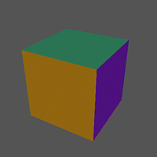
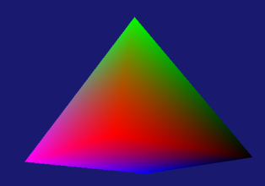
Moving to 3D Finally?
Almost
What do we need extra to get a 3D shape?
  Ex: rotating pyramid or spinning cube?
  A 3D model
    Ex: 4-sided pyramid. how many verts? Tris?
  World matrix to place the cube in world space
  Camera matrices to convert from World to NDC (view and perspective)
  Passing those matrices to the shaders (more constant buffers)
Creating a 3D model isn’t too difficult (next slide)
Matrices: Those will require need some explanations: In particular
  Available methods
  Row vs column major

Slide 48

A 3D Colored Pyramid
Let’s create a simple colored, 4-sided pyramid
For now, we’ll be using vertices in format: position + color
struct SimpleVertex
{
Vect Pos;
Vect Color;
};
SimpleVertex vertices[] =
{
{ Vect( 0.0f, 1.0f, 0.0f), Colors::Lime },
{ Vect(-1.0f, -1.0f, -1.0f), Colors::Black },
{ Vect(+1.0f, -1.0f, -1.0f), Colors::Red },
{ Vect(+1.0f, -1.0f, +1.0f), Colors::Magenta },
{ Vect(-1.0f, -1.0f, +1.0f), Colors::Blue }
};
D3D11_BUFFER_DESC bd;
ZeroMemory(&bd, sizeof(bd));
bd.Usage = D3D11_USAGE_DEFAULT;
bd.ByteWidth = sizeof(SimpleVertex) * 5; // <= adjust!
bd.BindFlags = D3D11_BIND_VERTEX_BUFFER;
bd.CPUAccessFlags = 0;
D3D11_SUBRESOURCE_DATA InitData;
ZeroMemory(&InitData, sizeof(InitData));
InitData.pSysMem = vertices;
hr = md3dDevice->CreateBuffer(&bd, &InitData, &mpVertexBuffer);
WORD indices[] =
{
0, 2, 1, // back face
0, 4, 3, // front face
0, 3, 2, // left face
0, 1, 4, // right face
1, 2, 3, // bottom faces
1, 3, 4
};
bd.Usage = D3D11_USAGE_DEFAULT;
bd.ByteWidth = sizeof(WORD) * 3 * 6; // 3 indices for 6 tris
bd.BindFlags = D3D11_BIND_INDEX_BUFFER;
bd.CPUAccessFlags = 0;
InitData.pSysMem = indices;
hr = md3dDevice->CreateBuffer(&bd, &InitData, &mpIndexBuffer);

Slide 49
Part 7:
Matrix and Vect classes and HSLS matrices

Slide 50
Matrix and Vector Classes
Our applications will be using the Matrix and Vect classes taken from the same AZUL package you’ll use in other courses
Why?
  You’ll be using those classes in other courses anyway
  They offer all the functionality we’d want for linear algebra operations
  Already optimized for SIMD (though we don’t really use it, it’s nice to have)
  I want to make it clear that you do NOT need DirectXMath to work with DirectX
    Yet another aspect not clearly stated in most DX demos (or OpenGL demos for that matter)
Important: I assume everyone is familiar with basic linear algebra (covered in GAM 324/425). What follows here is merely a review of the syntax of the most common operations we’ll need.

Slide 51
Vect Common Functions
Using Visual Studio, I definitely recommend you explore Vect.h, but here are some of the more common functions and operations:
Common Constructors:
Common Methods: Given a vector v
Vect(x, y, z, w); // Returns a 4-dim vector with coords (x,y,z,w)
Vect(x, y, z); // As above, but w=0: (x, y, z, 1) (ie: a point)
v.X(); // returns the x component (similarly with Y(), Z() and W(). )
v[x]; // returns the x component (similarly with [y], [z] and [w]. )
v.norm(); // normalize (length 1) v (ie: changes v)
v.getNorm(); // returns a normalize version of v (v is left unchanged)
v.mag(); // returns the magnitude (length) of v
v.magSqr(); // returns the square magnitude (length) of v
v.dot(u); // returns the dot product of u and v
v.cross(u); // returns the cross product of u and v
v.getAngle(u); // returns the angle (in radians) between u and v

Slide 52
Matrix Common Functions
Using Visual Studio, I definitely recommend you explore Matrix.h, but here are some of the more common functions and operations:
Common Constructors:
Common Methods: Given a Matrix M
Matrix(IDENTITY); // Returns a 4x4 identify matrix
Matrix(SCALE, sx, sy, sz) // Scale matrix using these scaling factors
Matrix(TRANS, tx, ty, tz) // Translation matrix using these offset values
Matrix(ROT_X, ang)
Matrix(ROT_Y, ang) // Rotation about world axis by ang in radians
Matrix(ROT_Z, ang)
Matrix(ROT_AXIS_ANGLE, axis, ang) // Rotation about arbitrary axis by ang in radian
Matrix(ROT_ORIENT, fwd_axis, up_axis) // Rotation aligned with fwd (z) and up (y)
M.T(); // Transpose M (ie: changes M)
M.getT(); // Returns a Transpose M (ie: M itself is left unchanged)
M.inv(); // Inverts M (ie: change M)
M.getInv(); // Returns the inverse of M (ie: M itself is left unchanged)
WARNING: This matrix class is row major (LASR), the opposite of what we covered in GAM 325/425. Makes sure to properly transpose your operations!
By the way: DirectXMath is also row major

Slide 53
HLSL Vectors and Matrices
As we saw earlier, HLSL vectors and matrices are declared as follow
Common Operations: (many, many more… see full list)
float4 Pos // A 4 dim vector of floats
float4x4 World; // A 4x4 matrix of floats
mul( x, y ) // multiplies x, y whatever they are, in that order. See HLSL/mul
dot( u, v ) // returns the dot product of u and v
cross( u, v ) // returns the cross product of u and v
length( v ) // returns the length of v
transpose( M ) // returns the transpose of M
WARNING: HLSL defaults to column-major!
Transferring our row-major matrices to HLSL will require some changes.
Think about this: HLSL and DirectXMath were created more or less together yet they chose different matrix standards…
Interesting related links
http://xboxforums.create.msdn.com/forums/t/112276.aspx
https://msdn.microsoft.com/en-us/library/windows/desktop/ff729728(v=vs.85).aspx

Slide 54
Part 8:
Camera Matrices

Slide 55
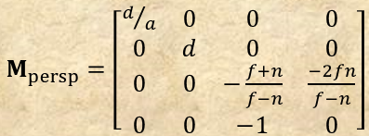

Camera Class
(See also GAM 324/425)
The Camera class: holder/constructor for the View and Projection matrices
void Camera::privUpdateProjectionMatrix(void)
{
float d = 1 / tanf(fovy/2);
this->projMatrix[m0] = d / aspectRatio;
this->projMatrix[m1] = 0.0f;
this->projMatrix[m2] = 0.0f;
this->projMatrix[m3] = 0.0f;
this->projMatrix[m4] = 0.0f;
this->projMatrix[m5] = d;
this->projMatrix[m6] = 0.0f;
this->projMatrix[m7] = 0.0f;
this->projMatrix[m8] = 0.0f;
this->projMatrix[m9] = 0.0f;
this->projMatrix[m10] = -(this->farDist + this->nearDist) / (this->farDist - this->nearDist);
this->projMatrix[m11] = -1.0f;
this->projMatrix[m12] = 0.0f;
this->projMatrix[m13] = 0.0f;
this->projMatrix[m14] = (-2.0f * this->farDist * this->nearDist) / (this->farDist - this->nearDist);
this->projMatrix[m15] = 0.0f;
// Converting from OpenGL-style NDC of [-1,1] to DX's [0,1]. See note: https://anteru.net/blog/2011/12/27/1830/
// (Note: NDCConvert should be precomputed once and stored for reuse)
Matrix B(TRANS, 0, 0, 1.0f);
Matrix S(SCALE, 1, 1, 0.5f);
Matrix NDCConvert = B * S;
projMatrix = projMatrix * NDCConvert;
};
Transposing, since we are row-major
Needed to rescale the NDC of $M_{persp}$

Slide 56
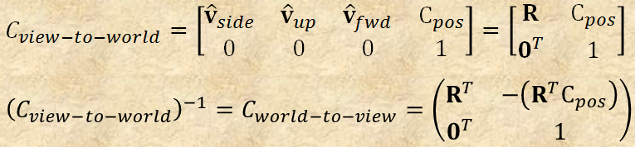
Camera Class
(See also GAM 324/425)
The Camera class: holder/constructor for the View and Projection matrices
void Camera::privUpdateViewMatrix(void)
{
this->viewMatrix[m0] = this->vRight[x];
this->viewMatrix[m1] = this->vUp[x];
this->viewMatrix[m2] = this->vDir[x];
this->viewMatrix[m3] = 0.0f;
this->viewMatrix[m4] = this->vRight[y];
this->viewMatrix[m5] = this->vUp[y];
this->viewMatrix[m6] = this->vDir[y];
this->viewMatrix[m7] = 0.0f;
this->viewMatrix[m8] = this->vRight[z];
this->viewMatrix[m9] = this->vUp[z];
this->viewMatrix[m10] = this->vDir[z];
this->viewMatrix[m11] = 0.0f;
// Apply R^t( -Pos ). Use dot-product with the basis vectors
this->viewMatrix[m12] = -vPos.dot(vRight);
this->viewMatrix[m13] = -vPos.dot(vUp);
this->viewMatrix[m14] = -vPos.dot(vDir);
this->viewMatrix[m15] = 1.0f;
};
Transposing, since we are row-major

Slide 57
DXApp Demo
Putting all this knowledge about matrices and camera together in the DXApp:
But how do we send all this to the GPU to be used by the render pipeline?
// DXApp.h file
Camera mCam;
Matrix mWorld;
// DXApp.cpp file
void DXApp::InitDemo()
{
< … >
mWorld = Matrix(IDENTITY); // Initialize the worldmat
// Initialize the projection matrix
mCam.setPerspective(45, mClientWidth / (float) mClientHeight, 1.0f, 1000.0f);
void DXApp::UpdateScene()
{
mWorld *= Matrix(ROT_Y, .0001f); // Simple slow rotation about y axis
// Build the view matrix. (using gimmicky click drag trick)
Vect target = Vect(0, 0, 0, 0);
Vect up = Vect(0, 1, 0, 0);
Vect pos = Vect(0, 0, -mRadius) * Matrix(ROT_Y, mTheta) * Matrix(ROT_X, mPhi);
mCam.setOrientAndPosition(up, target, pos);
mCam.updateCamera();
}

Slide 58
Part 9:
Yes, Now we can do 3D…
But it’ll have to wait next week…

