Slide 1
GAM 370/470:
Rendering and Graphics Programming
Lecture 3:
Camera Class,
Pipeline Management
and Model Class

Slide 2
Part 1:
Review

Slide 3

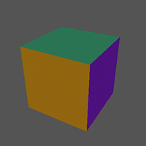
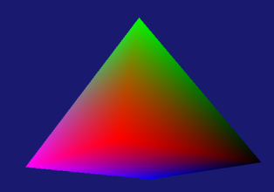
Moving to 3D Finally?
Almost…
What do we need extra to get a 3D shape?
  Ex: rotating pyramid or spinning cube?
  A 3D model
    Ex: 4-sided pyramid. how many verts? Tris?
  World matrix to place the cube in world space
  Camera matrices to convert from World to NDC (view and perspective)
  Passing those matrices to the shaders (more constant buffers)
Creating a 3D model isn’t too difficult (next slide)
Matrices: Those will require need some explanations: In particular
  Available methods
  Row vs column major

Slide 4

A 3D Colored Pyramid
Let’s create a simple colored, 4-sided pyramid
For now, we’ll be using vertices in format: position + color
struct SimpleVertex
{
Vect Pos;
Vect Color;
};
SimpleVertex vertices[] =
{
{ Vect( 0.0f, 1.0f, 0.0f), Colors::Lime },
{ Vect(-1.0f, -1.0f, -1.0f), Colors::Black },
{ Vect(+1.0f, -1.0f, -1.0f), Colors::Red },
{ Vect(+1.0f, -1.0f, +1.0f), Colors::Magenta },
{ Vect(-1.0f, -1.0f, +1.0f), Colors::Blue }
};
D3D11_BUFFER_DESC bd;
ZeroMemory(&bd, sizeof(bd));
bd.Usage = D3D11_USAGE_DEFAULT;
bd.ByteWidth = sizeof(SimpleVertex) * 5; // <= adjust!
bd.BindFlags = D3D11_BIND_VERTEX_BUFFER;
bd.CPUAccessFlags = 0;
D3D11_SUBRESOURCE_DATA InitData;
ZeroMemory(&InitData, sizeof(InitData));
InitData.pSysMem = vertices;
hr = md3dDevice->CreateBuffer(&bd, &InitData, &mpVertexBuffer);
WORD indices[] =
{
0, 2, 1, // back face
0, 4, 3, // front face
0, 3, 2, // left face
0, 1, 4, // right face
1, 2, 3, // bottom faces
1, 3, 4
};
bd.Usage = D3D11_USAGE_DEFAULT;
bd.ByteWidth = sizeof(WORD) * 3 * 6; // 3 indices for 6 tris
bd.BindFlags = D3D11_BIND_INDEX_BUFFER;
bd.CPUAccessFlags = 0;
InitData.pSysMem = indices;
hr = md3dDevice->CreateBuffer(&bd, &InitData, &mpIndexBuffer);

Slide 5
Part 1-1:
Matrix and Vect classes and HSLS matrices

Slide 6
Matrix and Vector Classes
Our applications will be using the Matrix and Vect classes taken from the same AZUL package you’ll use in other courses
Why?
  You’ll be using those classes in other courses anyway
  They offer all the functionality we’d want for linear algebra operations
  Already optimized for SIMD (though we don’t really need it, it’s nice to have)
  I want to make it clear that you do NOT need DirectXMath to work with DirectX
    Yet another aspect not clearly stated in most DX demos (or OpenGL demos for that matter)
Important: I assume everyone is familiar with basic linear algebra (covered in GAM 325/425). What follows here is merely a review of the syntax of the most common operations we’ll need.

Slide 7
Vect Common Functions
Using Visual Studio, I definitely recommend you explore Vect.h, but here are some of the more common functions and operations:
Common Constructors:
Common Methods: Given a vector v
Vect(x, y, z, w); // Returns a 4-dim vector with coords (x,y,z,w)
Vect(x, y, z); // As above, but w=0: (x, y, z, 1) (ie: a point)
v.X(); // returns the x component (similarly with Y(), Z() and W(). )
v[x]; // returns the x component (similarly with [y], [z] and [w]. )
v.norm(); // normalize (length 1) v (ie: changes v)
v.getNorm(); // returns a normalize version of v (v is left unchanged)
v.mag(); // returns the magnitude (length) of v
v.magSqr(); // returns the square magnitude (length) of v
v.dot(u); // returns the dot product of u and v
v.cross(u); // returns the cross product of u and v
v.getAngle(u); // returns the angle (in radians) between u and v

Slide 8
Matrix Common Functions
Using Visual Studio, I definitely recommend you explore Matrix.h, but here are some of the more common functions and operations:
Common Constructors:
Common Methods: Given a Matrix M
Matrix(IDENTITY); // Returns a 4x4 identify matrix
Matrix(SCALE, sx, sy, sz) // Scale matrix using these scaling factors
Matrix(TRANS, tx, ty, tz) // Translation matrix using these offset values
Matrix(ROT_X, ang)
Matrix(ROT_Y, ang) // Rotation about world axis by ang in radians
Matrix(ROT_Z, ang)
Matrix(ROT_AXIS_ANGLE, axis, ang) // Rotation about arbitrary axis by ang in radian
Matrix(ROT_ORIENT, fwd_axis, up_axis) // Rotation aligned with fwd (z) and up (y)
M.T(); // Transpose M (ie: changes M)
M.getT(); // Returns a Transpose M (ie: M itself is left unchanged)
M.inv(); // Inverts M (ie: change M)
M.getInv(); // Returns the inverse of M (ie: M itself is left unchanged)
WARNING: This matrix class is row major (LASR), the opposite of what we covered in GAM 325/425. Makes sure to properly transpose your operations!
By the way: DirectXMath is also row major

Slide 9
HLSL Vectors and Matrices
As we saw earlier, HLSL vectors and matrices are declared as follow
Common Operations: (many, many more… see full list)
float4 Pos // A 4 dim vector of floats
float4x4 World; // A 4x4 matrix of floats
mul( x, y ) // multiplies x, y whatever they are, in that order. See HLSL/mul
dot( u, v ) // returns the dot product of u and v
cross( u, v ) // returns the cross product of u and v
length( v ) // returns the length of v
transpose( M ) // returns the transpose of M
WARNING: HLSL defaults to column-major!
Transferring our row-major matrices to HLSL will require some changes.
Think about this: HLSL and DirectXMath were created more or less together yet they chose different matrix standards…
Interesting links
http://xboxforums.create.msdn.com/forums/t/112276.aspx
https://msdn.microsoft.com/en-us/library/windows/desktop/ff729728(v=vs.85).aspx

Slide 10
Part 1-2:
Camera Matrices

Slide 11
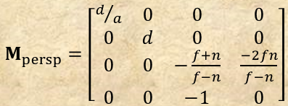

Camera Class
(See also GAM 325/425)
The Camera class: holder/constructor for the View and Projection matrices
void Camera::privUpdateProjectionMatrix(void)
{
float d = 1 / tanf(fovy/2);
this->projMatrix[m0] = d / aspectRatio;
this->projMatrix[m1] = 0.0f;
this->projMatrix[m2] = 0.0f;
this->projMatrix[m3] = 0.0f;
this->projMatrix[m4] = 0.0f;
this->projMatrix[m5] = d;
this->projMatrix[m6] = 0.0f;
this->projMatrix[m7] = 0.0f;
this->projMatrix[m8] = 0.0f;
this->projMatrix[m9] = 0.0f;
this->projMatrix[m10] = -(this->farDist + this->nearDist) / (this->farDist - this->nearDist);
this->projMatrix[m11] = -1.0f;
this->projMatrix[m12] = 0.0f;
this->projMatrix[m13] = 0.0f;
this->projMatrix[m14] = (-2.0f * this->farDist * this->nearDist) / (this->farDist - this->nearDist);
this->projMatrix[m15] = 0.0f;
// Converting from OpenGL-style NDC of [-1,1] to DX's [0,1]. See note: https://anteru.net/blog/2011/12/27/1830/
// (Note: NDCConvert should be precomputed once and stored for reuse)
Matrix B(TRANS, 0, 0, 1.0f);
Matrix S(SCALE, 1, 1, 0.5f);
Matrix NDCConvert = B * S;
projMatrix = projMatrix * NDCConvert;
};
Transposing since we are row-major
Needed to rescale the NDC of $M_{persp}$

Slide 12
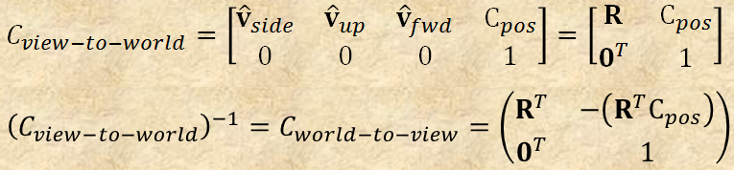
Camera Class
(See also GAM 325/425)
The Camera class: holder/constructor for the View and Projection matrices
void Camera::privUpdateViewMatrix(void)
{
this->viewMatrix[m0] = this->vRight[x];
this->viewMatrix[m1] = this->vUp[x];
this->viewMatrix[m2] = this->vDir[x];
this->viewMatrix[m3] = 0.0f;
this->viewMatrix[m4] = this->vRight[y];
this->viewMatrix[m5] = this->vUp[y];
this->viewMatrix[m6] = this->vDir[y];
this->viewMatrix[m7] = 0.0f;
this->viewMatrix[m8] = this->vRight[z];
this->viewMatrix[m9] = this->vUp[z];
this->viewMatrix[m10] = this->vDir[z];
this->viewMatrix[m11] = 0.0f;
// Apply R^t( -Pos ). Use dot-product with the basis vectors
this->viewMatrix[m12] = -vPos.dot(vRight);
this->viewMatrix[m13] = -vPos.dot(vUp);
this->viewMatrix[m14] = -vPos.dot(vDir);
this->viewMatrix[m15] = 1.0f;
};
Transposing since we are row-major

Slide 13
DXApp Demo
Putting all this knowledge about matrices and camera together in the DXApp:
But how do we send all this to the GPU to be used by the render pipeline?
// DXApp.h file
Camera mCam;
Matrix mWorld;
// DXApp.cpp file
void DXApp::InitDemo()
{
< … >
mWorld = Matrix(IDENTITY); // Initialize the worldmat
// Initialize the projection matrix
mCam.setPerspective(45, mClientWidth / (float) mClientHeight, 1.0f, 1000.0f);
void DXApp::UpdateScene()
{
mWorld *= Matrix(ROT_Y, .0001f); // Simple slow rotation about y axis
// Build the view matrix. (using gimmicky click drag trick)
Vect target = Vect(0, 0, 0, 0);
Vect up = Vect(0, 1, 0, 0);
Vect pos = Vect(0, 0, -mRadius) * Matrix(ROT_Y, mTheta) * Matrix(ROT_X, mPhi);
mCam.setOrientAndPosition(up, target, pos);
mCam.updateCamera();
}

Slide 14
Part 1-3:
Yes, Now we can do 3D…

Slide 15
Vertex Shader & Matrices
Recall: vertex shader’s job is to apply the world and camera matrices to all vertex.
Answer 2: Force row-major packing
#pragma pack_matrix( row_major )
cbuffer ConstantBuffer : register( b0 )
{
float4x4 World;
float4x4 View;
float4x4 Projection;
}
Problem 2: What about the issue with row/column major?
Answer 1: a constant buffer
struct VS_OUTPUT
{
float4 Pos : SV_POSITION;
float4 Color : COLOR;
};
VS_OUTPUT VS( float4 Pos : POSITION, float4 Color : COLOR )
{
VS_OUTPUT output;
output.Pos = mul( Pos, World);
output.Pos = mul( output.Pos, View);
output.Pos = mul( output.Pos, Projection);
output.Color = Color;
return output;
}
A vertex from the vertex buffer
Problem 1: Where did those matrices come from?
Corresponding position in NDC (missing the homog. coord div.
The rasterizer computes the corresponding pixels on screen
float4 PS( VS_OUTPUT input ) : SV_Target
{
return input.Color;
}
Colors the pixels accordingly

Slide 16
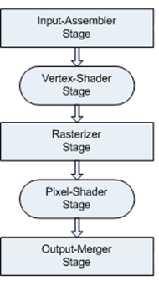
Constant Buffers for Matrices
As before, we must:
  Create a GPU resource for all 3 matrices and keep a handle on the CPU
  Connect these resources to the pipeline, specifically to a shader constants for VS
  Update the data as needed
GPU
Verts
DirectX App
Indices
VS
mpcbWVPBuffer
ID3D11Buffer
World
CCW
Viewport
View
PS
Projection

Slide 17
Constant Buffers for Matrices
Step 1: GPU Resource: Buffer handle and structure (same process as before)
// DXApp.h file
ID3D11Buffer* mpcbWVPBuffer;
struct WVPmatrices
{
Matrix mWorld;
Matrix mView;
Matrix mProjection;
};
// DXApp.cpp file
D3D11_BUFFER_DESC bd;
bd.Usage = D3D11_USAGE_DEFAULT;
bd.ByteWidth = sizeof(WVPmatrices);
bd.BindFlags = D3D11_BIND_CONSTANT_BUFFER;
bd.CPUAccessFlags = 0;
hr = md3dDevice->CreateBuffer(&bd, nullptr, &mpcbWVPBuffer);
assert(SUCCEEDED(hr));
GPU
Verts
DirectX App
Indices
VS
mpcbWVPBuffer
ID3D11Buffer
World
CCW
Viewport
View
PS
Projection

Slide 18
Constant Buffers for Matrices
Step 2: Connect resources to pipeline: The shader (slide) has shader constants
  We only need to connect the corresponding constant buffer to the pipeline
md3dImmediateContext->VSSetConstantBuffers(0, 1, &mpcbWVPBuffer);
Note: This time, only the VS makes use of the shader constants
GPU
Verts
DirectX App
Indices
VS
mpcbWVPBuffer
ID3D11Buffer
World
CCW
Viewport
View
PS
Projection

Slide 19
Constant Buffers for Matrices
Step 3: Updating Data: Sending the matrices from CPU to the GPU buffer
  Problem: The world, view and perspective matrices may change during the update
  Answer: Send the updated data as part of the draw step.
void DXApp::UpdateScene()
{
mWorld *= Matrix(ROT_Y, .0001f); // Simple slow rotation about y axis
Vect target = Vect(0, 0, 0, 0); // Build the view matrix using gimmicky trick
Vect up = Vect(0, 1, 0, 0);
Vect pos = Vect(0, 0, -mRadius) * Matrix(ROT_Y, mTheta) * Matrix(ROT_X, mPhi);
mCam.setOrientAndPosition(up, target, pos);
mCam.updateCamera();
}
Why? During the Update step, many events could have caused the values to change (key pres, collision, etc.). We don’t want to send data to the GPU unnecessarily.
GPU
Verts
DirectX App
Indices
VS
mpcbWVPBuffer
ID3D11Buffer
World
CCW
Viewport
View
PS
Projection

Slide 20
Constant Buffers for Matrices
Step 3: Updating Data: Sending the matrices from CPU to the GPU buffer
  Problem: The world, view and perspective matrices may change during the update
  Answer: Send the updated data as part of the draw step.
void DXApp::UpdateScene()
{
mWorld *= Matrix(ROT_Y, .0001f); // Simple slow rotation about y axis
Vect target = Vect(0, 0, 0, 0); // Build the view matrix using gimmicky trick
Vect up = Vect(0, 1, 0, 0);
Vect pos = Vect(0, 0, -mRadius) * Matrix(ROT_Y, mTheta) * Matrix(ROT_X, mPhi);
mCam.setOrientAndPosition(up, target, pos);
mCam.updateCamera();
}
Why? During the Update step, many events could have caused the values to change (key pres, collision, etc.). We don’t want to send data to the GPU unnecessarily.
GPU
Verts
Indices
VS
Note: Fundamentally, this is why we have a draw step at all.
  Compute all changes for the next frame (Update step)
  With all the data in its final form, package it all to the GPU and render the next frame (Draw step)
World
CCW
Viewport
View
PS
Projection

Slide 21
Constant Buffers for Matrices
Step 3: Updating Data: Sending the matrices from CPU to the GPU buffer
  Problem: The world, view and perspective matrices may change during the update
  Answer: Send the updated data as part of the draw step.
void DXApp::UpdateScene()
{
mWorld *= Matrix(ROT_Y, .0001f); // Simple slow rotation about y axis
Vect target = Vect(0, 0, 0, 0); // Build the view matrix using gimmicky trick
Vect up = Vect(0, 1, 0, 0);
Vect pos = Vect(0, 0, -mRadius) * Matrix(ROT_Y, mTheta) * Matrix(ROT_X, mPhi);
mCam.setOrientAndPosition(up, target, pos);
mCam.updateCamera();
}
void DXApp::DrawScene()
{
md3dImmediateContext->ClearRenderTargetView(mRenderTargetView, VasA(BackgroundColor) );
WVPmatrices cb;
cb.mWorld = mWorld;
cb.mView = mCam.getViewMatrix();
cb.mProjection = mCam.getProjMatrix();
md3dImmediateContext->UpdateSubresource(mpcbWVPBuffer, 0, nullptr, &cb, 0, 0);
md3dImmediateContext->DrawIndexed(3 * 6, 0, 0); // 3 indices for each triangle in a list
mSwapChain->Present(0, 0);
}
Note: the data is pushed to GPU every frame.

Slide 22
Part 2:
Depth Buffer Woes….

Slide 23
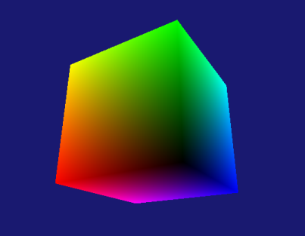
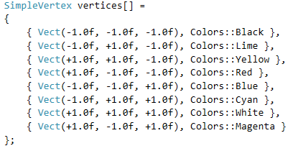
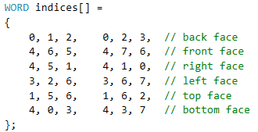
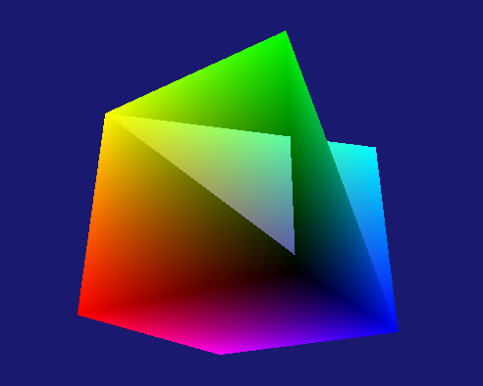
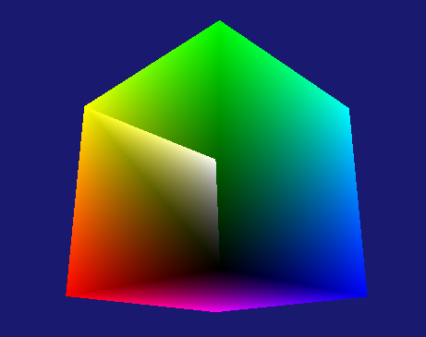
Colored Cube
The logical progression at this point would be to have you create a colored cube as part of the next assignment:
  Use the same shaders as the colored pyramid
  Adjust the code to use the following vertices and indices
  Unfortunately: without adjusting yet another DX setting, a slight error might give you any of the following (or worse):
What we are seeing here is a problem with the depth buffer

Slide 24
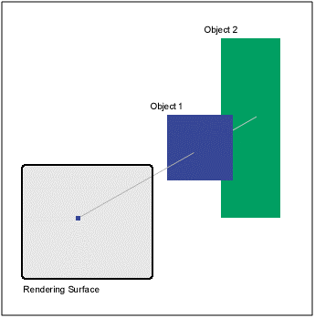
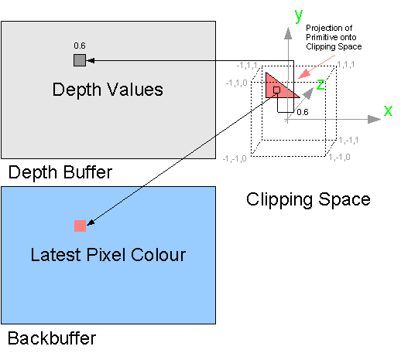
Depth Buffering (aka z-buffering):
The Olden Days…
When a pixel is targeted by two or more objects, depth buffering will compare their respective NDC z values: the one closest to the screen wins.
Typical implementation:
  Keep a separate buffer to track the depth of each pixel
  A pixel is recolored only if the new color has a lower z value
Life was simple back then….

Slide 25
Depth Buffering (aka z-buffering):
The Olden Days… Until…
At some point, somebody realized the following:
  The depth buffer is really just a grey-scale image. (Darker pixels = further back)
  The individual pixels of the depth buffer image filter what goes on the back buffer…
  Yes/No is a pretty simplistic filtering rule
What if instead:
  We upgraded the depth buffer from grey-scale to containing a full image?
  Allowed more general filter rules?

Slide 26
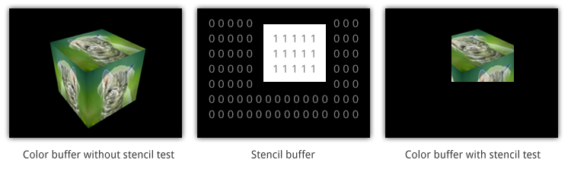
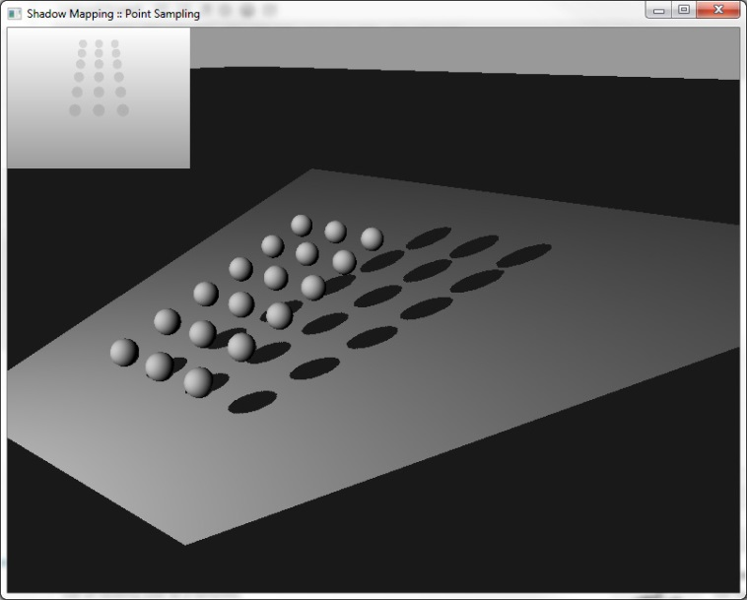
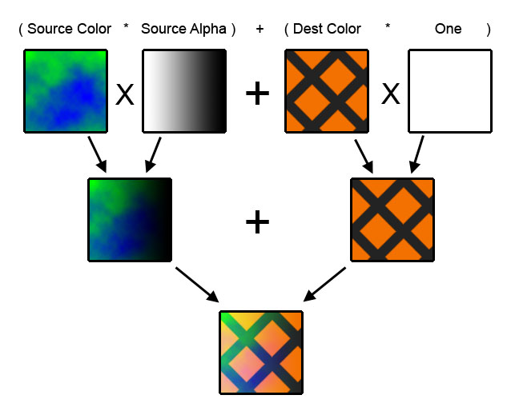
Depth Buffer Evolution:
Stencil Buffer
At this point, we have a general filtering tool called a stencil
We can do some clever tricks:
  Masking
  Blending
  Shadows

Slide 27
Stenciling
Modern graphic environments deal with z-buffer as part of the more general concept of using a stencil buffer.
  Pro: Far more powerful and versatile machinery
  Con: Pain in the rear-end when we just want the simple z-buffer test…
Bottom line:
  The whole concept of Stenciling is covered in chapter 10 of the book
    We’ll get there soon enough…
  By default, the Output Merger (OM) stage does not do any sort of filtering test.
    That’s why our ‘mistakes’ with the cube had this space-bending appearance.
  Right now, we just want a working z-buffer without diving too deeply in the stenciling rabbit-hole.
Therefore:
I will give you the esoteric DX code to get us a functioning z-buffer.
We will return to general stenciling later in the quarter

Slide 28
Basic, No-Frills Z-Buffer
// DXApp::InitDirect3D
D3D11_TEXTURE2D_DESC descDepthTextureBuf;
descDepthTextureBuf.Width = mClientWidth;
descDepthTextureBuf.Height = mClientHeight;
descDepthTextureBuf.MipLevels = 1;
descDepthTextureBuf.ArraySize = 1;
descDepthTextureBuf.Format = DXGI_FORMAT_D24_UNORM_S8_UINT;
descDepthTextureBuf.SampleDesc = sampDesc;
descDepthTextureBuf.Usage = D3D11_USAGE_DEFAULT;
descDepthTextureBuf.BindFlags = D3D11_BIND_DEPTH_STENCIL;
descDepthTextureBuf.CPUAccessFlags = 0;
descDepthTextureBuf.MiscFlags = 0;
ID3D11Texture2D* pDepthStencil;
hr = md3dDevice->CreateTexture2D(&descDepthTextureBuf, NULL, &pDepthStencil);
assert(SUCCEEDED(hr));
// Create the depth stencil view
D3D11_DEPTH_STENCIL_VIEW_DESC descDSV;
ZeroMemory(&descDSV, sizeof(descDSV));
descDSV.Format = descDepthTextureBuf.Format;
descDSV.ViewDimension = D3D11_DSV_DIMENSION_TEXTURE2DMS;
descDSV.Texture2D.MipSlice = 0;;
hr = md3dDevice->CreateDepthStencilView(pDepthStencil, &descDSV, &mpDepthStencilView);
assert(SUCCEEDED(hr));
ReleaseAndDeleteCOMobject(pDepthStencil);
// DXApp.h file
// Gasp! Another resource handle!
ID3D11DepthStencilView* mpDepthStencilView;
DX Esoterica to create a Depth Stencil View

Slide 29
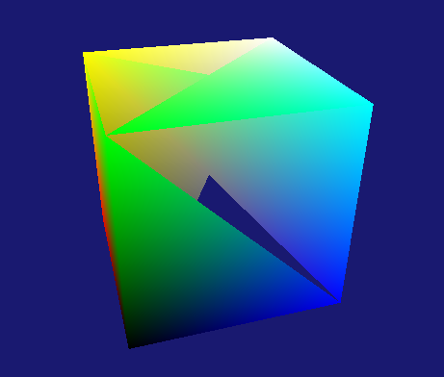
Basic, No-Frills Z-Buffer
Slight change with how we initialize the OM stage
Finally, a slight change in the draw step operations:
// DXApp::InitDirect3D
//md3dImmediateContext->OMSetRenderTargets(1, &mRenderTargetView, nullptr);
md3dImmediateContext->OMSetRenderTargets(1, &mRenderTargetView, mpDepthStencilView);
Also: remember to release mpDepthStencilView in DXApp’s destructor
// DXApp::DrawScene
// Clear the back buffer
md3dImmediateContext->ClearRenderTargetView(mRenderTargetView, VasA(BackgroundColor) );
// Clear the depth stencil;
md3dImmediateContext->ClearDepthStencilView(mpDepthStencilView, D3D11_CLEAR_DEPTH, 1.0f, 0);
That’s it!
Now if your rendering still looks like it’s bending space, it’s all on you…

Slide 30
Part 3:
Managing the Render Pipeline

Slide 31
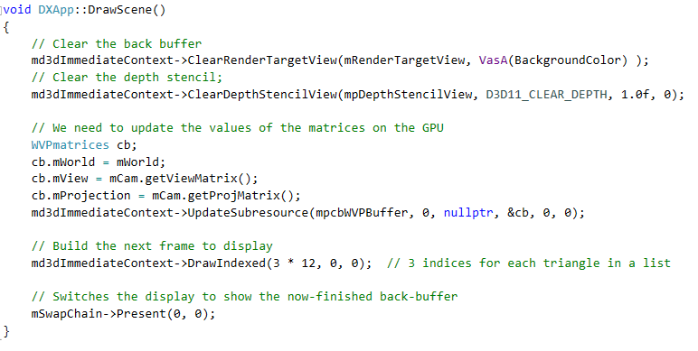
Back to Constant Buffers and
Updating Data
With our current demo, the constant buffer on the GPU (for matrices) is actually updated every frame (in the DrawScene method)
Note: we need to push the data to GPU when it changes
This makes complete sense since the world and camera matrices may be updated at runtime.
But it highlights a flaw in our demo code: Many operations that we performed as ‘initialization’ may not always be one-time only.

Slide 32
Order of Operations…
We have been cavalier about when we should perform certain DX operations:
  BTW: Most graphic environments demos have this problem: It’s up to you to figure out that some ‘initialization’ code rightly belongs elsewhere.
In our DXApp demo code:
  All the operations in DXInit are more or less fine: proper initialization stuff (for now)
    There are exceptions even here: what if you want to mix rendering in solid and wireframe mode?
  The operations in InitDemo however are less clear:
    Some things need to be done once only
      Ex: Loading shaders, vertex/index buffers to the GPU
    Others depends context:
      Which model are we using? ( And did the vertex layout change? )
      Did we change shaders? Do we need different constant buffers?
      Does the data in the constant buffers need updating?
To render a complex scene we must also manage the pipeline:
i.e.: Control which shader, resources, data are necessary and adjust the pipeline accordingly.

Slide 33
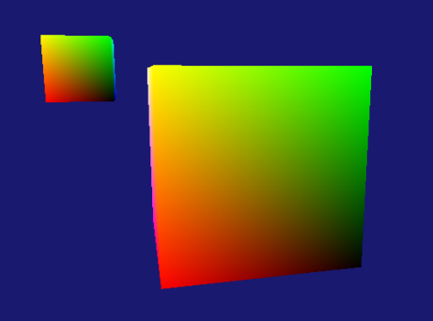
Moving Data Around
How do we render two colored cubes?
void DXApp::DrawScene()
{
md3dImmediateContext->ClearRenderTargetView(mRenderTargetView, VasA(BackgroundColor) );
md3dImmediateContext->ClearDepthStencilView(mpDepthStencilView, D3D11_CLEAR_DEPTH, 1.0f, 0);
// We need to update the values of the matrices on the GPU
// Sending the data for Object #1
WVPmatrices cb;
cb.mWorld = mWorld1;
cb.mView = mCam.getViewMatrix();
cb.mProjection = mCam.getProjMatrix();
md3dImmediateContext->UpdateSubresource(mpcbWVPBuffer, 0, nullptr, &cb, 0, 0);
// render Object #1
md3dImmediateContext->DrawIndexed(3 * 12, 0, 0);
// Sending the data for Object #2
cb.mWorld = mWorld2;
cb.mView = mCam.getViewMatrix();
cb.mProjection = mCam.getProjMatrix();
md3dImmediateContext->UpdateSubresource(mpcbWVPBuffer, 0, nullptr, &cb, 0, 0);
// render Object #2
md3dImmediateContext->DrawIndexed(3 * 12, 0, 0);
// Switches the display to show the now-finished back-buffer
mSwapChain->Present(0, 0);
}
// DXApp.h file
Matrix mWorld1;
Matrix mWorld2;
// And suitably updated
Note: The camera matrices are sent twice despite not changing. Very inefficient!
How inefficient?
Placing 1000 cubes in the scene at 60 fps represents 7.3MB/s of wasted bandwidth to the GPU to send the same View and Proj matrices for each of them!

Slide 34
Constant Buffers and
Data Update Frequency
When creating shaders, you should group shaders constants by how often they will need to be updated.
  What that means depends greatly on the scene, the objects and shaders used…
  But generally speaking, you have three broad categories:
  Common to all objects in the scene
    Ex: View and Projections matrices
      Often these are multiplied on the CPU to avoid repeated recomputation in each shader
    Ex: position and data related to lighting sources
  Common to all instances of an object type
    Ex: Texture, colors (ex: all tree bark and foliage textures)
  Unique to a specific instance
    Ex: World matrix, texture, color (ex: one tree might have a carved symbol on the trunk)
Also worth considering: maximizing the use of vertex/index buffers, shaders, etc.
  As we create more complex scenes, we will develop this concept

Slide 35

Improving the ColorSelected Shader
Combining 3D and user selected colors:
  Two shader constants
    Separating camera data from instance data
  VS and PS perform the expected operations
cbuffer CamData : register(b0)
{
matrix View;
matrix Projection;
}
cbuffer InstanceData : register(b1)
{
matrix World;
float4 SelectedColor;
};
struct VS_OUTPUT
{
float4 Pos : SV_POSITION;
float4 Color : COLOR;
};
VS_OUTPUT VS( float4 Pos : POSITION )
{
VS_OUTPUT output = (VS_OUTPUT)0;
output.Pos = mul( Pos, World );
output.Pos = mul( output.Pos, View );
output.Pos = mul( output.Pos, Projection );
output.Color = SelectedColor;
return output;
}
float4 PS( VS_OUTPUT input ) : SV_Target
{
return input.Color;
}
Let’s look more closely at the shader constants

Slide 36
Shader Constants and
Registers
See also Shader Constants
Registers are the internal HLSL storage for
constant buffers.
  Up to 14 register per stage… That’s a lot!
The ‘b’ number identifies which internal buffer register to use
  Specifying the register is optional: If no register is specified than HLSL assigns the constant to the first available starting with register(b0)
  You will need to use the register number to set up the rendering pipeline, so might as well clearly specify it in the shader!
  When managing multiple shaders simultaneously, it’s best to specify some convention:
    Example: Camera data is always in register(b0), light position in register(b1), etc.
cbuffer CamData : register(b0)
{
matrix View;
matrix Projection;
}
cbuffer InstanceData : register(b1)
{
matrix World;
float4 SelectedColor;
};

Slide 37
Using the ColorSelected3D Shader
Setting up the constant buffers is done the same way as before:
However, to connect the constant buffers with the shader constants, we must specify the register number!
// DXApp.h file
ID3D11Buffer* mpcbViewProj;
struct ViewProjData
{
Matrix mView;
Matrix mProjection;
};
ID3D11Buffer* mpcbWorldColor;
struct WorldColorData
{
Matrix World;
Vect Color;
};
// DXApp::InitDemo
// **** View and projection buffer
bd.Usage = D3D11_USAGE_DEFAULT;
bd.ByteWidth = sizeof(ViewProjData);
bd.BindFlags = D3D11_BIND_CONSTANT_BUFFER;
bd.CPUAccessFlags = 0;
hr = md3dDevice->CreateBuffer(&bd, nullptr, &mpcbViewProj);
assert(SUCCEEDED(hr));
// **** World and Color buffer
bd.Usage = D3D11_USAGE_DEFAULT;
bd.ByteWidth = sizeof(WorldColorData);
bd.BindFlags = D3D11_BIND_CONSTANT_BUFFER;
bd.CPUAccessFlags = 0;
hr = md3dDevice->CreateBuffer(&bd, nullptr, &mpcbWorldColor);
assert(SUCCEEDED(hr));
md3dImmediateContext->VSSetConstantBuffers(0, 1, &mpcbViewProj);
md3dImmediateContext->VSSetConstantBuffers(1, 1, &mpcbWorldColor);

Slide 38
Connecting Constant Buffers with
Shader constants
The register numbers must match
Remember that register numbers are used even if not specified!
  Ex: See ShaderSelected.hlsl
  When not specified, the order is top to bottom starting at 0
cbuffer CamData : register(b0)
{
matrix View;
matrix Projection;
}
cbuffer InstanceData : register(b1)
{
matrix World;
float4 SelectedColor;
};
md3dImmediateContext->VSSetConstantBuffers(0, 1, &mpcbViewProj);
md3dImmediateContext->VSSetConstantBuffers(1, 1, &mpcbWorldColor);

Slide 39
Rendering Two Pyramids
void DXApp::DrawScene()
{
md3dImmediateContext->ClearRenderTargetView(mRenderTargetView, VasA(BackgroundColor) );
md3dImmediateContext->ClearDepthStencilView(mpDepthStencilView, D3D11_CLEAR_DEPTH, 1.0f, 0);
// ------- Camera data can be sent only once
ViewProjData vpdata;
vpdata.mView = mCam.getViewMatrix();
vpdata.mProjection = mCam.getProjMatrix();
md3dImmediateContext->UpdateSubresource(mpcbViewProj, 0, nullptr, &vpdata, 0, 0);
// --- Object #1's data needs to be sent
WorldColorData wcdata;
wcdata.World = mWorld1;
wcdata.Color = Colors::Firebrick;
md3dImmediateContext->UpdateSubresource(mpcbWorldColor, 0, nullptr, &wcdata, 0, 0);
// --- Render Object #1;
md3dImmediateContext->DrawIndexed(3 * 6, 0, 0);
// ------- Object #2's data needs to be sent
wcdata.World = mWorld2;
wcdata.Color = Colors::Orange;
md3dImmediateContext->UpdateSubresource(mpcbWorldColor, 0, nullptr, &wcdata, 0, 0);
// --- Render Object #2;
md3dImmediateContext->DrawIndexed(3 * 6, 0, 0);
// Switches the display to show the now-finished back-buffer
mSwapChain->Present(0, 0);
}
Clearly we are now much more efficient with updating the camera constant buffers
Unfortunately, there are other sources of inefficiencies

Slide 40
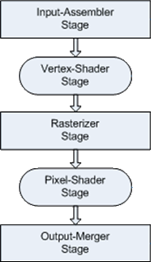
Managing The Pipeline
In general, to render one object on the screen means (at minimum)
  Initialization:
    Genereal initialization of the graphics environment
    Load all external resources on the GPU:
      all shaders, models (vertices and indices) and textures
      Also includes input layouts…
  During game loop (Draw step):
    Ensure that all stages have the right settings for the current object
      Solid/Wireframe, Viewport settings, Stencil, etc.
    Connecting the pipeline with the right vertex and pixel shaders
    Connection the IA to the right input layout
    Connecting the shader constants with the correct constant buffers
    Upload the data to the constant buffers
    Render one object
    And then repeat the above list for every objects to render.
      Yes, this means any of these element may change for any object to render

Slide 41
Managing The Pipeline:
Options
Assume the simplest setting for a complex scene:
  We have a large number of objects to render
  We have few shaders, but each object uses only one.
  All constant buffers data are either unique to one instance or common to all instances.
  The general pipeline settings do not to change.
  Which is the better arrangement for the draw step?
This is far simpler than any ‘typical’ game situation…
Update common constant buffers
  camera, lighting info, etc.
  For each object <obj>:
  Connect the VS and PS stages obj’s <vs, ps>
  Connect the IA with the proper input layout
  Update the constant buffers for <obj>:
    worldmat, color, etc.
  Render <obj>
Update common constant buffers
  camera, lighting info, etc.
For each shader <vs, ps>:
  Connect the vertex and pixel stages to <vs, ps>
  Connect the IA with the proper input layout
  For each object <obj> using <vs,ps>:
    Update the for constant buffers for <obj>:
    worldmat, color, etc.
    Render <obj>
Results in a much simpler API for our users
Lots of wasted re-connection to the pipeline
  Re-connection are not just switching internal GPU pointers around…
Typically better performance
Difficult to generalize for ‘typical’ cases
Results in a more complicated API for users

Slide 42
Managing The Pipeline:
Option Selected
Our eventual goal is still to create a proper API to hide away much of the complexity in using a graphic environment.
For our purpose, the option below will suffice.
  Good enough in practice for simple games
  The resulting API is simple enough for a first attempt
Update common constant buffers
  camera, lighting info, etc.
  For each object <obj>:
  Connect the VS and PS stages obj’s <vs, ps>
  Connect the IA with the proper input layout
  Update the constant buffers for <obj>:
    worldmat, color, etc.
  Render <obj>
In the future, you will built many such API. Over time, you may decide on a different order of operations that is better suited for your particular case at the time.
But for now: this will be good enough
Results in a much simpler API for our users
Lots of wasted re-connection to the pipeline
  Saving grace: re-connection are not as expensive as wasted data uploads

Slide 43
Part 4:
Speaking of API…

Slide 44
We Learned a Lot!
I hope that by now you have a much better grasp of graphic environments.
We have covered a lot of ground in 3 weeks
DirectX App
GPU
md3dDevice
ID3D11Device
Main Controls
md3dImmediateContext
ID3D11DeviceContext
Verts
Indices
mpVertexBuffer
ID3D11Buffer
Layout
mpIndexBuffer
ID3D11Buffer
VS
mpVertexLayout
ID3D11InputLayout
CCW
Viewport
mpVertexShader
ID3D11VertexShader
PS
mpPixelShader
ID3D11PixelShader
Swap Chain
FrontBuffer
BackBuffer
Buffer #1
mSwapChain
IDXGISwapChain
Buffer #2
mRenderTargetView
ID3D11RenderTargetView
Render Target View
Send to SwapChain->BackBuffer

Slide 45
We Learned a Lot! (Much left to do…)
I hope that by now you have a much better grasp of graphic environments.
We have covered a lot of ground in 3 weeks
Unfortunately, the code DXApp is becoming far too unwieldly to use:
  One file with 545 lines of code is horrible…
  Any attempt at a complex scene would create a giant mess impossible to debug
  Even with a single-object-per-scene, the code is unpleasant to work with.
  Adding the new materials such as texturing, lighting, multi-mesh models, etc. will just make the situation worse.
Therefore: we now begin the process of ‘cleaning up’ DXApp
  We’ll start with a few simple classes to encapsulate data and related operations
  At first, I will usually give you partial code for these classes, but you will build them up over time (homework)
  You’re welcome to add your own code organization as you see fit.
  This work will build the components needed for the final project.

Slide 46
First Up: Model
Looking at DXApp, what ‘stuff’ do we want to encapsulate into a ‘Model’?
  Vertices and indices
  Handles for vertex and index buffers
What operations/services do we want for a ‘Model’?
  Construction: either passing in the vertices and indices or having pre-made models
  Connect the buffers to the pipeline
  Call the DrawIndexed command
This is good enough to start
We’ll be adding more features to the Model class over time.

Slide 47
Standardizing Vertices and Indices
Having too many format for vertices and indices across multiple models will quickly get messy. We need to standardize:
Changing from ‘Word’ (16 bits) to unsigned int (32 bits)
struct StandardVertex : public Align16
{
Vect Pos;
Vect Color;
void set(float _x, float _y, float _z,
float _r = 1, float _g = 1, float _b = 1)
{
Pos = Vect(_x, _y, _z);
Color = Vect(_r, _g, _b);
}
void set(float _x, float _y, float _z, const Vect& c)
{
Pos = Vect(_x, _y, _z);
Color = c;
}
void set(const Vect& v, const Vect& c)
{
Pos = v;
Color = c;
}
};
struct TriangleByIndex
{
unsigned int v0;
unsigned int v1;
unsigned int v2;
void set(int _v0, int _v1, int _v2)
{
v0 = _v0;
v1 = _v1;
v2 = _v2;
}
};
Not much different from what we’ve done,
but we’ll add to these in the near future
Similarly, these accessors will be useful later
These changes work towards (eventually) being compatible with loading models from file (later)

Slide 48
Using the New Standard
Slight changes in how we construct the arrays of vertices and indices.
The only other difference:
  The index buffer needs to reflect the change from 16bit to 32bit data format
StandardVertex* vertices = new StandardVertex[8];
vertices[0].set( Vect(-0.5f, -0.5f, -0.5f), Colors::Black );
vertices[1].set( Vect(-0.5f, +0.5f, -0.5f), Colors::Lime );
vertices[2].set( Vect(+0.5f, +0.5f, -0.5f), Colors::Yellow );
vertices[3].set( Vect(+0.5f, -0.5f, -0.5f), Colors::Red );
vertices[4].set( Vect(-0.5f, -0.5f, +0.5f), Colors::Blue );
vertices[5].set( Vect(-0.5f, +0.5f, +0.5f), Colors::Cyan );
vertices[6].set( Vect(+0.5f, +0.5f, +0.5f), Colors::White );
vertices[7].set( Vect(+0.5f, -0.5f, +0.5f), Colors::Magenta );
TriangleByIndex* indices = new TriangleByIndex[12];
indices[0].set(0, 1, 2);
indices[1].set(0, 2, 3);// back face
indices[2].set(4, 6, 5);
indices[3].set(4, 7, 6);// front face
indices[4].set(4, 5, 1);
indices[5].set(4, 1, 0);// right face
indices[6].set(3, 2, 6);
indices[7].set(3, 6, 7);// left face
indices[8].set(1, 5, 6);
indices[9].set(1, 6, 2);// top face
indices[10].set(4, 0, 3);
indices[11].set(4, 3, 7);// bottom face
md3dImmediateContext->IASetIndexBuffer(mpIndexBuffer, DXGI_FORMAT_R32_UINT, 0);

Slide 49
Model Ctor:
Providing the Verts and Indices
A Model constructor should allow to pass in the verts and indices:
// in DXApp::InitDemo
StandardVertex* vertices = new StandardVertex[8];
<init array>
TriangleByIndex* indices = new TriangleByIndex[12];
<init array>
pModel1 = new Model(md3dDevice, vertices, 8, indices, 12);
And of course, Model handles all the work related to vertex and index buffers
(see code)
// in DXApp::DrawScene
//md3dImmediateContext->DrawIndexed(3*12, 0, 0);
pModel1->Render(md3dImmediateContext);
Important: The Model class does not deal with things like world matrix, color or even the camera matrices (or their associated buffers).
Other classes will deal with those, eventually giving us the ability to have a proper graphic object able to juggle all these.

Slide 50
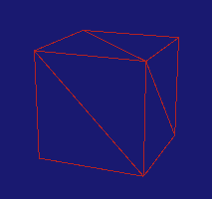
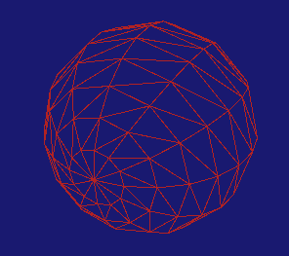
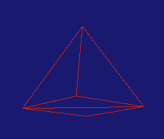
Model Ctor:
Using Pre-Made Models
It’s convenient to have some premade shapes. Typically, unit boxes and spheres are very useful either for testing/debug or visualization.
// in DXApp::InitDemo
<no arrays>
pModel1 = new Model( md3dDevice, Model::PreMadedeModels::UnitBox );
// in DXApp::InitDemo
Model::Model(ID3D11Device* dev, Model::PreMadedeModels pm)
{
<…>
switch (pm)
{
case UnitBox:
ModelTools::CreateUnitBox(pStdVerts, numVerts, pTriList, numTris);
break;
//case UnitPyramid:
//ModelTools::CreateUnitPyramid(pStdVerts, numVerts, pTriList, numTris);
//break;
//case UnitSphere:
//ModelTools::CreateUnitSphere(12, 12, pStdVerts, numVerts, pTriList, numTris);
//break;
default:
assert(false && "Invalid option");
}
privLoadDataToGPU();
}
Guess what’s in your homework?

Slide 51
Model:
Benefits
Thanks to the Model class:
  We cut down on 60+ lines of code in DXApp
  Removed two handles (per model) that we don’t need to deal with
  We can easily create models ‘by hand’ by passing in the arrays of verts and indices
  The premade models will simplify testing and demos
The Model class will be improved over the next few weeks (and as par of your own homework)
In the coming weeks, we’ll continue the code clean-up as we learn more aspect of graphic environments.

