Slide 1
GAM 370/470:
Rendering and Graphics Programming
Lecture 4:
Shader Class and
Texture shading

Slide 2
Part 1:
Minor Changes to Model

Slide 3
Upgrading Model Class
Mea Culpa: I should have caught this last week, but didn’t.
Before:
Now:
void Model::Render(ID3D11DeviceContext* context)
{
UINT stride = sizeof(StandardVertex);
UINT offset = 0;
context->IASetVertexBuffers(0, 1, &mpVertexBuffer, &stride, &offset);
context->IASetIndexBuffer(mpIndexBuffer, DXGI_FORMAT_R32_UINT, 0);
context->IASetPrimitiveTopology(D3D11_PRIMITIVE_TOPOLOGY_TRIANGLELIST);
context->DrawIndexed(numTris * 3, 0, 0);
}
void Model::SetToContext(ID3D11DeviceContext* context)
{
UINT stride = sizeof(StandardVertex);
UINT offset = 0;
context->IASetVertexBuffers(0, 1, &mpVertexBuffer, &stride, &offset);
context->IASetIndexBuffer(mpIndexBuffer, DXGI_FORMAT_R32_UINT, 0);
context->IASetPrimitiveTopology(D3D11_PRIMITIVE_TOPOLOGY_TRIANGLELIST);
}
void Model::Render(ID3D11DeviceContext* context)
{
context->DrawIndexed(numTris * 3, 0, 0);
}
Same work, but split across two functions
Why? More on this later (performance)

Slide 4
Part 2:
More Clean-up with Shader Class

Slide 5
More Clean-up of DXApp:
Shader Class
We definitely want to encapsulate the shaders stuff. But…
  Problem: Unlike for the Model class, we should have
    A shader base class:
      Holds/manages data and operations that are common to all shaders.
    Various derived shader classes: one for each of our HLSL shaders
      Holds/manages what is specific to that shader.
Q: How would you design these classes? (what data members and what services?)
A: One possibility:
Shader Base Class:
Data Members:
Handles for vertex & pixel shaders
Handle for input layout
Operation/Services:
Compile Shaders and send to GPU
Set the shaders to DX context
Shader Derived Class:
Data Members:
Handles for resource buffers
Operation/Services:
Provide detail for input layout
Set resource buffers to context
Update data to resource buffers

Slide 6
ShaderBase
class ShaderBase : public Align16
{
private:
ID3D11Device*mDevice;
ID3D11DeviceContext*mContext;
ID3D11VertexShader* mpVertexShader;
ID3D11PixelShader* mpPixelShader;
ID3D11InputLayout* mpVertexLayout;
ID3DBlob* pVSBlob;
ID3DBlob* pPSBlob;
void privBuildShaders(WCHAR* filename, LPCSTR vsModel, LPCSTR psModel);
HRESULT CompileShaderFromFile( <…> );
protected:
ID3D11Device* GetDevice() { return mDevice; }
ID3D11DeviceContext* GetContext() { return mContext; }
ShaderBase(ID3D11Device* device, WCHAR* filename, LPCSTR vsModel = "vs_4_0", LPCSTR psModel = "ps_4_0");
void CreateInputLayout(D3D11_INPUT_ELEMENT_DESC* layoutdesc, UINT size);
void SetContext(ID3D11DeviceContext* devcon);
void SetToContext_VS_PS_InputLayout();
public:
virtual ~ShaderBase();
virtual void SetToContext(ID3D11DeviceContext* devcon) = 0;
};
Stored pointers to avoid passing them in every method
Actual objects managed by this class
(create, release, etc.)
We need these to build shaders and create input layout
Build and send the VS and PS to GPU
Ctor: get device pointer and shader file
Layout (with input from derived class)
Saves the pointer to current DX context
Sets the DX context to use these VS, PS and input layout
How the derived class is set to DX Context

Slide 7
Shader Derived Class:
ShaderColor
class ShaderColor : public ShaderBase
{
private:
struct CamMatrices
{
Matrix View;
Matrix Projection;
};
ID3D11Buffer* mpBufferCamMatrices;
struct Data_WorldColor
{
Matrix World;
Vect Color;
};
ID3D11Buffer* mpBuffWordColor;
public:
~ShaderColor();
ShaderColor(ID3D11Device* device);
virtual void SetToContext(ID3D11DeviceContext* devcon) override;
void SendCamMatrices(const Matrix& view, const Matrix& proj);
void SendWorldColor(const Matrix& world, const Vect& col);
};
ShaderColor::ShaderColor(ID3D11Device* device)
: ShaderBase(device, L"../Assets/Shaders/ColorSelected3D.hlsl")
{
// Define the input layout
D3D11_INPUT_ELEMENT_DESC layout[] =
{
{ "POSITION", 0, <…> }
};
UINT numElements = ARRAYSIZE(layout);
this->CreateInputLayout(layout, numElements);
< set up the buffer handles>
}
Hard-coded shader file
Managed handles
(create, release, etc.)
Shader is constructed looking specifically for “ColorSelected3D”
What to do to set this shader to DX context (How?)
void ShaderColor::SetToContext(ID3D11DeviceContext* devcon)
{
ShaderBase::SetContext(devcon);
ShaderBase::SetToContext_VS_PS_InputLayout();
devcon->VSSetConstantBuffers(0, 1, &mpBufferCamMatrices);
devcon->VSSetConstantBuffers(1, 1, &mpBuffWordColor);
}
Sending to the GPU the data this shader needs

Slide 8
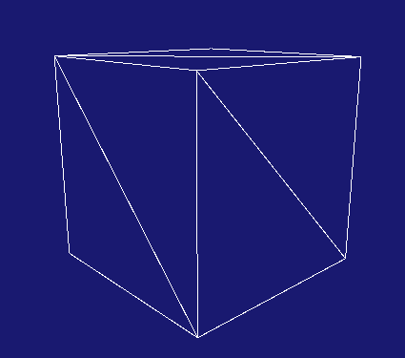
Shader Class Demo
// DXApp.h
ShaderColor* pShColor;
//ID3D11VertexShader* mpVertexShader;
//ID3D11PixelShader* mpPixelShader;
//ID3D11InputLayout* mpVertexLayout;
//ID3D11Buffer* mpcbViewProj;
//
//struct ViewProjData
//{
// Matrix mView;
// Matrix mProjection;
//};
//ID3D11Buffer* mpcbWorldColor;
//struct WorldColorData
//{
// Matrix World;
// Vect Color;
//};
// DXApp::InitDemo
// LOTS of code removed!!!
pShColor = new ShaderColor(md3dDevice);
pShColor->SetToContext(md3dImmediateContext);
pModel1 = new Model( md3dDevice, Model::PreMadedeModels::UnitBox );
void DXApp::DrawScene()
{
md3dImmediateContext->ClearRenderTargetView(mRenderTargetView, VasA(BackgroundColor));
md3dImmediateContext->ClearDepthStencilView(mpDepthStencilView, D3D11_CLEAR_DEPTH, 1.0f, 0);
//ViewProjData vpdata;
//vpdata.mView = mCam.getViewMatrix();
//vpdata.mProjection = mCam.getProjMatrix();
//md3dImmediateContext->UpdateSubresource(mpcbViewProj, 0, nullptr, &vpdata, 0, 0);
//WorldColorData wcdata;
//wcdata.World = mWorld;
//wcdata.Color = Colors::Yellow;
//md3dImmediateContext->UpdateSubresource(mpcbWorldColor, 0, nullptr, &wcdata, 0, 0);
pShColor->SendCamMatrices(mCam.getViewMatrix(), mCam.getProjMatrix());
pShColor->SendWorldColor(mWorld, Colors::White );
pModel1->Render(md3dImmediateContext);
mSwapChain->Present(0, 0);
}

Slide 9
Unpacking the Sequence:
Constructor
// DXApp::InitDemo
pShColor = new ShaderColor(md3dDevice);
pShColor->SetToContext(md3dImmediateContext);
Specific shader file
ShaderColor::ShaderColor(ID3D11Device* device)
: ShaderBase(device, L"../Assets/Shaders/ColorSelected3D.hlsl")
{
D3D11_INPUT_ELEMENT_DESC layout[] =
{
{ "POSITION", 0, DXGI_FORMAT_R32G32B32_FLOAT, 0, 0, D3D11_INPUT_PER_VERTEX_DATA, 0 }
};
UINT numElements = ARRAYSIZE(layout);
this->CreateInputLayout(layout, numElements);
HRESULT hr;
// View Projection buffer
D3D11_BUFFER_DESC bd;
bd.Usage = D3D11_USAGE_DEFAULT;
bd.ByteWidth = sizeof(CamMatrices);
bd.BindFlags = D3D11_BIND_CONSTANT_BUFFER;
bd.CPUAccessFlags = 0;
bd.MiscFlags = 0;
bd.StructureByteStride = 0;
hr = this->GetDevice()->CreateBuffer(&bd, nullptr, &mpBufferCamMatrices);
assert(SUCCEEDED(hr));
// Color buffer
bd.Usage = D3D11_USAGE_DEFAULT;
bd.ByteWidth = sizeof(Data_WorldColor);
bd.BindFlags = D3D11_BIND_CONSTANT_BUFFER;
bd.CPUAccessFlags = 0;
bd.MiscFlags = 0;
bd.StructureByteStride = 0;
hr = this->GetDevice()->CreateBuffer(&bd, nullptr, &mpBuffWordColor);
assert(SUCCEEDED(hr));
}
ShaderBase::ShaderBase(ID3D11Device* device,
WCHAR* filename,
LPCSTR vsModel,
LPCSTR psModel)
: mDevice(device)
{
privBuildShaders(filename, vsModel, psModel);
}
Layout defined and passed to base class
void ShaderBase::CreateInputLayout(D3D11_INPUT_ELEMENT_DESC* layoutdesc, UINT size)
{
HRESULT hr = mDevice->CreateInputLayout(layoutdesc, size, pVSBlob->GetBufferPointer(), pVSBlob->GetBufferSize(), &mpVertexLayout);
assert(SUCCEEDED(hr));
}
Creating the resource buffers needed for this specific shader

Slide 10
Unpacking the Sequence:
SetToContext
// DXApp::InitDemo
pShColor = new ShaderColor(md3dDevice);
pShColor->SetToContext(md3dImmediateContext);
void ShaderBase::SetToContext_VS_PS_InputLayout()
{
mContext->VSSetShader(mpVertexShader, nullptr, 0);
mContext->PSSetShader(mpPixelShader, nullptr, 0);
mContext->IASetInputLayout(mpVertexLayout);
}
void ShaderColor::SetToContext(ID3D11DeviceContext* devcon)
{
ShaderBase::SetContext(devcon);
ShaderBase::SetToContext_VS_PS_InputLayout();
devcon->VSSetConstantBuffers(0, 1, &mpBufferCamMatrices);
devcon->VSSetConstantBuffers(1, 1, &mpBuffWordColor);
}
Obviously the data format of the constant buffers must be compatible with the shader constants found in the file
Abstract method in ShaderBase.
Must be defined ShaderColor
class ShaderColor : public ShaderBase
{
private:
struct CamMatrices
{
Matrix View;
Matrix Projection;
};
ID3D11Buffer* mpBufferCamMatrices;
struct Data_WorldColor
{
Matrix World;
Vect Color;
};
ID3D11Buffer* mpBuffWordColor;
cbuffer CamData : register(b0)
{
float4x4 View;
float4x4 Projection;
}
cbuffer InstanceData : register(b1)
{
float4x4 World;
float4 SelectedColor;
};

Slide 11
Unpacking the Sequence:
DrawScene
// DXApp::InitDemo
pShColor = new ShaderColor(md3dDevice);
pShColor->SetToContext(md3dImmediateContext);
void ShaderColor::SendCamMatrices( const Matrix& view, const Matrix& proj)
{
CamMatricesmCamMatrices;
mCamMatrices.View = view;
mCamMatrices.Projection = proj;
this->GetContext()->UpdateSubresource(mpBufferCamMatrices, 0, nullptr, &mCamMatrices, 0, 0);
}
void DXApp::DrawScene()
{
md3dImmediateContext->ClearRenderTargetView(mRenderTargetView, VasA(BackgroundColor));
md3dImmediateContext->ClearDepthStencilView(mpDepthStencilView, D3D11_CLEAR_DEPTH, 1.0f, 0);
pShColor->SendCamMatrices(mCam.getViewMatrix(), mCam.getProjMatrix());
pShColor->SendWorldColor(mWorld, Colors::White );
pModel1->Render(md3dImmediateContext);
mSwapChain->Present(0, 0);
}
void ShaderColor::SendWorldColor(const Matrix& world, const Vect& col)
{
Data_WorldColor wc;
wc.World = world;
wc.Color = col;
this->GetContext()->UpdateSubresource(mpBuffWordColor, 0, nullptr, &wc, 0, 0);
}
Shaders and Constant buffers set to context (InitDemo)
Constant buffers updated (above).
We are ready to render!

Slide 12
What Next ?
More API work …
With the Model and Shader classes, we’ve done a lot of clean-up in DXApp.
Future demos will focus on specific rendering topics but it will be your job to incorporate these new elements in new shaders and models.
  This means some of my future demos may not be available to you on perforce.
  You will need to rely on your own work as we proceed.
This will make you slowly build your own graphics API to use in the final project

Slide 13
Part 3:
Performance Consideration

Slide 14
Performance
Looking at ColorSelected3D, we see a potential problem:
Q: How can we fix this?
A: Compute the product on the CPU an pass it along
This is part of your assignment
Every vertex will compute the same product World*View*Projection
VS_OUTPUT VS( float4 Pos : POSITION )
{
VS_OUTPUT output;
output.Pos = mul( Pos, World );
output.Pos = mul( output.Pos, View );
output.Pos = mul( output.Pos, Projection );
output.Color = SelectedColor;
return output;
}
Over many vertices, this can add up…
cbuffer CamData : register(b0)
{
float4x4 WVP;
float4 SelectedColor;
};
But can we test (at least informally) whether this is an improvement or not?

Slide 15
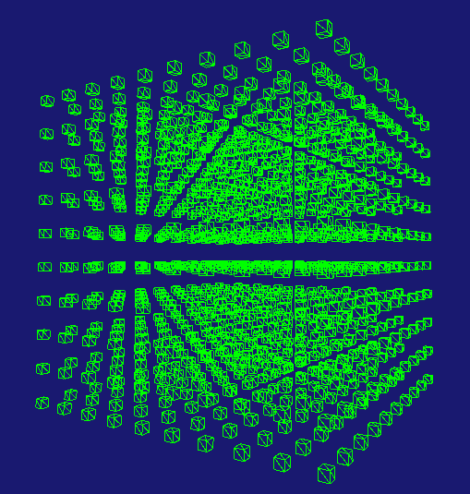
Simple (Simplistic?)
Stress Test
Let’s render a lot of these and see how it goes.
  That’s a lot of models and matrices…
Step 1: Step up the model and a lot of World matrices
Step 2: Init the matrices
ShaderColor* pShColor;
ShaderColorOpt* pShColOpt;
static const int SIDE_COUNT = 10; // count per side
static const int SEPERATION = 2; // distance between units
Model* pModel1;
Matrix arrWorld[SIDE_COUNT][SIDE_COUNT][SIDE_COUNT];
Vect pos(0,0,0);
pos[x] = -SIDE_COUNT * SEPERATION / 2;
for (int i = 0; i < SIDE_COUNT; i++)
{
pos[y] = -SIDE_COUNT * SEPERATION / 2;
for (int j = 0; j < SIDE_COUNT; j++)
{
pos[z] = -SIDE_COUNT * SEPERATION / 2;
for (int k = 0; k < SIDE_COUNT; k++)
{
arrWorld[i][j][k] = Matrix(SCALE, .5f,.5f, .5f) * Matrix(TRANS, pos);
pos[z] += SEPERATION;
}
pos[y] += SEPERATION;
}
pos[x] += SEPERATION;
}
The cluster will be centered at the origin
Now we can compare different arrangements of shader operations

Slide 16

Case 1: ShaderColor, Silly User
Original ShaderColor:
  Separate constant buffers for camera and instance data
  Silly user updates camera every instance
Results: 32 fps and
void DXApp::DrawScene()
{
<…>
for (int i = 0; i < SIDE_COUNT; i++)
{
for (int j = 0; j < SIDE_COUNT; j++)
{
for (int k = 0; k < SIDE_COUNT; k++)
{
pShColor->SendWorldColor(arrWorld[i][j][k], Colors::Lime);
pShColor->SendCamMatrices(mCam.getViewMatrix(), mCam.getProjMatrix());
pModel1->SetToContext(md3dImmediateContext);
pModel1->Render(md3dImmediateContext);
}
}
}
<…>
}
We well keep setting to context and updating matrices to simulate a more dymanic scene
SetToContext is biggest drain, but the total of sending matrices is more…
In Visual Studio: Analyze/Performance Profiler. Expand the largest percentage

Slide 17

Case 2: ShaderColor, Normal User
Original ShaderColor:
  Separate constant buffers for camera and instance data
  Normal user updates camera only once per frame
Results: 43 fps and
void DXApp::DrawScene()
{
<…>
pShColor->SendCamMatrices( mCam.getViewMatrix(), mCam.getProjMatrix());
for (int i = 0; i < SIDE_COUNT; i++)
{
for (int j = 0; j < SIDE_COUNT; j++)
{
for (int k = 0; k < SIDE_COUNT; k++)
{
pShColor->SendWorldColor(arrWorld[i][j][k], Colors::Lime);
pModel1->SetToContext(md3dImmediateContext);
pModel1->Render(md3dImmediateContext);
}
}
}
<…>
}
Better FPS and SendCamMatrices barely registers.
Model::SetToContext is looking like the bottleneck

Slide 18

Case 3: ShaderColorOpt V1
Homework problem
cbuffer Data : register(b0)
{
float4x4 WVP;
float4 SelectedColor;
};
ShaderColorOpt:
  CPU computes product for WVP, sent as a single matrix to GPU
Results: 41 fps and
void DXApp::DrawScene()
{
<…>
for (int i = 0; i < SIDE_COUNT; i++)
{
for (int j = 0; j < SIDE_COUNT; j++)
{
for (int k = 0; k < SIDE_COUNT; k++)
{
pShColOpt->SendWVPCol(arrWorld[i][j][k], mCam.getViewMatrix(), mCam.getProjMatrix(), Colors::Lime);
pModel1->SetToContext(md3dImmediateContext);
pModel1->Render(md3dImmediateContext);
}
}
}
<…>
}
No significant differences

Slide 19

Case 4: ShaderColorOpt V2
ShaderColorOpt:
  CPU computes product for WVP, sent as a single matrix to GPU
  Also precompute the VP product once only;
Results: 42 fps and
Homework problem
void DXApp::DrawScene()
{
<…>
Matrix VP = mCam.getViewMatrix() * mCam.getProjMatrix();
for (int i = 0; i < SIDE_COUNT; i++)
{
for (int j = 0; j < SIDE_COUNT; j++)
{
for (int k = 0; k < SIDE_COUNT; k++)
{
pShColOpt->SendWVPCol(arrWorld[i][j][k], VP, Colors::Lime);
pModel1->SetToContext(md3dImmediateContext);
pModel1->Render(md3dImmediateContext);
}
}
}
<…>
}
Again…No appreciable difference
(but time spent in SendWVPCol did go down slightly)

Slide 20

Case 5: ShaderColorOpt, Unrealistic
ShaderColorOpt:
  Same as before, but SetToContext once per frame;
Results: 85 fps and
void DXApp::DrawScene()
{
<…>
Matrix VP = mCam.getViewMatrix() * mCam.getProjMatrix();
pModel1->SetToContext(md3dImmediateContext);
for (int i = 0; i < SIDE_COUNT; i++)
{
for (int j = 0; j < SIDE_COUNT; j++)
{
for (int k = 0; k < SIDE_COUNT; k++)
{
pShColOpt->SendWVPCol(arrWorld[i][j][k], VP, Colors::Lime);
pModel1->Render(md3dImmediateContext);
}
}
}
<…>
}
A ‘real’ scene would have multiple models and there would need to be a quite a few number of calls to Model::SetToContext for each model
Major boost in performance!
Good argument for ordering the draws based on model instance. See also: geometry instancing
Missing from this test: swapping shaders

Slide 21
Performance: Conclusion
The take away is that improving rendering performance is not as straightforward are one might think.
  The FPS and/or frametime is a good start, but won’t give you a clear indication of what the bottlenecks are
  Performance analysis tools help, but replicating a ‘representative’ scene is not simple.
  Performance will also very greatly depending on hardware and settings
  Also important: we haven’t look at GPU performance either. That’s a whole other can of worms!
Bottom line:
Use the performance tools during development to spot egregious problems. However, finding *the* best solution may not be possible: too many variables. The best solution will always depend on the specifics of the final scene/game/product.

Slide 22
Part 4:
Texture Mapping

Slide 23
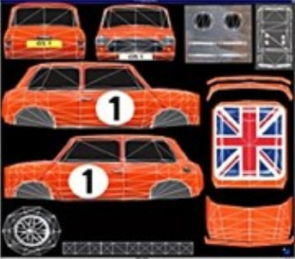
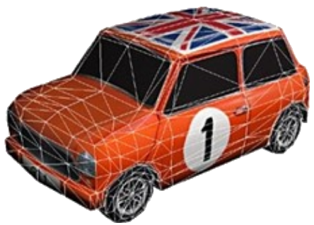
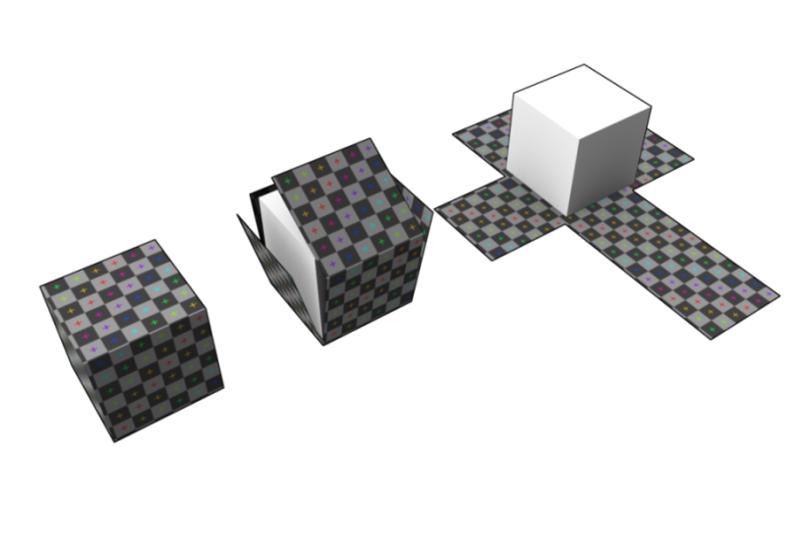
Texture Mapping
Texture mapping is the process by which you map each triangle of a model to a specific area of a texture.
  The mapping is usually imbedded as part of the vertex data
  Every vertex needs a pair (u, v) of value indicating their position on the texture
  Duplicate verts: The cube below requires 24 vertices to accommodate the uv mapping

Slide 24
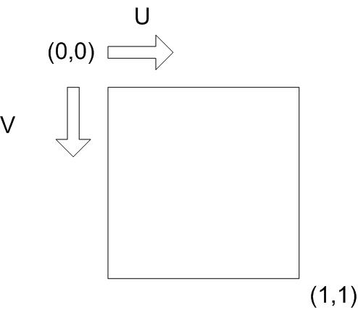

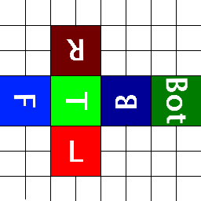
Texture Mapping
Texture mapping is the process by which you map each triangle of a model to a specific area of a texture.
  The mapping is usually imbedded as part of the vertex data
  Every vertex needs a pair (u, v) of value indicating their position on the texture
  Duplicate verts: The cube below requires 24 vertices to accommodate the uv mapping
  Both u and v range is [0,1] and (in DX) start at the upper-left corner
  Ex: To render the green T on the top of a cube:
    The top 4 vertices would need the following
    UV coord
0.25
0.50
( u , v )
(0.25, 0.375)
(0.50, 0.375)
(0.25, 0.625)
(0.50, 0.625)
0.375
0.625
Note: This texture mapping is different from the cube on the preceding page

Slide 25
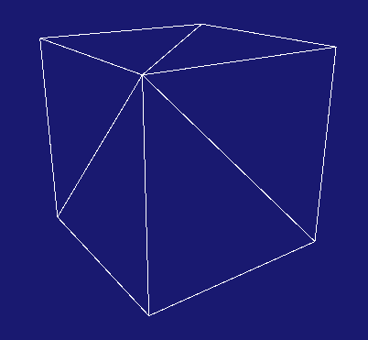
Augmenting our Standard Vertices
To accommodate Texture mapping,
we need to augment our Standard Vertices
We also modify the Set function
to have default u, v values
struct StandardVertex : public Align16
{
Vect Pos;
float u; // UV texture coordinate
float v;
Vect Color;
};
void set(float _x, float _y, float _z,
float _u = 0, float _v = 0,
float _r = 1, float _g = 1, float _b = 1)
{
Pos = Vect(_x, _y, _z);
u = _u;
v = _v;
Color = Vect(_r, _g, _b);
}
This allows existing pre-made models to still work correctly (though they will not have useful u,v values)
pModel1 = new Model( md3dDevice, Model::PreMadedeModels::UnitBox );

Slide 26
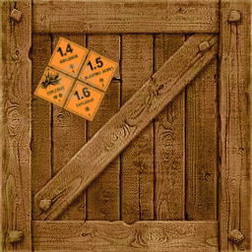
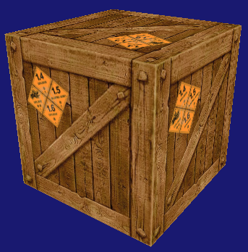
First Step:
A Simpler Textured Cube
We want a cube model that can be textured as:
  One texture wrapped on all 6 faces
But a good starting point is create a simpler cube:
  Same texture on every face
Before we get into textures in DX, we must first create a cube model that has the u,v coordinates to apply one texture on every face.
This will be your homework

Slide 27
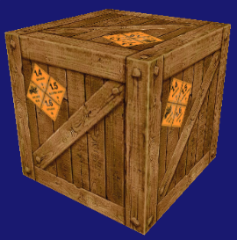
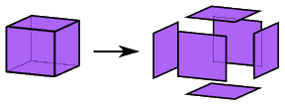
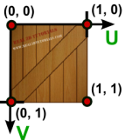
New PreMadeModel:
UnitBoxRepeatedTexture
we need the new unit cube model with proper uv-coordinates on each face:
  For each of the 6 faces we need:
    4 vertices and 2 triangles
    The (u,v) for the 4 vertices should correspond to this diagram
The full code can be found in ModelTools::CreateUnitBoxRepTexture
You’re welcome!
pModel1 = new Model( md3dDevice, Model::PreMadedeModels::UnitBoxRepeatedTexture);
Looks the same, of course.
But this model should have the u,v to apply a texture
Now we tackle using a texture as a GPU resource.

Slide 28
Part 5:
Loading Textures

Slide 29
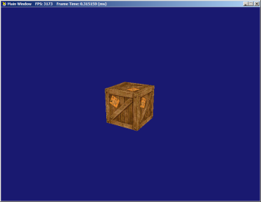
Texture Loading
There are a number of steps required to use a texture in a shader:
  Loading texture from file:
    Problem: DX11 can handle BMP, PNG, JPG, GIFF and TIFF, but not TGA
    We do want TGA as it’s quite common nowadays
    Solution: The ‘DirectXTex’ library will allow us to load TGAs
  Loading a texture on the GPU:
    Needs to be stored in a special ‘texture’ buffer using a ‘resource view’.
    As usual: we’ll also need to
    Keep a handle for it on the CPU
    Set it to context at the right time
  Setting up a texture sampler:
    The number screen pixels usually won’t match the texture size: The sampler dictates how to best compute the texture element to send on the screen
    As usual: we’ll also need to
    Keep a handle for it on the CPU
    Set it to context at the right time
We’ll review all three steps in the next few slides
70x70
256x256

Slide 30
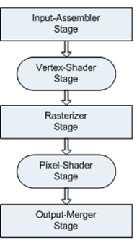
Texture:
Com Objects (The “Handles”)
We’ll need two handles:
  One for the resource view holding the image data (using DirectXTex lib)
DirectX::ScratchImage myTexture;
hr = LoadFromTGAFile(L"../Assets/Textures/CrateFace.tga", nullptr, myTexture);
assert(SUCCEEDED(hr));
CreateShaderResourceView( md3dDevice,
myTexture.GetImage(0, 0, 0), myTexture.GetImageCount(), myTexture.GetMetadata(),
&mpTextureRV );
// DXApp.h
ID3D11ShaderResourceView* mpTextureRV;
ID3D11SamplerState* mpSampler;
GPU
DirectX App
VS
mpTextureRV
ID3D11ShaderResourceView
Image data
CCW
Viewport
mpSampler
ID3D11SamplerState
Sampler
PS

Slide 31
Texture:
Com Objects (“handles”)
We’ll need two handles:
  One for the resource view holding the image data
  One for the sampler state to correctly ‘sample’ the image
D3D11_SAMPLER_DESC sampDesc;
ZeroMemory(&sampDesc, sizeof(sampDesc));
sampDesc.Filter = D3D11_FILTER_MIN_MAG_MIP_POINT;
sampDesc.AddressU = D3D11_TEXTURE_ADDRESS_WRAP;
sampDesc.AddressV = D3D11_TEXTURE_ADDRESS_WRAP;
sampDesc.AddressW = D3D11_TEXTURE_ADDRESS_WRAP;
sampDesc.ComparisonFunc = D3D11_COMPARISON_NEVER;
sampDesc.MinLOD = 0;
sampDesc.MaxLOD = D3D11_FLOAT32_MAX;
hr = md3dDevice->CreateSamplerState(&sampDesc, &mpSampler);
But what is sampling anyway?
What are all these options?
// DXApp.h
ID3D11ShaderResourceView* mpTextureRV;
ID3D11SamplerState* mpSampler;
GPU
DirectX App
VS
mpTextureRV
ID3D11ShaderResourceView
Image data
CCW
Viewport
mpSampler
ID3D11SamplerState
Sampler
PS

Slide 32
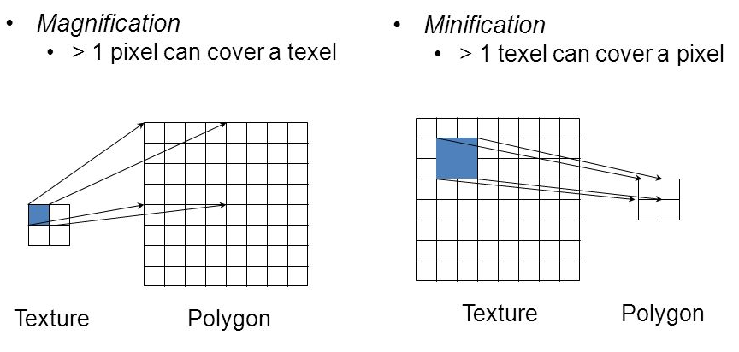
Texture Sampling:
Filter Modes
Definitions:
  Pixel: screen (picture) element
  Texel: texture element
Texture sampling happens in three different form:
  Minification: many texels sent to a single pixel
  Magnification: one texel sent to many pixels
  MIP mapping: Skipping for now.
For each of these, we have can apply different filters
All three situations require some computation of the texels and pixels to determine what should be on screen
Let’s see some examples to make sense of these

Slide 33


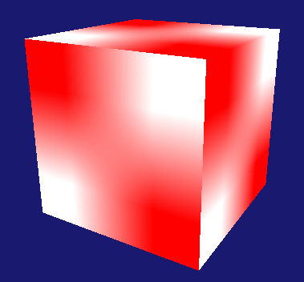
Magnification: Point vs Linear
Texture: 2x2 texels, red and black (test2.tga):
Applied to Cube (requires magnification):
  Using Mag-Point filter Using Mag-Linear filter
By definition, linear filter will blur-out sharp contrasts.
Rarely good in extreme magnification

Slide 34


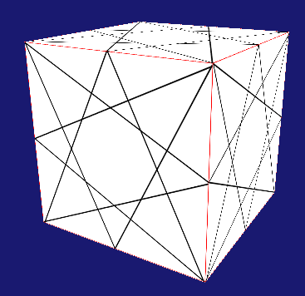

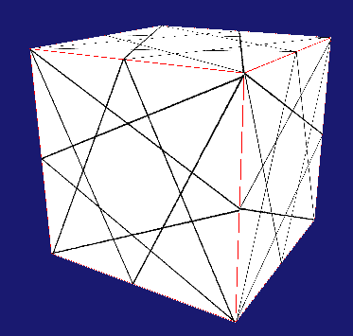
Minification: Point vs Linear
Texture: 512x512 texels, fine pattern with red border (Test512.tga)
Applied to Cube (requires minification):
  Using Min-Point filter Using Min-Linear filter
Very subtle but noticeable differences in a real scene

Slide 35
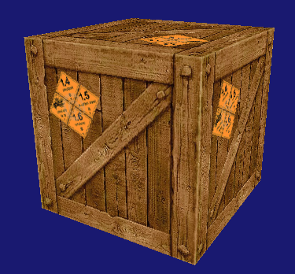
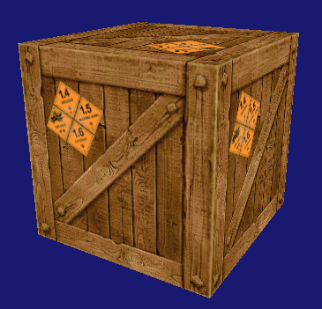
Minification: Point vs Linear
Texture: 512x512 texels, fine pattern with red border (Test512.tga)
Applied to Cube (requires minification):
  Using Min-Point filter Using Min-Linear filter
Very subtle but noticeable differences in a real scene

Slide 36
Which Filter to Chose?
Which filter to use depends a lot on the texture details and preference of the artist.
  The all-linear D3D11_FILTER_MIN_MAG_MIP_LINEAR is safe for most applications, though gets blurry in extreme magnification
  D3D11_FILTER_MIN_POINT_MAG_MIP_LINEAR has good detail in magnification, but can create strange artifacts with busy textures
Either way: these are matters of aesthetics, not programming…

Slide 37
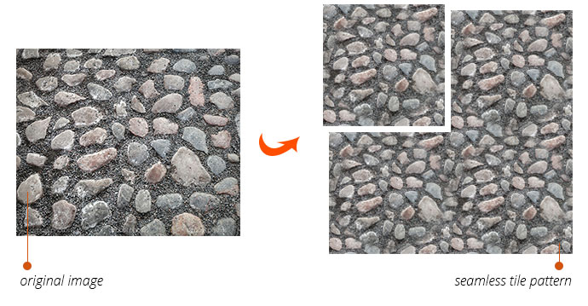
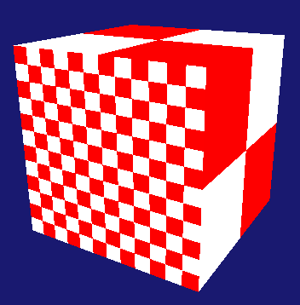
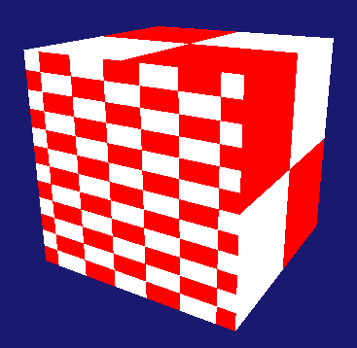
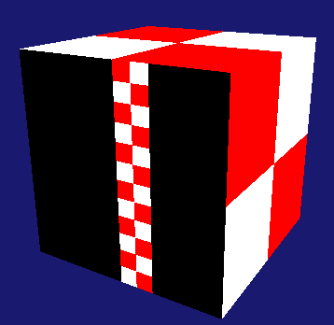




Texture Address Modes
(aka ‘Repeats’)
Texture address modes are useful if you need the texture to ‘repeat’ on mapping
Test these by changing the cube’s back-face uv’s to range [-3,3] instead of [01]
  WRAP MIRROR (U only) Border (U only) CLAMP (U only)
D3D11_SAMPLER_DESC sampDesc;
ZeroMemory(&sampDesc, sizeof(sampDesc));
sampDesc.Filter = D3D11_FILTER_MIN_MAG_MIP_POINT;
sampDesc.AddressU = D3D11_TEXTURE_ADDRESS_WRAP;
sampDesc.AddressV = D3D11_TEXTURE_ADDRESS_WRAP;
sampDesc.AddressW = D3D11_TEXTURE_ADDRESS_WRAP;
sampDesc.ComparisonFunc = D3D11_COMPARISON_NEVER;
sampDesc.MinLOD = 0;
sampDesc.MaxLOD = D3D11_FLOAT32_MAX;

Slide 38
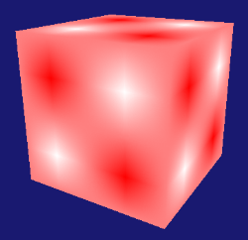
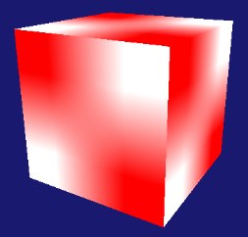
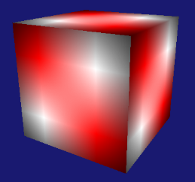
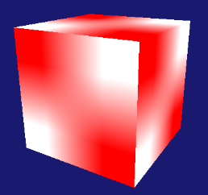
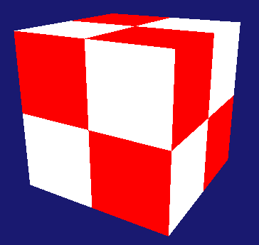
Filter & Address Mode Interplay
In actuality, you must consider the effects of Filters and Address Modes together.
Example: Using Test2.tga and focusing on magnification only:
 | WRAP | MIRROR | BORDER | CLAMP
LINEAR
POINT

Slide 39
Part 6:
Texture Shader

Slide 40
HLSL Texture Shader
Now that we loaded texture and sampler on the GPU: How can a shader use them?
All we need now is to do the standard
shader work to connect it to the pipeline
Texture2D mainTexture : register(t0);
SamplerState aSampler: register(s0);
cbuffer CamData : register(b0)
{
float4x4 View;
float4x4 Projection;
}
cbuffer InstanceData : register(b1)
{
matrix World;
};
struct VS_INPUT
{
float4 Pos : POSITION;
float2 Tex : TEXCOORD;
};
struct VS_OUTPUT
{
float4 Pos : SV_POSITION;
float2 Tex : TEXCOORD;
};
VS_OUTPUT VS( VS_INPUT input)
{
VS_OUTPUT output;
output.Pos = mul(input.Pos, World);
output.Pos = mul(output.Pos, View);
output.Pos = mul(output.Pos, Projection);
output.Tex = input.Tex;
return output;
}
float4 PS(VS_OUTPUT input) : SV_Target
{
return mainTexture.Sample( aSampler, input.Tex);
}
Texture and
register
Vertex:
Pos + uv
Sampler State and register
Send uv’s to PS
Expected constant buffers
Extract texel using sampler

Slide 41
Setting-Up Texture.hlsl:
Standard Steps
// DXApp.h
// Old friends
ID3D11VertexShader* mpVertexShader;
ID3D11PixelShader* mpPixelShader;
ID3D11InputLayout* mpVertexLayout;
// New texture shader stuff
ID3D11ShaderResourceView* mpTextureRV;
ID3D11SamplerState* mpSampler;
ID3D11Buffer* mpcbViewProj;
struct ViewProjData
{
Matrix mView;
Matrix mProjection;
};
ID3D11Buffer* mpcbWorld;
struct WorldData
{
Matrix World;
};
// DXApp::InitDemo
ID3DBlob* pVSBlob = nullptr;
hr = CompileShaderFromFile(L"../Assets/Shaders/Texture.hlsl", "VS", "vs_4_0", &pVSBlob);
hr = md3dDevice->CreateVertexShader(pVSBlob->GetBufferPointer(), pVSBlob->GetBufferSize(), nullptr, &mpVertexShader);
// Define the input layout
D3D11_INPUT_ELEMENT_DESC layout[] =
{
{ "POSITION", 0, DXGI_FORMAT_R32G32B32A32_FLOAT, 0, 0, D3D11_INPUT_PER_VERTEX_DATA, 0 },
{ "TEXCOORD", 0, DXGI_FORMAT_R32G32_FLOAT, 0, D3D11_APPEND_ALIGNED_ELEMENT , D3D11_INPUT_PER_VERTEX_DATA, 0 },
};
UINT numElements = ARRAYSIZE(layout);
// Create the input layout
hr = md3dDevice->CreateInputLayout(layout, numElements, pVSBlob->GetBufferPointer(), pVSBlob->GetBufferSize(), &mpVertexLayout);
// Compile the pixel shader
ID3DBlob* pPSBlob = nullptr;
hr = CompileShaderFromFile(L"../Assets/Shaders/Texture.hlsl", "PS", "ps_4_0", &pPSBlob);
// Create the pixel shader
hr = md3dDevice->CreatePixelShader(pPSBlob->GetBufferPointer(), pPSBlob->GetBufferSize(), nullptr, &mpPixelShader);
md3dImmediateContext->VSSetShader(mpVertexShader, nullptr, 0);
md3dImmediateContext->PSSetShader(mpPixelShader, nullptr, 0);
md3dImmediateContext->IASetInputLayout(mpVertexLayout);
Also pretty standard stuff
Note the semantic and format for uv coord.
Pretty standard stuff

Slide 42
Setting-Up Texture.hlsl:
Standard Steps
// DXApp.h
// Old friends
ID3D11VertexShader* mpVertexShader;
ID3D11PixelShader* mpPixelShader;
ID3D11InputLayout* mpVertexLayout;
// New texture shader stuff
ID3D11ShaderResourceView* mpTextureRV;
ID3D11SamplerState* mpSampler;
ID3D11Buffer* mpcbViewProj;
struct ViewProjData
{
Matrix mView;
Matrix mProjection;
};
ID3D11Buffer* mpcbWorld;
struct WorldData
{
Matrix World;
};
// DXApp::InitDemo
// Create the constant buffer
D3D11_BUFFER_DESC bd;
ZeroMemory(&bd, sizeof(bd));
bd.Usage = D3D11_USAGE_DEFAULT;
bd.ByteWidth = sizeof(ViewProjData);
bd.BindFlags = D3D11_BIND_CONSTANT_BUFFER;
bd.CPUAccessFlags = 0;
hr = md3dDevice->CreateBuffer(&bd, nullptr, &mpcbViewProj);
assert(SUCCEEDED(hr));
// Create the perFrameData buffer
bd.Usage = D3D11_USAGE_DEFAULT;
bd.ByteWidth = sizeof(WorldData);
bd.BindFlags = D3D11_BIND_CONSTANT_BUFFER;
bd.CPUAccessFlags = 0;
hr = md3dDevice->CreateBuffer(&bd, nullptr, &mpcbWorld);
assert(SUCCEEDED(hr));
md3dImmediateContext->VSSetConstantBuffers(0, 1, &mpcbViewProj);
md3dImmediateContext->VSSetConstantBuffers(1, 1, &mpcbWorld);
Also pretty standard stuff
Pretty standard stuff

Slide 43
Setting-Up Texture.hlsl:
New Steps
We also need to connect the pixel shader with our chose texture and sampler:
As with the constant buffers, we need to pay attention to the register numbers:
Texture2D mainTexture : register(t0);
SamplerState aSampler: register(s0);
<…>
float4 PS(VS_OUTPUT input) : SV_Target
{
return mainTexture.Sample( aSampler, input.Tex);
}
// DXApp::InitDemo
md3dImmediateContext->PSSetShaderResources(0, 1, &mpTextureRV);
md3dImmediateContext->PSSetSamplers(0, 1, &mpSampler);

Slide 44
Rendering with Texture.hlsl
The rendering code should not be too surprising either:
void DXApp::DrawScene()
{
md3dImmediateContext->ClearRenderTargetView(mRenderTargetView, VasA(BackgroundColor));
md3dImmediateContext->ClearDepthStencilView(mpDepthStencilView, D3D11_CLEAR_DEPTH, 1.0f, 0);
// ------- Camera data
ViewProjData vpdata;
vpdata.mView = mCam.getViewMatrix();
vpdata.mProjection = mCam.getProjMatrix();
md3dImmediateContext->UpdateSubresource(mpcbViewProj, 0, nullptr, &vpdata, 0, 0);
// --- Object #1's data needs to be sent
WorldData wcdata;
wcdata.World = mWorld;
md3dImmediateContext->UpdateSubresource(mpcbWorld, 0, nullptr, &wcdata, 0, 0);
// --- Render Object #1;
pModel1->Render(md3dImmediateContext);
mSwapChain->Present(0, 0);
}
Note that the texture doesn’t need updating
(and it already has been set to context, just like the constant buffers)

Slide 45
Part 7:
Code Clean Up

Slide 46
Texture Class
Creating the Texture class is straightforward
class Texture
{
public:
Texture(ID3D11Device* d3dDev, LPCWSTR filepath, D3D11_FILTER filter = D3D11_FILTER_MIN_MAG_MIP_LINEAR );
void SetToContext(ID3D11DeviceContext* devcon, int texResSlot = 0, int sampSlot = 0);
private:
ID3D11ShaderResourceView* mpTextureRV;
ID3D11SamplerState* mpSampler;
};
Texture::Texture(ID3D11Device* d3dDev, LPCWSTR filepath, D3D11_FILTER filter)
{
DirectX::ScratchImage testTexture;
HRESULT hr = LoadFromTGAFile(filepath, nullptr, testTexture);
assert(SUCCEEDED(hr));
CreateShaderResourceView(d3dDev, testTexture.GetImage(0, 0, 0), testTexture.GetImageCount(), testTexture.GetMetadata(), &mpTextureRV);
// Create the sample state
D3D11_SAMPLER_DESC sampDesc;
ZeroMemory(&sampDesc, sizeof(sampDesc));
sampDesc.Filter = filter;
sampDesc.AddressU = D3D11_TEXTURE_ADDRESS_WRAP;
sampDesc.AddressV = D3D11_TEXTURE_ADDRESS_WRAP;
sampDesc.AddressW = D3D11_TEXTURE_ADDRESS_WRAP;
sampDesc.ComparisonFunc = D3D11_COMPARISON_NEVER;
sampDesc.MinLOD = 0;
sampDesc.MaxLOD = D3D11_FLOAT32_MAX;
hr = d3dDev->CreateSamplerState(&sampDesc, &mpSampler);
assert(SUCCEEDED(hr));
}
Same code that was in DXApp:InitDemo
but we also include a parameter for the filter
(with a default value)

Slide 47
Texture Class
Creating the Texture class is straightforward
class Texture
{
public:
Texture(ID3D11Device* d3dDev, LPCWSTR filepath, D3D11_FILTER filter = D3D11_FILTER_MIN_MAG_MIP_LINEAR );
void SetToContext(ID3D11DeviceContext* devcon, int texResSlot = 0, int sampSlot = 0);
private:
ID3D11ShaderResourceView* mpTextureRV;
ID3D11SamplerState* mpSampler;
};
void Texture::SetToContext(ID3D11DeviceContext* devcon, int texResSlot, int sampSlot)
{
devcon->PSSetShaderResources(texResSlot, 1, &mpTextureRV);
devcon->PSSetSamplers(sampSlot, 1, &mpSampler);
}
Designed to be called by shaders in their ‘SetToContext’. Only the shaders will know which slot to use for the resource view and sampler

Slide 48
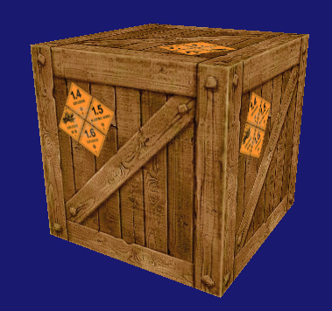
Texture Class in Action
// DXApp.h
// New texture shader stuff
//ID3D11ShaderResourceView* mpTextureRV;
//ID3D11SamplerState* mpSampler;
Texture* mTex1;
// DXApp::InitDemo
// Load texture and send to GPU
//DirectX::ScratchImage myTexture;
//hr = LoadFromTGAFile(L"../Assets/Textures/CrateFace.tga", nullptr, myTexture);
//assert(SUCCEEDED(hr));
//CreateShaderResourceView(md3dDevice, myTexture.GetImage(0, 0, 0), myTexture.GetImageCount(), myTexture.GetMetadata(), &mpTextureRV);
//// Create the sample state
//D3D11_SAMPLER_DESC sampDesc;
//ZeroMemory(&sampDesc, sizeof(sampDesc));
//sampDesc.Filter = D3D11_FILTER_MIN_MAG_MIP_LINEAR;
//sampDesc.AddressU = D3D11_TEXTURE_ADDRESS_WRAP;
//sampDesc.AddressV = D3D11_TEXTURE_ADDRESS_WRAP;
//sampDesc.AddressW = D3D11_TEXTURE_ADDRESS_WRAP;
//sampDesc.ComparisonFunc = D3D11_COMPARISON_NEVER;
//sampDesc.MinLOD = 0;
//sampDesc.MaxLOD = D3D11_FLOAT32_MAX;
//hr = md3dDevice->CreateSamplerState(&sampDesc, &mpSampler);
//assert(SUCCEEDED(hr));
mTex1 = new Texture(md3dDevice, L"../Assets/Textures/CrateFace.tga");00
DrawScene does not change in this demo
// Setting to Context
//md3dImmediateContext->PSSetShaderResources(0, 1, &mpTextureRV);
//md3dImmediateContext->PSSetSamplers(0, 1, &mpSampler);
mTex1->SetToContext(md3dImmediateContext);

Slide 49
Texture Class and Samplers:
Possible Improvements
The current design for the Texture class creates one sampler per texture.
While this is an easier design to present, it’s a bit wasteful.
  Typically, the vast majority of texture in a scene use the same sampler settings
    The GPU will be filled with identically working samplers….
  Only specific cases may require special sampler setting
    Ex: terrain textures. See also Anisotropic filtering next week…
  Therefore, a better design might be to create a Sampler Manager:
  Holds unique instances of samplers needed for the scene
  Provides access services to those samplers
  Textures would refer to the Sampler Manager to get the needed sampler
  I leave it up to you to explore how to set up this option.

Slide 50
More Clean Up:
Creating ShaderTexture Class
That’s your homework!

