Slide 1
GAM 370/470:
Rendering and Graphics Programming
Lecture 7:
Lighting

Slide 2
Part 1:
Illumination Model

Slide 3
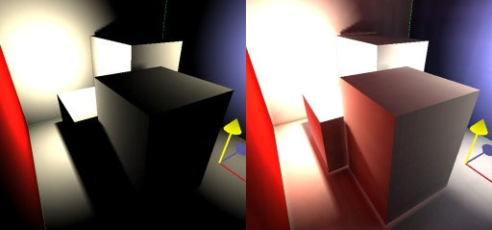
Illumination Models
To light a scene, we must know how light interacts with surfaces and pigments. Unfortunately computing the exact physical light would make the rendering task too expensive. Therefore, CG approximates light using an Illumination model.
Light models come in two forms:
  Global Illumination: (Ex: Ray tracing, etc.)
    Realistic appearance, but computationally very intensive
    Most games avoid this or at most use it in very limited ways
  Local Illumination: (Ex: Phong, etc.)
    Looks ‘realistic enough’ for most applications
    The more features we add (shadows, reflections, refractions, radiosity, etc.) the more computationally costly it gets

Slide 4
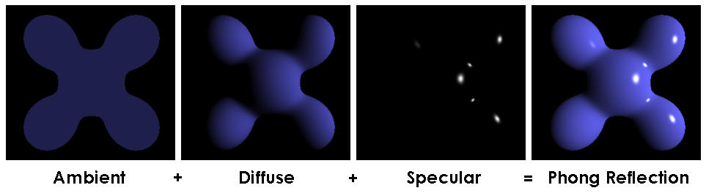
Phong Illumination Model
One of the most common model is the Phong Illumination Model.
  Break light’s into 3 components: ambient (A), diffuse (D) and specular (S).
  The contribution of each component is computed independently
  The total illumination value at any point is simply the sum of all the contributions
It’s main characteristics:
  It approximates light reasonably well and reasonably efficiently
  Computes the interaction between light and surfaces
  Light come from either a point source or is ambient.

Slide 5
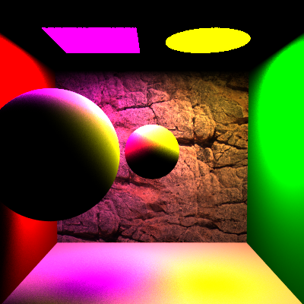
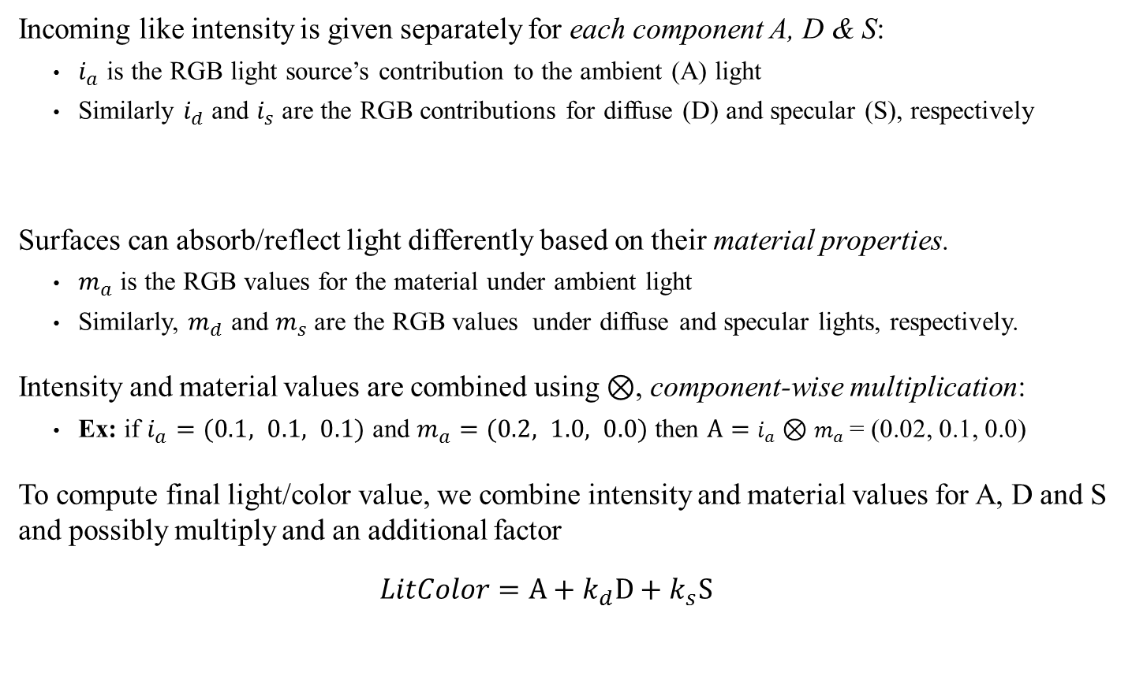
Phong Illumination Model:
Basics concepts
  Incoming like intensity is given separately for each component A, D & S:
    $i_{a}$ is the RGB light source’s contribution to the ambient (A) light
    Similarly $i_{d}$ and $i_{s}$ are the RGB contributions for diffuse (D) and specular (S), respectively
  Surfaces can absorb/reflect light differently based on their material properties.
    $m_{a}$ is the RGB values for the material under ambient light
    Similarly, $m_{d}$ and $m_{s}$ are the RGB values under diffuse and specular lights, respectively.
  Intensity and material values are combined using $⊗$, component-wise multiplication:
    Ex: if $i_{a}=(0.1, 0.1, 0.1)$ and $m_{a}=(0.2, 1.0, 0.0)$ then $A=$ $i_{a}⊗m_{a}$= (0.02, 0.1, 0.0)
  To compute final light/color value, we combine intensity and material values for A, D and S and possibly multiply and an additional factor
  $$LitColor=A+k_{d}D+k_{s}S$$
Q: Shouldn’t the light color be the same for each of A, D and S, only changing in intensity?
A: Maybe but we’re approximating light, so this gives the artist more freedom to get a scene to ‘look right’
Let’s looks at the math/details

Slide 6
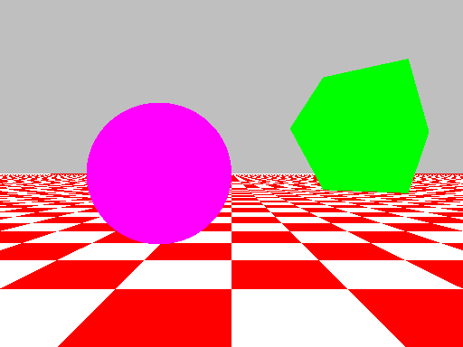
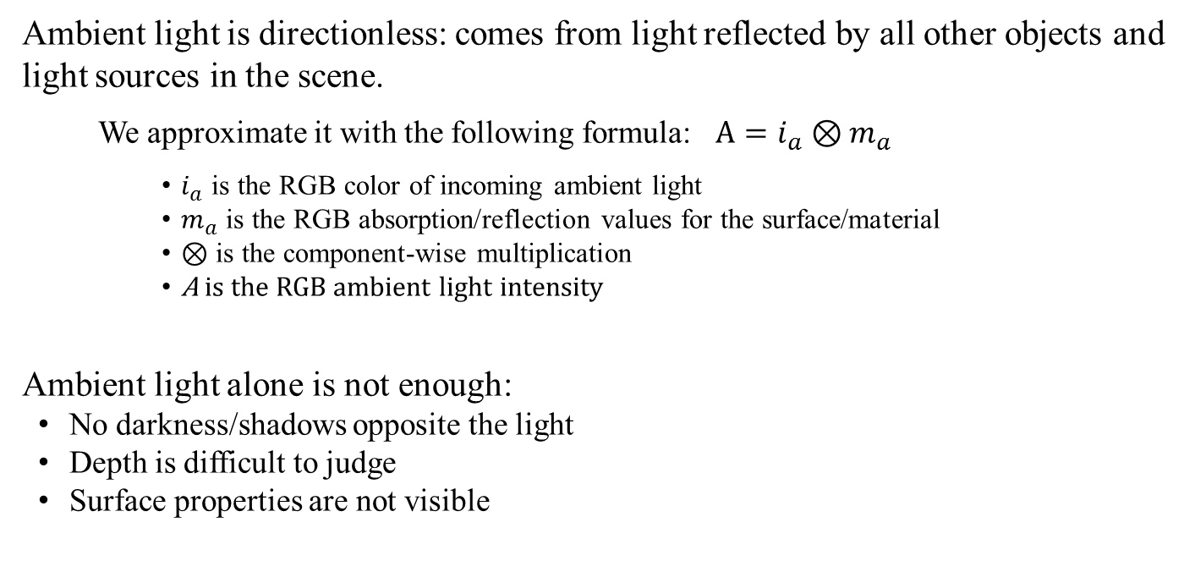
Phong:
Ambient Light Component
Ambient light is directionless: comes from light reflected by all other objects and light sources in the scene.
  We approximate it with the following formula: $A=i_{a}⊗m_{a}$
  $i_{a}$ is the RGB color of incoming ambient light
  $m_{a}$ is the RGB absorption/reflection values for the surface/material
  $⊗$ is the component-wise multiplication
  A is the RGB ambient light intensity
Ambient light alone is not enough:
  No darkness/shadows opposite the light
  Depth is difficult to judge
  Surface properties are not visible
Note: ambient light is not computed from the scene. Instead, it is set through these coefficients.

Slide 7
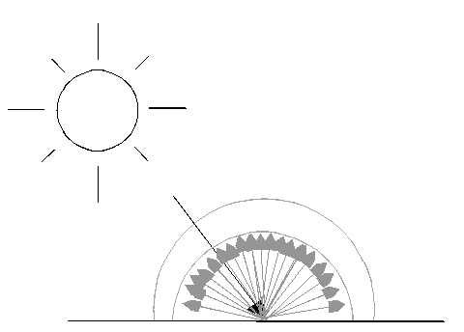
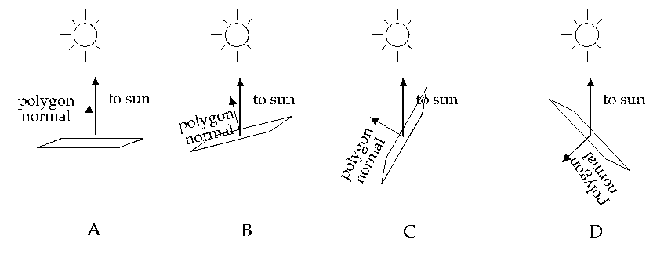
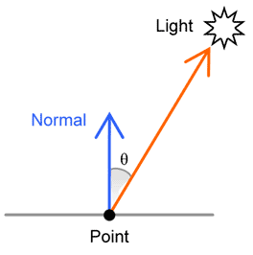
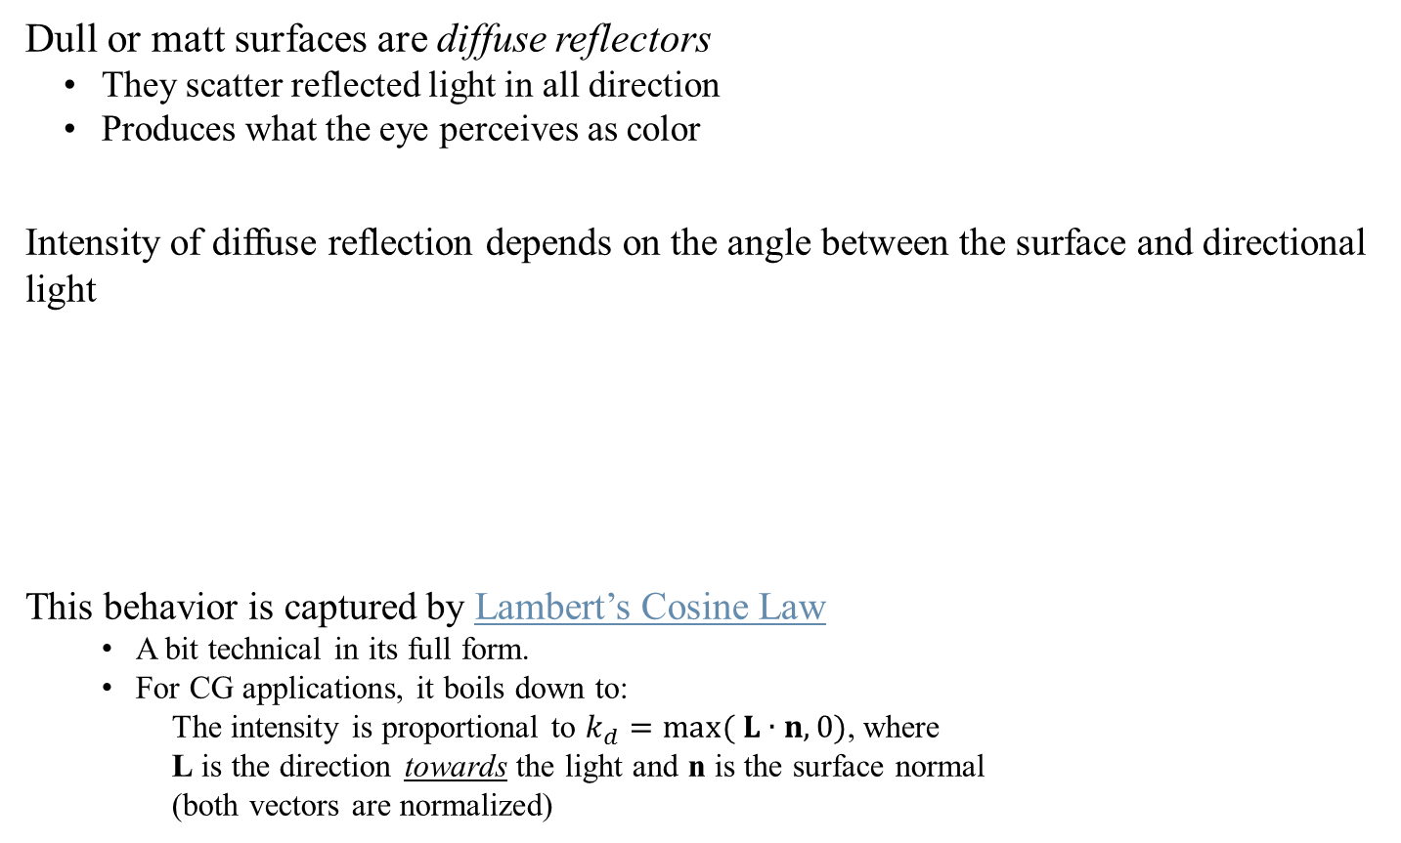
Diffuse Lighting and
Lambert’s Cosine Law
Dull or matt surfaces are diffuse reflectors
  They scatter reflected light in all direction
  Produces what the eye perceives as color
Intensity of diffuse reflection depends on the angle between the surface and directional light
This behavior is captured by Lambert’s Cosine Law
  A bit technical in its full form.
  For CG applications, it boils down to:
  The intensity is proportional to $k_{d}=\max{( L∙n,0)}$, where
  L is the direction towards the light and n is the surface normal
  (both vectors are normalized)
maximum high low zero
Intensity of reflected light
n
L

Slide 8
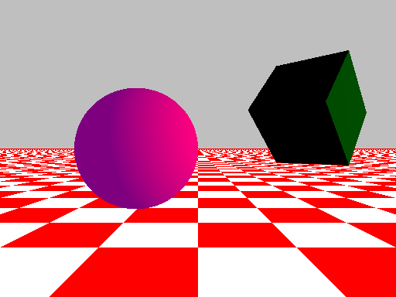
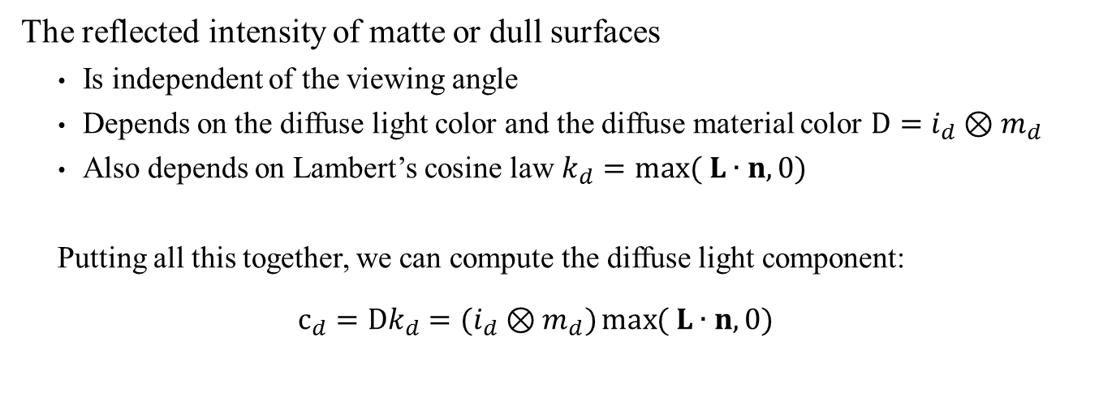
Phong:
Diffuse Light Component
The reflected intensity of matte or dull surfaces
  Is independent of the viewing angle
  Depends on the diffuse light color and the diffuse material color $D=i_{d}⊗m_{d}$
  Also depends on Lambert’s cosine law $k_{d}=\max{( L∙n,0)}$
  Putting all this together, we can compute the diffuse light component:
  $$c_{d}=Dk_{d}=(i_{d}⊗m_{d})\max{( L∙n,0)}$$

Slide 9
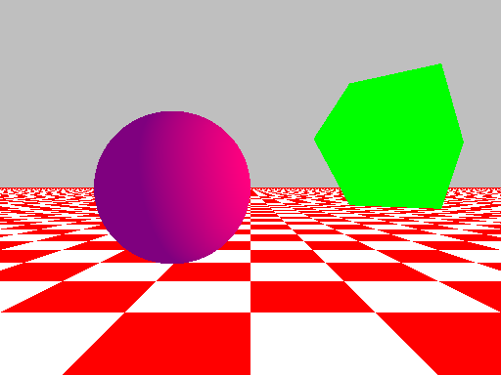
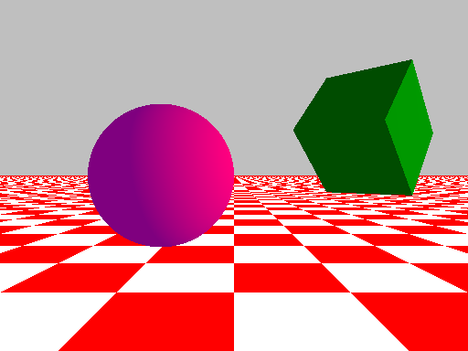

Phong:
Ambient and Diffuse Light
So far, our lighting equation has two components: Ambient and Diffuse
$$LitColor=A+k_{d}D \\ =i_{a}⊗m_{a}+\max{( L∙n,0)}(i_{d}⊗m_{d})$$
We can visualize these components below:
Properly lit
Light source to the right
Only ambient
Only diffuse reflec.
Balanced

Slide 10
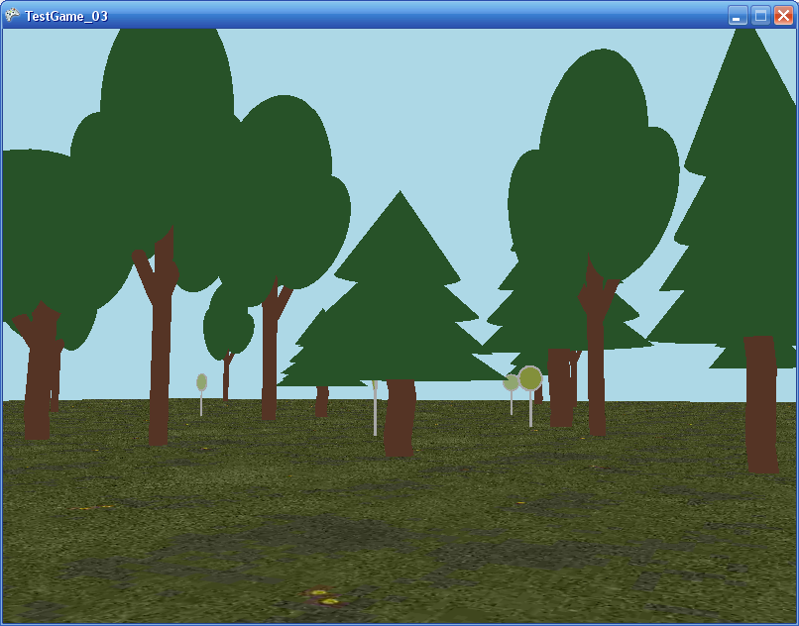
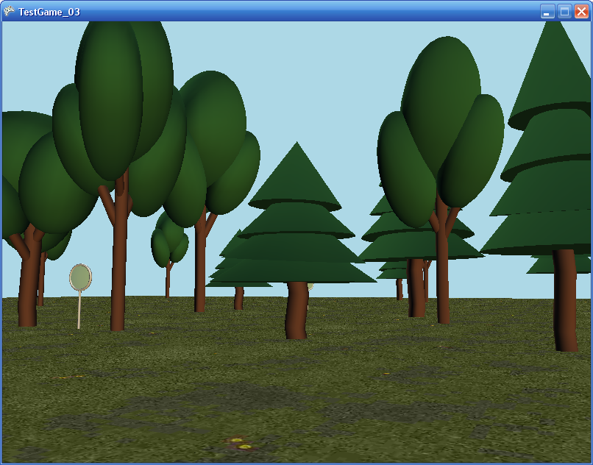
Phong:
Ambient and Diffuse Light
So far, our lighting equation has two components: Ambient and Diffuse
$$LitColor=A+k_{d}D \\ =i_{a}⊗m_{a}+\max{( L∙n,0)}(i_{d}⊗m_{d})$$
We can visualize these components below:
Next we’ll add the last component: specular reflection
Only ambient
Balanced

Slide 11
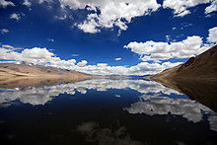


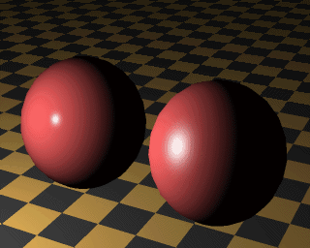
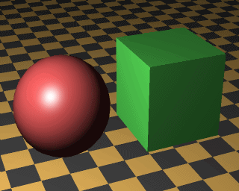
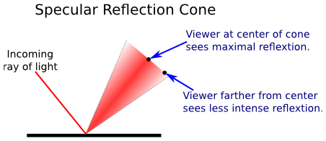
Specular Reflections
In general, specular reflection is the mirror-like reflection seen on shiny surfaces. However…
The Phong model is only concerned with the light source being reflected (ie: the highlight or ‘bright spot’)
Specular reflection determined by:
  Intensity of directional light
  Position of directional light
  Orientation of the surface
  Surface color & roughness
  Position of viewer
We need a formula to capture this highlight (bright spot) effect

Slide 12
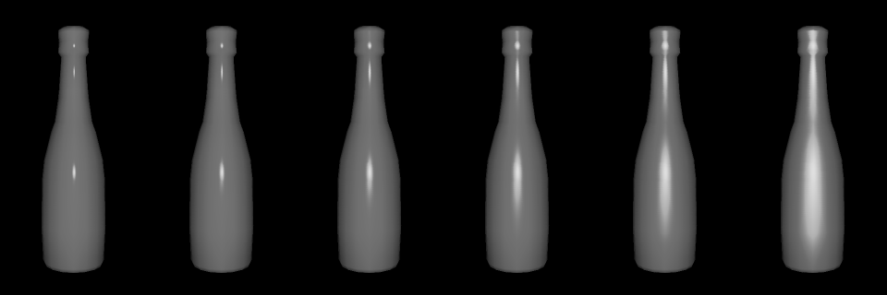
Highlights
Highlight occur when the light source is reflected back to the viewer. This occurs when the viewing angle and reflected angle are ‘close’ the each other.
Surface roughness also plays a rule in the appearance of highlights

Slide 13
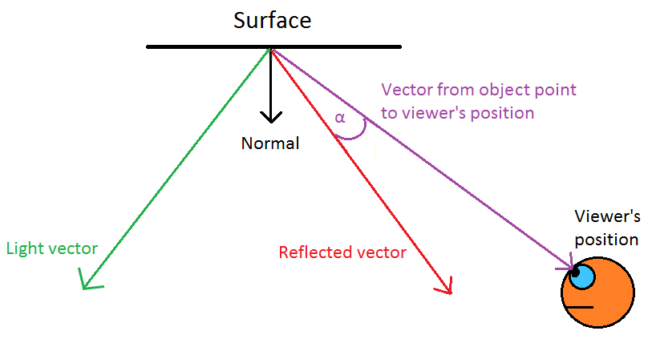
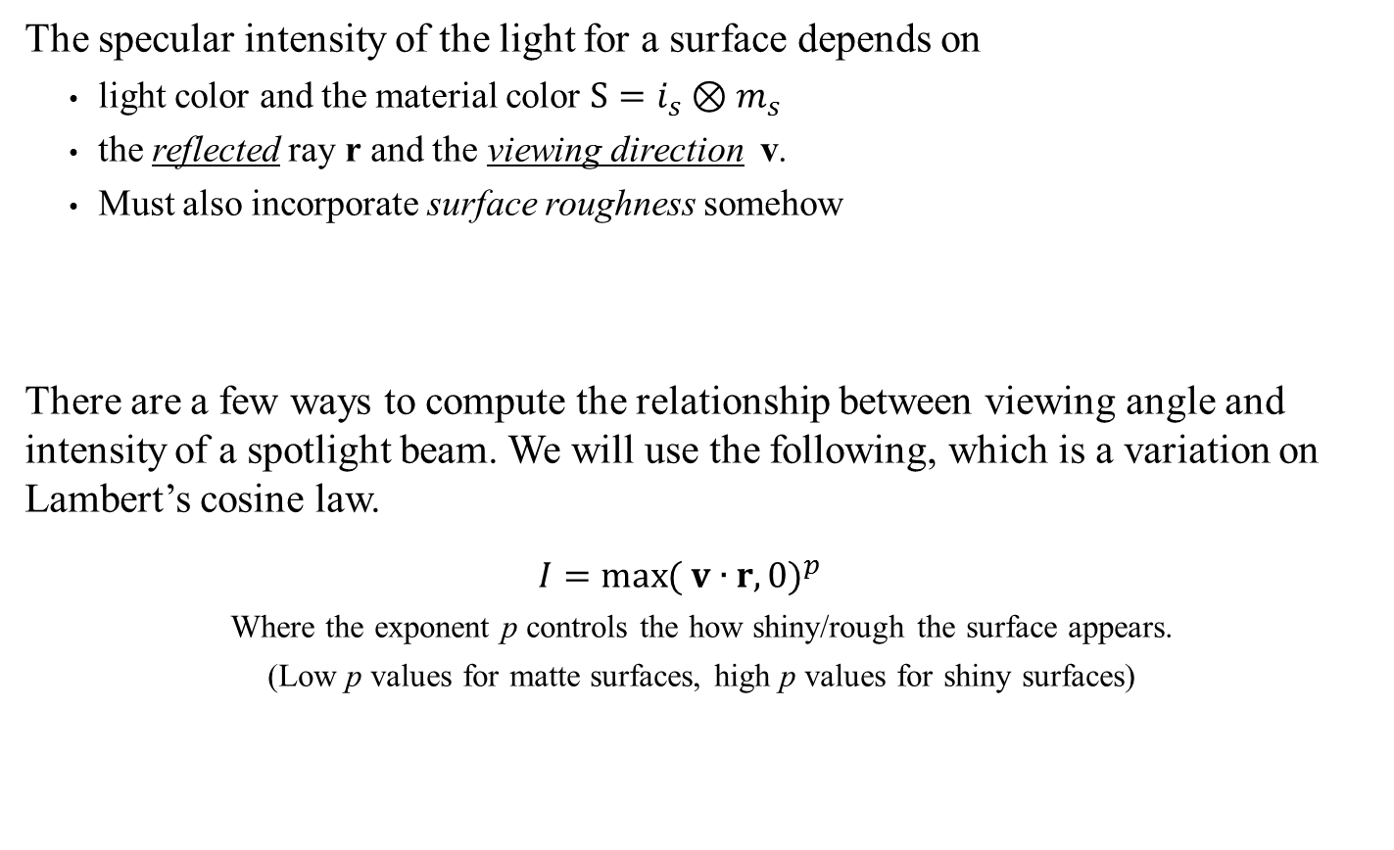
Phong:
Specular Light Component
The specular intensity of the light for a surface depends on
  light color and the material color $S=i_{s}⊗m_{s}$
  the reflected ray r and the viewing direction v.
  Must also incorporate surface roughness somehow
There are a few ways to compute the relationship between viewing angle and intensity of a spotlight beam. We will use the following, which is a variation on Lambert’s cosine law.
  $$I={\max{( v∙r,0)}}^{p}$$
  Where the exponent p controls the how shiny/rough the surface appears.
  (Low p values for matte surfaces, high p values for shiny surfaces)
n
Small problem: How to compute the reflected vector r?
v
L
r

Slide 14
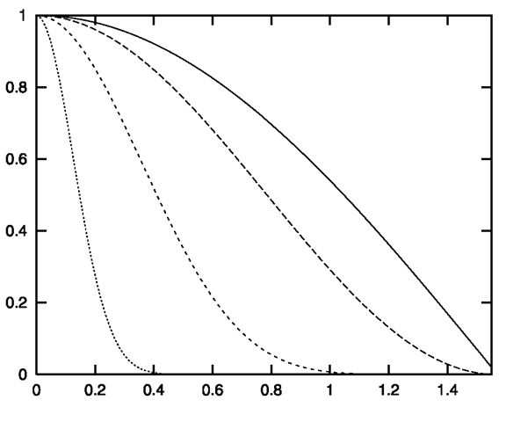

Phong:
Specular Light Component
The graph below shows the function: $f\left(p\right)= {\max{( v∙r,0)}}^{p}$ for p = 1, 2, 8 & 64
The Phong model calculates the specular light component as:
  $$c_{s}=k_{s}S=k_{s}(i_{s}⊗m_{s})$$
  where $k_{s}=\left\{\begin{matrix}{\max{( v∙r,0)}}^{p} & L∙n>0 \\ 0 & L∙n≤0\end{matrix}\right.$
p = 2
p = 1
p = 8
p = 64
The higher p is, the more rapidly the intensity falls off

Slide 15
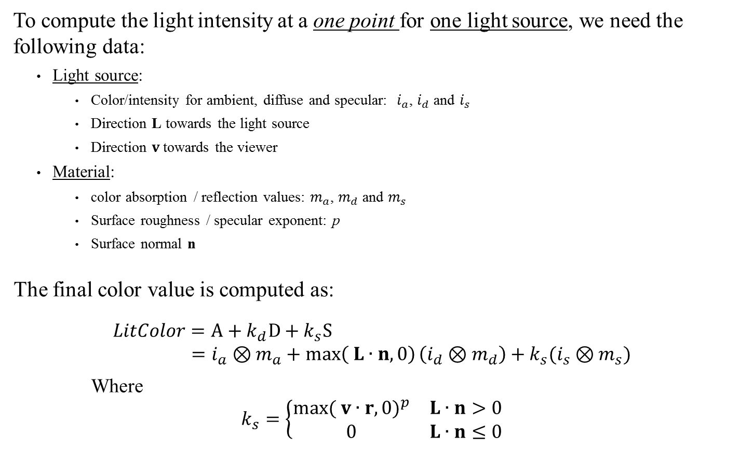
Phong Illumination Model:
Putting it all together
To compute the light intensity at a one point for one light source, we need the following data:
  Light source:
    Color/intensity for ambient, diffuse and specular: $i_{a}$, $i_{d}$ and $i_{s}$
    Direction L towards the light source
    Direction $v$towards the viewer
  Material:
    color absorption / reflection values: $m_{a}$, $m_{d}$ and $m_{s}$
    Surface roughness / specular exponent: p
    Surface normal n
The final color value is computed as:
$$LitColor=A+k_{d}D+k_{s}S \\ =i_{a}⊗m_{a}+\max\left( L∙n,0\right)\left(i_{d}⊗m_{d}\right)+k_{s}(i_{s}⊗m_{s})$$
Where
$$k_{s}=\left\{\begin{matrix}{\max{( v∙r,0)}}^{p} & L∙n>0 \\ 0 & L∙n≤0\end{matrix}\right.$$
Now let’s use all this math in a shader

Slide 16
Part 2:
Phong Shader

Slide 17
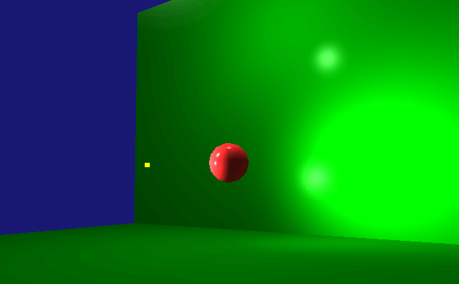
Using the Phong Model:
ShaderColorLight
We will demonstrate how to use the Phong Illumination model by modifying the old color shader.
  Your homework will be to adapt your texture shader similarly

Slide 18

Using the Phong Model
Compare: $LitColor=A+k_{d}D+k_{s}S$
$=i_{a}⊗m_{a}+\max\left( L∙n,0\right)\left(i_{d}⊗m_{d}\right)+k_{s}(i_{s}⊗m_{s})$
Where
$$k_{s}=\left\{\begin{matrix}{\max{( v∙r,0)}}^{p} & L∙n>0 \\ 0 & L∙n≤0\end{matrix}\right.$$
Note: these are just struct, not cbuffers
struct Material
{
float4 Ambient;
float4 Diffuse;
float4 Specular; // Hack: w holds the specular power
};
struct PhongADS
{
float4 Ambient;
float4 Diffuse;
float4 Specular;
};
void PhongModel( Material mat, PhongADS lightint,
float3 L, float3 normal, float3 DirToEye,
out float4 ambient, out float4 diffuse, out float4 spec
)
{
ambient = mat.Ambient * lightint.Ambient;
float diffuseFactor = dot(L, normal);
if (diffuseFactor > 0.0f)
{
diffuse = diffuseFactor * mat.Diffuse * lightint.Diffuse;
float3 r = reflect(-L, normal); // compute the reflected ray
float spec_val = max(dot(r, DirToEye), 0);
float specFactor = pow(spec_val, mat.Specular.w);
spec = specFactor * mat.Specular * lightint.Specular;
}
else
{
diffuse = float4(0, 0, 0, 0);
spec = float4(0, 0, 0, 0);
}
}
Note: this is just a function, not VS or PS
So, apply this per pixel and we’re done?
Not quite….

Slide 19
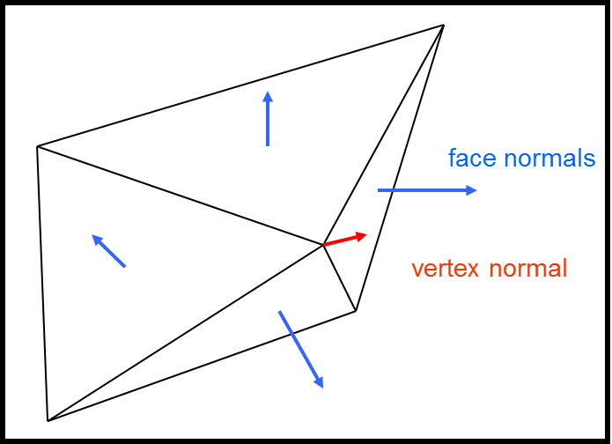
Models and Normals
We need to modify our StandardVertex to include face normals
Premade Models must also be updated:
  For the Cube and and flat plane, the normals are easy
  For the sphere: it’s also easy (think about it)
  For Pyramid and Terrain, things are more complicated
    Pyramid: use the three vertices of a face to find the face normal
    For terrain: each vertex is incident (touches) multiple faces.
      Compute the normal for each face.
      The normal for a vertex is the average of the face normal incident on it
struct StandardVertex
{
Vect Pos;
float u;
float v;
Vect normal;
Vect Color;
}

Slide 20
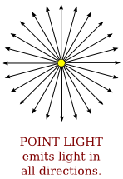
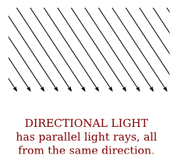
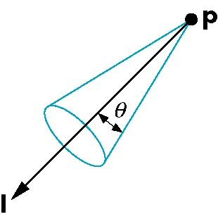
Light Types
The Phong illumination model is limited, but it still offer some latitude as to the type of light source we can model.
Directional Light:
  Simulates the sun (or any far away source)
  All light rays are parallel.
  No attenuation with distance
Point Light:
  Simulates a small light source at a known position
  Light ray emanate in all directions
  Attenuates with distance
Spot Light:
  Very directional with sharp fall-off at the edge of the beam
  Attenuates with distance

Slide 21
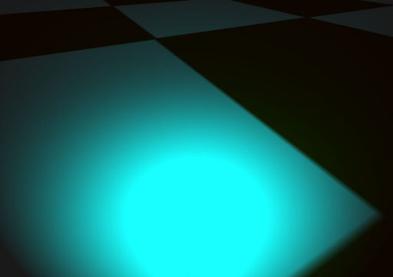
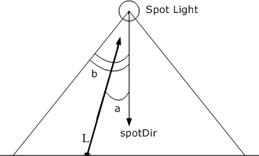

Spotlight Fall-Off
The fall-off factor is computed once again using a power cosine
  $$s_{f}={\max{( −L∙spotDir,0)}}^{p}$$

Slide 22
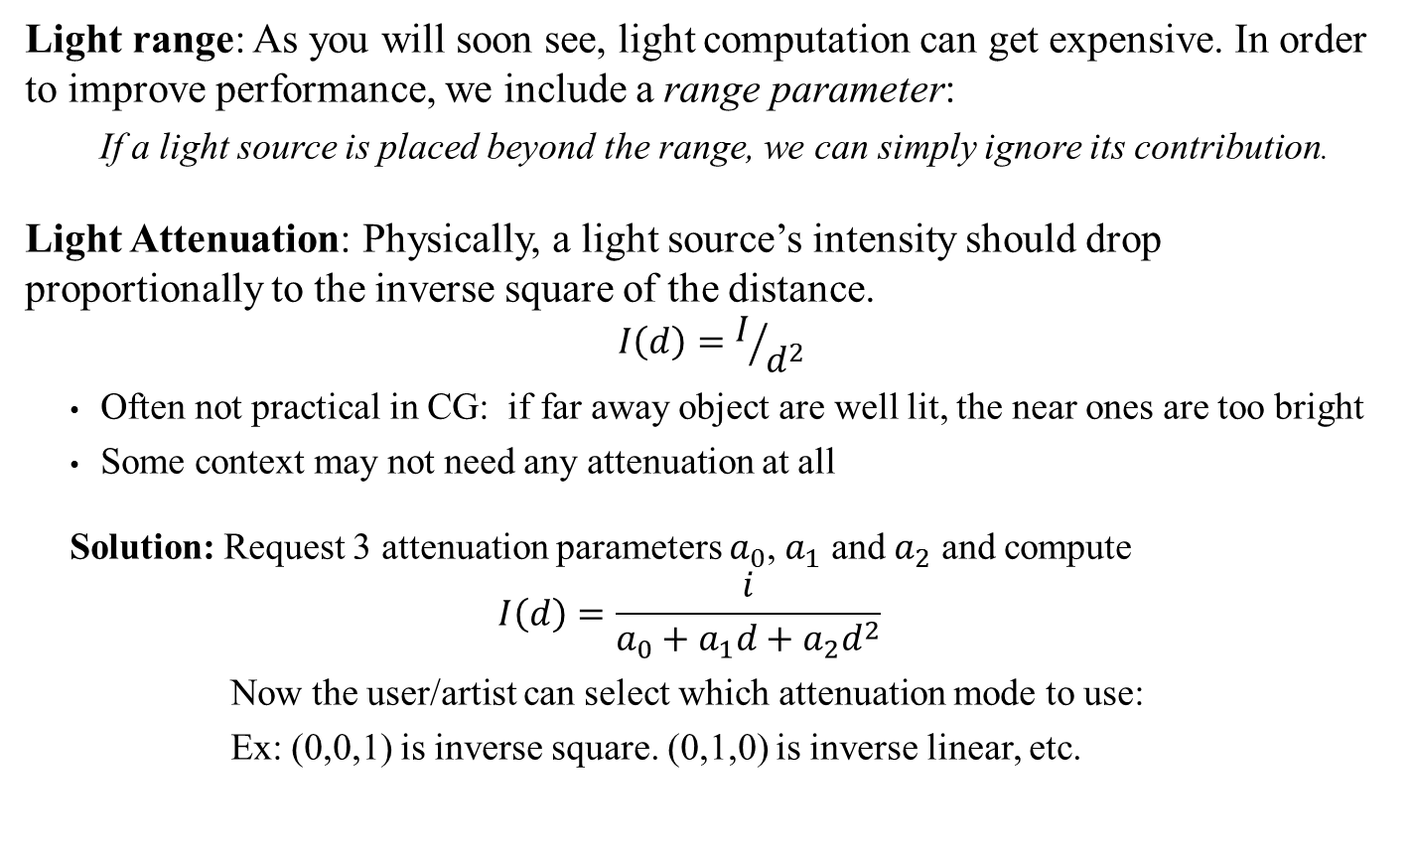
Light Source Attenuation and Range
Light range: As you will soon see, light computation can get expensive. In order to improve performance, we include a range parameter:
  If a light source is placed beyond the range, we can simply ignore its contribution.
Light Attenuation: Physically, a light source’s intensity should drop proportionally to the inverse square of the distance.
$$I\left(d\right)=I/{d^{2}}$$
  Often not practical in CG: if far away object are well lit, the near ones are too bright
  Some context may not need any attenuation at all
  Solution: Request 3 attenuation parameters $a_{0}$, $a_{1}$ and $a_{2}$ and compute
  $$I\left(d\right)=\frac{i}{a_{0}+a_{1}d+a_{2}d^{2}}$$
    Now the user/artist can select which attenuation mode to use:
    Ex: (0,0,1) is inverse square. (0,1,0) is inverse linear, etc.

Slide 23
Back to Light Types in Shader
How can we code these light types?
Directional Light:
  Simulate Sun (or far away source)
  All light rays are parallel.
  No attenuation with distance
Point Light:
  Simulate a small light source at a known position
  Light ray emanate in all directions
  Attenuates with distance
Spot Light:
  Very directional with sharp fall off at the edge of the beam
  Attenuates with distance
struct PhongADS
{
float4 Ambient;
float4 Diffuse;
float4 Specular;
};
struct DirectionalLight
{
PhongADS Light;
float4 Direction;
};
struct PointLight
{
PhongADS Light;
float4 Position;
float4 Attenuation;
float Range;
};
struct SpotLight
{
PhongADS Light;
float4 Position;
float4 Attenuation;
float4 Direction;
float SpotExp;
float Range;
};
Note: these are still just struct, not cbuffers

Slide 24
Shader Constants
This is a lot of data!
And the ShaderColor class must replicate all this
We’ll use 3 constant buffers
Standard camera data
Light data (all three options)
  Also: eye position for specular ref
Instance data
  Includes Material info
  World mat and its inverse
cbuffer CamData : register(b0)
{
float4x4 View;
float4x4 Projection;
};
cbuffer LightParameters : register (b1)
{
DirectionalLight DirLight;
PointLight PntLight;
SpotLight SpLight;
float4 EyePosWorld;
};
cbuffer InstanceData : register(b2)
{
float4x4 World;
float4x4 WorldInv;
Material Mater;
};
struct PhongADS
{
float4 Ambient;
float4 Diffuse;
float4 Specular;
};
struct DirectionalLight
{
PhongADS Light;
float4 Direction;
};
struct PointLight
{
PhongADS Light;
float4 Position;
float4 Attenuation;
float Range;
};
struct SpotLight
{
PhongADS Light;
float4 Position;
float4 Attenuation;
float4 Direction;
float SpotExp;
float Range;
};
Note: We’ll compute light in model-local space, hence WorldInv
Sending CamData or Instance data is nothing new
Sending Light data is done similarly
struct Material
{
float4 Ambient;
float4 Diffuse;
float4 Specular; // w=spec exp
};

Slide 25
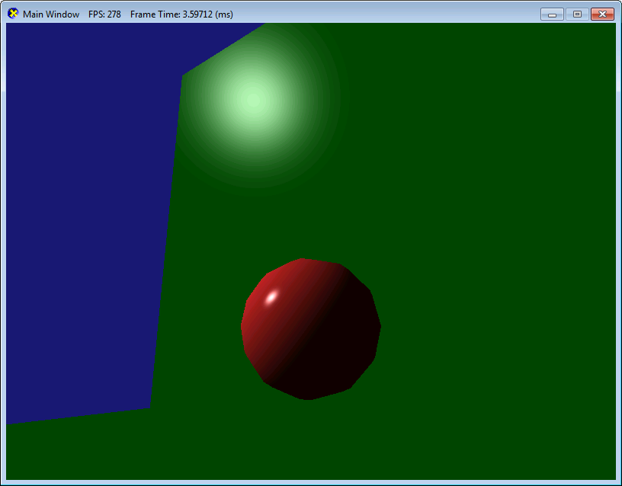
Using ShaderColorLight:
Directional Light
void DXApp::InitDemo()
{
pShaderColLight = new ShaderColorLight(md3dDevice);
pShaderColLight->SetDirectionalLightParameters(Vect(-1,-1,1).getNorm(), .1 * Vect(1,1,1), .5 * Vect(1,1,1), Vect(1,1,1));
Light dir
ambient
diffuse
specular
void DXApp::DrawScene()
{
…
pShaderColLight->SetToContext(md3dImmediateContext);
pShaderColLight->SendCamMatrices(mCam.getViewMatrix(), mCam.getProjMatrix());
Vect eyepos;
mCam.getPos(eyepos);
pShaderColLight->SendLightParameters(eyepos);
pShaderColLight->SendWorldAndMaterial(mWorld1, Colors::Firebrick, Colors::Firebrick, Vect(1,1,1,100));
pModel1->Render(md3dImmediateContext);
ambient
diffuse
Spec & exp
Important: Play around with light intensities and material properties to get a sense of their contributions
But how did the shader work this out?

Slide 26
Using ShaderColorLight:
Vertex Shader
The vertex shader isn’t too different than what we are used to.
  We just make sure to pass along to the PS the model-space position and face normal
struct VS_OUTPUT
{
float4 Pos : SV_POSITION;
float4 PosMS : POSITION;
float4 Norm : NORMAL;
};
VS_OUTPUT VS( float4 Pos : POSITION, float4 nor : NORMAL )
{
VS_OUTPUT output;
output.PosMS = Pos; // We pass along the raw model space position
output.Norm = nor; // and the face normal
output.Pos = mul( Pos, World );
output.Pos = mul( output.Pos, View );
output.Pos = mul( output.Pos, Projection );
return output;
}

Slide 27
Using ShaderColorLight:
Pixel Shader (Directional Light)
float4 PS( VS_OUTPUT input ) : SV_Target
{
float4 msEyePos = mul(EyePosWorld, WorldInv); // Compute light values in model-space
float4 msToEye = normalize(msEyePos - input.PosMS);
float4 ambient = float4(0, 0, 0, 0);
float4 diffuse = float4(0, 0, 0, 0);
float4 spec = float4(0, 0, 0, 0);
float4 A, D, S;
ComputeDirectionalLight(Mater, DirLight, normalize(input.Norm), msToEye, A, D, S);
ambient += A; diffuse += D; spec += S;
<…>
float4 litColor = ambient + diffuse + spec;
return litColor;
}
Warning: As usual in CG, scaling (particularly non-uniform scaling) really makes a mess of things
Let’s add a point light next
void ComputeDirectionalLight(
Material mat, DirectionalLight DirLit,
float4 normal, float4 toEye,
out float4 ambient, out float4 diffuse, out float4 spec
)
{
ambient = float4(0, 0, 0, 0); // Zeroing out the initial ADS contributions
diffuse = float4(0, 0, 0, 0);
spec = float4(0, 0, 0, 0);
// we compute the model-space position
// For directional light, the source is infinitely far, so translation have no effect
float3 L = normalize(mul(-DirLit.Direction.xyz, (float3x3)WorldInv));
PhongModel(mat, DirLight.Light, L, normal.xyz, toEye.xyz, ambient, diffuse, spec);
}

Slide 28
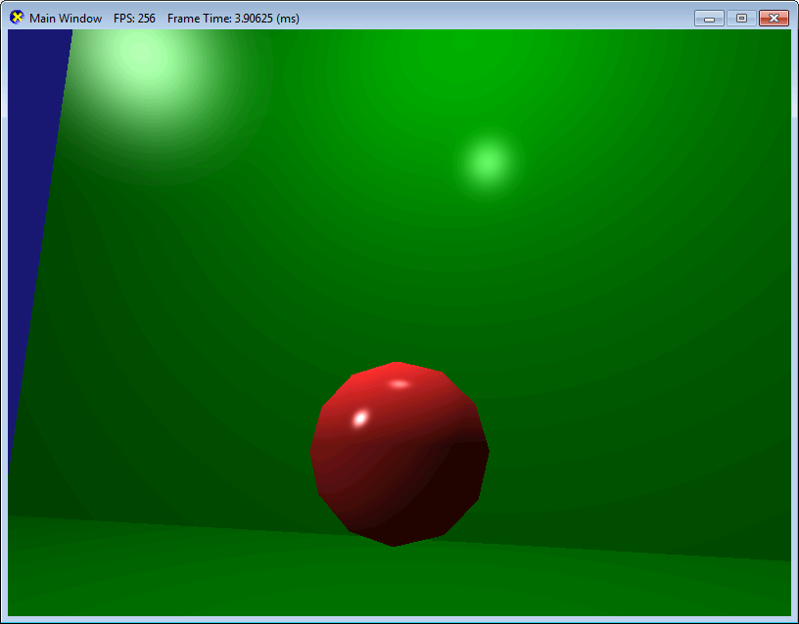
Using ShaderColorLight:
Point Light
Nothing to change in DrawScene
void DXApp::InitDemo()
{
pShaderColLight = new ShaderColorLight(md3dDevice);
pShaderColLight->SetDirectionalLightParameters(Vect(-1,-1,1).getNorm(), .1 * Vect(1,1,1), .5 * Vect(1,1,1), Vect(1,1,1));
pShaderColLight->SetPointLightParameters(Vect(0,10,0), 100, .2 * Vect(0,1,0), .1 * Vect(1,1,1), 2 * Vect(1,1,1), 1*Vect(1,1,1));
Light pos
ambient
diffuse
specular
range
Attenuation
Again: Play around with the various parameters to get a sense of their contributions
But how did the shader work this out?

Slide 29
Using ShaderColorLight:
Pixel Shader (Point Light)
Let’s add a spotlight next
float4 PS( VS_OUTPUT input ) : SV_Target
{
float4 msEyePos = mul(EyePosWorld, WorldInv); // Compute light values in model-space
float4 msToEye = normalize(msEyePos - input.PosMS);
<…> // Includes contributions from Directional Light
ComputePointLight(Mater, PntLight, input.PosMS, normalize(input.Norm), msToEye, A, D, S);
ambient += A;
diffuse += D;
spec += S;
<…>
float4 litColor = ambient + diffuse + spec;
return litColor;
}
void ComputePointLight(
Material mat, PointLight PLight,
float4 posms, float4 normal, float4 toEye,
out float4 ambient, out float4 diffuse, out float4 spec
)
{
ambient = float4(0, 0, 0, 0);
diffuse = float4(0, 0, 0, 0);
spec = float4(0, 0, 0, 0);
// we compute the model-space position
float3 litPosMS = mul(PLight.Position, WorldInv).xyz;
float3 L = litPosMS - posms.xyz;
// Early out if out of range
float d = length(L);
if (d > PLight.Range)
return;
L /= d; // normalize
PhongModel(mat, PLight.Light, L, normal.xyz, toEye.xyz, ambient, diffuse, spec);
// Now we attenuate based on range
float att = 1 / dot(PLight.Attenuation.xyz, float3(1,d, d*d) );
// Ambient not attenuated
diffuse *= att;
spec *= att;
}
Warning: scaling evils
Again: Play around with the various parameters to get a sense of their contributions

Slide 30
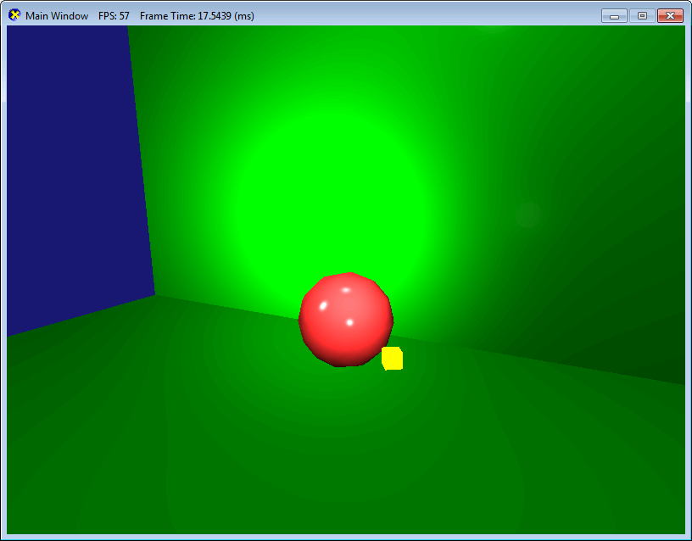
Using ShaderColorLight:
SpotLight
Just for fun, we’ll make it a moving spotlight
void DXApp::UpdateScene()
{
mWorld2 *= Matrix(ROT_Y, .0003f) ; // Simple slow rotation about y axis
pos2 = mWorld2.get(MatrixRowType::ROW_3);
void DXApp::DrawScene()
{
…
pShaderColLight->SetSpotLightParameters( pos2, 100, 1 * Vect(1, 0, 0),
-pos2.getNorm(), 12,
.2 * Vect(1, 1, 1), 3*Vect(1, 1, 1), 1*Vect(1, 1, 1, 150 ));
pShaderColLight->SetToContext(md3dImmediateContext);
pShaderColLight->SendCamMatrices(mCam.getViewMatrix(), mCam.getProjMatrix());
Vect eyepos;
mCam.getPos(eyepos);
pShaderColLight->SendLightParameters(eyepos);
pShaderColLight->SendWorldAndMaterial(mWorld1, Colors::Firebrick, Colors::Firebrick, Vect(1,1,1,100));
pModel1->Render(md3dImmediateContext);
Light pos, range & att
Light dir & spot exp.
Light dir & spot exp.
Warning: Set the parameters before sending the light parameters

Slide 31
Using ShaderColorLight:
Pixel Shader (SpotLight)
float4 PS( VS_OUTPUT input ) : SV_Target
{
float4 msEyePos = mul(EyePosWorld, WorldInv); // Compute light values in model-space
float4 msToEye = normalize(msEyePos - input.PosMS);
<…> // Includes contributions from Directional Light & Point light
ComputeSpotLight(Mater, SpLight, input.PosMS, normalize(input.Norm), msToEye, A, D, S);
ambient += A;
diffuse += D;
spec += S;
float4 litColor = ambient + diffuse + spec;
return litColor;
}
void ComputeSpotLight(
Material mat, SpotLight SptLight,
float4 posms, float4 normal, float4 toEye,
out float4 ambient, out float4 diffuse, out float4 spec
)
{
ambient = float4(0, 0, 0, 0);
diffuse = float4(0, 0, 0, 0);
spec = float4(0, 0, 0, 0);
// ****** Same calculations as Point Light ****
float3 litPosMS = mul(SptLight.Position, WorldInv).xyz;
float3 L = litPosMS - posms.xyz;
<…>
// *****************************************
// now we compute the spotlight factor
float4 msLitDir = SptLight.Direction;
msLitDir.w = 0; // making sure we have a vector and not a point
msLitDir = normalize(mul(msLitDir, WorldInv));
float spot = pow(max(dot(-L, msLitDir.xyz), 0), SptLight.SpotExp);
ambient *= spot;
diffuse *= spot;
spec *= spot;
}
Warning: scaling evils
Again: Play around with the various parameters to get a sense of their contributions
Warning: The book is confusing here…

Slide 32
ShaderColorLight:
Pixel Shader (in full)
The pixel shader is simply adding the ADS contributions of each light source.
float4 PS( VS_OUTPUT input ) : SV_Target
{
float4 msEyePos = mul(EyePosWorld, WorldInv);
float4 msToEye = normalize(msEyePos - input.PosMS);
float4 ambient = float4(0, 0, 0, 0);
float4 diffuse = float4(0, 0, 0, 0);
float4 spec = float4(0, 0, 0, 0);
float4 A, D, S;
ComputeDirectionalLight(Mater, DirLight, normalize(input.Norm), msToEye, A, D, S);
ambient += A;
diffuse += D;
spec += S;
ComputePointLight(Mater, PntLight, input.PosMS, normalize(input.Norm), msToEye, A, D, S);
ambient += A;
diffuse += D;
spec += S;
ComputeSpotLight(Mater, SpLight, input.PosMS, normalize(input.Norm), msToEye, A, D, S);
ambient += A;
diffuse += D;
spec += S;
float4 litColor = ambient + diffuse + spec;
return litColor;
}
This would work even with multiple light sources of the same type: we simply compute their individual ADS contributions and add it all up
What about texture with light?
Simply multiply the texture color by LitColor

Slide 33
Part 3:
Odds and Ends

Slide 34
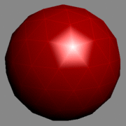
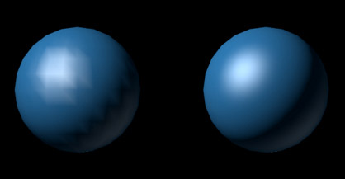
General Comments
Gouraud Shading (per-vertex)
  We’ve applied the Phong model at each pixel.
  A cheaper alternative is to apply Phong at each vertex and simply let the color on the face be interpolated by the rasterizer stage (Gouraud Shading)
  Pro: much faster! Preferred for underpowered systems (or old-school games)
  Con: Lots of visual artefact with the faces, particularly with specular highlights

Slide 35
General Comments
HLSL swizzles (Book App B, p 814, also swizzle):
  Look it up!
Structure packing (Book 7.12.2, p 293):
  We have been cavalier with how we pass data to the GPU: Using Vect/float4 to store only 3 floats is wasteful
  With some additional data manipulation, we could easily compress the number of bytes sent, which would save GPU memory and improve performance
  Also be aware of the 16-byte alignment issues, which may require you to pad your structure
  NOTE: I am not requiring you to do this for this class. (But you should!)

