Slide 1
GAM 370/470:
Rendering and Graphics Programming
Lecture 8:
Graphic Objects and
Model Meshes

Slide 2
Part I:
Discussion

Slide 3
Light and Scale
Light and scaling are tricky to juggled together:
Our light shader works in Model space:
  The positions and directions of light are converted to model space
  If a model’s worldmat includes scaling, this means that in local space:
    Distances get distorted
    Vector length change (in particular, normals aren’t unit length)
This means lighting computation will give unexpected results
Converting the light shader to work in World space is not ideal:
  Requires constantly moving the normals to world space (and renormalizing)
  Overall more costly
As a rule: models should always be presented to the engine at the proper scale already.

Slide 4
Part II:
Graphic Object

Slide 5
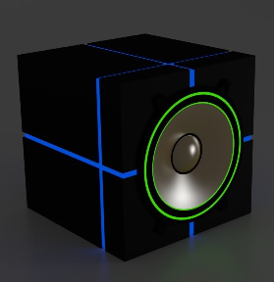
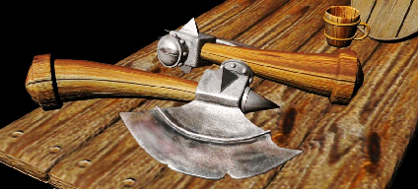
Models and Shaders are Linked
To render a model requires a set ordered operations which depend greatly on the shader being used.
void DXApp::DrawScene()
{
<…>
// Set the shader and send common data
pShaderColLight->SetToContext(md3dImmediateContext);
pShaderColLight->SendCamMatrices(mCam.getViewMatrix(), mCam.getProjMatrix());
pShaderColLight->SendLightParameters(eyepos);
// Render Objects main object;
pShaderColLight->SendWorldAndMaterial( <…> );
pModel1->Render(md3dImmediateContext);
// Planes/box with light
pShaderColLight->SendWorldAndMaterial( <…> );
pPlane->Render(md3dImmediateContext);
pShaderColLight->SendWorldAndMaterial( <…> );
pPlane->Render(md3dImmediateContext);
// --- Render orbiting object
pShaderCol->SetToContext(md3dImmediateContext);
pShaderCol->SendCamMatrices(mCam.getViewMatrix(), mCam.getProjMatrix());
pShaderCol->SendWorldColor(mWorld2, Colors::Yellow);
pModel2->Render(md3dImmediateContext);
<…>
}
For both shader here:
  Send shader specific data
  Call render on the model
As we use more complex shaders and soon more complex models, rendering a model will require more careful operations:
  Multi-mesh models
  Specific properties per mesh: Texture, material, etc.
  Examples:

Slide 6
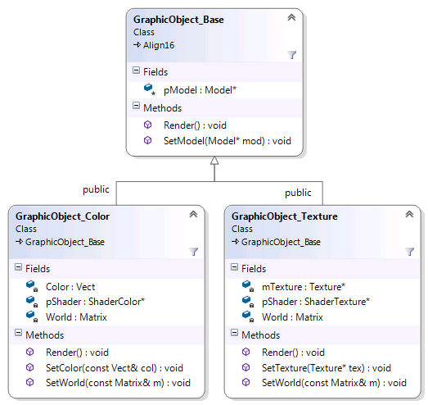
Graphic Objects
A graphic object is a way to package a model, its associated shader and how to properly send the relevant data to that shader
  The base class contains a pointer to a Model and an abstract ‘Render()’ method
  The derived classes has shader specific data and related operations
  The derived class also properly defines the Render method
GraphicObject_Color::GraphicObject_Color(
ShaderColor* shader,
Model* mod)
{
SetModel(mod );
pShader = shader;
Color = Vect(1, 1, 1);
World = Matrix(IDENTITY);
}
void GraphicObject_Color::SetColor(const Vect& col){ Color = col;}
void GraphicObject_Color::SetWorld(const Matrix& m){ World = m;}
void GraphicObject_Color::Render()
{
pShader->SendWorldColor(World, Color);
pModel->Render(pShader->GetContext());
}
Note: Shader and model passed
in as pointers. Not created!

Slide 7
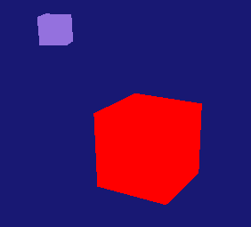
Using GraphicObject_Color:
(Code Example)
void DXApp::InitDemo()
{
pShaderCol = new ShaderColor(md3dDevice);
pModel1 = new Model(md3dDevice, Model::UnitBoxSixFacesTexture);
pModel2 = new Model(md3dDevice, Model::UnitBoxSixFacesTexture);
GraphObj1 = new GraphicObject_Color(pShaderCol, pModel1);
GraphObj1->SetColor(Colors::Red);
GraphObj2 = new GraphicObject_Color(pShaderCol, pModel2);
GraphObj2->SetColor(Colors::MediumPurple);
// Initialize the world matrix
mWorld1 = Matrix(IDENTITY);
mWorld2 = Matrix(SCALE, .5f, .5f, .5f) * Matrix(TRANS, 2, 1, 3);
GraphObj1->SetWorld(mWorld1);
GraphObj2->SetWorld(mWorld2);
<…>
}
void DXApp::DrawScene()
{
<…>
// Shader set up
pShaderCol->SetToContext(md3dImmediateContext);
pShaderCol->SendCamMatrices(mCam.getViewMatrix(), mCam.getProjMatrix());
// Rendering objects
GraphObj1->Render();
GraphObj2->Render();
<…>
}
void GraphicObject_Color::Render()
{
pShader->SendWorldColor(World, Color);
pModel->Render(pShader->GetContext());
}

Slide 8
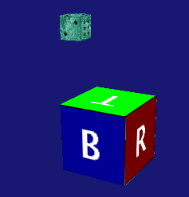
Using GraphicObject_Texture:
(part of homework)
void DXApp::InitDemo()
{
pShaderTex = new ShaderTexture(md3dDevice);
pTex1 = new Texture(md3dDevice, L"../Assets/Textures/CubeFaces.tga");
pTex2 = new Texture(md3dDevice, L"../Assets/Textures/Dice.tga");
pModel1 = new Model(md3dDevice, Model::UnitBoxSixFacesTexture);
pModel2 = new Model(md3dDevice, Model::UnitBoxSixFacesTexture);
GraphObj1 = new GraphicObject_Texture(pShaderTex, pModel1);
GraphObj1->SetTexture(pTex1);
GraphObj2 = new GraphicObject_Texture(pShaderTex, pModel2);
GraphObj2->SetTexture(pTex2);
// Initialize the world matrix
mWorld1 = Matrix(IDENTITY);
mWorld2 = Matrix(SCALE, .5f, .5f, .5f) * Matrix(TRANS, 2, 1, 3);
GraphObj1->SetWorld(mWorld1);
GraphObj2->SetWorld(mWorld2);
<…>
}
void DXApp::DrawScene()
{
<…>
// Shader set up
pShaderTex->SetToContext(md3dImmediateContext);
pShaderTex->SendCamMatrices(mCam.getViewMatrix(), mCam.getProjMatrix());
GraphObj1->Render();
GraphObj2->Render();
<…>
}

Slide 9
Graphics Object
The point of graphic object (GO) is to hide the minutia associated with the shader data transfer:
Users create the models, shaders, textures, etc.
Users interact with GO to adjust the relevant data
At the draw stage:
  Set the shader to context and pass the common data
  Render each graphic object
void DXApp::InitDemo()
{
pShaderCol = new ShaderColor(md3dDevice);
pModel1 = new Model(md3dDevice, Model::UnitBoxSixFacesTexture);
pModel2 = new Model(md3dDevice, Model::UnitBoxSixFacesTexture);
GraphObj1 = new GraphicObject_Color(pShaderCol, pModel1);
GraphObj1->SetColor(Colors::Red);
GraphObj2 = new GraphicObject_Color(pShaderCol, pModel2);
GraphObj2->SetColor(Colors::MediumPurple);
// Initialize the world matrix
mWorld1 = Matrix(IDENTITY);
mWorld2 = Matrix(SCALE, .5f, .5f, .5f) * Matrix(TRANS, 2, 1, 3);
GraphObj1->SetWorld(mWorld1);
GraphObj2->SetWorld(mWorld2);
<…>
}
The benefits of using graphics object are even more apparent when using complex shaders:
lighting, multiple meshes, etc.
void DXApp::DrawScene()
{
<…>
// Shader set up
pShaderCol->SetToContext(md3dImmediateContext);
pShaderCol->SendCamMatrices(mCam.getViewMatrix(), mCam.getProjMatrix());
GraphObj1->Render();
GraphObj2->Render();
<…>
}
In principle, we could even have a game engine manage all the shaders at render time and make sure each graphic object is rendered when the correct shader is active

Slide 10
Part III:
Loading Models From Files

Slide 11
Models from Files
Using default geometric models was fine for testing shaders, but it’s getting old. How about some models created by actual artists?
Problems:
  Artists work with modeling software (Maya, 3DS Max, Blender, etc.) that have their own proprietary file format (.ma//mb, .3ds, .blend, etc)
  The modelling software can export to more common exchange formats (.fbx for example)
  All these formats are great for data exchange, but game engines typically have their own internal data format designed with performance and data packing in mind
  This means we need to convert the model files to the engine’s file format…
Creating such converters is no small feat. Engine tool makers are typically given the task.
But this is outside our scope for now.
Let’s look at how Azul does this

Slide 12
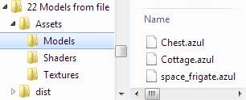
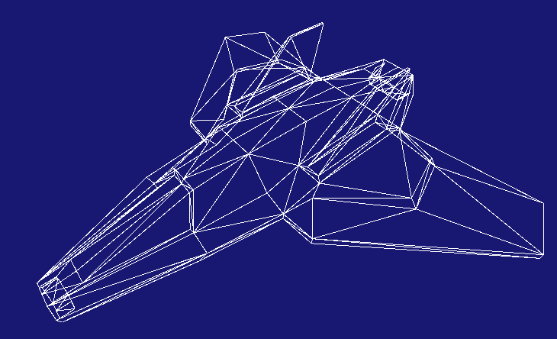
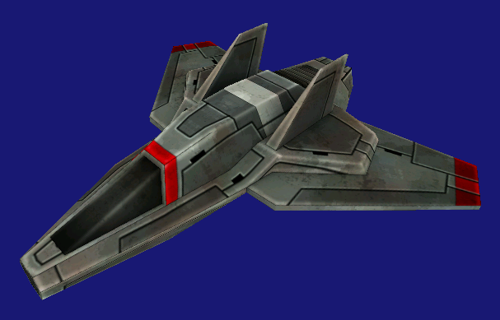
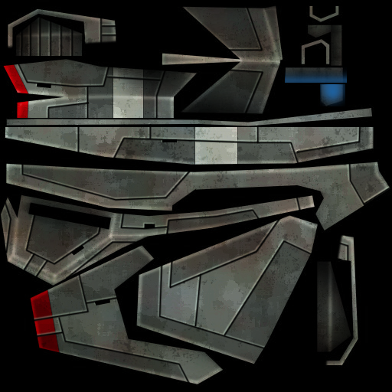
Loading Model: Azul Style
Using its own .azul file format
Packs all the vertex data needed for models
Indices are set up as triangle list
Rendering is done the same way as our previous models
pShaderCol = new ShaderColor(md3dDevice);
pModel1 = new Model(md3dDevice, "../Assets/Models/space_frigate.azul");
GraphObj1 = new GraphicObject_Color(pShaderCol, pModel1);
GraphObj1->SetColor(Colors::White);
And should work just as readily with your own texture/light shaders

Slide 13
Class Changes:
Model
Not too much needs to change (I’m giving you the file reading code)
class Model
{
private:
// <data members>
void privLoadDataToGPU();
void privLoadDataFromFile(const char * const _modelName,
StandardVertex*& pVerts, int& nverts,
TriangleByIndex*& ptlist, int& ntri);
public:
<…>
Model(ID3D11Device* dev, StandardVertex *pVerts, int nverts, TriangleByIndex *ptlist, int ntri);
Model(ID3D11Device* dev, PreMadedeModels pm);
Model(ID3D11Device* dev, const char * const _modelName);
void Render(ID3D11DeviceContext* context);
};
Reads the data from file and fills up the vertex and index arrays
New constructor with file name
Let’s look at the code for loading from file:
(Warning: Another Mea Culpa!)

Slide 14
Loading .Azul Data
Loading the data from the file isn’t particularly difficult:
  The class axulFileHdr has the file format details and accessors
  For vertices:
    Read in the number
    Set the arrays size and format
    Dump the raw bytes into the array
  For indices: same process
  Close files and return
void Model::privLoadDataFromFile(const char * const _modelName, StandardVertex*& pVerts, int& nverts, TriangleByIndex*& ptlist, int& ntri)
{
<…>
// Get the file format for the data
AzulFileHdr azulFileHdr;
<…>
// create the vertex buffer
nverts = azulFileHdr.numVerts;
VertexStride_VUN* pTmpVerts = new VertexStride_VUN[nverts];
// load the verts
ferror = File::seek(fh, FILE_SEEK_BEGIN, azulFileHdr.vertBufferOffset);
<…>
ferror = File::read(fh, pTmpVerts, nverts * sizeof(VertexStride_VUN));
assert(ferror == FILE_SUCCESS);
// create the triLists buffer
<similar process as vertices…>
// close
ferror = File::close(fh);
assert(ferror == FILE_SUCCESS);
}
Or that would be the end of it if we (*I*) had been more careful about data packing…

Slide 15
Structure Packing
(The gist of this is covered in the book, Sect 7.12.2, p293)
The short version is that if our data is 16-byte aligned (using packing), both the CPU and GPU can use internal performance optimization.
  But we also want to keep this 16-byte alignment with minimal padding. This is where we have been sloppy.
Azul’s vertex format is more efficient
struct StandardVertex
{
Vect Pos;
float u;
float v;
Vect normal;
Vect Color;
}
struct VertexStride_VUN
{
float x;
float y;
float z;
float u;
float v;
float meshnum;
float nx;
float ny;
float nz;
float r;
float g;
float b;
}
We need to convert an array of these into an aray of these
Not used for now
Alignment requires hidden 8 bytes of padding. Also, we could argue that we don’t need the 4th value for Pos, Normal and Color

Slide 16
Fixing This On-The-Fly
We should probably change our Standard Vertex to be better packed (and next year I will definitely do so) but in the mean time, we’ll cheat our way out:
Load data into a temp array of the
proper type for AZUL
Loop through the array and copy
the data into a new array of the right
format for us.
void Model::privLoadDataFromFile(const char * const _modelName, StandardVertex*& pVerts, int& nverts, TriangleByIndex*& ptlist, int& ntri)
{
// Get the file format for the data
AzulFileHdr azulFileHdr;
<…>
struct VertexStride_VUN {…}
// create the vertex buffer
nverts = azulFileHdr.numVerts;
VertexStride_VUN* pTmpVerts = new VertexStride_VUN[nverts];
// load the verts
<…>
// **** Overly complicated detour Part 2: now we copy the vertex data into our StandardVertex
pVerts = new StandardVertex[nverts];
StandardVertex* v;
VertexStride_VUN* tmp;
for (int i = 0; i < nverts; i++)
{
tmp = &(pTmpVerts[i]);
v = &(pVerts[i]);
v->set(tmp->x, tmp->y, tmp->z, tmp->u, tmp->v, tmp->nx, tmp->ny, tmp->nz, tmp->r, tmp->g, tmp->b);
}
delete[] pTmpVerts;
}
Sloppy? Absolutely.
I’ll toss in a few bonus points to anyone who converts StandardVertex to be correctly packed (and update all associated shader, shader classes, etc.)

Slide 17
Converting from FBX to Azul
Where to get FBX models?
  Make them yourself or search online (ex: 3DExport Free Zelda Pack)
In “Reference/FBX Converter”, you will find the executable
  DO NOT COPY IT! Work in that folder only!
  Copy your fbx files in this folder and open a command window there.
  Type: (piping the output to a log file greatly speeds up the conversion process)
  You now have a file chair.azul ready to be used.
  Copy this .azul file into you’re the asset folder of your project.
DO NOT SAVE YOUR EXPERIMENTS ON PERFORCE!
We have enough space problems without you guys dumping 100s of MB of model/texture searches.
Just keep the final .azul files you’ve selected for your project

Slide 18
Converter Limitations
This is an in-house converter with some serious limitation. YMMV…
  It should work for simple models without skin, animation, bones, etc.
  Many details are up to the artist:
    Ex: chest.azul points upwards, chair.azul is… not right…
    In a real game setting, these models would need to be realigned and rescaled properly to match our engine’s standards for ‘forward’ and scale.
  Texture uv vary for different environments. DX has uv’s 0,0 in the upper left but other environments has it in lower left.
    You may need to flip the textures vertically to have the uv line-up correctly (I had to do it for chest.tga)
  BEWARE OF TEXTURE SIZE! The original chest texture was 2048x2048 (5MB)! That is insane for our purpose! Please resize those textures to no more than 512x512
Beggars can’t be choosers. The converter is all we have right now to get models in azul format.
Work within its limitations

Slide 19
Part IV:
Models in Multiple Meshes

Slide 20

Models In Parts
Performance-wise, it is best to have each model as a single mesh, using a single texture and having a single set of light properties:
  Old-school game engines had it easy…
However, as soon as we introduce more complex shader effects, things get more complicated:
  Ex: Different parts have different material
  values for light.
We need a way to manage models composed of multiple parts.
This is where Meshes come in.
Not shiny
Shiny

Slide 21
Meshes and
AZUL Format for Vertices
The converter identifies meshes based on textures:
  All vertices assigned to a specific texture are considered part of the same mesh
  The converter assumes that no vertex will ever be used for two distinct textures
  For technical reasons, the converter can only manage up to 4 meshes per model
  This isn’t a perfect system, but it’ll serve us for now
Recall the vertex format used in AZUL files:
  The ‘meshnum’ value encodes the mesh for this vertex
  (it’s a float only for technical reasons in the converter)
struct VertexStride_VUN
{
float x;
float y;
float z;
float u;
float v;
float meshnum;
float nx;
float ny;
float nz;
float r;
float g;
float b;
}
Ok, we can separate the vertices by meshes.
Does it mean we’ll need to create (up to) four pairs of vertex and index buffers for each model?
Nope: fortunately for us, the DrawIndexed can help!

Slide 22
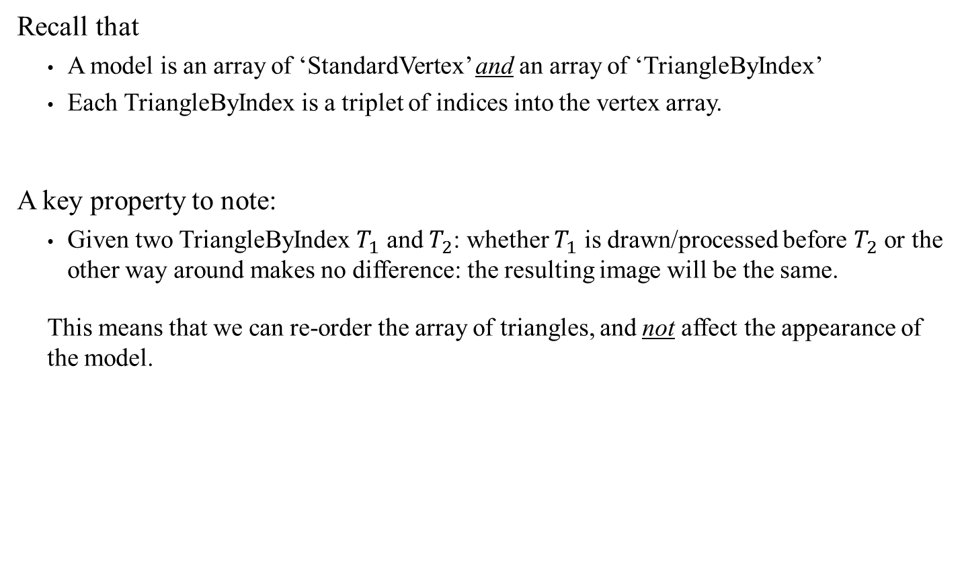
Reordering the Triangle Array
Recall that
  A model is an array of ‘StandardVertex’ and an array of ‘TriangleByIndex’
  Each TriangleByIndex is a triplet of indices into the vertex array.
A key property to note:
  Given two TriangleByIndex $T_{1}$ and $T_{2}$: whether $T_{1}$ is drawn/processed before $T_{2}$ or the other way around makes no difference: the resulting image will be the same.
  This means that we can re-order the array of triangles, and not affect the appearance of the model.
struct TriangleByIndex
{
unsigned int v0;
unsigned int v1;
unsigned int v2;
}
Why does that matter? It all hinges on how the DrawIndexed function works

Slide 23
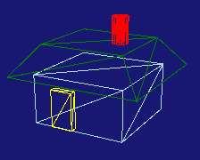
DrawIndexed: Partial Drawing
Consider this simple 4-part cottage.
  A single model where each part (mesh) was rendered using a diff. color.
We will leave the vertex buffer untouched.
But consider the index buffer.
  For clearer visualization:
    will represent one entry of type TriangleByIndex
    will represent the entries with the corresponding mesh numbers
    Initially, the vertex buffer might look like this: Random ordering of mesh numbers
    But we just argued that the following ordering would work just as well
0
1
2
3
3
2
2
3
0
0
2
1
0
1
1
3
…
3
1
2
2
3
3
3
…
3
0
0
0
…
0
2
2
2
…
2
1
1
1
…
1
Grouped by mesh number

Slide 24
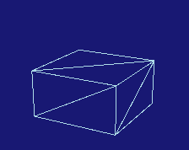
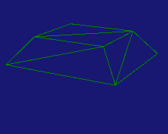
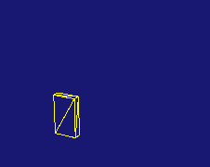
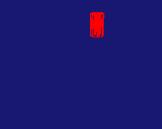
DrawIndexed: Partial Drawing
Therefore, we reorder the triangles and keep track of following data:
  for each ‘sub array’:
    Index of the first entry: ‘trioffset’
    Number of triangles in the sub array: ‘tricount’
We can render any one mesh by calling DrawIndexed on a partial index array
3
3
3
…
3
0
0
0
…
0
2
2
2
…
2
1
1
1
…
1
Tricount = c0
Trioffet = 0
Tricount = c1
Trioffet = c0
Tricount = c2
Trioffet = c1
Tricount = c3
Trioffet = c2
devcon->DrawIndexed(tricount * 3, trioffset * 3, 0);

Slide 25
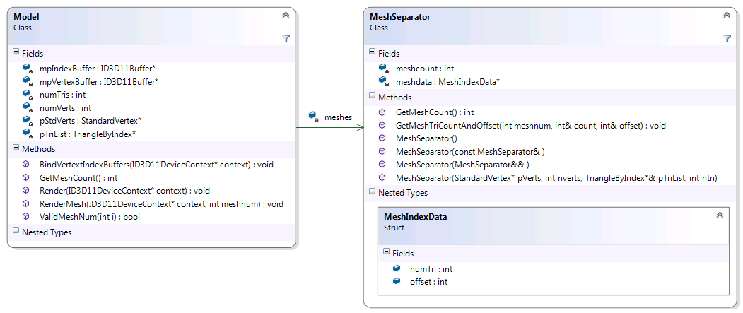
Reordering the Index Buffer:
MeshSeperator Class
Each Model now has an instance of MeshSeparator
  It reorders the index buffers
  Keeps track of the meshes’s start and size
void Model::privLoadDataToGPU()
{
// Extract mesh information
meshes = new MeshSeparator(pStdVerts, numVerts, pTriList, numTris);

Slide 26
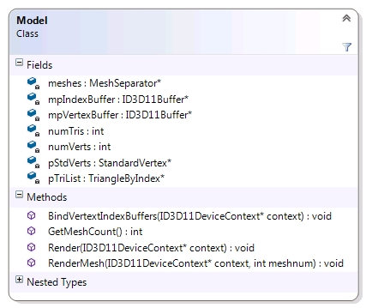
Changes To:
Model Class
The Model class also needs to add some other mesh functionalities
  The Render changed a bit:
    We separate the IA context setting from the rendering
    We still allow the old Render of all meshes at once
  RenderMesh: to render a specific mesh only
  GetMeshCount: Returns the # of meshes
Note that which mesh to render is not decided here. That decision must be made up the chain, in the graphic object

Slide 27
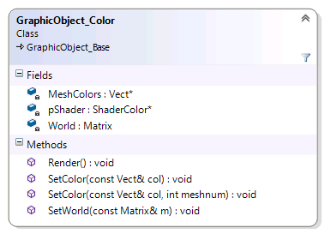
Changes To:
GraphicObject_Color Class
Instead of a single color, we need to store an array of colors, one for each mesh
The only new method needed here is the option to set the color per mesh
GraphicObject_Color::GraphicObject_Color(ShaderColor* shader, Model* mod)
{
SetModel(mod );
pShader = shader;
//Color = Vect(1, 1, 1);
World = Matrix(IDENTITY);
int n = mod->GetMeshCount();
MeshColors = new Vect[n];
for (int i = 0; i < n; i++)
MeshColors[i] = Vect(0, 0, 0);
}
Note: Each mesh uses the same World matrix!
void GraphicObject_Color::SetColor(const Vect& col, int meshnum)
{
assert(pModel->ValidMeshNum(meshnum));
MeshColors[meshnum] = col;
}

Slide 28
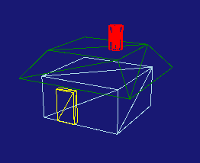
Changes To:
GraphicObject_Color Class
The ‘Render’ method however needs to change:
  We set the buffers to context once
  Then we render each mesh in turn
void GraphicObject_Color::Render()
{
pModel->BindVertexIndexBuffers(pShader->GetContext());
for (int i = 0; i < pModel->GetMeshCount(); i++)
{
pShader->SendWorldColor(World, MeshColors[i]);
pModel->RenderMesh(pShader->GetContext(), i);
}
}

