Slide 1

Airline prediction
Group 4
Yiteng Tu, Yudi Wang, Yuchen Xu, Mario Ma

Slide 2
About the Data

Slide 3
Data Merging and Data Processing
1.We merged the data based on the match between the airport and the weather station_id. For airports missing station ID, we identified up to 3 nearest stations within 50 km to impute missing data. The other missing we regard as NA, eg ISN,PIH. After merging we got 9720184 flights with weather data for 395 airports.
2. For data processing:
date-related variables were converted to categories,
"TimeBlk" categorized by hour
"WindSpeed" was treated as categorical in 45-degree intervals
'T' in "HourlyPrecipitation" was imputed as 0.05
STAT 628 2024 FALL, MODEL 3, TUESDAY GROUP 4

Slide 4
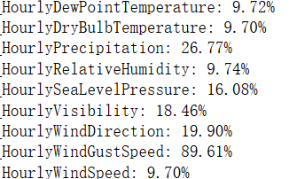
Deal with Missing Data
Missing values in "HourlyPrecipitation" and "HourlyWindGustSpeed," are imputed by 0.
Use cluster means for other numeric variables.
Use an "NA" category for categorical variables.
After processing, the final data contained 9,700,585 flights for 387 airports and 34 features with no missing values.
STAT 628 2024 FALL, MODEL 3, TUESDAY GROUP 4

Slide 5
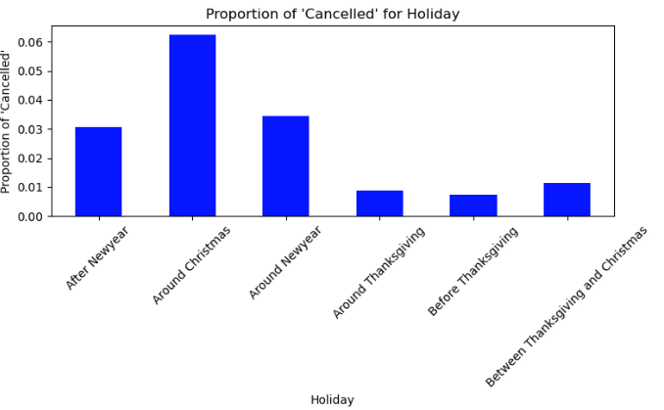
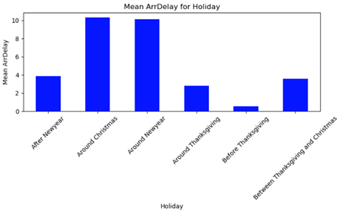
Create A New Category
To capture the relationships between the date and “canceled” and “ArrDelay”, we created additional categories by grouping "DayofMonth" into seven categories based on three key holidays.
STAT 628 2024 FALL, MODEL 3, TUESDAY GROUP 4

Slide 6
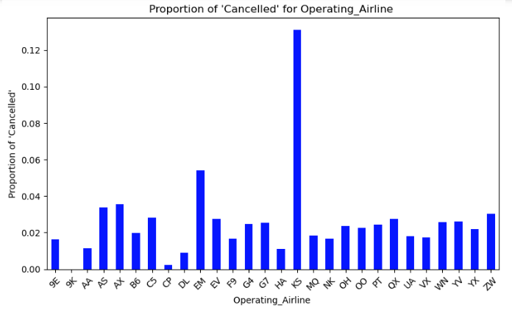
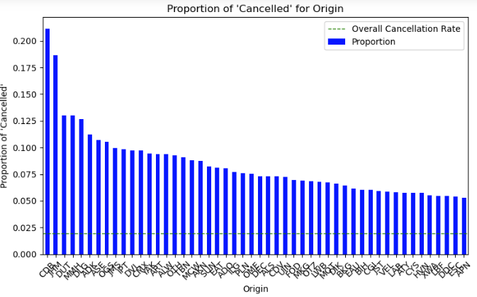
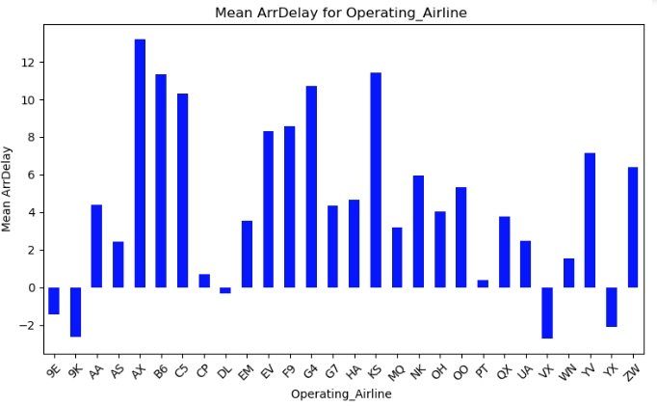
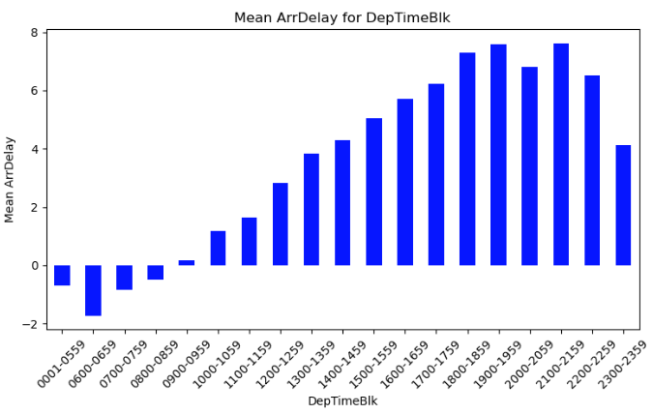
Data Visualization
STAT 628 2024 FALL, MODEL 3, TUESDAY GROUP 4

Slide 7
Cancellation Prediction
Notes:
We would like to predict the cancellation first.

Slide 8
Method Selection
Testing Set Confusion Matrix | Logistic Regression | LightGBM | Random Forest
Raw data
Oversampling |  | Fail to run due to memory issues
1902k
497
1872k
30k
1452k
450k
0
0
0
Actual
Actual
Actual
37k
727
25k
14k
13k
25k
1
1
1
0
1
0
1
0
1
Predicted
Predicted
Predicted
1311k
591k
1794k
108k
0
0
Actual
Actual
11k
27k
26k
12k
1
1
0
1
0
1
Predicted
Predicted
STAT 628 2024 FALL, MODEL 3, TUESDAY GROUP 4
Notes:
We tested three models: logistic regression, LightGBM, and random forest, with both raw data and data after oversampling. Here are their confusion matrices on the test set. When selecting a model, we aim to avoid cases where an actual non-cancellation is predicted as a cancellation—in other words, the top-right value in the confusion matrix. Therefore, we chose to use the logistic regression model with raw data to fit the model.

Slide 9
Logistic Regression Model Using Raw Data
Confusion Matrix
Accuracy for training set: 0.98
Accuracy for testing set: 0.98
ROC-AUC of training set: 0.810
ROC-AUC for testing set: 0.808
Training Set
Testing Set
7606k
1888
1902k
497
0
0
Actual
Actual
150k
3042
37k
727
1
1
0
1
0
1
Predicted
Predicted
STAT 628 2024 FALL, MODEL 3, TUESDAY GROUP 4
Notes:
We achieved a high accuracy on both the training and test sets. However, this is not very convincing due to the data imbalance ratio, which is close to 1:50. We’re more pleased to see the ROC-AUC score exceeding 0.8, meaning it has good capability to distinguish between classes.

Slide 10
Importance Variables
Very Important
Important
Not Important
Airports
Operating Airline
Holiday
Dest Relative Humidity
Origin Relative Humidity
Origin Wind Speed
Dest Wind Speed
Departure Time Block
Origin Visibility
Dest Visibility
Origin Precipitation
Dest Precipitation
Origin Wind Gust Speed
STAT 628 2024 FALL, MODEL 3, TUESDAY GROUP 4

Slide 11
How to avoid cancellation?
Airports
Operating Airline
Origin from JHM: ↑‌ 1920%
Dest to JHM: ↑‌ 1080%
Choose LNY (↓ 44%) and MKK (↓ 73%) instead!
Don’t choose Empire Airlines (EM) & PenAir (KS)!
Choose Air Canada (CP ↓ 83%), Delta (DL ↓ 47%) & Alaska Airlines (VX ↓ 46%)!
Day of Week
Holiday Time
Sat > Sun > Tue > Wed > Fri > Thu > Mon
Around Christmas: ↑‌ 104%
STAT 628 2024 FALL, MODEL 3, TUESDAY GROUP 4
Notes:
说一下和可视化结果一致

Slide 12
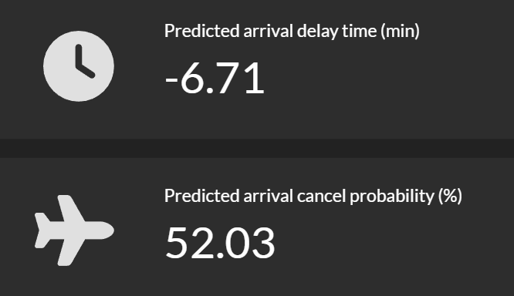
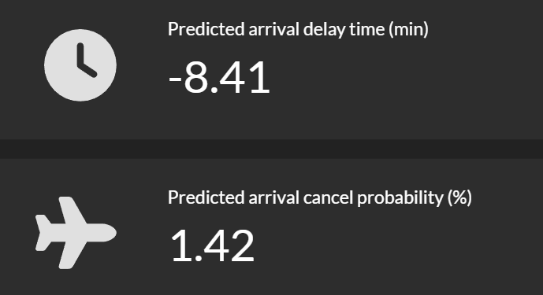

Example: Hawaii → ORD
9E & 2024-11-12 & 12:00PM – 22:30 PM
JHM
MKK
LNY
STAT 628 2024 FALL, MODEL 3, TUESDAY GROUP 4

Slide 13
Delay Prediction

Slide 14
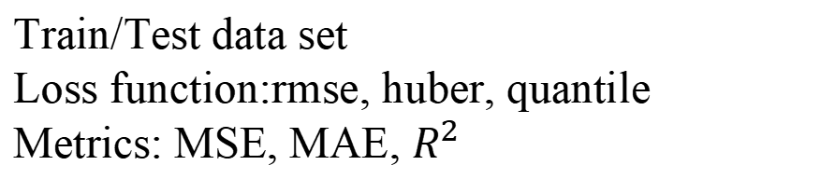
Model Seletion
Train/Test data set
Loss function:rmse, huber, quantile
Metrics: MSE, MAE, $R^{2}$
Models | Performance (TEST MAE) | Training Time | Interpretability
Linear Regression | 23.09 min | Very fast | easy to interpret; can’t handle nan
Random Forest | 23.04 min | Long | capture importance feature ; decision paths are complex
LightGBM | 20.46 min | Very efficient | capture importance feature ; model structure is complex
Netural Network | 23.09 min | Long | black boxes
STAT 628 2024 FALL, MODEL 3, TUESDAY GROUP 4

Slide 15
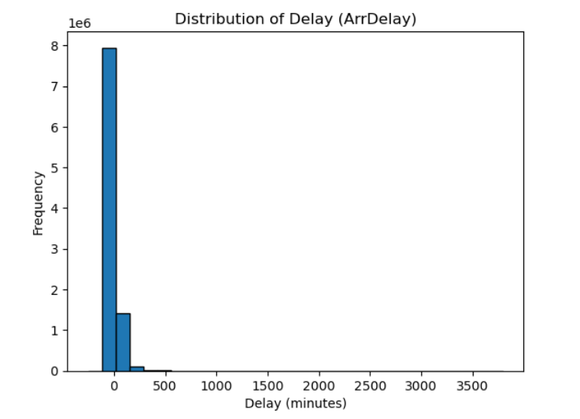
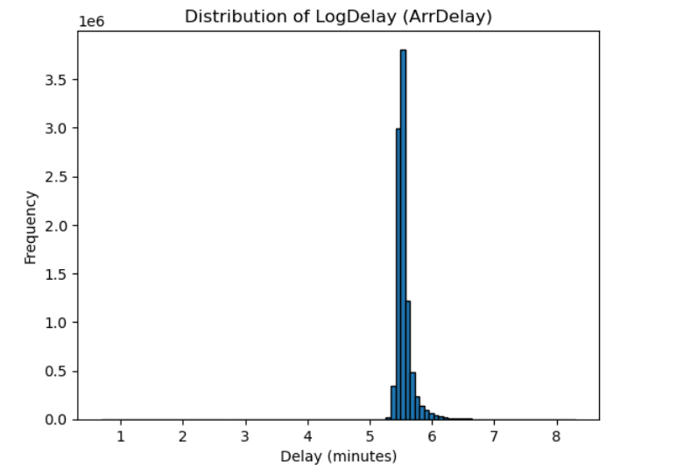
Final Model
LightGBM
Log transform
Huber Loss
RandomizedSearchCV
MAE: 20.46 min
STAT 628 2024 FALL, MODEL 3, TUESDAY GROUP 4

Slide 16
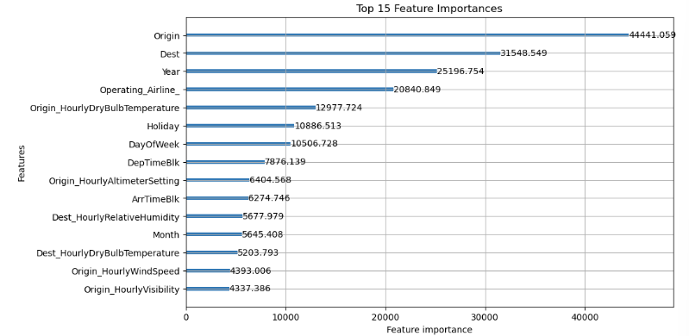
Importance Variables (By SHAP and gain)
Very Important
Moderately Important
Not Important
Origin Airport
Dest Airport
Operating Airline
Tempature
Holiday
DayOfWeek
DepTimeBlk
Distance
Visbility
Precipitation
WindGustSpeed
STAT 628 2024 FALL, MODEL 3, TUESDAY GROUP 4

Slide 17
Interpret
Impact of Origin and Destination on Delay：
Interpreting the impact of origin and destination is challenging and may be influenced by airport congestion levels.
Example: For flights from Chicago to LAX, switching from ORD to MDW shortens delay time by approximately 7.93 minutes. This reduction may be related to lower congestion at MDW compared to ORD.
Impact of Temperature:
Leading to additional procedures like de-icing, increased pre-flight checks, and adjustments in ground operations.
Example:Temperature decreases from 10°C to -10°C, Delay Time Increase 6.74 minutes
STAT 628 2024 FALL, MODEL 3, TUESDAY GROUP 4

Slide 18
Some tips
1.Select airlines with lower delay rates. For example, choosing Delta over JetBlue from ORD toJFK can decrease delay time by around 20 minutes.
2.Travel during non-peak times and avoid holidays. Shifting travel from “Between Thanksgiving and Christmas” to “Around New Year” can increase delays by 15%.
3.Consider weather condition like visibility. A drop in visibility from 20 km to 5 km is associated with a 14.48% increase in delays, according to our model predictions.
4.Plan Departure Times Carefully: Flights after 6 PM and on Sundays or Mondays are more likely to delays.
STAT 628 2024 FALL, MODEL 3, TUESDAY GROUP 4

Slide 19
Summary and shiny

Slide 20


Advantages
For Model
For Data
For Prediction
Hello | We | Are | Group | Four
27 | 47 | NA | 1
47 | 27 | 58 | 94 | 16
66 |  | 26 | 85 | 67
NA
5+ Days
Cluster, Mean ...
Imputation!
Handle input even with NA
Keep more original data
Get real time data
STAT 628 2024 FALL, MODEL 3, TUESDAY GROUP 4

Slide 21
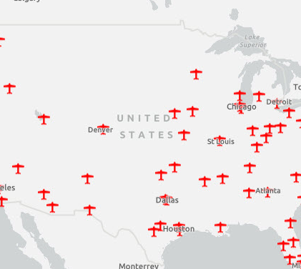
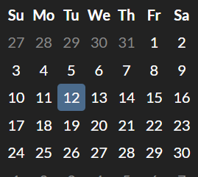


Disadvantage
For Model
For Data
For Prediction
Accuracy is not perfect
Some airports missing
Can't predict far future
STAT 628 2024 FALL, MODEL 3, TUESDAY GROUP 4

Slide 22
Shiny
https://mario2747.shinyapps.io/flightpredict/
STAT 628 2024 FALL, MODEL 3, TUESDAY GROUP 4

Slide 23
Airline prediction
Group 4
Yiteng Tu, Yudi Wang, Yuchen Xu, Mario Ma

