Slide 2
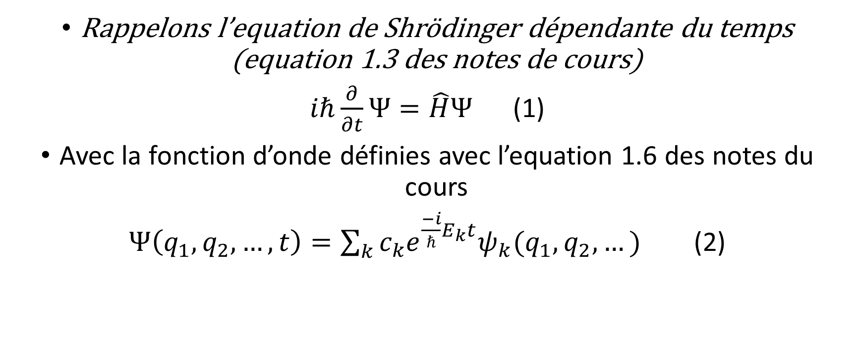
Rappelons l’equation de Shrödinger dépendante du temps (equation 1.3 des notes de cours)
$iℏ\frac{∂}{∂t}Ψ=\hat{H}Ψ$ (1)
Avec la fonction d’onde définies avec l’equation 1.6 des notes du cours
$Ψ\left(q_{1},q_{2},…,t\right)=\sum_{k}{c_{k}e^{\frac{−i}{ℏ}E_{k}t}ψ_{k}(q_{1},q_{2},…)}$ (2)

Slide 3
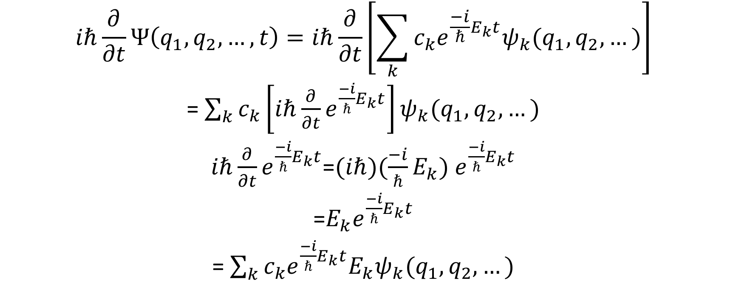
$$iℏ\frac{∂}{∂t}Ψ\left(q_{1},q_{2},…,t\right)=iℏ\frac{∂}{∂t}\left[\sum_{k}{c_{k}e^{\frac{−i}{ℏ}E_{k}t}ψ_{k}(q_{1},q_{2},…)}\right]$$
= $\sum_{k}{c_{k}\left[{iℏ\frac{∂}{∂t}e}^{\frac{−i}{ℏ}E_{k}t}\right]ψ_{k}(q_{1},q_{2},…)}$
${iℏ\frac{∂}{∂t}e}^{\frac{−i}{ℏ}E_{k}t}$=${(iℏ)(\frac{−i}{ℏ}E_{k}) e}^{\frac{−i}{ℏ}E_{k}t}$
=$E_{k}e^{\frac{−i}{ℏ}E_{k}t}$
= $\sum_{k}{c_{k}{e^{\frac{−i}{ℏ}E_{k}t}E_{k}ψ}_{k}(q_{1},q_{2},…)}$

Slide 4
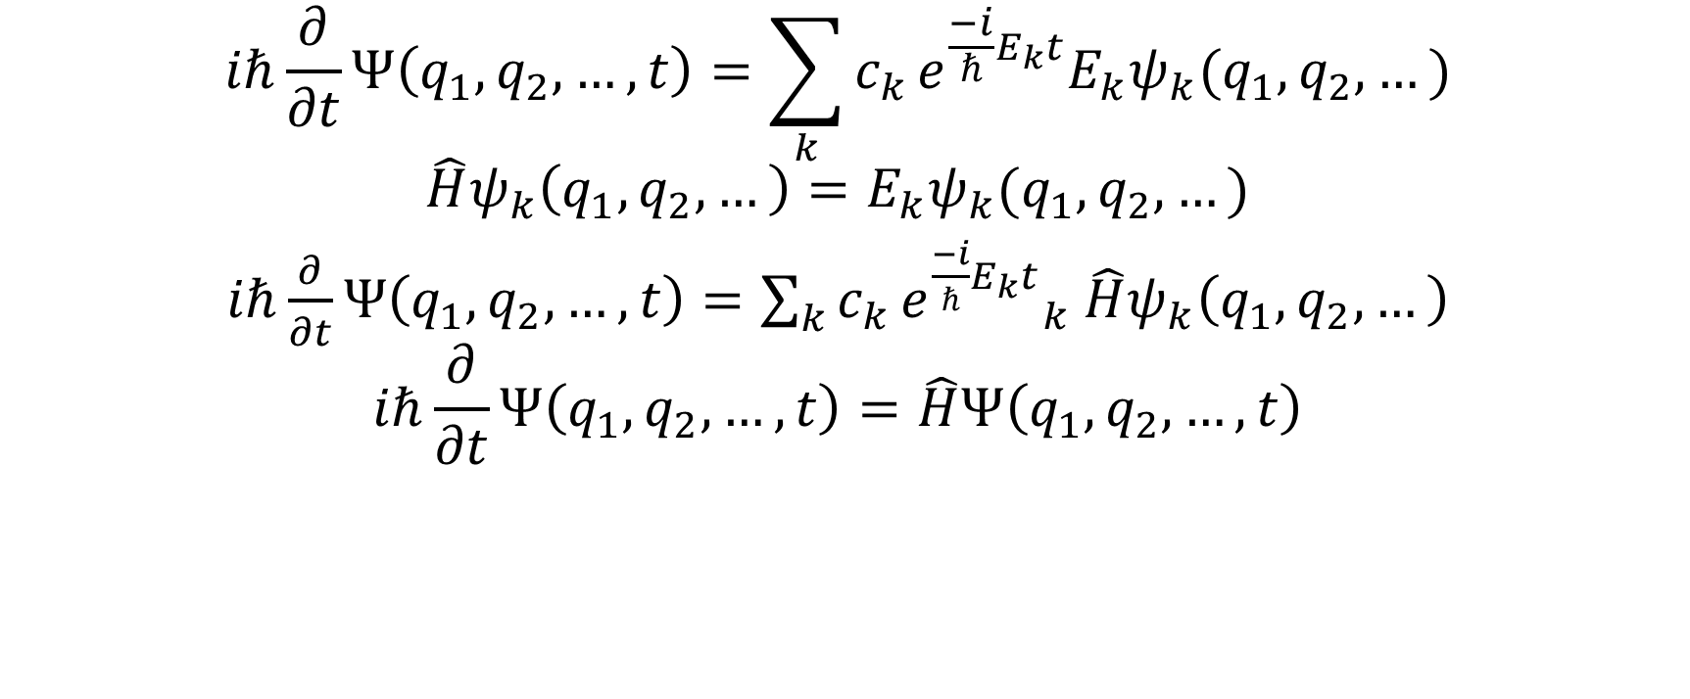
$$iℏ\frac{∂}{∂t}Ψ\left(q_{1},q_{2},…,t\right)=\sum_{k}{c_{k}}{e^{\frac{−i}{ℏ}E_{k}t}E_{k}ψ}_{k}(q_{1},q_{2},…)$$
$$\hat{H}ψ_{k}\left(q_{1},q_{2},…\right)={E_{k}ψ}_{k}(q_{1},q_{2},…)$$
$iℏ\frac{∂}{∂t}Ψ\left(q_{1},q_{2},…,t\right)=\sum_{k}{c_{k}}{e^{\frac{−i}{ℏ}E_{k}t}}_{k}$ ${\hat{H}ψ}_{k}\left(q_{1},q_{2},…\right)$
$$iℏ\frac{∂}{∂t}Ψ\left(q_{1},q_{2},…,t\right)=\hat{H}Ψ\left(q_{1},q_{2},…,t\right)$$

