Slide 1
９章素材置き場
2024/11/26
B4 大江慧成

Slide 2

p264
$π\left(a | s\right)$
$π_{θ}\left(a | s\right)$
$τ=\left(S_{0},A_{0},R_{0},S_{1},A_{1},R_{1},⋯,S_{T+1}\right)$
$G\left(τ\right)=R_{0}+γR_{1}+γ^{2}R_{2}+⋯+γ^{T}R_{T}$

Slide 3
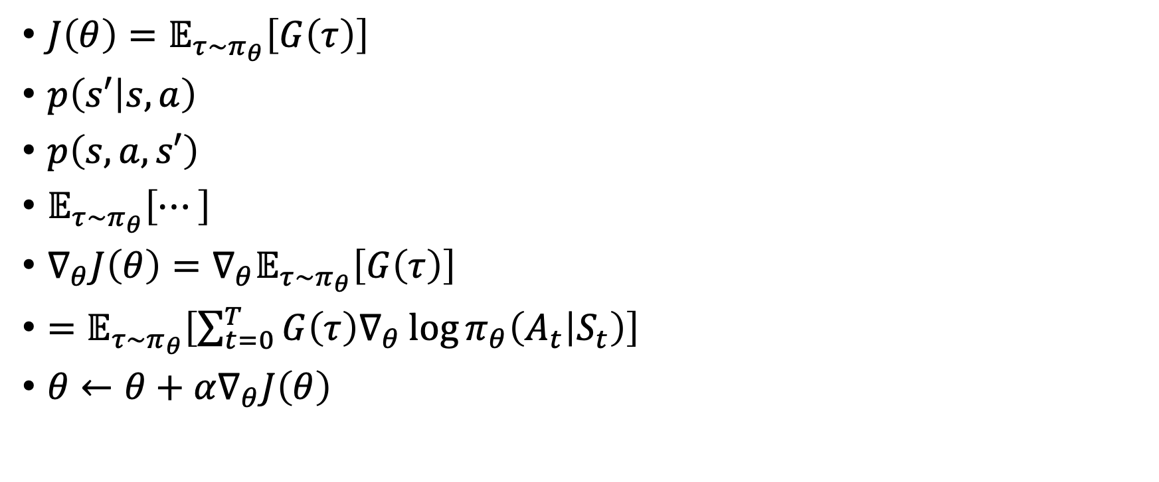
p265
$J\left(θ\right)=𝔼_{τ\sim π_{θ}}\left[G\left(τ\right)\right]$
$p\left(s′ | s,a\right)$
$p\left(s,a,s′\right)$
$𝔼_{τ\sim π_{θ}}\left[⋯\right]$
$∇_{θ}J\left(θ\right)=∇_{θ}𝔼_{τ\sim π_{θ}}\left[G\left(τ\right)\right]$
$=𝔼_{τ\sim π_{θ}}\left[\sum_{t=0}^{T}{G\left(τ\right)∇_{θ}\log{π_{θ}\left(A_{t} | S_{t}\right)}}\right]$
$θ←θ+α∇_{θ}J\left(θ\right)$

Slide 4
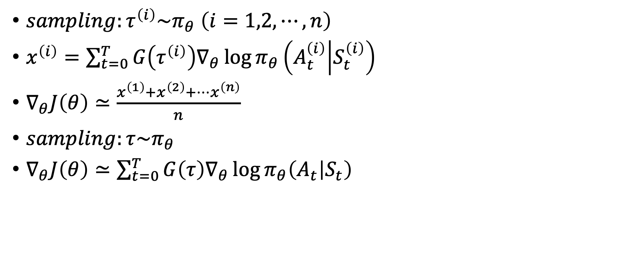
p266
$sampling:τ^{\left(i\right)}\sim π_{θ} \left(i=1,2,⋯,n\right)$
$x^{\left(i\right)}=\sum_{t=0}^{T}{G\left(τ^{\left(i\right)}\right)∇_{θ}\log{π_{θ}\left(A_{t}^{\left(i\right)} | S_{t}^{\left(i\right)}\right)}}$
$∇_{θ}J\left(θ\right)≃\frac{x^{\left(1\right)}+x^{\left(2\right)}+⋯x^{\left(n\right)}}{n}$
$sampling:τ\sim π_{θ}$
$∇_{θ}J\left(θ\right)≃\sum_{t=0}^{T}{G\left(τ\right)∇_{θ}\log{π_{θ}\left(A_{t} | S_{t}\right)}}$

Slide 5








P266-2
$$⋯$$
$$S_{0}$$
$$A_{0}$$
$$S_{1}$$
$$A_{1}$$
$$S_{T}$$
$$A_{T}$$
$$S_{T+1}$$
$$G\left(τ\right)∇_{θ}\log{π_{θ}\left(A_{0} | S_{0}\right)+}G\left(τ\right)∇_{θ}\log{π_{θ}\left(A_{1} | S_{1}\right)}+⋯+G\left(τ\right)∇_{θ}\log{π_{θ}\left(A_{T} | S_{T}\right)}$$

Slide 6

p267
$∇_{θ}\log{π_{θ}\left(A_{t} | S_{t}\right)}=\frac{∇_{θ}π_{θ}\left(A_{t} | S_{t}\right)}{π_{θ}\left(A_{t} | S_{t}\right)}$
$\frac{1}{π_{θ}\left(A_{t} | S_{t}\right)}$
$G\left(τ\right)∇_{θ}\log{π_{θ}\left(A_{t} | S_{t}\right)}$

Slide 7

p268
$y_{i}=\frac{e^{x_{i}}}{\sum_{k=1}^{n}{e^{x_{i}}}}$
$\sum_{i=1}^{n}{y_{i}}=1$

Slide 8

p269
$G\left(τ\right)∇_{θ}\log{π_{θ}\left(A_{0} | S_{0}\right)}$
$π_{θ}\left(A_{0} | S_{0}\right)$
$G\left(τ\right)\log{π_{θ}\left(A_{0} | S_{0}\right)}$

Slide 9
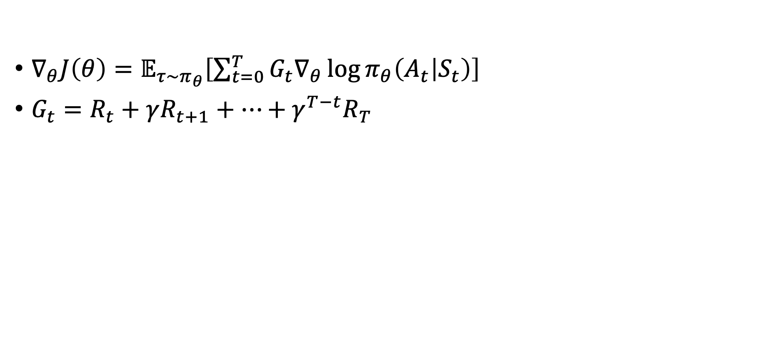
p273
$∇_{θ}J\left(θ\right)=𝔼_{τ\sim π_{θ}}\left[\sum_{t=0}^{T}{G_{t}∇_{θ}\log{π_{θ}\left(A_{t} | S_{t}\right)}}\right]$
$G_{t}=R_{t}+γR_{t+1}+⋯+γ^{T−t}R_{T}$

Slide 10

p274
$∇_{θ}J\left(θ\right)$

Slide 11
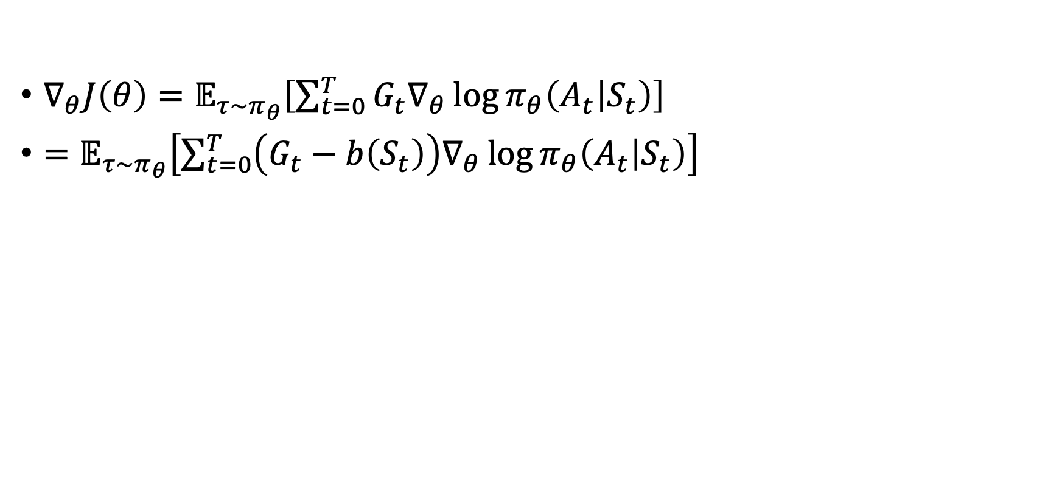
p277
$∇_{θ}J\left(θ\right)=𝔼_{τ\sim π_{θ}}\left[\sum_{t=0}^{T}{G_{t}∇_{θ}\log{π_{θ}\left(A_{t} | S_{t}\right)}}\right]$
$=𝔼_{τ\sim π_{θ}}\left[\sum_{t=0}^{T}{\left(G_{t}−b\left(S_{t}\right)\right)∇_{θ}\log{π_{θ}\left(A_{t} | S_{t}\right)}}\right]$

Slide 12

p278
$b\left(S_{t}\right)=V_{π_{θ}}\left(S_{t}\right)$
$v_{π_{θ}}\left(S_{t}\right)$
$V_{π_{θ}}\left(s\right)=3$

Slide 13

p279
$G−V_{π_{θ}}$
$∇_{θ}J\left(θ\right)=𝔼_{τ\sim π_{θ}}\left[\sum_{t=0}^{T}{\left(G_{t}−b\left(S_{t}\right)\right)∇_{θ}\log{π_{θ}\left(A_{t} | S_{t}\right)}}\right]$

Slide 14

p280
$w$
$V_{w}\left(S_{t}\right)$
$∇_{θ}J\left(θ\right)=𝔼_{τ\sim π_{θ}}\left[\sum_{t=0}^{T}{\left(G_{t}−V_{w}\left(S_{t}\right)\right)∇_{θ}\log{π_{θ}\left(A_{t} | S_{t}\right)}}\right]$

Slide 15






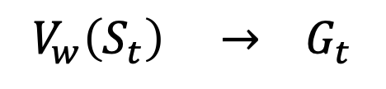


P280-2
【モンテカルロ法】
$$⋯⋯$$
$$S_{t}$$
$$A_{t}$$
$$R_{t}$$
$$S_{t+1}$$
$$A_{T−1}$$
$$R_{T−1}$$
$$S_{T}$$
$$V_{w}\left(S_{t}\right) → G_{t}$$

Slide 16

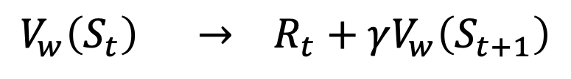


P280-3
【TD法】
$$S_{t}$$
$$A_{t}$$
$$R_{t}$$
$$S_{t+1}$$
$$V_{w}\left(S_{t}\right) → R_{t}+γV_{w}\left(S_{t+1}\right)$$

Slide 17

p281
$V_{w}\left(S_{t}\right)$
$R_{t}+γV_{w}\left(S_{t+1}\right)$
$G_{t}$
$∇_{θ}J\left(θ\right)=𝔼_{τ\sim π_{θ}}\left[\sum_{t=0}^{T}{\left(R_{t}+γV_{w}\left(S_{t+1}\right)−V_{w}\left(S_{t}\right)\right)∇_{θ}\log{π_{θ}\left(A_{t} | S_{t}\right)}}\right]$

Slide 18




p285
状態
ニューラル
ネットワーク
$$1.7$$
平均
$$S$$
$$0.4$$
分散
行動
$$1.82$$
サンプリング
正規分布

Slide 19
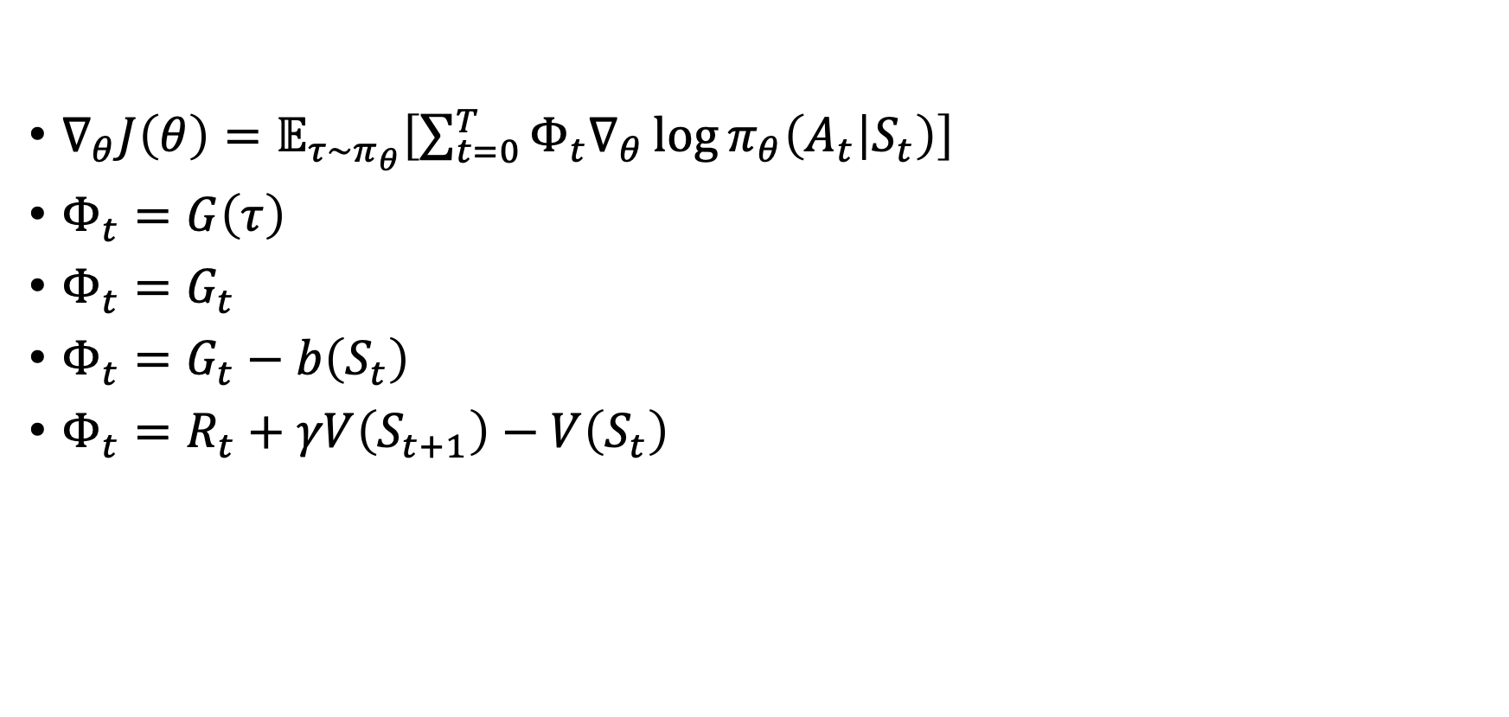
p286
$∇_{θ}J\left(θ\right)=𝔼_{τ\sim π_{θ}}\left[\sum_{t=0}^{T}{Φ_{t}∇_{θ}\log{π_{θ}\left(A_{t} | S_{t}\right)}}\right]$
$Φ_{t}=G\left(τ\right)$
$Φ_{t}=G_{t}$
$Φ_{t}=G_{t}−b\left(S_{t}\right)$
$Φ_{t}=R_{t}+γV\left(S_{t+1}\right)−V\left(S_{t}\right)$

Slide 20

p287
$Φ_{t}=Q\left(S_{t},A_{t}\right)$
$Φ_{t}=Q\left(S_{t},A_{t}\right)−V\left(S_{t}\right)$
$=A\left(S_{t},A_{t}\right)$
$A\left(s,a \right)$

