Slide 1
STUDENT DROPOUT
A Two-Stage Targeting Model for Caldwell University
GROUP 3 | Weimin Wu | Qunfeng Zhou | Mei Qiong Xue | Yufei Cai
05/05/2026
Notes:
30 sec

Slide 2
THE PROBLEM & THE EVIDENCE
25.6%
of Caldwell students withdraw — 115 of 450
The decision
How should the Dean of Student Success allocate finite advising capacity across hundreds of students each term?
A missed at-risk student costs 30x more than a false flag — recall over precision.
Dropout risk by Credit Completion Ratio
Risk concentrates sharply with academic struggle.
< 50% completed
62.3%
50–70%
27.3%
70–85%
14.3%
85%+
3.7%
Notes:
one min

Slide 3
A TWO-STAGE
APPROACH
STAGE 1
Classification
Random Forest screens which students are at elevated risk. Tuned for recall over precision — missing an at-risk student costs 30x more than a false flag.
STAGE 2
Prediction
Linear regression on the 115 dropouts predicts how far along flagged students will be when they leave. Separates urgency tiers so the Dean can match intervention type to expected exit timing.
Notes:
One min

Slide 4
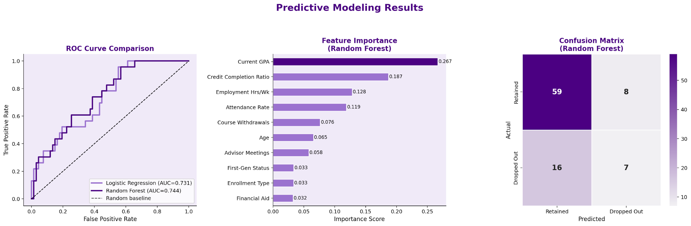
STAGE 1 RESULTS
Accuracy: 73% | Precision: 47% | Recall: 30% ★ optimization target | F1: 0.37 | AUC-ROC: 0.744
AUC = 0.744. Recall = 30% on the dropout class — the optimization target.
Top features: GPA (0.27) and Credit Completion Ratio (0.19) drive 45% of predictive power.
Notes:
Two min

Slide 5
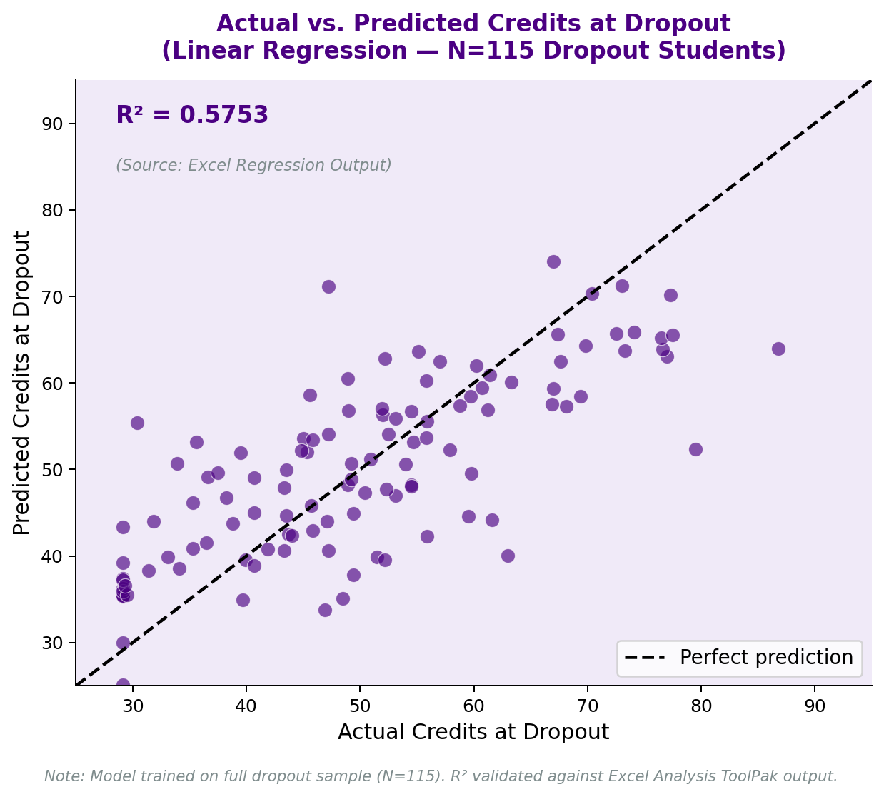
STAGE 2 RESULTS
Two distinct dropout profiles
Splitting at the median (49 credits)
EARLY (n=57)
AVG GPA
2.02
WORK HRS/WK
18.7
→ Academic intervention
LATE (n=58)
AVG GPA
2.47
WORK HRS/WK
25.9
→ Financial / scheduling
Notes:
Two min

Slide 6
RECOMMENDATIONS & STAKEHOLDERS
HIGH-TOUCH
WHO
Early-dropout profiles
ACTION
Tutoring, course-load adjustment, probation review
Weekly contact
Early loss > $15K; fastest ROI
BI-WEEKLY
WHO
Late-dropout profiles
ACTION
Financial aid counseling, flexible enrollment
Bi-weekly meetings
Financial pressure, not GPA
MONITORING
WHO
Lower-risk flagged students
ACTION
Standard advising with risk score visible
Monthly check-in
Preserve capacity for high-risk
STAKEHOLDERS: Dean of Student Success (decision) | Academic Advisors (execution) | Financial Aid & Mentoring (support)
Notes:
Two min

Slide 7
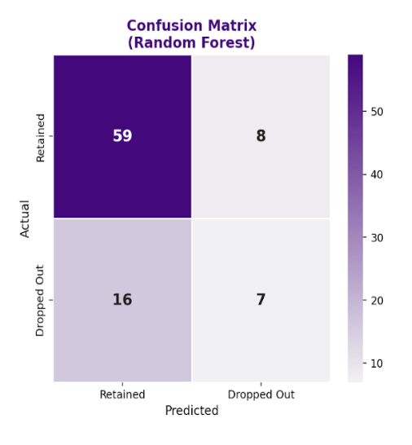
EXPECTED VALUE
EV ON TEST COHORT (n=90)
Three retention scenarios
Based on 7 true positives — 15 students flagged for intervention
Conservative (5% lift) −$2,250
Base (10% lift) +$3,000
Optimistic (20% lift) +$13,500
$15K saved per retained student | $500 outreach cost per flag
Notes:
Two min

Slide 8
MEASUREMENT PLAN
TECHNICAL KPIs
Model performance
Recall, Precision, F1, AUC
Refresh every term to confirm model remains useful as a screening tool
BUSINESS KPIs
Institutional outcomes
Dropout rate in flagged cohort
Retention lift vs. baseline cohort
Cost per retained student
Tuition revenue protected
SMART TARGET: Reduce dropout in flagged cohort by 5pp within one term, with positive EV and 90%+ follow-up rate
Notes:
1 min

Slide 9
RISKS, ETHICS & NEXT STEPS
What this analysis can and cannot do
Analytical limits. Predictive, not causal. Mental health, housing burden, and family obligations are not in the data — omitted-variable bias affects feature interpretation.
Fairness. First-gen students drop out at 35.7% vs 21.6%. Audit the model per term to ensure it does not reinforce the very disparity it’s meant to address.
Governance. The model screens; advisors decide. Every flagged student passes through human review before action.
Next step: Pilot with a randomized control group inside the flagged cohort. Scale only if retention lift and EV are demonstrated.
Notes:
2min

