Slide 1
How to Estimate Body Fat Percentage
Group 8
An Analytical Study on Body Data
Members: Meiyi Yan, Minyuan Zhao, Siyu Wang

Slide 2
01
Introduction

Slide 3
01 Introduction
Goal
Solve the problem: Accurately measuring body fat is expensive
Develop a model: Simple, accurate, and uses easily accessible data to estimate body fat percentage
We consider the multiple linear regression
Data Set
A real data set of 252 men with measurements of their percentage of body fat and various body circumference measurements
IDNO | BODYFAT | DENSITY | AGE | WEIGHT | HEIGHT | ADIPOSITY | NECK | CHEST
ABDOMEN | HIP | THIGH | KNEE | ANKLE | BICEPS | FOREARM | WRIST
Introduction | Data Cleaning | Model Selection

Slide 4
02
Data Cleaning

Slide 5
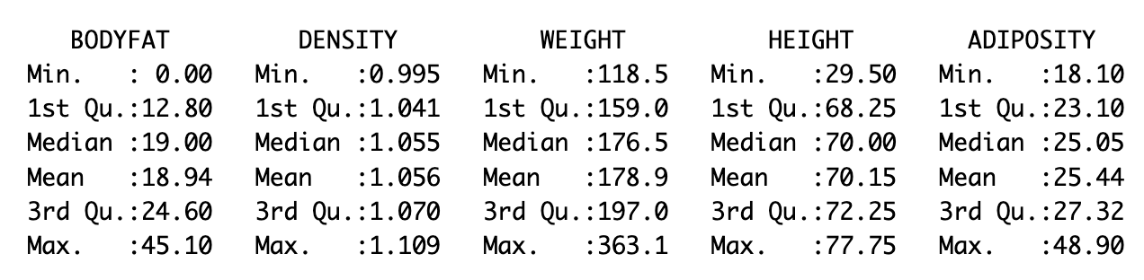
02 Data Cleaning
Characteristics of variables
Findings
Bodyfat(DV): Has two values(ID 172, 182) less than 2%(Essential fat).
Independent Variable: The minimum of height is abnormal(ID 42). Adiposity can be calculated from height and weight.
Measurements: Weight and height are in non-metric units.

Slide 6
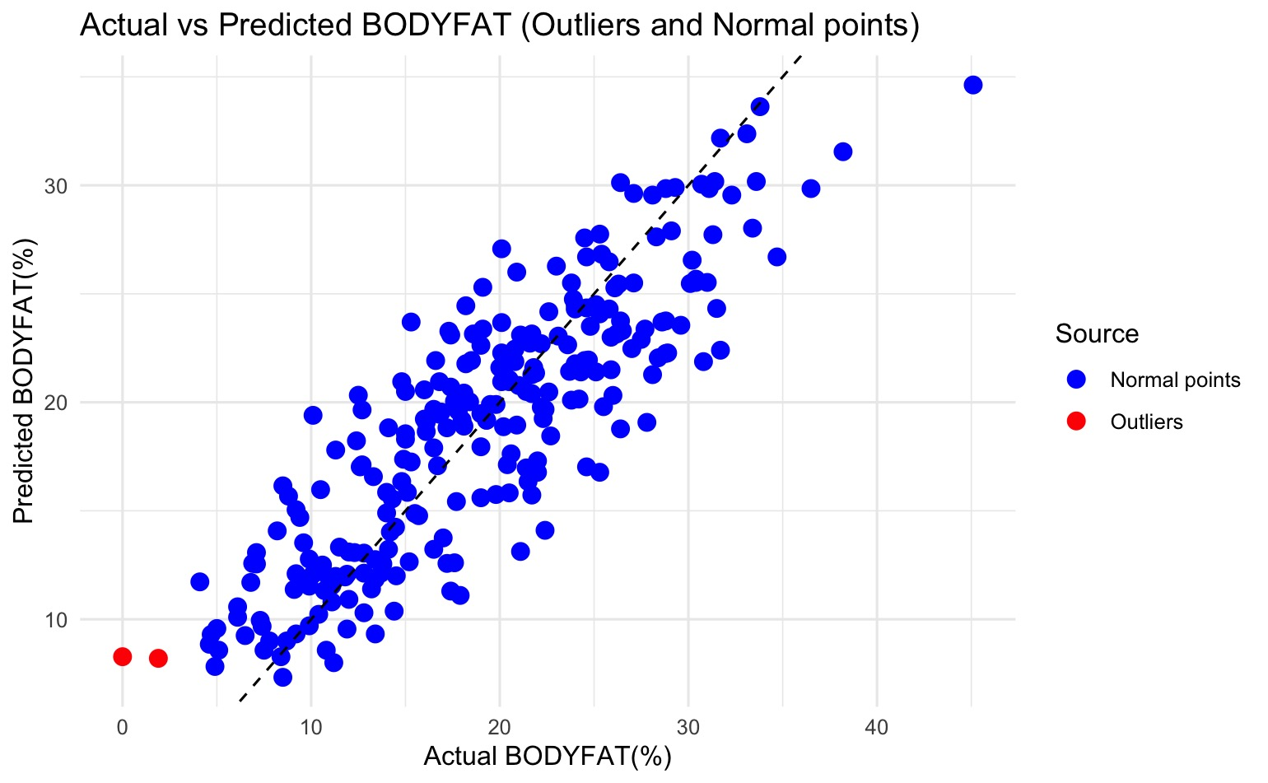
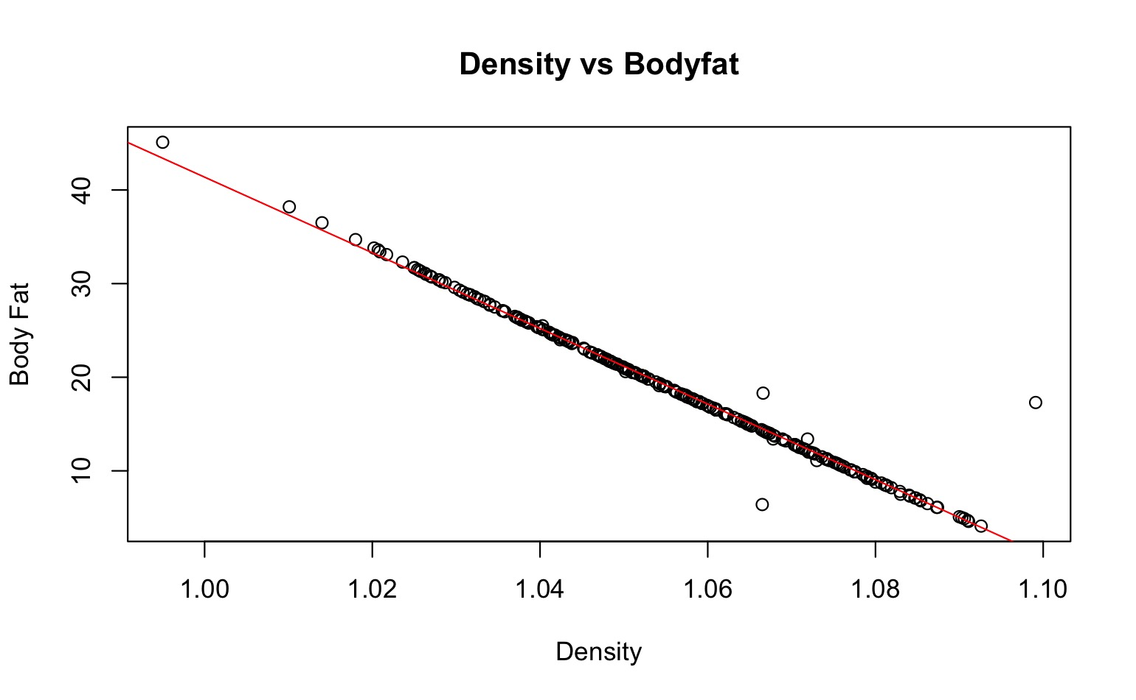
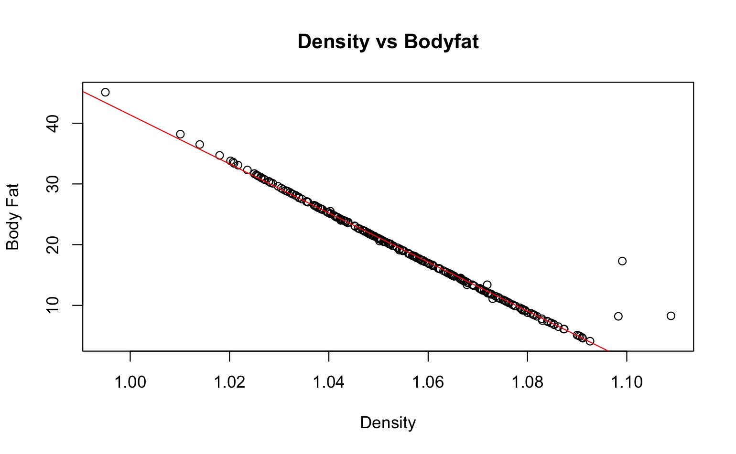
02 Data Cleaning
For Measurements
Convert weight and height to metric units. Use kg and cm.
For Independent Variable
Replace abnormally low height(ID 42) with calculated results from weight and adiposity
Substitute significantly differing adiposity results with those calculated from height and weight(ID 163, 211).
For dependent Variable
Exclude two abnormal values, fit a linear model using density and bodyfat to identify outliers(ID 48, 76).
Impute the two abnormal low bodyfat values(ID 172, 182) using KNN.
Figure 1 Before Imputation
Figure 2 After Imputation
Figure 3 KNN Imputation

Slide 7
03
Model Selection

Slide 8
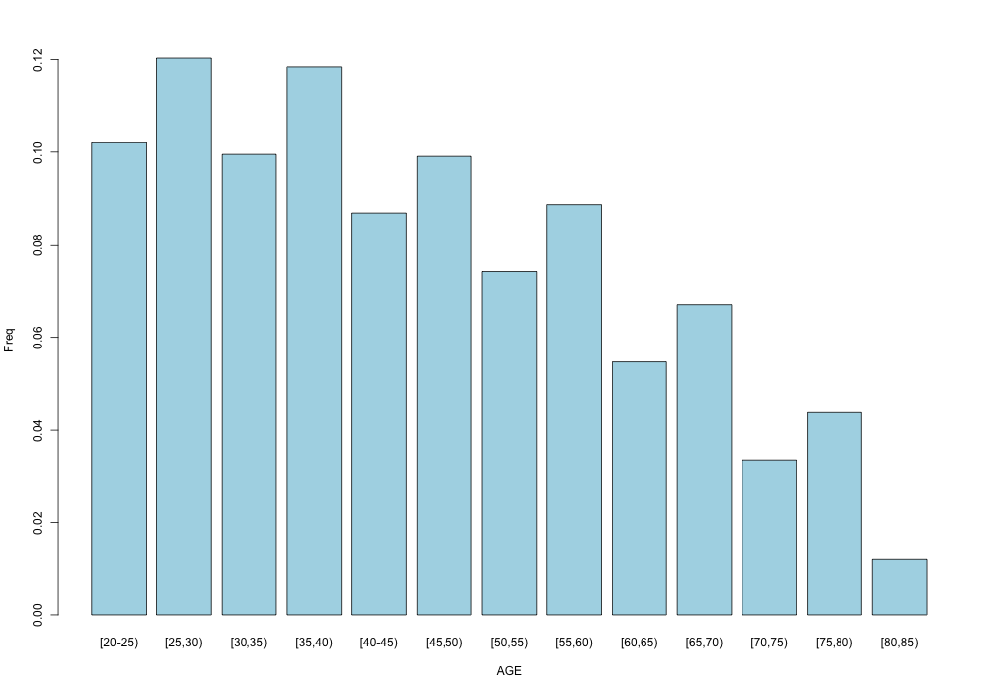
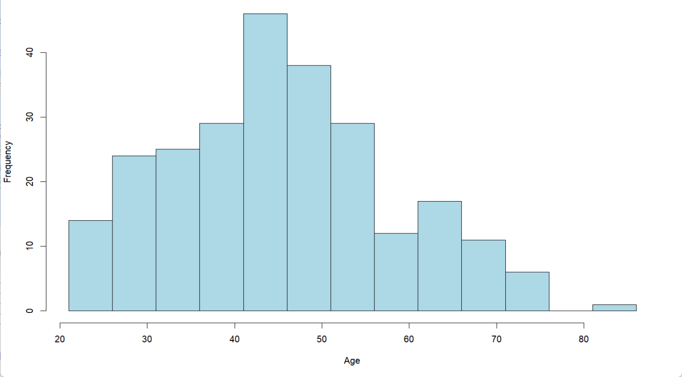

03 Model Selection
4 ways to fit model:
Age Distribution:
Forward selection
Backward selection
Stepwise selection
Lasso regression
Figure 4 Age Distribution of Sample
Figure 5 Age Distribution of World 2024*
* https://population-pyramid.net/
Consider use weighted least squares：
Due to the low response rate in some age groups, we used weighted least squares.
We grouped the data in 5-year intervals and calculated the proportion of each group within the 20-85 range for the sample and real data. The ratio of true to sample proportions was used as weights.
Forward selection
Backward selection
Stepwise selection
$$w\left(x_{i}\right)=\frac{p_{target(x_{i})}}{p_{sample(x_{i})}}$$

Slide 9
03 Model Selection
Select Final Model:
Use leave-one-out cross-validation to calculate the average MSE, and select the model with the smallest MSE based on the checking model assumptions.
Table 1 Choose Model
Model | MSE(LOOCV) | AIC | BIC
LASSO | 17.9561 | 717.5898 | 738.7663
OLS (Backward) | 15.9935 | 1412.9470 | 1455.3002
OLS (Forward) | 16.0438 | 1414.0327 | 1438.7387
OLS (Stepwise) | 15.9935 | 1414.0327 | 1438.7387
Weighted(Backward) | 16.2674 | 1459.9384 | 1484.6444
Weighted (Forward) | 16.6847 | 1459.3374 | 1484.0434
Weighted (Stepwise) | 16.2674 | 1459.3374 | 1484.0434
VIF for OLS (Backward)
AGE | ADIPOSITY | NECK | ABDOMEN | HIP | THIGH | FOREARM | WRIST | WEIGHT_inkg | HEIGHT_incm
2.099096 | 194.651748 | 4.269216 | 11.691448 | 14.069689 | 6.568962 | 2.009225 | 3.124204 | 237.556162 | 50.812141

Slide 10
04
Final Model

Slide 11
04 Final Model
Final Model:
$$bodyfat=−25.02+0.92abdomen−0.25weight_{inkg}−1.16wrist+0.47forearm−0.36neck+ε$$
Example Usage:
A man with 88.6cm abdomen, 89.92kg, 19.2cm wrist, 30cm forearm and 42.1cm neck is expected to have a body fat % of 11.23%, while the real data is 12%. His 95% prediction interval is between 9.62% and 12.84%.
Interpret Model：
Our estimated coefficients are -25.02, 0.92, -0.25, -1.16, 0.47, and -0.36, in the units of %, cm, kg, cm, cm, and cm.
For instance, the coefficient for wrist is -1.16, meaning that for every 1 cm increase in wrist circumference, body fat percentage is predicted to decrease by 1.16 percentage points, holding other variables constant.

Slide 12
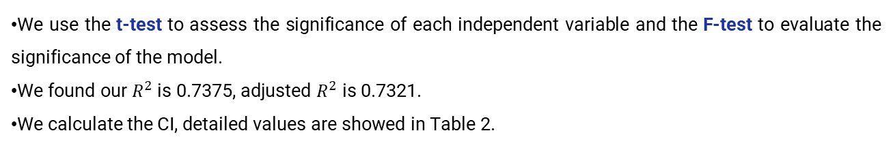
04 Final Model
Hypothesis Testing:
We use the t-test to assess the significance of each independent variable and the F-test to evaluate the significance of the model.
We found our $R^{2}$ is 0.7375, adjusted $R^{2}$ is 0.7321.
We calculate the CI, detailed values are showed in Table 2.
Table 2 Hypothesis Testing Results
 | Estimate | Std.Error | t value | 2.5% | 97.5% | P-value
(Intercept) | -25.01713 | 6.96761 | -3.59 | -38.7409 | -11.2933 | 0.000398 | ***
ABDOMEN | 0.92274 | 0.05129 | 17.991 | 0.8217 | 1.0238 | < 2E-16 | ***
WEIGHT_inkg | -0.24749 | 0.05189 | -4.77 | -0.3497 | -0.1453 | 3.16E-06 | ***
WRIST | -1.15995 | 0.4262 | -2.722 | -1.9994 | -0.3205 | 0.006961 | **
FOREARM | 0.46668 | 0.16745 | 2.787 | 0.1369 | 0.7965 | 0.005737 | **
NECK | -0.35585 | 0.20157 | -1.765 | -0.7529 | 0.0412 | 0.078747 | .
Signif. codes: 0 ‘***’ 0.001 ‘**’ 0.01 ‘*’ 0.05 ‘.’ 0.1 ‘ ’ 1
F-statistic: 138.2 on 5 and 246 DF, p-value: < 2.2e-16

Slide 13
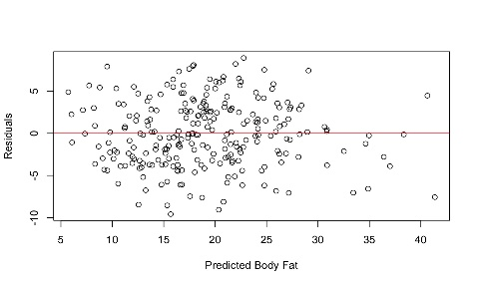
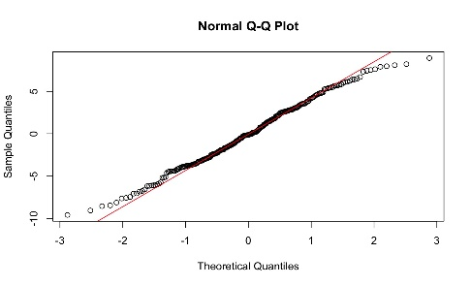
04 Final Model
Residuals:
Our model satisfies the assumptions of MLR as the residuals plot confirmed both linearity and homoscedasticity, the Q-Q plot validated the normality of residuals.
Figure 6 Residual plot
Figure 7 Residual QQ plot
Collinearity:
The VIF test showed no multicollinearity problem among the variables. The biggest VIF is 7.7398, which is smaller than 10.
VIF for OLS (Forward)
ABDOMEN | WEIGHT_inkg | WRIST | FOREARM | NECK
4.947962 | 7.739761 | 2.561036 | 1.852125 | 3.884095

Slide 14

04 Final Model
Strengths:
Our model includes five easily measurable variables, making it simple and interpretable. It satisfies the assumptions of homoscedasticity and no multicollinearity, supporting the validity of our results in predicting body fat.
Weakness:
Our model may overfit, relies on linear relationships, and struggles with extreme low body fat values.
Future Work:
Handling Extreme Body Fat Values: We will explore local regression for better handling.
Conclusion:
Based on data cleaning, we choose to perform multiple linear regression with forward selection to obtain a simple and effective model that includes five independent variables.
Shiny App: https://uw-madison-stat628-project2-mci.shinyapps.io/stat628_project2/
https://www.verywellhealth.com/body-fat-percentage-chart-8550202

Slide 15
Thank you for listening!

