Slide 1
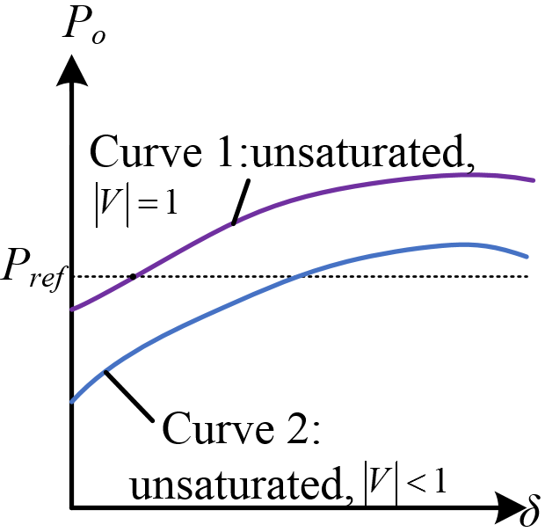
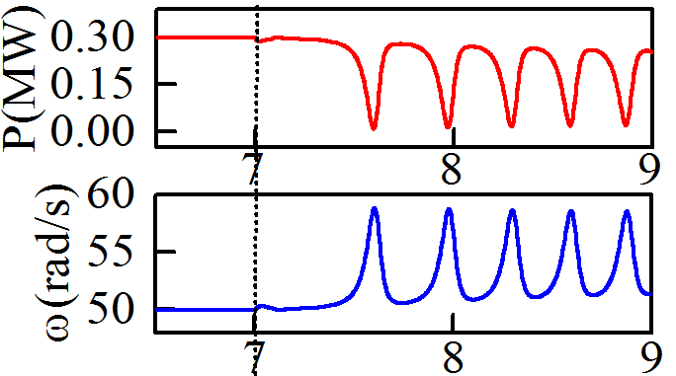
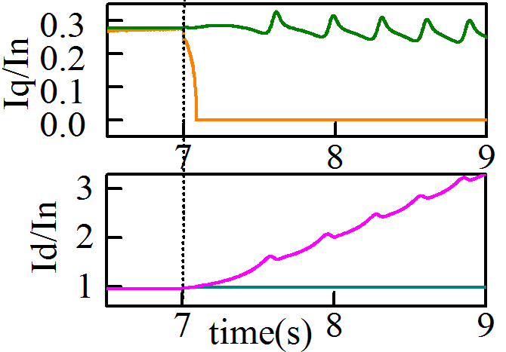
Curve 3,4,5:saturated,
Curve 3,4,5:saturated,
stable
unstable
C
A
E
A
D
D
C
B
B
simulation results: unstable
Notes:
Once the current limit activates, the output current of VSG-IIDG is identically equal to Imax. Then the VSG-IIDG turns into a current source. And the power-angle curve is like this. increasing power factor angle leads to translation of the curve to the right. Compared to the power angle curve without saturation, Part of the power-angle curve becomes inaccessible with saturation because the output current cannot exceed Imax. However, it should be pointed out that the d-axis current and q-axis current are still time-varying, the operating point will not just go along the saturated curve 3 but also curve 4 and 5 WITH DIFFERENT power factor angle . In other words, the control system can still regulate the output by adjusting the power factor angle , but in an uncontrollable way. The system can be stable if desaturation happens and the system will operate at point E. Or, the system may be unstable due to saturation of the controller and continuously rising deviations in the output current.

Slide 2
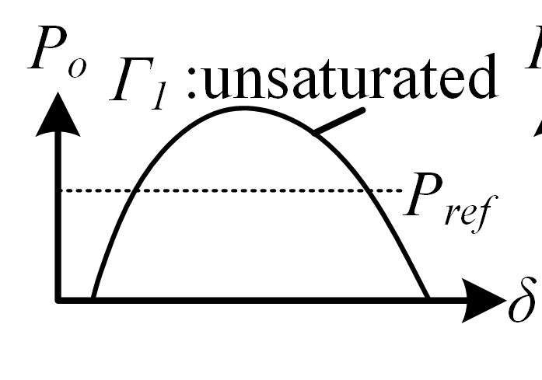
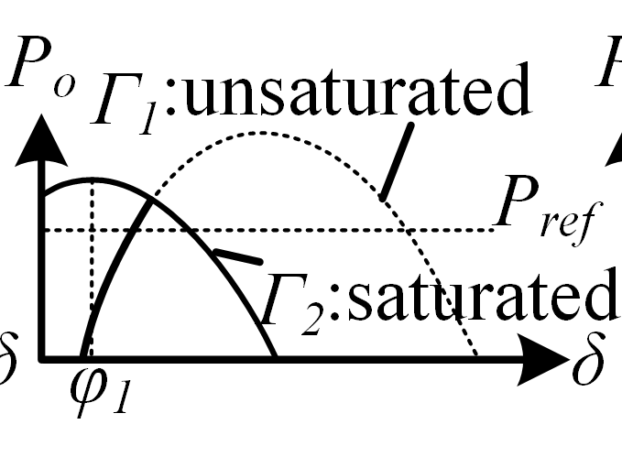
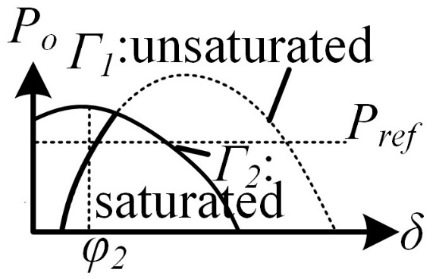
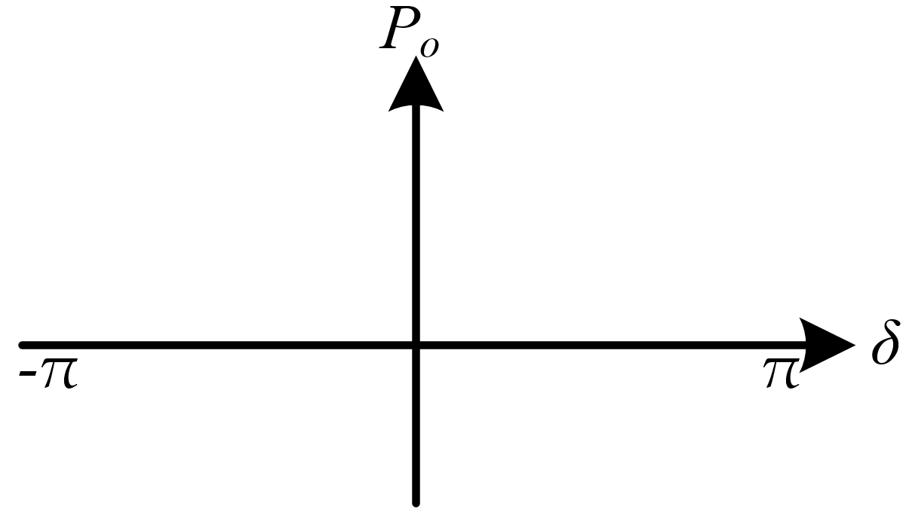

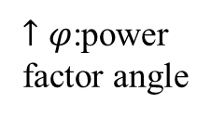
1)without saturation
2)with saturation
3)with large $φ$
power-angle characteristics
$↑φ$:power factor angle
current
source!
3
2
3
2
2
1
3
1
1
Notes:
Once the current limit activates, the output current of VSG-IIDG is identically equal to Imax. Then the VSG-IIDG turns into a current source. And the power-angle curve is like this. increasing power factor angle leads to translation of the curve to the right. Compared to the power angle curve without saturation, Part of the power-angle curve becomes inaccessible with saturation because the output current cannot exceed Imax. However, it should be pointed out that the d-axis current and q-axis current are still time-varying, the operating point will not just go along the saturated curve 3 but also curve 4 and 5 WITH DIFFERENT power factor angle . In other words, the control system can still regulate the output by adjusting the power factor angle , but in an uncontrollable way. The system can be stable if desaturation happens and the system will operate at point E. Or, the system may be unstable due to saturation of the controller and continuously rising deviations in the output current.

