Slide 1

ISyE 7406 Project
Walmart Trip Type Classification
Xianghui Gu, Jiaye Liu, Yang Wu, Chenwei Yue

Slide 2
What is
TRIP TYPE?
Observation
TripType_40:
Bought many (more than 10) items in DSD grocery, grocery dry goods, dairy per visit
TripType_5:
Bought pharmacy at Department of Pharmacy RX
A categorical id representing the type of shopping trip the customer made. (TripType_999 is an "other" category.)

Slide 3
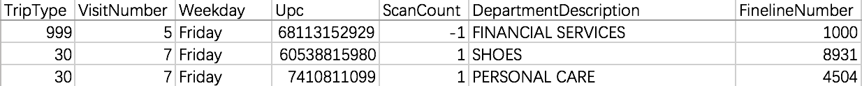
Candidate Variables
VisitNumber - an id corresponding to a single trip by a single customer
Weekday - the weekday of the trip
Upc - the UPC number of the product purchased
ScanCount - the number of the given item that was purchased. A negative value indicates a product return.
DepartmentDescription - a high-level description of the item's department
FinelineNumber - a more refined category for each of the products, created by Walmart

Slide 4
Descriptive
Stats

Slide 5
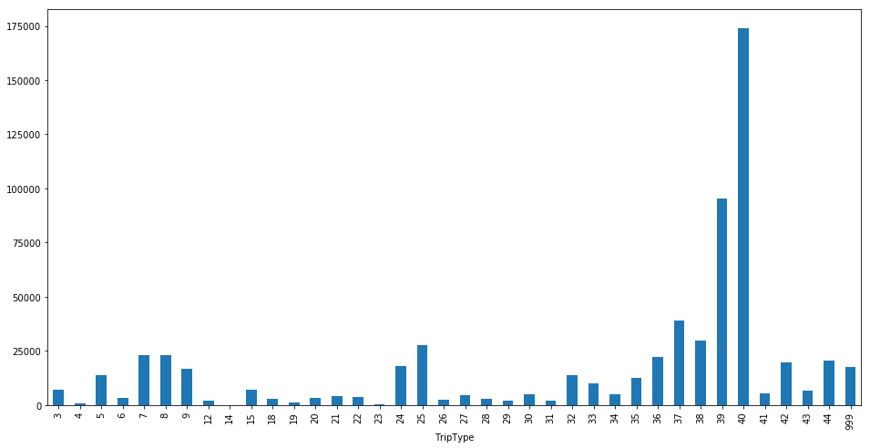
Trip Type Distribution
(#records vs trip type)

Slide 6
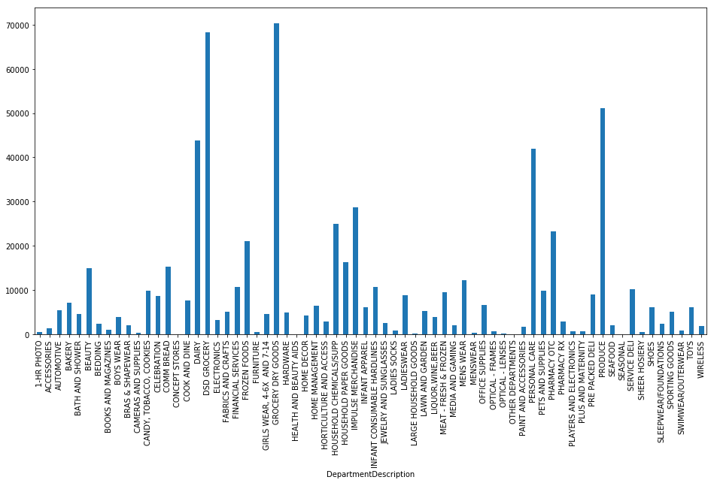
Department Distribution
(#records vs Dept)

Slide 7
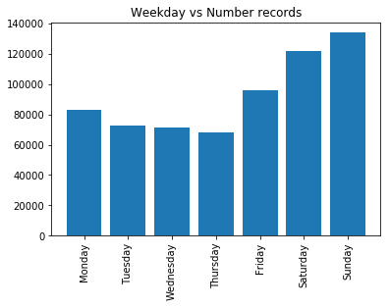
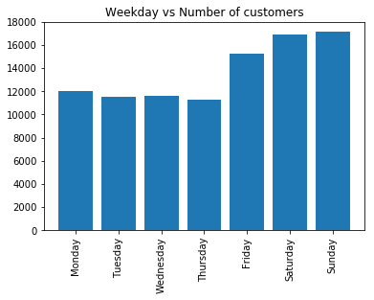
Weekday Distribution

Slide 8
Data
Preprocessing

Slide 9
More Variables
We need more variables to reflect the properties of one visit.
Per visit
Distinct Count:
E.g. How many different departments have you visited in this trip?
Sum:
E.g.
How many products have you bought in this department in this trip?
How many products have you returned in this trip?

Slide 10
More Variables
We convert Weekday and Department from String to Boolean Vector using one-hot presentation.
One-hot presentation
E.g. In Weekday,
“Friday”: [0, 0, 0, 0, 0, 1, 0]

Slide 11
Flow Chart
Start
Drop rows with missing Upc
Count unique
#Upc, #Dept, #fineline
per visit
Change Dept and Weekday to one-hot presentation
Combine similar
Departments
Save
Count items under this Dept / fineline per visit
Compute #buy & #return per visit
Sum item count
per visit

Slide 12
Models
KNN, Logistic Reg,
Random Forest, XGboost

Slide 13
Model 1 —— K-Nearest Neighbors
Advantage
Simple and intuitive classifier that works well on basic recognition problems
Robust to noisy training data especially if weighted distance is used
Parameters
Weight: “uniform” vs “distance”
Distance: Euclidean vs Manhattan

Slide 14
Model 2 —— Logistic Regression
Advantage
Able to handle nonlinear effects since it does not assume a linear relationship
More control on interaction and degrees
Less constraints on normality and equal variance
Parameters
Multi_class: 'ovr' (uses the one-vs-rest (OvR) scheme)
Penalty : L1 regularization
Notes:
It does not assume a linear relationship between the independent variables and dependent variable, so it may handle nonlinear effects.
The independent variables don’t have to be normally distributed, or have equal variance in each group.
We can add explicit interaction and power terms to improve the accuracy of our models.

Slide 15
Model 3 —— Random Forest
Advantage
Able to handle thousands of input variables without variable selection
Effective in estimating missing data with high accuracy when a large proportion of the data are missing.
Informative of the relation between the variables and the classification.
Parameters
Notes:
It can handle thousands of input variables without variable deletion.
It has an effective method for estimating missing data and maintains accuracy when a large proportion of the data are missing.
Prototypes are computed that give information about the relation between the variables and the classification.

Slide 16
Model 4 —— XGBoost
Advantage
Reduce overfitting by regularization
Prune tree by splitting into max_depth instead of negative loss in the split
Built-in cross-validation
Parameters
Notes:
Regularization:
Standard GBM implementation has no regularization like XGBoost, therefore it also helps to reduce overfitting.
In fact, XGBoost is also known as ‘regularized boosting‘ technique.
Parallel Processing:
XGBoost implements parallel processing and is blazingly faster as compared to GBM.
But hang on, we know that boosting is sequential process so how can it be parallelized? We know that each tree can be built only after the previous one, so what stops us from making a tree using all cores? I hope you get where I’m coming from. Check this link out to explore further.
XGBoost also supports implementation on Hadoop.
High Flexibility
XGBoost allow users to define custom optimization objectives and evaluation criteria.
This adds a whole new dimension to the model and there is no limit to what we can do.
Handling Missing Values
XGBoost has an in-built routine to handle missing values.
User is required to supply a different value than other observations and pass that as a parameter. XGBoost tries different things as it encounters a missing value on each node and learns which path to take for missing values in future.
Tree Pruning:
A GBM would stop splitting a node when it encounters a negative loss in the split. Thus it is more of a greedy algorithm.
XGBoost on the other hand make splits upto the max_depth specified and then start pruning the tree backwards and remove splits beyond which there is no positive gain.
Another advantage is that sometimes a split of negative loss say -2 may be followed by a split of positive loss +10. GBM would stop as it encounters -2. But XGBoost will go deeper and it will see a combined effect of +8 of the split and keep both.
Built-in Cross-Validation
XGBoost allows user to run a cross-validation at each iteration of the boosting process and thus it is easy to get the exact optimum number of boosting iterations in a single run.
This is unlike GBM where we have to run a grid-search and only a limited values can be tested.
Continue on Existing Model
User can start training an XGBoost model from its last iteration of previous run. This can be of significant advantage in certain specific applications.
GBM implementation of sklearn also has this feature so they are even on this point.

Slide 17
Prediction
Output
Dimension reduction
Upc decoding
Combination of classifiers
Results

Slide 18
Future Work
Dimension reduction
Upc decoding
Combination of classifiers

