Slide 1
TASK 1 • INDIVIDUAL CAPSTONE
FinSecure Pay: application and test evidence
Business need: release a transaction validation API reliably through automated quality gates
Application source: app.py
Build 27 console excerpts
@app.get("/health")
def health():
"""Return a JSON liveness status and HTTP 200 without checking dependencies."""
return {"status": "ok"}, 200
#12 naming to docker.io/library/
finsecure-pay-test:27 done
#12 DONE 2.9s
+ docker run --rm finsecure-pay-test:27
collecting ... collected 39 items
Field-validation response (lines 76–79)
errors = validate_transaction_payload(body)
if errors:
response = jsonify({"valid": False, "errors": errors})
return response, 400
39 passed in 0.37s
Nonblank IDs, finite numeric amounts in (0, 10000], and SGD/USD/EUR currencies. Invalid JSON, fields, and content types are tested.
Transaction dataclass
transaction_id: str
account_id: str
amount: float
currency: str
GitHub repository and feature-branch history
Chua Mei Yun • 2 November 2026
FINSECURE PAY
01
Notes:
Individual capstone by Chua Mei Yun. The application validates payloads only and neither executes payments nor stores transactions. Source excerpts reproduce app.py lines 50–53 and 76–79, with indentation removed in the second excerpt. The Transaction fields come from transaction.py. Build/test log snippets reproduce selected lines from Jenkins build 27. The line break after docker.io/library/ is for display only. All 39 tests passed in that historical run, not a newly generated test result. Test coverage includes amounts, currencies, IDs, missing fields, malformed and non-object JSON, and media type. Booleans are invalid amounts.
Public repository: https://github.com/meiyun1995/capstone-finpay-cicd
Final implementation on main: https://github.com/meiyun1995/capstone-finpay-cicd/tree/main
Source: app.py
Source: transaction.py
Source: tests/test_app.py
Source: screenshots/task 5/trivy_success_console_output.txt

Slide 2
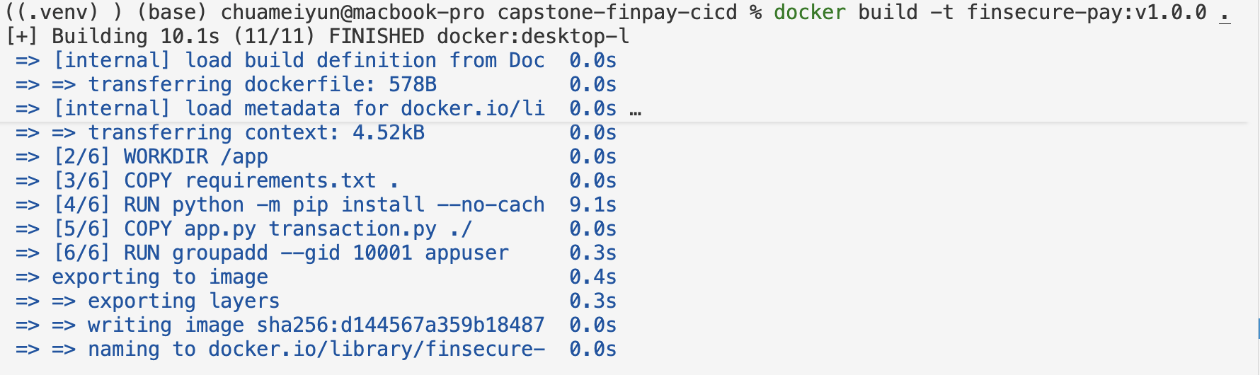
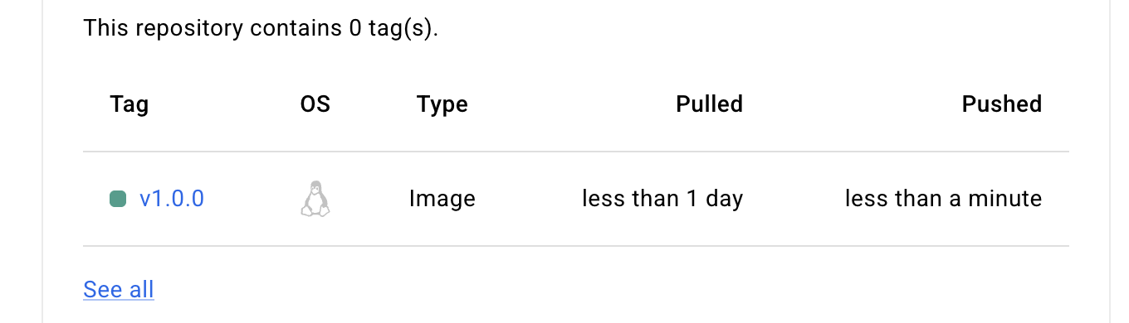
TASK 2
Dockerfile image version and container execution
The current image uses a pinned Alpine base and a non-root Gunicorn process
Current Dockerfile
Successful image build
FROM python:3.12-alpine@sha256:e6dae589c1c05976188fd3bd019afd091445fc533ed2ea29001beddc7368a9c8
WORKDIR /app
ENV PYTHONDONTWRITEBYTECODE=1
ENV PYTHONUNBUFFERED=1
COPY requirements.txt .
RUN python -m pip install --no-cache-dir -r requirements.txt
COPY app.py transaction.py ./
RUN addgroup -S -g 10001 appuser \
&& adduser -S -D -H -u 10001 -G appuser \
-s /sbin/nologin appuser
USER appuser
EXPOSE 8000
CMD ["python", "-m", "gunicorn", "--bind", "0.0.0.0:8000", "--access-logfile", "-", "app:app"]
Versioned local image
Docker Hub registry: v1.0.0
Blank lines removed and long lines wrapped for display.
Running container: docker ps
FINSECURE PAY
02
Notes:
The Dockerfile is the current repository file, reproduced with blank lines removed and line wrapping only. It pins the official Python 3.12 Alpine base by its full SHA-256 digest, installs requirements, runs as UID/GID 10001, exposes 8000, and launches Gunicorn. The task 2 build/local image/registry/docker ps screenshots show the earlier Debian-based v1.0.0 release. Do not infer that those historical screenshots used the later Alpine base. The Alpine migration is shown on slides 6–7. Image is the build artifact; container is its running instance. The docker ps screenshot records an Up container and host 127.0.0.1:8080 forwarded to container port 8000.
Docker Hub: https://hub.docker.com/r/cmyaa/finsecure-pay/tags
Source: Dockerfile
Source: screenshots/task 2/success_build_image.png
Source: screenshots/task 2/image_listing.png
Source: screenshots/task 2/image_running.png
Source: screenshots/task 2/docker_hub_repo.png
Source: screenshots/task 2/health_response_user_identity.png

Slide 3
TASK 3
AKS manifests and health probes
Baseline manifest: v1.0.0. Jenkins injects build-N for releases. Complete YAML files are linked below.
Deployment
Readiness and liveness
ConfigMap
apiVersion: apps/v1
kind: Deployment
metadata:
name: finsecure-pay
spec:
replicas: 2
readinessProbe:
httpGet:
path: /health
port: 8000
initialDelaySeconds: 5
periodSeconds: 5
timeoutSeconds: 2
failureThreshold: 3
livenessProbe:
httpGet:
path: /health
port: 8000
initialDelaySeconds: 15
periodSeconds: 10
timeoutSeconds: 2
failureThreshold: 3
apiVersion: v1
kind: ConfigMap
metadata:
name: finsecure-pay-config
data:
PYTHONUNBUFFERED: "1"
PYTHONDONTWRITEBYTECODE: "1"
Container settings
LoadBalancer Service
name: finsecure-pay
image: cmyaa/finsecure-pay:v1.0.0
ports:
- containerPort: 8000
envFrom:
- configMapRef:
name: finsecure-pay-config
apiVersion: v1
kind: Service
metadata:
name: finsecure-pay-service
spec:
type: LoadBalancer
selector:
app: finsecure-pay
ports:
- protocol: TCP
port: 80
targetPort: 8000
FINSECURE PAY
03
Notes:
These are selected, verbatim repository excerpts, with common indentation removed for display. Complete files are linked from the section labels. The Deployment excerpt preserves the original v1.0.0 image in the manifest. Jenkins replaces the image in a temporary rendered manifest with build-N during deployment. The Service selector matches the pod label app=finsecure-pay. Port 80 forwards to 8000. ConfigMap contains only non-sensitive Python runtime settings. Both probes request /health on 8000. Readiness initial delay/period/timeout/failure threshold = 5s/5s/2s/3. Liveness = 15s/10s/2s/3. Full manifest also configures CPU/memory requests and limits. Cluster is managed Azure AKS in East Asia, one Standard_D4s_v5 worker node. Two pods on one worker do not provide node-level high availability.
Source: k8s/deployment.yaml
Source: k8s/service.yaml
Source: k8s/configmap.yaml
Source: README.md

Slide 4
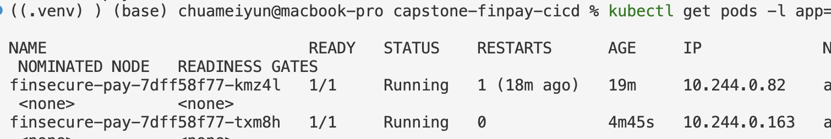
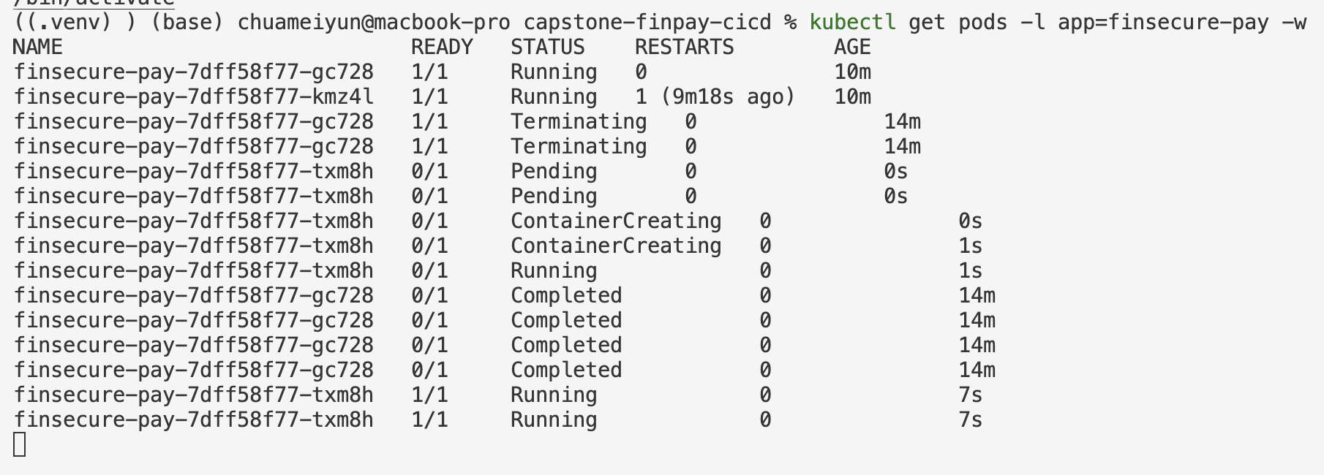
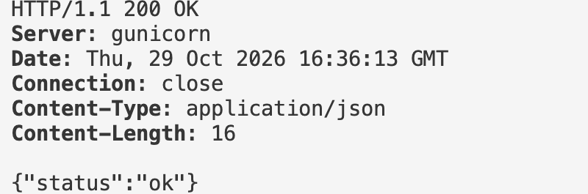
TASKS 3 AND 4
Cloud access automatic recovery and release rollback
Managed AKS runs two ready pods and replaces a deleted pod automatically
Two Running / Ready pods
Deleted pod replaced automatically
External application access
57.158.99.15/health
HTTP 200
{"status":"ok"}
New pod txm8h reached 1/1 Ready at about 7 seconds.
Forward rollout: build-17
Rollback: restored build-15
deployment "finsecure-pay" successfully rolled out
finsecure-pay 2/2
cmyaa/finsecure-pay:build-17
rollout undo --to-revision=2 completed successfully.
FINSECURE PAY
04
Notes:
Task 3 evidence: final_pod_state.png shows both pods 1/1 Running. health_output.png records a real external request to http://57.158.99.15/health with HTTP 200 and JSON status ok. after_disruption_new_pod_creation.png records old pod gc728 Terminating and new pod txm8h Pending/ContainerCreating/Running, then 1/1 at 7s. This establishes automatic pod replacement. It does not establish node-level HA or a zero-downtime guarantee.
Forward rollout excerpts come from screenshots/task 4/reverted_build_success_console_output.txt: Jenkins set the local manifest image to build-17, applied it, waited for rollout completion, and reported 2/2 ready. The final two displayed lines are selected table fields, not one raw row. Rollback screenshot records kubectl rollout undo deployment/finsecure-pay --to-revision=2, deployment rolled back, and rollout status success. The post-rollback file successful_rollout.png confirms build-15, two ready pods, and external HTTP 200 despite its misleading filename. All shown events are historical demonstrations.
Source: screenshots/task 3/final_pod_state.png
Source: screenshots/task 3/health_output.png
Source: screenshots/task 3/after_disruption_new_pod_creation.png
Source: screenshots/task 3/delete_pod.png
Source: screenshots/task 4/reverted_build_success_console_output.txt
Source: screenshots/task 4/rollback_to_rev2.png
Source: screenshots/task 4/successful_rollout.png

Slide 5
TASK 4
Jenkinsfile automation and the failed-test gate
SCM polling triggers the declarative pipeline on the dedicated finsecure-agent
Build 27: successful execution through Deploy
Build 16: Test fails and release stages are skipped
Jenkinsfile excerpts
Failed-test console excerpts
label 'finsecure-agent'
pollSCM('H/2 * * * *')
stage('Test') {
sh 'docker run --rm finsecure-pay-test:$BUILD_NUMBER'
1 failed, 39 passed in 0.53s
Stage "Push" skipped due to earlier failure(s)
Stage "Deploy" skipped due to earlier failure(s)
ERROR: script returned exit code 1
FINSECURE PAY
05
Notes:
The Jenkinsfile excerpt consists of selected noncontiguous lines with common indentation removed. It is not a complete executable block. The complete declarative file is linked. Checkout builds a test image, runs pytest, checks source/dependencies, creates a source tarball, builds/scans/pushes the runtime image, then applies and waits for AKS rollout. Credentials are bound at execution time. Build 27 passed all final security stages and deployed. Build 16 is earlier and deliberately added tests/test_pipeline_gate.py::test_pipeline_blocks_failed_tests with assert False. The failed console records 1 failed and 39 passed, then skips Push and Deploy and exits 1. Pipeline screenshots show actual recorded stage status. The build 27 full screenshot/console confirms Started by an SCM change. Rollout and rollback evidence appears on slide 4.
Source: Jenkinsfile
Source: screenshots/task 5/trivy_pipeline_success.png
Source: screenshots/task 4/build_failed_error_pipeline.png
Source: screenshots/task 4/build_error_console_output.txt
Source: screenshots/task 4/trigger_evidence_build.png

Slide 6

TASK 5
Security scan reports and release thresholds
SAST, dependency scanning, and image scanning produce separate evidence
SonarQube SAST
Snyk dependency report
Tested 13 dependencies for known issues,
found 0 issues, 0 vulnerable paths.
Open Security issues: 0
Overall Security Rating must remain A. The original CSRF finding was reviewed as a false positive for this stateless API.
Report used --severity-threshold=high.
Lower severities are outside this release threshold.
Trivy report comparison
Report / base OS | High | Critical
Build 25 / Debian 13.7 | 44 | 0
Build 27 / Alpine 3.24.3 | 0 | 0
--severity HIGH,CRITICAL --exit-code 1
44 package/CVE entries represented 8 distinct CVEs.
FINSECURE PAY
06
Notes:
The SonarQube screenshot is a physical crop of quality-gate-passed.png, showing its recorded QUALITY GATE STATUS: PASSED line. The gate configured the overall Security Rating threshold A. Earlier quality-gate-summary.png records the failed gate due to a CSRF finding. That finding was reviewed as not applicable and marked false positive, not described as patched. Snyk text is a verbatim, wrapped excerpt of synk_console_output_success.txt, run with --severity-threshold=high.
Trivy table is calculated from full JSON reports: trivy-25.json contains 44 High entries, zero Critical, eight distinct CVEs, including CVE-2026-76642 in util-linux-related packages and CVE-2026-54369 in libacl1. The report listed no fixed versions for affected OS entries. trivy-27.json after migration contains no High/Critical vulnerabilities. These are findings at scan time, not a permanent security guarantee. The Jenkinsfile saves all-severity JSON then converts with HIGH,CRITICAL and exit code 1, failing release when the threshold is met. No --ignore-unfixed bypass was used.
Source scans and report artifacts are archived by Jenkins.
Source: screenshots/task 5/quality-gate-passed.png
Source: screenshots/task 5/quality-gate-summary.png
Source: screenshots/task 5/synk_console_output_success.txt
Source: screenshots/task 5/snyk-24.json
Source: screenshots/task 5/trivy-25.json
Source: screenshots/task 5/trivy-27.json
Source: Jenkinsfile
Source: sonar-project.properties

Slide 7
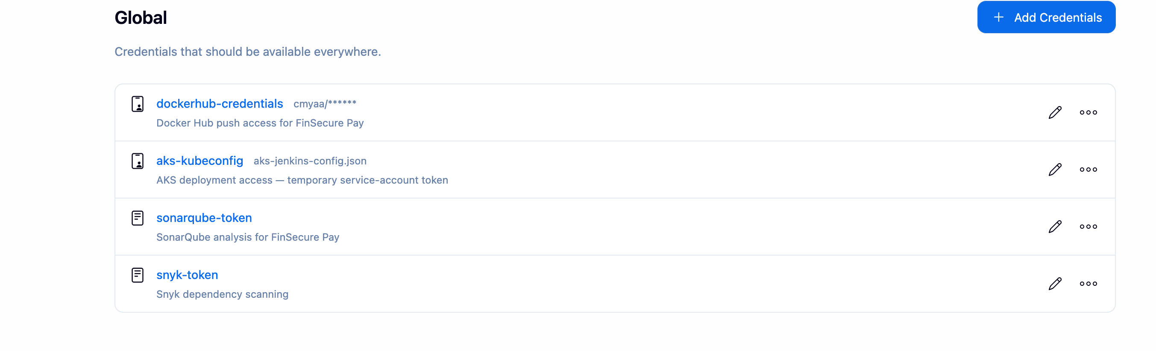
TASK 5
Blocked release remediation and secure credentials
The image gate stopped release until the base-image migration passed the pipeline
Build 25: Trivy failure blocks Push and Deploy
Remediation: pinned Alpine migration
Jenkins Credentials Manager
Both app and test images changed. Build 27 passed 39 tests and the image gate, then pushed and deployed.
Credential IDs and types only. Secret values remain hidden.
FINSECURE PAY
07
Notes:
Build 25 actual stage screenshot shows Trivy Container Scan red and later Push/Deploy skipped. The complete failed console contains Total 44 (HIGH 44, CRITICAL 0). Commit c11fe8c changed Dockerfile and jenkins/Dockerfile.test to a pinned official Python Alpine base. Updating slim first did not remove the OS findings. The commit screenshot is actual Git output, cropped to the change and commit summary. Build 27 successful stage capture is on slide 5 and its scan comparison on slide 6. Successful remediation deployment screenshot shows build-27 with 2/2 ready, up-to-date, and available. The corresponding HTTP 200 screenshot is retained in the evidence folder.
Jenkins credential screenshot shows dockerhub-credentials, aks-kubeconfig, sonarqube-token, and snyk-token IDs/types only. Tokens and kubeconfig contents are never embedded. Jenkins injects them only into relevant stages, masks variables, disables shell tracing around secrets, and uses temporary Docker configuration. Discord webhook URL stays outside Git. Service-account kubeconfig credentials have a limited lifetime, which caused the earlier authentication issue.
Source: screenshots/task 5/trivy_pipeline_failed.png
Source: screenshots/task 5/trivy-failed-console-output.txt
Source: screenshots/task 5/remediation-changes-base-image.png
Source: screenshots/task 5/trivy_pipeline_success.png
Source: screenshots/task 5/successful_remediation_deployment.png
Source: screenshots/task 5/successful_service_aft_remediation.png
Source: screenshots/task 5/secret_management.png
Source: Dockerfile
Source: jenkins/Dockerfile.test
Source: Jenkinsfile

Slide 8
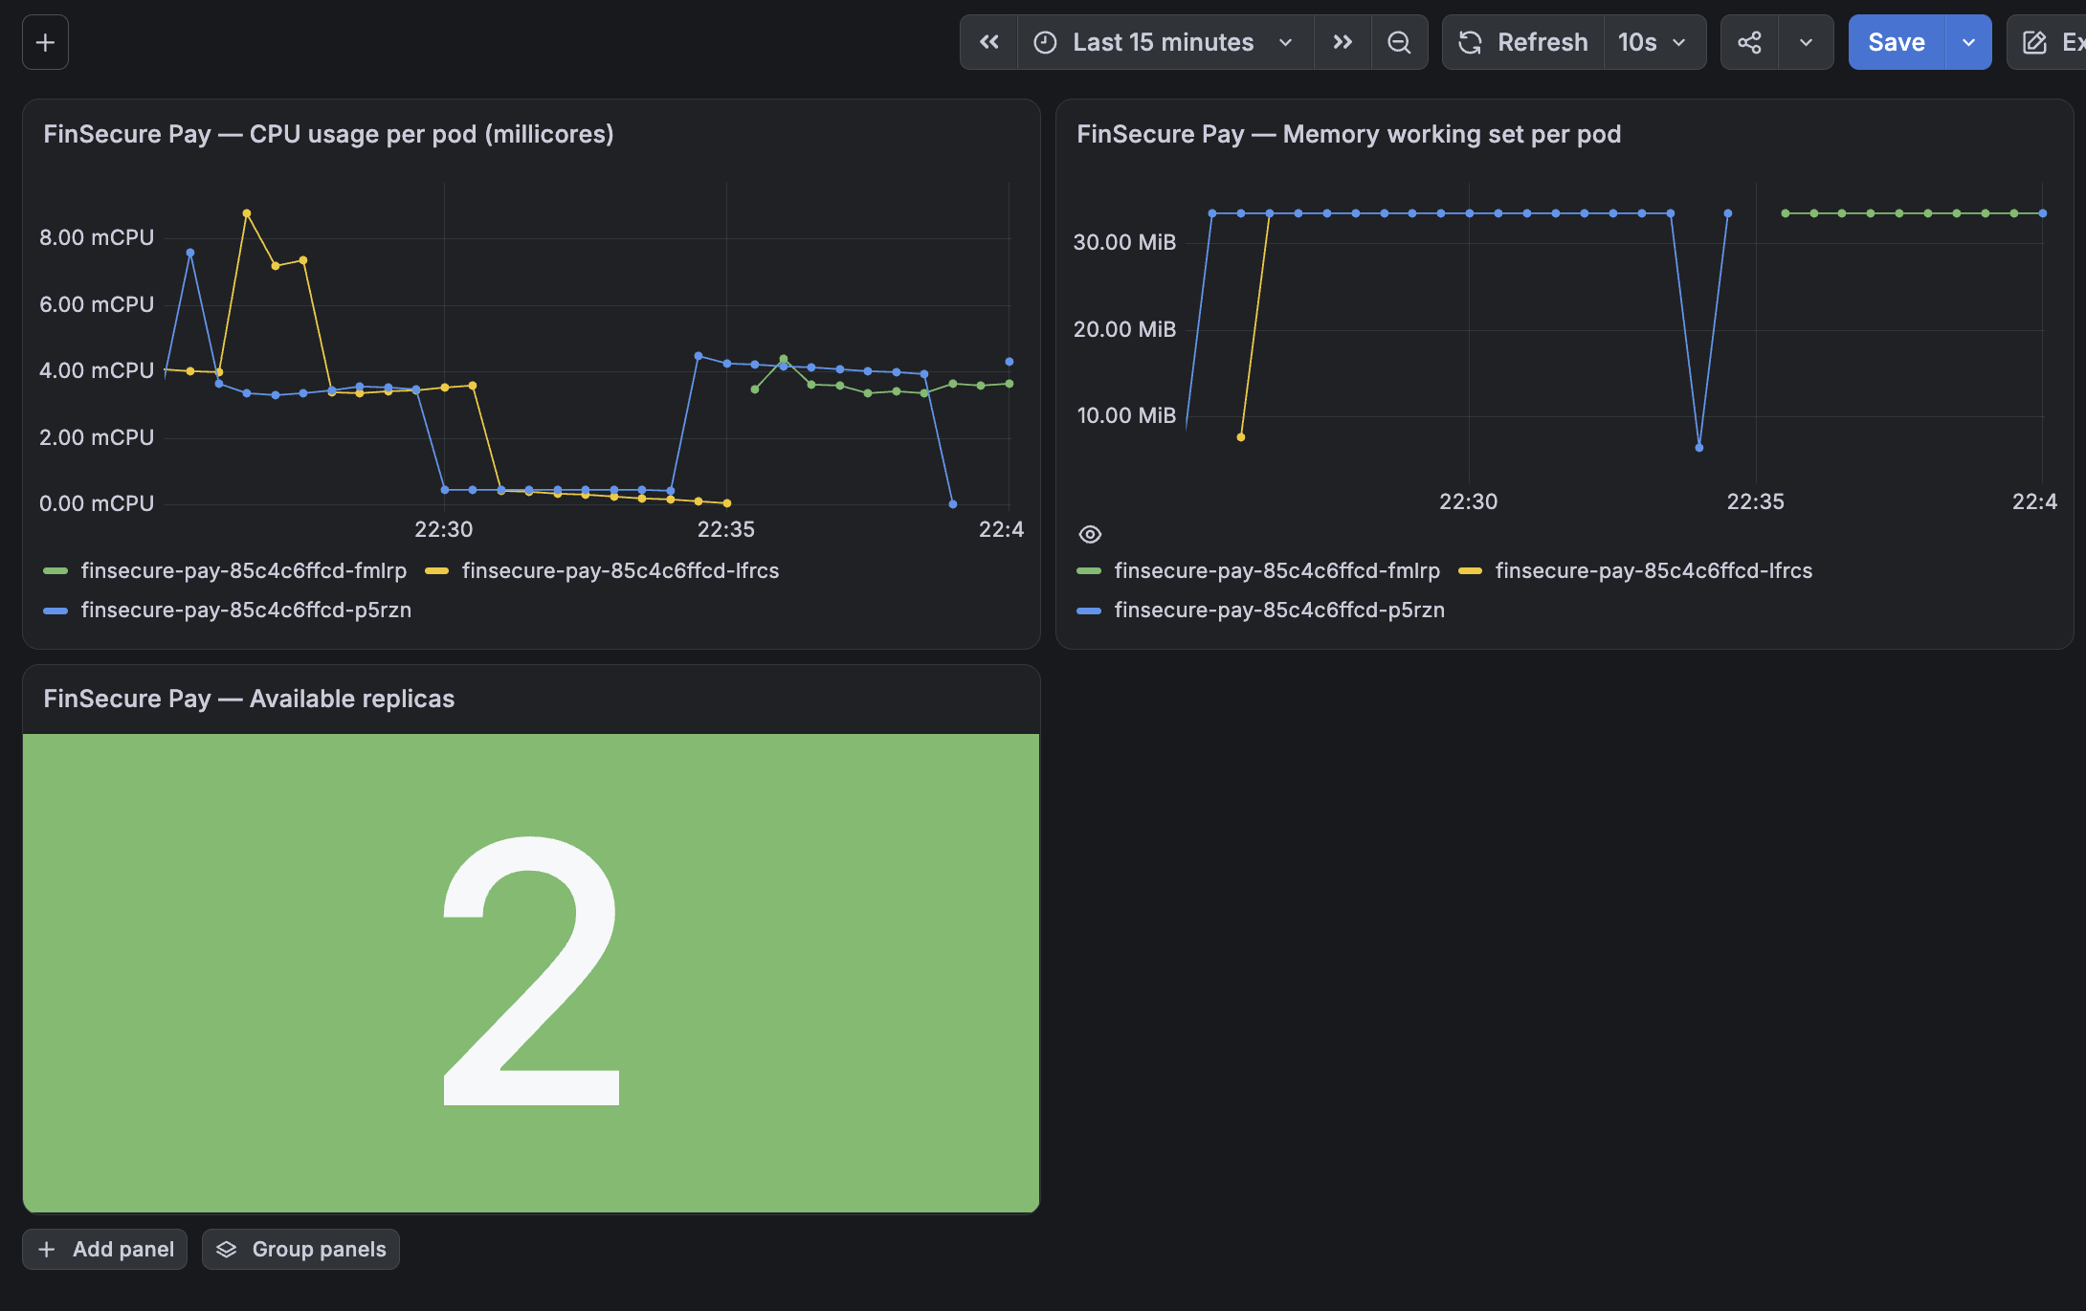
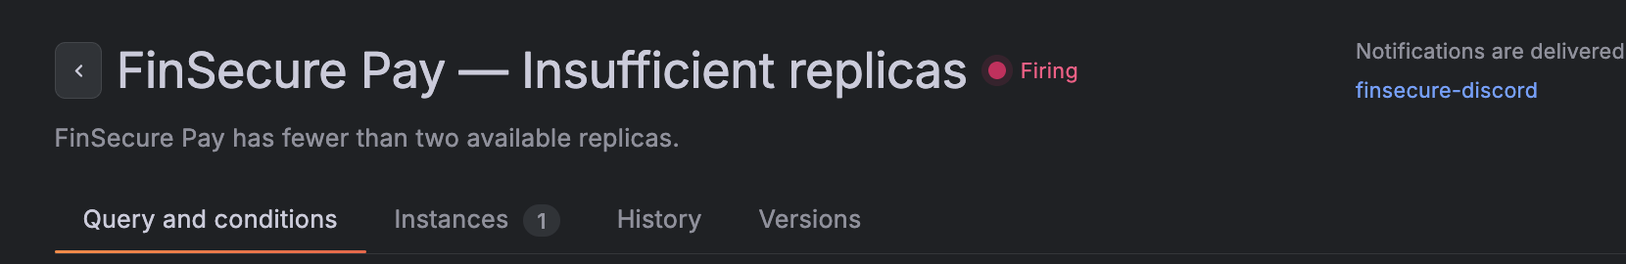
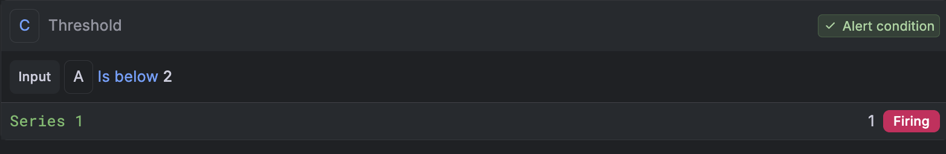
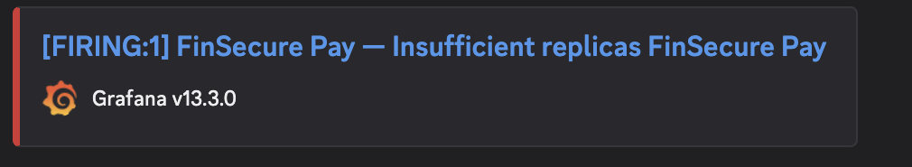
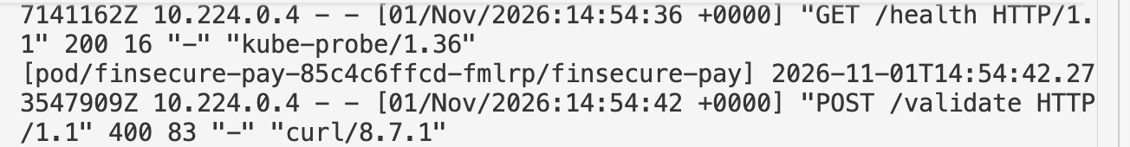
TASK 6
Live monitoring alert delivery and troubleshooting logs
Replica alert: below 2 for 1 minute, evaluated every 30 seconds
Grafana rule and Firing state
Actual Discord notification
Firing received at 1 replica. Resolved received at 2.
kubectl logs: expected HTTP 400
Live CPU (millicores), memory (MiB), and available replicas.
FINSECURE PAY
08
Notes:
The dashboard is a real capture of live Prometheus metrics shown in Grafana. It includes CPU usage per app pod in mCPU, memory working set in MiB, and available Deployment replicas. Dashboard refresh is 10s over a 15m window. Helm installed kube-prometheus-stack 92.17.0 in monitoring namespace. Prometheus stores two days of metrics on a 10Gi managed-csi PVC; Grafana has a 5Gi PVC. Grafana handles alert evaluation and routing, with standalone Alertmanager disabled.
Alert configuration screenshot is cropped from firing_state.png. Query A is max(kube_deployment_status_replicas_available{namespace="default",deployment="finsecure-pay"}). Threshold C: A is below 2. Evaluation every 30s with 1m pending period. Scaling to 1 replica caused Pending then Firing and a real Discord message. Restoring two replicas produced Resolved, shown in the supplied resolved_discord_alert.png and recorded in the dashboard. No webhook URL appears on the slide.
The log screenshot contains actual GET /health 200 and deliberately invalid POST /validate 400. Command used: kubectl --context aks-finsecure-pay -n default logs -l app=finsecure-pay --prefix=true --timestamps=true. HTTP 400 is expected input validation behavior and does not trigger the replica rule. Logs are accessed through kubectl, not centrally stored or included in Grafana. Retention is limited by container rotation and pod/node lifecycle.
Source: screenshots/task 6/dashboard_restored_2_replica.png
Source: screenshots/task 6/firing_state.png
Source: screenshots/task 6/discord_alert.png
Source: screenshots/task 6/resolved_discord_alert.png
Source: screenshots/task 6/kubectl_logs_200_400.png
Source: screenshots/task 6/scale_down.png
Source: screenshots/task 6/restore_2_replica.png
Source: monitoring/values.yaml
Source: monitoring/finsecure-pay-dashboard.json
Source: README.md

Slide 9
TASK 7 CONCEPTUAL PROPOSAL
AI-assisted incident triage
A read-only assistant could assemble incident evidence for an engineer to review
Problem and expected benefit
Required inputs
Metrics, logs, and rollout history are spread across tools. A concise evidence summary could reduce investigation time and improve handovers.
Alert timestamps, CPU/memory trends, pod events and logs, commit/image references, and approved runbooks.
Risks and governance
Integration and evaluation
Incorrect diagnoses, sensitive-data exposure, and instructions hidden in logs. Redact inputs, cite evidence, and keep engineers accountable.
Grafana starts a read-only collector. An approved LLM summarizes evidence for engineer review. Jenkins tests prompts and redaction rules.
Written proposal only. Engineers approve actions. Expected benefits require pilot evaluation.
FINSECURE PAY
09
Notes:
Conceptual only. An authenticated triage service would receive a copy of the Grafana alert while direct Discord notifications continue. A namespace-scoped read-only Kubernetes collector assembles a bounded evidence window and links Jenkins commit/image references. An approved model receives sanitized telemetry plus approved runbooks. Output separates evidence, hypotheses, uncertainty, and suggested read-only checks, citing sources. The model receives no Kubernetes write credentials, shell execution, registry tokens, or deployment authority. Engineers verify evidence, approve actions, and remain accountable. Governance covers sensitive data, provider retention and region, prompt injection in logs, hallucinations, missing evidence, latency, cost and availability. Jenkins versions/tests prompts, schemas and redaction rules. Evaluate a pilot against manual triage before claiming MTTR improvement.
References: NIST AI 600-1 https://doi.org/10.6028/NIST.AI.600-1 and OWASP Prompt Injection https://genai.owasp.org/llmrisk/llm01-prompt-injection/
Source: docs/task7-design-document.md
Source: docs/task7-design-document.pdf

Slide 10
TASKS 1 THROUGH 7
Architecture design choices and project resources
Local Jenkins gates releases. AKS runs the application and monitoring.
GitHub
Source and SCM polling
Jenkins
Controller and agent
pytest Bandit
SonarQube Snyk
Docker build
Versioned image
Trivy
Image gate
Docker Hub
Public registry
AKS pulls the approved image
AKS deployment
LoadBalancer and 2 pods
ConfigMap and /health probes
Prometheus
Kubelet and exporters
Grafana
Dashboard and alerts
Discord
Notifications
Lessons: gates must block release, notifications need delivery tests, and two pods on one node share failure risk.
Next: multiple nodes, TLS/authentication, centralized redacted logs, and deployment by digest.
GitHub repository
Final implementation: main
Docker Hub image tags
github.com/meiyun1995/capstone-finpay-cicd
FINSECURE PAY
10
Notes:
Editable architecture of the implemented system. Jenkins applies Deployment changes only after all tests and scan gates pass. It runs locally with controller, dedicated agent, and TLS-connected privileged Docker-in-Docker engine. SonarQube is local, Snyk uses its API, Trivy scans the exported built image, and Docker Hub stores version-tagged images. AKS independently pulls the approved image. Prometheus scrapes kubelet/cAdvisor, kube-state-metrics, and node exporter, not a custom app /metrics endpoint. Grafana shows metrics and sends alerts directly to Discord. Helm installs monitoring separately from app deployment. Logs remain available through kubectl. The AI assistant is proposed only.
Single worker node was chosen for credit/quota limits, creating a shared failure domain. Local Jenkins/SonarQube depend on the laptop. Future improvements include multiple nodes and topology spread, TLS/authentication, centralized redacted logs, deployment by digest, short-lived identity, automated alert provisioning, and a governed AI pilot.
Public repository: https://github.com/meiyun1995/capstone-finpay-cicd
Final implementation on main: https://github.com/meiyun1995/capstone-finpay-cicd/tree/main
Docker Hub: https://hub.docker.com/r/cmyaa/finsecure-pay/tags
Local Jenkins/SonarQube/Grafana links are excluded because evaluators cannot reach them.
Source: README.md
Source: docs/task7-design-document.md
Source: docs/assets/finsecure-architecture.drawio
Source: Jenkinsfile
Source: k8s/deployment.yaml
Source: monitoring/values.yaml

