Slide 1
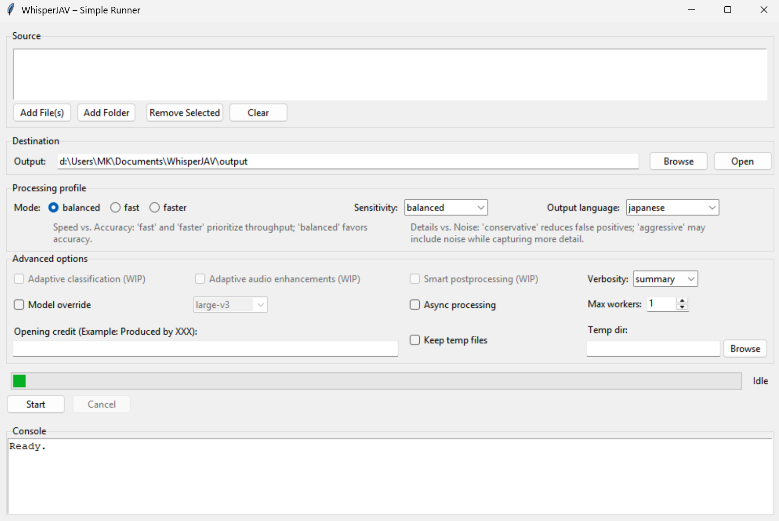
WHISPERJAV-GUI EXISTING UI

Slide 2
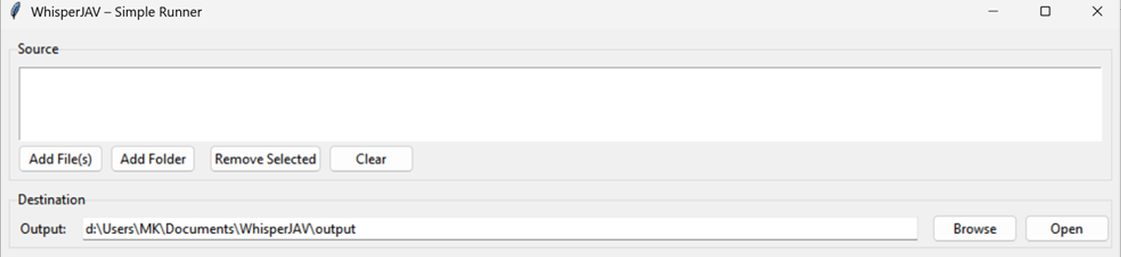
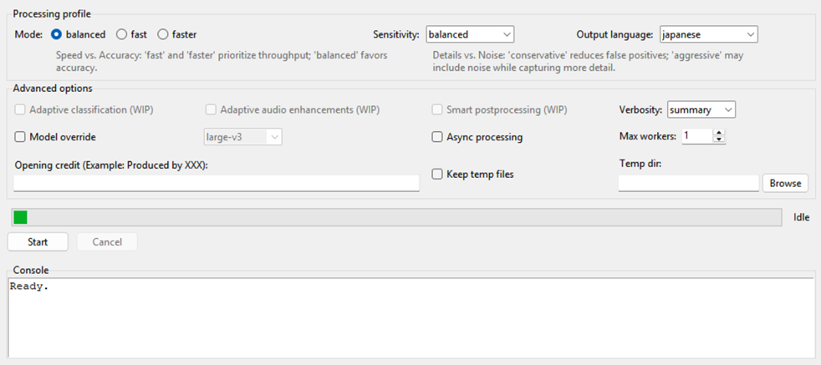
WHISPERJAV-GUI proposed new UI
Transcription Mode
Transcription Adv. Options
AI Translation Options
Ensemble Options
The new proposed UI adds the above tabs as separators for
whisperJAV major components When a tab is selected by users, this section is switched to show UI elements and options for that tab (component)

Slide 3
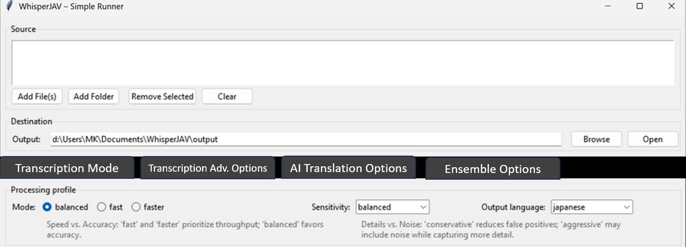
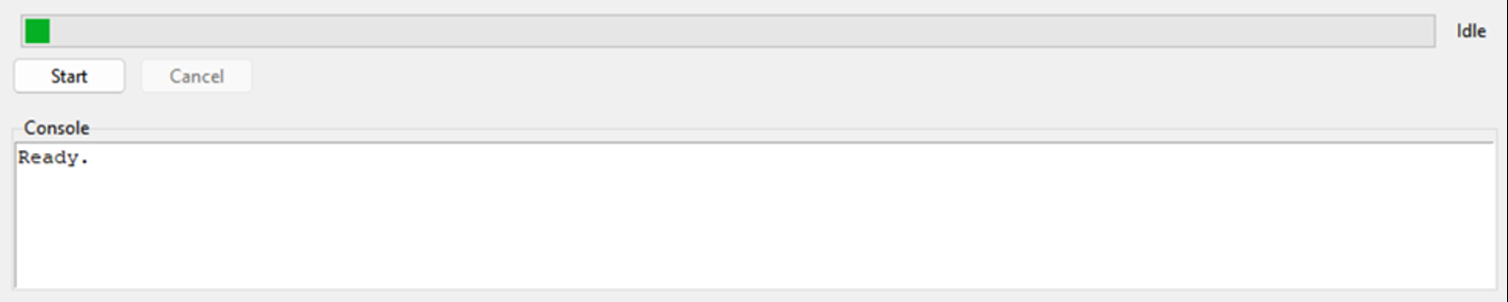
WHISPERJAV-GUI proposed new UI TAB: TRANSCRIPTION Component
Transcription Adv. Options
AI Translation Options
Ensemble Options

Slide 4
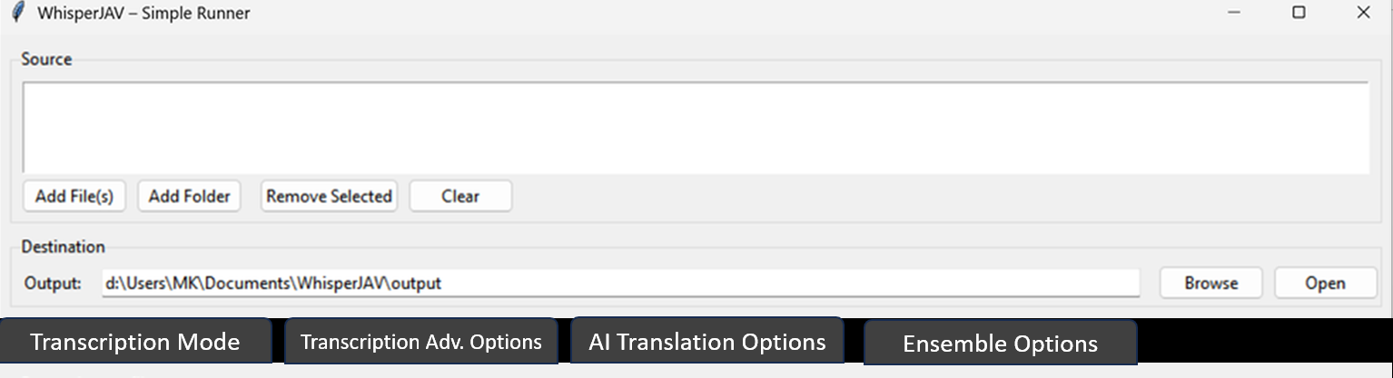
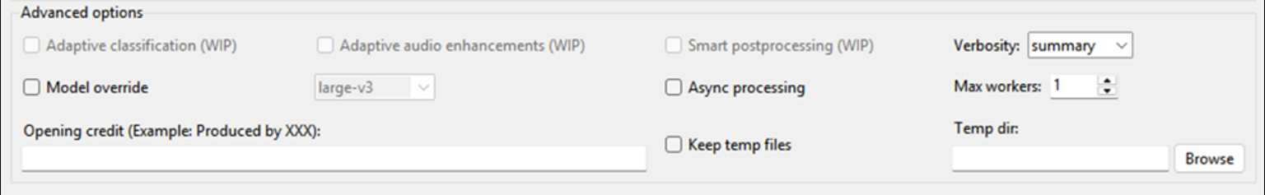
WHISPERJAV-GUI proposed new UI TAB: Advanced Options Component
Transcription Mode
AI Translation Options
Ensemble Options

Slide 5
WHISPERJAV-GUI proposed new UI TAB: AI Translation Options (whisperjav-translate) Component
Transcription Mode
Transcription Adv. Options
Ensemble Options
THIS IS AI TRANSLATION SUB-SECTION TO BE DESIGNED WITH THE SELECTED OPTIONS FROM WHISPERJAV-TRANSLATE

Slide 6
WHISPERJAV-GUI proposed new UI TAB: Ensemble (whisperjav-ensemble) Component. This component is reserved for future release.
Transcription Mode
Transcription Adv. Options
AI Translation Options
THIS IS AS RESERVED SUB-SECTION FOR FUTURE DEVELOPMENT
RESEDRVED FOR ENSEMBLE MODE WHISPERJAV-ENSEMBLE

