Slide 1
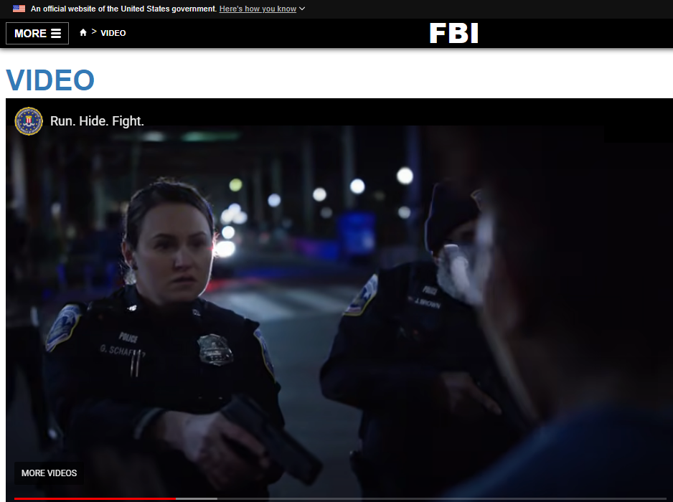
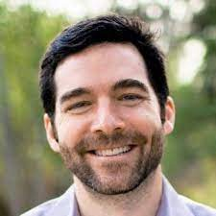
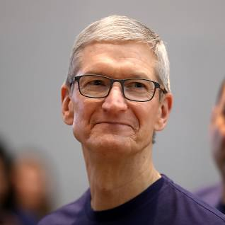

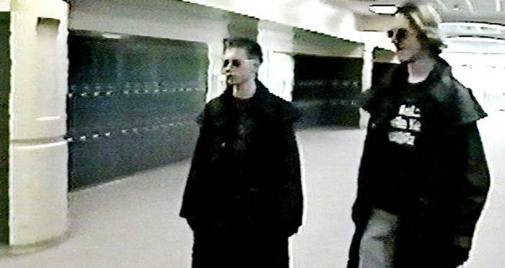

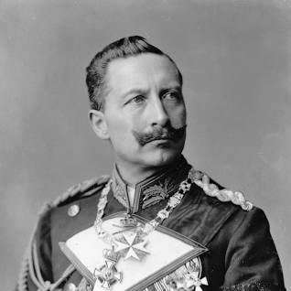

FBI
ATOMICCLOCK
WWI 30Y DE-FRA Verdun
Wieland
Timo (nonPoliceTimerLogical)
roth.ibm.damiler.*
https://www.fbi.gov/video-repository/run-hide-fight-092120.mp4/view
2014 roth.ibm.damiler.cisco.morning: 401k
ibm.dmiler.apple.employee.tim.cook
J
§187
PREA
§422.6
Hate Crime
https://www.fbi.gov/video-repository/run-hide-fight-092120.mp4/view
WWII
WWI
Tribal Homeland Security
Grant Program
[x] no

Slide 2
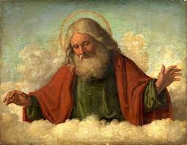
FBI
ATOMICCLOCK
Ibm.dmiler.visa.employe.morgan.freeman
J
.maxplank.marx
shooter school seververs kid
Boner
41.MLK(boner).&!JFK
[x] no

Slide 3
FBI
douglass abolitionist
[x] no

Slide 4
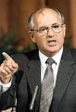
FBI
Douglass Exit
ATOMICCLOCK
Ibm.dmiler.visa.employe.morgan.freeman
J
.maxplank.marx
Visa.wieland
88th
Braun
Ghcoheo(dr/j)
J
J
roth.ibm.damiler.*
roth.ibm.dmiler.apple.linekdin
roth.ibm.dmaierl.apple
shooter school seververs kid
Boner
41.MLK(boner).&!JFK
douglass abolitionist
[x] no

Slide 5
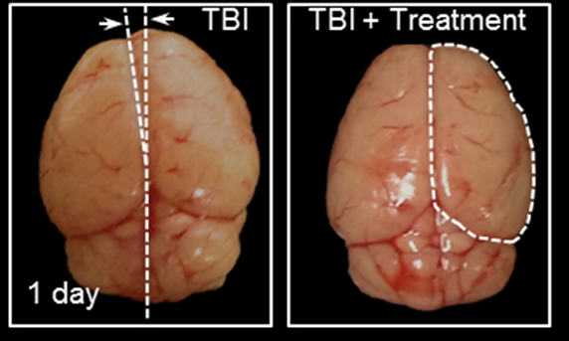
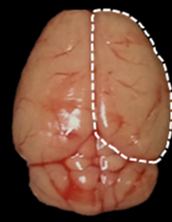
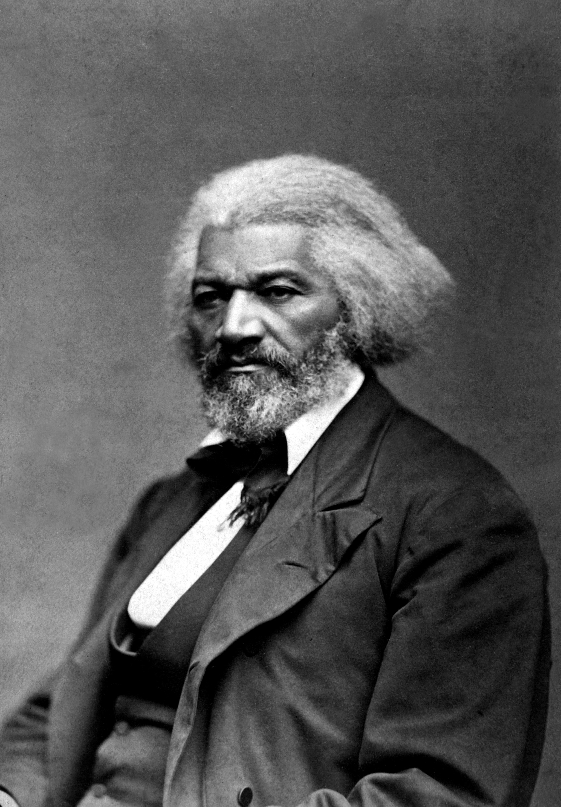
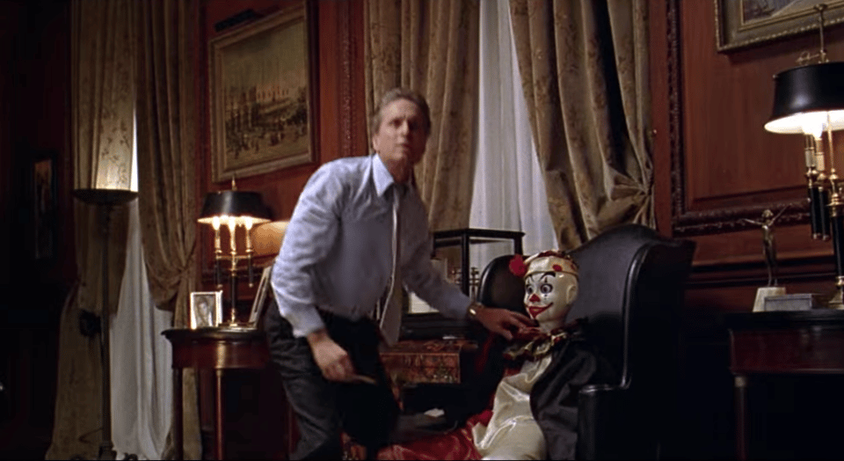
FBI
Brain Swelling
ATOMICCLOCK
swelling
nonPoliceTRX
nonPoliceTRX
WWII
WWI
Douglass, Frederik
The Game, Aboslist
roth.Ibm.damierl.karstadt.employe.peter.bushman.linst(the game)
IPX
ghocheo(redhous, treated wood marijuana bowls)
WWI( jens pfrafman portal, dancing micheal portals)
treaded wood marijuana bowles
https://www.fbi.gov/video-repository/run-hide-fight-092120.mp4/view
[x] no

Slide 6
FBI
douglass abolitionist
[x] no

Slide 7
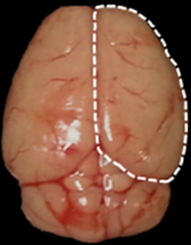
FBI
Brain Swelling
ATOMICCLOCK
WW2.nonPoliceTRX
WWI
v2.nonPolcieNSA.nonPolciIncident
WWII
WWI
WW1.nonPoliceTRX
Wieland:
Dieter-is-Thomas
Kaiser Wilhelm, bla
Before
500 TPS
WW2.nonPoliceTRX
swelling
WWII
WWI
1500 TPS
WW1.nonPoliceTRX
After
WW2.nonPoliceTRX
[x] no
[x] no

Slide 8
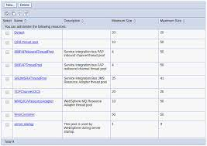
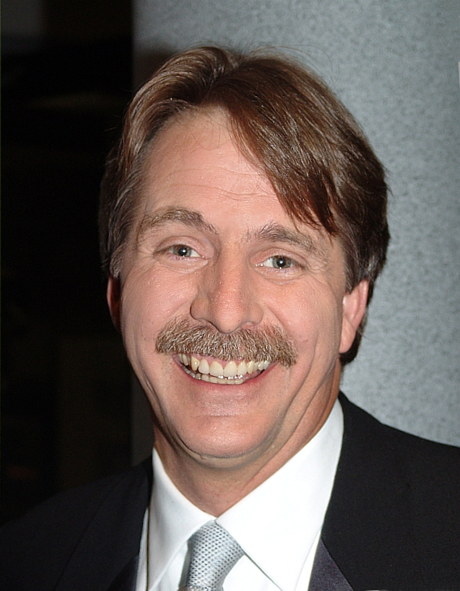



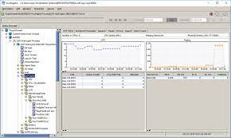
FBI
HOMCIDE:LUX:IS-A-BELL
ATOMICCLOCK
EBJ Threshold Setting, Larry2
PENTAGON(merkel.(deere))
ebj
Floran:32
v2.nonPolcieNSA.nonPolciIncident
WWII
WWI
WW1.nonPoliceTRX
Wieland:
Dieter-is-Thomas
Kaiser Wilhelm, bla
Before
500 TPS
WW2.nonPoliceTRX
WWII
WWI
1500 TPS
WW1.nonPoliceTRX
After
WW2.nonPoliceTRX
[x] no
[x] no

Slide 9

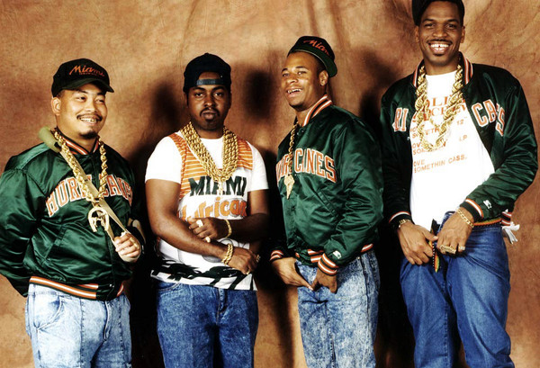
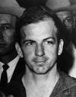

FBI
HOMCIDE:LUX:IS-A-BELL
ATOMICCLOCK
EBJ Threshold Setting, Larry2
PENTAGON(merkel.(deere))
ebj
1989 HUDSON COURT
Floran:32
Ronsons:pop cherrytree
(DR)MATIAS:32
Soul; Asylum, Guns and Roes, Big; with you
0.1 katie: New kids on the block
Denise:10 Febrayr 1991
Feb 14, 2023 — View credits, reviews, tracks and shop for the 1991 CD release of "New Kids On The Block" on Discogs.
[x] no

Slide 10
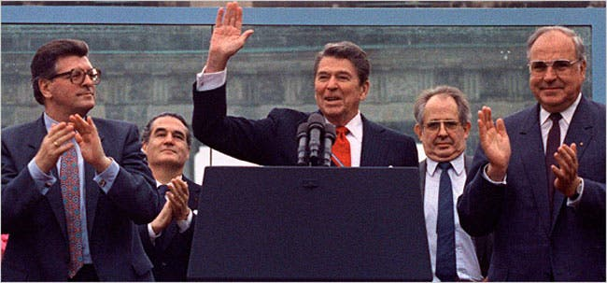
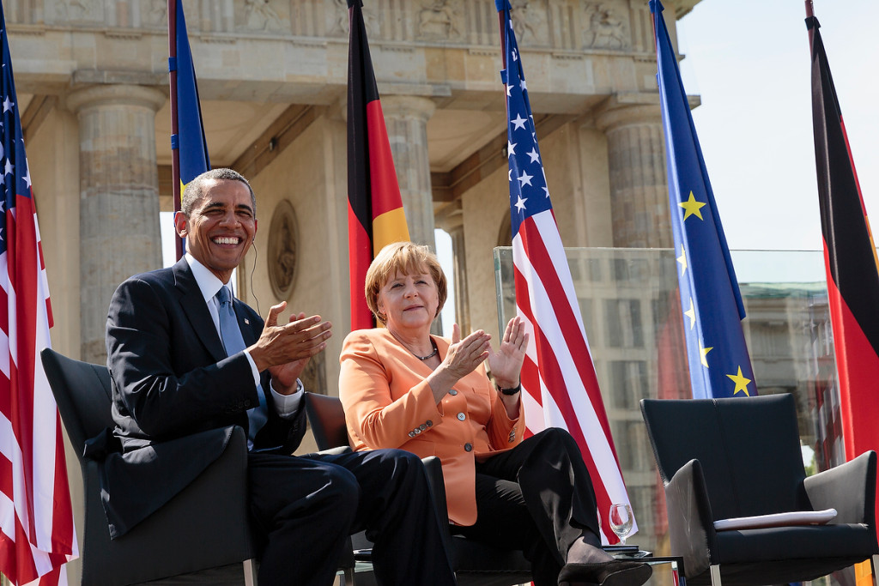
1979 Fetus MERKEL §212 Abortion, §187 Homicde ibm.damielr.apple
FBI
1980
1981
1982
1983
Baby
ATOMICCLOCK
Infant
Age 2
Toddler – Kindergarden - WATER
Age 3
Child – Kindergarden - WATER
4th Grade September 1990
4th February 1991
5th Adolf-Reich-Schein Schule
Gesamtschule
dense elementary
5th gesamtschule
6t cannot fail FRA
1984 – Preshool-
1985 - Preschool
1986 Preschool – Zyanthe
1987 1st Grade
1988 2nd Grade
1989 3rd Grade
1990 4th Grade 44th Denise
1991 5th Grade
1992 6th Grade
1993 7th Grade
1994 8th Grade
1995 8th Grade 88th
1996 9th Grade
1997 Business School
1997 Sales Business Appretiship
2000 High School
2001 Univeristy
2004 John Deere
2005 IBM
2023
[x] no

Slide 11
FBI
ATOMICCLOCK
The did not notice Jason’s Birth certifcat
And the two HOMCIDE:LUX:FETUS and
On WAR(kriesstrasse) B-10 to Whitehouse
Pentagion Cook Whitehouse
Vising Jason with google
Front Door shooes cherrytree(0)
[x] no

