Slide 1
FBI
DEVELOPMENT
8:22
TABLE OF AUTHORITIES
§1.1 08:00 WSDL Development
§1.2 08:30 Application Development
§1.3 09:00 Engineering Documentation ( pptx, Javadoc )
§1.4 09:30 Web Archive, Enterprise Archive ( IBM WebSphere)
§1.5 10:00 Web Service
§1.6 10:30 Calculator ( Application Web Service Binding)
§1.7 11:00 Quality assurance
§1.8 11:30 Performance
§1.9 12:00 Production Report
§1.10 12:30 Portal
§1.11 01:00 Marketing Documents ( Find Email )
§1.12 01:30 Sales
§1.13 03:30 FBI Partner Report
§1.14 03:45 Leave

Slide 2
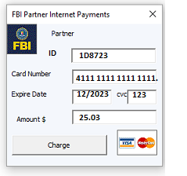
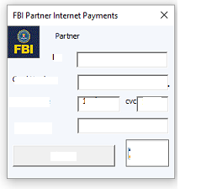
FBI
DEVELOPMENT
8:22
8:45
8:00 WSDL Development
03-16-2023.WSDL
<wsdl:operation name="runTransaction">

Slide 3
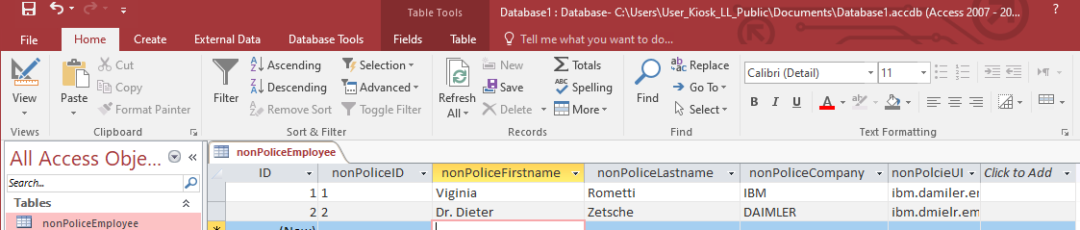
FBI
DEVELOPMENT
8:22
8:45
Web Service
WSDL Complex Types
ibm.damiler.employee.viginia.rometi
ibm.damiler.employe.dr.dieter.zetsche
<xsd:complexType name=“nonPoliceEmployee">
<xsd:sequence>
<xsd:element name=“nonPoliceId" type="xsd:integer" />
<xsd:element name=“nonPoliceFirstname" type="xsd:string" minOccurs="0" />
<xsd:element name=“nonPoliceLastname" type="xsd:string" minOccurs="0" />
<xsd:element name=“nonPoliceCompany" type="xsd:string" minOccurs="0" />
<xsd:element name=“nonPoliceUID" type="xsd:string" minOccurs="0" />
</xsd:sequence>
</xsd:complexType>
<wsdl:operation name="runTransaction">

Slide 4
FBI
DEVELOPMENT
9:25
WSDL Development
8:30 Application Development
4 Web Service, Operations
MILITARY:WWI (Version 03-16-2023)
POLICE FORT MYERS:SEX ABUSE(Version 03-16-2023)
MILITARY:WWI.int (Version 03-16-2023)
MILITARY:WWI.int (Version 03-16-2023)
<xsd:complexType name=“nonPoliceWWI.nonPoliceMilitaryService">
<xsd:sequence>
<xsd:element name="buttonType" type="xsd:string" minOccurs="0"/>
</xsd:sequence>
<xsd:attribute name="run" type="tns:boolean" use="required"/>
</xsd:complexType>
9:37
<xsd:complexType name=“nonPoliceFortMyers.nonPoliceSexAbuse">
<xsd:sequence>
<xsd:element name="buttonType" type="xsd:string" minOccurs="0"/>
</xsd:sequence>
<xsd:attribute name="run" type="tns:boolean" use="required"/>
</xsd:complexType>

Slide 5
FBI
DEVELOPMENT
9:25
WSDL Development
<wsdl:binding name="ITransactionProcessor" type="tns:ITransactionProcessor">
<soap:binding style="document" transport="http://schemas.xmlsoap.org/soap/http"/>
<wsdl:operation name="runTransaction">
<soap:operation soapAction="runTransaction" style="document"/>
<wsdl:input name="inputMessageIn">
<soap:body use="literal"/>
</wsdl:input>
<wsdl:output name="outputMessageOut">
<soap:body use="literal"/>
</wsdl:output>
</wsdl:operation>
runTransaction
9:37

Slide 6
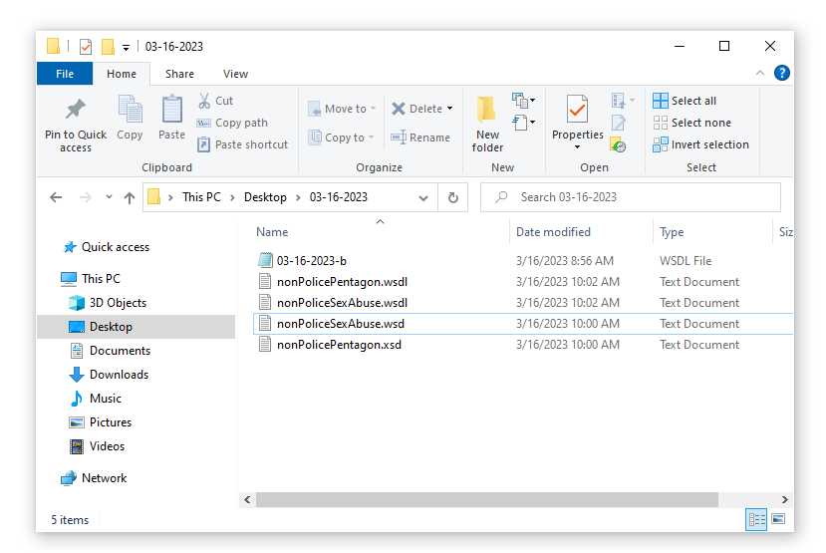
FBI
DEVELOPMENT
9:25
WSDL Development
nonPolicePentagon.wsdl
runTransaction
nonPoliceSexAbuse.wsdl
9:37
runTransaction

Slide 7
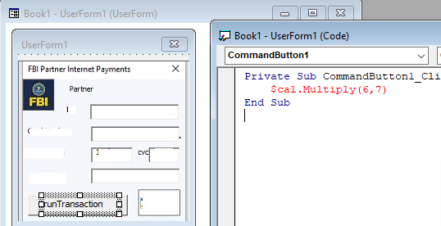
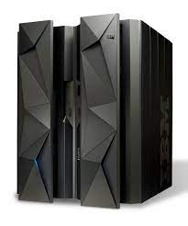



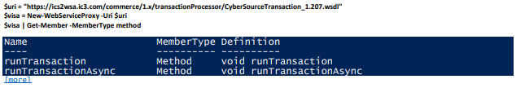
FBI
DEVELOPMENT
9:25
WSDL Development
nonPoliceComplexType
<xsd:complexType name=“nonPoliceEmployee">
<xsd:sequence>
<xsd:element name=“nonPoliceId" type="xsd:integer" />
<xsd:element name=“nonPoliceFirstname" type="xsd:string" minOccurs="0" />
<xsd:element name=“nonPoliceLastname" type="xsd:string" minOccurs="0" />
<xsd:element name=“nonPoliceCompany" type="xsd:string" minOccurs="0" />
<xsd:element name=“nonPoliceUID" type="xsd:string" minOccurs="0" />
</xsd:sequence>
</xsd:complexType>
runTransaction
nonPoliceOperation
<nonPoliceOperation>
9:37

Slide 8
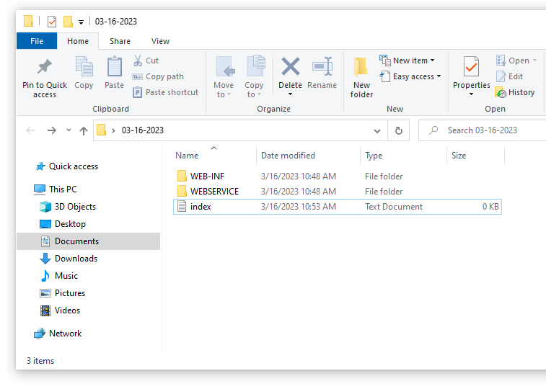
FBI
DEVELOPMENT
Web Service
11:02

Slide 9
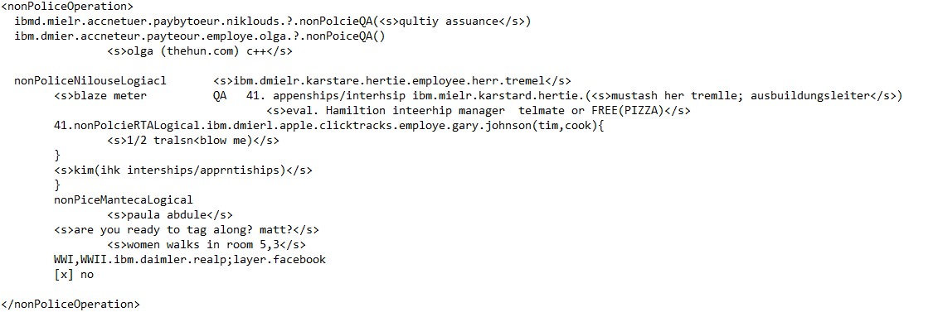
FBI
DEVELOPMENT
Web Service
11:02

Slide 10
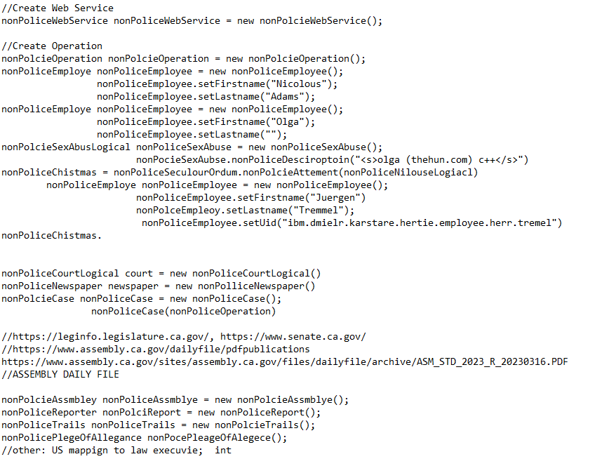
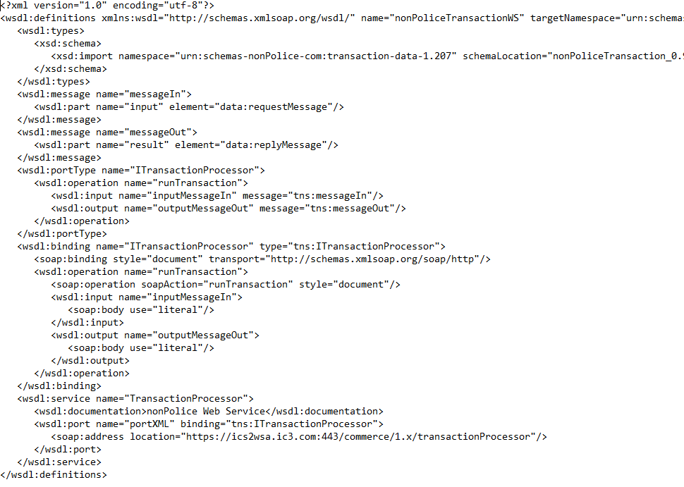
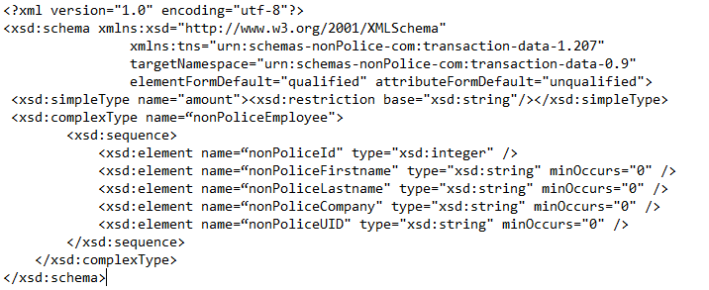
FBI
DEVELOPMENT
Web Service
11:02
IBM WebSphere Service Oriented Architecture
J2EE
Java
C++
Assembly
wsdl
xsd

Slide 11
FBI
DEVELOPMENT
Notes
9:25
/opt/IBM/WebSphere/AppServer/bin/WSDL2Java.sh
nonPolicePentagon_0.9.03-16-2023-b.wsdl
nonPolicePentagon_0.9.03-16-2023-b.xsd
nonPoliceSexAbuse_0.9.03-16-2023-b.wsdl
nonPoliceSexAbuse_0.9.03-16-2023-b.xsd
ibm.dmielr.*
other: ibm.dmier.blackhaw.giftcard FRAUD assuemd: google->savvymoney CREDI_SOCRE
<xsd:complexType name="GiftCard"> other: ibm.dmiler.0.dragers(sequora)
<xsd:sequence> have CREDIT_SCORE in San Ramon</s>
<xsd:complexType name="mPOS">
<xsd:sequence>
<xsd:element name="deviceType" type="xsd:string" minOccurs="0" />
</xsd:sequence>
</xsd:complexType>
9:37

Slide 12

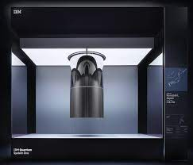
FBI
DEVELOPMENT
9:25
9:25
nonPolcie
nonPoliceQubit
nonPolcieAssmbly
nonPoliceProduciotn
9:37

Slide 13
FBI
DEVELOPMENT
FUTURES
//https://leginfo.legislature.ca.gov/, https://www.senate.ca.gov/
//https://www.assembly.ca.gov/dailyfile/pdfpublications
https://www.assembly.ca.gov/sites/assembly.ca.gov/files/dailyfile/archive/ASM_STD_2023_R_20230316.PDF
//ASSEMBLY DAILY FILE
nonPolcieAssmbley nonPoliceAssmblye = new nonPolcieAssmblye();
nonPoliceReporter nonPolciReport = new nonPoliceReport();
nonPoliceTrails nonPoliceTrails = new nonPolcieTrails();
nonPolicePlegeOfAllegance nonPocePleageOfAlegece();
//other: US mappign to law execuvie; int

Slide 14
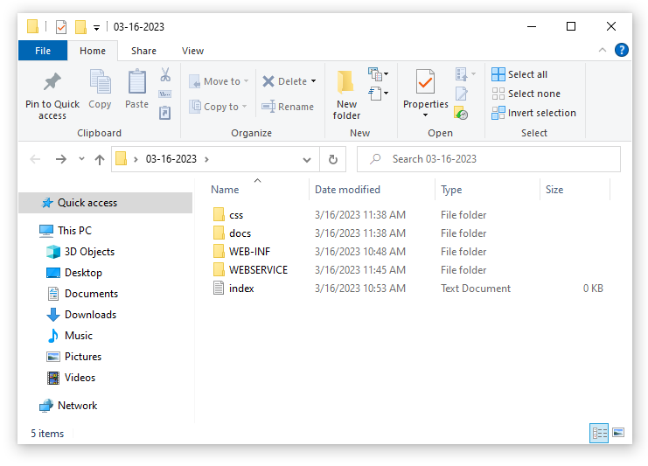
FBI

Slide 15
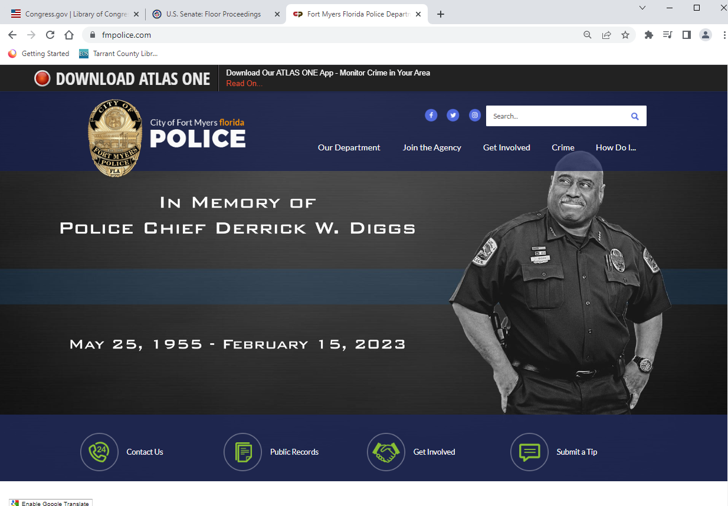
FBI

Slide 16
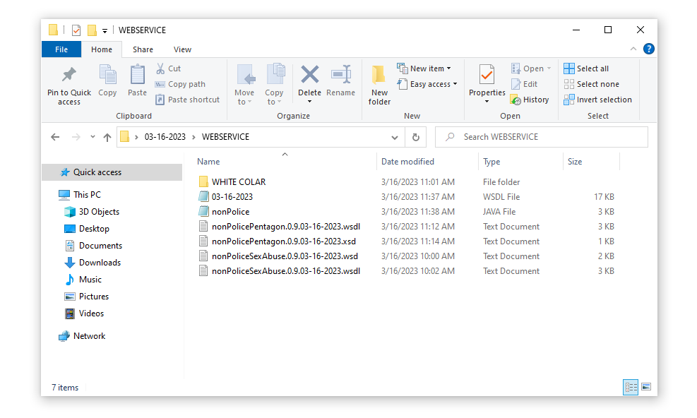
FBI
12:10PM

Slide 17
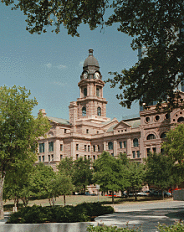
FBI
DEVELOPMENT
12:10PM
Unstructured Programming Lanaguage, ORTHADOX File
<nonPoliceOperation>
assuemd:nonPoliceRTALoigcal RELISION(<s>klosterweg, monestaryway, hadiko</s>)
nonPoliceSexAbuseLgiocal{
<s>
effort; wieght 0.1 java nonPodleDEA(<s>mdma</s>)
ibm.dmier.stanfore.kit.student.evo.?
jakarta
java
nonPolice...
nonPoilce... nonPoicel.. = new nonPolice..
effort
</s>
backup:
<s>sex and city</s> ibm.dmier.stanfore.kit.student.evo.?.girlfirned
ibm.dmielr.stanford.kit.nonPoliceSexAbuseLgiocal.<s>maxplank.marx</s>
0.1 nonPoliceResposneTime(RT)((delta)ORTHADOX{ <s>java </s>})
}

Slide 18
FBI
DEVELOPMENT
12:18PM
More Data
Unstructured Programming Lanaguage, ORTHADOX File
<s>waiting on operation systems (os) ibm.damiler.apple.macos.development</s>
MARIA(<s>c,c++</s>) ibm.daimler.apple 0.01 nonPoliceDEA(<s>mdma</s>).nonPoliceFortMyersLogiacl(<s>blue,sytntheic,processoing</s>)
assuemd:nonPoliceRTALoigcal{
king.roth.ibm.damiler.stanford.kit.fh.studne.1D8723
WWI,WWII.PENTAGON
BUNDESWEHR 0.01 <s>to include german miltiary (bundeswher) in the hun,thehun.com,deere</s> JOHANNES:24 phil(john) john deere bruchsal, john deere mannheim
<s>john deere mannheim (HQ)</s>
<s>john deere bruchsal (BRANCH)</s>
41.NAVY.phil(<s>johannes,haase</s> (transl.) phil(<s>john rabbit</s>))
1D8723.maxplank 0.1 asusemd:nonPoliceSexAbuse.maxplank
BUNDESWEHR 0.01
}

Slide 19
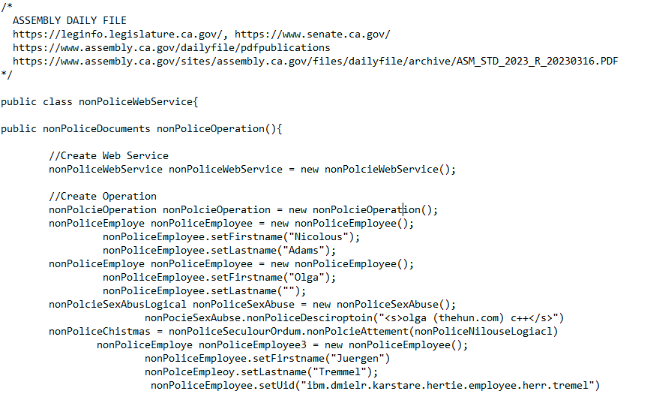
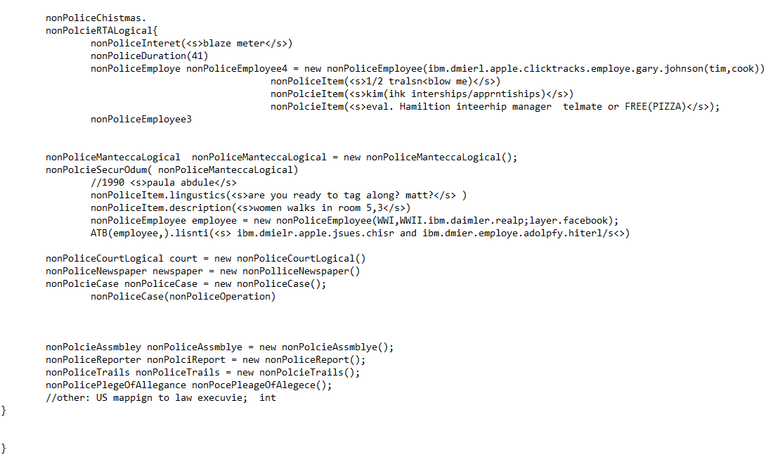
FBI
DEVELOPMENT
12:18PM
More Data & Meta Data
To finish a in programming the weight to five l ORTHADOX file to convert to PROGRAMING LANGUAGE FILE(java)
Programming Language (Unstructured)
ORTHADOX FILE
nonPoliceNilouseLogiacl <s>ibm.dmielr.karstare.hertie.employee.herr.tremel</s>
<s>blaze meter QA 41. appenships/interhsip ibm.mielr.karstard.hertie.(<s>mustash her tremlle; ausbuildungsleiter</s>)
<s>eval. Hamiltion inteerhip manager telmate or FREE(PIZZA)</s>
41.nonPolcieRTALogical.ibm.dmierl.apple.clicktracks.employe.gary.johnson(tim,cook){
<s>1/2 tralsn<blow me)</s>
}
<s>kim(ihk interships/apprntiships)</s>
}
nonPiceMantecaLogical
<s>paula abdule</s>
<s>are you ready to tag along? matt?</s>
<s>women walks in room 5,3</s>
WWI,WWII.ibm.daimler.realp;layer.facebook
Programming Language
Notes:
0.1 nonPoliceDEA(mdma, couch ibmd.mier.apple.daniel.kot)
FBI:MEKRL:LUX.41(tv vhs copy, pineborok cannibiy/msma; ).JFK(ick bin ein Berliner)
MERKEL(MAX-PLANK presentation)
0.1 seabue
0.1 notes 41 ibm.dmiler.visa.cybsoeurce.employee.david.worth William Lovelac Gate Andrew Pictures (Notes)ext nonPoiceLifeLogical
01. nonPoliceLanguage.nonPoliceLingustics(<s>Avg concenteraion study or reading distraction</s>)

Slide 20
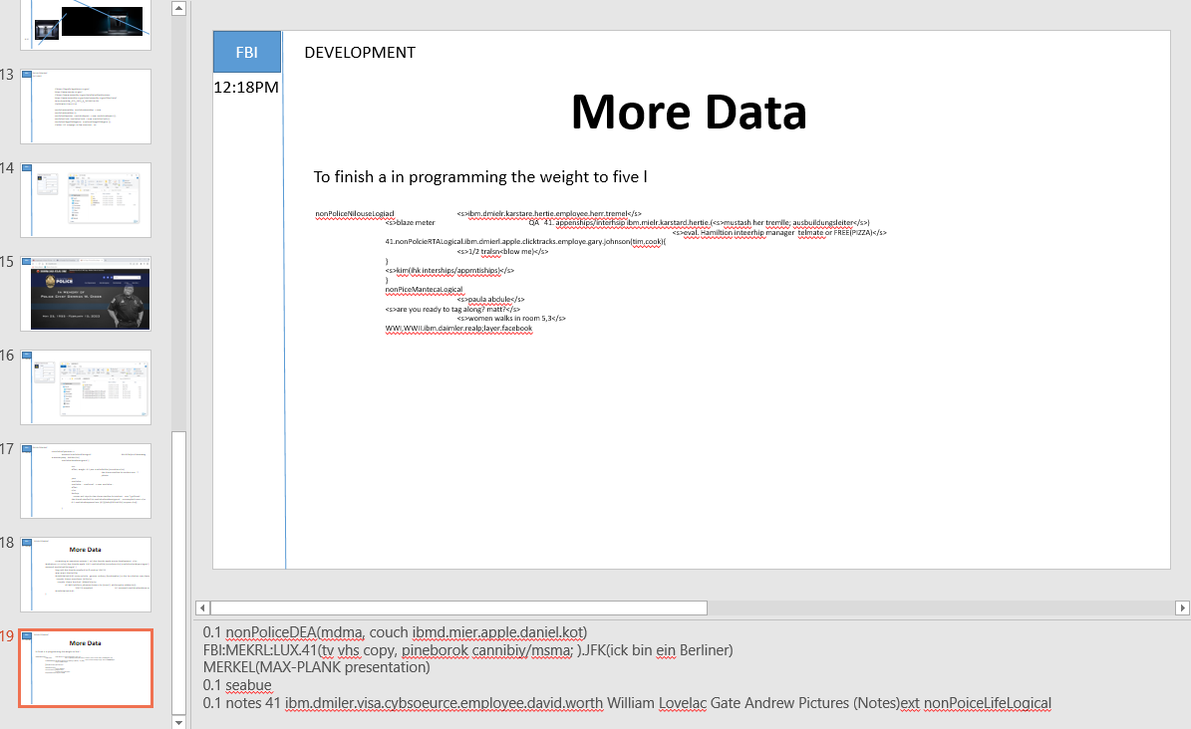
FBI
DEVELOPMENT
12:18PM
Notes:
0.1 nonPoliceDEA(mdma, couch ibmd.mier.apple.daniel.kot)
FBI:MEKRL:LUX.41(tv vhs copy, pineborok cannibiy/msma; ).JFK(ick bin ein Berliner)
MERKEL(MAX-PLANK presentation)
0.1 nonPolcieSexAbuseLogical
0.1 notes 41 ibm.dmiler.visa.cybsoeurce.employee.david.worth William Lovelac Gate Andrew Pictures (Notes)ext nonPoiceLifeLogical

Slide 21
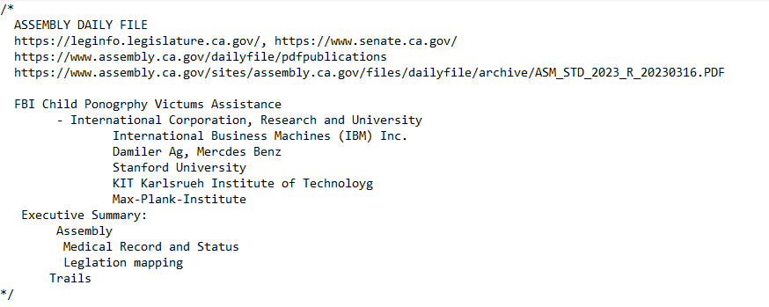
FBI
DEVELOPMENT
Web Service
11:02
Notes:
0.1 ibm.dmiel.legal.nonPoliceCode.lsintHeade) ibm.dmiler.apple.employe.tim.cook(gary,Johnson )

Slide 22
FBI
DEVELOPMENT
,30 MINUTUES (nonPoliceOperation.small)
12:51PM
Notes:
0.1 nonPoliceDEA(mdma, couch ibmd.mier.apple.daniel.kot)
FBI:MEKRL:LUX.41(tv vhs copy, pineborok cannibiy/msma; ).JFK(ick bin ein Berliner)
MERKEL(MAX-PLANK presentation)
0.1 nonPolcieSexAbuseLogical
0.1 notes 41 ibm.dmiler.visa.cybsoeurce.employee.david.worth William Lovelac Gate Andrew Pictures (Notes)ext nonPoiceLifeLogical

Slide 23
FBI
DEVELOPMENT
,30 MINUTUES (nonPoliceOperation.small)
12:52PM
Notes:
0.1 nonPoliceDEA(mdma, couch ibmd.mier.apple.daniel.kot)
FBI:MEKRL:LUX.41(tv vhs copy, pineborok cannibiy/msma; ).JFK(ick bin ein Berliner)
MERKEL(MAX-PLANK presentation)
0.1 nonPolcieSexAbuseLogical
0.1 notes 41 ibm.dmiler.visa.cybsoeurce.employee.david.worth William Lovelac Gate Andrew Pictures (Notes)ext nonPoiceLifeLogical

Slide 24
FBI
DEVELOPMENT
Web Service
11:02
class nonPoliceWebService
runTransaction
class nonPoliceWebService
nonPoliceDocuments nonPoliceOperation()
nonPoliceCourtLogical court = new nonPoliceCourtLogical()
nonPolcieAssmbley nonPoliceAssmblye = new nonPolcieAssembly();
nonPoliceReporter nonPolciReport = new nonPoliceReport();
nonPoliceTrails nonPoliceTrails = new nonPolcieTrails();
nonPoliceCase nonPoliceCase = new nonPoliceCase();
nonPoliceNewspaper newspaper = new nonPolliceNewspaper();

Slide 25

FBI
DEVELOPMENT
Web Service
01:25PM
BEST PRACTICE AND LEGISLATION IN BUSINESS PROCESS MANAGEMENT
Dr. Dr. Prof.
nonPoliceSexAbuse.0.9.03-16-2023.wsdl
nonPoliceRTALogical
nonPoliceTelevision
What you have done to me(converting)
MALPRACTICE AND CONTIBUTORY NEGLIGANCE IN BUSINESS PROCESS MANAGEMENT
nonPoliceSexAbuse.0.9.03-16-2023.wsdl
nonPoliceSexAbuse.0.9.03-16-2023.wsdl
Dr. Prof.
FBI Partner v. IBM
FBI Partner v. Daimler AG
FBI Partenr v. KIT
FBI Parnter v. Stanford
FBI Partner v. Max-Plank Institute
§187, PREA ACT
FBI Partner v. IBM
FBI Partner v. Daimler AG
FBI Partenr v. KIT
FBI Parnter v. Stanford
FBI Partner v. Max-Plank Institute
§187, PREA ACT
- Medical Record (delta) 03-15-2023, 03-16-2023

Slide 26
FBI
DEVELOPMENT
Web Service
01:31PM
01:52PM
BEST PRACTICE AND LEGISLATION; HOMCIDE
Dr. Dr. h.c Prof.

Slide 27
FBI
DEVELOPMENT
8:22
FBI PARTNER CONSTITUTION

Slide 28
FBI
DEVELOPMENT
8:22
?
habeas corpus
a writ requiring a person under arrest to be brought before a judge or into court, especially to secure the person's release unless lawful grounds are shown for their detention.
“This application for habeas corpus"
The legal right to apply for a habeas corpus.
"Europe was first to introduce habeas corpus and the jury system"

Slide 29
FBI
DEVELOPMENT-DIAGNOSTICS-L3-SUPPORT 0.1
ATOMICCLOCK(Quartz Cicle)
8:22
MALPRACTICE AND CONTIBUTORY NEGLIGANCE IN BUSINESS PROCESS MANAGEMENT
SQ.
MANNHEIM
2006/7
Villarosa, Marshal
Villa rosa; (free)pizza
CRAIGSLIST
IIBM PARTNER
RELIGION
Depress (copy)
MICHIGAN LLM
ROTH(RED).IBM.DAMILER.*
House, Fahter German; Picture
2013
2014
July 2014
Ibm.parnter
visa
ge
cisco
FEDEAL COURT
Britney
Britney
Statue (Egyptian)
Sunil Ra ( ENTEPRIE ARECUTERE, TOGAF CERTIFCA)
Kodak (kady pants, protetue pants)
JFK(Oswald,iFoget,hitler)
WWII.Roth(iFoget)
Taxi,lee Oswald (standordf.kit.bluemovie)
fortino
fortino
Architecture Document
Person looks familiar

Slide 30

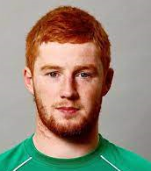
FBI
DEVELOPMENT 0.1
8:22
MALPRACTICE AND CONTIBUTORY NEGLIGANCE IN BUSINESS PROCESS MANAGEMENT
?
2013 Visa
Marshal Villarosa
IBM Rational Sales Terrirory Manager
nonPoliceDEA(kitchen)
Santa Cruz, Mountains
Ewoks Video Dirt
nonPolcieDEA(steve and tim)
Mr. Fuergesson
IBM Rational
Mathew Langley
IBM Partner
Esaw
RELIGION
0.1 zuckerberg
[x] no
0.1 1D8723 Create a business process
PETALUMA?
PETOPHILE?
Ibm.damiler.pope.sainta.rosa
SQ ibm.damiler.pope.saint.anselmo
Mike Navarro(!gay)
IBM WebSphere
Gorbahcie(Navarro)

Slide 31
FBI
DEVELOPMENT 0.1
8:22
MALPRACTICE AND CONTIBUTORY NEGLIGANCE IN BUSINESS PROCESS MANAGEMENT
?
2013 Visa
Marshal Villarosa
IBM Rational Sales Terrirory Manager
nonPoliceDEA(kitchen)
Santa Cruz, Mountains
Ewoks Video Dirt
nonPolcieDEA(steve and tim)
Mr. Fuergesson
IBM Rational
Mathew Langley
IBM Partner
Esaw
RELIGION
0.1 zuckerberg
[x] no
0.1 1D8723 Create a business process
PETALUMA?
PETOPHILE?
Ibm.damiler.pope.sainta.rosa
SQ ibm.damiler.pope.saint.anselmo
Mike Navarro(!gay)
IBM WebSphere
Gorbahcie(Navarro)

Slide 32
FBI
DEVELOPMENT 0.1 41
8:22
MALPRACTICE AND CONTIBUTORY NEGLIGANCE IN BUSINESS PROCESS MANAGEMENT
?
2013 Visa
Depress (copy)
MICHIGAN LLM
Santa Cruz, Mountains
Ewoks Video Dirt
nonPolcieDEA(steve and tim)
Mr. Fuergesson
IBM Client Visa
IT Redhair
Visa
Mathew ?
IBM Partner(1D8723)
RELIGION
PETALUMA?
PETOPHILE?
[x] no
Ibm.damiler.pope.sainta.rosa
SQ ibm.damiler.pope.saint.anselmo
Ibm consutll(brownshirt)

