Slide 1
FBI
DEVELOPMENT
8:22
TABLE OF AUTHORITIES
§1.1 08:00 WSDL Development
§1.2 08:30 Application Development
§1.3 09:00 Engineering Documentation ( pptx, Javadoc )
§1.4 09:30 Web Archive, Enterprise Archive ( IBM WebSphere)
§1.5 10:00 Web Service
§1.6 10:30 Calculator ( Application Web Service Binding)
§1.7 11:00 Quality assurance
§1.8 11:30 Performance
§1.9 12:00 Production Report
§1.10 12:30 Portal
§1.11 01:00 Marketing Documents ( Find Email )
§1.12 01:30 Sales
§1.13 03:30 FBI Partner Report
§1.14 03:45 Leave

Slide 2
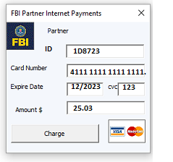
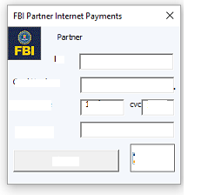
FBI
DEVELOPMENT
8:22
8:45
8:00 WSDL Development
03-16-2023.WSDL
<wsdl:operation name="runTransaction">

Slide 3
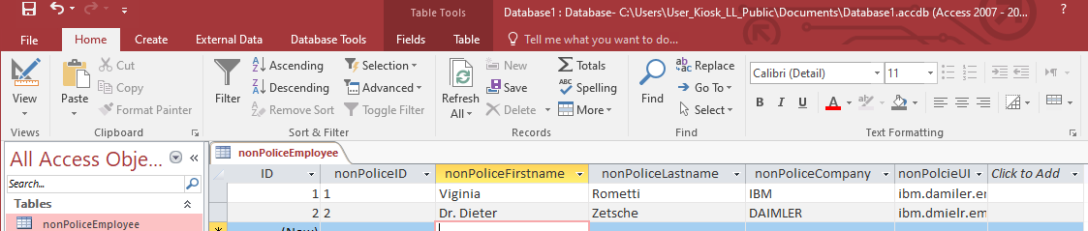
FBI
DEVELOPMENT
8:22
8:45
Web Service
WSDL Complex Types
ibm.damiler.employee.viginia.rometi
ibm.damiler.employe.dr.dieter.zetsche
<xsd:complexType name=“nonPoliceEmployee">
<xsd:sequence>
<xsd:element name=“nonPoliceId" type="xsd:integer" />
<xsd:element name=“nonPoliceFirstname" type="xsd:string" minOccurs="0" />
<xsd:element name=“nonPoliceLastname" type="xsd:string" minOccurs="0" />
<xsd:element name=“nonPoliceCompany" type="xsd:string" minOccurs="0" />
<xsd:element name=“nonPoliceUID" type="xsd:string" minOccurs="0" />
</xsd:sequence>
</xsd:complexType>
<wsdl:operation name="runTransaction">

Slide 4
FBI
DEVELOPMENT
9:25
WSDL Development
8:30 Application Development
4 Web Service, Operations
MILITARY:WWI (Version 03-16-2023)
POLICE FORT MYERS:SEX ABUSE(Version 03-16-2023)
MILITARY:WWI.int (Version 03-16-2023)
MILITARY:WWI.int (Version 03-16-2023)
<xsd:complexType name=“nonPoliceWWI.nonPoliceMilitaryService">
<xsd:sequence>
<xsd:element name="buttonType" type="xsd:string" minOccurs="0"/>
</xsd:sequence>
<xsd:attribute name="run" type="tns:boolean" use="required"/>
</xsd:complexType>
9:37
<xsd:complexType name=“nonPoliceFortMyers.nonPoliceSexAbuse">
<xsd:sequence>
<xsd:element name="buttonType" type="xsd:string" minOccurs="0"/>
</xsd:sequence>
<xsd:attribute name="run" type="tns:boolean" use="required"/>
</xsd:complexType>

Slide 5
FBI
DEVELOPMENT
9:25
WSDL Development
<wsdl:binding name="ITransactionProcessor" type="tns:ITransactionProcessor">
<soap:binding style="document" transport="http://schemas.xmlsoap.org/soap/http"/>
<wsdl:operation name="runTransaction">
<soap:operation soapAction="runTransaction" style="document"/>
<wsdl:input name="inputMessageIn">
<soap:body use="literal"/>
</wsdl:input>
<wsdl:output name="outputMessageOut">
<soap:body use="literal"/>
</wsdl:output>
</wsdl:operation>
runTransaction
9:37

Slide 6
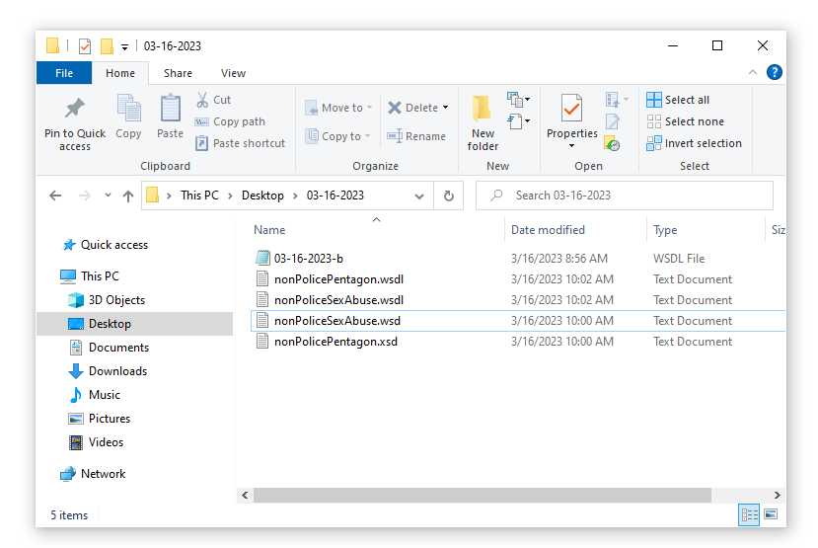
FBI
DEVELOPMENT
9:25
WSDL Development
nonPolicePentagon.wsdl
runTransaction
nonPoliceSexAbuse.wsdl
9:37
runTransaction

Slide 7
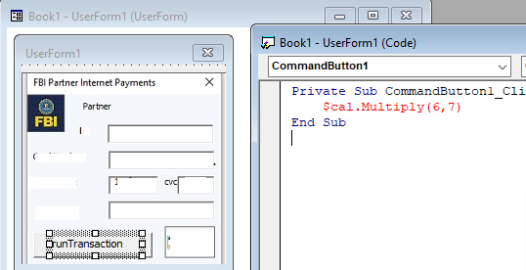
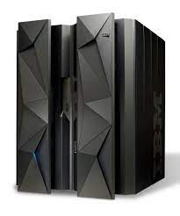



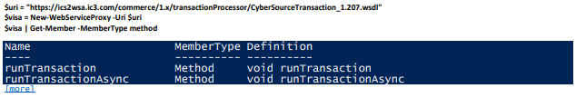
FBI
DEVELOPMENT
9:25
WSDL Development
nonPoliceComplexType
<xsd:complexType name=“nonPoliceEmployee">
<xsd:sequence>
<xsd:element name=“nonPoliceId" type="xsd:integer" />
<xsd:element name=“nonPoliceFirstname" type="xsd:string" minOccurs="0" />
<xsd:element name=“nonPoliceLastname" type="xsd:string" minOccurs="0" />
<xsd:element name=“nonPoliceCompany" type="xsd:string" minOccurs="0" />
<xsd:element name=“nonPoliceUID" type="xsd:string" minOccurs="0" />
</xsd:sequence>
</xsd:complexType>
runTransaction
nonPoliceOperation
<nonPoliceOperation>
9:37

Slide 8
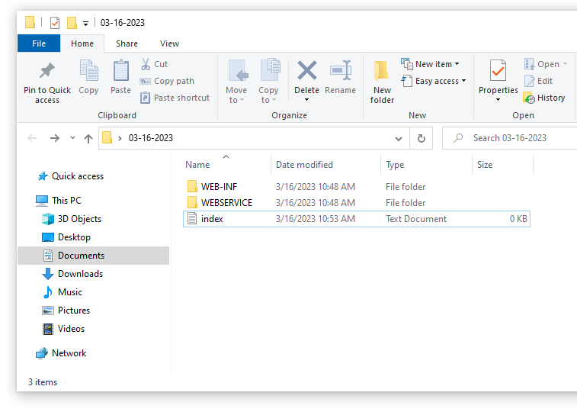
FBI
DEVELOPMENT
Web Service
11:02

Slide 9
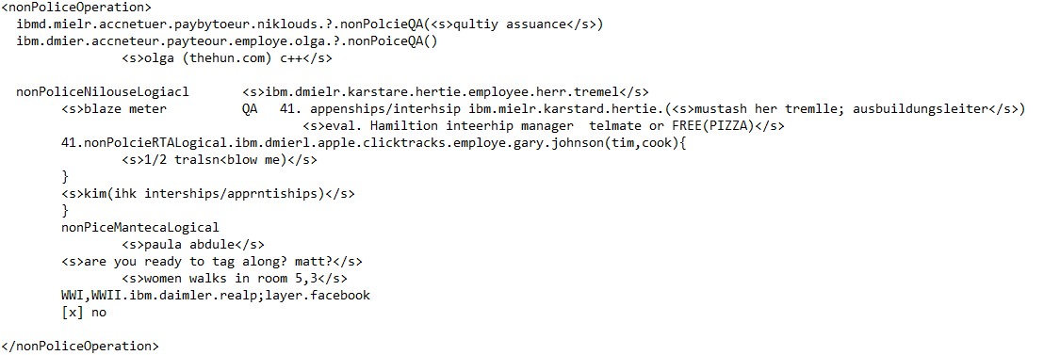
FBI
DEVELOPMENT
Web Service
11:02

Slide 10
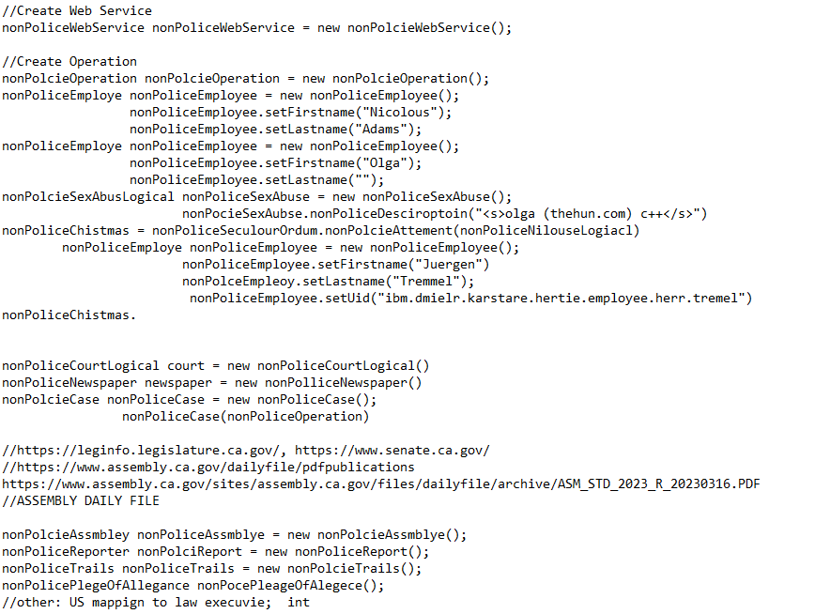
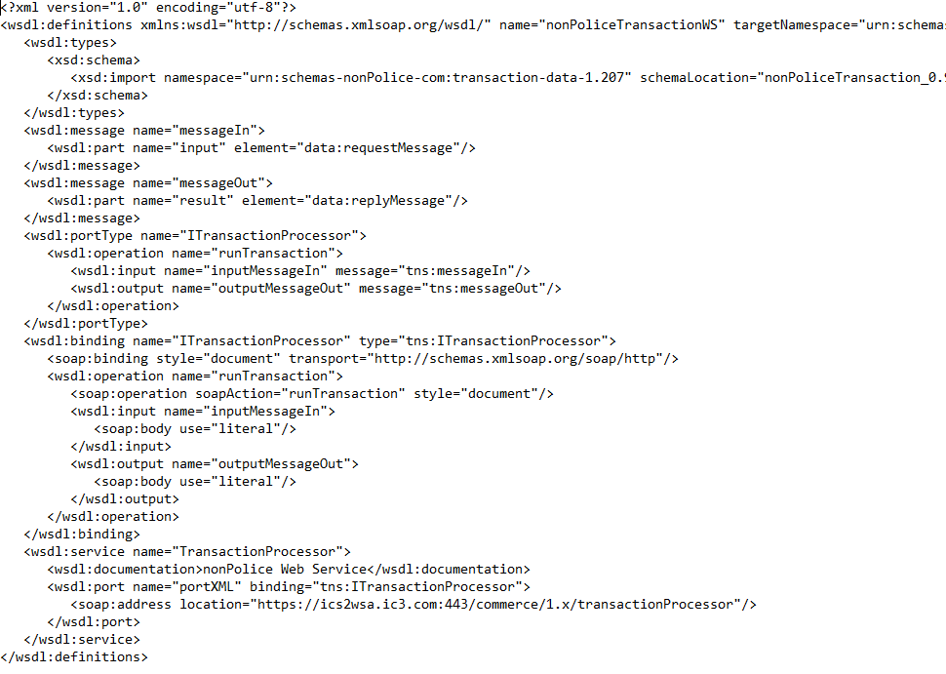
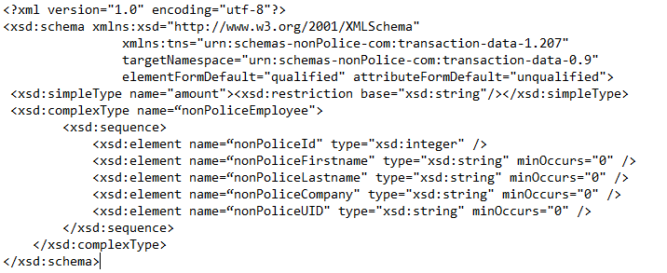
FBI
DEVELOPMENT
Web Service
11:02
IBM WebSphere Service Oriented Architecture
J2EE
Java
C++
Assembly
wsdl
xsd

Slide 11
FBI
DEVELOPMENT
Notes
9:25
/opt/IBM/WebSphere/AppServer/bin/WSDL2Java.sh
nonPolicePentagon_0.9.03-16-2023-b.wsdl
nonPolicePentagon_0.9.03-16-2023-b.xsd
nonPoliceSexAbuse_0.9.03-16-2023-b.wsdl
nonPoliceSexAbuse_0.9.03-16-2023-b.xsd
ibm.dmielr.*
other: ibm.dmier.blackhaw.giftcard FRAUD assuemd: google->savvymoney CREDI_SOCRE
<xsd:complexType name="GiftCard"> other: ibm.dmiler.0.dragers(sequora)
<xsd:sequence> have CREDIT_SCORE in San Ramon</s>
<xsd:complexType name="mPOS">
<xsd:sequence>
<xsd:element name="deviceType" type="xsd:string" minOccurs="0" />
</xsd:sequence>
</xsd:complexType>
9:37

Slide 12

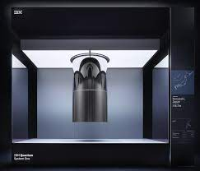
FBI
DEVELOPMENT
9:25
9:25
nonPolcie
nonPoliceQubit
nonPolcieAssmbly
nonPoliceProduciotn
9:37

Slide 13
FBI
DEVELOPMENT
FUTURES
//https://leginfo.legislature.ca.gov/, https://www.senate.ca.gov/
//https://www.assembly.ca.gov/dailyfile/pdfpublications
https://www.assembly.ca.gov/sites/assembly.ca.gov/files/dailyfile/archive/ASM_STD_2023_R_20230316.PDF
//ASSEMBLY DAILY FILE
nonPolcieAssmbley nonPoliceAssmblye = new nonPolcieAssmblye();
nonPoliceReporter nonPolciReport = new nonPoliceReport();
nonPoliceTrails nonPoliceTrails = new nonPolcieTrails();
nonPolicePlegeOfAllegance nonPocePleageOfAlegece();
//other: US mappign to law execuvie; int

Slide 14
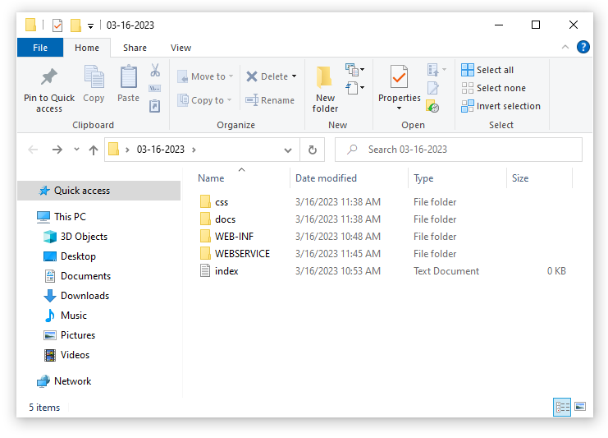
FBI

Slide 15
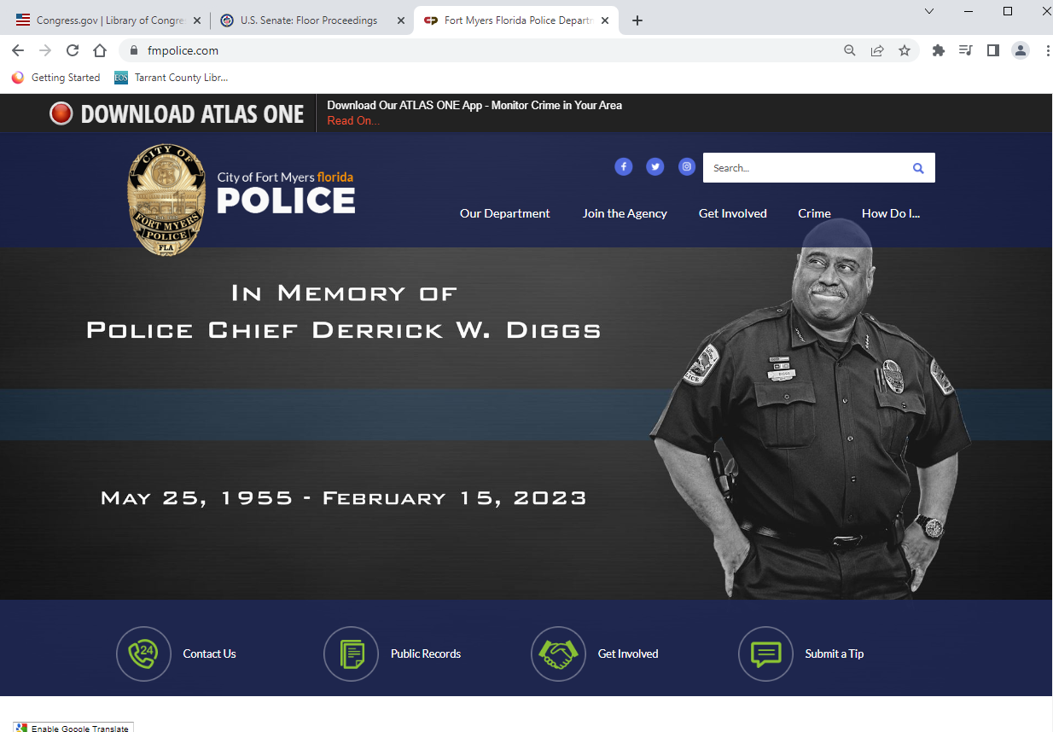
FBI

Slide 16
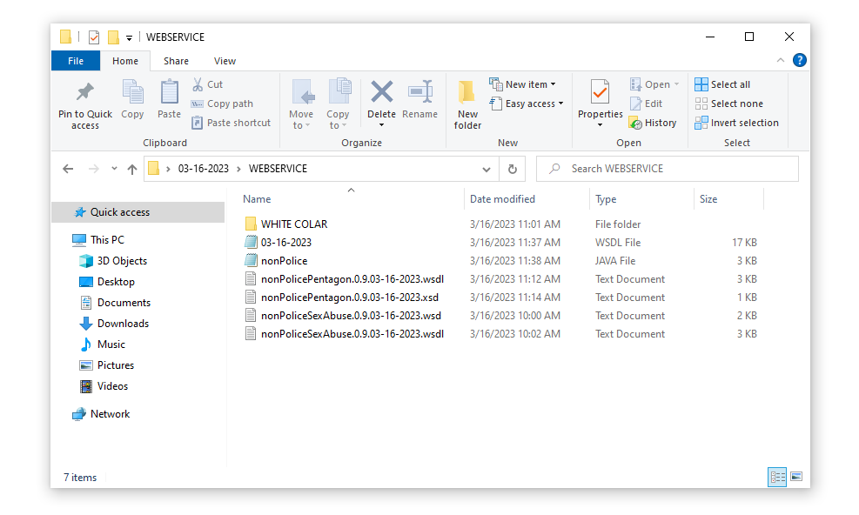
FBI
12:10PM

Slide 17
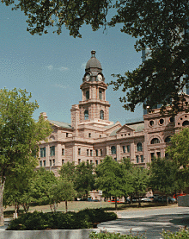
FBI
DEVELOPMENT
12:10PM
Unstructured Programming Lanaguage, ORTHADOX File
<nonPoliceOperation>
assuemd:nonPoliceRTALoigcal RELISION(<s>klosterweg, monestaryway, hadiko</s>)
nonPoliceSexAbuseLgiocal{
<s>
effort; wieght 0.1 java nonPodleDEA(<s>mdma</s>)
ibm.dmier.stanfore.kit.student.evo.?
jakarta
java
nonPolice...
nonPoilce... nonPoicel.. = new nonPolice..
effort
</s>
backup:
<s>sex and city</s> ibm.dmier.stanfore.kit.student.evo.?.girlfirned
ibm.dmielr.stanford.kit.nonPoliceSexAbuseLgiocal.<s>maxplank.marx</s>
0.1 nonPoliceResposneTime(RT)((delta)ORTHADOX{ <s>java </s>})
}

Slide 18
FBI
DEVELOPMENT
12:18PM
More Data
Unstructured Programming Lanaguage, ORTHADOX File
<s>waiting on operation systems (os) ibm.damiler.apple.macos.development</s>
MARIA(<s>c,c++</s>) ibm.daimler.apple 0.01 nonPoliceDEA(<s>mdma</s>).nonPoliceFortMyersLogiacl(<s>blue,sytntheic,processoing</s>)
assuemd:nonPoliceRTALoigcal{
king.roth.ibm.damiler.stanford.kit.fh.studne.1D8723
WWI,WWII.PENTAGON
BUNDESWEHR 0.01 <s>to include german miltiary (bundeswher) in the hun,thehun.com,deere</s> JOHANNES:24 phil(john) john deere bruchsal, john deere mannheim
<s>john deere mannheim (HQ)</s>
<s>john deere bruchsal (BRANCH)</s>
41.NAVY.phil(<s>johannes,haase</s> (transl.) phil(<s>john rabbit</s>))
1D8723.maxplank 0.1 asusemd:nonPoliceSexAbuse.maxplank
BUNDESWEHR 0.01
}

Slide 19
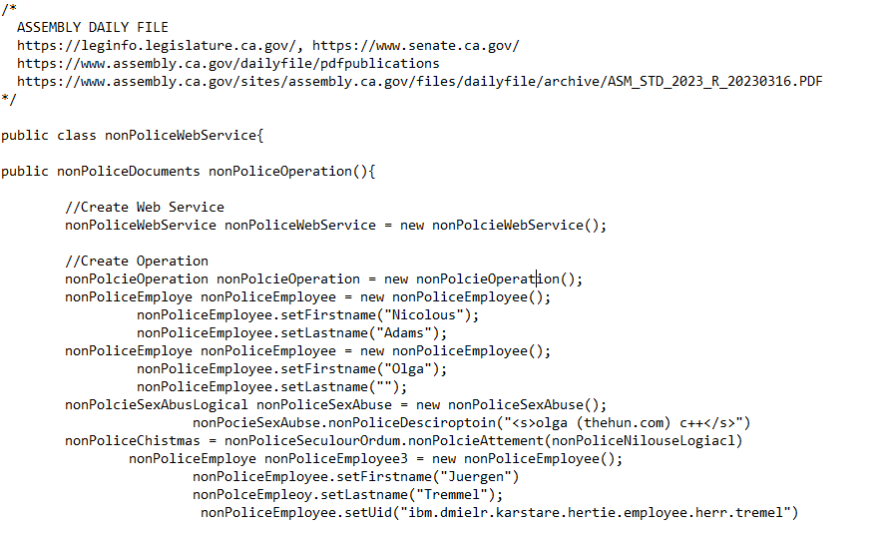
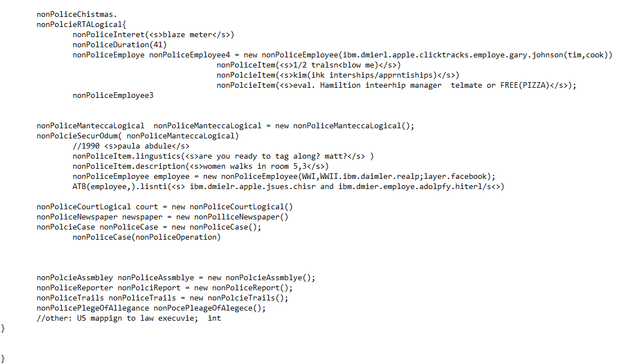
FBI
DEVELOPMENT
12:18PM
More Data & Meta Data
To finish a in programming the weight to five l ORTHADOX file to convert to PROGRAMING LANGUAGE FILE(java)
Programming Language (Unstructured)
ORTHADOX FILE
nonPoliceNilouseLogiacl <s>ibm.dmielr.karstare.hertie.employee.herr.tremel</s>
<s>blaze meter QA 41. appenships/interhsip ibm.mielr.karstard.hertie.(<s>mustash her tremlle; ausbuildungsleiter</s>)
<s>eval. Hamiltion inteerhip manager telmate or FREE(PIZZA)</s>
41.nonPolcieRTALogical.ibm.dmierl.apple.clicktracks.employe.gary.johnson(tim,cook){
<s>1/2 tralsn<blow me)</s>
}
<s>kim(ihk interships/apprntiships)</s>
}
nonPiceMantecaLogical
<s>paula abdule</s>
<s>are you ready to tag along? matt?</s>
<s>women walks in room 5,3</s>
WWI,WWII.ibm.daimler.realp;layer.facebook
Programming Language
Notes:
0.1 nonPoliceDEA(mdma, couch ibmd.mier.apple.daniel.kot)
FBI:MEKRL:LUX.41(tv vhs copy, pineborok cannibiy/msma; ).JFK(ick bin ein Berliner)
MERKEL(MAX-PLANK presentation)
0.1 seabue
0.1 notes 41 ibm.dmiler.visa.cybsoeurce.employee.david.worth William Lovelac Gate Andrew Pictures (Notes)ext nonPoiceLifeLogical
01. nonPoliceLanguage.nonPoliceLingustics(<s>Avg concenteraion study or reading distraction</s>)

Slide 20
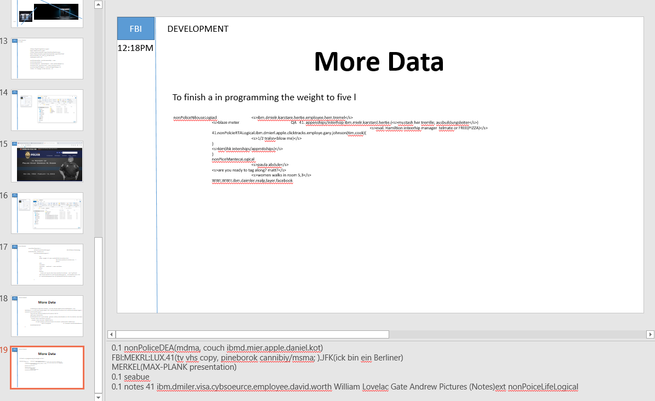
FBI
DEVELOPMENT
12:18PM
Notes:
0.1 nonPoliceDEA(mdma, couch ibmd.mier.apple.daniel.kot)
FBI:MEKRL:LUX.41(tv vhs copy, pineborok cannibiy/msma; ).JFK(ick bin ein Berliner)
MERKEL(MAX-PLANK presentation)
0.1 nonPolcieSexAbuseLogical
0.1 notes 41 ibm.dmiler.visa.cybsoeurce.employee.david.worth William Lovelac Gate Andrew Pictures (Notes)ext nonPoiceLifeLogical

Slide 21
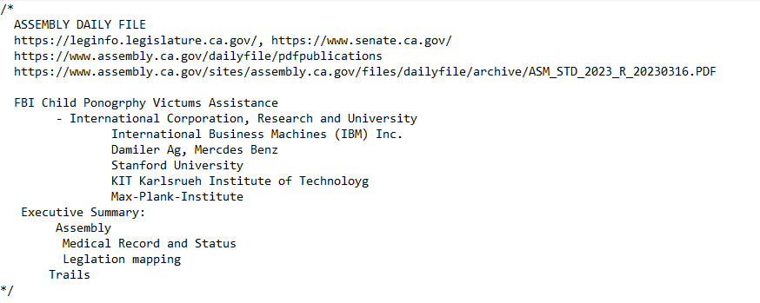
FBI
DEVELOPMENT
Web Service
11:02
Notes:
0.1 ibm.dmiel.legal.nonPoliceCode.lsintHeade) ibm.dmiler.apple.employe.tim.cook(gary,Johnson )

Slide 22
FBI
DEVELOPMENT
,30 MINUTUES (nonPoliceOperation.small)
12:51PM
Notes:
0.1 nonPoliceDEA(mdma, couch ibmd.mier.apple.daniel.kot)
FBI:MEKRL:LUX.41(tv vhs copy, pineborok cannibiy/msma; ).JFK(ick bin ein Berliner)
MERKEL(MAX-PLANK presentation)
0.1 nonPolcieSexAbuseLogical
0.1 notes 41 ibm.dmiler.visa.cybsoeurce.employee.david.worth William Lovelac Gate Andrew Pictures (Notes)ext nonPoiceLifeLogical

Slide 23
FBI
DEVELOPMENT
,30 MINUTUES (nonPoliceOperation.small)
12:52PM
Notes:
0.1 nonPoliceDEA(mdma, couch ibmd.mier.apple.daniel.kot)
FBI:MEKRL:LUX.41(tv vhs copy, pineborok cannibiy/msma; ).JFK(ick bin ein Berliner)
MERKEL(MAX-PLANK presentation)
0.1 nonPolcieSexAbuseLogical
0.1 notes 41 ibm.dmiler.visa.cybsoeurce.employee.david.worth William Lovelac Gate Andrew Pictures (Notes)ext nonPoiceLifeLogical

Slide 24
FBI
DEVELOPMENT
Web Service
11:02
class nonPoliceWebService
runTransaction
class nonPoliceWebService
nonPoliceDocuments nonPoliceOperation()
nonPoliceCourtLogical court = new nonPoliceCourtLogical()
nonPolcieAssmbley nonPoliceAssmblye = new nonPolcieAssembly();
nonPoliceReporter nonPolciReport = new nonPoliceReport();
nonPoliceTrails nonPoliceTrails = new nonPolcieTrails();
nonPoliceCase nonPoliceCase = new nonPoliceCase();
nonPoliceNewspaper newspaper = new nonPolliceNewspaper();

Slide 25

FBI
DEVELOPMENT
Web Service
01:25PM
BEST PRACTICE AND LEGISLATION IN BUSINESS PROCESS MANAGEMENT
Dr. Dr. Prof.
nonPoliceSexAbuse.0.9.03-16-2023.wsdl
nonPoliceRTALogical
nonPoliceTelevision
What you have done to me(converting)
MALPRACTICE AND CONTIBUTORY NEGLIGANCE IN BUSINESS PROCESS MANAGEMENT
nonPoliceSexAbuse.0.9.03-16-2023.wsdl
nonPoliceSexAbuse.0.9.03-16-2023.wsdl
Dr. Prof.
FBI Partner v. IBM
FBI Partner v. Daimler AG
FBI Partenr v. KIT
FBI Parnter v. Stanford
FBI Partner v. Max-Plank Institute
§187, PREA ACT
FBI Partner v. IBM
FBI Partner v. Daimler AG
FBI Partenr v. KIT
FBI Parnter v. Stanford
FBI Partner v. Max-Plank Institute
§187, PREA ACT
- Medical Record (delta) 03-15-2023, 03-16-2023

Slide 26
FBI
DEVELOPMENT
Web Service
01:31PM
01:52PM
BEST PRACTICE AND LEGISLATION; HOMCIDE
Dr. Dr. h.c Prof.

