Slide 1
FBI
WWI.nonPoliceSin.nonPolicePin
CIVIL_CODE
LABOR_CODE
What I can may you say
What I can make you do
6c Andereas Kaiser
nonPoliceContentItem
Ronsons
Marathoin, millionare
Holest Swedish sperm
nonPoliceContentItem
Mexicans wash my car
nonPoliceAudience:6c
nonPoliceAudience:88th
Ibm.damier.cisco.monitroing
0.01 ibm.dmier.apple.vw.steb[Wieland,staanf].jobs.<s>mydick</s>
nonPoliceDiagnosticsLogical:
nonPoliceAudience
2006 LANGLEY Zuckerberg (Webpsher Portal) – Redhair
2010 MARY denise wer-kennt-wen, faceobok
2010-2019
Ibm.damiler.~int32

Slide 2
FBI
CIVIL_CODE
LABOR_CODE
What I can may you say
What I can make you do
nonPoliceContentItem
Starbucks
Ibm.dmiler.visa.employe.leah.smith
nonPoliceContentItem
¼ LUX(vioalsteve)

Slide 3
FBI
USER INTERFACE QUALITYR ASSUSNCE
ibm.dmiler.google.savvymonery.employe.prateba.?.linguist(manual tests functional validation)
CIVIL_CODE
LABOR_CODE
What I can may you say
What I can make you do
2005 IBM nonPoliceRTA(ibm ration test agent) Pformance Tester, Funtaion Tester
2007/8 IBM ROBOT
Ibm.daimler.employee.Britney.tong
Ibm.daimler.rational.robot
ibm.daimler.accenture.payttouch
ibm.daimler.visa.cybersource
2010 IBM ROBOT
2010 DR(wasadi)
biotmetic touch
aparatues
Ghcohe(dell) ROBOT quest montoring transaction recorder
ghcoheov(dell,ERASMUS MEDICAL CNETER)
MEKREL(david hassefhof, hassel the hoffe(erassumemtn)
82.jobs/jobs/meiers/meiers/meiers/meiers/meiers
41.mother manic
0.1 merkel(ronsons, !touch; cannot)
TOUCH
0.1 HOMICIDE
Ibm.dmiler.accneet.payteouvh.employe.sabyr.tozin

Slide 4
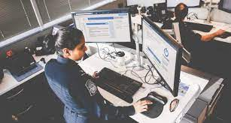
FBI
CIVIL_CODE
LABOR_CODE
What I can may you say
What I can make you do
D.A.R.E Street Crime Fighting
you are racist
Bitch ass nigger
ther: only gays can work here, bullshit talking
flowing allot bull shit talking
nonPoliceRTA.manic,biolar
Know the person/not know the person
§422.6 Hate crime
Radius π 3.14, invert.!invert
invert
Int.travat@cost
ibm
avg
dailer
tamgroup
visa
linkedin
apple
bertellmasn
plans
Ibm.damiler.*: accodirng to our plans the CILVI_CODE, §422.6 Hate Crimes status WWI and WWII
Welcome to America(NSA AIRPORT CHINESE)
Would have said by then

Slide 5
FBI
CIVIL_CODE
LABOR_CODE
POWER USER, IBM/J2EE PROGRAMMER, I only program here.
What I can may you say
What I can make you do
§422.6 Hate crime
Radius π 3.14, invert.!invert
plans
nonPoliceDouglass.nonPoliceExit
nonPoliceDouglass.nonPoliceExit
nonPoliceDouglass.nonPoliceExit

Slide 6
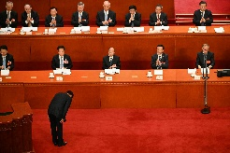
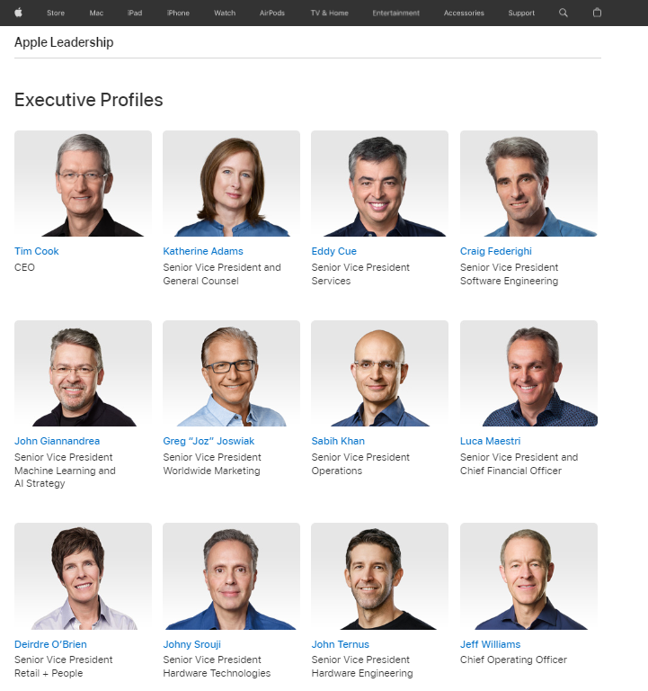
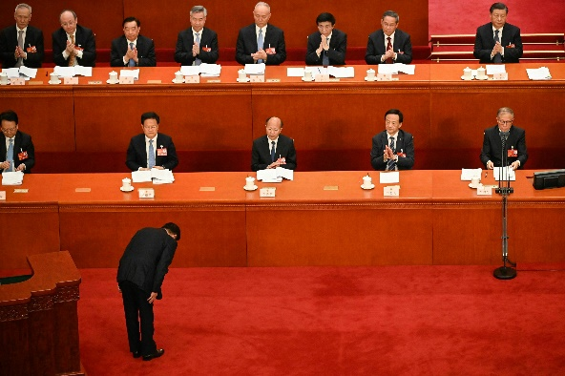
FBI
§422.6 Hate crime
Radius π 3.14, invert.!invert
CIVIL_CODE
LABOR_CODE
What I can may you say
What I can make you do
noc
Int.travat@cost
glu
41.WHITE
Grobache(Dr/J)
apple
bertellmasn
plans
NOC
Appel,yAHOO, LINKEDIN,etc
source

Slide 7
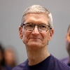
FBI
§422.6 Hate crime
Radius π 3.14, invert.!invert
CIVIL_CODE
LABOR_CODE
What I can may you say
What I can make you do
eval
glu
nonPoliceDuoglas
nonPioceExit
41.WHITE
Grobache(Dr/J)
DULIN-LOSGATOS
bertellmasn
In addition RUBBING IN
WWI
huey,pham
I want feel your(ghocheo(dr/j,white))
Keep front gate wyalnd
AGG.ASSUALT
AGG.ASSUALT
AGG.ASSUALT
AGG.ASSUALT
nonPoliceDuoglas
nonPioceExit
nonPoliceDuoglas
nonPioceExit
nonPoliceDuoglas
nonPioceExit
nonPoliceDuoglas
nonPioceExit
nonPoliceDuoglas
nonPioceExit
plans
Robert: ? Homides
? Merkel?
… 2 peoipe missing?
guy with musaahce greay hair haircown

Slide 8


FBI
§422.6 Hate crime
Radius π 3.14, invert.!invert
CIVIL_CODE
LABOR_CODE
What I can may you say
What I can make you do
I caught him
On Camera jumping
Over fense
person jumps over fence
I tried him lie 12
Fro Ghceoh(grazzin)
Davis High School
41.Ibm.damiler: laywers gone crazymovie dances on table
I know. Walmart.com(south san franciso)
Walmart labs, letter 2015
§212 Stb: Theft Reprots 6x

Slide 9
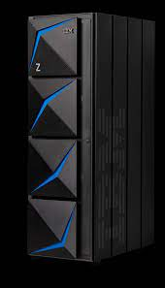
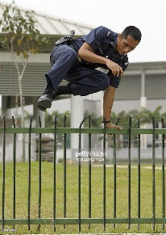
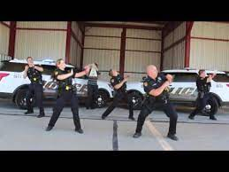
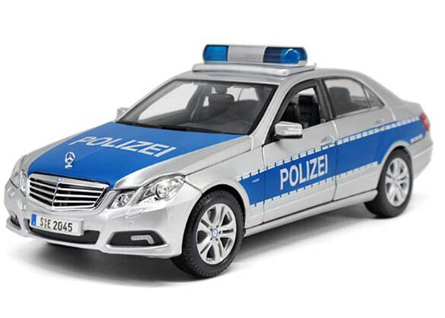
FBI
CIVIL_CODE
LABOR_CODE
POWER USER, IBM/J2EE PROGRAMMER, I am only program here.
What I can may you say
What I can make you do
§422.6 Hate crime
Radius π 3.14, invert.!invert

Slide 10
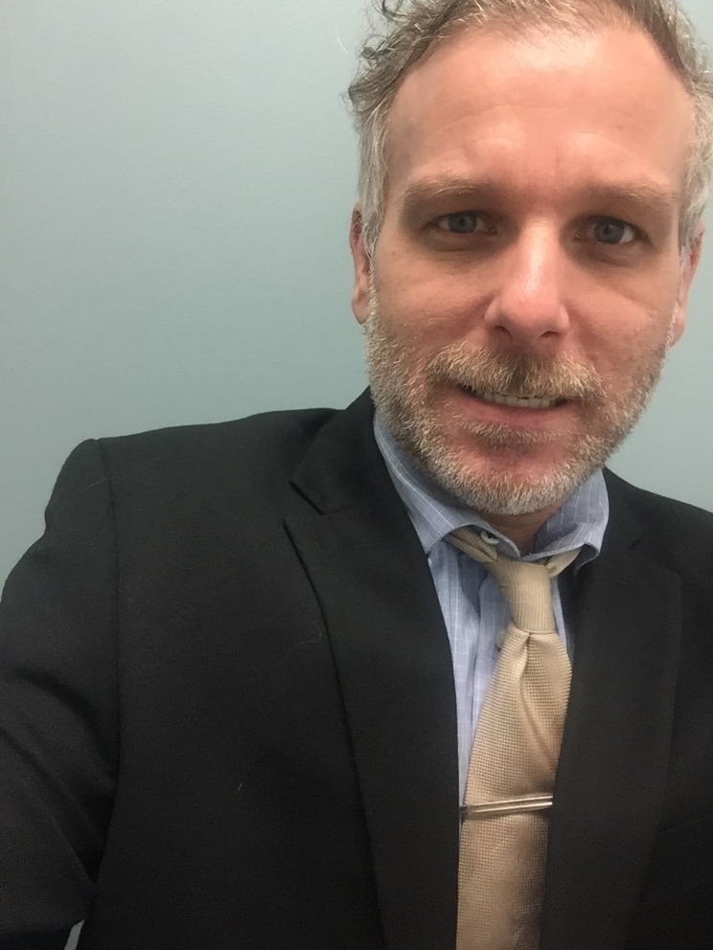
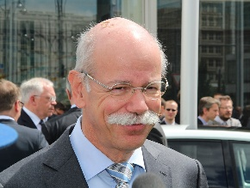
FBI
CIVIL_CODE
LABOR_CODE
§422.6 Hate crime
Radius π 3.14, invert.!invert
What I can may you say
What I can make you do
In addition RUBBING IN
WWI
huey,pham
I want feel your (LOSGATOS-DUBLIN)
(ghocheo(dr/j,white))
Keep front gate wyalnd
thomas
Robert:
- Atoms

