Slide 1

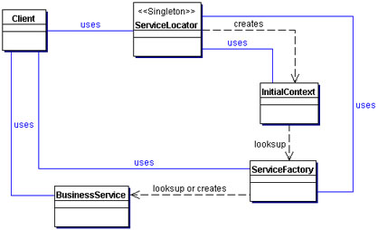

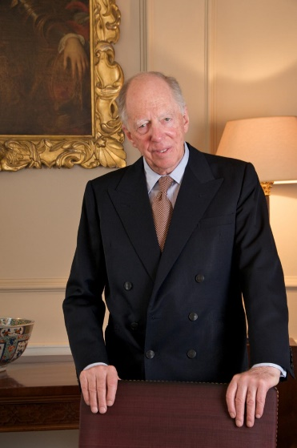
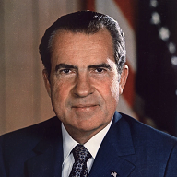

FBI
<nonPoliceOperation>
FBI:KIDDNAPPING
FBI:CVPA
OBAMA.SWARZENGGER (nonPoliceCfgLogical: <s>pope.lisa: pising on dauhter; default sentance until dauther onsite </s>)
roth.ibm.damiler.{
ibm.dmielr.employe.eva(wielanddnaiel).bruan 41.<s>cputoer easter card, !univsity</s>.avg
<s>harold pissing in forgarden</s>
nonPolciContentItemLocial(nonPceLife)
- <s>bier sound</s>
}
ipx
ibm.damiler.visa.cygwource.nonPcieContITems(<s>black peope apple picture fontyard</s>)
ibm.dmiler.apple.<s>sad.marx</s>
FBI:KIDDNAPPING
FBI:CVPA
<nonPoliceOperation>
J2EE Pattern
Serviec Locator
w/sam
client
Db2:octigate:database:table(traps)
Trap & Alert Management Set software traps and alerts to monitor a Group of servers or selected server. By setting traps and alerts, the user will be notified immediately when the system meets the conditions of the trap and the alert they set. An action will either be sending an email or creating a record in a file
Ibm.damiler.sap.legal.
Ibm.dmiler.ubs.legal
AGG ASSUALT.HOMICDE.nonPoliceCfgLogical
41.roth(shld).Ibm.damier.emloye.Harold.?
0.1 incest village HOMICDE hitter in brazil, waitin to die avg
nonPoliceStatus.MERKEL

Slide 2

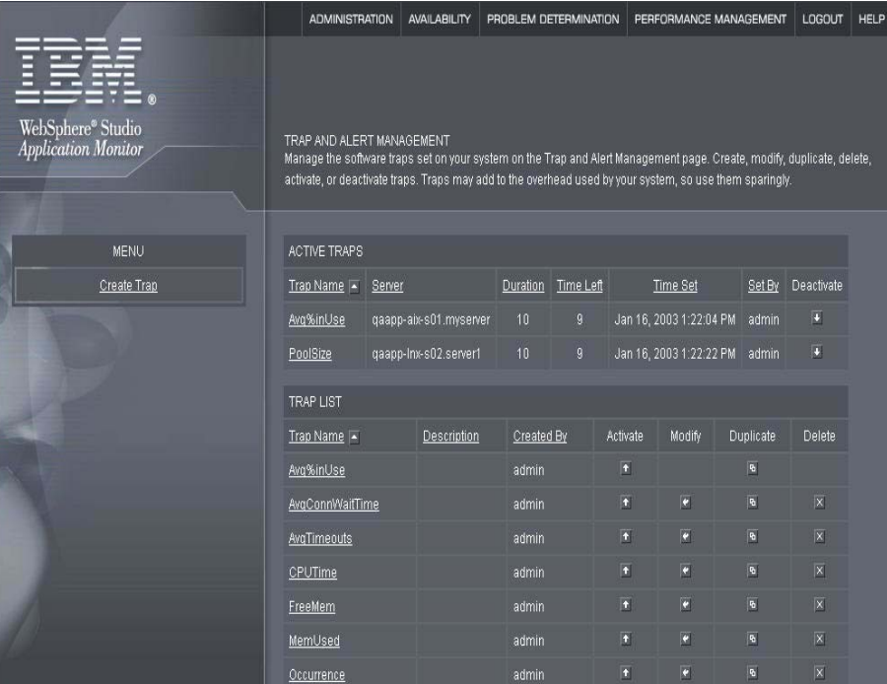
FBI
HOMICIDE:KYRSTAL.0.00001.nonPoliceQOSLocal
Ibm.damiler.wsam.client.ubs.employe.(1/4 Swiss)
J2EE Pattern
Serviec Locator
EJB TRAPS

Slide 3
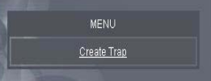
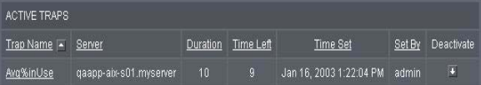
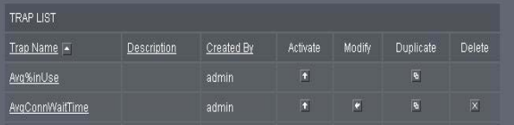
FBI
HOMICIDE:KYRSTAL.0.00001.nonPoliceQOSLocal
Ibm.damiler.wsam.client.ubs.employe.(1/4 Swiss)
I want to know
When the application
CPU is 40%
Defining custom traps
XML file Compressed
For updating myself
Actvation
41.Requirments Defintion
CVPA Lee, Fort Worth
nonPoliceSexAbuse.labor_code.civil_code: viginai rommit nonPoliceContnetItems
Selection
J2EE
XML automated traps in Java
PENTAOGN(rmi-iiop, virtuailzaiotn-engine.war)
wsam octigate datbase

Slide 4
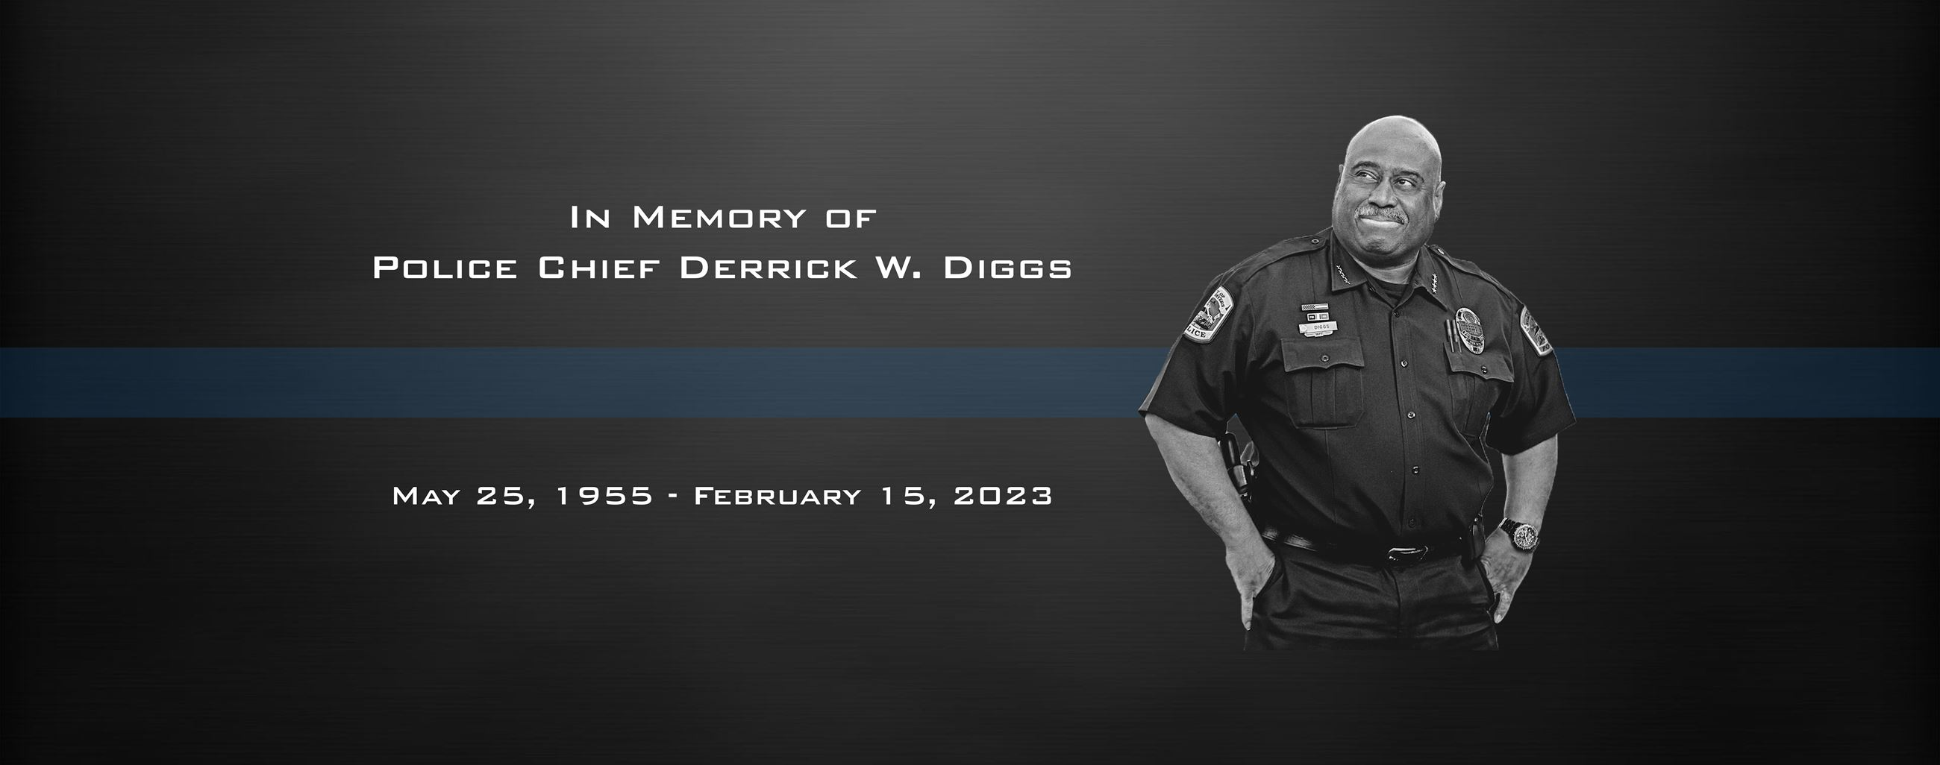

FBI

Slide 5

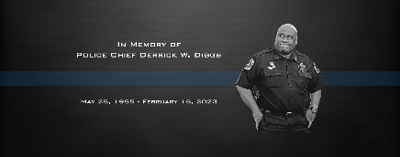
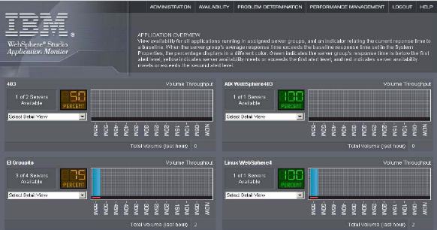
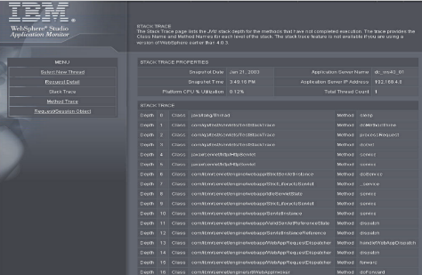

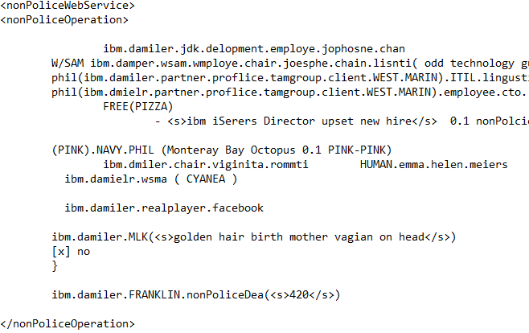
FBI
TECNOLOGY
L3 SWAT SOFWARE ENGINEER
IBM W/SAM
com.Ibm.websphere.Proxy.java
com.ibm.wephre.wsam.Proxy.java
Build fixpack wsam.3.1.0.1.fp.0.1
nonPOLICE
SWIMLANES
wsam.3.1.0.1.fp.0.1
nonPOLICE
SWIMLANES
wsam.3.1.0.1.fp.0.2
nonPOLICE
SWIMLANES
wsam.3.1.0.1.fp.0.3

Slide 6
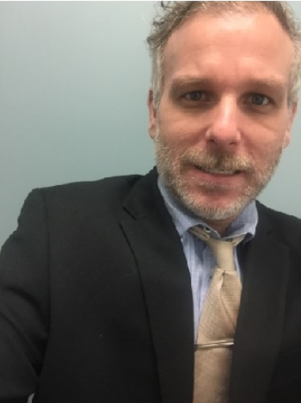
FBI
TECNOLOGY
L3 SWAT SOFWARE ENGINEER
IBM W/SAM
LEFT
RIGHT

Slide 7
FBI
TECNOLOGY
L3 SWAT SOFWARE ENGINEER
IBM W/SAM
nonPoliceIDLoical
US , DE
LEFT
REPULICAN , CDU, AfD
DEMOCRATE, SPD, LINKE

Slide 8
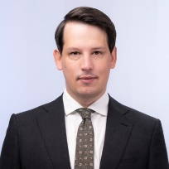
FBI
TECNOLOGY
L3 SWAT SOFWARE ENGINEER
IBM W/SAM
nonPoliceIDLoical
US , DE
1D8723.DE-AfD
LEFT
AfD
DEMOCRATE, SPD, LINKE
Andreas Bleck

Slide 9
FBI
TECNOLOGY
L3 SWAT SOFWARE ENGINEER
IBM W/SAM
“I am working to much”
1D8723
.DE-AfD
nonPOLICE
SWIMLANES
wsam.3.1.0.1.fp.0.1
Andreas Bleck

Slide 10
FBI
TECNOLOGY
L3 SWAT SOFWARE ENGINEER
IBM W/SAM
“you are working too much”
1D8723
.DE-AfD
“you are working too much”
Andreas Bleck

Slide 11
FBI
“I am !working too much”

Slide 12
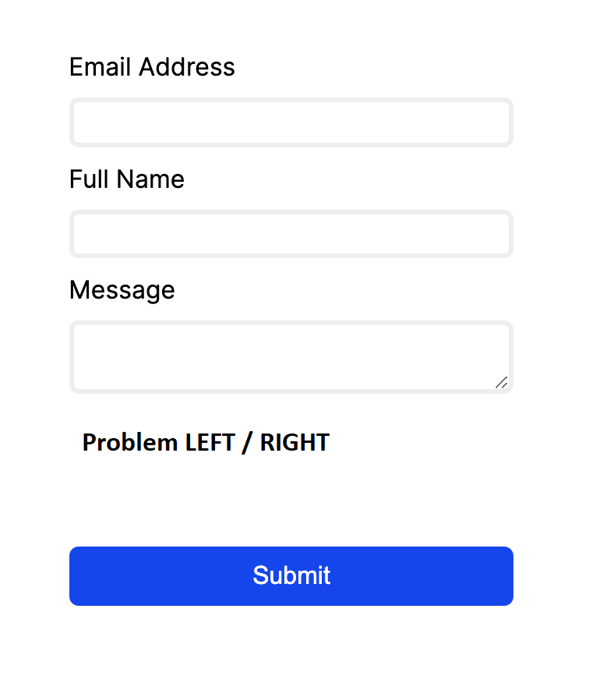
FBI
TECNOLOGY
L3 SWAT SOFWARE ENGINEER
IBM W/SAM
Id:us,de
nonPOliceTRXLgoical
id: mx,us

