Slide 1
FBI
1D8723
JFK (report to), MLK (report from)
Ibm.damiler.apple.touch
LABOR_CODE(pit)
2020
Ibm.damiler.moody
white=Ghocheo(dr/j,Ibm.damielr.sap)
Ibm.damiler.apple.touch
white
(Baby)infant
nonPolieQOS
White(American-chinse;
jospheon chan, arthush tsan, james chong)
White
Ibm.dmiler.linkedin
1997
2005 Ibm.dmielr.
2014
2015
2016
2004
2o10
§187.PREA
LABOR_CODE(pit)
2019
Ibm.dmiler.glu
LABOR_CODE(pit)

Slide 2
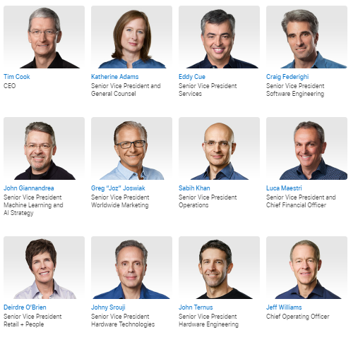
CRACK
FBI
LABOR_CODE(pit)
JFK (report to), MLK (report from)
Phil(joephs saunders)
MERKEL(Ibm.dmiler.touch)
2019
Ibm.daimler.touch
2004
2014
2013
2005
1997
1994
Phil(joe)
0.1!white
14
Cook
17
Apprenticeship
other
Musk
Newspaper Boy
Martelli
white
Ibm.dmiler.glu
Elke DM – DEUTHC MARK LUOIS 10DM
Spy Rirardo JOSPHSE, FORD
JFK(report to densie)
Zoran is Chris Lovelace
JFK(report to)
20 !white.avg
nonPolcieContentItem
ibm.damiler (VGGG)
Small hands turkey ( next apprtence)
LABOR_CODE(pit)
ny cuptertion index
apple

Slide 3
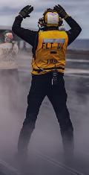
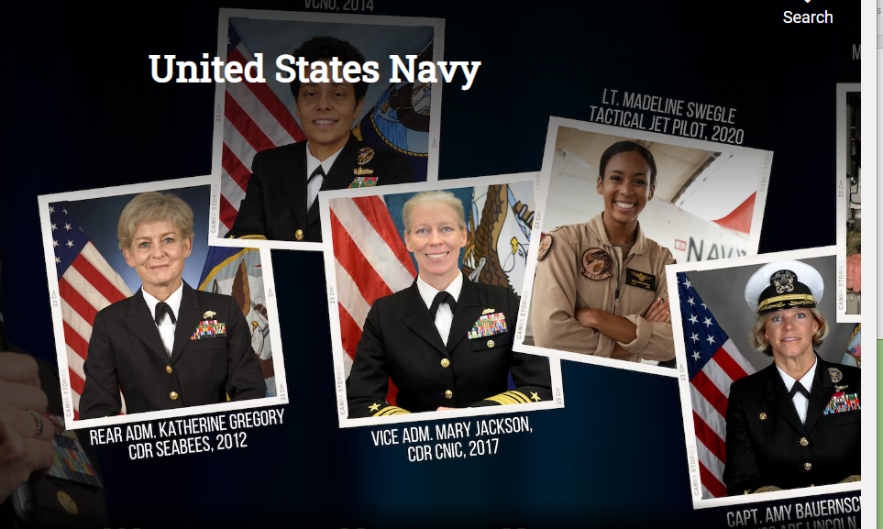
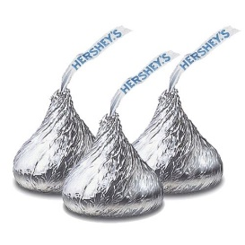
FBI
FREE(PIZZA)
INT.nonPolieTV.nonPoiceQOS

Slide 4
FBI
calc
x

Slide 5
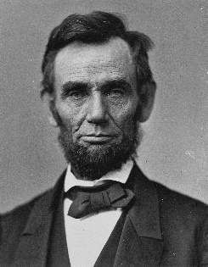
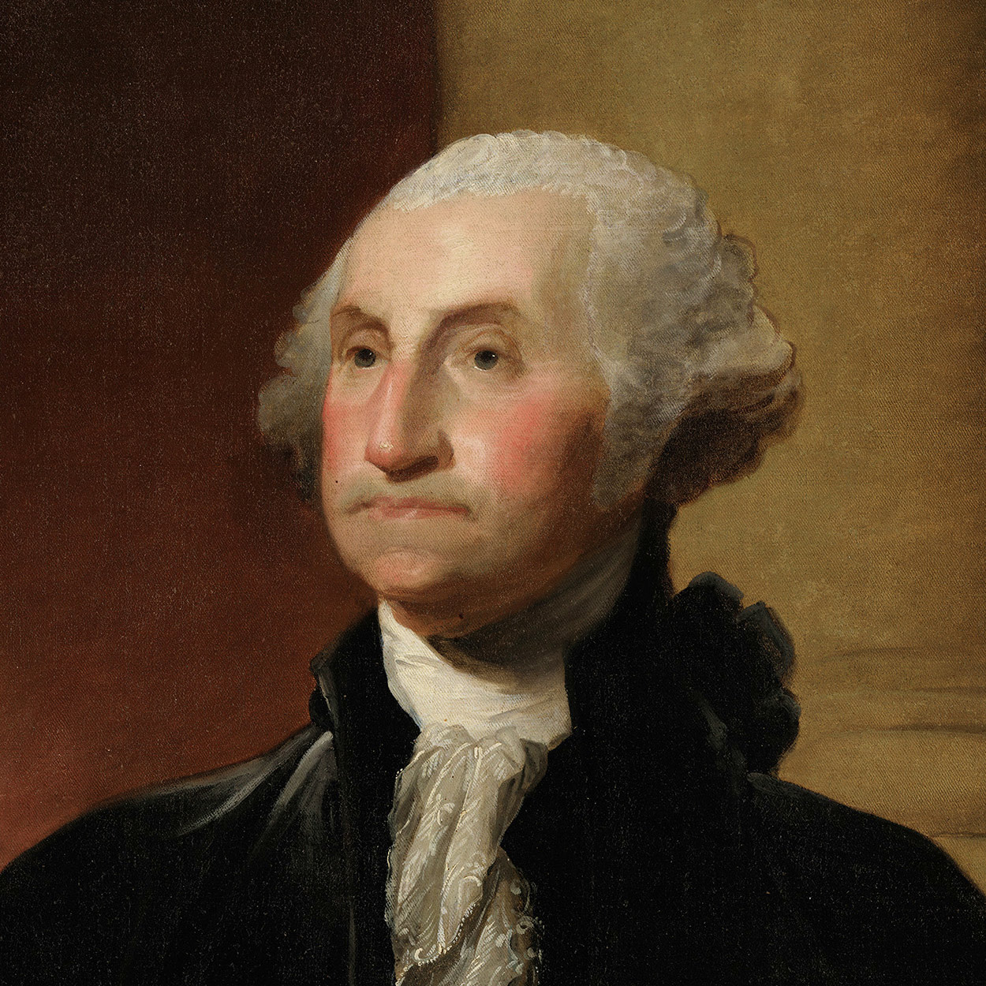
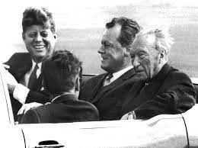

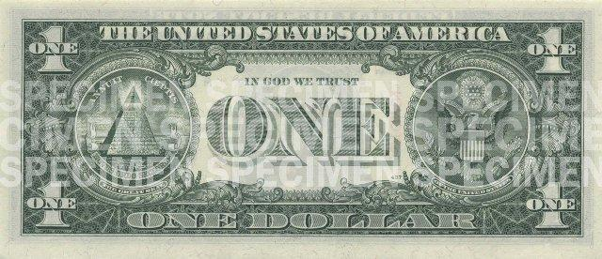
FBI
1st PRESIDENT
1987
41.
0.1 Other: calc ( would he had read the law?)
yes[], no[]
41.HAMITON
BLACK(PREA) Ibm.damiler.apple.touch
nonPoliceCFGLogical
WHITE
passthrough
0.1 Cool
Ibm.damiler.apple.touch
Popped colar
Avg.(German)
I am not cool hydrun
Thoma uncool
When I saw
The FBI
Report Kidnapping
SCREEN nonPoliceRTA
SCRREN(nonPoliceTheaterLogical)
(delta) FBI 3-letter code I.B.M
https://www.uscurrency.gov/denominations

Slide 6
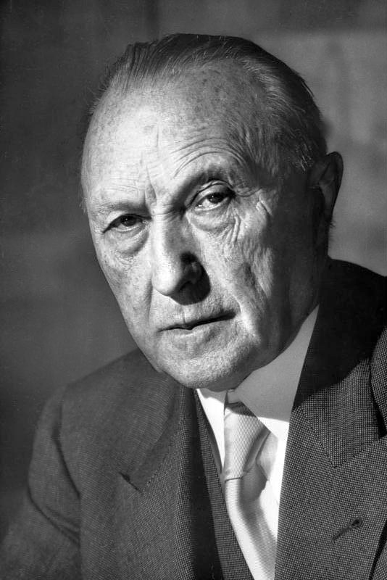
FBI
1st PRESIDENT
0.1 Cool
Say cool?
[x] no
https://www.uscurrency.gov/denominations

Slide 7
FBI
1st PRESIDENT.int.nat[]
calc

Slide 8
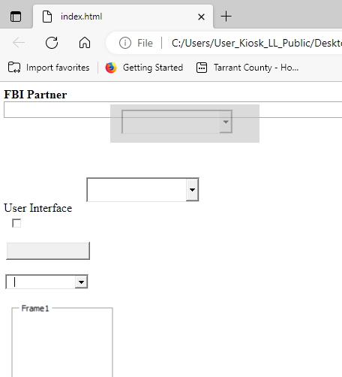
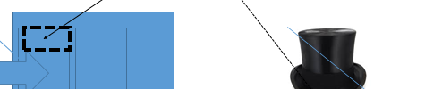
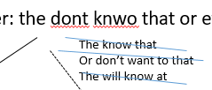
FBI
2010
KING(bismarkstrasse)
41
HOMICDE:JFK(Ibm.damiler.partner.camsolutions.inc)
Jerry Yang
draggable="true"
Stanford: Page Yang

Slide 9
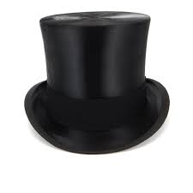
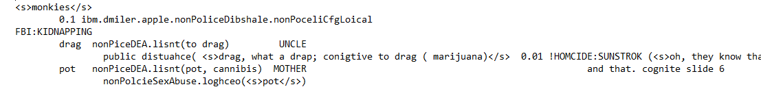
FBI
Other: the dont knwo that or ever
The know that
Or don’t want to that
The will know at
Kito – Brain Pipe
Black Bald Man Brain Venes
training

Slide 10
FBI
2010
KING(bismarkstrasse)
They could have known that
1987/8 Riddel brownstone room
Int.MOVE.ibmdmiler.apple.steve.jobs
Bill Gate Steves Frined PX.200 camera
000.LUX.nonPolcieBankLogcail
0.1 THEFT roth.ibm.dmile. COGNITIVE
roth.ibm.daimler.*
training
draggable="true"
§212 Diebsthatl ( THEFT)
cognitive

